Slide 1
Path Planning for Autonomous Vehicles in Uneven Terrain
Mushty Sri Sai Kaushik (UID - 116917094)
Divyam Garg (UID - 117032475)
John DiNofrio (UID - 117036350)

Slide 2

Intro & Problem Statement
Searching algorithms like Dijkstra and A* are useful and can be very powerful, but…
They are limited to a single constraint
Cost → distance to goal
In the real world, we need to satisfy multiple
heuristic constraints
Distance, energy, time, money, etc…
A* algorithm against CSA* algorithm
CSA*→ Constraint Satisfying A*
This searching algorithm takes into account multiple heuristics
Notes:
s

Slide 3
Constraint Satisfying A*
CSA* is a much more intelligent model of A*
By looking into multiple cost aspects, CSA* can find the most efficient path while satisfying all constraints
Why this is important
Paths that may look undesirable early on are discarded by A*
But as the search progresses, one or several constraints might be broken
CSA* takes this into account and utilizes the old undesirable paths

Slide 4
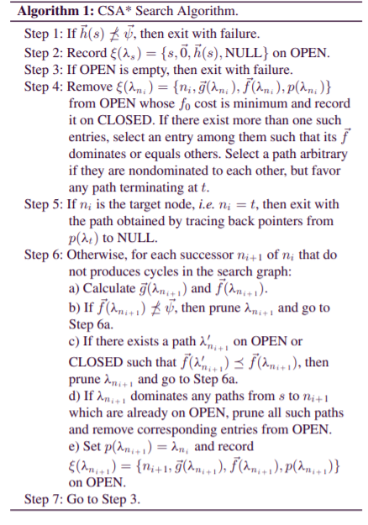
How CSA* Works
Same as A* but with multiple constraints
f(ƛ) is the expected cost for reaching a point in the search graph and g(ƛ) is its corresponding cost vector
Even though a path might have a low g(ƛ), it might violate one of the constraints
Therefore, the path is invalid
Undesirable paths may become more desirable as the search goes on because of that
Might have a higher g(ƛ), but not violate any constraints

Slide 5
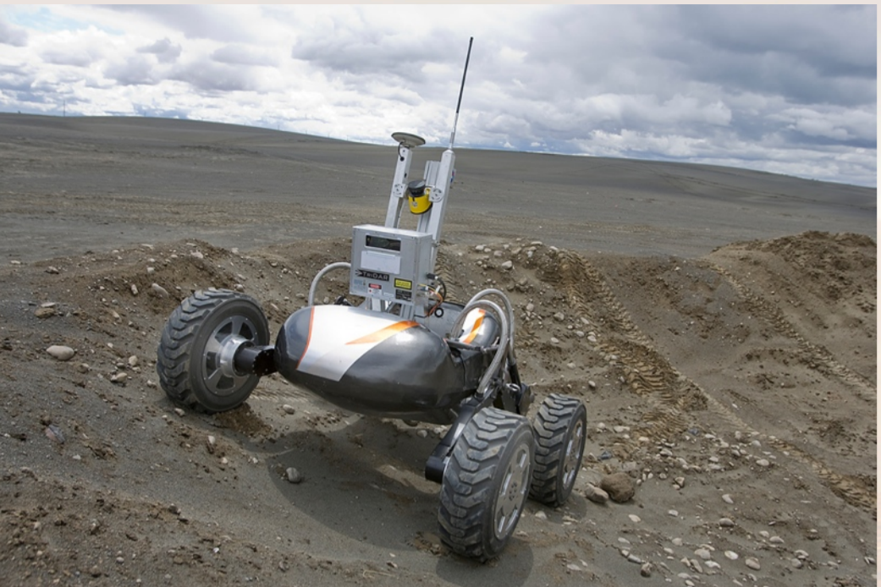
Pros and Cons of using CSA* over Dijkstra
Dijkstra algorithm considers only shortest distance in most cases. It does not have a heuristic function in order to consider other factors.
Good for shortest path of each point in urban areas
Not good for rough terrain coz no heuristic function so might not always give energy efficient path
Example: Drill sampling robot

Slide 6
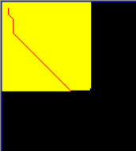
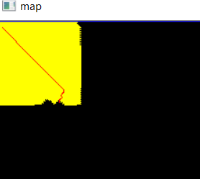
Results of Dijkstra

Slide 7

Cost Functions & Constraints
Optimize the shortest path to the goal while minimizing energy consumption
Work = Force x Distance
Work is energy, and the robot is trying to avoid areas which increase work
High opposing force, long distances, impassable routes
Needed constraints that the robot could understand
Force of Friction & Force of Gravity
Velocity & Time
Rough Areas of Terrain - robot has higher RPM but slower movement
RPM↑ ∝ Work ↑
Smooth Areas of Terrain - robot has lower RPM but faster movement
RPM↓ ∝ Work ↓

Slide 8
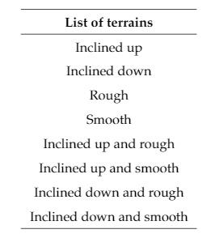
Creating the Environment
We use a simple rectangular environment to demonstrate and highlight the differences between A* and CAS*
Environment uses planar equations to express
High and low friction areas
Inclines and declines

Slide 9
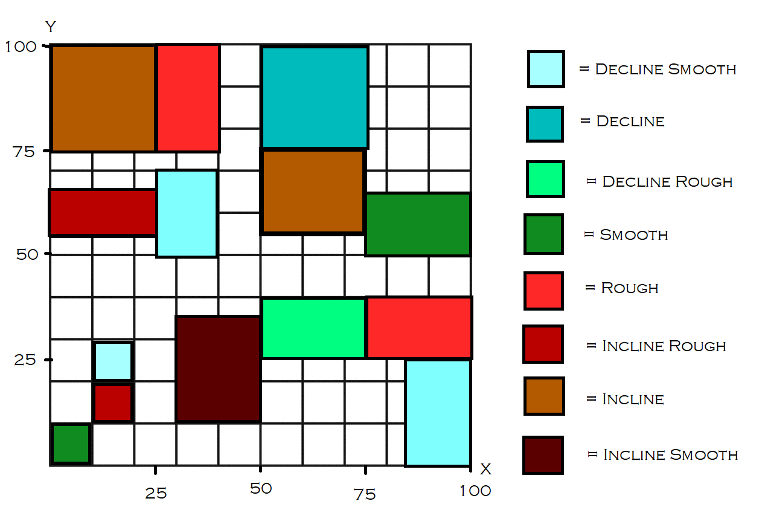
Terrain Environment

Slide 10

Costs - Min Distance & Work
Euclidean distance calculates straight path distance
Note - uphill and downhill don’t add or subtract too much distance
But uphill adds a lot of energy and downhill saves a lot of energy
This is something normal A* cannot comprehend
Work is calculated by multiplying force the robot exerts times the distance

Slide 11
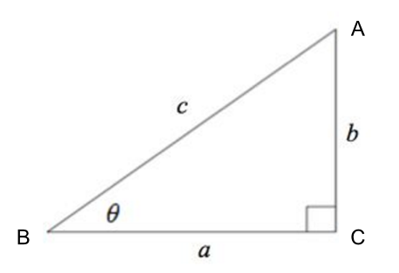


Constraints - Force
𝛳 = angle from the ground
N = normal force
m = mass of robot (contant 1.6 kg)
g = gravity (constant 9.81 m/s)
μ = coefficient of friction

Slide 12



Constraints - Force
Robot maintains constant RPMs
Force of the robot must always be
Above the force of gravity
Below the force of friction
UNLESS GOING DOWN HILL
On even ground the robot will always exert at least
1.75N and can only exert a max of 13N
Breaking one of these conditions means
the path is unpassable

Slide 13

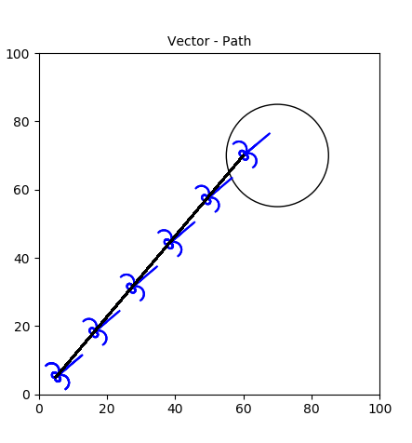
A*
Total Energy Cost = 74.6 KJ
Distance Traveled = 94.8 m
Time = 149.8 s

Slide 14
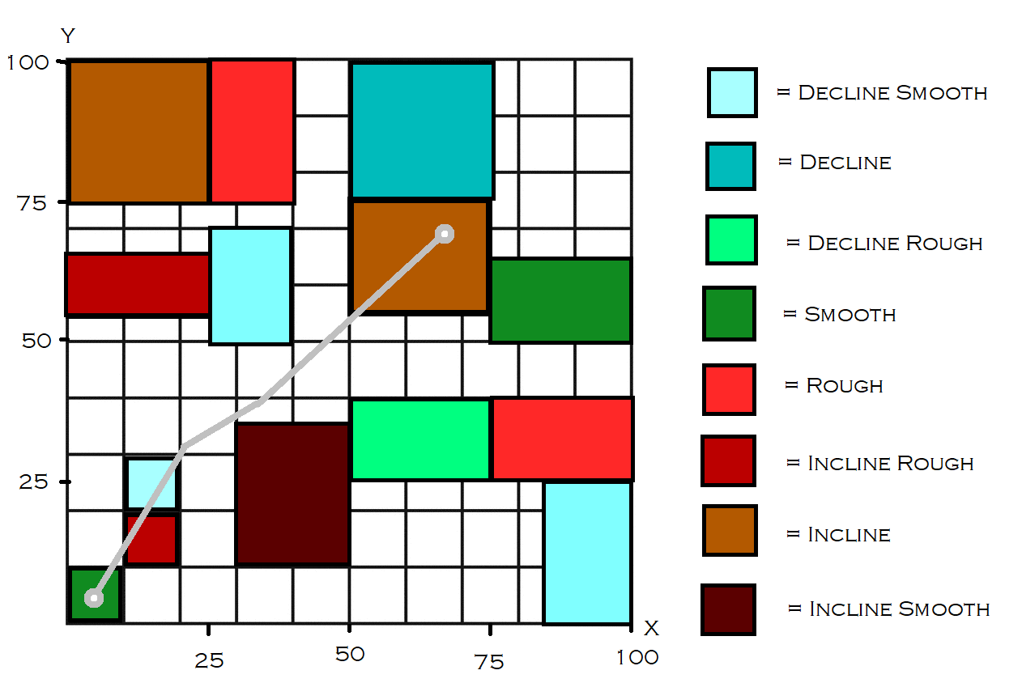
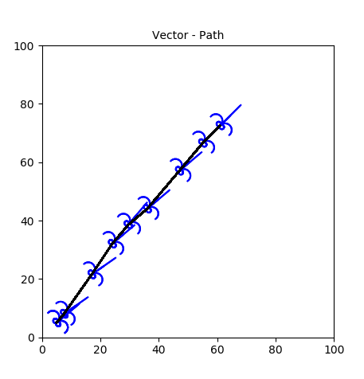
CSA*
Total Energy Cost = 17.8 KJ
Distance Traveled = 96.7 m
Time = 151.3 s

Slide 15
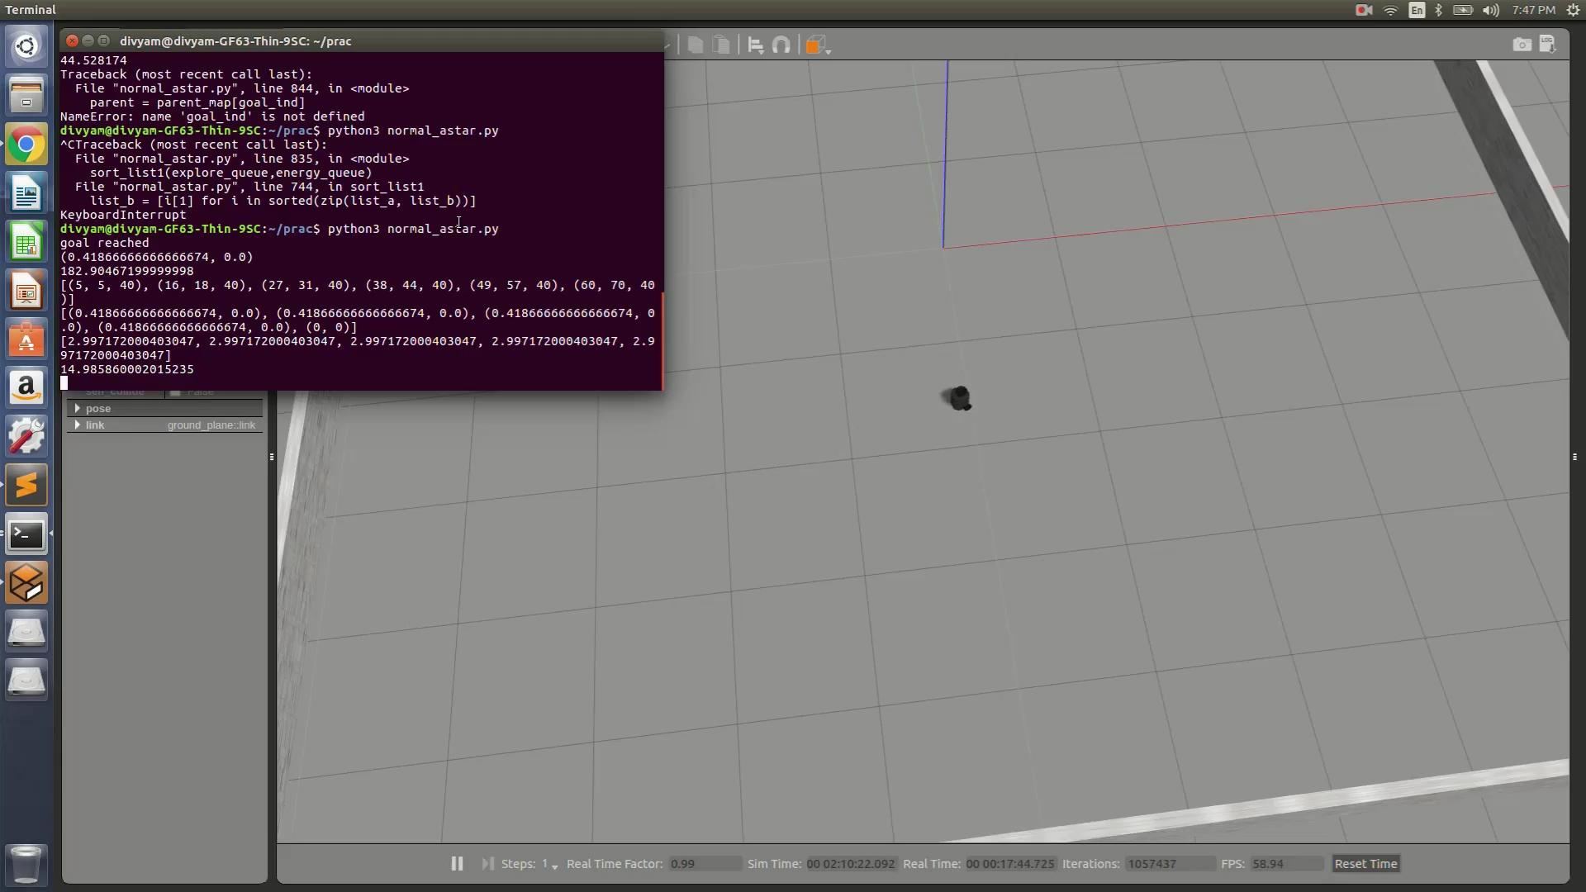
Simulation of A* in ROS

Slide 16
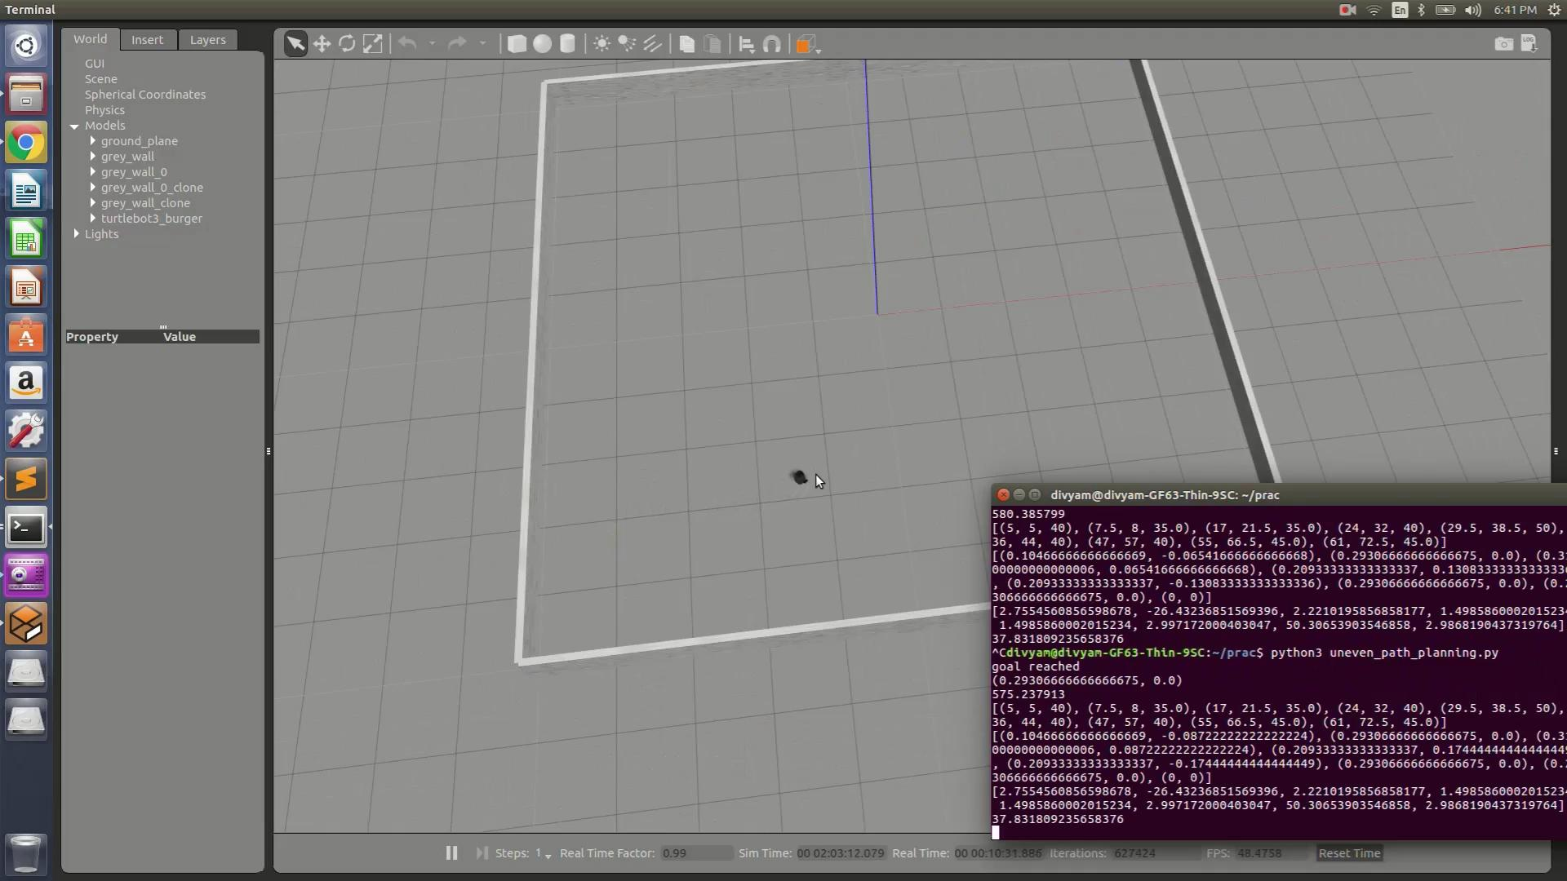
Simulation of CSA* in ROS

Slide 17
Results
CSA* performed exceptionally better than A*
Time
CSA* was only 1.5 seconds slower than A* (1% slower)
Energy
CSA* reduced the energy consumption by 56.82 KJ (76% less energy)
Purposefully steered toward smooth decline because it save energy
Distance
CSA* path was only 1.9 m longer (2% longer)
Note: (***CSA* accomplished all of this while satisfying all constraints
A* ignored the force limits when it went through the smooth incline***)

Slide 18
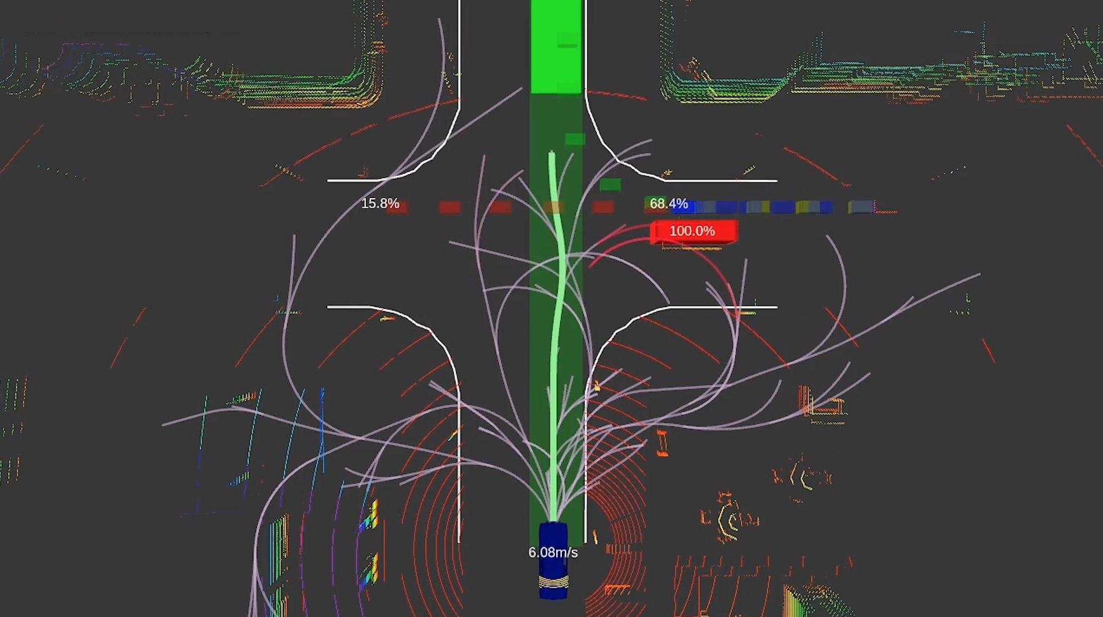
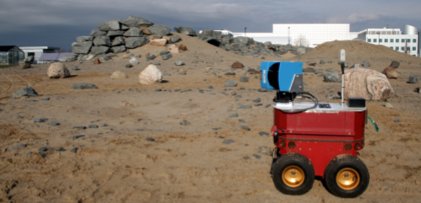
Future Scope
LiDAR for detection of the terrain and map, letting us implement triangular mesh to calculate for a more optimal output
PyBullet and other simulation environment to improve the visual output with realistic terrains and obstacles
Estimate real time values of angles of inclination for the calculation

Slide 19
References
1) Shortest Path Planning for Energy-Constrained Mobile Platforms Navigating on Uneven Terrains
Nuwan Ganganath, Chi-Tsun Cheng, Tyrone Fernando Herbert H. C. Iu and Chi K. Tse
2) Energy-Efficient Shortest Path Planning on Uneven Terrains: A Composite Routing Metric Approach
Mohamed Saad, Ahmed I. Salameh, Saeed Abdallah
3) Path Planning for Autonomous Vehicles in Unknown Semi-structured Environments
Dmitri Dolgov, Sebastian Thrun, Michael Montemerlo and James Diebel
4) Path Planning for Planetary Exploration
Jean-Luc Bedwani, Erick Dupuis, and Pierre Allard

