Slide 1
Brain Norm

Slide 2
Week 1

Slide 11
Week 2 & 3
Convert Homer3 preprocessed .snirf file to MNE compatible .snirf.
Run a GLM from Homer3
Check what is going wrong with the modified pruning files.
Try to validate .snirf files without processing it through Homer3

Slide 12
Convert Homer3 preprocessed .snirf file to MNE compatible .snirf
SNIRF files exported from Homer3 are partially compatible with MNE, but not fully compliant with the strict SNIRF standard that MNE expects.
You can load them in MNE after cleaning or patching the file but not directly — because of metadata and label mismatches.

Slide 13
Issue | Homer3 Export Behavior | What MNE Expects
TimeUnit | Often missing or None | Must be "s" (seconds)
Channel Type Labels | Can be "hrf hbo", "hbt", "hrf hbr" etc. | Must be exactly "hbo", "hbr", "fnirs_od", etc.
Probe Labels | May include None, empty strings, or duplicated names | Must be valid UTF-8 strings, all unique
Stimulus Events | Sometimes unnamed or duplicated | Must have a non-empty "name" field

Slide 14
The demo dataset is downloaded directly from the official MNE-Python dataset server passes the validation.

Slide 15
Your Homer3-exported .snirf file exists and loads, but it fails SNIRF validation according to pysnirf2.validateSnirf().

Slide 16
Generate a MNE compatible .snirf

Slide 19
Week 4
Export the .snirf file without block_avg
Run Homer3 without gui to avoid export bug
Remove HbT channel (not recognized by MNE)
Fix metadata
Validate snirf file

Slide 20
Validate file and check file loading in MNE

Slide 21
Export the .snirf file without block_avg

Slide 22
Run Homer3 without gui to avoid export bug

Slide 23
Loading SNIRF: sub-bndy_ses-tp1_task-arith_run-1_nirs_with_events.snirf
Running hmrR_PruneChannels...
hmrR_PruneChannels: excluded channels [ 1 2 3 4 7 10 11 12 16 17 26 27 28 33 37 45 1 2 3 4 7 12 16 17 26 27 28 33 ] based on dRange=[ 0.005 0.9 ] at wavelength 2
Running hmrR_Intensity2OD...
Running hmrR_MotionArtifactByChannel...
Running hmrR_MotionCorrectSpline...
Running hmrR_MotionCorrectWavelet...
Loading /Users/divijnalge/Library/CloudStorage/OneDrive-NanyangTechnologicalUniversity/ntu/Brain Norm/Homer3/Install/db2.mat
*****************************************
** DWT Extension Mode: Periodization **
*****************************************
Running hmrR_BandpassFilt (hpf = 0.010, lpf = 0.200)...
Running hmrR_OD2Conc...
Saving continuous HbO/HbR SNIRF:
output_preproc_hb.snirf
Done.

Slide 24
Remove HbT channel (not recognized by MNE)

Slide 25
(nirs) divijnalge@Divijs-MacBook-Pro MNE % python homer3_to_mne_compatible.py
Input SNIRF: /Users/divijnalge/Library/CloudStorage/OneDrive-NanyangTechnologicalUniversity/ntu/Brain Norm/Brain_Norm_Files/fNIRS preproc/BN_DY/ses-tp1arith/nirs-homer3/3cond/output_preproc_hb.snirf
Will write: /Users/divijnalge/Library/CloudStorage/OneDrive-NanyangTechnologicalUniversity/ntu/Brain Norm/Brain_Norm_Files/fNIRS preproc/BN_DY/ses-tp1arith/nirs-homer3/3cond/output_preproc_hb_mne.snirf
Unique dataTypeLabel values BEFORE: ['HbO', 'HbR', 'HbT']
Total channels: 138
Keeping 92 channels (HbO/HbR only)
Dropping 46 channels (e.g. HbT)
Done.

Slide 26
Fix metadata – Error 1
TypeError: iteration over a 0-d array
...
for idx, dign in enumerate(digname):

Slide 27
Fix metadata - warnings

Slide 29
Fix metadata – Error 2
ValueError: np.float64(nan) is not in list
...
wavelength_idx = wavelengths.index(raw_wavelengths[idx - 1]) + 1

Slide 31
Week 5
Run glm from MNE
Run glm from Homer3 without gui
Use the customized pruning scripts to do above

Slide 32
Running GLM on MNE

Slide 33
Subject – BNKG; Run 1

Slide 35
Running GLM on Homer3

Slide 37
Week 6 to 9
Session level glm using Homer3 (no gui)
Session level glm using MNE

Slide 38
MATLAB (Homer3) script
Input: multiple run SNIRFs
Preproc: prune → OD → motion corr (spline+wavelet) → bandpass → Hb
Run-level GLM: hmrR_GLM per run (sanity outputs)
Subject/session GLM: hmrS_GLM
Concatenates time series and stims internally
Builds a base design matrix A
Adds short-sep regressor depending on method
Then does your per-run expansion of nuisance columns (drift/aux/short-sep) to mimic “run-specific nuisance”
Export: one CSV per (ses, task) group + plots

Slide 39
Error 1
*** Running subject/session-level GLM (hmrS_GLM) for group: ses-tp1__task-arith ***
Index exceeds the number of array elements. Index must not exceed 46.
Error in hmrS_GLM (line 260)
lstSS = lst(find(rhoSD<=rhoSD_ssThresh & mlAct(lst)==1));
Error in homer3_without_gui_subject_glm (line 225)
hmrS_GLM(dcRuns, stimRuns, probe_first, mlActRuns, AauxRuns, tIncAutoRuns, rcMapRuns, ...

Slide 40
mlActAuto = hmrR_PruneChannels(data, probe, mlActMan, tIncMan, dRange, SNRthresh, SDrange)
Output mlActAuto (92x4)
Row 45: 19 16 0 1
Row 46: 20 16 1 1
Row 47: 1 1 0 2
Row 48: 2 1 0 2
[ Src , Det , ActiveFlag , WavelengthIndex ]

Slide 41
data (DataClass)
dataTimeSeries: 1740 × 92 → 1740 time points, 92 channels
time: 1740 × 1
measurementList: 1 × 92 MeasListClass objects (one per channel)
probe (ProbeClass)
wavelengths: [751; 843] → 2 wavelengths
sourcePos3D: 20 × 3 → 20 sources
detectorPos3D: 16 × 3 → 16 detectors
So:
92 channels = 46 source–detector pairs × 2 wavelengths.

Slide 42
measList = data(iBlk).GetMeasList(); 92 x 4
ml = data_y(iBlk).GetMeasListSrcDetPairs('reshape’); 46 x 2
mlActRuns – 4 (92 x 4) measLists for 4 runs
Initial mlActAuto without pruning.

Slide 43
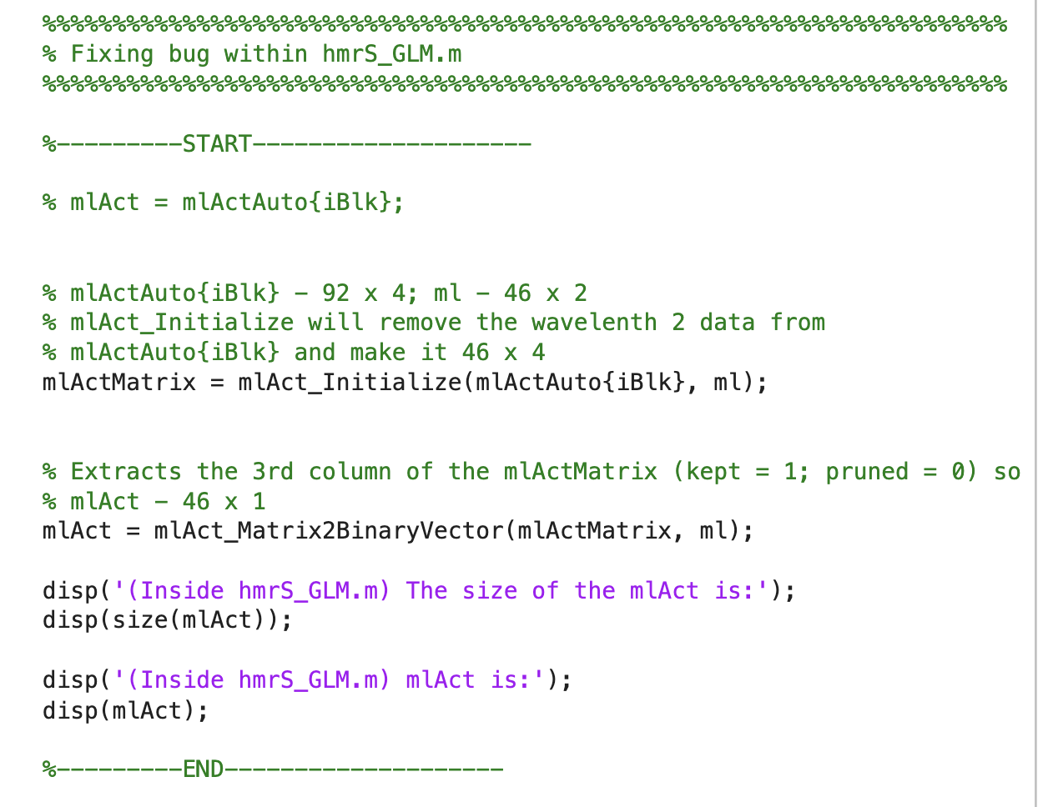

Slide 44
In hmrS_GLM.m
% get mlActRuns from one of the runs
disp('(Inside hmrS_GLM.m) The size of the mlActRuns{1} is:');
disp(size(mlActRuns{1}));
mlActAuto{1} = cell2mat(mlActRuns{1});
MY FIX: Instead you keep channels not pruned in all runs

Slide 45
In hmrS_GLM.m
size of data_y.dataTimeSeries :
6949 138
size of data_y.time
6949 1
size of data_y.measurementList
1 138

Slide 46
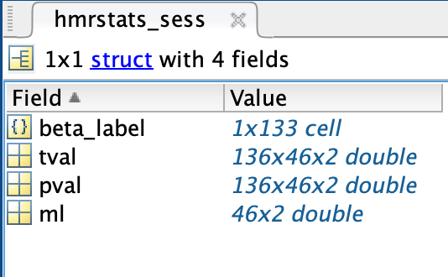
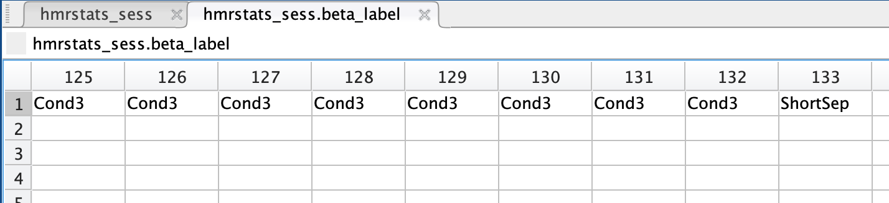
Error 2
Index exceeds the number of array elements. Index must not exceed 133.
Error in homer3_without_gui_subject_glm_FIXED_mlActSession>export_hmrstats_csv (line 312) thisLabel = beta_label{iB};
Error in homer3_without_gui_subject_glm_FIXED_mlActSession (line 263) export_hmrstats_csv(hmrstats_sess, out_glm_sess_csv);

Slide 47
nB = floor((trange(2) - trange(1)) / gms) - 1;
trange = [-5.0 40.0] → total window = 44 seconds
gms = 1 s (your Gaussian spacing)
Condition 1 → 44 columns
Condition 2 → 44 columns
Condition 3 → 44 columns

Slide 48
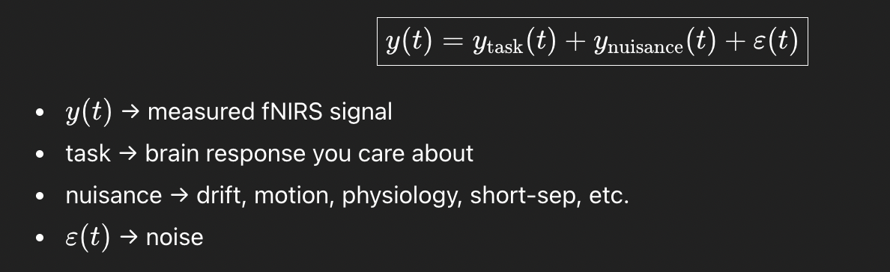
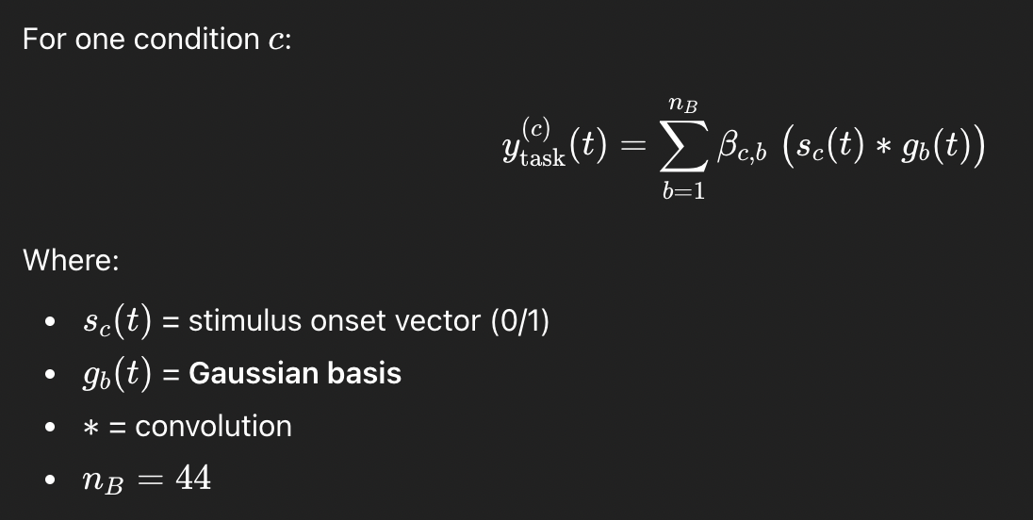

Slide 49
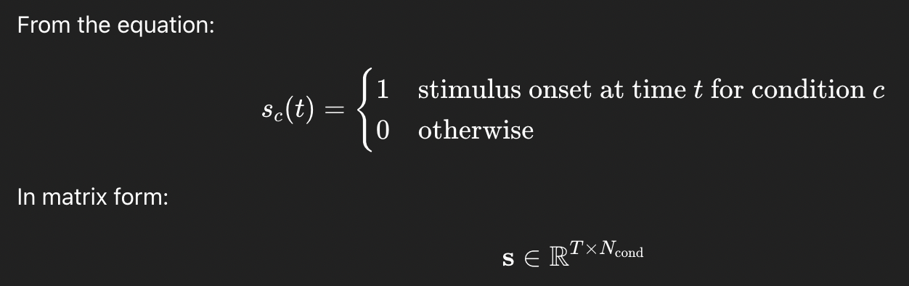

Slide 50
Convolution
t: 1 2 3 4 5 6 7 8
s_c(t): 0 0 1 0 0 1 0 0 (non-zero at t=3 anf t=6)
g_b(t): 0 0.2 0.8 1.0 0.8 0.2 0
Place one Gaussian at t=3
Place another Gaussian at t=6
Add them
(s_c * g_b)(t):
0 0 0.2 0.8 1.0 1.0 1.0 0.2

Slide 51
Nuisance Terms
Drift terms (slow baseline changes)
Short-separation regressors
Aux regressors (Aaux)
Motion regressors (currently off)

Slide 52
Error Fix
dA (HRF part) has 132 columns
Runs = 4
Final At columns = 132 + 4 = 136
But beta_label is still 133
So the missing labels are exactly the 3 extra copies of that one nuisance regressor for runs 2–4.
Your code intentionally makes ShortSep run-specific (separate nuisance per run)
Therefore the labeling must also become run-specific

Slide 53
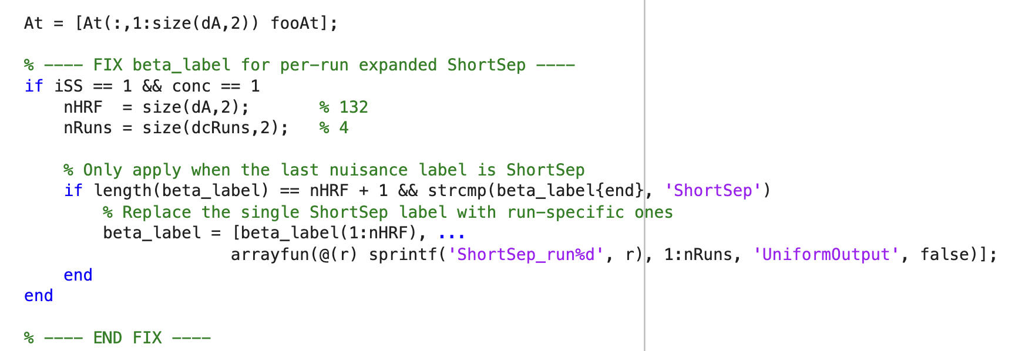
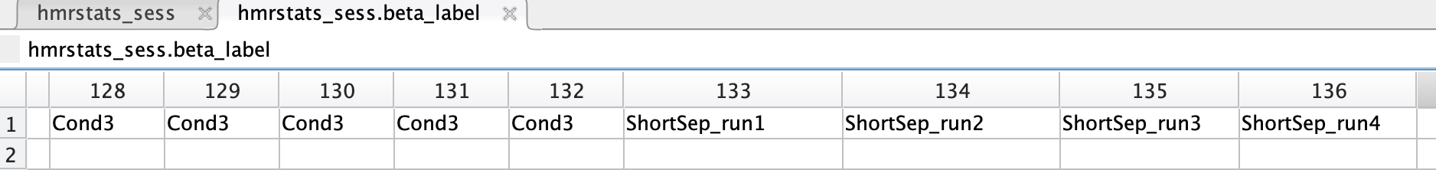

Slide 54
Python (MNE/MNE-NIRS) script
Input: multiple run SNIRFs
Preproc: intensity → OD → Hb (if needed), keep long channels
Design matrix idea:
Conditions are shared across runs
Drift/constant are run-specific (drift_run1, drift_run2, …)
Fit: 1 GLM on concatenated data (run_glm(raw_all, dm_subject))
Export: one CSV of subject-level GLM results

Slide 55
Use Qtnirs for preprocessing (DONE)
Understand how shortSep works in homer3 glm (17,
Work on the MNE script for glm
Understand the homer3 session level glm script
SSCs should be
S12-R11
S17-R15

Slide 56
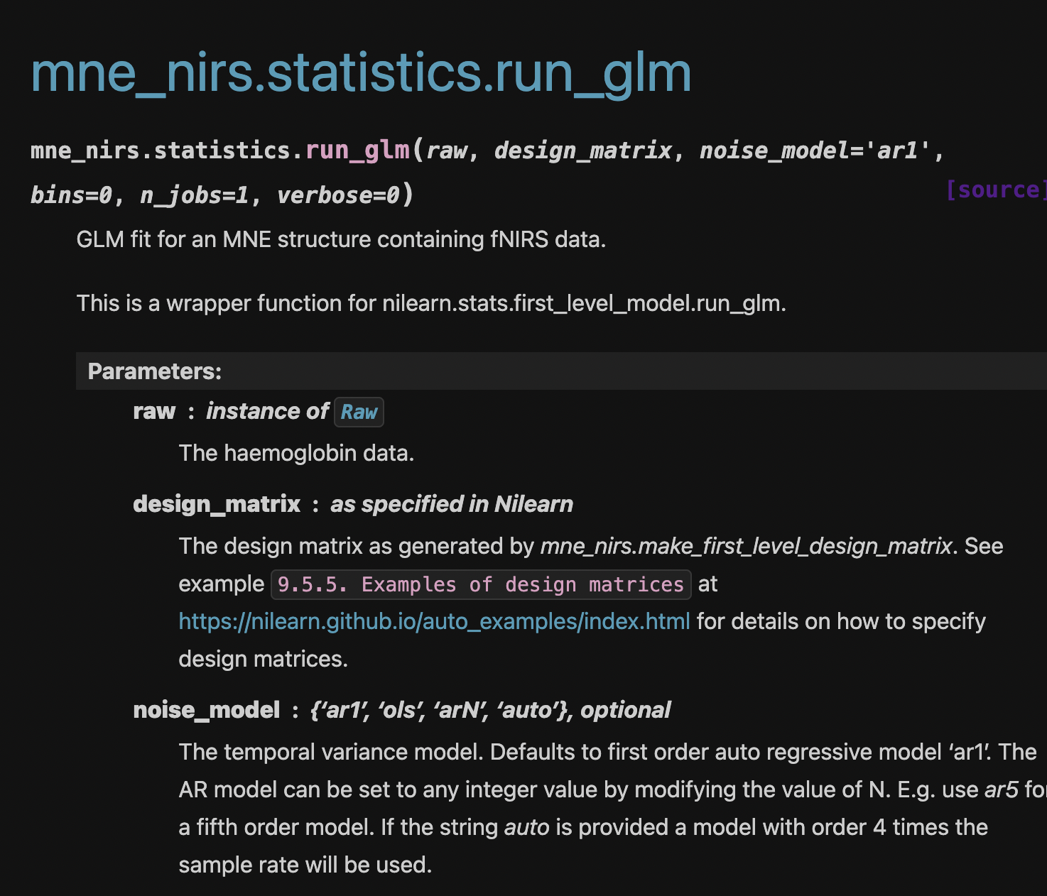
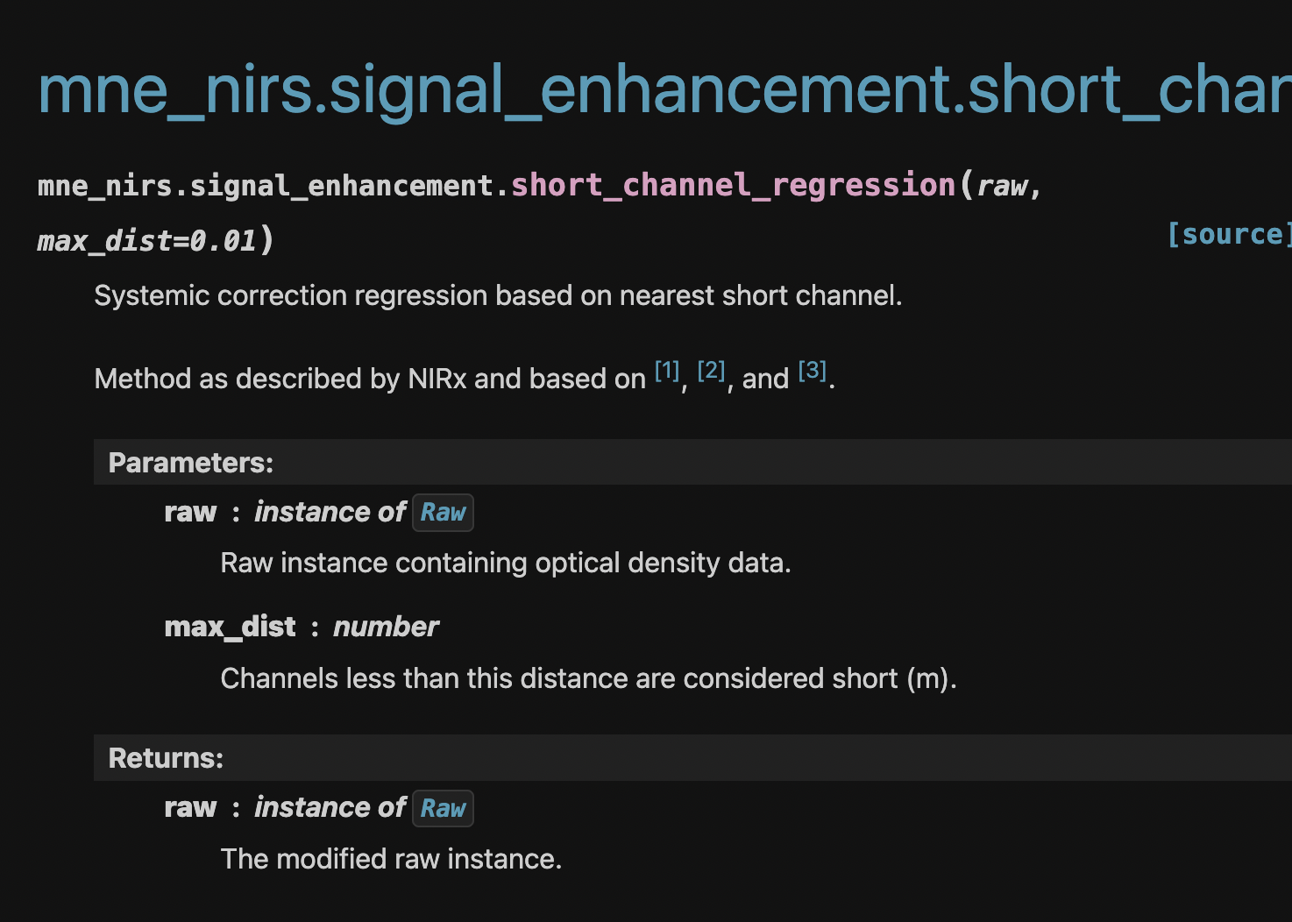
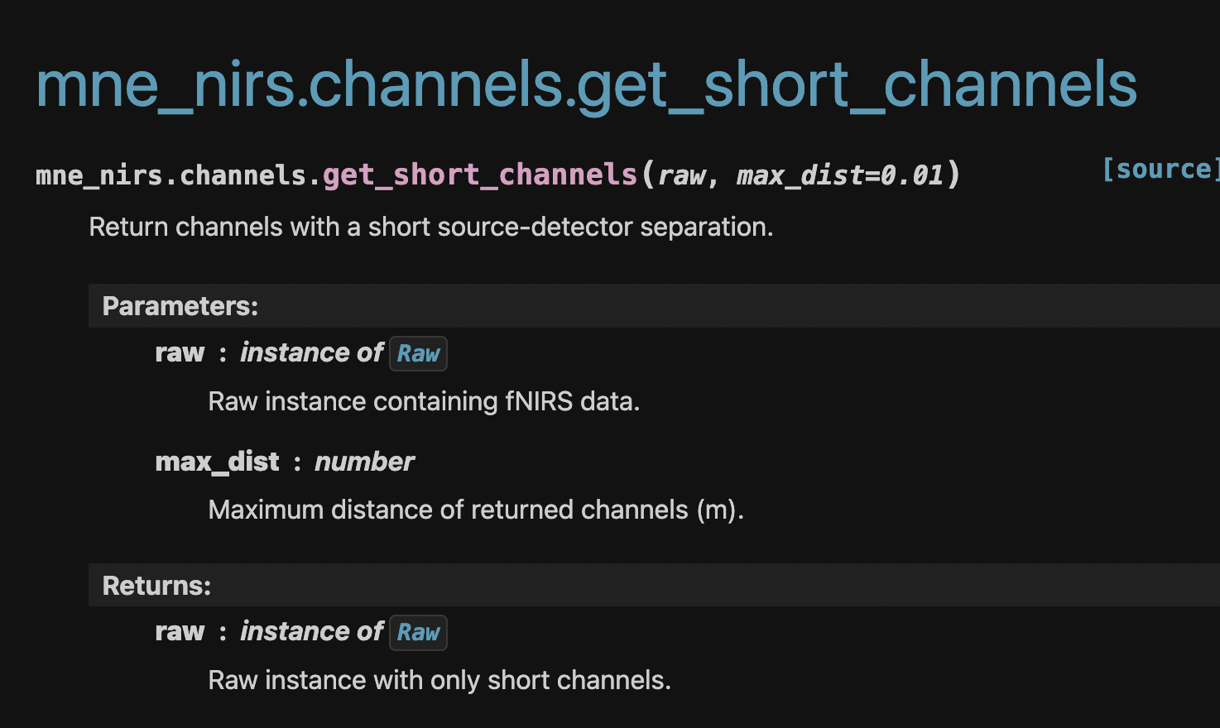
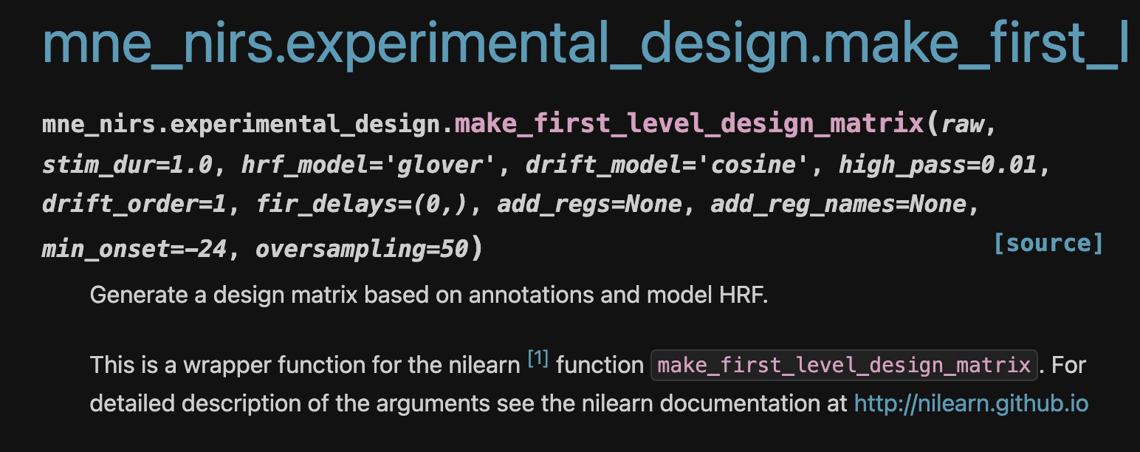

Slide 57
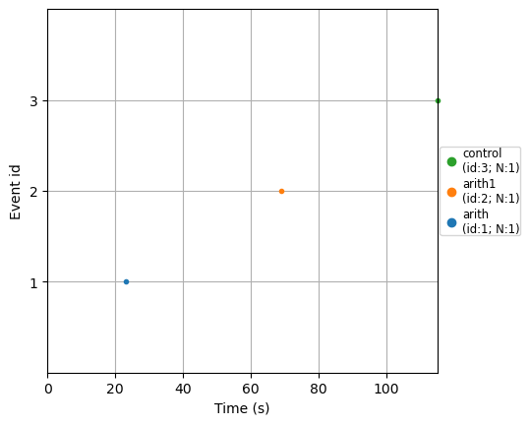
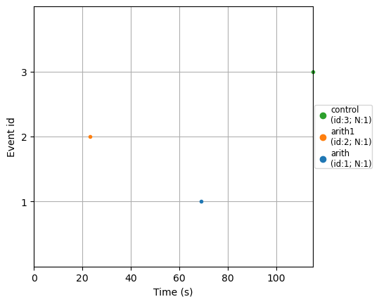
Events for runs
Run 1
Run 2
Run 3
Run 4

Slide 58
Short and long channels (run 1)
Short channel count : 4
Short channels : ['S12_D11 hbo', 'S12_D11 hbr', 'S17_D15 hbo', 'S17_D15 hbr']
Long channel count : 88
Long channels : ['S1_D1 hbo', 'S1_D1 hbr', 'S2_D1 hbo', 'S2_D1 hbr', 'S3_D1 hbo', 'S3_D1 hbr', 'S1_D2 hbo', 'S1_D2 hbr', 'S3_D2 hbo', 'S3_D2 hbr', 'S4_D2 hbo', 'S4_D2 hbr', 'S2_D3 hbo', 'S2_D3 hbr', 'S3_D3 hbo', 'S3_D3 hbr', 'S5_D3 hbo', 'S5_D3 hbr', 'S3_D4 hbo', 'S3_D4 hbr', 'S4_D4 hbo', 'S4_D4 hbr', 'S5_D4 hbo', 'S5_D4 hbr', 'S7_D5 hbo', 'S7_D5 hbr', 'S6_D5 hbo', 'S6_D5 hbr', 'S8_D5 hbo', 'S8_D5 hbr', 'S6_D6 hbo', 'S6_D6 hbr', 'S8_D6 hbo', 'S8_D6 hbr', 'S9_D6 hbo', 'S9_D6 hbr', 'S7_D7 hbo', 'S7_D7 hbr', 'S8_D7 hbo', 'S8_D7 hbr', 'S10_D7 hbo', 'S10_D7 hbr', 'S8_D8 hbo', 'S8_D8 hbr', 'S10_D8 hbo', 'S10_D8 hbr', 'S9_D8 hbo', 'S9_D8 hbr', 'S11_D9 hbo', 'S11_D9 hbr', 'S13_D9 hbo', 'S13_D9 hbr', 'S11_D10 hbo', 'S11_D10 hbr', 'S13_D10 hbo', 'S13_D10 hbr', 'S14_D10 hbo', 'S14_D10 hbr', 'S15_D11 hbo', 'S15_D11 hbr', 'S13_D11 hbo', 'S13_D11 hbr', 'S13_D12 hbo', 'S13_D12 hbr', 'S14_D12 hbo', 'S14_D12 hbr', 'S15_D12 hbo', 'S15_D12 hbr', 'S16_D13 hbo', 'S16_D13 hbr', 'S18_D13 hbo', 'S18_D13 hbr', 'S16_D14 hbo', 'S16_D14 hbr', 'S18_D14 hbo', 'S18_D14 hbr', 'S19_D14 hbo', 'S19_D14 hbr', 'S18_D15 hbo', 'S18_D15 hbr', 'S20_D15 hbo', 'S20_D15 hbr', 'S18_D16 hbo', 'S18_D16 hbr', 'S19_D16 hbo', 'S19_D16 hbr', 'S20_D16 hbo', 'S20_D16 hbr']

Slide 59
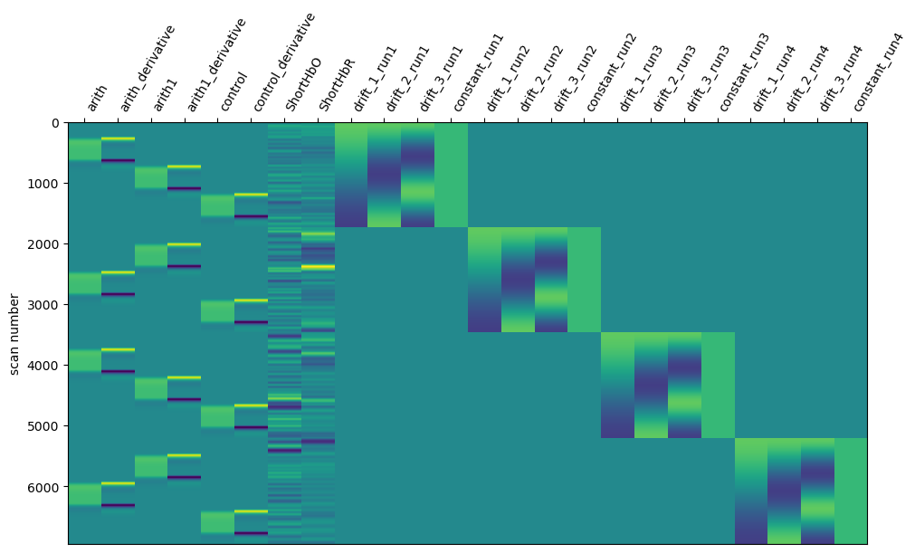
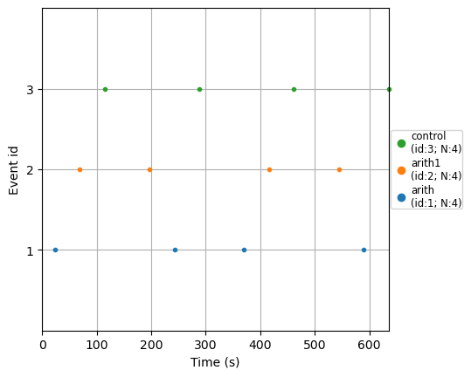
Design matrix
Events for concatenated runs

Slide 60
Best channel (based on metrics)
Strongest task effect → biggest |t| (most common)
Best (abs_t):
S18_D15 hbo
{'theta': 6.304180487841417e-05, 't': 15.235009486741607, 'p_value': 7.735254367161266e-14}
Most significant → smallest p_value
Best (min_p):
S18_D15 hbo
{'theta': 6.304180487841417e-05, 't': 15.235009486741607, 'p_value': 7.735254367161266e-14}
Largest effect size → biggest |theta|
Best (abs_theta):
S10_D8 hbo
{'theta': 0.00012926978437222337, 't': 11.92319800911666, 'p_value': 1.427383209402533e-11}

Slide 61
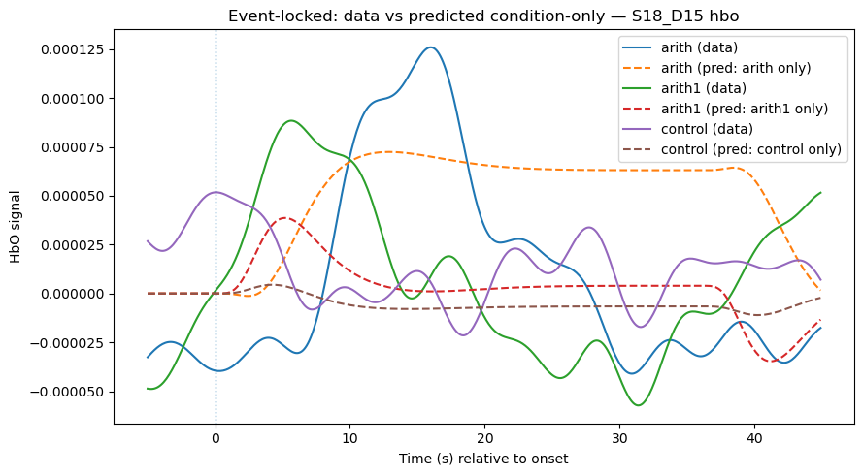
Hemodynamic response for different triggers

Slide 62
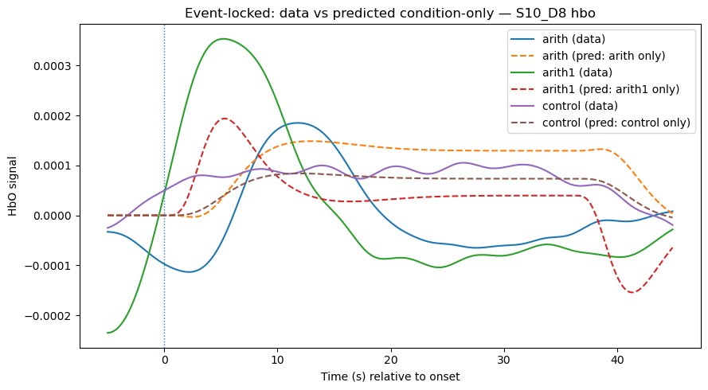

Slide 63
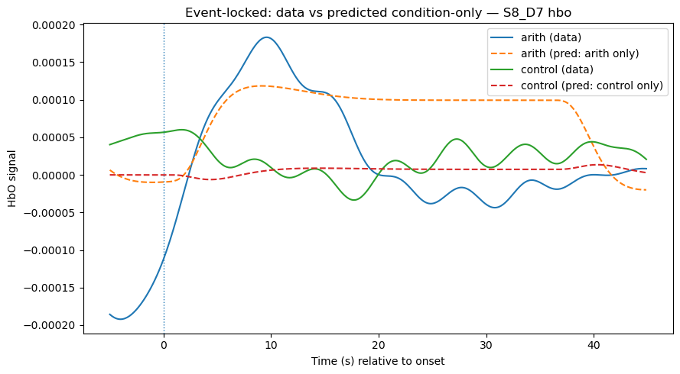
Treat arith and arith1 as the same trigger
raw_hb.annotations.rename({"arith1": "arith"})

Slide 64
hrf_model used for the glm
hrf_model used - {‘spm + derivative’}
Out csv from mne –
{44 long channels x 2 (hbo/hbr) x 24 regressors}
x 12 columns (generated metrics for each regressor)
Csv – 2112 rows x 12 columns

Slide 65
theta (MOST IMPORTANT)
This is the beta coefficient.
Plain meaning: “How big is the effect of this condition on this channel?”
Positive → signal goes up
Negative → signal goes down
Near zero → no effect

Slide 66
se
Uncertainty in theta.
small se → confident estimate
large se → noisy estimate

Slide 67
t
Signal-to-noise ratio.
Rule of thumb:
|t| > 2 → likely meaningful
|t| < 2 → probably noise

Slide 68
p_value
Probability this effect is just chance.
Common rule:
p < 0.05 → statistically significant

Slide 69
df
Degrees of freedom.
This comes from:
#timepoints − #regressors
Same across conditions for a given channel.

Slide 70
mse
Noise level left after fitting the model.
Lower = better fit.

Slide 71
Current GLM code using MNE
ShortHbO = mean(all short HbO channels at each time point)
ShortHbR = mean(all short HbR channels at each time point)
To improve results –
PCA short regressors (2–3 components) for HbO and HbR
Nearest-short mapping using channel locations (when your montage has positions)

