Slide 1




AegisCore: An Intelligent API Security Monitoring and Threat Intelligence Platform
Project Review -1
(24SDCS03) – SOA Programming and Microservices
 | Under the Guidance of Dr. K. Venkateshwari CSE Professor, Department of Computer Science and Engineering, KLH CSE Bowrampet Campus
Team Members Harshini – 2420030113 Pallavi – 2420030373 Divija – 2420030481
Date
SOA Project Review-1
1
Notes:
1.7.2013
1
‹#›

Slide 2
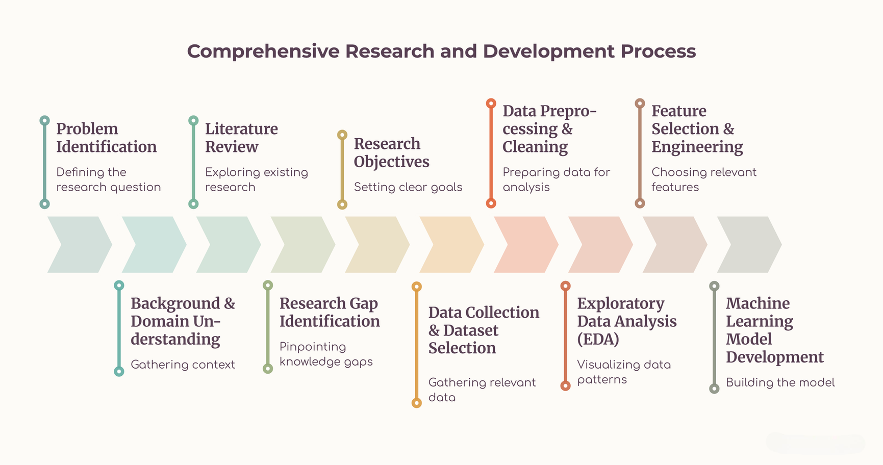
Outline of Project Work
2

Slide 3



Problem Statement
Modern applications depend on complex API ecosystems that traditional, static security controls fail to protect against dynamic, behavior-driven threats and coordinated abuse.
1
High API Exposure
2
Evolving Threats
3
Limited Context
Expanding endpoint inventories across public, partner, and internal environments significantly enlarges an organization's attack surface by creating hard-to-monitor entry points. Without consistent authentication and oversight, these exposed vectors enable malicious actors to bypass perimeter defenses, intercept traffic, and breach sensitive backend data.
Threat patterns like credential abuse, injection, and API misuse constantly evolve alongside baseline traffic shifts, rendering static defense rules obsolete. Adapting to these dynamic risks requires continuous monitoring and behavioral analytics to detect anomalous request bursts and block unauthorized access in real time.
Without behavioral context, static rules produce isolated alerts that fail to reveal broader attack patterns or highlight true severity. This leaves security teams drowning in unprioritized noise, unable to correlate related indicators or focus on high-impact threats.
Therefore, AegisCore aims to continuously monitor API activity, detect anomalies, correlate threat intelligence, and present actionable security alerts.

Slide 4

Objectives
1
Continuous Monitoring
2
Behavioral Detection
Collect and analyze API gateway and application activity for continuous security visibility.
Identify deviations from normal API behavior using machine-learning-based anomaly detection.
3
Threat Intelligence
4
Risk Scoring
Correlate suspicious IPs, request patterns, endpoints, and threat indicators for better context.
Assign meaningful risk levels so security teams can prioritize high-impact events.
5
Security Dashboard
6
Scalable Architecture
Visualize traffic trends, anomalies, targeted endpoints, alerts, and API health metrics.
Design the platform around modular services suitable for API-driven and microservices environments.

Slide 5
Literature Survey
Authors / Source | Title | Methodology | Inferences | Limitation / Future Work
Baye et al. [1] (2021) | API Security in Large Enterprises: Leveraging Machine Learning for Anomaly Detection | ML-based API traffic analysis; features include bandwidth and requests per token; SVM used for binary classification. | Shows that ML can classify abnormal API traffic and support security monitoring in large microservice environments. | Dataset scarcity led to a synthetic dataset; broader real-world validation is needed.
OWASP Foundation [2] (2023) | OWASP API Security Top 10 | Security-risk taxonomy covering authorization, authentication, resource consumption, SSRF, misconfiguration, inventory, and unsafe API consumption. | Provides a practical baseline for identifying and prioritizing API-specific security risks. | Primarily an awareness and risk framework; it does not itself provide continuous ML-based anomaly detection.
MDPI [3] (2026) | Context-Aware ML/NLP Pipeline for Real-Time Anomaly Detection and Risk Assessment in Cloud API Traffic | Combines numerical anomaly detection with NLP-based analysis of access logs using rules, TF-IDF, and character-level models. | Connects technical API anomalies with business risk and supports both request-level and log-level analysis. | Broader deployment validation and scalability across diverse real-world API environments remain important future directions.
[1] Baye et al., IEEE ISNCC 2021 [2] OWASP API Security Top 10, 2023 [3] MDPI, Machine Learning, Knowledge Extraction, 2026
5
Notes:
1.7.2013
5
‹#›

Slide 6
Authors / Source | Title | Methodology | Inferences | Limitation / Future Work
Zhang et al. (2024) | TAD-LLM: API Traffic Anomaly Detection Based on Large Language Model | Uses an LLM-based approach with S2GS data transformation, prompt optimization and LoRA fine-tuning to analyze API traffic and detect complex attacks. | Shows that LLMs can capture contextual information in API traffic and improve detection of complex API attacks. | LLM-based detection can introduce computational overhead and requires suitable API-traffic data for domain adaptation.
Aharon et al. (2024/2025) | A Classification-by-Retrieval Framework for Few-Shot Anomaly Detection to Detect API Injection Attacks | Uses FastText API-specific embeddings with Approximate Nearest Neighbor retrieval for few-shot anomaly detection. Evaluated on CSIC 2010 and ATRDF 2023. | Demonstrates that API injection attacks can be detected with very few examples of normal API requests, addressing the scarcity of labeled API-security datasets. | Focuses primarily on API injection; broader attack categories and more diverse real-world API environments require further evaluation.
Tanveer et al. (2025) | Context-Aware ML/NLP Pipeline for Real-Time Anomaly Detection and Risk Assessment in Cloud API Traffic | Combines numerical anomaly detection with NLP-based analysis of access logs using rules, TF-IDF, and character-level models. | Connects technical API anomalies with business risk and supports both request-level and log-level analysis. | Broader deployment validation and scalability across diverse real-world API environments remain important future directions.
[1] Baye et al., IEEE ISNCC 2021 [2] OWASP API Security Top 10, 2023 [3] MDPI, Machine Learning, Knowledge Extraction, 2026
5
Notes:
1.7.2013
5
‹#›

Slide 7

Problem Gap Identification
1
Fragmented Monitoring
2
Static Detection
3
Alert Overload
API logs, gateway events, and security indicators are often analyzed separately, limiting end-to-end visibility.
Rule and signature-based controls may struggle with novel, evolving, or behavior-driven API attacks.
Large volumes of API events can make it difficult to distinguish high-risk incidents from normal traffic.
4
Weak Threat Context
5
Need for Integration
A suspicious request is more useful when linked with indicators, endpoint behavior, and related activity.
There is a need for a modular platform combining monitoring, anomaly detection, threat intelligence, risk scoring, and visualization.
Research gap addressed by AegisCore: move from isolated API security checks toward continuous, behavior-aware monitoring with contextual threat intelligence.

Slide 8

Innovation, Creativity, and Novelty
1
Behavior + Threat Intelligence
2
Adaptive API Baselines
Combines behavioral anomaly scores with threat indicators to provide richer incident context.
Learns normal request behavior so unusual frequency, endpoint usage, or authentication patterns can be highlighted.
3
Unified Risk Scoring
4
Explainable Security Dashboard
Converts multiple signals into a prioritized risk level instead of treating every alert equally.
Shows why an event is suspicious through request features, endpoint behavior, indicators, and alert history.
5
Microservices-Oriented Design
Separates collection, processing, detection, intelligence, alerting, and visualization into modular components.

Slide 9



Feasibility and Project Plan
Technical Feasibility
• Java + Spring Boot + Spring Cloud
• Eureka + API Gateway
• JWT, RBAC, CORS
• Kafka, Postman
Operational Feasibility
• Continuous API monitoring
• Anomaly and threat detection
• Risk scoring and security alerts
• Dashboard-based investigation
Project Plan – Phase Flow
Requirements
Planning &
Architecture
Microservices
Development
Gateway &
Security
Security
Monitoring
Testing &
Semgrep
CI/CD &
Integration
Final Demo &
Documentation
12-Week Project Timeline
W1
W2
W3
W4
W5
W6
W7
W8
W9
W10
W11
Requirements
Planning & Architecture
Microservices Development
Gateway & Security
Security Monitoring
Testing & Semgrep
W12
CI/CD & Integration
Final Demo & Documentation

Slide 10
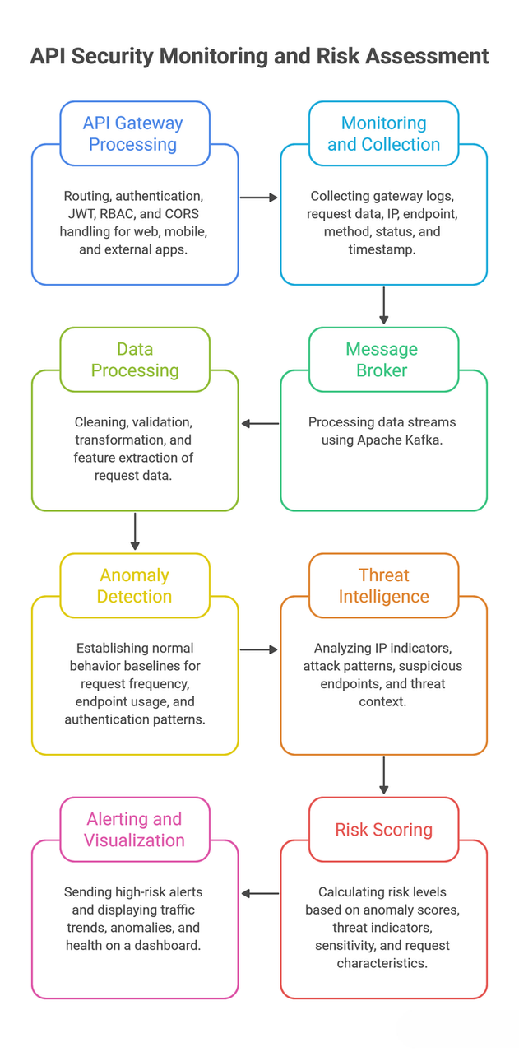
Project Architecture
    AegisCore follows a modular security-monitoring architecture that processes API activity through multiple stages, from request collection to security analysis and visualization. API requests are first handled by the API Gateway, where routing and security controls such as JWT, RBAC and CORS are applied. Relevant request and gateway information is then collected for further analysis.
    The collected API data is streamed through a message broker and passed to the data-processing layer, where the information is cleaned, validated and transformed into security-relevant features. The processed data is analyzed by the anomaly detection module to identify deviations from established API behavior patterns.
    Suspicious activity is further enriched through threat-intelligence analysis, considering indicators such as IP addresses, attack patterns and endpoint behavior. These signals are combined by the risk-scoring module to determine the severity of detected events. Finally, high-risk events are communicated through alerts and visualized on a security dashboard for monitoring and investigation.

Slide 11
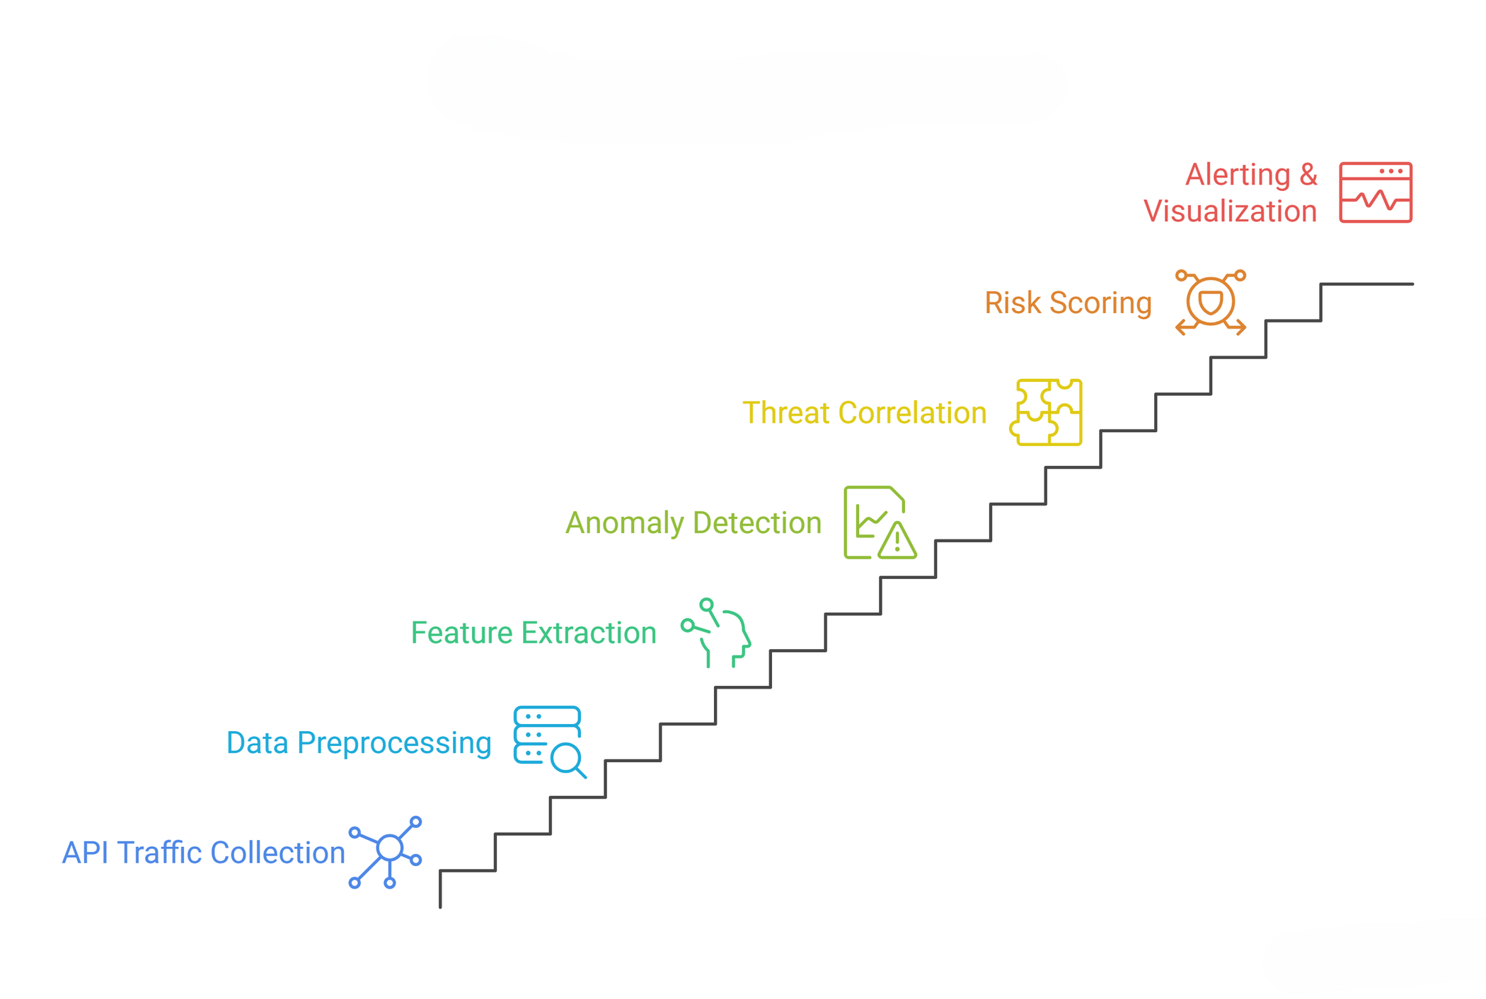
System Methodology

Slide 12
System Methodology
1. API Traffic Collection
Collect API gateway and application activity including IP, endpoint, HTTP method, status and timestamp.
2. Data Preprocessing
Clean, validate and transform raw API logs into structured security data.
3. Feature Extraction
Extract behavioral indicators such as request frequency, endpoint usage and authentication patterns.
4. Anomaly Detection
Compare incoming API behavior against established normal patterns to identify suspicious deviations.
5. Threat Intelligence Correlation
Enrich suspicious activity using IP indicators, attack patterns, endpoint behavior and threat context.
6. Risk Scoring
Combine anomaly and contextual security signals to determine the severity/risk level of an event.
7. Alerting & Visualization
Generate security alerts and present traffic trends, anomalies, risk levels and API health through the dashboard.

Slide 13
Technology and Stack
Backend & Microservices
    Java
    Spring Boot
    Spring Cloud
    API & Service Management
    Spring Cloud Gateway
    Eureka Server
    REST APIs
    Security
    JWT
    RBAC
    CORS
Communication & Testing
    Apache Kafka
    Postman
    Security Analytics
    ML-based Anomaly Detection
    Feature-based API Behavioral Analysis
    Security Testing
    Semgrep

Slide 14
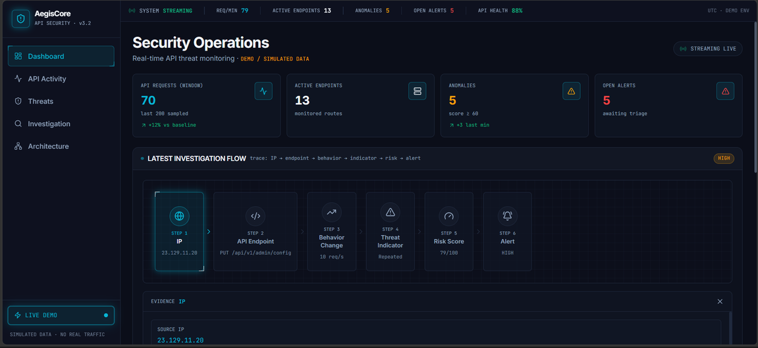
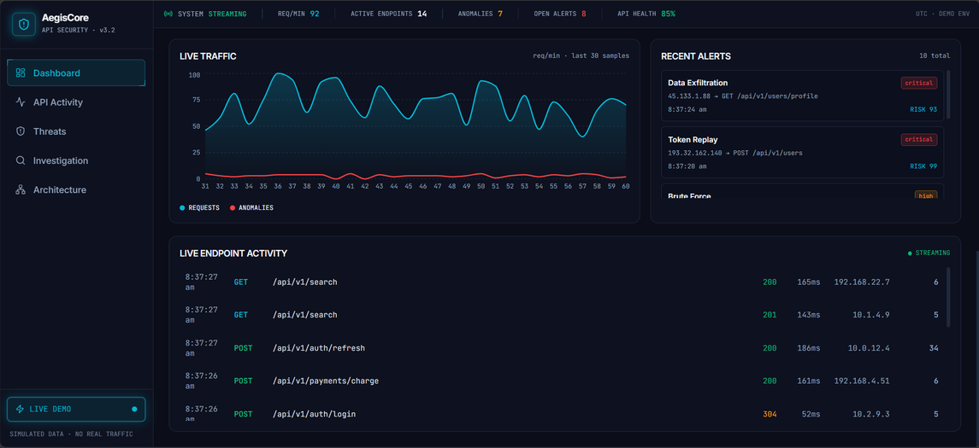
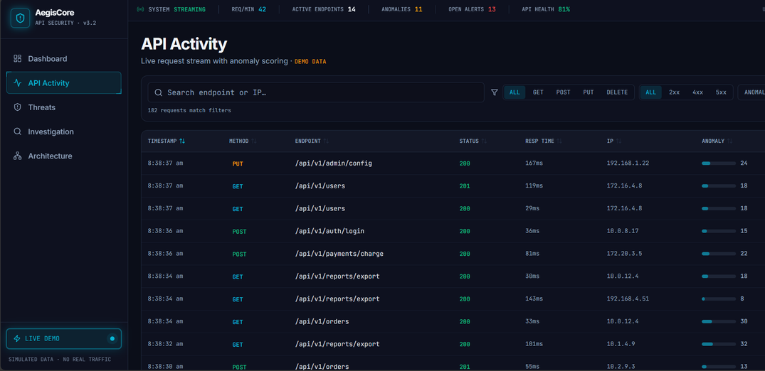
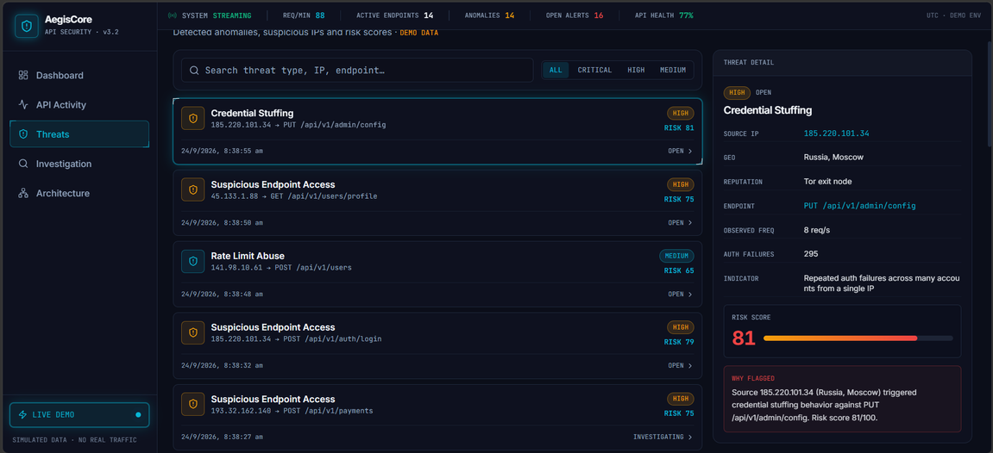
Frontend Results

