Slide 1

AegisCore: An Intelligent API Security Monitoring and Threat Intelligence Platform
Project Review -1
(24SDCS03) – SOA Programming and Microservices
 | Under the Guidance of Dr. K. Venkateshwari CSE Professor, Department of Computer Science and Engineering, KLH CSE Bowrampet Campus
Team Members Harshini – 2420030113 Pallavi – 2420030373 Divija – 2420030481

Slide 2
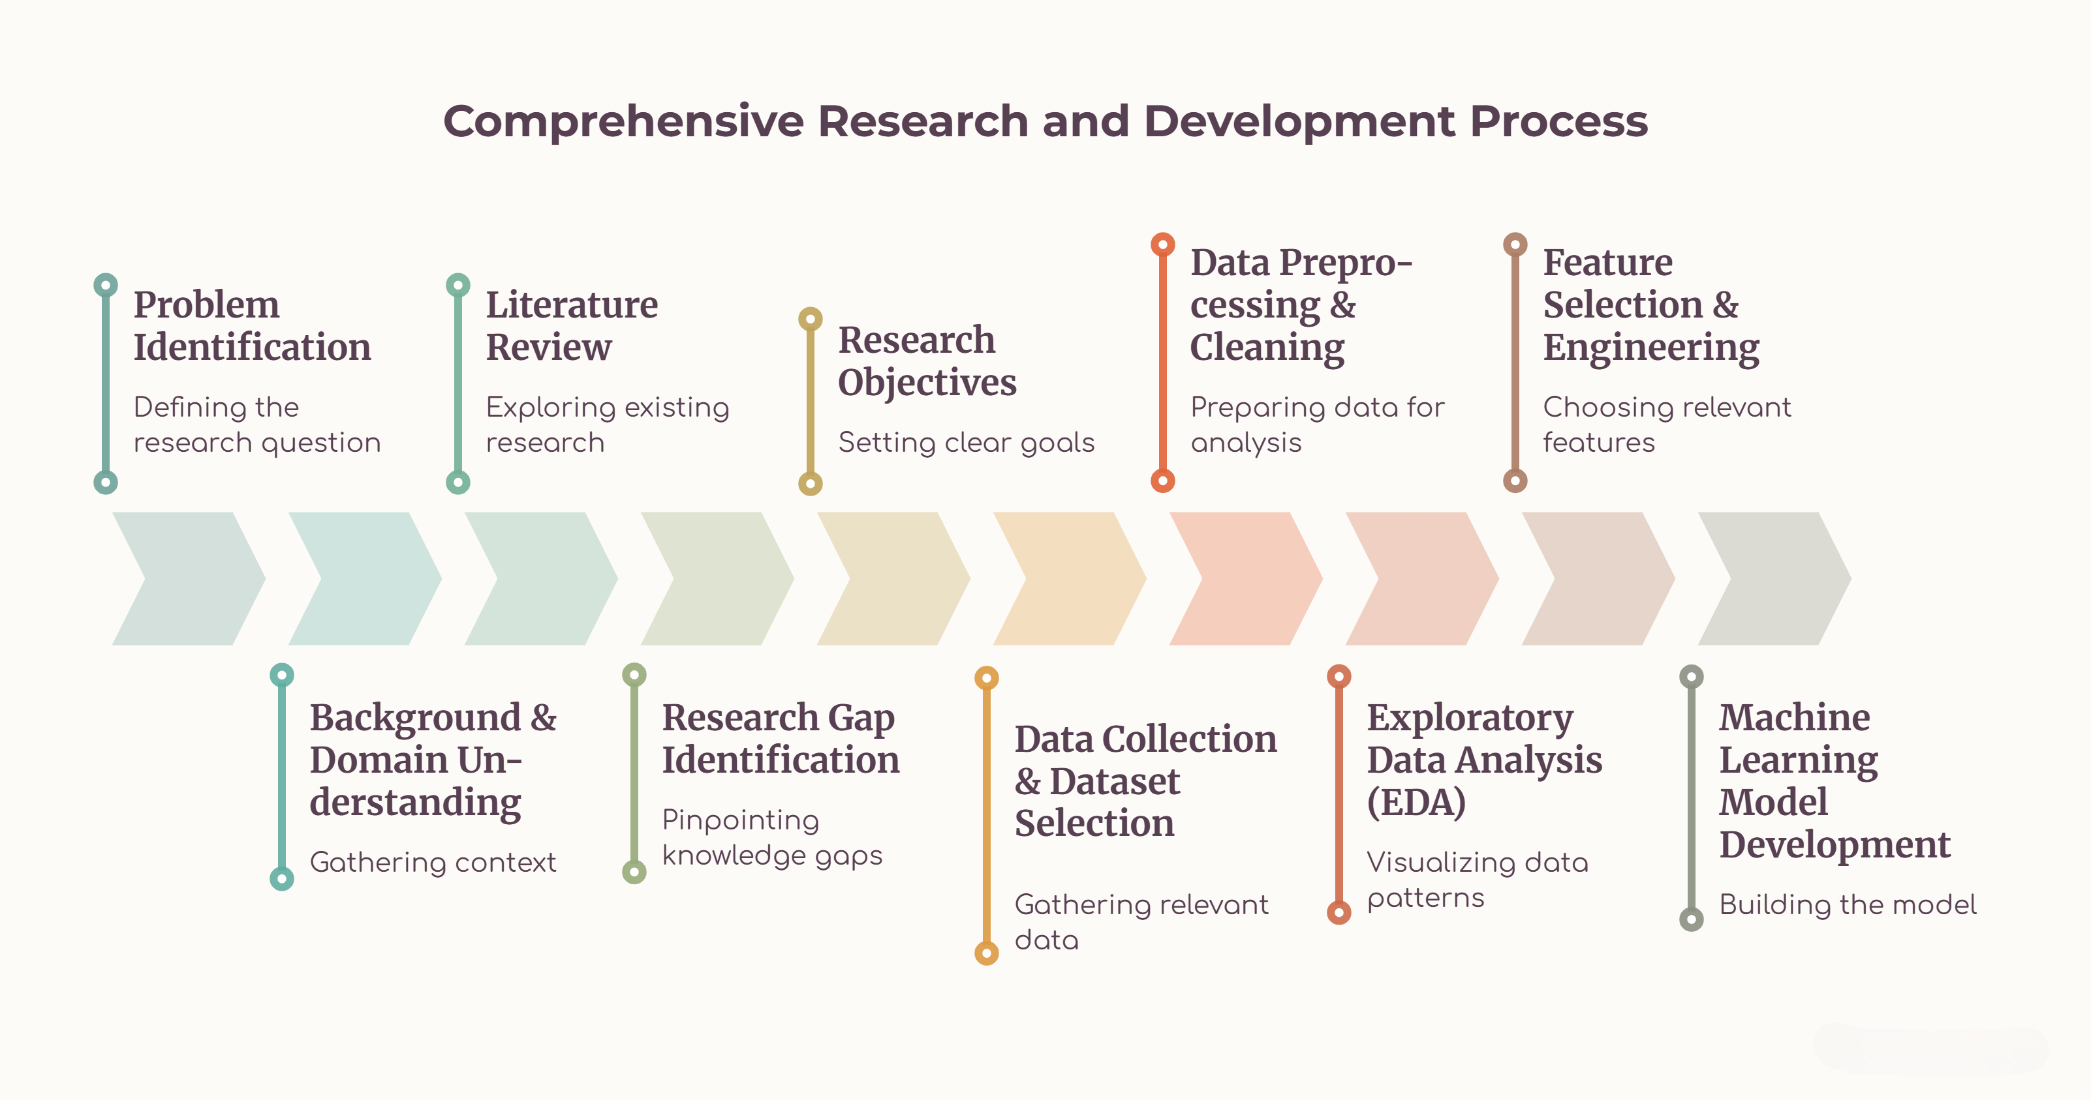
Outline of Project Work

Slide 3
Problem Statement
Modern applications depend heavily on APIs, making them a major attack surface. Traditional rule-based monitoring and manual log analysis can miss abnormal behavior, evolving attacks, and coordinated API abuse.
1
High API Exposure
2
Evolving Threats
3
Limited Context
Large numbers of public, partner, and internal endpoints increase the attack surface and may expose sensitive data.
Credential abuse, injection, abnormal request bursts, unauthorized access, and API misuse can change over time.
Static rules may generate alerts without enough behavioral context to prioritize incidents or connect related indicators.
Therefore, AegisCore aims to continuously monitor API activity, detect anomalies, correlate threat intelligence, and present actionable security alerts.

Slide 4
Objectives
1
Continuous Monitoring
2
Behavioral Detection
Collect and analyze API gateway and application activity for continuous security visibility.
Identify deviations from normal API behavior using machine-learning-based anomaly detection.
3
Threat Intelligence
4
Risk Scoring
Correlate suspicious IPs, request patterns, endpoints, and threat indicators for better context.
Assign meaningful risk levels so security teams can prioritize high-impact events.
5
Security Dashboard
6
Scalable Architecture
Visualize traffic trends, anomalies, targeted endpoints, alerts, and API health metrics.
Design the platform around modular services suitable for API-driven and microservices environments.

Slide 5
Literature Survey
Authors / Source | Title | Methodology | Inferences | Limitation / Future Work
Baye et al. [1] (2021) | API Security in Large Enterprises: Leveraging Machine Learning for Anomaly Detection | ML-based API traffic analysis; features include bandwidth and requests per token; SVM used for binary classification. | Shows that ML can classify abnormal API traffic and support security monitoring in large microservice environments. | Dataset scarcity led to a synthetic dataset; broader real-world validation is needed.
OWASP Foundation [2] (2023) | OWASP API Security Top 10 | Security-risk taxonomy covering authorization, authentication, resource consumption, SSRF, misconfiguration, inventory, and unsafe API consumption. | Provides a practical baseline for identifying and prioritizing API-specific security risks. | Primarily an awareness and risk framework; it does not itself provide continuous ML-based anomaly detection.
MDPI [3] (2026) | Context-Aware ML/NLP Pipeline for Real-Time Anomaly Detection and Risk Assessment in Cloud API Traffic | Combines numerical anomaly detection with NLP-based analysis of access logs using rules, TF-IDF, and character-level models. | Connects technical API anomalies with business risk and supports both request-level and log-level analysis. | Broader deployment validation and scalability across diverse real-world API environments remain important future directions.
[1] Baye et al., IEEE ISNCC 2021 [2] OWASP API Security Top 10, 2023 [3] MDPI, Machine Learning, Knowledge Extraction, 2026

Slide 6
Problem Gap Identification
1
Fragmented Monitoring
2
Static Detection
3
Alert Overload
API logs, gateway events, and security indicators are often analyzed separately, limiting end-to-end visibility.
Rule and signature-based controls may struggle with novel, evolving, or behavior-driven API attacks.
Large volumes of API events can make it difficult to distinguish high-risk incidents from normal traffic.
4
Weak Threat Context
5
Need for Integration
A suspicious request is more useful when linked with indicators, endpoint behavior, and related activity.
There is a need for a modular platform combining monitoring, anomaly detection, threat intelligence, risk scoring, and visualization.
Research gap addressed by AegisCore: move from isolated API security checks toward continuous, behavior-aware monitoring with contextual threat intelligence.

Slide 7
Innovation, Creativity, and Novelty
1
Behavior + Threat Intelligence
2
Adaptive API Baselines
Combines behavioral anomaly scores with threat indicators to provide richer incident context.
Learns normal request behavior so unusual frequency, endpoint usage, or authentication patterns can be highlighted.
3
Unified Risk Scoring
4
Explainable Security Dashboard
Converts multiple signals into a prioritized risk level instead of treating every alert equally.
Shows why an event is suspicious through request features, endpoint behavior, indicators, and alert history.
5
Microservices-Oriented Design
Separates collection, processing, detection, intelligence, alerting, and visualization into modular components.

Slide 8
Feasibility and Project Plan
Technical Feasibility
• Java + Spring Boot + Spring Cloud
• Eureka + API Gateway
• JWT, RBAC, CORS
• Kafka, Postman
Operational Feasibility
• Continuous API monitoring
• Anomaly and threat detection
• Risk scoring and security alerts
• Dashboard-based investigation
Project Plan – Phase Flow
Requirements
Planning &
Architecture
Microservices
Development
Gateway &
Security
Security
Monitoring
Testing &
Semgrep
CI/CD &
Integration
Final Demo &
Documentation
12-Week Project Timeline
W1
W2
W3
W4
W5
W6
W7
W8
W9
W10
W11
Requirements
Planning & Architecture
Microservices Development
Gateway & Security
Security Monitoring
Testing & Semgrep
W12
CI/CD & Integration
Final Demo & Documentation
AegisCore: Continuous API monitoring → anomaly detection → threat intelligence → risk scoring → actionable security insights

