Slide 1

Extended Training and Execution of a
Neural Network Localization System
Dinkar Khattar, Divij Ohri, Samar Seth, Sharon John
E96 Introduction to Engineering Design Final Presentation

Slide 2
Presentation Objective
The objectives for the presentation are these:
Provide documentation of your team’s accomplishments in E96
Provide experience in technical presentation preparation and delivery
Provide documentation that you may use for your future goals in interviews for internships or undergraduate research opportunities.

Slide 3
Our Product Development Mission
Our project deals with wireless localization of an IoT system, which has far ranging applications in the industry.
The short-range wireless communication capabilities of such systems make it possible to track location and movement in the physical realm. This is particularly important for application in product life-cycle management, which are already extensively adopting RFID technologies.
Identification and proximity detection schemes that make use of inexpensive RFIDs have also become a choice for commercial deployments in the logistics field.

Slide 4
Development Mission (continued)
Research: Localization systems represent an old research line of the 90s. Interestingly, recent advancement of ultra-wideband radio frequency technologies stimulated research for very fine-grained location estimation and ranging.
Healthcare: Application of IoT in healthcare (Internet of Medical Things), involves mobile medical applications or wearable devices that allow patients to capture their health data. Hospitals use IoT to keep tabs on the location of medical devices, personnel and patients. Recently, drug dispensing has also emerged as an important application in this field.

Slide 5
Design Overview: Technical Challenges I
We were often unable to find the same MAC addresses corresponding to the different points at which we tested our Edison. We resolved this issue by maximising our sample space, i.e taking many different values at different points. However, this was a recurring issue for unknown reasons. We speculate that it may have something to do with the structure of the eduroam wifi network system.

Slide 6
Design Overview: Technical Challenges II
Furthermore, the outputs produced by the neural network were not always in line with what was actually manually obtained, particularly in cases where the locations were not spaced out far enough. This could be from the imprecision of the IoT device or perhaps due to physical obstructions at various locations creating non-uniformly distributed wifi signal ranges. This was resolved by sufficiently spacing out the locations.

Slide 7
Design Overview: Technical Approach
Physical probing of locations to obtain the RSSI values
Comparison of RSSI values obtained at different locations for the same MAC address
Ensuing data set was subjected to FANN neural network training
Check to see if the neural net pinpoints the physical locations accurately

Slide 8
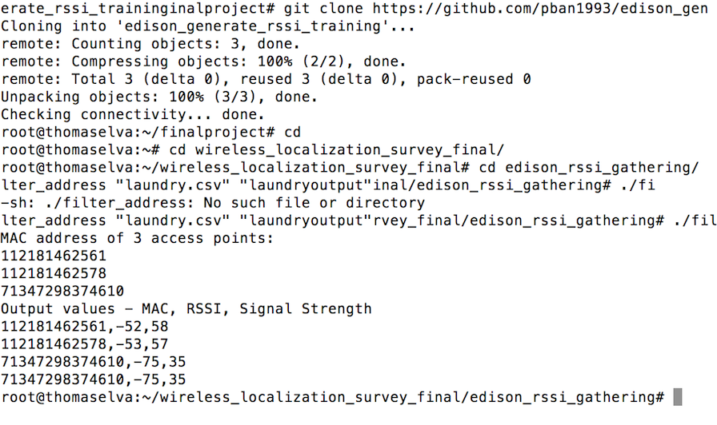
IoT System Implementation
Our project involved obtaining RSSI values at different points using the Intel Edison, finding the common MAC addresses at 4 locations, creating a data set involving values at 4 locations.

Slide 9
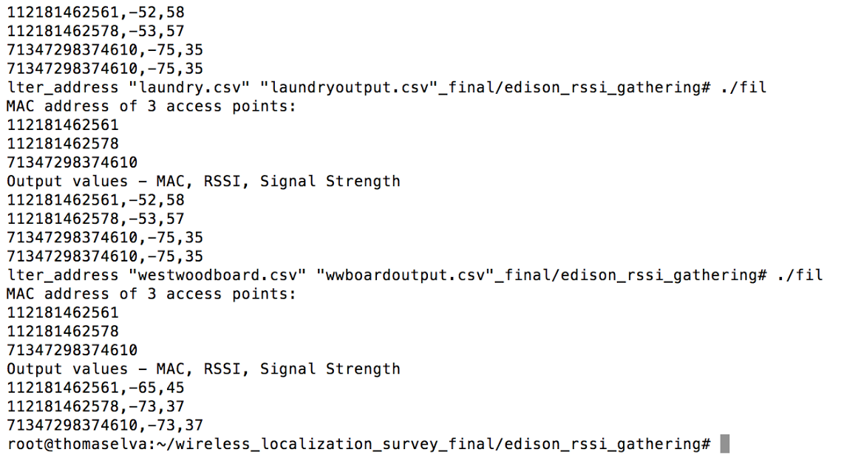
IoT System Implementation
We then trained it on the provided FANN neural network. Following this, we returned to the locations initially tested to aid in the training of the values.

Slide 10
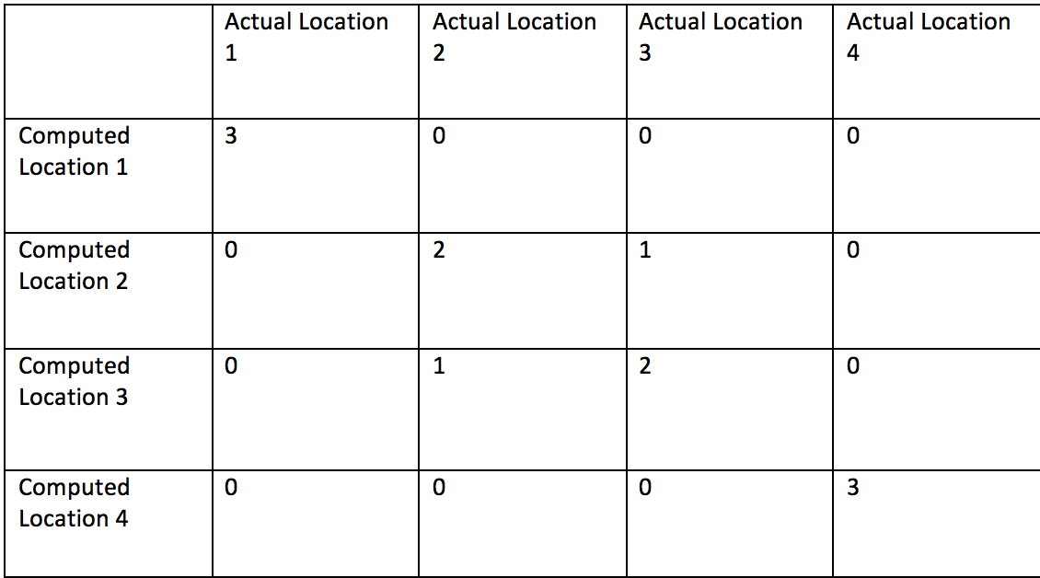
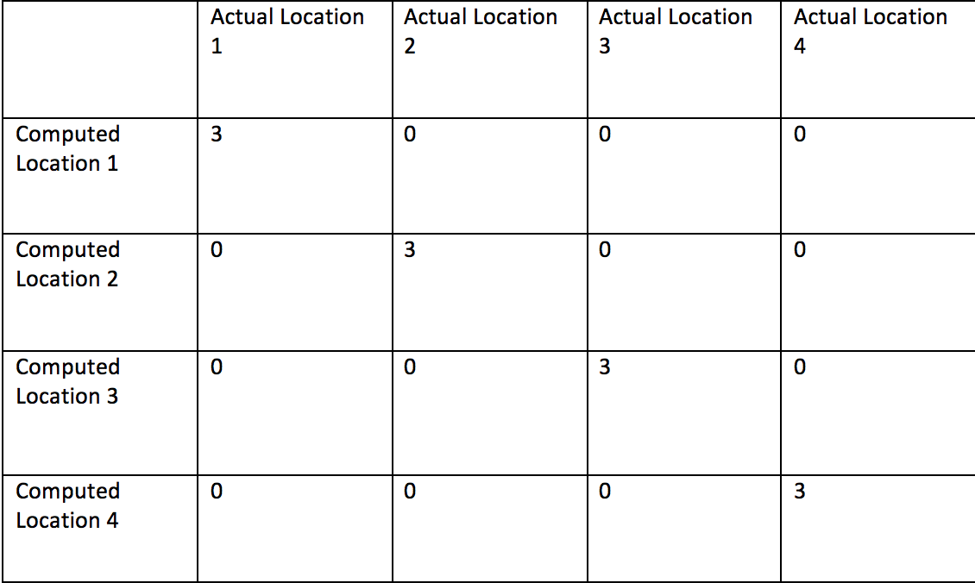
IoT System Implementation
We then simply checked to see if the neural nets were able to accurately reverse-engineer the locations we obtained the corresponding data at. This was the core element of our wifi localization system

Slide 11
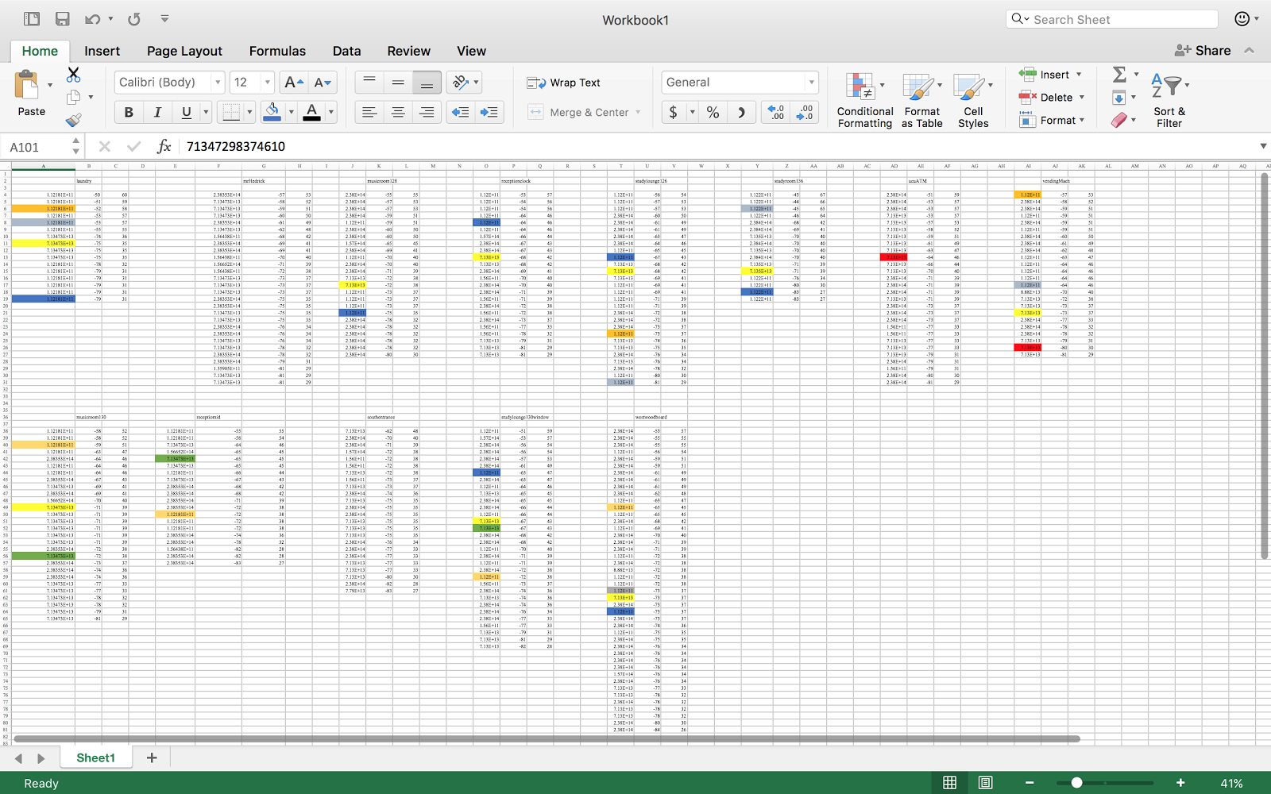

Slide 12
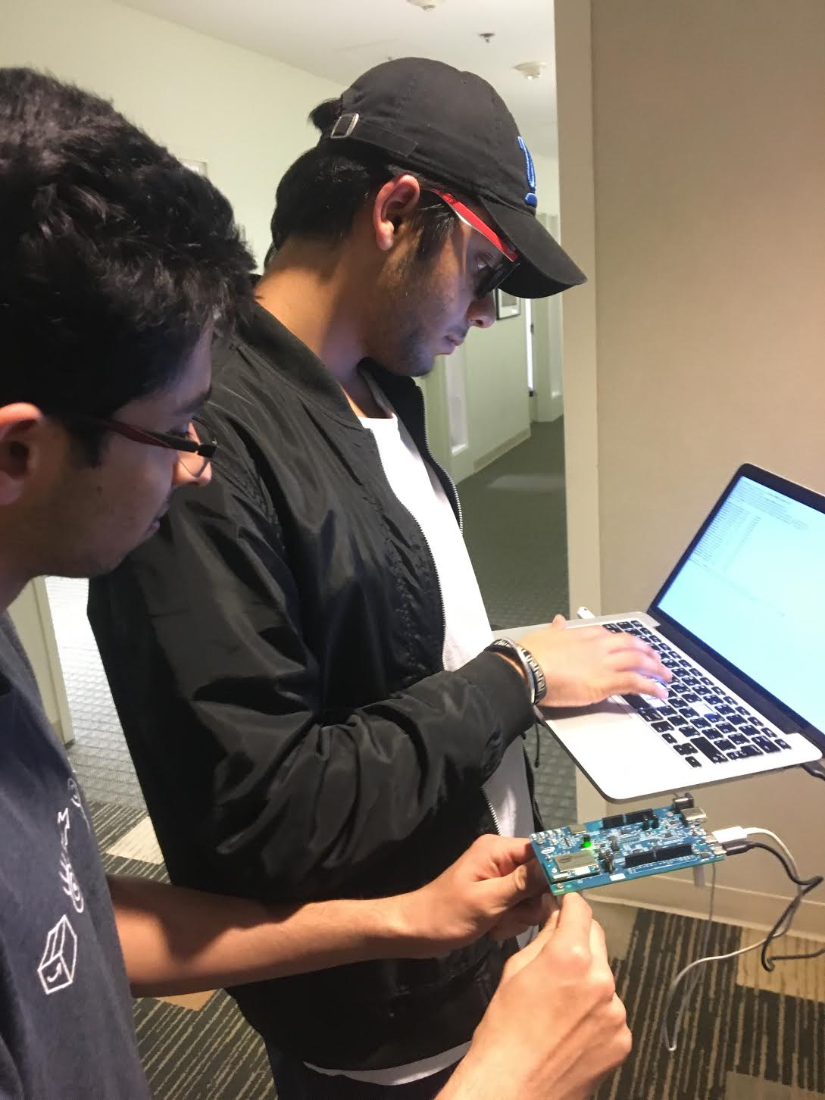

Slide 13
The Team
Dinkar:
  Trained the neural network
  Organized RSSI values
Divij:
  Responsible for creating the presentation
  Did project and design documentation (research)

Slide 14
Samar:
  Received the RSSI values
  Analyzed the data collected
Sharon:
  Contributed towards project documentation
  Created the confusion matrix and helped in research

Slide 15
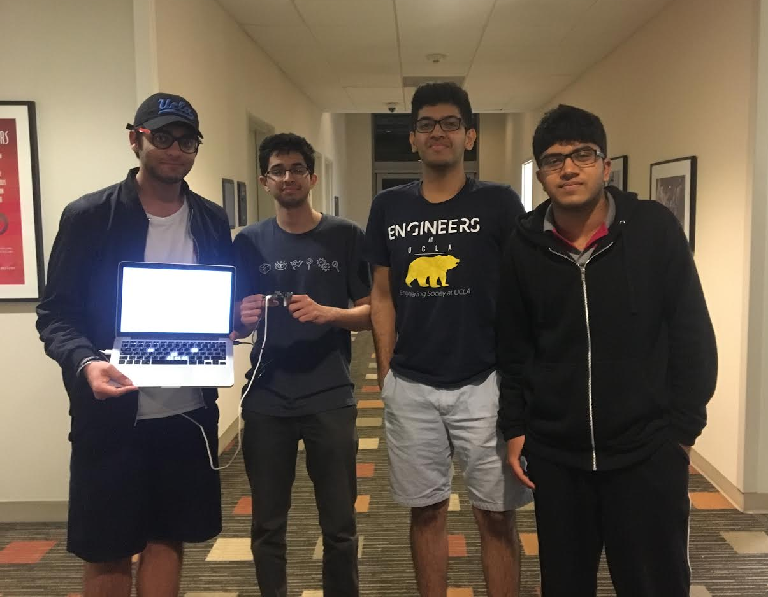

Slide 16
Future IoT Missions
With enough data points and enough neural net testing perhaps with the addition of supervised learning and allowing for user input to serve in classification, an internet of things hardware device can be made ‘aware’ of its physical location at each instant which spells endless applications in security and resource optimization. A distance calculator application availing the device’s knowledge of locations A and B that could suggest optimal paths between two locations is an interesting application we are looking at.
Divij was influenced by internet of things and has applied to a healthcare based IoT internship this summer.

Slide 17
Value Addition from 96C
We feel that we acquired a familiarity with the Terminal and using the bash commands (Linux language), which is essential to any software engineer’s repertoire.
Learned to use Neural network libraries; acquired a high level understanding of IoT systems.

