Slide 1
E(Length of Smallest Interval)
Project 7
Team - BiasedCoin

Slide 2
Problem Statement
Suppose we pick n points randomly uniformly and independently from the [0,1] line segment. This will create n+1 intervals. What is the expected length of the smallest interval among these intervals?

Slide 3
7 Points
n = 7
X_{i} : Length of i^{th} interval
Minimum
Length
X₁
X₂
X₃
X₄
X₅
X₆
X₇
X₈

Slide 4
Observations
X_{i} and X_{j}
PD(X_{i}) = PD(X_{j})
X_{i}
..
X_{j}

Slide 5
Observations
X_{i} and X_{j}
PD(X_{i}) = PD(X_{j})
..
X_{i}
X_{j}

Slide 6
Notation
i^{th} interval vs i^{th} point
4
2
5
7
1
6
3
X₁
X₂
X₃
X₄
X₅
X₆
X₇
X₈

Slide 7
What makes this problem interesting?
X_{i} : Length of i^{th} interval
Y_{i} : Distance of i^{th} point from the start of line
X₁
X₂
X₃
X₄
X₅
X₆
X₇
X₈
Y₇
Y₁

Slide 8
What makes this problem interesting?
Clearly, Y_{i} and Y_{j} are independent ∀ i≠j
If we arrange Y_{i} in ascending order, we will get them in order of distance from the origin, call them Z_{i}
It is clear that Z_{i} - Z_{i-1} = X_{i}
But Z_{i}s are not independent
X₁
X₂
X₃
X₄
X₅
X₆
X₇
X₈
Z₃
Z₄

Slide 9
Joint Density Function
X_{i} = Z_{i} - Z_{i-1} Z₀ = 0, Z_{n+1} = 1
f_{Y}(y₁,y₂,...,y_{n-1},y_{n}) = 1 0≤y_{i}≤1
f_{Z}(z₁,z₂,...,z_{n-1},z_{n}) = n! 0≤z₁≤z₂≤...≤z_{n-1}≤z_{n}≤1
X₁
X₂
X₃
X₄
X₅
X₆
X₇
X₈
Z₃
Z₄ - Z₃
Z₄

Slide 10
Joint Density Function
f_{Z}(z₁,z₂,...,z_{n-1},z_{n}) = n! 0≤z₁≤z₂≤...≤z_{n-1}≤z_{n}≤1
f_{X}(X₁ = x₁, X₂ = x₂,...,X_{n} = x_{n},X_{n+1} = x_{n+1})
= f_{X}(Z₁ = x₁, Z₂-Z₁ = x₂,...,Z_{n}-Z_{n-1} = x_{n},1-Z_{n} = x_{n+1})
= f_{X}(Z₁ = x₁,Z₂ = x₂+x₁,...,Z_{n} = x_{n}+x_{n-1}+...+x₁,1 = x_{n+1}+..+x₁)
= n! x₁+x₂+...+x_{n}+x_{n+1}=1

Slide 11
Joint Density Function
f_{X}(x₁,x₂,...,x_{n},x_{n+1}) = n!
x₁ + x ₂+ ... + x _{n} + x_{n+1} = 1
not easy to find Cumulative Distribution Function using this because of the condition

Slide 12
Approach 1
P(X₁≥c | 1st point is nearest to the origin) =
(dx₁)
(1-x₁)^{(n-1)}
(1-x₁)
(1-x₁)
(1-x₁)
x₁
dx₁

Slide 13
Approach 1
P(X₁≥c | 1st point is nearest to the origin) =
∫
(1-c)^{n}
1
(dx₁)
(1-x₁)^{(n-1)}
=
c
n
x₁
dx₁

Slide 14
Approach 1
P(X₁≥c) =
P(X₁≥c | 1st point is nearest to the origin) +
P(X₁≥c | 2^{nt} point is nearest to the origin) +
P(X₁≥c | 3rd point is nearest to the origin) +
…

Slide 15
Approach 1
As points are drawn randomly and uniformly, each point is equally likely to be the first point
(1-c)^{n}
P(X₁≥c | i^{th} point is nearest to origin) =
n

Slide 16
Approach 1
(1-c)^{n}
P(X₁≥c) =
n
= (1-c)^{n}
n
P(X₁≥c | 1st point is nearest to the origin) +
P(X₁≥c | 2^{nt} point is nearest to the origin) +
P(X₁≥c | 3rd point is nearest to the origin) +
…

Slide 17
Approach 1
Denote P_{i,j}(X₁≥c) = P(X₁≥c | i,j : order of dist from O)
x₁=1
x₂=1
∫
∫
Denote P_{i,j}(X₁≥c, X₂≥c) =
dx₁dx₂(1-x₁-x₂)^{(n-2)}
x₁=c
x₂=c
(1-2c)^{n}
=
n(n-1)

Slide 18
Approach 1
First two points can be picked randomly uniformly with same probability
P(X₁≥c, X₂≥c) = 2!^{n}C₂ * P_{i,j}(X₁≥c, X₂≥c)
= (1-2c)^{n}

Slide 19
Approach 1
P(X₁≥c, X₂≥c, X₃≥c) = 3!^{n}C₃ * P_{i,j,k}(X₁≥c, X₂≥c, X₃≥c)
(1-3c)^{n}
=
3!^{n}C₃
n(n-1)(n-2)
= (1-3c)^{n}
Similarly...

Slide 20
Approach 1
P(X₁≥c, X₂≥c,..., X_{k}≥c) = (1-kc)^{n}
where kc ≤ 1
A more generalised result can be proved similarly,
P(X₁≥c₁, X₂≥c₂,..., X_{k}≥c_{k}) = (1-∑c_{i})^{n}
where ∑c_{i} ≤ 1

Slide 21
Approach 1
P(X₁≥c, X₂≥c,..., X_{k}≥c) = (1-kc)^{n}
where kc ≤ 1
P(min(X_{i}) ≥ c ∀ i∈(1,k)) = (1-kc)^{n}
P(min(X_{i}) ≥ c ∀ i) = (1-(n+1)c)^{n}
k = n + 1
P(min(X) ≤ c) = 1 - P(min(X) ≥ c)
= 1 - (1-(n+1)c)^{n}

Slide 22
Approach 1
P(min(X) ≤ c) = 1 - (1-(n+1)c)^{n}
F_{min(X)}(x) = P(min(X) ≤ x) = 1 - (1-(n+1)x)^{n}
where F_{min(X)}(x) is CDF (Cumulative Distribution Function) of random variable min(X)
dF_{min(X)}(x)
= f_{min(X)}(x)
dx
where f_{min(X)}(x) is PDF (Probability Density Function) of random variable min(X)

Slide 23
Approach 1
f_{min(X)}(x) = n(n+1)(1-(n+1)x)^{(n-1)}
∫
E(min(X)) =
xf_{min(X)}(x)dx
x = 1/(n+1)
∫
E(min(X)) =
n(n+1)
x(1-(n+1)x)^{(n-1)}dx
x = 0
1
1
= n(n+1)
=
n(n+1)³
(n+1)²

Slide 24
Approach 1
1
E(min(X)) = E(min(X_{i}) ∀ i∈(1,n+1)) =
(n+1)²
So, Expected Length of Smallest Segment comes out to be
1
(n+1)²

Slide 25
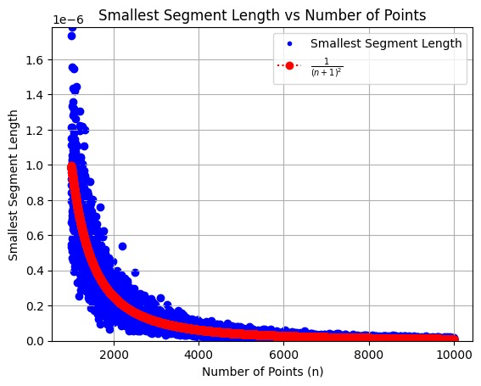
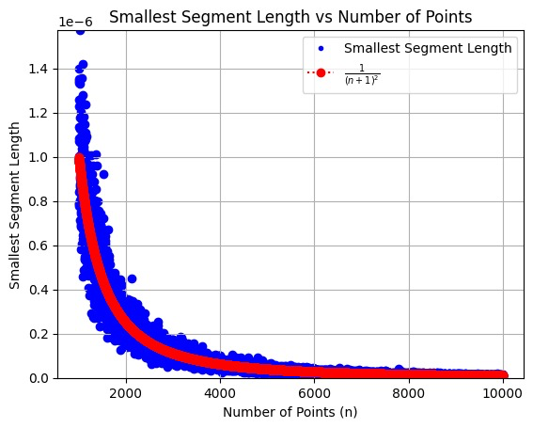
Testing and Verification
20
Simulated the experiment
10
times per n and took avg

Slide 26
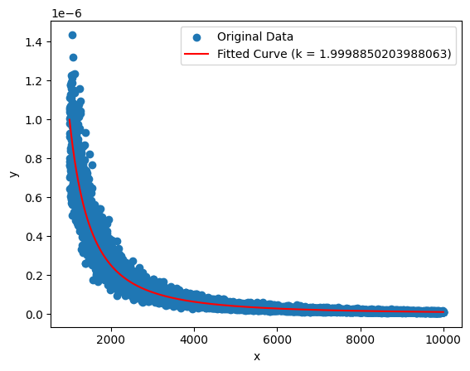
Testing and Verification
1
Curve Fit with yielded k ≈ 1.9998850
(n+1)^{k}

Slide 27
Results
P(X₁≥c₁, X₂≥c₂,..., X_{k}≥c_{k}) = (1-∑c_{i})^{n}
where ∑c_{i} ≤ 1
P(X₁≥x) = (1-x)^{n}
P(X₁≤x) = 1 - (1-x)^{n}
F_{X1}(x) = 1 - (1-x)^{n}
where F_{X1} is CDF of X₁
f_{X1}(x) = n(1-x)^{n-1}
where f_{X1} is PDF of X₁
We already know distribution of each X_{i} is same, so
f_{X1}(x) = f_{X2}(x) = ... = f_{X(n+1)}(x) = n(1-x)^{n-1}

Slide 28
Approach 2
Exponential Random Variables
Z ̴ Exp(λ)
f(z:λ) = λe^{-λz} z≥0 0 o/w
where f is pdf (probability density function)
F(z:λ) = 1 - e^{-λz} z≥0
0 o/w
where F is cdf (cumulative distb function)

Slide 29
Approach 2
Exponential Random Variables
F(z) = P(Z≤z) = 1 - e^{-λz}
Consider n+1 IIDs {Z₀,Z₁,....,Z_{n-1},Z_{n}} ̴ Exp(λ)
P(Z₀≥z,Z₁≥z,....,Z_{n-1}≥z,Z_{n}≥z) = e^{-λ(n+1)z}
P(min(Z_{i})≥z ∀ i∈(0,n)) = e^{-λ(n+1)z}
P(min(Z_{i})≤z ∀ i∈(0,n)) = F_{min(Z)}(z) = 1 - e^{-λ(n+1)z}
f_{min(Z)}(z) = λ(n+1)e^{-λ(n+1)z}

Slide 30
Approach 2
Exponential Random Variables
f_{min(Z)}(z) = λ(n+1)e^{-λ(n+1)z}
f_{min(Z)}(z) = (n+1)e^{-(n+1)z} λ= 1
min(Z) is also exponential and has mean 1/(n+1)
e^{-z}z^{n}
f_{ΣZ}(z) =
n!
ΣZ has mean (n+1)

Slide 31
Approach 2
Exponential Random Variables
f_{Z0,Z1...,Zn}(z₀,z₁..,z_{n}) = e^{-(z0+z1+..zn)}= e^{-(Σz)}
f_{Z0,Z1...,Zn,ΣZ}(z₀,z₁..,z_{n},s) = e^{-s}
e^{-s}s^{n}
f_{ΣZ}(s) =
n!
e^{-s}
f_{(Z0,Z1...,Zn )|ΣZ}(z₀,z₁..,z_{n}| s) =
= n!s^{-n}
e^{-s}s^{n}
n!

Slide 32
Approach 2
Exponential Random Variables
f_{(Z0,Z1...,Zn )|ΣZ}(z₀,z₁..,z_{n}| s) = n!s^{-n}
f_{(Z0,Z1...,Zn )|ΣZ}(z₀,z₁..,z_{n}| s = 1) = n!
same as the joint pdf of interval lengths
f_{X}(x₁,x₂,...,x_{n},x_{n+1}) = n!

Slide 33
Approach 2
Exponential Random Variables
f_{Zi,ΣZ}(Z_{i} = z_{i}, ΣZ = s)
f_{Zi|ΣZ}(z_{i}| s) =
f_{ΣZ}(s)
=
f_{Zi,ΣZ}(Z_{i} = z_{i}, Z₀+Z₁+..Z_{i-1}+Z_{i+1}+..Z_{n} = s-z_{i})
f_{ΣZ}(s)
e^{-(s-zi)}(s-z_{i})^{n-1}
=
e^{-zi}
e^{-s}s^{n}
(n-1)!
n!

Slide 34
Approach 2
Exponential Random Variables
n(1 - z_{i}/s)^{n-1}
f_{Zi|ΣZ}(z_{i}| s) =
s
same as the pdf of X_{i}
f_{Zi|ΣZ}(z_{i}| s = 1) = n(1-z_{i})^{n-1}
f_{Xi}(x) = n(1-x)^{n-1}

Slide 35
Approach 2
Exponential Random Variables
We can express interval lengths as iid exponential random variables on condition that their sum = 1
Earlier problem when interval lengths were not independent at all is simplified

Slide 36
Approach 2
Exponential Random Variables
f_{min(Z),ΣZ}(min(Z) = z, ΣZ = s)
f_{min(Z)|ΣZ}(z| s) =
f_{ΣZ}(s)
=
f_{min(Z),ΣZ}(min(Z) = z, Z₀+Z₁+...(n terms) = s-z )
f_{ΣZ}(s)

Slide 37
Bound on E(X_{min})
Define X^{i,min} : Minimum Length when i points are sampled
2
i
1
3
X₁
X₂
X₃
X₄
X₅
X₆
X₈

Slide 38
Bound on E(X_{min})
Define E_{i} : X^{i,min} < X^{i-1,min}
2
i-1
1
i
3

Slide 39
Bound on E(X_{min})
2
i-2
1
i-1
3
P(E_{i}) = P(X^{i,min} < X^{i-1,min}) =
(i)X^{i-1,min}
Σmin(X^{i-1,min},X^{i-1}_{j}-X^{i-1,min})
j
where N = Number of intervals whose length ≥ 2X^{i-1,min}
= N(2X^{i-1,min})+ΣX^{i-1}_{j}

Slide 40
Bound on E(X_{min})
where N = Number of intervals whose length ≥ 2X^{i-1,min}
P(E_{i}) = N(2X^{i-1,min})+ΣX^{i-1}_{j}
E(P(E_{i})) = E(N)(2E(X^{i-1,min})) + ΣE(X^{i-1}_{j})
E(E(P(E_{i}))) = E(P(E_{i}))= E(N)(2E(X^{i-1,min})) + E((i-N)/i)
E(P(E_{i})) = E(N)(2/i²) + 1 - E(N)/i

