Slide 1
Apache Pulsar

Slide 2
Apache Pulsar is a cloud-native, distributed messaging and streaming platform originally created at Yahoo! and now a top-level Apache Software Foundation project.

Slide 3
Advantages
Easy to deploy, lightweight compute process, developer-friendly APIs, no need to run your own stream processing engine.
Low publish latency (< 5ms) at scale with strong durability guarantees.
Persistent message storage based on Apache BookKeeper. IO-level isolation between write and read operations.
Configurable replication between data centers across multiple geographic regions.
REST Admin API for provisioning, administration, tools and monitoring. Can be deployed on bare metal, Kubernetes, Amazon Web Services(AWS), and DataCenter Operating System(DC/OS).
Expand capacity seamlessly to hundreds of nodes.

Slide 4
Messaging and streaming

Slide 5
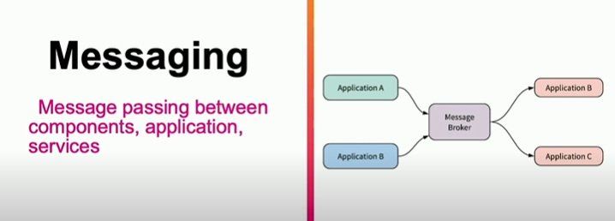

Slide 6
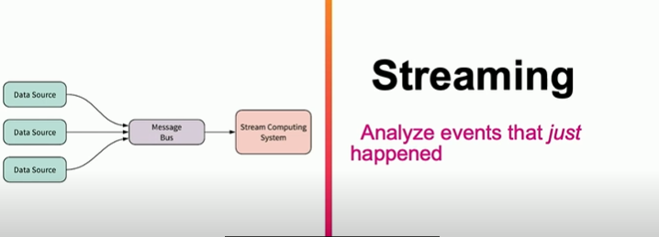

Slide 7
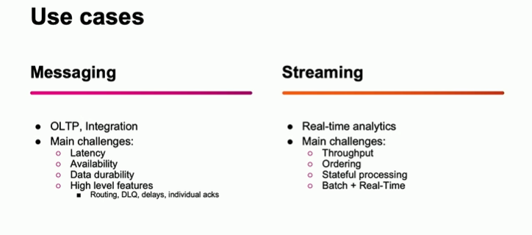

Slide 8
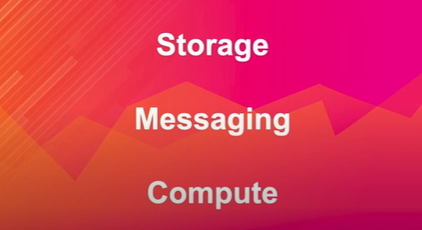

Slide 9
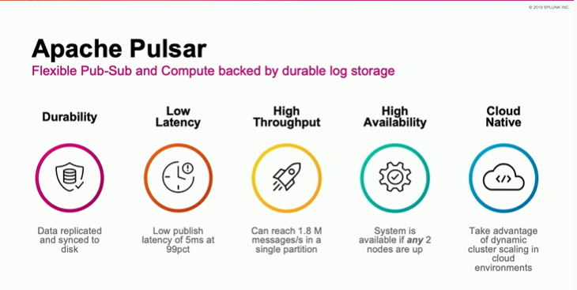
Design choice of pulsar storage

Slide 10
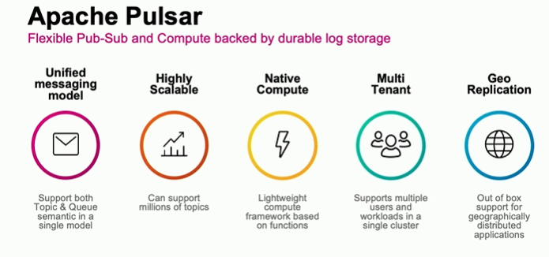

Slide 11
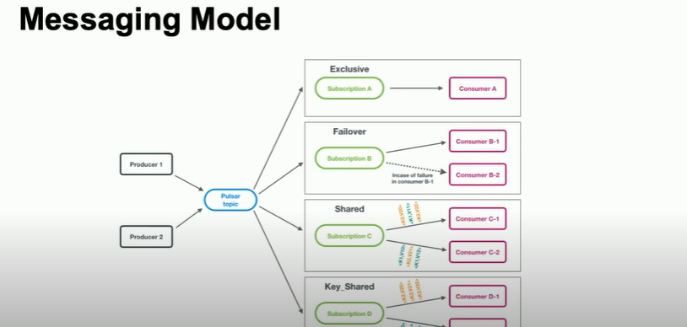

Slide 12
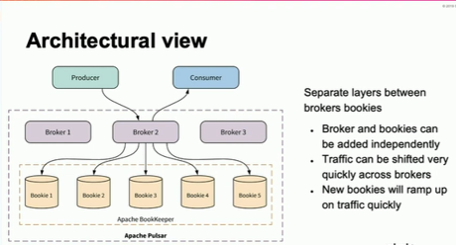

Slide 13
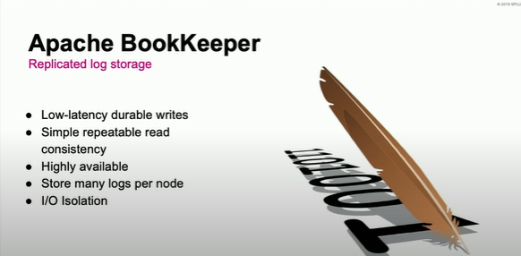

Slide 14
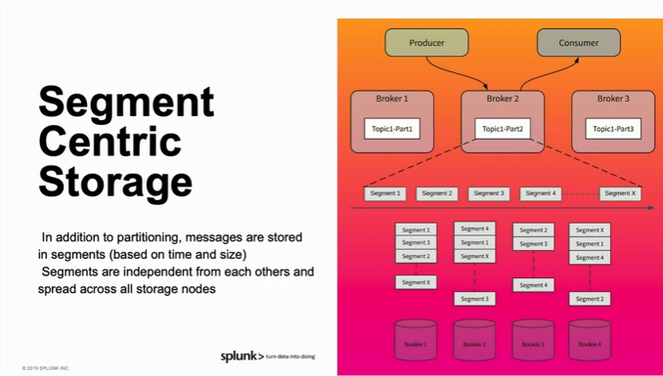

Slide 15
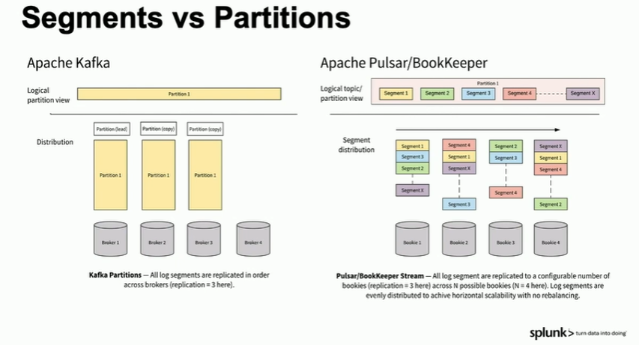

Slide 16
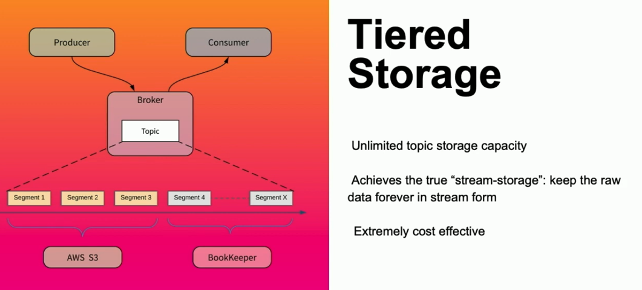

Slide 17
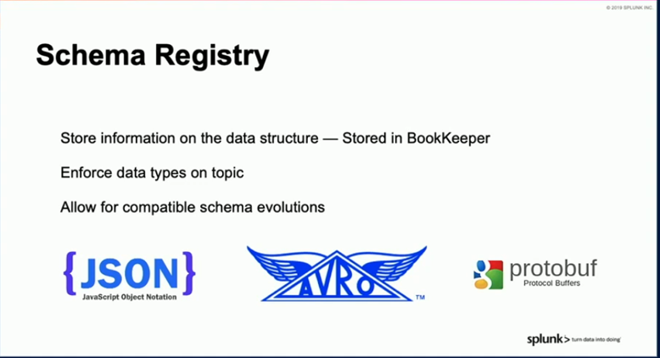

Slide 18
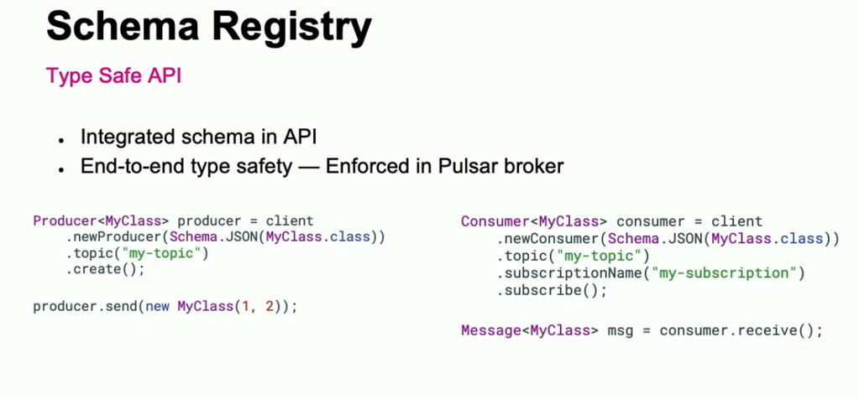

Slide 19
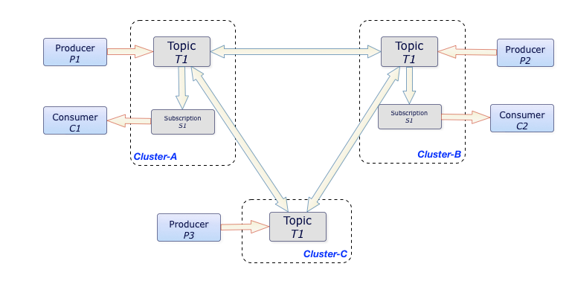
Geo-replication

Slide 20


Slide 21
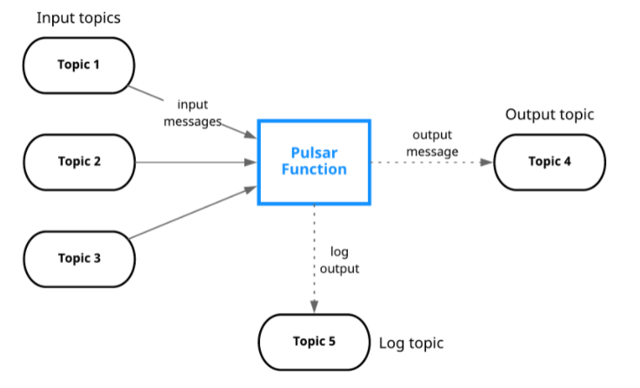

Slide 22
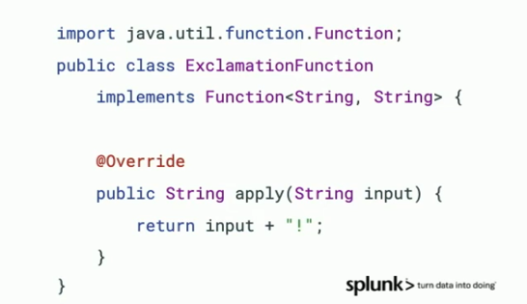

Slide 23
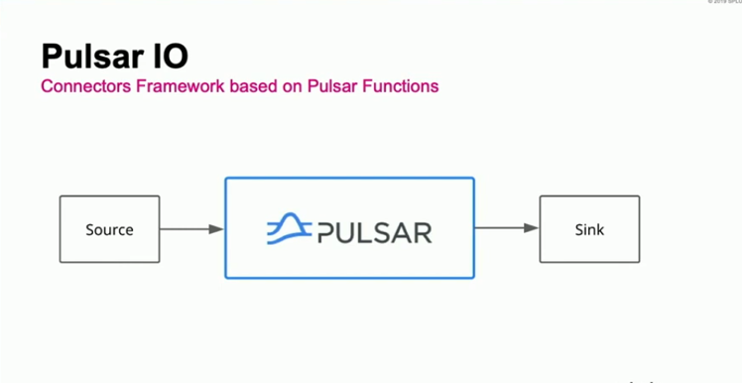

Slide 24
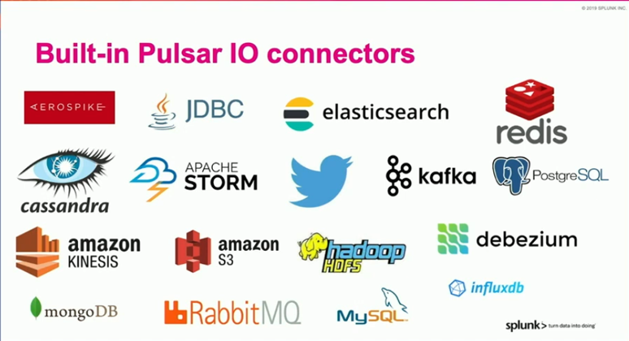

Slide 25
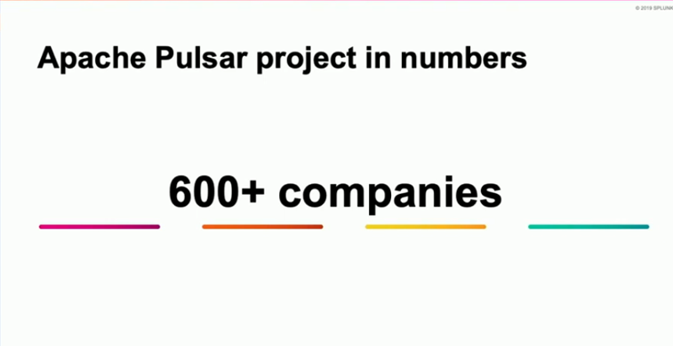

Slide 26
