Slide 1
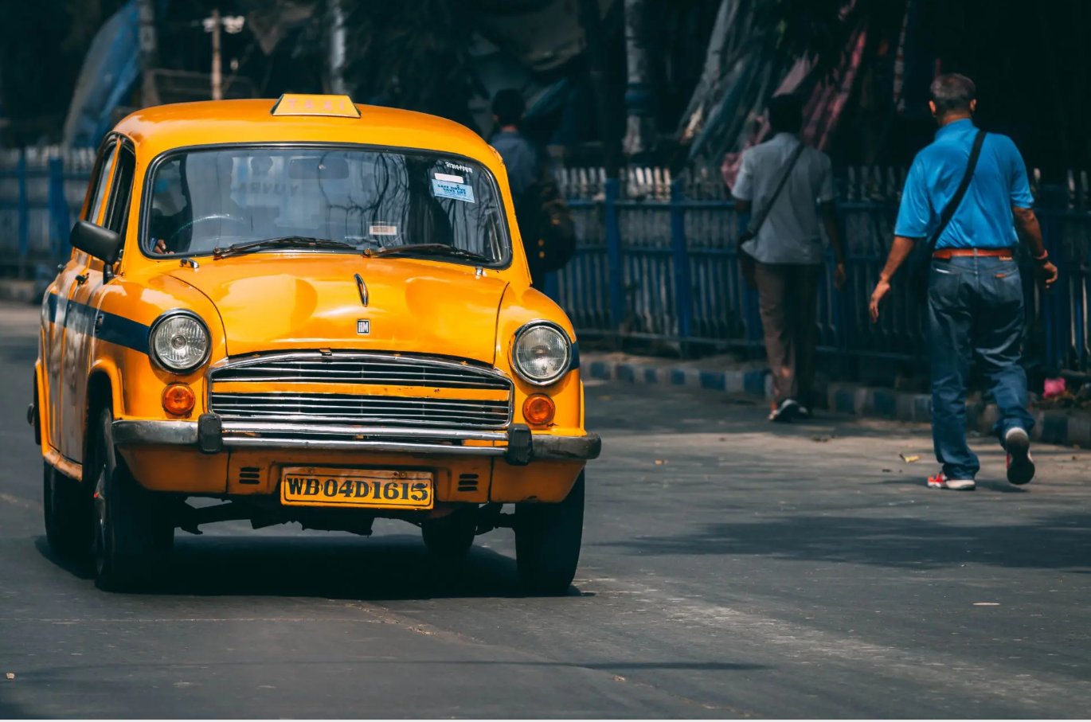

Goodscab
Sales & Revenue Analysis

Slide 2

Table of Content
Company Overview
Problem Statement
Ad-hoc Business Requests
Primary Research Questions
Secondary Research Questions
Recommendations
Domain: Transportation & Mobility

Slide 3
Goodcabs: Driving Growth in Tier-2 Cities
Who We Are:
A two-year-old cab service company operating in 10 tier-2 cities across India.
Focused on supporting local drivers while ensuring exceptional passenger experiences.
Market Focus:
Tier-2 cities with rising demand for urban mobility.
Competitive edge: Personalized services, commitment to local economic growth, and high repeat passenger rates.
Domain: Transportation & Mobility

Slide 4
Problem Statement
Purpose:
Analyze Jan-2024 to Jun-2024 performance across trip volume, passenger satisfaction, repeat passenger rate, and trip distribution.
Meet ambitious growth and customer satisfaction targets through actionable insights.
Problem Statement:
Need data-driven insights to address:
City-specific performance variations.
Passenger behavior patterns (new vs. repeat).
Trends across tourism vs. business cities.
Deliver a self-explanatory dashboard and clear recommendations to guide 2024 strategy.
Domain: Transportation & Mobility

Slide 5
a
Ad-hoc Business Request
Domain: Transportation & Mobility

Slide 6
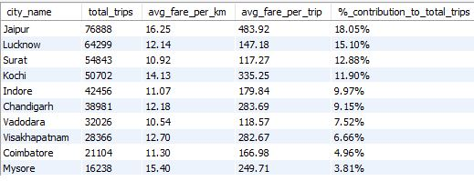
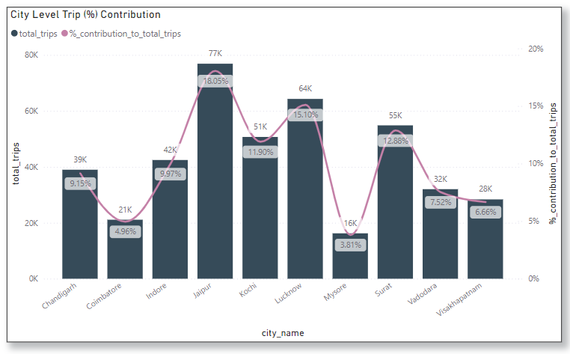
1. City-Level Fare and Trip Summary Report
a
Domain: Transportation & Mobility

Slide 7
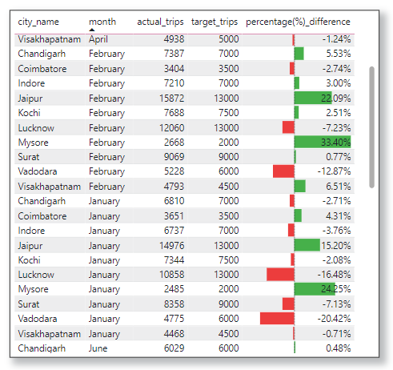
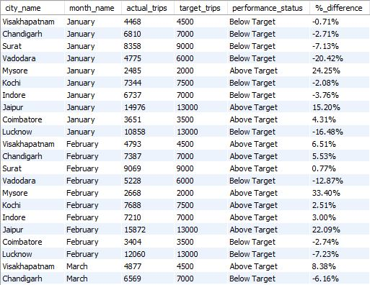
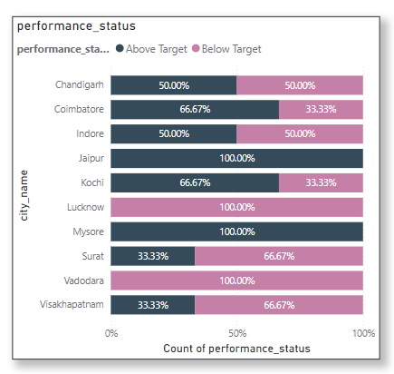
2. Monthly City-Level Trips Target Performance Report
Domain: Transportation & Mobility

Slide 8
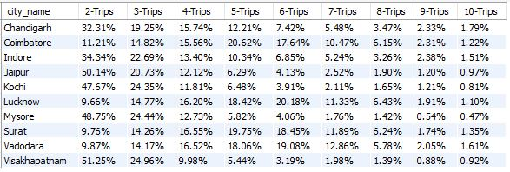
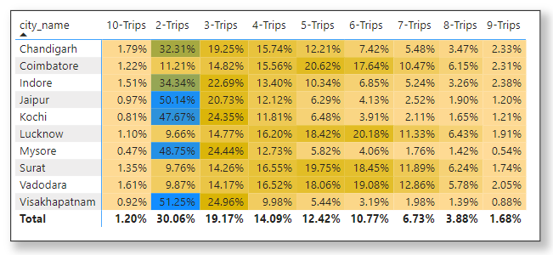
3. City-Level Repeat Passenger Trip Frequency Report
Domain: Transportation & Mobility

Slide 9
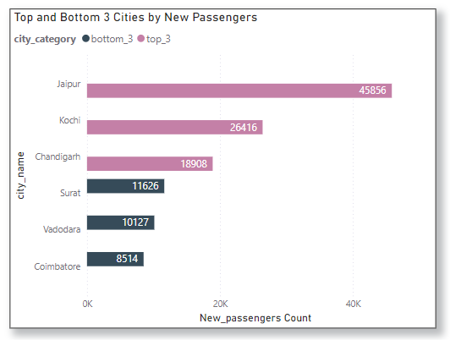
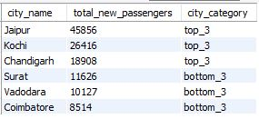
4. Identify Cities with Highest and Lowest Total New Passengers
Domain: Transportation & Mobility

Slide 10
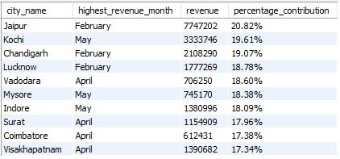
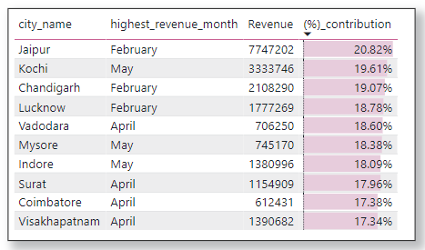
5. Month with Highest Revenue for Each City
Domain: Transportation & Mobility

Slide 11
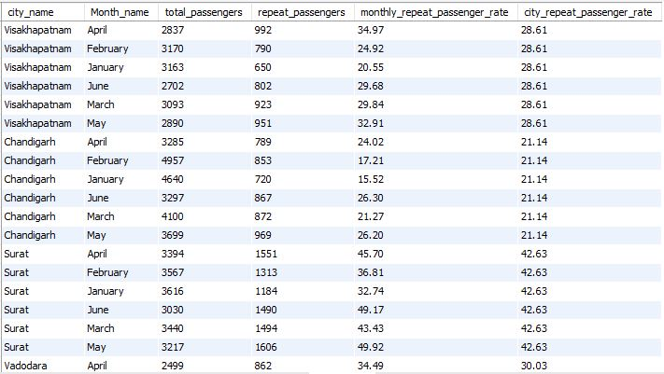
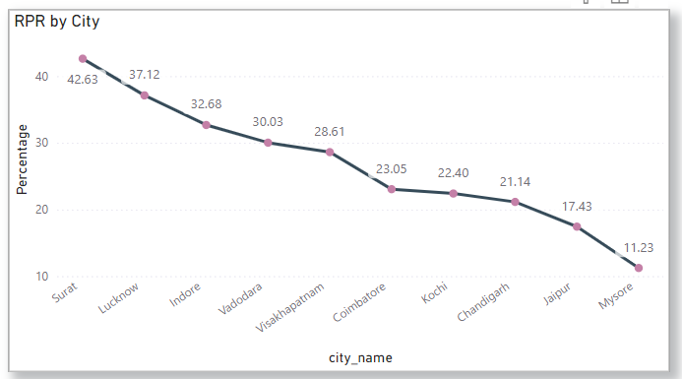
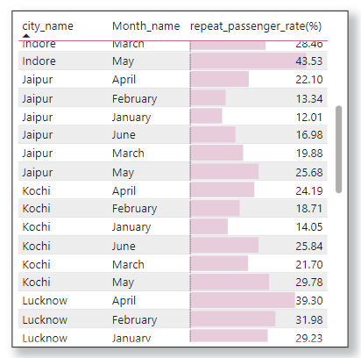
6. Repeat Passenger Rate Analysis
Domain: Transportation & Mobility

Slide 12
a
Primary Research Question
Domain: Transportation & Mobility

Slide 13
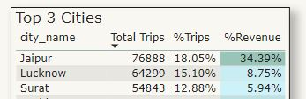
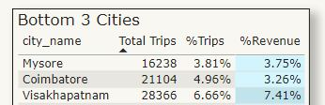
1. Top 3 and Bottom 3 Performing cities by total trips
Insight :
Jaipur is the top performing city with 18.05% of total trips and contributing 34.39% in the total revenue.
Mysore is the least performing city in terms of total trips but Coimbatore is the least performing city in terms of revenue.
Visakhapatnam’s revenue contribution is more than Surat which is in 3rd place in terms of total trips.
Domain: Transportation & Mobility

Slide 14
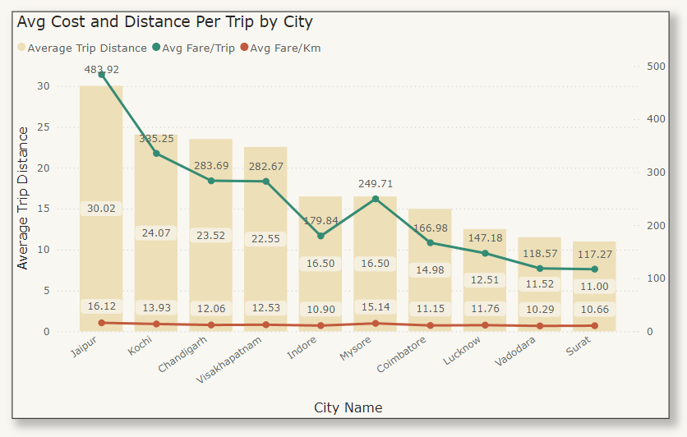
2. Average Fare per Trip by City
Insight :
Surat has the lowest avg fare per trip.
Jaipur has the highest avg fare/trip, avg fare/km and avg trip distance.
Mysore has the second highest avg fare/km.
Domain: Transportation & Mobility

Slide 15
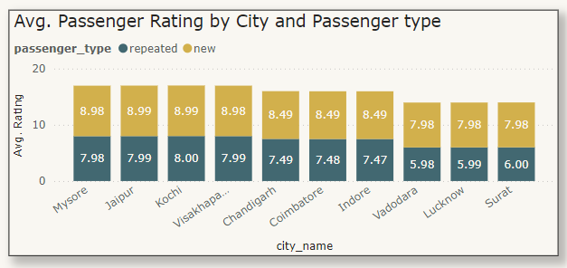
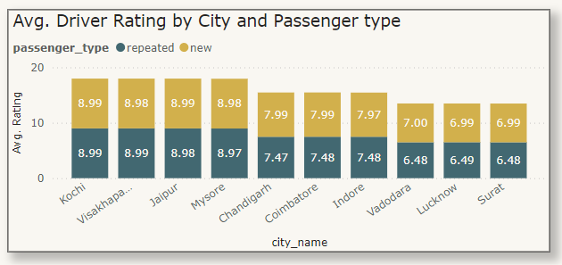
3. Average Ratings by City and Passenger type
Insight :
For new passengers Kochi and Jaipur has the highest passenger rating and Vadodara has the lowest rating.
For repeated passengers Kochi has the highest rating while Vadodara has the lowest rating.
Insight :
For new passengers Kochi and Jaipur has the highest driver rating while Vadodara and Surat has the lowest rating.
For repeated passengers Kochi and Visakhapatnam has the highest rating while Vadodara and Surat has the lowest rating
Domain: Transportation & Mobility

Slide 16
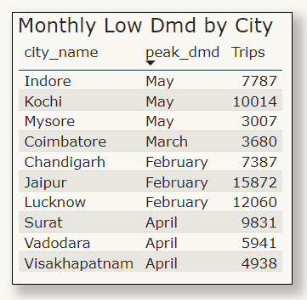
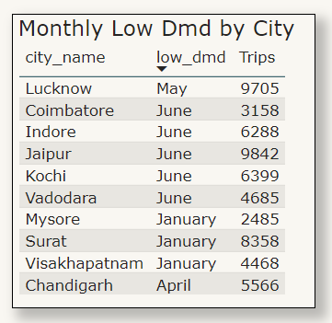
4. Peak and Low Demand Months by City
Insight :
February followed by April and May were the peak demand months.
Insight :
June has lowest demand in almost 50% of the cities followed by January.
Domain: Transportation & Mobility

Slide 17
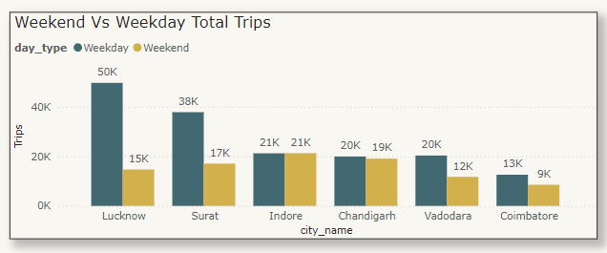
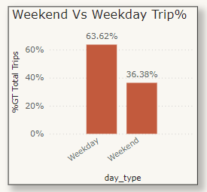
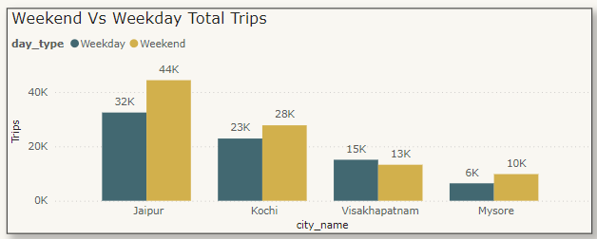
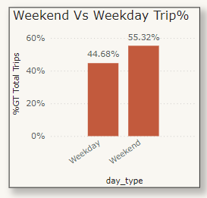
5. Weekend Vs Weekday Trip Demand by City
Insight :
Weekdays has high trip count but high revenue is generated from weekends.
Business cities have more trips in weekdays.
Lucknow and Surat has the high demand difference between weekend vs weekday whereas Indore and Chandigarh demand is almost same.
Tourism cities have more trips in weekends.
Jaipur has the highest demand difference whereas Visakhapatnam has the high demand in weekday.
Domain: Transportation & Mobility

Slide 18
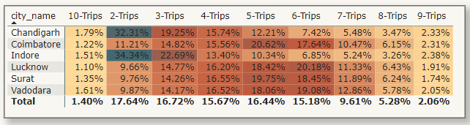
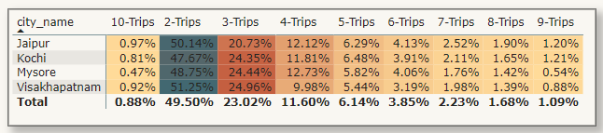
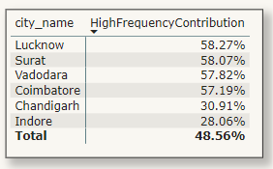
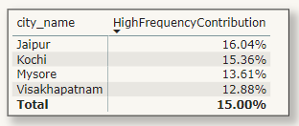
6. Repeat Passenger Frequency and City Contribution Analysis
Insight :
High Frequency Contribution = Trip Count > 4
We can see business cities has overall 48.56% high frequency contribution while tourist cities has only 15% contribution.
This shows that people are continuously visiting for their business purpose.
Tourist places has shown 2-trips as 50% contribution.
Domain: Transportation & Mobility

Slide 19
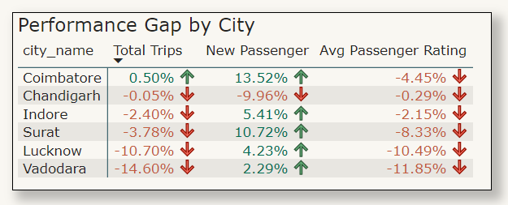
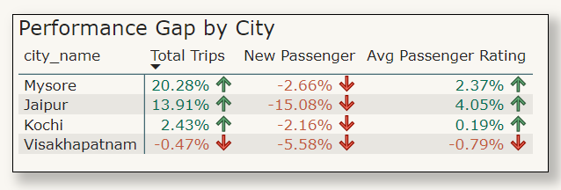
7. Monthly Target Achievement Analysis for Key Metrics
Insight :
Total trips – Tourist cities except Visakhapatnam achieved their target while business cities except Coimbatore were not able to achieve their target. Chandigarh and Visakhapatnam just missed their target but Lucknow and Vadodara were quite far.
New passengers - For business cities except Chandigarh everyone Achieved their target. None of the tourist cities were able to achieve their target.
Avg Passenger Rating – For tourist places except Visakhapatnam all cities were able to achieve their target. None of the business cities were able to achieve their target.
Domain: Transportation & Mobility

Slide 20
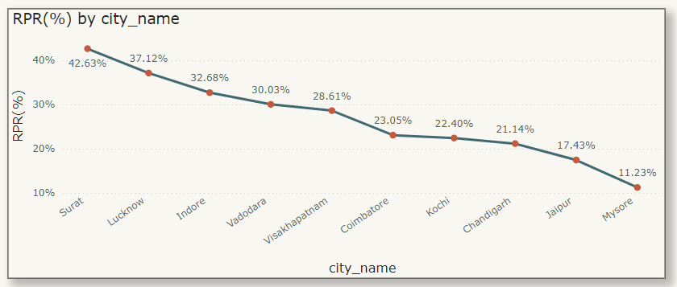
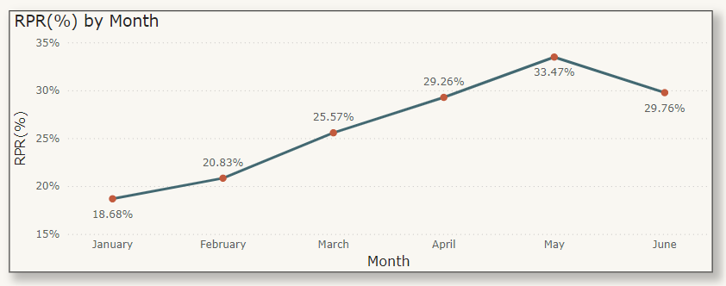
8. Repeat Passenger Rate (RPR%) by City and Month
Insight :
Top 2 cities:
Surat followed by Lucknow were top 2 cities with highest RPR%.
Bottom 2 cities: Mysore and Jaipur were the bottom 2 cities with lowest RPR%.
Monthly Trend:
May has highest RPR% (33.47%)
January has the lowest RPR% (18.68%).
Domain: Transportation & Mobility

Slide 21
a
Secondary Research Question
Domain: Transportation & Mobility

Slide 22
a
1. Factors Influencing Repeat Passenger Rates
Trip Experience: Driver behavior, cleanliness, vehicle quality, and punctuality significantly impact repeat passenger rates.
Trip Purpose: Business commuters are more likely to repeat trips than occasional tourists.
City-Specific Factors: High-performing cities (e.g., Jaipur, Kochi, Chandigarh) have better passenger acquisition and retention due to efficient service and demand density.
Competition and Local Preferences: Availability of alternative mobility services like auto-rickshaws, taxis, or metro impacts repeat customer rates.
Cities like Surat (42.63%) and Lucknow (37.12%) lead in repeat passenger rates, indicating strong customer retention strategies.
Visakhapatnam (11.23%) and Mysore (13.80%) have lower high-frequency contributions, reflecting challenges in retaining passengers beyond 2 trips.
Jaipur's strong acquisition of new passengers (45,856) contributes to a balanced growth strategy.
Domain: Transportation & Mobility

Slide 23
a
2. Tourism vs Business Demand Impact
Tourism-Driven Demand:
Cities like Jaipur and Kochi have strong seasonal tourism demand due to historical landmarks, festivals, and natural attractions.
Example: Peak months (February, May) in Jaipur show high trip performance linked to seasonal tourism.
Business-Driven Demand:
Cities like Surat, Lucknow, and Coimbatore see steady demand due to business travelers, especially in manufacturing and commercial hubs.
Conferences, trade fairs, or events create short-term spikes.
Surat and Vadodara showed April as a key month, likely linked to business activity cycles.
February emerges as a critical month for demand, with cities like Jaipur (22.09% above target) and Mysore (33.40% above target) performing strongly.
April shows significant business demand in cities like Surat and Vadodara, aligning with local business activity cycles.
Kochi’s high revenue in May (₹3,333,746) reflects seasonal tourism boosts.
Domain: Transportation & Mobility

Slide 24
a
3. Emerging Mobility Trends and GoodCab’s Adaptation
Trends:
Sustainable Mobility: Rising demand for electric vehicles (EVs) and green mobility solutions in urban cities.
Multi-Modal Integration: Cities like Kochi and Chandigarh are adopting metro and bus services, creating opportunities for last-mile connectivity.
Digital Payments & App-Based Services: Increased adoption of cashless payments and mobile apps for booking cabs.
Shared Rides & Micro-Mobility: Growing interest in carpooling, shared rides, and electric scooters for shorter trips.
High-frequency contributions (>4 trips) are strongest in cities like Surat (59.42%) and Vadodara (59.44%), reflecting opportunities for shared ride models.
Revenue patterns highlight emerging demand in cities like Jaipur (20.82% revenue contribution) and Kochi (19.61%).
Cities with declining June performance (e.g., Kochi: -28.90%) indicate potential seasonal adaptations.
Domain: Transportation & Mobility

Slide 25
a
4. Partnership Opportunities with Local Businesses
Potential Collaborations:
Hotels and Tourism Agencies:
Tie-ups with hotels in tourist cities (e.g., Jaipur, Kochi) to offer pick-up and drop-off services for guests.
Joint campaigns with tourism boards to attract travelers.
Corporate Partnerships:
Partner with local businesses in Surat, Coimbatore, and Lucknow to provide employee transportation services.
Offer corporate subscription packages for daily commuters.
Event Planners and Venues:
Collaborate with event organizers for weddings, conferences, and exhibitions.
Local Businesses for Promotions:
Cross-promote with restaurants, shopping malls, and entertainment hubs for bundled discounts.
Example: A partnership offering discounts on cab rides to malls or dining hotspots.
Domain: Transportation & Mobility

Slide 26
a
5. Data Collection for Enhanced Decision-Making
Key Data Points to Collect:
Passenger Feedback: Real-time ratings for driver behavior, vehicle condition, and trip experience.
Trip Data: Trip frequency, key time slots.
Event Impact Analysis: Track trips during local events (festivals, conferences) to predict demand surges.
Customer Demographics: Age group, trip purpose (business or leisure), and spending patterns to tailor marketing campaigns.
Service Quality Metrics: Cancellation rates, wait times, and repeat usage trends.
Strategies for Data-Driven Decisions:
Customer Surveys: Conduct periodic surveys to understand pain points and expectations.
Real-Time Monitoring: Use GPS and app-based insights to track trip efficiency and identify underperforming areas.
Domain: Transportation & Mobility

Slide 27
Recommendations
Loyalty Programs:
Introduce rewards for frequent users to encourage repeat trips.
City-Specific Offers:
Adjust pricing strategies in high-fare cities to encourage regular usage.
Feedback System:
Collect data on customer experience and pain points to improve service quality
Seasonal Campaigns:
Partner with tourism boards to offer special packages during festival seasons.
Promote airport and hotel drop-offs in tourist hotspots.
Business Event Focus:
Collaborate with conference centers and local businesses to ensure ride availability during events.
Dynamic Pricing:
Offer tailored pricing during low-demand months and premium service packages for high-demand seasons.
Green Fleet Transition:
Introduce EV options to align with sustainability goals.
Last-Mile Partnerships:
Collaborate with metro stations, airports, and bus terminals to facilitate seamless last-mile travel.
Shared Mobility:
Launch shared cab services in high-density cities to attract budget-conscious travelers.
Enhanced Digital Experience:
Offer mobile wallet integrations and subscription plans to boost user adoption..
Domain: Transportation & Mobility

Slide 28
Thank You
Domain: Transportation & Mobility

