Slide 1


Slide 2
Agenda
Company Overview
Objectives
Data, Request & Tools
SQL questions
Key Insights

Slide 3

Company Overview
AtilQ Hardware is a Computer Hardware and Accessory manufacture.
The company manufactures product under 3 major divisions i.e. Networking & Storage, PC, Peripherals & Accessories.
AtilQ Hardware is operated in NA, LATAM, EU, APAC regions.

Slide 4
Objective
Analyzing ad-hoc requests, crafting precise SQL queries to extract relevant insights, and presenting these findings in a creative and engaging manner tailored for top-level management. Assisting the management team in gaining deeper insights into the business, enabling data-driven decisions to scale operations effectively.

Slide 5
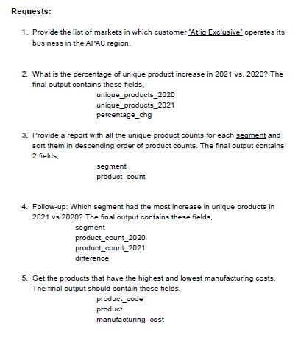
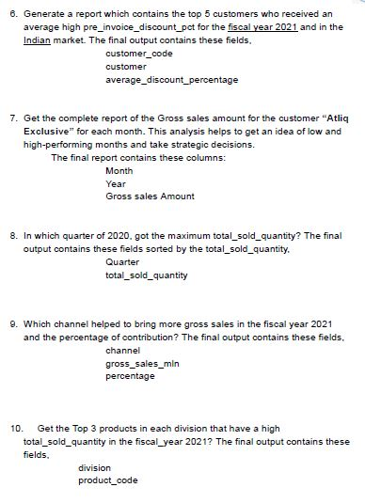


Request and Tools
For Analysis and Visualization
For Ad hoc Queries
10 Ad hoc request

Slide 6
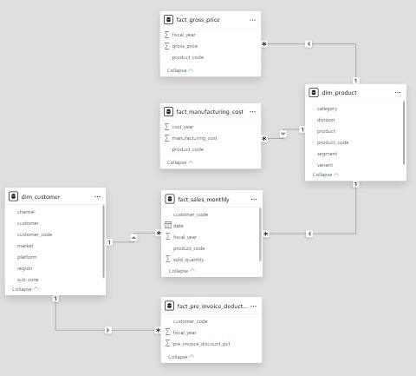
Data

Slide 7
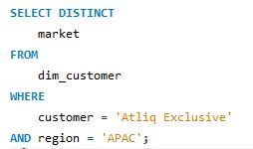
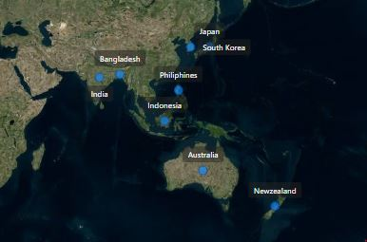
1. Provide the list of markets in which customer "Atliq Exclusive" operates its business in the APAC region.

Slide 8
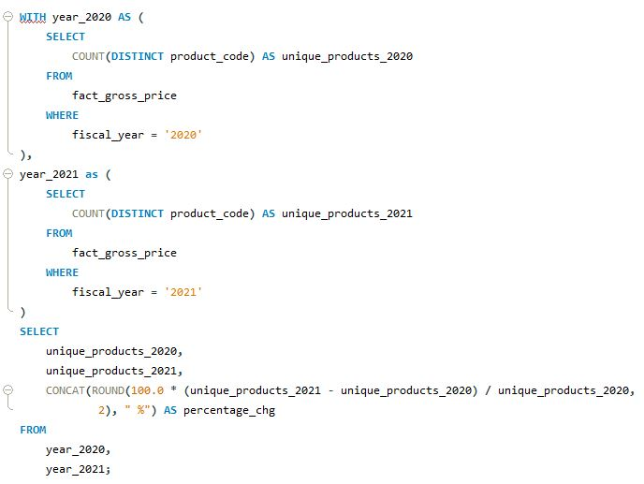
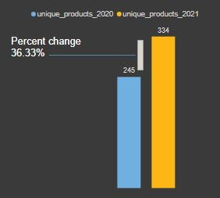
2. What is the percentage of unique product increase in 2021 vs. 2020? The final output contains these fields, unique_products_2020 unique_products_2021 percentage_chg

Slide 9
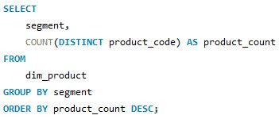
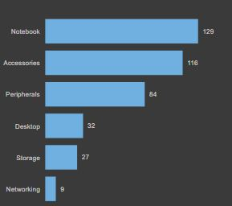
3. Provide a report with all the unique product counts for each segment and sort them in descending order of product counts. The final output contains 2 fields, segment product_count

Slide 10
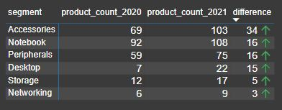
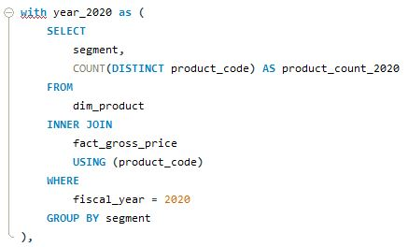
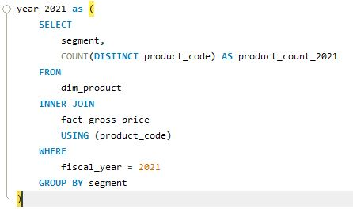
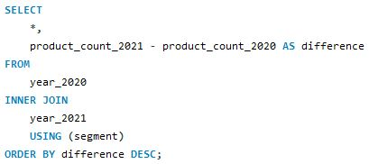
4. Follow-up: Which segment had the most increase in unique products in 2021 vs 2020? The final output contains these fields, segment product_count_2020 product_count_2021 difference

Slide 11
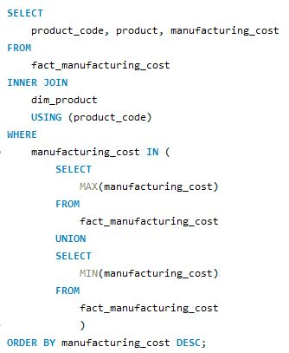



5. Get the products that have the highest and lowest manufacturing costs. The final output should contain these fields, product_code product manufacturing_cost

Slide 12
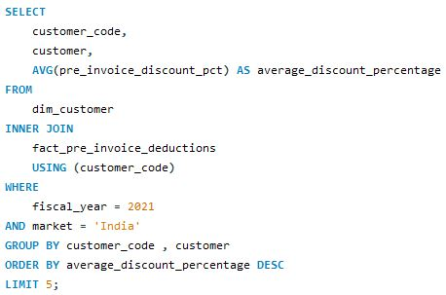
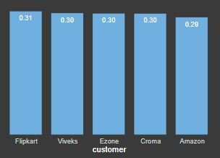
6. Generate a report which contains the top 5 customers who received an average high pre_invoice_discount_pct for the fiscal year 2021 and in the Indian market. The final output contains these fields, customer_code customer average_discount_percentage

Slide 13
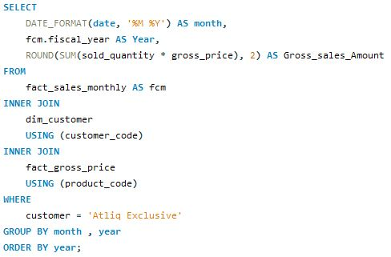
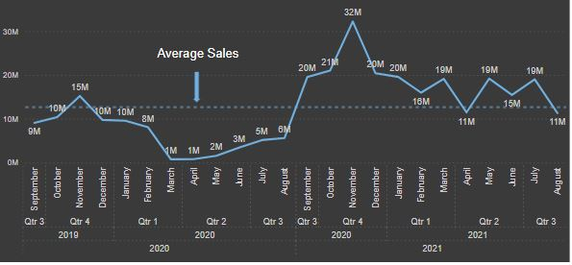
7. Get the complete report of the Gross sales amount for the customer “Atliq Exclusive” for each month . This analysis helps to get an idea of low and high-performing months and take strategic decisions. The final report contains these columns: Month Year Gross sales Amount

Slide 14
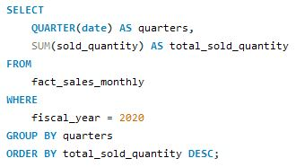
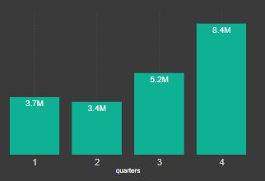
8. In which quarter of 2020, got the maximum total_sold_quantity? The final output contains these fields sorted by the total_sold_quantity, Quarter total_sold_quantity

Slide 15
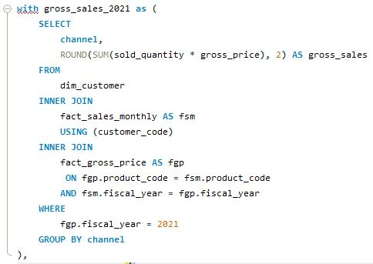
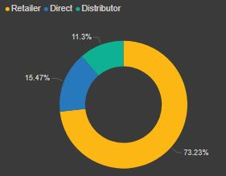
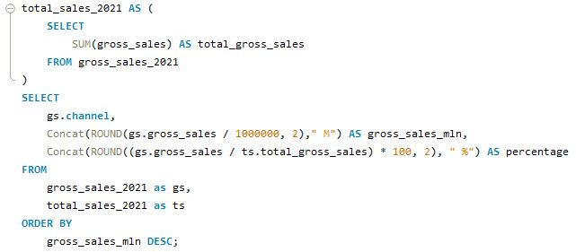
9. Which channel helped to bring more gross sales in the fiscal year 2021 and the percentage of contribution? The final output contains these fields, channel gross_sales_mln percentage

Slide 16
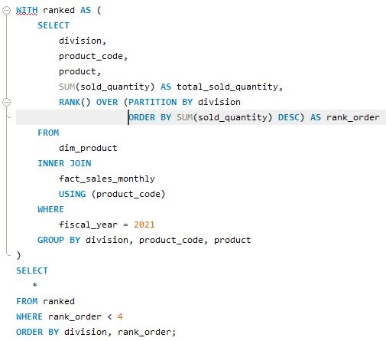
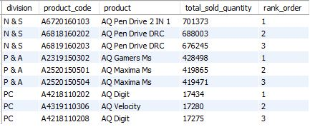
10. Get the Top 3 products in each division that have a high total_sold_quantity in the fiscal_year 2021? The final output contains these fields: division, product_code, product, total_sold_quantity, rank_order

Slide 17
𝗞𝗲𝘆 𝗜𝗻𝘀𝗶𝗴𝗵𝘁𝘀 𝗳𝗿𝗼𝗺 𝘁𝗵𝗲 𝗔𝗱 𝗵𝗼𝗰 𝗥𝗲𝗾𝘂𝗲𝘀𝘁𝘀:
🔹 Significant increase in unique products, with 334 in 2021 compared to 245 in 2020, a 36.33% change.
🔹 The "Notebook" segment has the highest product count, with 129 products.
🔹 Storage, Networking and Desktop should be focused to increase sales by providing package deals.
🔹 Accessories segment had the most increase in unique products i.e. 34 in 2021 vs 2020.
🔹 Mouse has the lowest and Personal Desktop has the highest manufacturing cost.
🔹 "Flipkart" leads with the highest average pre-invoice discount percentage at 30.83%.
🔹 Fiscal year 2020's sales dipped in March and April but improved in fiscal year 2021.
🔹 Highest sales were found in Nov 2020, while lowest sales were found in Mar 2020.
🔹 In 2021 average sales were constant which means new policies after 2020 were impactful.
🔹 The "Retailer" channel contributes 73.22% of gross sales, making it a major player.

