Slide 1








COMMAND CENTRE
Dayne Core Technologies
One inbox that measures—and closes—your attention leak.
WhatsApp, Instagram, Facebook, TikTok, LinkedIn, X and Google Reviews — side by side, ranked by who’s waited longest. Every reply is AI-drafted and human-sent, natively.
WhatsApp
Instagram
Facebook
TikTok
LinkedIn
X
Google
Pilot customer: Avion Hub — WhatsApp-native travel agency, Lagos

Slide 2
THE PROBLEM
Attention can’t be in six places at once
42
9d 10h
15m
3.7%
CUSTOMERS WAITING FOR A REPLY
THE OLDEST HAS WAITED
MEDIAN FIRST RESPONSE
ANSWERED WITHIN THE 5-MIN GOAL
Nobody is negligent — attention simply leaked to whichever app was open. And the ignored customer doesn’t complain. They buy elsewhere, silently.
Real numbers from a live Command Centre tenant — not a projection.
Command Centre
2

Slide 3
WHY IT HAPPENS
One owner. Six inboxes. Zero visibility.
While the owner is deep in a WhatsApp thread, Instagram DMs pile up, a Facebook “is this available?” sits cold, and a 2-star review festers for nine days.
There is no shared queue, no ranking by urgency — just whichever app happens to be open. The most valuable customer can be the most invisible one.
Owner
Command Centre
3

Slide 4



THE SOLUTION
Allocate attention by urgency — not by which app is open
See who’s waiting
Reply natively, everywhere
AI drafts, human sends
A live Attention Leak dashboard ranks every channel by unanswered load and oldest wait — the number that makes the problem undeniable.
Every thread is a real two-way conversation. Replies land in the customer’s own platform thread — never a bridge or relay.
Every reply is drafted for you and sent only when you approve, edit, or reject it. The AI assists; it never auto-sends.
Command Centre
4

Slide 5




HOW IT WORKS
From six inboxes to one queue
1
2
3
4
Connect your accounts
The inbox ranks by urgency
AI drafts the reply
You approve — it sends
Real WhatsApp, Instagram and more — mock for a demo, live when you’re ready.
Every channel, one queue — sorted by who has waited longest.
Grounded in your brand voice and the thread’s own history.
Delivered natively, queued through flaky networks, never lost or duplicated.
Composed offline, it delivers the moment you reconnect — never lost, never sent twice.
Command Centre
5

Slide 6
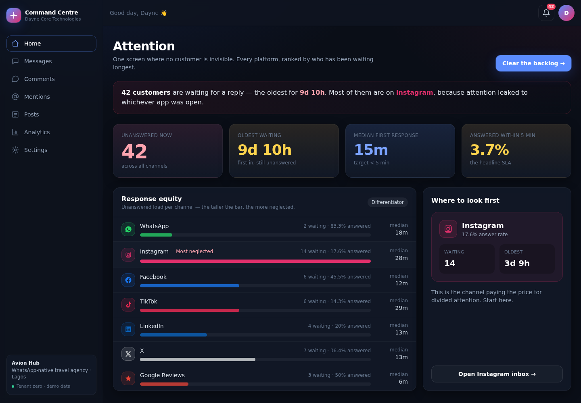

THE PRODUCT
See exactly who’s waiting
Response equity ranks every channel by neglect — not just a raw unread count.
The most-neglected channel is named outright, with one click through to it.
Real numbers, refreshed live — not a static report from last week.
The Attention dashboard — live tenant data, Avion Hub
Command Centre
6

Slide 7


WHAT YOU GET
Six features, one accountability system
Attention Leak dashboard
Two-way native messaging
AI drafts, human sends
Unanswered count, oldest wait, and per-channel response equity.
Start, continue or reply on any platform — in the customer’s own thread.
Every reply is drafted for you, sent only when you approve it.
Works on flaky networks
Naira-native billing
Connect your own accounts
Compose offline; it delivers the moment you reconnect. Never lost, never duplicated.
Subscriptions via Monnify — card or bank transfer, built for how Lagos SMEs pay.
Link real WhatsApp, Instagram and more. Mock for the demo, live on a config switch.
Command Centre
7

Slide 8
WHY IT'S DIFFERENT
Not just an inbox — an accountability system
Generic social inbox tools
Command Centre
✕
Not typically
✓
Measures response equity per channel, not just a raw unread badge
✕
Not typically
✓
Sends natively into the platform thread — never a bridge or relay
✕
Not typically
✓
Human-gated AI: approve, edit or reject — never auto-send
✕
Not typically
✓
Naira billing via Monnify — card or reserved bank account
✕
Not typically
✓
Durable offline queue — nothing lost on a flaky connection
✕
Not typically
✓
Tells the truth about platform limits, instead of faking an inbox
Command Centre
8

Slide 9
BUSINESS MODEL
Naira-native pricing, built for Lagos SMEs
RECOMMENDED
Starter
Growth
Scale
₦15,000
₦45,000
₦120,000
per month
per month
per month
3 channels · 1 seat · 200 AI drafts / mo
7 channels · 5 seats · 2,000 AI drafts / mo · Google Reviews
7 channels · 20 seats · Unlimited AI drafts · Google Reviews
Card or bank transfer via Monnify — subscriptions never activate from a client-side success screen, only a verified server-side webhook.
Command Centre
9

Slide 10
MARKET & ROADMAP
Where this lands, and what’s next
TARGET MARKET
ROADMAP
Nigerian SMEs running commerce over WhatsApp and social DMs
Travel agencies, retail, hospitality and services — anyone juggling six inboxes at once
Pilot tenant: Avion Hub, a WhatsApp-native travel agency in Lagos
WhatsApp Cloud API integration — live-capable today
OAuth connect shipped for Facebook, Instagram, X, LinkedIn, Google and TikTok
Next: platform app reviews (Meta, TikTok) to flip each channel from mock to live
CHANNEL STATUS TODAY
WhatsApp
Instagram
Facebook
TikTok
LinkedIn
X
Google
Live-capable
OAuth ready
OAuth ready
OAuth ready
OAuth ready
OAuth ready
OAuth ready
Command Centre
10

Slide 11
Stop leaking customers to your own inbox.
Command Centre — one inbox that measures, and closes, your attention leak.
Let’s talk →
Dayne Core Technologies · Command Centre

