Slide 1
Predicting Income

Slide 2
About the Data
The US Adult Census dataset is a repository of 48,842 entries extracted from the 1994 US Census database.
Each entry contains the following information about the class of individual:
age: the age of an individual
workclass: a general term to represent the employment status of an individual
fnlwgt: final weight. In other words, this is the number of people the census believes the entry represents.
education: the highest level of education achieved by an individual.
education-num: the highest level of education achieved in numerical form.
marital-status: marital status of an individual. Note: Married-civ-spouse corresponds to a civilian spouse while Married-AF-spouse is a spouse in the Armed Forces.

Slide 3
About the Data 2
occupation: the general type of occupation of an individual
relationship: represents what this individual is relative to others. For example an individual could be a Husband. Each entry only has one relationship attribute and is somewhat redundant with marital status.
race: Descriptions of an individual’s race
sex: the biological sex of the individual
capital-gain: capital gains for an individual (money gained outside of salary)
capital-loss: capital loss for an individual (money lost outside of salary)
hours-per-week: the hours an individual has reported to work per week
native-country: country of origin for an individual
income: whether or not an individual makes more than 50,000 annually.

Slide 4
Action Plan
We will explore the data at face value in order to understand the trends and representations of certain demographics in the census and then we will use these insights to form machine learning models to help predict whether an individual would make more or less than 50,000 USD in 1994.

Slide 5
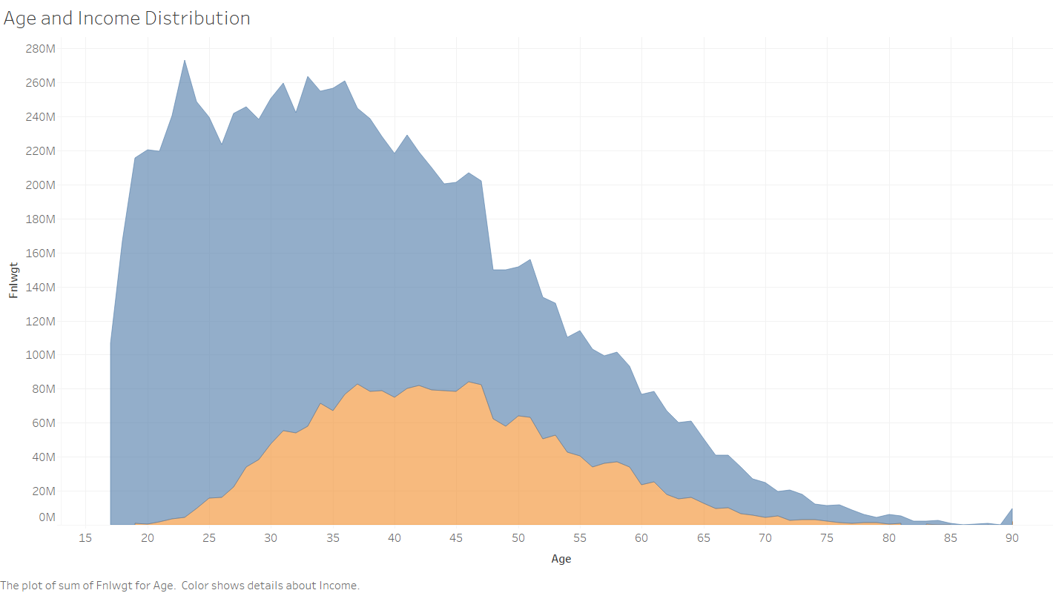

Slide 6
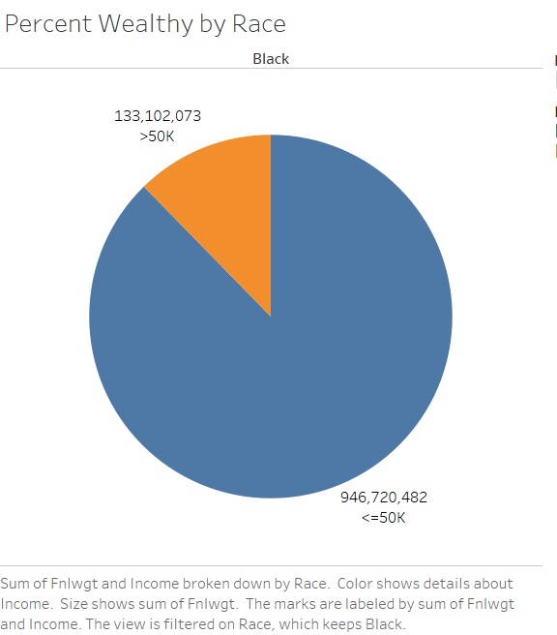

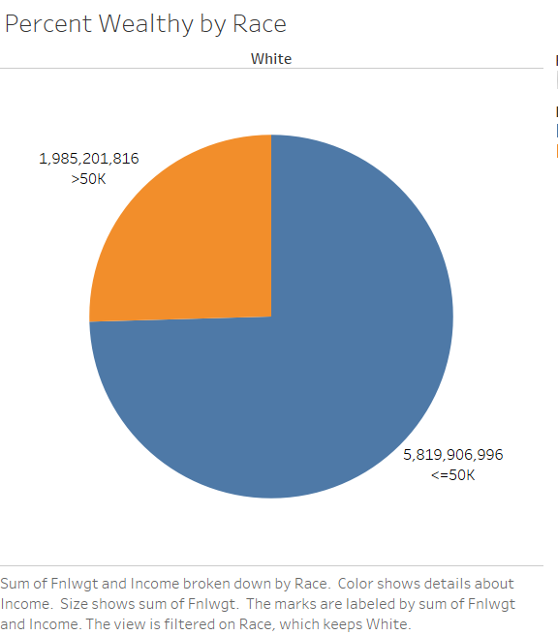
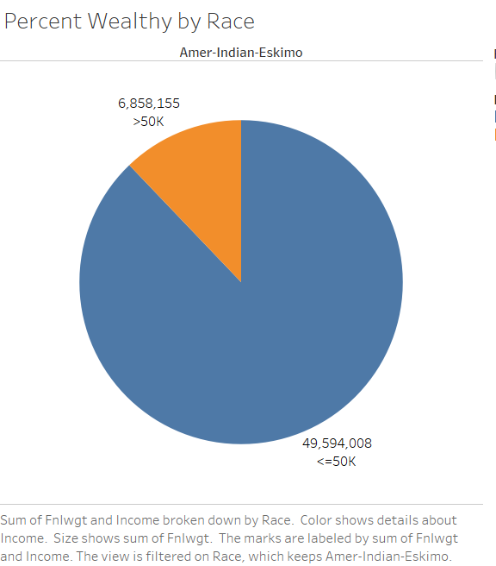
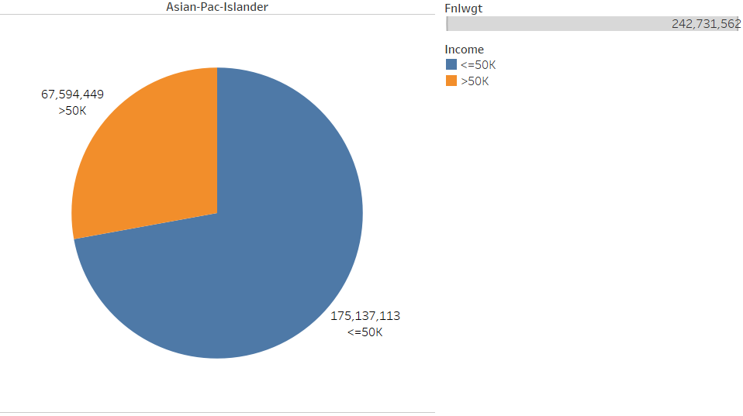
Go Asians!

Slide 7
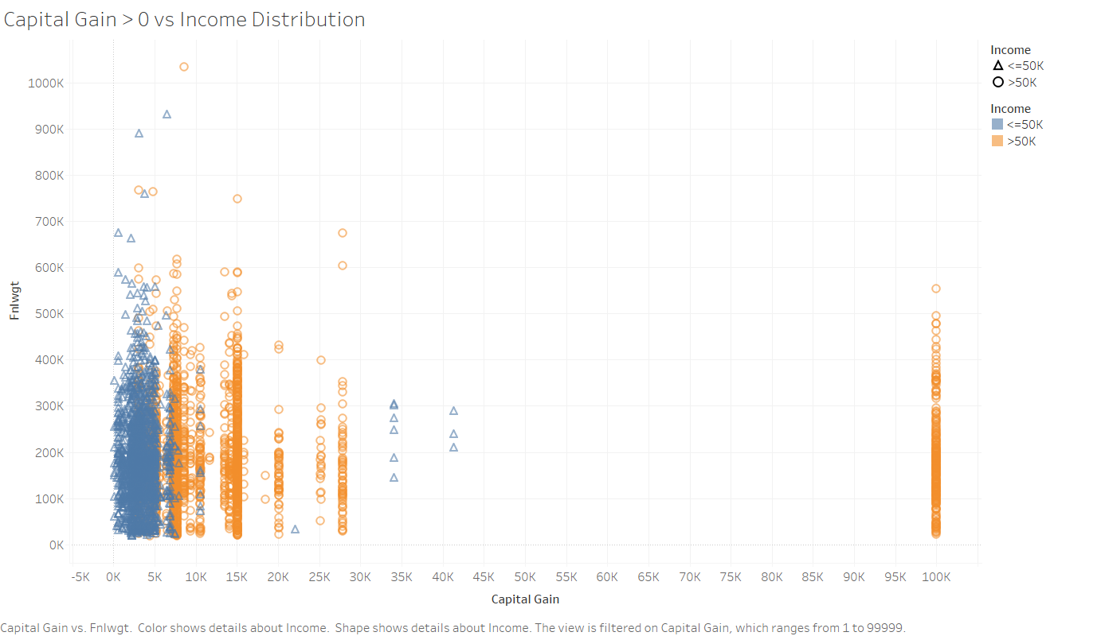

Slide 8
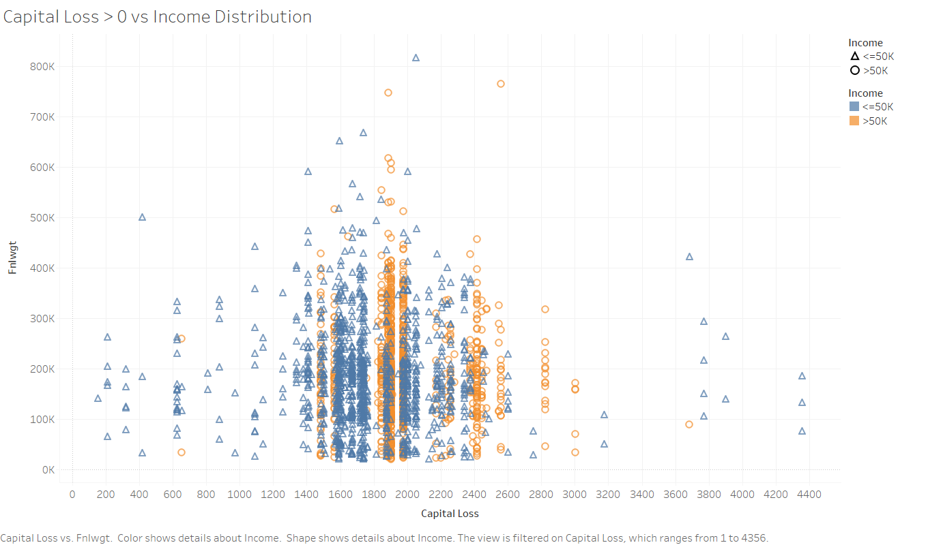

Slide 9
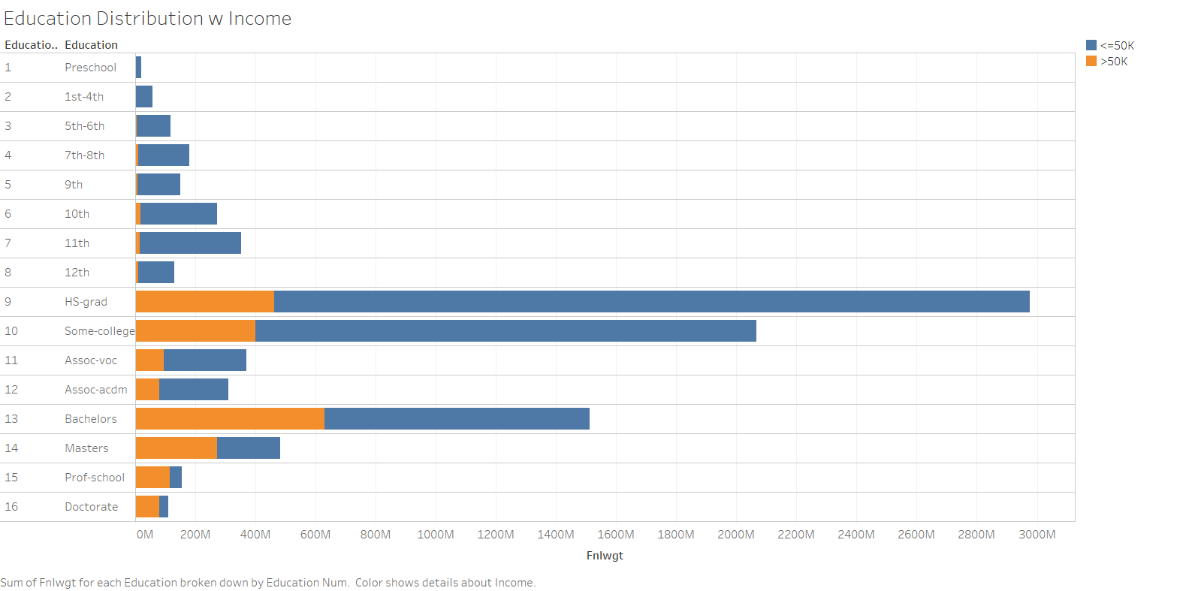

Slide 10
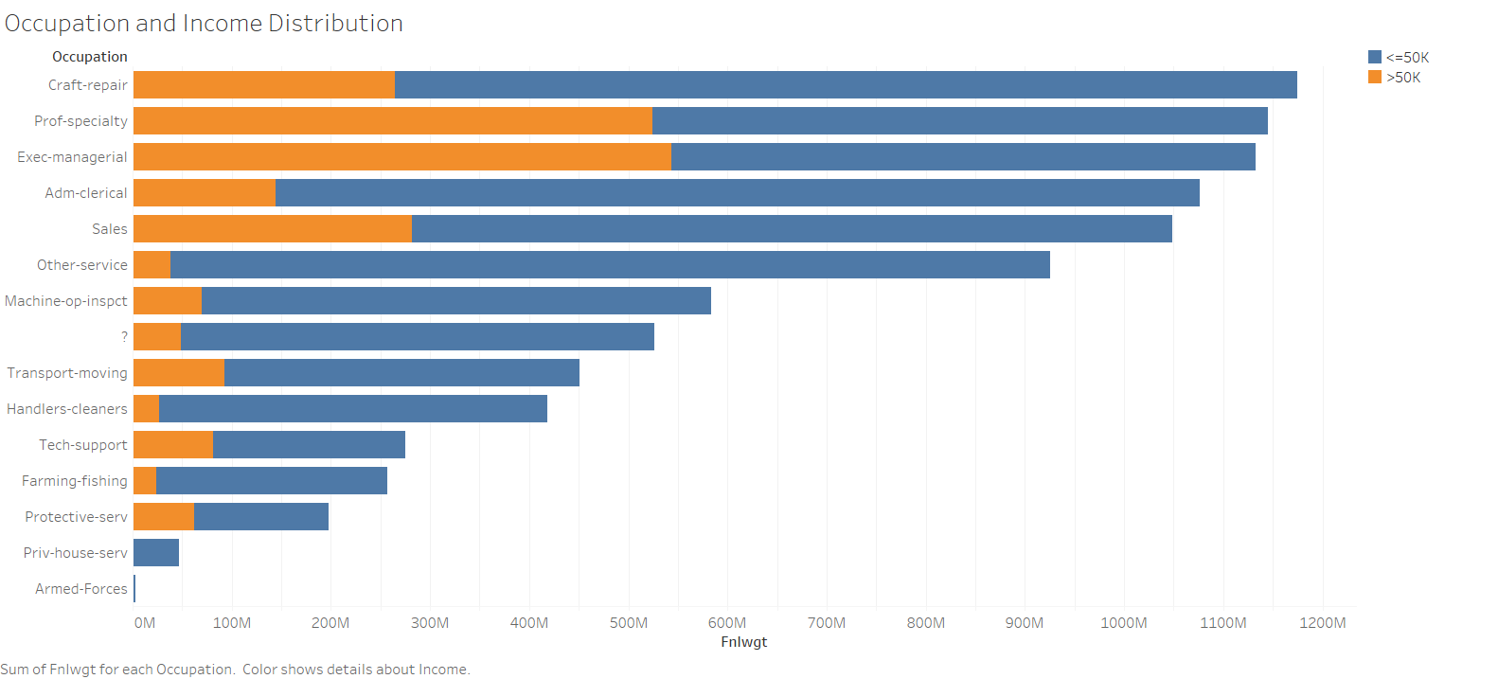

Slide 11
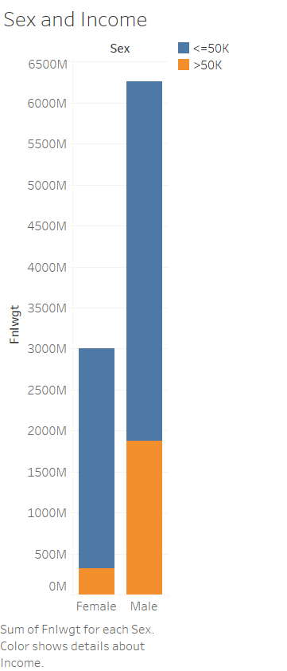
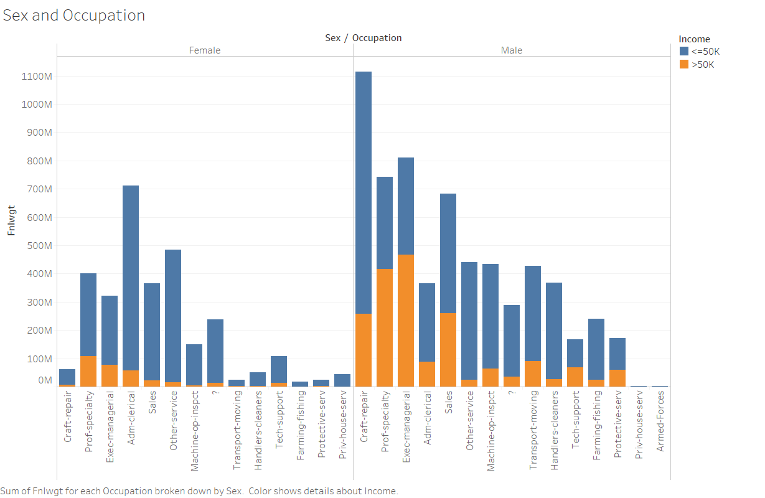

Slide 12
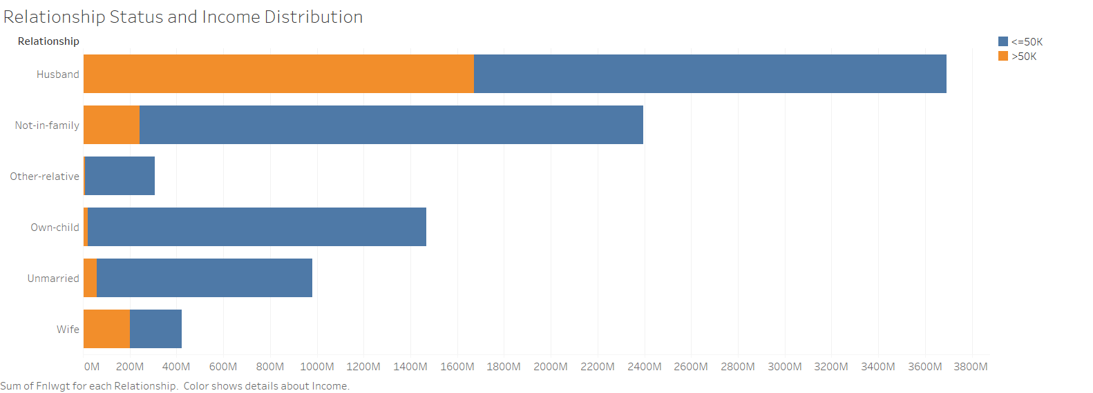

Slide 13
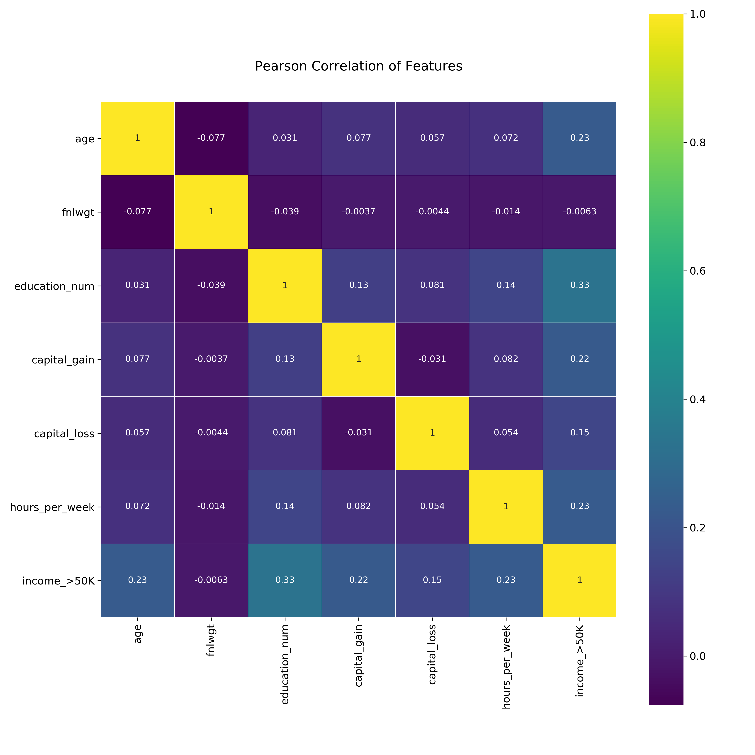

Slide 14
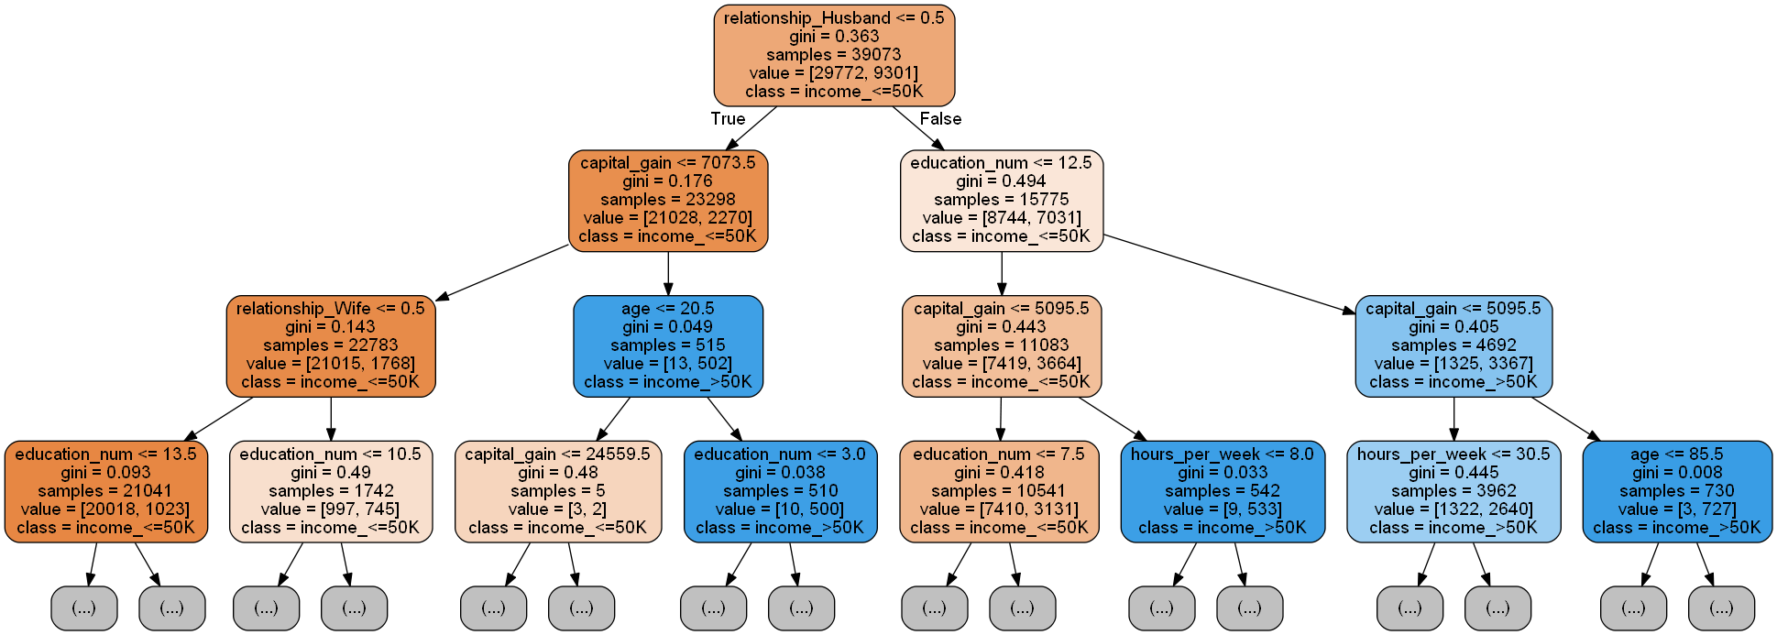
Decision Tree vs Random Forest
('relationship_Husband', 0.24022227776617505),
('capital_gain', 0.1974372740362737),
('education_num', 0.16012239751917648),
('age', 0.08209723212060077),
('hours_per_week', 0.0579356319963014),
('relationship_Not-in-family', 0.04865200766546678),
('occupation_Exec-managerial', 0.04085603962006724),
('relationship_Own-child', 0.03805349249015408),
('capital_loss', 0.03552910129107107),
('occupation_Prof-specialty', 0.030961502151851557),

Slide 15
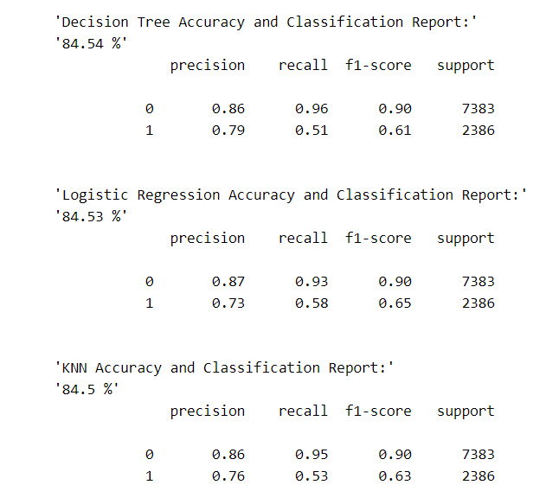
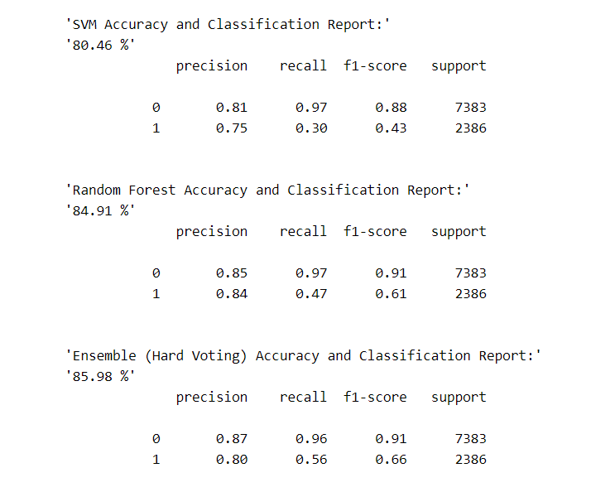

Slide 16
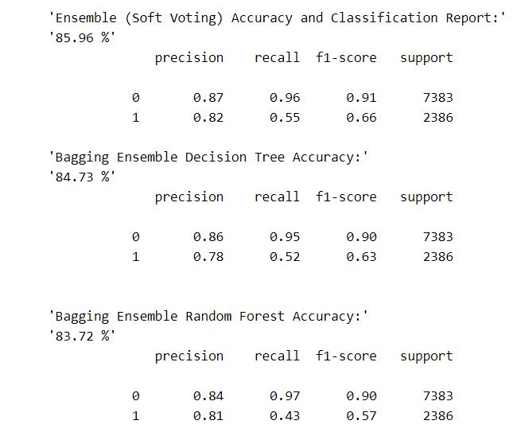
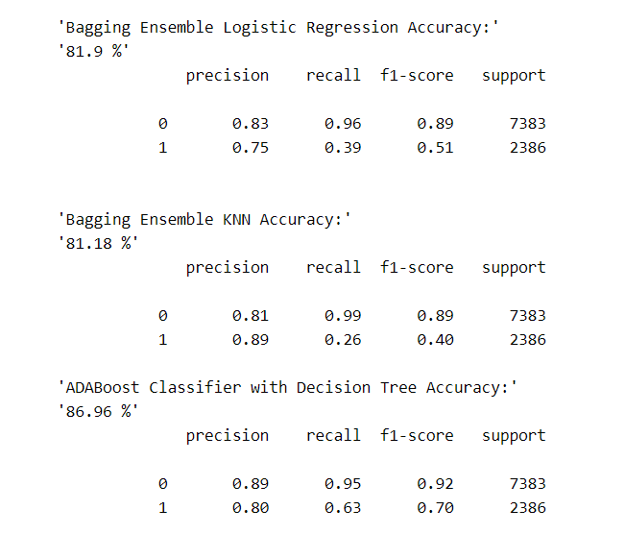

Slide 17
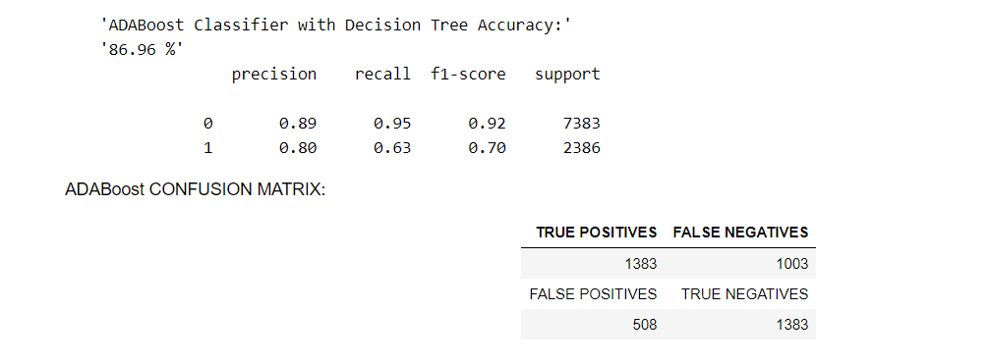
If I state it is a 0, I have a 89% chance I’m correct. If I state it is a 1, I have a 80% chance I’m correct.
If I state it is NOT a 0, I have a 95% chance I’m correct. If I state it is NOT a 1, I only have a 63% that I’m correct.
So say, if you focus on predicting 1s, you have a 20% chance of predicting false positive and a 37% chance of predicting a false negative.

