Slide 1

Gwangju Filipino Catholic Community
PUT YOUR CELLPHONE ON SILENT MODE DURING THE MASS.
Thank you.
Gwangju Filipino Catholic Community
Pre-Mass

Slide 2
Gwangju Filipino Catholic Community
Lent Celebration
2026-03-15
Celebrant: Rev. Fr. Jonrey Lauron, RCJ
Gospel: John 9:1-41 Season: Lent · Sunday Lectionary Year A
Excerpt: “Neither did this man sin, nor his parents; but, that the works of God might be revealed in him.”
Liturgical color: Purple (lent)
Below: World English Bible (WEB) fallback — verify NABRE on bible.usccb.org.
Gwangju Filipino Catholic Community
Title

Slide 3
Gwangju Filipino Catholic Community
Welcome to the celebration of the Holy Eucharist.
Please stand and join in singing the Entrance hymn.
Gwangju Filipino Catholic Community
Intro

Slide 4
Gwangju Filipino Catholic Community
Glory and Praise to Our God
GLORY AND PRAISE TO OUR GOD,
WHO ALONE GIVES LIGHT TO OUR DAYS.
MANY ARE THE BLESSINGS
HE BEARS TO THOSE WHO TRUST IN HIS WAYS.
Gwangju Filipino Catholic Community
Entrance

Slide 5
Gwangju Filipino Catholic Community
WE THE DAUGHTERS AND SONS OF HIM
WHO BUILT THE VALLEYS AND PLAINS,
PRAISE THE WONDERS OUR GOD HAS DONE,
WHOSE MOTHER IS OVER ALL.
Gwangju Filipino Catholic Community
Entrance

Slide 6
Gwangju Filipino Catholic Community
REMEMBER THE WORKS OF OUR GOD,
FROM THE HEAVENS, THE EARTH, AND THE SEA.
ALL WHO DWELL ON THE EARTH,
SING PRAISE FOR HIS MARVELOUS DEEDS.
Gwangju Filipino Catholic Community
Entrance

Slide 7
Gwangju Filipino Catholic Community
GLORY AND PRAISE TO OUR GOD,
WHILE HIS PEOPLE THEIR HOMAGE PROCLAIM.
HE HAS POURED OUT HIS LOVE,
AND HAS SHOWN US THE STRENGTH OF HIS HAND.
Gwangju Filipino Catholic Community
Entrance

Slide 8
Gwangju Filipino Catholic Community
FAITHFUL FATHER, WE COME TO YOU:
HEAL YOUR CHILDREN, REMEMBER YOUR CARE.
YOU DELIVER YOUR OWN FROM SIN;
WE WILL SING OF YOUR MERCY FOR ALL.
Gwangju Filipino Catholic Community
Entrance

Slide 9
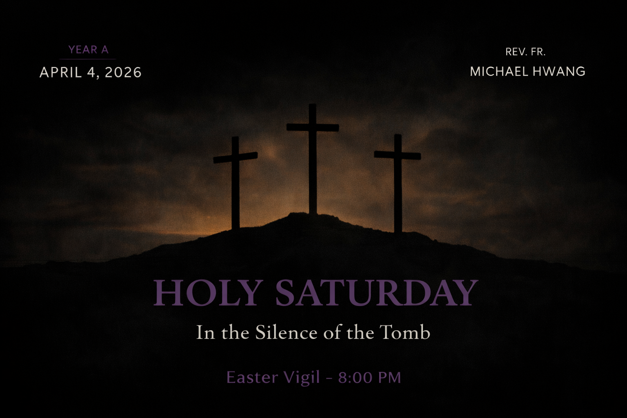
Gwangju Filipino Catholic Community
MASS CELEBRANT:
Rev. Fr. Jonrey Lauron, RCJ
Gwangju Filipino Catholic Community
Gospel (John 9:1-41)
“Neither did this man sin, nor his parents; but, that the works of God might be revealed in him.”
YEAR A
2026-03-15 · Lent
Gwangju Filipino Catholic Community
Mass poster / divider

Slide 10
Gwangju Filipino Catholic Community
Priest: In the Name of the Father, and of the Son, and of the Holy Spirit.
All: Amen.
Priest: The Lord be with you.
All: And with your spirit.
Gwangju Filipino Catholic Community
Introductory Rites

Slide 11
Gwangju Filipino Catholic Community
Priest: Brethren (brothers and sisters), let us acknowledge our sins, and so prepare ourselves to celebrate the sacred mysteries.
All: I confess to almighty God
and to you, my brothers and sisters,
that I have greatly sinned,
in my thoughts and in my words,
in what I have done and in what I have failed to do,
through my fault, through my fault,
through my most grievous fault;
therefore I ask blessed Mary ever-Virgin,
all the Angels and Saints,
and you, my brothers and sisters,
to pray for me to the Lord our God.
Priest: May almighty God have mercy on us, forgive us our sins, and bring us to everlasting life.
All: Amen.
Gwangju Filipino Catholic Community
Penitential Act

Slide 12
Gwangju Filipino Catholic Community
Lord, have mercy.
Lord, have mercy.
Christ, have mercy.
Christ, have mercy.
Lord, have mercy.
Lord, have mercy.
This acclamation may also be sung, or the invocations from the Missal or approved pastoral practice may be used in full.
Gwangju Filipino Catholic Community
Kyrie Eleison

Slide 13
Gwangju Filipino Catholic Community
Glory to God in the highest,
and on earth peace to people of good will.
We praise you, we bless you, we adore you,
we glorify you, we give you thanks
for your great glory,
Lord God, heavenly King, O God, almighty Father.
Lord Jesus Christ, Only Begotten Son,
Lord God, Lamb of God, Son of the Father,
you take away the sins of the world, have mercy on us;
you take away the sins of the world, receive our prayer;
you are seated at the right hand of the Father, have mercy on us.
For you alone are the Holy One,
you alone are the Lord,
you alone are the Most High,
Jesus Christ,
with the Holy Spirit,
in the glory of God the Father.
Amen.
Gwangju Filipino Catholic Community
Gloria

Slide 14
Gwangju Filipino Catholic Community
Priest: Let us pray.
All pray silently with the Priest for a moment. Then the Priest says the Collect for the day, that is, the Opening Prayer, in full from the Roman Missal for this celebration—nothing abbreviated. The people respond at the end.
All: Amen.
Gwangju Filipino Catholic Community
Liturgy of the Word

Slide 15
Gwangju Filipino Catholic Community
LITURGY OF THE WORD
Gwangju Filipino Catholic Community
Liturgy of the Word

Slide 16
Gwangju Filipino Catholic Community
Liturgy of the Word
First Reading (1 Samuel 16:1b, 6-7, 10-13a)
1 Samuel 16:1b, 6-7, 10-13a
Full text was not loaded from bible.usccb.org. Open today’s readings for this date and paste if needed.
Gwangju Filipino Catholic Community
Liturgy of the Word

Slide 17
Gwangju Filipino Catholic Community
Liturgy of the Word
Responsorial Psalm (Psalm 23: 1-3a, 3b-4, 5, 6)
Psalm 23: 1-3a, 3b-4, 5, 6
Full text was not loaded from bible.usccb.org. Open today’s readings for this date and paste if needed.
Gwangju Filipino Catholic Community
Liturgy of the Word

Slide 18
Gwangju Filipino Catholic Community
Liturgy of the Word
Second Reading (Ephesians 5:8-14)
Ephesians 5:8-14
Full text was not loaded from bible.usccb.org. Open today’s readings for this date and paste if needed.
Gwangju Filipino Catholic Community
Liturgy of the Word

Slide 19
Gwangju Filipino Catholic Community
ALLELUIA! ALLELUIA! ALLELUIA! ALLELUIA!
Sing the verse of the Gospel Acclamation given in the Lectionary for this Mass in full, not shortened.
Gwangju Filipino Catholic Community
Gospel Acclamation

Slide 20
Gwangju Filipino Catholic Community
If a commentator announces the verse before the Gospel Acclamation, the verse from the Lectionary is spoken in full, and then the assembly sings the Alleluia and response without abbreviation.
Gwangju Filipino Catholic Community
Gospel Acclamation

Slide 21
Gwangju Filipino Catholic Community
Priest: The Lord be with you.
All: And with your spirit.
The Priest says the full introductory dialogue from the Roman Missal, using the complete sentence from the Lectionary for this Mass, beginning “A reading from the holy Gospel according to [name the evangelist or book in full, as printed in the Lectionary—never abbreviated].”
All: Glory to you, O Lord.
Gwangju Filipino Catholic Community
Gospel Acclamation

Slide 22
Gwangju Filipino Catholic Community
John 9:1-41
All: “Neither did this man sin, nor his parents; but, that the works of God might be revealed in him.”
Gwangju Filipino Catholic Community
Gospel

Slide 23
Gwangju Filipino Catholic Community
Gospel
John 9:1-41 · slide 1 of 6
As he passed by, he saw a man blind from birth. His disciples asked him, “Rabbi, who sinned, this man or his parents, that he was born blind?” Jesus answered, “Neither did this man sin, nor his parents; but, that the works of God might be revealed in him. I must work the works of him who sent me, while it is day. The night is coming, when no one can work. While I am in the world, I am the light of the world.” When he had said this, he spat on the ground, made mud with the saliva, anointed the blind man’s eyes with the mud, and said to him, “Go, wash in the pool of Siloam” (which means “Sent”). So he went away, washed, and came back seeing.
Gwangju Filipino Catholic Community
Gospel

Slide 24
Gwangju Filipino Catholic Community
Gospel (continued)
John 9:1-41 · slide 2 of 6
The neighbors therefore, and those who saw that he was blind before, said, “Isn’t this he who sat and begged?” Others were saying, “It is he.” Still others were saying, “He looks like him.” He said, “I am he.” They therefore were asking him, “How were your eyes opened?” He answered, “A man called Jesus made mud, anointed my eyes, and said to me, ‘Go to the pool of Siloam, and wash.’ So I went away and washed, and I received sight.” Then they asked him, “Where is he?” He said, “I don’t know.” They brought him who had been blind to the Pharisees. It was a Sabbath when Jesus made the mud and opened his eyes. Again therefore the Pharisees also asked him how he received his sight.
Gwangju Filipino Catholic Community
Gospel

Slide 25
Gwangju Filipino Catholic Community
Gospel (continued)
John 9:1-41 · slide 3 of 6
He said to them, “He put mud on my eyes, I washed, and I see.” Some therefore of the Pharisees said, “This man is not from God, because he doesn’t keep the Sabbath.” Others said, “How can a man who is a sinner do such signs?” There was division among them. Therefore they asked the blind man again, “What do you say about him, because he opened your eyes?” He said, “He is a prophet.” The Jews therefore did not believe concerning him, that he had been blind, and had received his sight, until they called the parents of him who had received his sight, and asked them, “Is this your son, whom you say was born blind? How then does he now see?” His parents answered them, “We know that this is our son, and that he was born blind; but how he now sees, we don’t know; or who opened his eyes, we don’t know. He is of age.
Gwangju Filipino Catholic Community
Gospel

Slide 26
Gwangju Filipino Catholic Community
Gospel (continued)
John 9:1-41 · slide 4 of 6
Ask him. He will speak for himself.” His parents said these things because they feared the Jews; for the Jews had already agreed that if any man would confess him as Christ, he would be put out of the synagogue. Therefore his parents said, “He is of age. Ask him.” So they called the man who was blind a second time, and said to him, “Give glory to God. We know that this man is a sinner.” He therefore answered, “I don’t know if he is a sinner. One thing I do know: that though I was blind, now I see.” They said to him again, “What did he do to you? How did he open your eyes?” He answered them, “I told you already, and you didn’t listen. Why do you want to hear it again? You don’t also want to become his disciples, do you?” They insulted him and said, “You are his disciple, but we are disciples of Moses.
Gwangju Filipino Catholic Community
Gospel

Slide 27
Gwangju Filipino Catholic Community
Gospel (continued)
John 9:1-41 · slide 5 of 6
We know that God has spoken to Moses. But as for this man, we don’t know where he comes from.” The man answered them, “How amazing! You don’t know where he comes from, yet he opened my eyes. We know that God doesn’t listen to sinners, but if anyone is a worshiper of God, and does his will, he listens to him. Since the world began it has never been heard of that anyone opened the eyes of someone born blind. If this man were not from God, he could do nothing.” They answered him, “You were altogether born in sins, and do you teach us?” They threw him out.
Gwangju Filipino Catholic Community
Gospel

Slide 28
Gwangju Filipino Catholic Community
Gospel (continued)
John 9:1-41 · slide 6 of 6
Jesus heard that they had thrown him out, and finding him, he said, “Do you believe in the Son of God?” He answered, “Who is he, Lord, that I may believe in him?” Jesus said to him, “You have both seen him, and it is he who speaks with you.” He said, “Lord, I believe!” and he worshiped him. Jesus said, “I came into this world for judgment, that those who don’t see may see; and that those who see may become blind.” Those of the Pharisees who were with him heard these things, and said to him, “Are we also blind?” Jesus said to them, “If you were blind, you would have no sin; but now you say, ‘We see.’ Therefore your sin remains.
Gwangju Filipino Catholic Community
Gospel

Slide 29
Gwangju Filipino Catholic Community
Priest: The Gospel of the Lord.
All: Praise to you, Lord Jesus Christ.
Gwangju Filipino Catholic Community
Gospel Acclamation

Slide 30
Gwangju Filipino Catholic Community
Time for the homily — Father will now preach.
Commentator may introduce the theme.
Gwangju Filipino Catholic Community
Homily

Slide 31
Gwangju Filipino Catholic Community
MASS CELEBRANT:
Rev. Fr. Jonrey Lauron, RCJ
Gwangju Filipino Catholic Community
Gospel (John 9:1-41)
“Neither did this man sin, nor his parents; but, that the works of God might be revealed in him.”
YEAR A
2026-03-15 · Lent
Gwangju Filipino Catholic Community
Mass poster / divider

Slide 32
Gwangju Filipino Catholic Community
All: I believe in one God,
the Father almighty,
maker of heaven and earth,
of all things visible and invisible.
I believe in one Lord Jesus Christ,
the Only Begotten Son of God,
born of the Father before all ages.
God from God, Light from Light,
true God from true God,
begotten, not made, consubstantial with the Father;
through him all things were made.
For us men and for our salvation
he came down from heaven,
and by the Holy Spirit was incarnate of the Virgin Mary,
and became man.
For our sake he was crucified under Pontius Pilate,
he suffered death and was buried,
and rose again on the third day
in accordance with the Scriptures.
He ascended into heaven
and is seated at the right hand of the Father.
He will come again in glory
to judge the living and the dead
and his kingdom will have no end.
I believe in the Holy Spirit, the Lord, the giver of life,
who proceeds from the Father and the Son,
who with the Father and the Son is adored and glorified,
who has spoken through the prophets.
I believe in one, holy, catholic and apostolic Church.
I confess one Baptism for the forgiveness of sins
and I look forward to the resurrection of the dead
and the life of the world to come. Amen.
Gwangju Filipino Catholic Community
Nicene Creed

Slide 33
Gwangju Filipino Catholic Community
MASS CELEBRANT:
Rev. Fr. Jonrey Lauron, RCJ
Gwangju Filipino Catholic Community
Gospel (John 9:1-41)
“Neither did this man sin, nor his parents; but, that the works of God might be revealed in him.”
YEAR A
2026-03-15 · Lent
Gwangju Filipino Catholic Community
Mass poster / divider

Slide 34
Gwangju Filipino Catholic Community
The Universal Prayer is led so that each petition is spoken in full and each response by the people is sung or said in full (for example, “Lord, hear our prayer”), never abbreviated.
Priest: For the holy Church of God throughout the world, that the Lord may guard her and grant her peace and unity according to his will: let us pray to the Lord.
All: Lord, hear our prayer.
Gwangju Filipino Catholic Community
Prayer of the Faithful

Slide 35
Gwangju Filipino Catholic Community
Priest: The Priest concludes the Prayer of the Faithful with a prayer in full, for example:
Priest: Heavenly Father, hear the prayers of the Church, which we make through Christ our Lord.
All: Amen.
Gwangju Filipino Catholic Community
Prayer of the Faithful

Slide 36
Gwangju Filipino Catholic Community
MASS CELEBRANT:
Rev. Fr. Jonrey Lauron, RCJ
Gwangju Filipino Catholic Community
Gospel (John 9:1-41)
“Neither did this man sin, nor his parents; but, that the works of God might be revealed in him.”
YEAR A
2026-03-15 · Lent
Gwangju Filipino Catholic Community
Mass poster / divider

Slide 37
Gwangju Filipino Catholic Community
Christify
CHRISTIFY THE GIFTS WE BRING TO YOU
BOUNTY OF THE EARTH RECEIVE ANEW
TAKE AND BLESS THE WORK OF OUR HANDS
CHRISTIFY THESE GIFTS AT YOUR COMMAND
Gwangju Filipino Catholic Community
Offertory

Slide 38
Gwangju Filipino Catholic Community
RAIN AND SUNSHINE, SEED AND SOIL,
DRAW FROM US THIS OFFERING TOIL.
MAKE US WORTHY OF YOUR NAME
AS WE SHARE YOUR BREAD AND WINE.
Gwangju Filipino Catholic Community
Offertory

Slide 39
Gwangju Filipino Catholic Community
CHRISTIFY THE GIFTS WE BRING TO YOU
BOUNTY OF THE EARTH RECEIVE ANEW
TAKE AND BLESS THE WORK OF OUR HANDS
CHRISTIFY THESE GIFTS AT YOUR COMMAND
Gwangju Filipino Catholic Community
Offertory

Slide 40
Gwangju Filipino Catholic Community
BLESS US THIS DAY THAT WE MAY PROVE
WORTHY OF THE LIFE WE HAVE IN YOU.
MAKE US YOUR LIVING BODY HERE,
BRINGING YOUR LOVE TO ALL WE MEET.
Gwangju Filipino Catholic Community
Offertory

Slide 41
Gwangju Filipino Catholic Community
CHRISTIFY THE GIFTS WE BRING TO YOU
BOUNTY OF THE EARTH RECEIVE ANEW
TAKE AND BLESS THE WORK OF OUR HANDS
CHRISTIFY THESE GIFTS AT YOUR COMMAND
Gwangju Filipino Catholic Community
Offertory

Slide 42
Gwangju Filipino Catholic Community
LITURGY OF THE EUCHARIST
Gwangju Filipino Catholic Community
Liturgy of the Eucharist

Slide 43
Gwangju Filipino Catholic Community
Priest: Pray, brethren, that my sacrifice and yours may be acceptable to God, the almighty Father.
All: May the Lord accept the sacrifice at your hands, for the praise and glory of his name, for our good and the good of all his holy Church.
Gwangju Filipino Catholic Community
Liturgy of the Eucharist

Slide 44
Gwangju Filipino Catholic Community
LITURGY OF THE EUCHARIST
Gwangju Filipino Catholic Community
Liturgy of the Eucharist

Slide 45
Gwangju Filipino Catholic Community
Priest: The Lord be with you.
All: And with your spirit.
Priest: Lift up your hearts.
All: We lift them up to the Lord.
Priest: Let us give thanks to the Lord our God.
All: It is right and just.
Gwangju Filipino Catholic Community
Liturgy of the Eucharist

Slide 46
Gwangju Filipino Catholic Community
The Priest continues with the Preface of the day from the Roman Missal — the entire Preface proper for this Mass, not truncated — until the point where the people join in singing or saying the Holy, Holy (Sanctus).
Gwangju Filipino Catholic Community
Liturgy of the Eucharist

Slide 47
Gwangju Filipino Catholic Community
Holy, Holy, Holy Lord God of hosts.
Heaven and earth are full of your glory.
Hosanna in the highest.
Blessed is he who comes in the name of the Lord.
Hosanna in the highest.
Gwangju Filipino Catholic Community
Sanctus

Slide 48
Gwangju Filipino Catholic Community
LITURGY OF THE EUCHARIST
Gwangju Filipino Catholic Community
Liturgy of the Eucharist

Slide 49
Gwangju Filipino Catholic Community
All: We proclaim your Death, O Lord,
and profess your Resurrection
until you come again.
(Alternate forms may be used as approved by the Conference of Bishops.)
Gwangju Filipino Catholic Community
The Eucharistic Prayer

Slide 50
Gwangju Filipino Catholic Community
LITURGY OF THE EUCHARIST
Gwangju Filipino Catholic Community
Liturgy of the Eucharist

Slide 51
Gwangju Filipino Catholic Community
All: Amen.
The people respond “Amen” once to the doxology at the end of the Eucharistic Prayer, unless local solemn custom repeats it.
Gwangju Filipino Catholic Community
Great Amen

Slide 52
Gwangju Filipino Catholic Community
Our Father, who art in heaven,
hallowed be thy name;
thy kingdom come,
thy will be done,
on earth as it is in heaven.
Give us this day our daily bread;
and forgive us our trespasses,
as we forgive those who trespass against us;
and lead us not into temptation,
but deliver us from evil.
Priest: Deliver us, Lord, we pray, from every evil, graciously grant peace in our days, that, by the help of your mercy, we may be always free from sin and safe from all distress, as we await the blessed hope and the coming of our Savior, Jesus Christ.
For the kingdom, the power, and the glory are yours now and for ever.
Gwangju Filipino Catholic Community
Our Father

Slide 53
Gwangju Filipino Catholic Community
MASS CELEBRANT:
Rev. Fr. Jonrey Lauron, RCJ
Gwangju Filipino Catholic Community
Gospel (John 9:1-41)
“Neither did this man sin, nor his parents; but, that the works of God might be revealed in him.”
YEAR A
2026-03-15 · Lent
Gwangju Filipino Catholic Community
Mass poster / divider

Slide 54
Gwangju Filipino Catholic Community
Priest: Deliver us, Lord, we pray, from every evil, graciously grant peace in our days, that, by the help of your mercy, we may be always free from sin and safe from all distress, as we await the blessed hope and the coming of our Savior, Jesus Christ.
All: For the kingdom, the power, and the glory are yours, now and for ever. Amen.
Gwangju Filipino Catholic Community
The Communion Rite

Slide 55
Gwangju Filipino Catholic Community
MASS CELEBRANT:
Rev. Fr. Jonrey Lauron, RCJ
Gwangju Filipino Catholic Community
Gospel (John 9:1-41)
“Neither did this man sin, nor his parents; but, that the works of God might be revealed in him.”
YEAR A
2026-03-15 · Lent
Gwangju Filipino Catholic Community
Mass poster / divider

Slide 56
Gwangju Filipino Catholic Community
Priest: The peace of the Lord be with you always.
All: And with your spirit.
Let us offer each other the sign of peace.
Gwangju Filipino Catholic Community
Sign of Peace

Slide 57
Gwangju Filipino Catholic Community
Lamb of God,
you take away the sins of the world,
have mercy on us.
Lamb of God,
you take away the sins of the world,
have mercy on us.
Lamb of God,
you take away the sins of the world,
grant us peace.
Gwangju Filipino Catholic Community
Lamb of God

Slide 58
Gwangju Filipino Catholic Community
Priest: Behold the Lamb of God, behold him who takes away the sins of the world. Blessed are those called to the supper of the Lamb.
All: Lord, I am not worthy that you should enter under my roof, but only say the word and my soul shall be healed.
Gwangju Filipino Catholic Community
The Communion Rite

Slide 59
Gwangju Filipino Catholic Community
MASS CELEBRANT:
Rev. Fr. Jonrey Lauron, RCJ
Gwangju Filipino Catholic Community
Gospel (John 9:1-41)
“Neither did this man sin, nor his parents; but, that the works of God might be revealed in him.”
YEAR A
2026-03-15 · Lent
Gwangju Filipino Catholic Community
Mass poster / divider

Slide 60
Gwangju Filipino Catholic Community
Taste and See
TASTE AND SEE THE GOODNESS OF THE LORD,
TASTE AND SEE THE GOODNESS OF THE LORD.
Gwangju Filipino Catholic Community
Communion (1)

Slide 61
Gwangju Filipino Catholic Community
I WILL BLESS THE LORD AT ALL TIMES,
HIS PRAISE SHALL BE ALWAYS IN MY MOUTH.
Gwangju Filipino Catholic Community
Communion (1)

Slide 62
Gwangju Filipino Catholic Community
TASTE AND SEE THE GOODNESS OF THE LORD,
TASTE AND SEE THE GOODNESS OF THE LORD.
Gwangju Filipino Catholic Community
Communion (1)

Slide 63
Gwangju Filipino Catholic Community
GLORIFY THE LORD WITH ME,
LET US EXALT HIS NAME TOGETHER.
Gwangju Filipino Catholic Community
Communion (1)

Slide 64
Gwangju Filipino Catholic Community
TASTE AND SEE THE GOODNESS OF THE LORD,
TASTE AND SEE THE GOODNESS OF THE LORD.
Gwangju Filipino Catholic Community
Communion (1)

Slide 65
Gwangju Filipino Catholic Community
LOOK TO HIM THAT YOU MAY BE RADIANT WITH JOY,
AND YOUR SOULS SHALL FIND THEIR JOY IN HIM.
Gwangju Filipino Catholic Community
Communion (1)

Slide 66
Gwangju Filipino Catholic Community
TASTE AND SEE THE GOODNESS OF THE LORD,
TASTE AND SEE THE GOODNESS OF THE LORD.
Gwangju Filipino Catholic Community
Communion (1)

Slide 67
Gwangju Filipino Catholic Community
On Eagle's Wings
(NO LYRICS IN LIBRARY FOR THIS HYMN.)
Gwangju Filipino Catholic Community
Communion (2)

Slide 68
Gwangju Filipino Catholic Community
Priest: Let us pray.
The Priest says the Post- Communion Prayer for the day in full from the Roman Missal. The people respond at the end.
All: Amen.
Gwangju Filipino Catholic Community
The Communion Rite

Slide 69
Gwangju Filipino Catholic Community
MASS CELEBRANT:
Rev. Fr. Jonrey Lauron, RCJ
Gwangju Filipino Catholic Community
Gospel (John 9:1-41)
“Neither did this man sin, nor his parents; but, that the works of God might be revealed in him.”
YEAR A
2026-03-15 · Lent
Gwangju Filipino Catholic Community
Mass poster / divider

Slide 70
Gwangju Filipino Catholic Community
MASS COLLECTION
Thank you for your generosity.
Date: Sunday, May 10, 2026
Gwangju Filipino Catholic Community
Mass Collection

Slide 71
Gwangju Filipino Catholic Community
FOOD SPONSORS
The community thanks our food sponsors.
(No sponsors listed — add names in Mass Builder.)
Gwangju Filipino Catholic Community
Food Sponsors

Slide 72
Gwangju Filipino Catholic Community
CHURCH ANNOUNCEMENTS
Insert bulletin points with complete sentences on the following slides or edit this deck.
Gwangju Filipino Catholic Community
Announcements

Slide 73
Gwangju Filipino Catholic Community
Welcome newcomers!
Photo collage optional.
Gwangju Filipino Catholic Community
Announcements

Slide 74
Gwangju Filipino Catholic Community
Sacrament of Confession
The Lord never tires of forgiving us; we are the ones who tire of seeking his mercy. — Pope Francis
Gwangju Filipino Catholic Community
Announcements

Slide 75
Gwangju Filipino Catholic Community
Updates and Announcements
Name your community page and invitation to follow in full; add a QR code to the slide master if you wish.
Gwangju Filipino Catholic Community
Announcements

Slide 76
Gwangju Filipino Catholic Community
Priest: The Lord be with you.
All: And with your spirit.
Priest: May almighty God bless you, the Father, and the Son, and the Holy Spirit.
All: Amen.
Priest: Go in peace, glorifying the Lord by your life.
All: Thanks be to God.
Gwangju Filipino Catholic Community
Final Blessing

Slide 77
Gwangju Filipino Catholic Community
Lead Me, Lord
LEAD ME, LORD, LEAD ME IN THY RIGHTEOUSNESS,
MAKE THY WAY PLAIN BEFORE MY FACE.
Gwangju Filipino Catholic Community
Recessional

Slide 78
Gwangju Filipino Catholic Community
FOR IT IS THOU, LORD, THOU, LORD ONLY,
THAT MAKEST ME DWELL IN SAFETY.
Gwangju Filipino Catholic Community
Recessional

Slide 79
Gwangju Filipino Catholic Community
GUIDE ME, LORD, GUIDE ME WHEN I AM WEARY,
BE MY STRENGTH WHEN SHADOWS FALL.
Gwangju Filipino Catholic Community
Recessional

Slide 80
Gwangju Filipino Catholic Community
TURN MY HEART TO THY HOLY WORD,
BE MY KEEPER, BE MY LORD.
Gwangju Filipino Catholic Community
Recessional

Slide 81
Gwangju Filipino Catholic Community
LEAD ME, LORD, LEAD ME IN THY RIGHTEOUSNESS,
MAKE THY WAY PLAIN BEFORE MY FACE.
Gwangju Filipino Catholic Community
Recessional

Slide 82
Gwangju Filipino Catholic Community
IN THY LIGHT WE SEE LIGHT;
IN THY TRUTH WE FIND OUR WAY.
BE OUR REFUGE AND OUR FORTRESS,
BE OUR STRENGTH FROM DAY TO DAY.
Gwangju Filipino Catholic Community
Recessional

Slide 83
Gwangju Filipino Catholic Community
LEAD ME, LORD, LEAD ME IN THY RIGHTEOUSNESS,
MAKE THY WAY PLAIN BEFORE MY FACE.
Gwangju Filipino Catholic Community
Recessional

Slide 84
Gwangju Filipino Catholic Community
MASS CELEBRANT:
Rev. Fr. Jonrey Lauron, RCJ
Gwangju Filipino Catholic Community
Gospel (John 9:1-41)
“Neither did this man sin, nor his parents; but, that the works of God might be revealed in him.”
YEAR A
2026-03-15 · Lent
Gwangju Filipino Catholic Community
Mass poster / divider

Slide 85
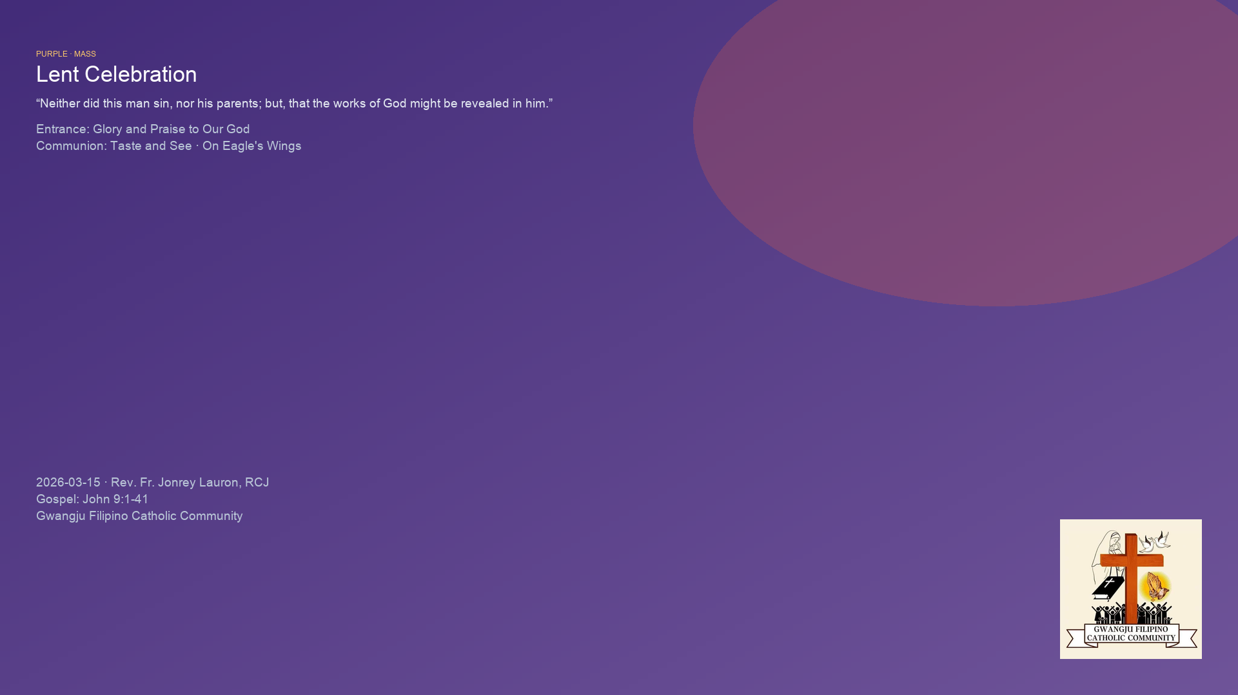

Slide 86
Gwangju Filipino Catholic Community
Below: World English Bible (WEB) fallback — verify NABRE on bible.usccb.org.
Gwangju Filipino Catholic Community
Scripture note

