Slide 1
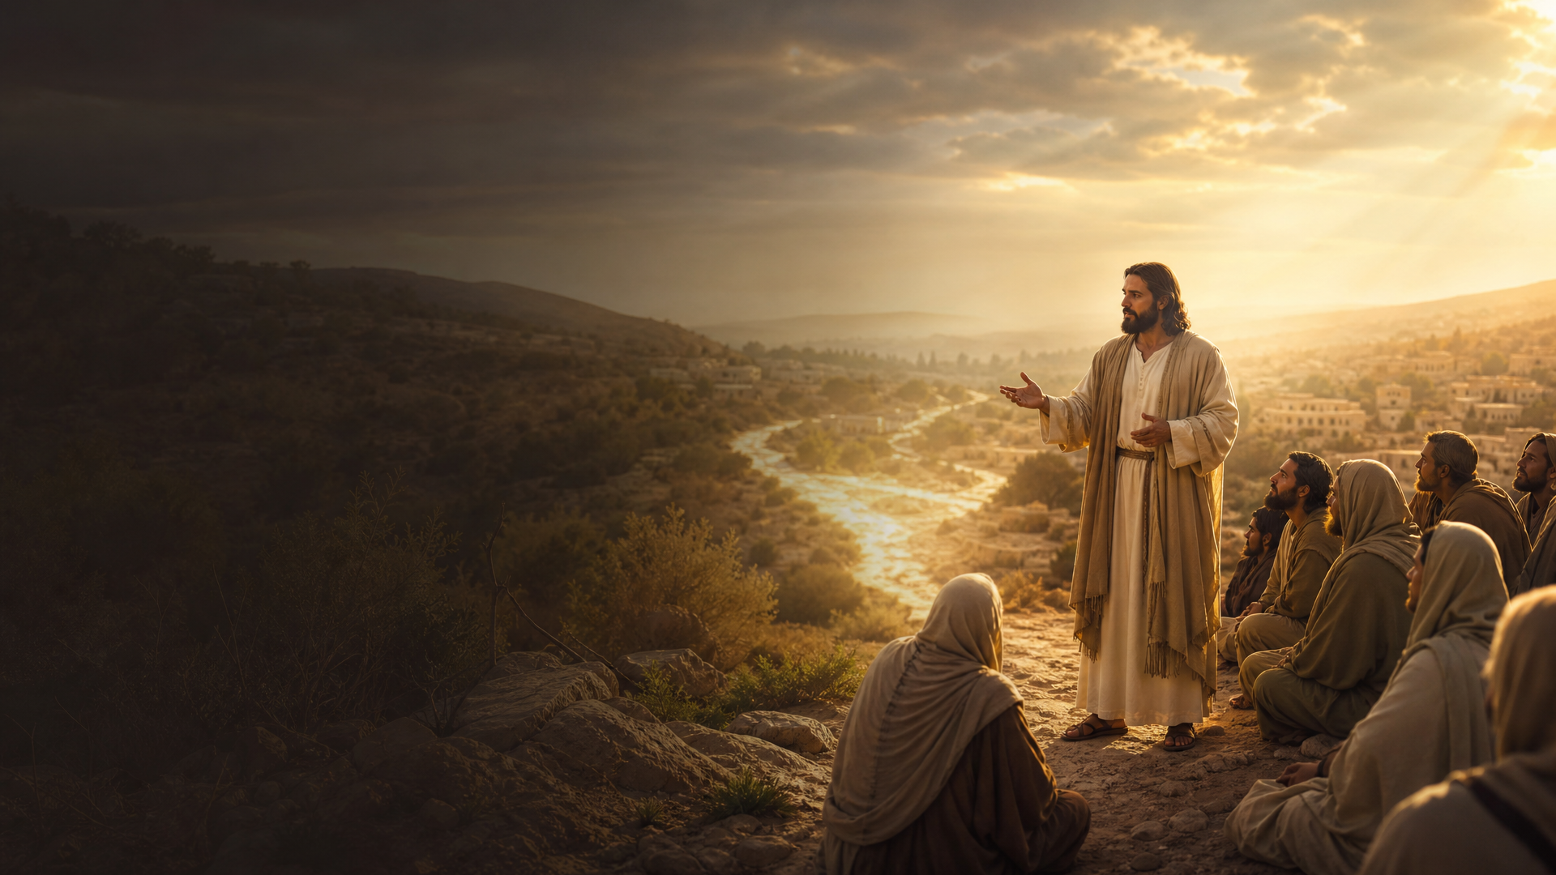
HOLY EUCHARISTIC CELEBRATION
Ika-27 Linggo sa Karaniwang Panahon
“Pakinggan ninyo ang isa pang talinghaga.”
TAON A
OCTOBER 4, 2026
HOLY MASS CELEBRANT:
GOSPEL
(MATEO 21, 33–43)
Divino Gabriel

