Slide 1
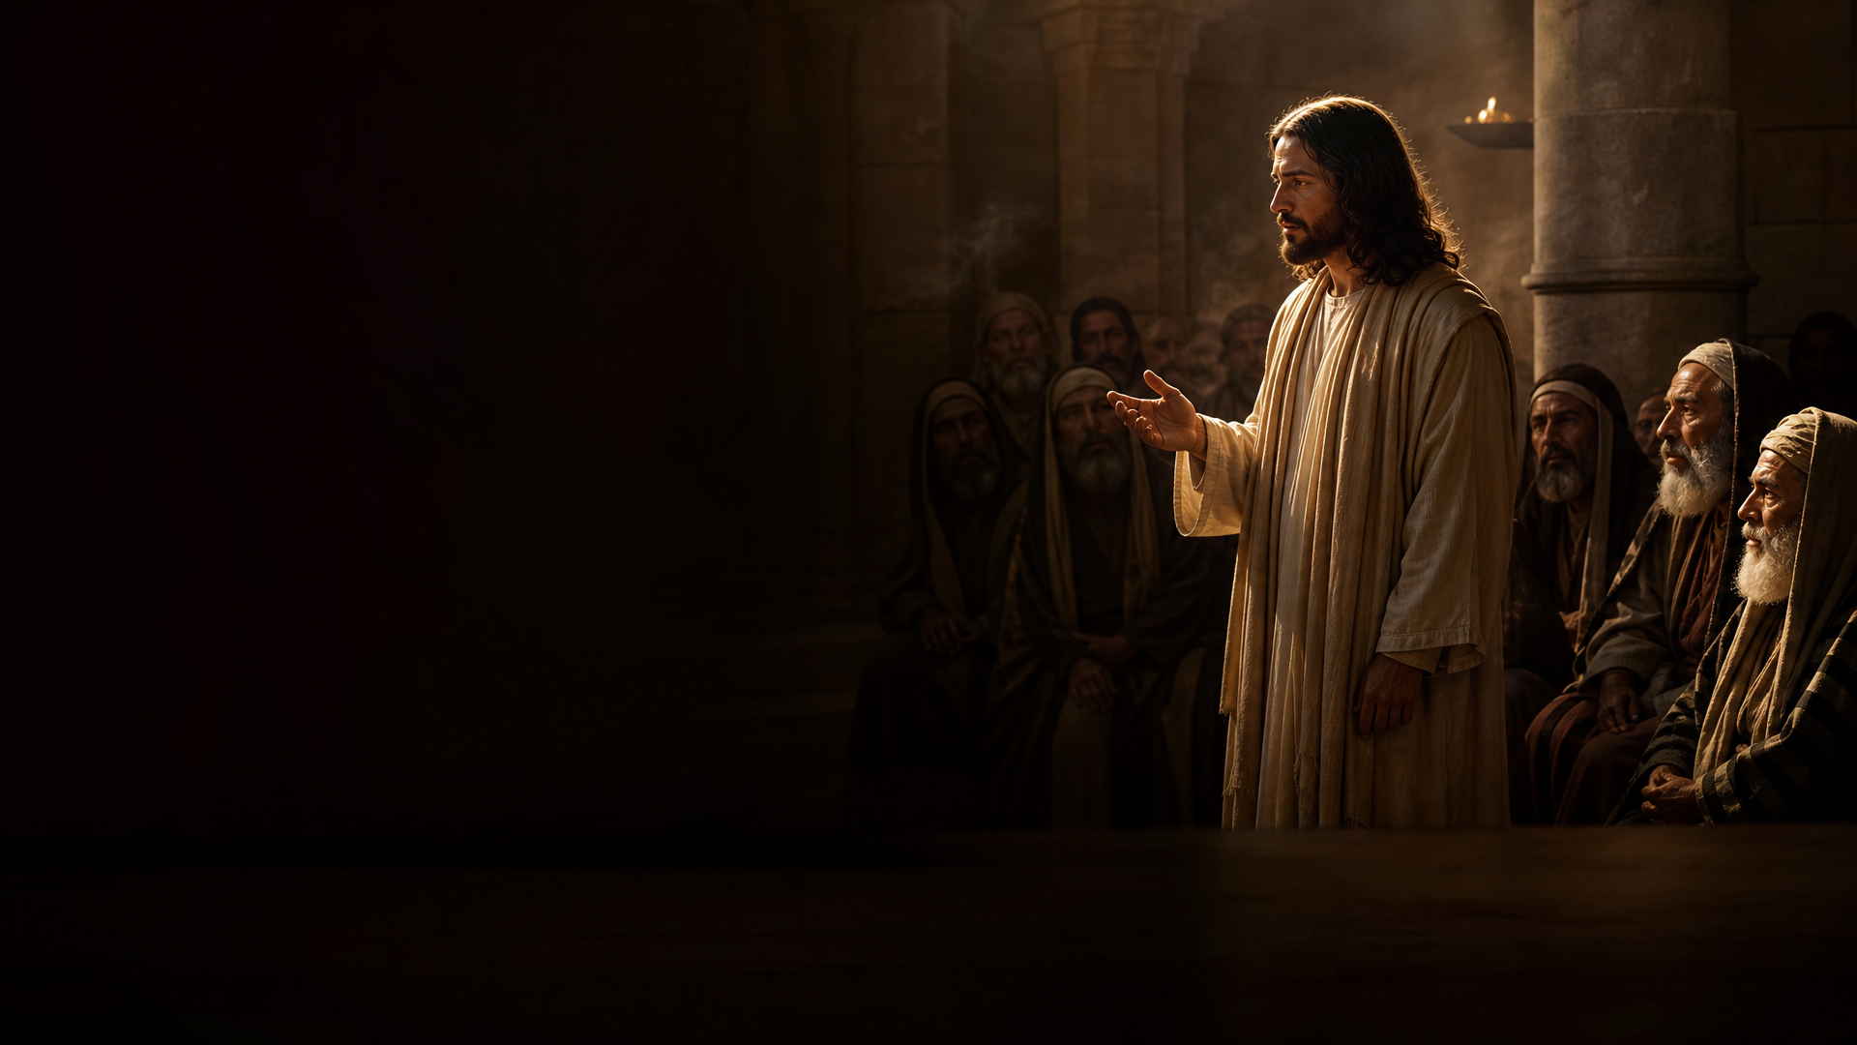
HOLY EUCHARISTIC CELEBRATION
26th Sunday
in Ordinary Time
“He came to the first and said, 'Son, go out and work in the vineyard today.' He said in reply, 'I will not,' but afterwards changed his mind and went.”
YEAR A
SEPTEMBER 27, 2026
HOLY MASS CELEBRANT:
Divino Gabriel
GOSPEL
(MATTHEW 21:28–32)

Slide 2
HOLY EUCHARISTIC CELEBRATION
26th Sunday
in Ordinary Time
“He came to the first and said, 'Son, go out and work in the vineyard today.' He said in reply, 'I will not,' but afterwards changed his mind and went.”
YEAR A
SEPTEMBER 27, 2026
HOLY MASS CELEBRANT:
Divino Gabriel
GOSPEL
(MATTHEW 21:28–32)

