Slide 1
SMART CROP RECOMMENDATION AND OPTIMAL ROUTE FOR MARKET ACCESS
Divinya E N
Hema Malathi R
Rhoda Philips

Slide 2
ABSTRACT
A Crop Recommendation System integrating Long Short-Term Memory (LSTM) and Ant Colony Optimization (ACO) enhances agricultural decision-making by providing data-driven insights for optimal crop selection.
Traditional methods like Support Vector Machine (SVM) offer high prediction accuracy but struggle with dynamic environmental changes.
LSTM captures temporal dependencies in weather patterns and seasonal shifts, improving long-term predictions.
ACO optimizes farm location by analyzing large datasets to identify high-yield regions.
The synergy of LSTM for time-series forecasting and ACO for spatial optimization maximizes productivity, minimizes risks, and enhances profitability, making agriculture more efficient and sustainable.

Slide 3
INTRODUCTION
The crop recommendation project leverages machine learning to assist farmers in selecting the most suitable crops based on soil quality, climate, and market demand.
By analyzing agronomic data, including historical crop performance, weather forecasts, and market trends, the system provides personalized, data-driven recommendations.
This approach enhances productivity, optimizes resource use, and ensures profitability by aligning crop selection with both environmental conditions and economic factors.
Ultimately, the project empowers farmers with actionable insights, making agriculture more efficient, sustainable, and resilient to changing conditions.

Slide 4
DEEP LEARNING
Deep learning is a subset of machine learning that uses artificial neural networks to model complex patterns in data.
It mimics the human brain by using multiple layers of interconnected neurons to process information, making it highly effective for tasks like image recognition, natural language processing, and autonomous decision-making.
Deep learning excels in handling large datasets and extracting meaningful features automatically, enabling breakthroughs in AI applications such as healthcare, finance, and autonomous systems.

Slide 5
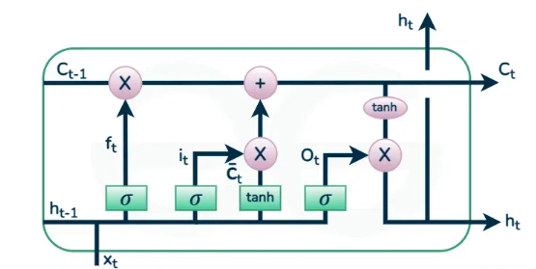
LSTM
Long Short-Term Memory (LSTM) is a type of recurrent neural network (RNN) designed to handle sequential data by capturing long-term dependencies.
Unlike traditional RNNs, LSTM uses gated mechanisms—input, forget, and output gates—to regulate the flow of information, preventing issues like vanishing gradients.
This makes LSTM highly effective for time-series forecasting, speech recognition, and natural language processing, where understanding past context is crucial for accurate predictions.

Slide 6
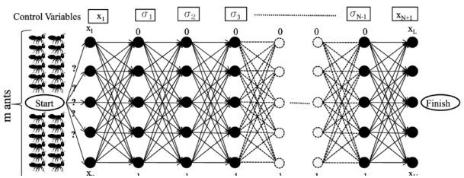
ANT COLONY OPTIMIZATION (ACO)
Ant Colony Optimization (ACO) is a bio-inspired optimization algorithm that mimics the foraging behavior of ants to find optimal solutions to complex problems.
Ants deposit pheromones on paths, reinforcing the shortest and most efficient routes over time.
In computational applications, ACO is used for solving optimization problems like route planning, scheduling, and clustering by iteratively improving solutions based on pheromone updates.
It is widely applied in logistics, network routing, and machine learning for efficient problem-solving.

Slide 7
OBJECTIVE OF THE PROJECT
The objective of this project is to develop an advanced crop recommendation system by integrating Long Short-Term Memory (LSTM) and Ant Colony Optimization (ACO).
LSTM enhances prediction accuracy by analyzing seasonal patterns, soil quality, and weather conditions, while ACO optimizes farmland selection by identifying high-yield regions.
This system empowers farmers with data-driven insights, enabling them to select the best crops and farming locations, ultimately improving agricultural productivity, profitability, and sustainability.

Slide 8
PROBLEM STATEMENT
Traditional crop recommendation methods rely on manual soil analysis, outdated charts, and soil testing kits with limited scope, leading to inaccurate predictions and economic losses for farmers.
Consulting agricultural experts may not always provide real-time, personalized guidance.
The lack of an advanced, data-driven approach in soil analysis and crop prediction highlights the need for an intelligent system that enhances accuracy, optimizes resource use, and improves farming productivity.

Slide 9
EXISTING SYSTEM
The existing crop prediction system relies on traditional methods like soil testing kits, expert consultations, and agricultural guidelines, which often provide generalized and non-real-time insights.
Modern approaches incorporate machine learning algorithms like Support Vector Machine (SVM) and Random Forest (RF) to analyze vast datasets, improving prediction accuracy by considering soil conditions, weather patterns, and historical data.
While these ML techniques enhance decision-making, they still face limitations in capturing long-term trends and dynamic environmental changes, highlighting the need for further advancements in precision agriculture.

Slide 10
PROPOSED SYSTEM
The proposed system combines Long Short-Term Memory (LSTM) and Ant Colony Optimization (ACO) to improve crop recommendation accuracy and farming efficiency.
LSTM analyzes sequential data, capturing long-term dependencies like seasonal patterns and weather trends to provide precise crop predictions.
ACO optimizes farm location selection by identifying high-yield regions based on large datasets.
Together, these algorithms enhance decision-making, maximize productivity, and promote sustainable farming by adapting to dynamic environmental conditions.

Slide 11
LITERATURE SURVEY
SNO | TITLE | AUTHOR | YEAR | AGORITHUM | ABOUT
1 | "Soil Quality Assessment for Crop Recommendation" | Joshi & Gupta | 2022 | Logistic Regression, SVM | Assesses soil quality parameters to recommend suitable crops.
2 | "AI-Powered Crop Suggestion System" | "AI-Powered Crop Suggestion System" | 2020 | Neural Networks, Random Forest | Utilizes AI techniques to enhance crop suggestion accuracy based on regional data.
3 | "Crop Selection Framework Using Remote Sensing" | Kumar et al. | 2023 | CNN, Image Processing Techniques | Develops a framework for crop selection using remote sensing technology.
4 | "Predictive Modelling for Sustainable Agriculture" | Nair & Patel | 2022 | Time Series Analysis, ML | Focuses on predictive modeling for sustainable crop management practices.
5 | "Data-Driven Decision Support System for Crop Management" | Mehta et al. | 2021 | Decision Trees, Clustering | Creates a decision support system for crop management using data analytics.

Slide 12
LITERATURE SURVEY
SNO | TITLE | AUTHOR | YEAR | AGORITHUM | ABOUT
6 | "Data-Driven Crop Recommendation System" | Choudhary et al. | 2020 | Logistic Regression, PCA | Develops a system based on data analytics to suggest crops based on conditions.
7 | "Crop Suggestion System Based on Soil and Climate" | Das & Kumar | 2021 | Fuzzy Logic, Genetic Algorithm | Combines soil and climatic parameters for effective crop suggestions.
8 | "Optimizing Crop Selection Using AI Techniques" | Singh et al. | 2023 | Q-learning, Decision Trees | Utilizes AI algorithms to optimize crop selection for different regions.
9 | "Machine Learning Approaches for Crop Suggestion" | Joshi & Mehta | 2020 | Random Forest, SVM | Explores various ML models for effective crop suggestion systems.
10 | "Integrated Crop Recommendation Using Big Data" | Sharma et al. | 2023 | Big Data Analytics, K-Means | Leverages big data analytics to enhance crop recommendation accuracy.

Slide 13
SYSTEM REQUIREMENT
HARDWARE REQUIREMENT
Processor : Intel(R) core(TM) i5-10th GEN (or above)
Ram: 4 GB (or above)
Processor speed: 2 GHz
Hard disk: 256 GB SSD (or above)
SOFTWARE REQUIREMENT:
Operating System: Windows 10 and above
Coding language: Python 3.7 and above
Front End: HTML, CSS, JavaScript
Back End: Sql lite
Tensor flow
Keras

Slide 14
MODULES USED
Data Collection from Kaggle Open Source:
The first step in building a crop recommendation system is gathering datasets from Kaggle, which provide essential agricultural data such as soil quality, climate conditions, crop yields, and environmental factors. These datasets help the model learn patterns and improve prediction accuracy.
Pre-Processing:
Raw data is cleaned by handling missing values, normalizing numerical variables, and encoding categorical features. Time-series data is structured to maintain chronological order, ensuring that LSTM models can effectively learn temporal dependencies.

Slide 15
MODULES USED
Feature Extraction:
Key features such as soil pH, nutrient levels, rainfall, and temperature are selected to improve prediction accuracy. Temporal features like seasonal trends and year-on-year variations are extracted to enhance the LSTM model’s ability to detect long-term dependencies.
Model Creation Using LSTM:
An LSTM-based model is built to analyze sequential data and predict crop suitability based on historical trends. The architecture includes input layers for environmental factors, LSTM layers for learning dependencies, and an output layer for crop recommendations.

Slide 16
MODULES USED
Test Data:
After training, the model is tested on unseen data to evaluate its performance using metrics like Mean Absolute Error (MAE) and Root Mean Squared Error (RMSE). This ensures the model generalizes well to real-world scenarios.
Prediction:
The trained model predicts the best crops to grow based on new soil and climate data. These predictions help farmers make data-driven decisions, reducing risks and optimizing yields by considering real-time conditions.

Slide 17
MODULES USED
Recommendation Using ACO:
Ant Colony Optimization (ACO) identifies the most profitable farming locations by simulating the foraging behavior of ants. It helps find high-yield regions based on soil quality, climate, and historical yield data, complementing LSTM predictions for better decision-making.

Slide 18
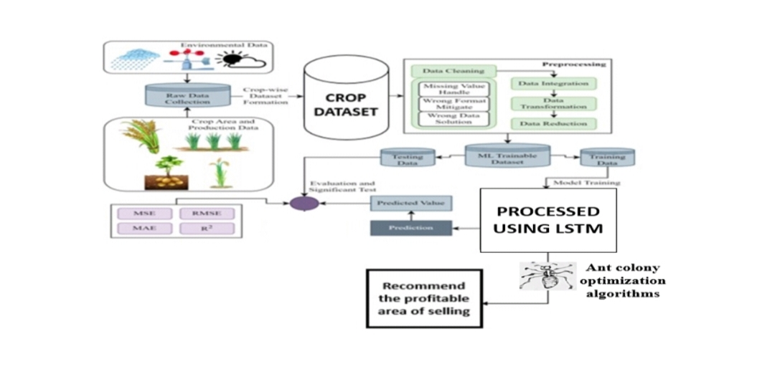

Slide 19
CONCLUSION
In conclusion, The proposed system integrates LSTM for accurate crop predictions and ACO for optimal farming location selection, enhancing agricultural decision-making.
By analyzing soil quality, climate, and historical data, LSTM captures long-term dependencies, while ACO optimizes land selection for maximum yield.
This AI-driven approach helps farmers make data-driven decisions, improving productivity, profitability, and sustainability in agriculture.

Slide 20
REFERENCES
1.Durai SKS. Shamil MD. Smart farming using machine learning and deep learning techniques. Decis Anal J. 2022:3: 100041
2. Sharma P. Dadheech P, Senthil ASK. Al-enabled crop recommendation system based on soil and weather patterns. In: Artificial Intelligence Tools and Technologies for Smart Farming and Agriculture Practices, pp. 184-199. IGI Global, 2023.
3. Elavarasan D. Vincent PD. Crop yield prediction using deep reinforcement learning model for sustainable Agrarian applications. IEEE Access 20208 86886-901
4. Cai Y, Guan K, Peng J, Wang S. Seifert C, Wardłow B, Li Z. A high-performance and in-season classification system of field-level crop types using time-series Landsat data and a machine learning approach. Remote Sens Environ. 2018,210:35-47
5. Ed-daoudi R. Alaoui A, Ettaki B, Zerouaoui J. A predictive approach to improving agricultural productivity in morocco through crop recommendations. Int J Adv Comput Sci Appl 2023:14(3)

