Slide 1
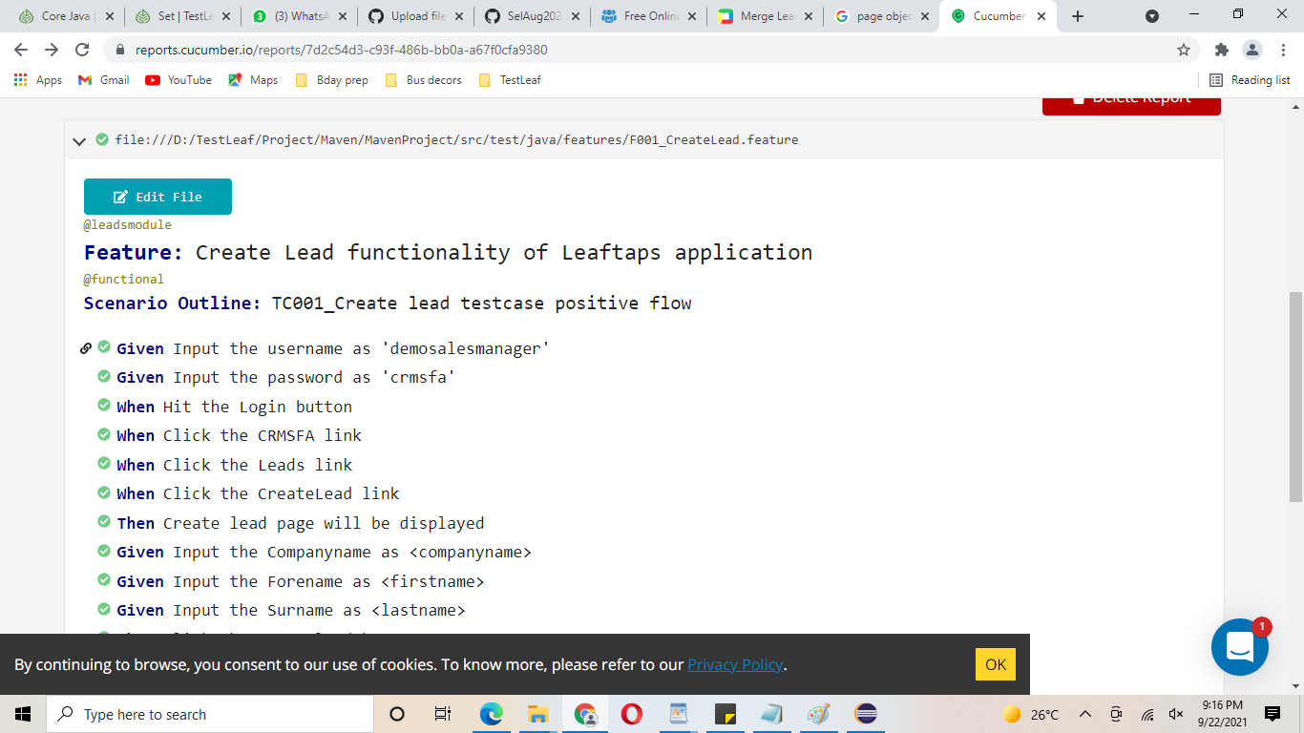
Leads module – Leaftaps – cucumber reports - https://reports.cucumber.io/reports/7d2c54d3-c93f-486b-bb0a-a67f0cfa9380

Slide 2
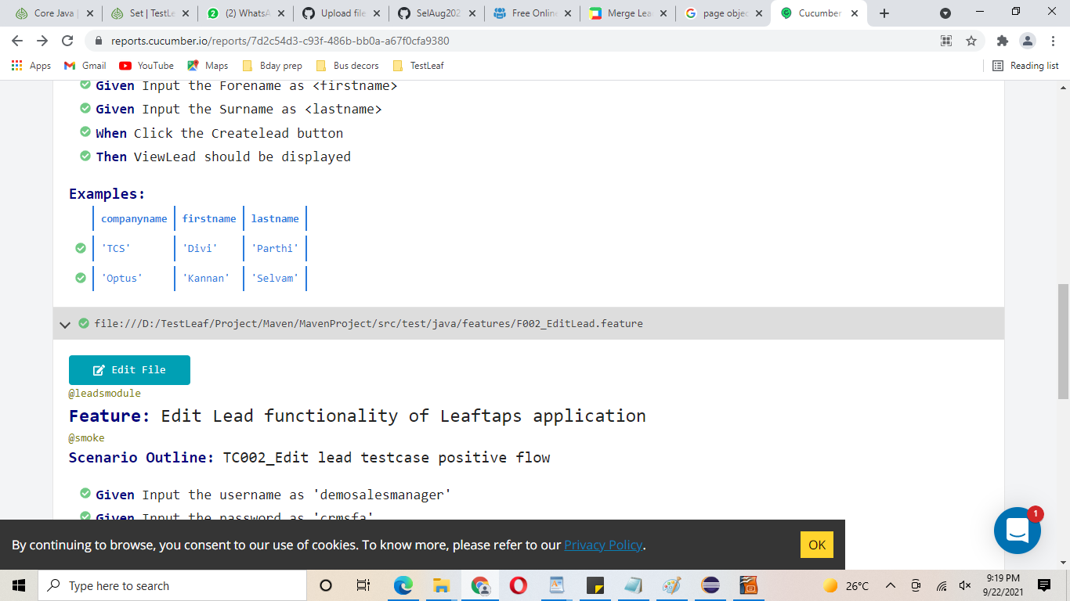

Slide 3
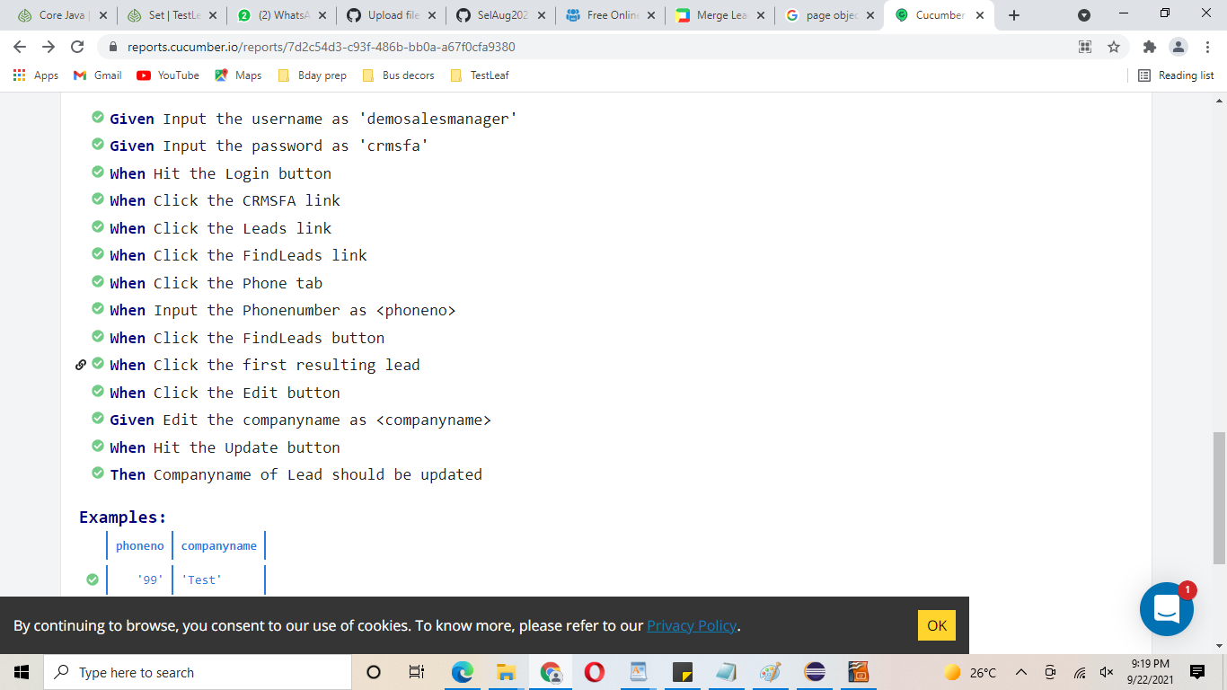

Slide 4
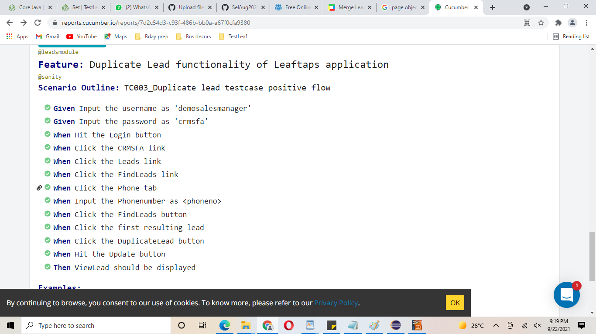

Slide 5
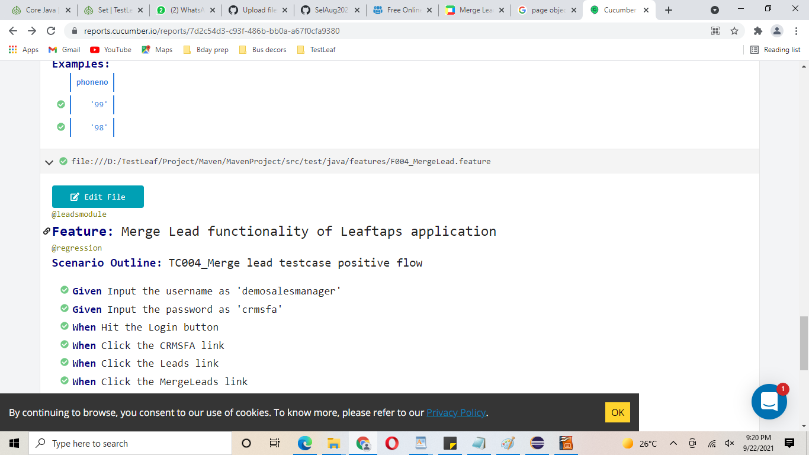

Slide 6
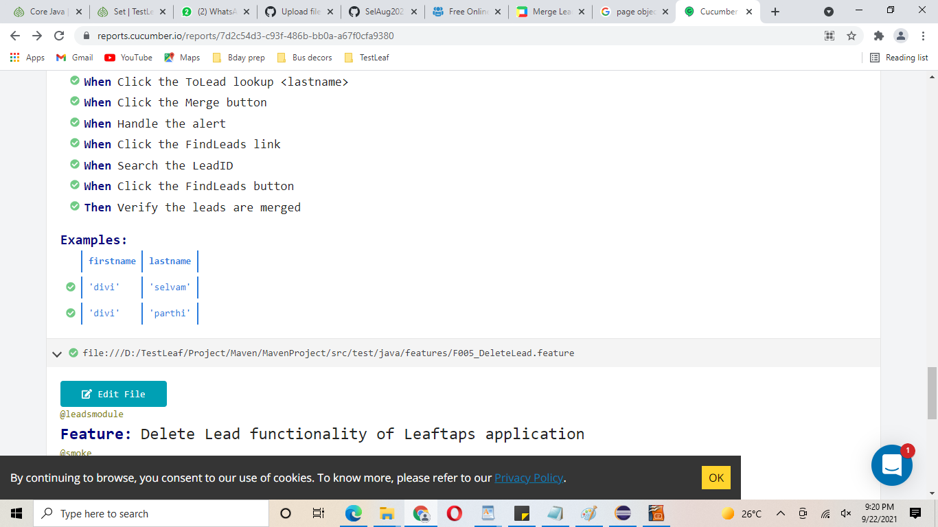

Slide 7
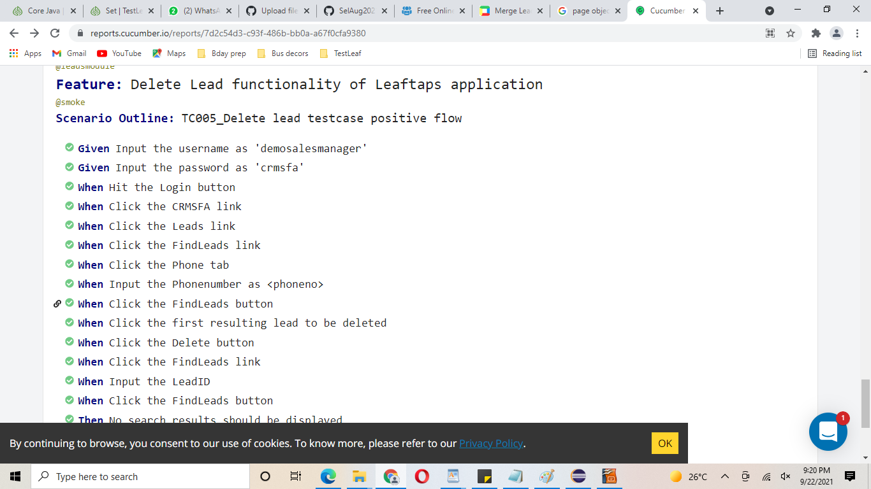

Slide 8
