Slide 1
DATA ANALYSIS ON ELITE EDUCATION CENTER ALY 6070 - Communication and Visualization for Data Analytics
PRESENTED BY: SUBMITTED TO:
DIVISHA CHOUDAVARAM PROF. HEMA SHESHADRI
NEETHU GOTTIPATI
RIDDHISHA CHITWADGI

Slide 2
OUR TEAM
Divisha Choudavaram
Masters in Analytics.
Concentration: Applied Machine Intelligence.
Graduated with a degree in Computer Science and Engineering in 2020.
Neethu Gottipati
Masters in Analytics.
Concentration: Applied Machine Intelligence.
Graduated with a degree in Computer Science and Engineering in 2022
Riddhisha Chitwadgi
Masters in Analytics.
Concentration: Applied Machine Intelligence.
Graduated with a degree in Industrial engineering and management in 2022.

Slide 3

BUSINESS OBJECTIVE
Our aim at "Elite Education Center" is to offer a diverse and individualized education that equips our students for academic achievement in higher education and beyond.
To fully comprehend each student's individual requirements, interests, and objectives, our committed teachers and staff work closely with them.
Our coursework is created to provide students with a demanding education and to get them ready for the SAT and AP tests.

Slide 4
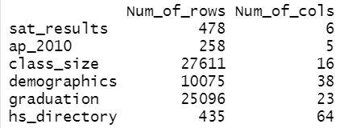
DATASET
The datasets used in this project are taken from the New York City Department of Education. They are stored in the following six files:
sat_results.csv: Data on Scholastic Aptitude Test (SAT) scores.
ap_2010.csv - Data on Advanced Placement (AP) test results. AP tests are taken by advanced high school students.
class_size.csv: Data on average school class size by grade and program type.
demographics.csv: Data on demographics of NYC school students, including race and sex.
graduation.csv: Data on graduation outcomes for cohorts, including percentages of students who graduated or dropped out of school.
hs_directory.csv: A directory of high schools that contains location information for each school.
PRE-PROCESSING

Slide 5
PRE-PROCESSING
Added three SAT section scores.
Changed the SAT section scores data from character datatype to
numeric.
Changed the AP data from character datatype to numeric.
Only the data where the GRADE variable has the value of "09-12" — grades that are regarded as being a component of high schools in the U.S.
Added a DBN variable to the class size data frame, which is used as a key to join other data frames.
The percentage values in the Total Grads - % of the cohort and Dropped Out - % of the cohort are formatted as character strings in Graduation Data.
Removed Duplicates before combining the datasets.
After combining removed the null values.
Exploratory Data Analysis

Slide 6

COMBINED DATASET

Slide 7
Data Analysis
Major focus – Analysis of the impact of NYC high schools’ demographics on students’ SAT results and competitors.
KPI’s –
Relation between Race and SAT results.
Relation between socioeconomic conditions and SAT results.
Relation between total enrollment and SAT results.
Relation between gender and SAT results.
Relation between Borough and SAT results.
Relation between Competitors, SAT results, and Total enrollment.

Slide 8
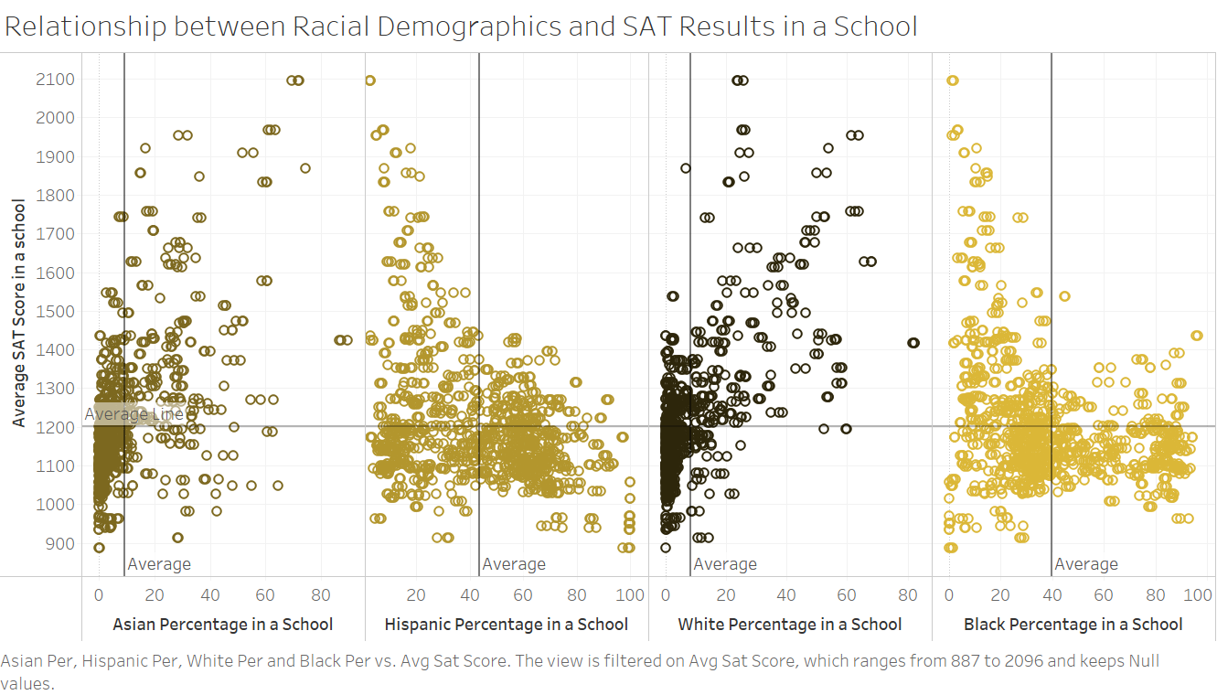

Relation between racial demographics and SAT results.
The proportions of Asian and White students have a positive correlation with average SAT scores, whereas the proportions of Hispanic and Black students have a negative correlation.

Slide 9
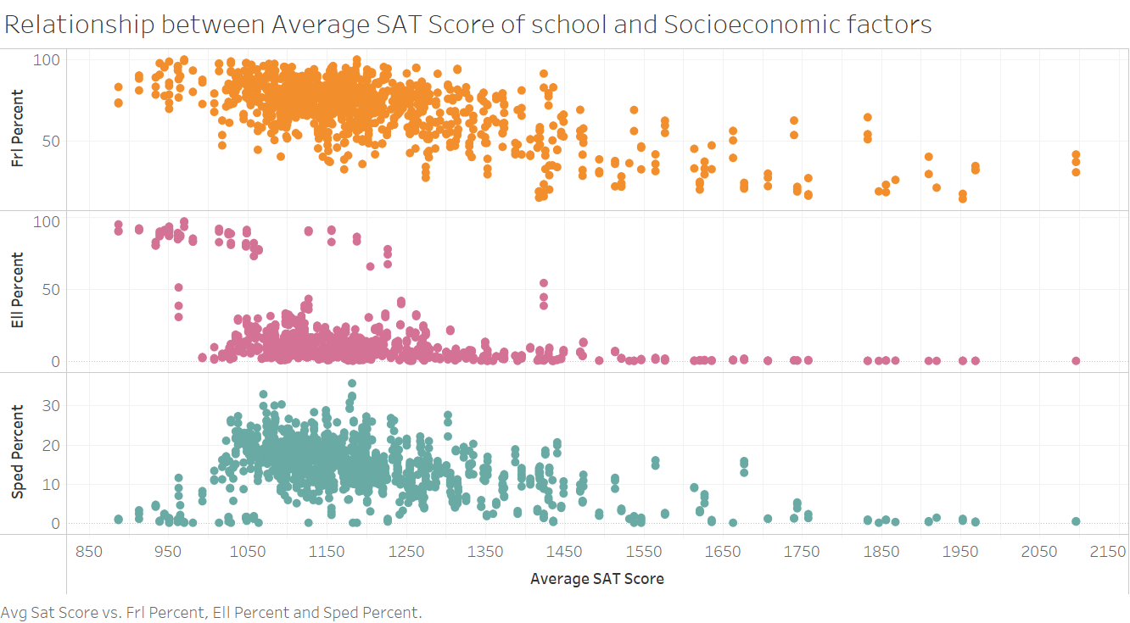
Relation between socioeconomic factors and SAT results
The average SAT score drops when the percentage of socioeconomic variables is large.

Slide 10
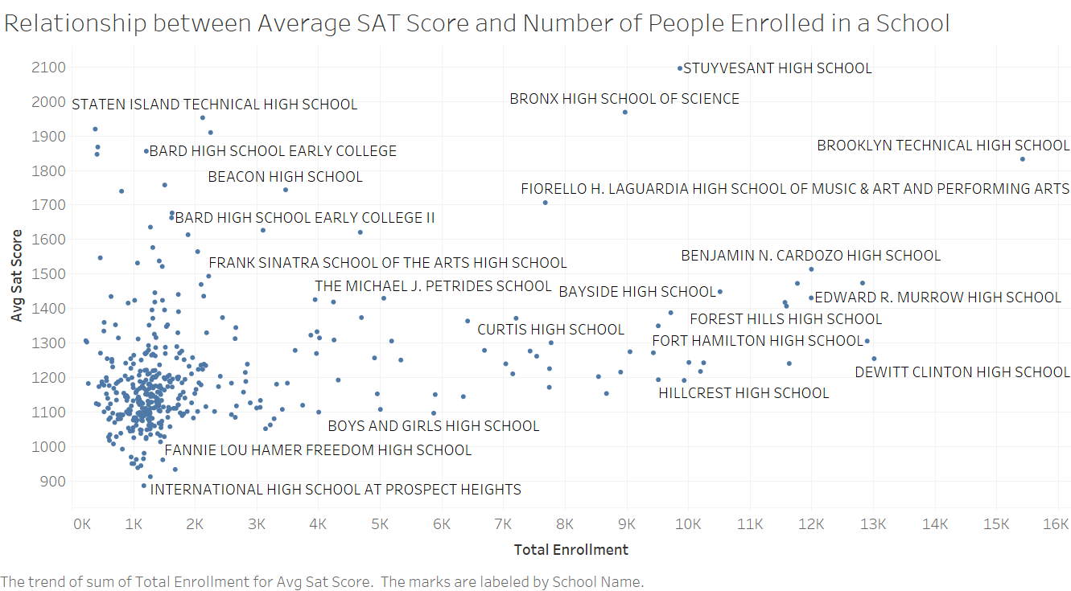
Relation between Total Enrollment and SAT results.
Average SAT score and the Total Number of people enrolled in a school are positively correlated.

Slide 11
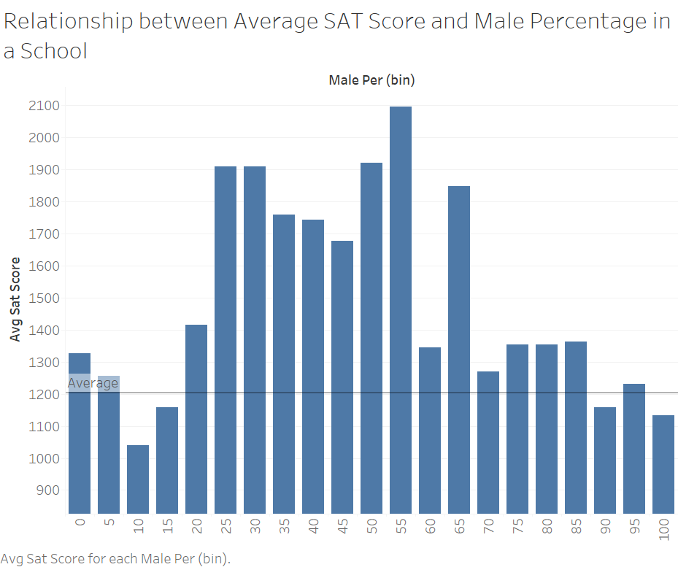
Relation between Gender and SAT results
The average SAT scores drop when the proportion of male students in a school is either noticeably high or low.

Slide 12
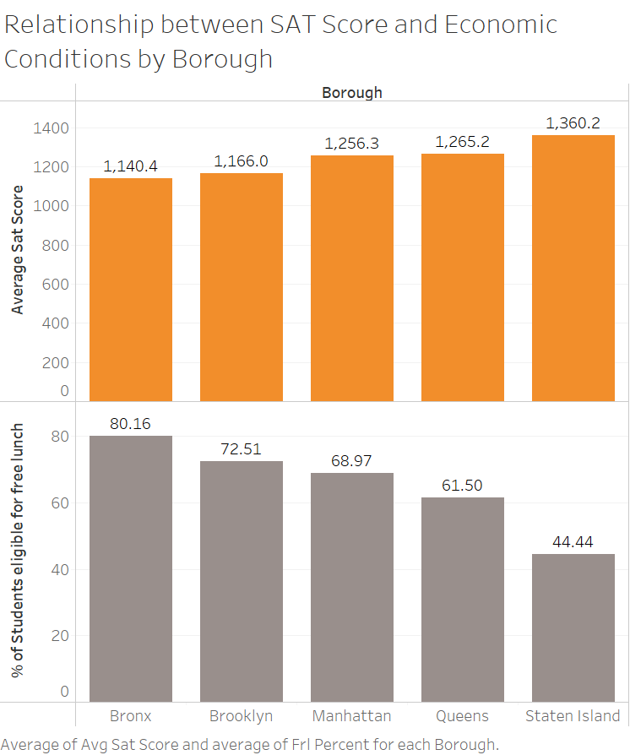
Relation between Economic conditions, Borough, and SAT results
Bronx's low average SAT score correlates with low economic conditions, as seen in the high percentage of students eligible for free lunch.

Slide 13
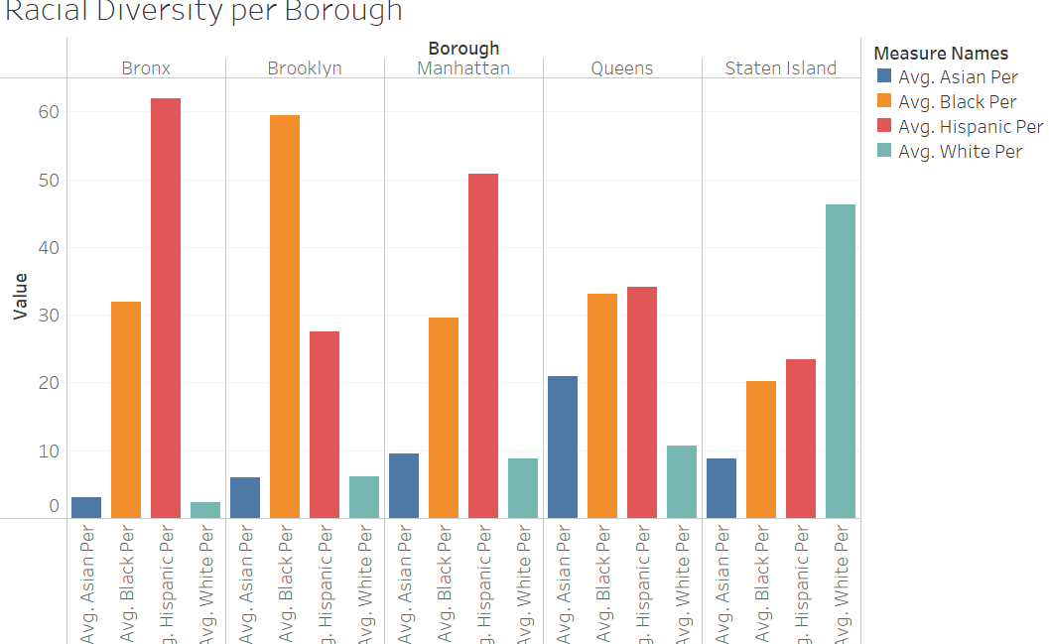
Relation between Racial diversity and Borough
The Bronx and Staten Island's average SAT scores are inversely proportional to the percentage of Hispanic students, with the Bronx having the highest and Staten Island having the lowest.

Slide 14
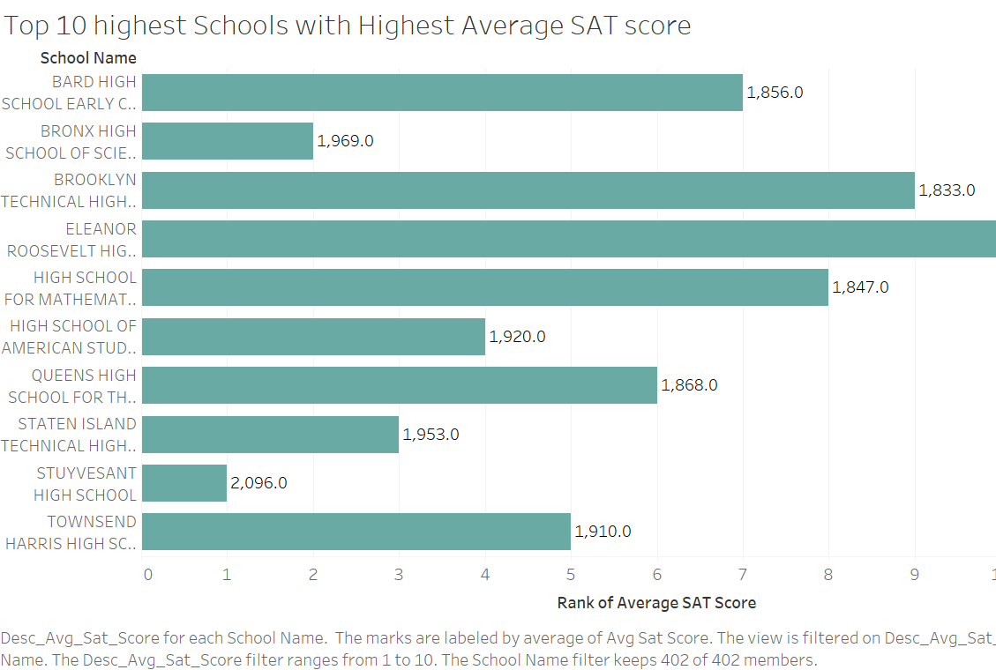
Top 10 Schools with Highest Average SAT score
The highest average SAT score is at Stuyvesant High School.

Slide 15
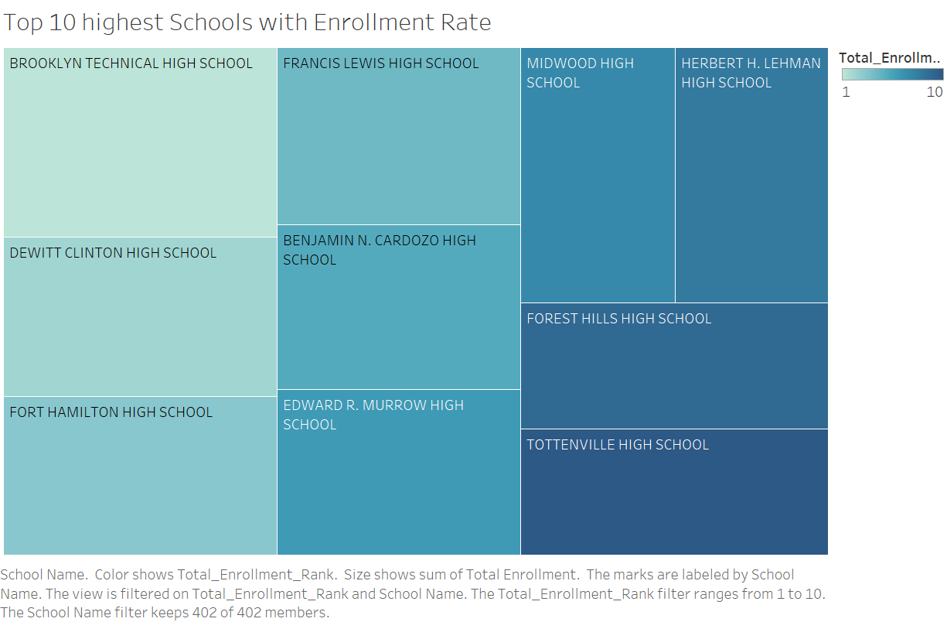
Top 10 schools with enrollment rate
Brooklyn Technical High school has the highest enrollment rate.

Slide 16
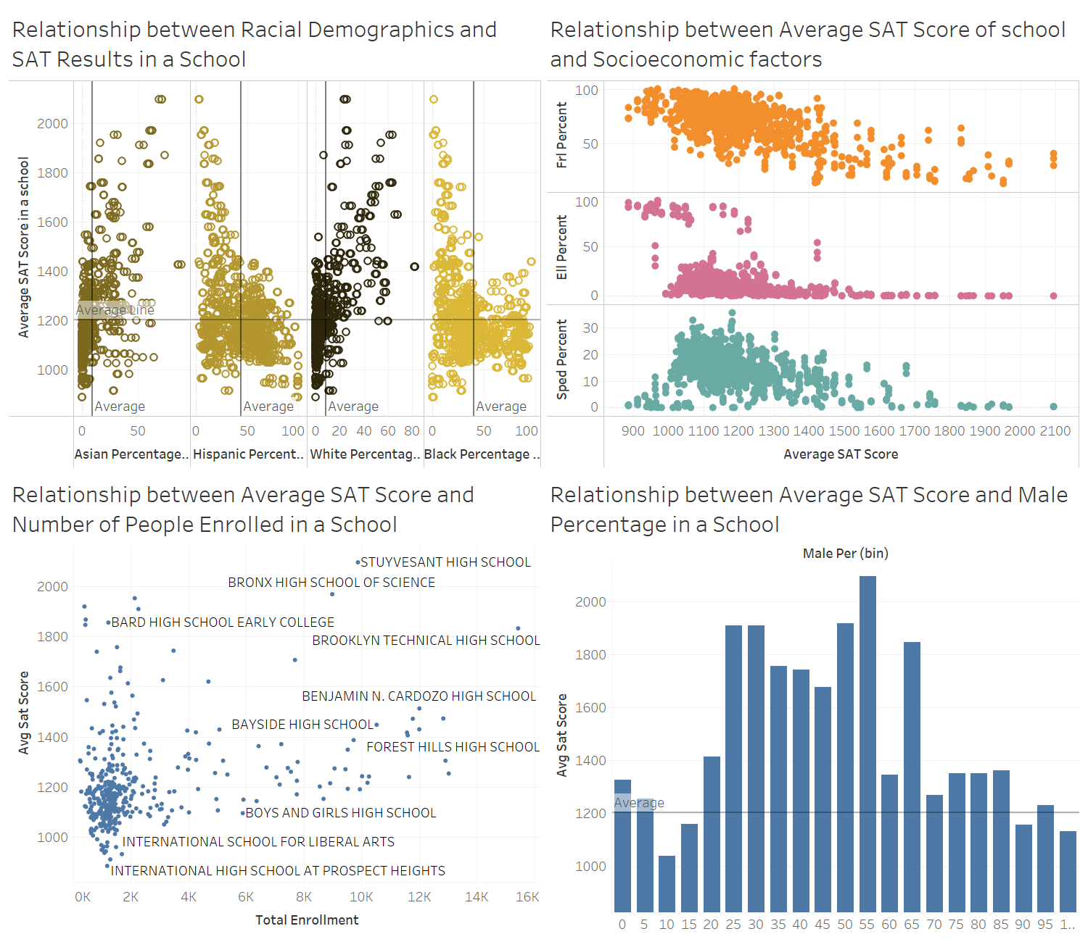
Dashboard 1 – SAT result Analysis
SAT scores are positively correlated with Asian and White students, negatively correlated with Hispanic and Black students, negatively correlated with students from low-income homes, and positively correlated with overall enrollment and student population diversity.

Slide 17
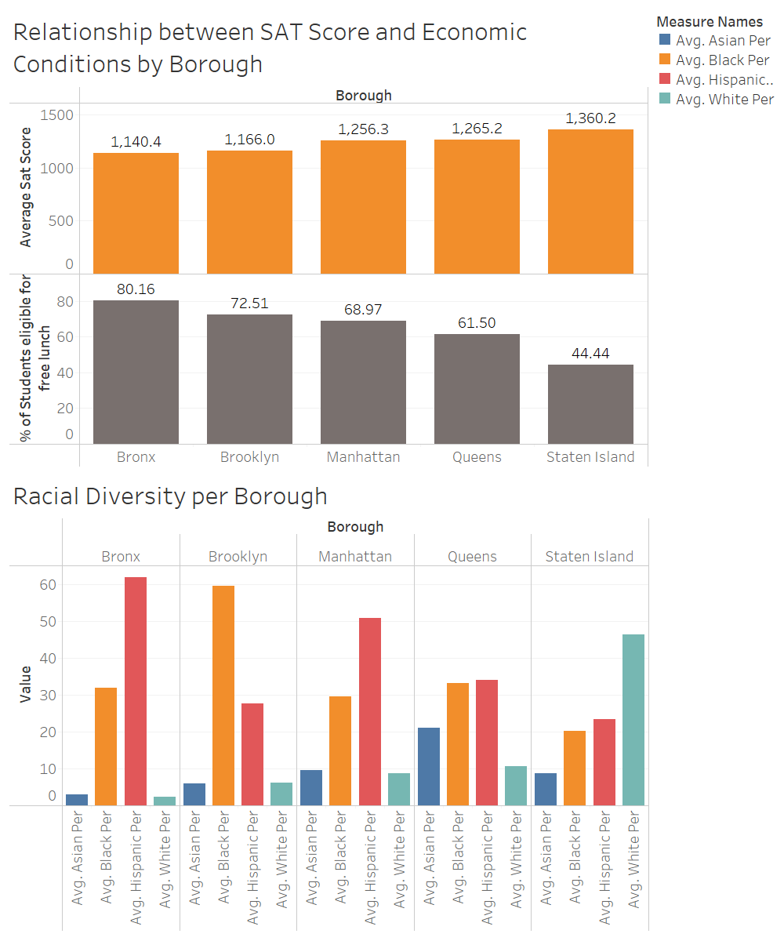
Dashboard 2 - SAT performance and Borough Demographics
Bronx is having the lowest Average SAT scores and low economic conditions.

Slide 18
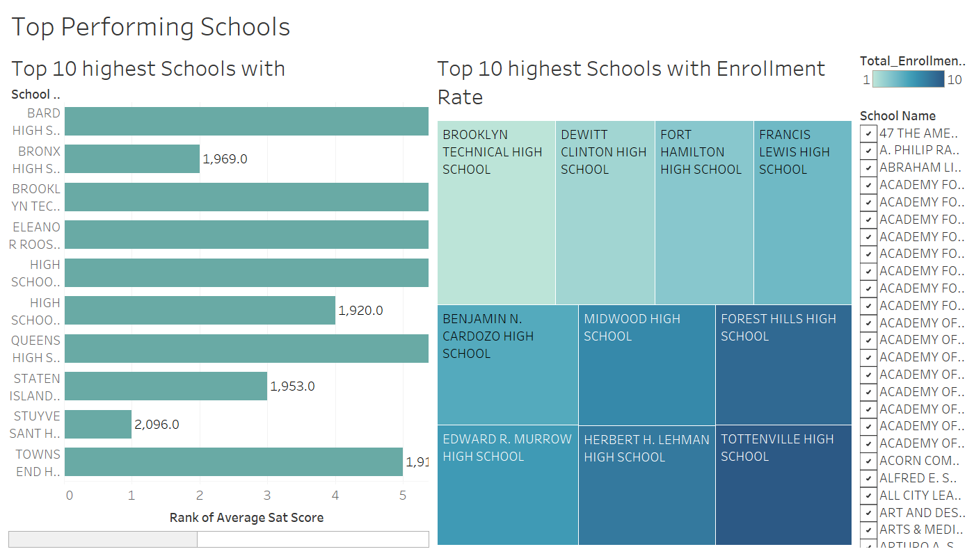
Dashboard 3 - Top Performing Schools
Brooklyn Technical school is the main competitor with high average SAT scores and high enrollment rates.

Slide 19
CONCLUSION
Correlations between race suggest that systemic barriers are preventing these students from achieving their full potential.
Poor economic conditions can have a significant impact on a student's ability to succeed in SAT exam.
Schools with higher diversity tend to have higher SAT scores.

Slide 20
THANK YOU!

