Slide 1

Elite Education Centre- Success Story Instructor: Hema Seshadri
Submitted by:
Neethu Gottipati
Riddhisha Chitwadgi
Divisha Choudavaram

Slide 2
OUR TEAM
Divisha Choudavaram
Masters in Analytics.
Concentration: Applied Machine Intelligence.
Graduated with a degree in Computer Science and Engineering in 2020.
Neethu Gottipati
Masters in Analytics.
Concentration: Applied Machine Intelligence.
Graduated with a degree in Computer Science and Engineering in 2022
Riddhisha Chitwadgi
Masters in Analytics.
Concentration: Applied Machine Intelligence.
Graduated with a degree in Industrial engineering and management in 2022.

Slide 3
BUSINESS STATEMENT
At Elite Education Center, we strive to provide a personalized and diverse education that prepares our students for success in higher education and beyond. Our dedicated teachers and staff work closely with each student to understand their unique needs, interests, and goals. Our curriculum is designed to challenge students and prepare them for the SAT and AP exams. Our goal is to equip our students with the skills and knowledge necessary for academic achievement.

Slide 4
BUSINESS OBJECTIVES
Improve the academic performance of students in higher education and beyond.
Foster close teacher-student relationships to understand individual needs.
Develop rigorous coursework to prepare students for SAT and AP tests.
Expand course offerings to provide a diverse educational experience.
Continuously assess and evaluate student progress to ensure academic success.
Maintain a high standard of education and commitment from teachers and staff.
Increase student enrollment by offering customized education.

Slide 5
DATA ANALYSIS
Enrollment Analysis
Academic Performance Analysis
Diversity Analysis
Student Progress Analysis
Competitor Analysis
Market Analysis

Slide 6
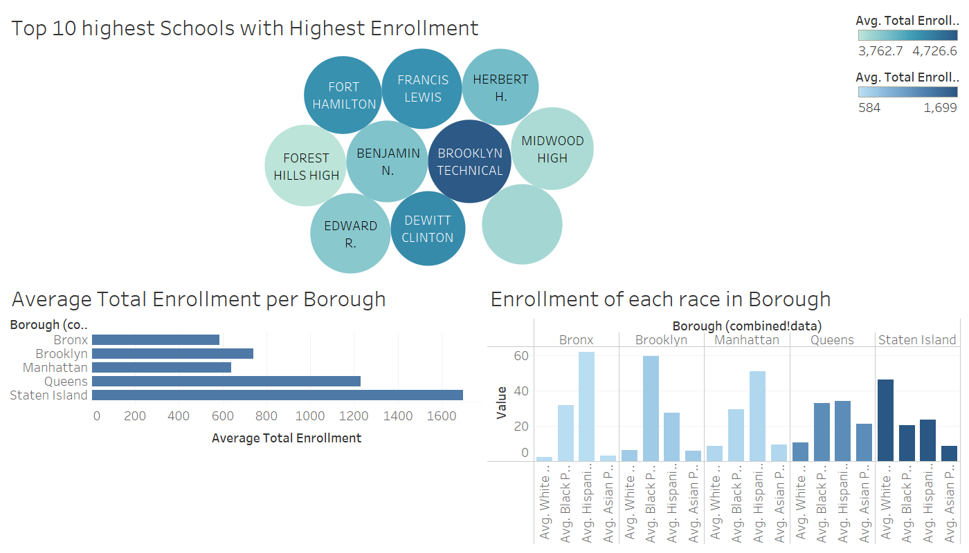
ENROLLMENT ANALYSIS
Determining target audience by analyzing enrolment rates based on racial demographics and boroughs.

Slide 7
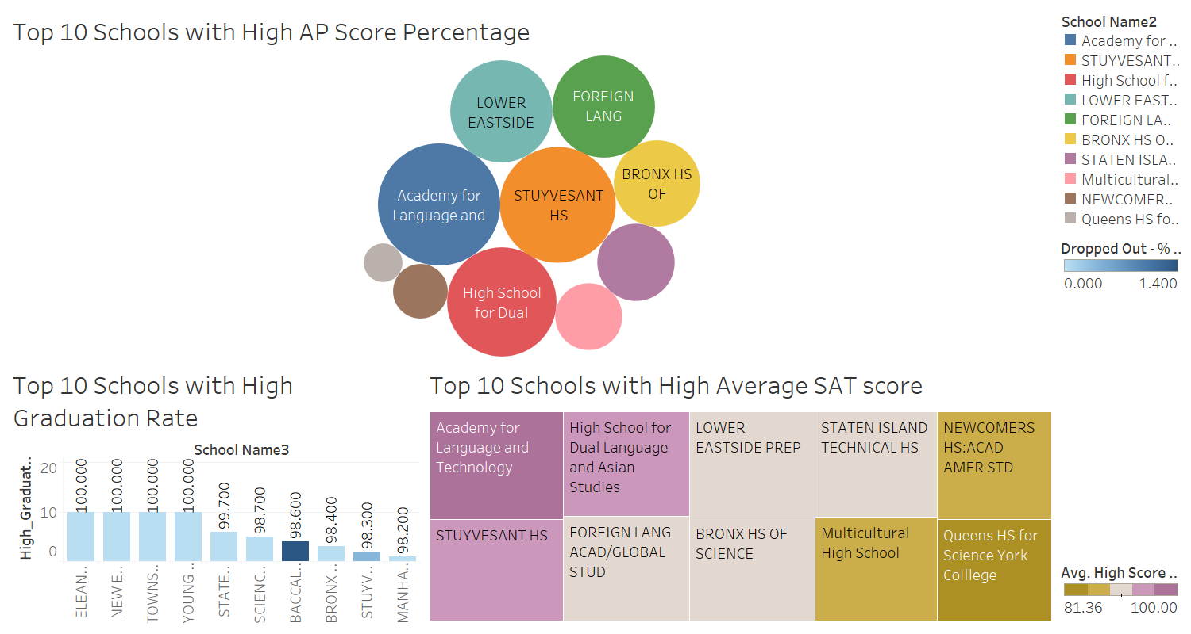
COMPETITOR ANALYSIS
Identifying top 10 competitors based on AP scores, SAT scores, and graduation rate.

Slide 8
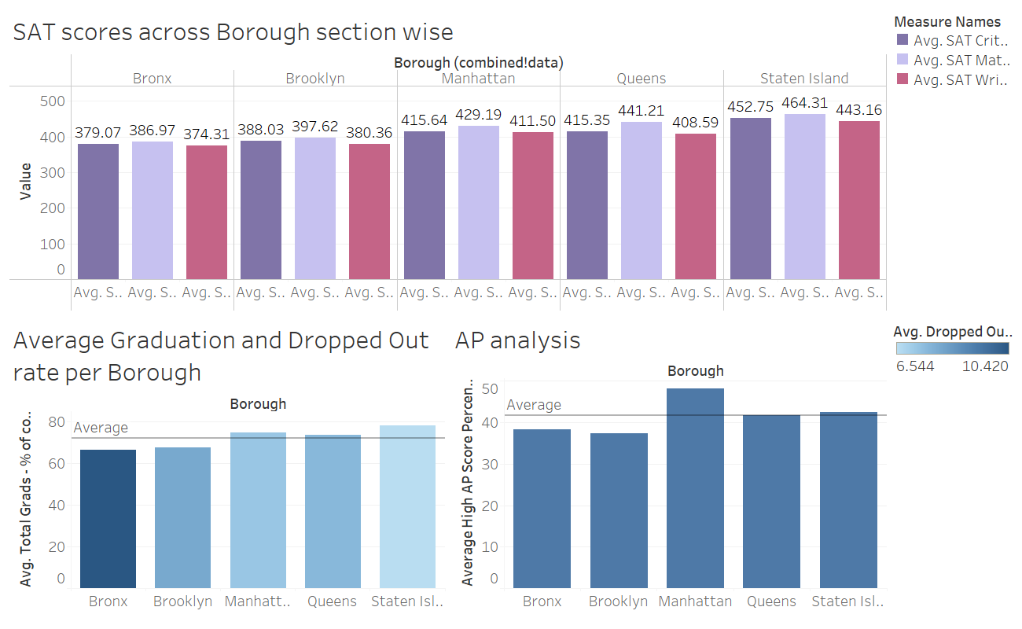
PERFORMANCE ANALYSIS
Analyzing performance based on sectional SAT scores, average graduation and dropout rates.

Slide 9
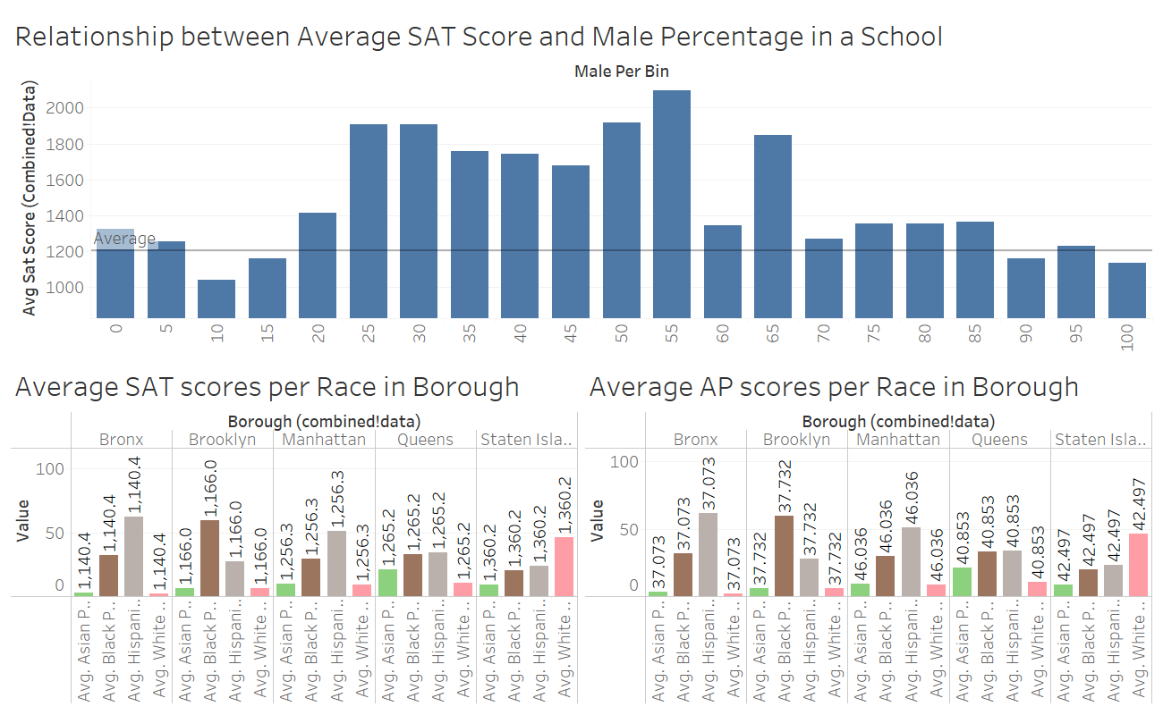
DIVERSITY ANALYSIS
Diversity analysis based on gender and racial demographics in each borough.

Slide 10
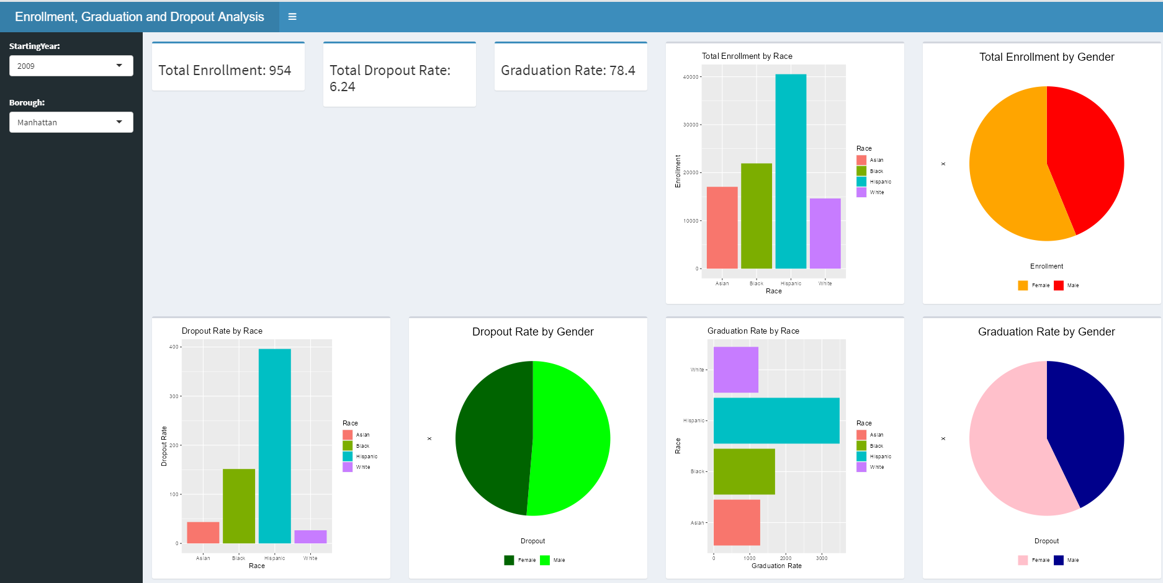
Enrollment, graduation and dropout analysis

Slide 11
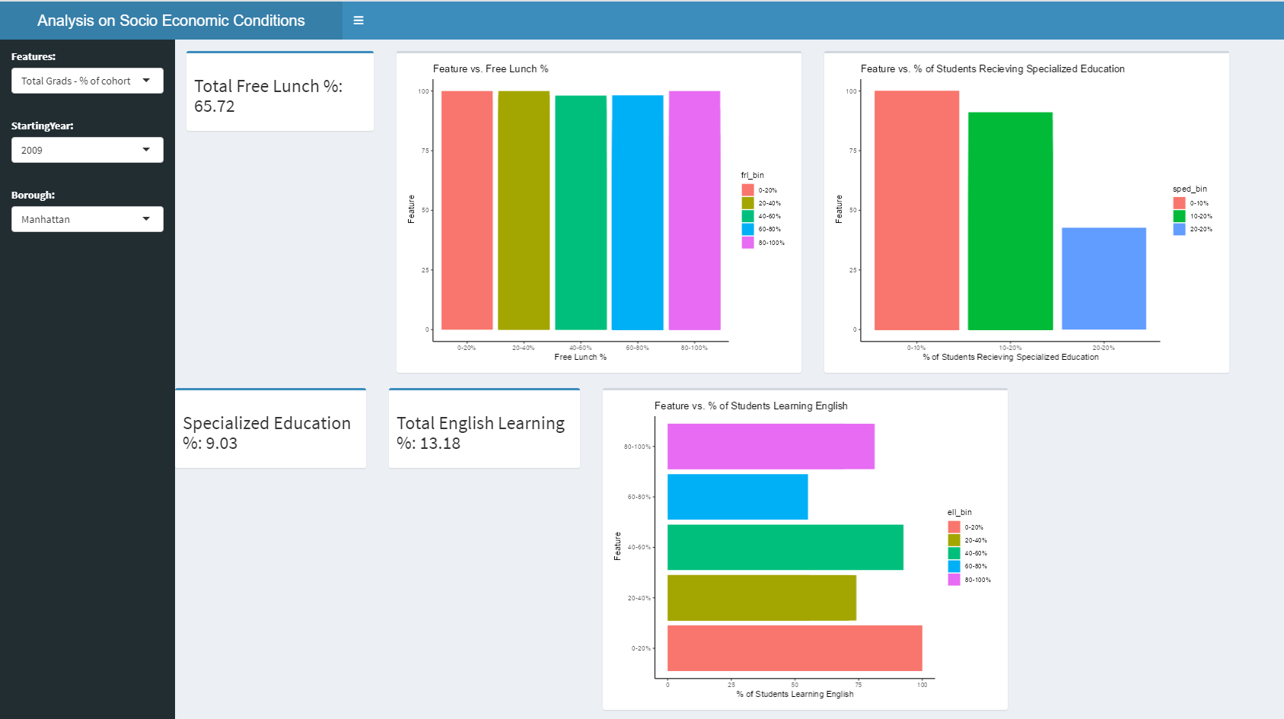

Slide 12
THANKYOU!

