Slide 1
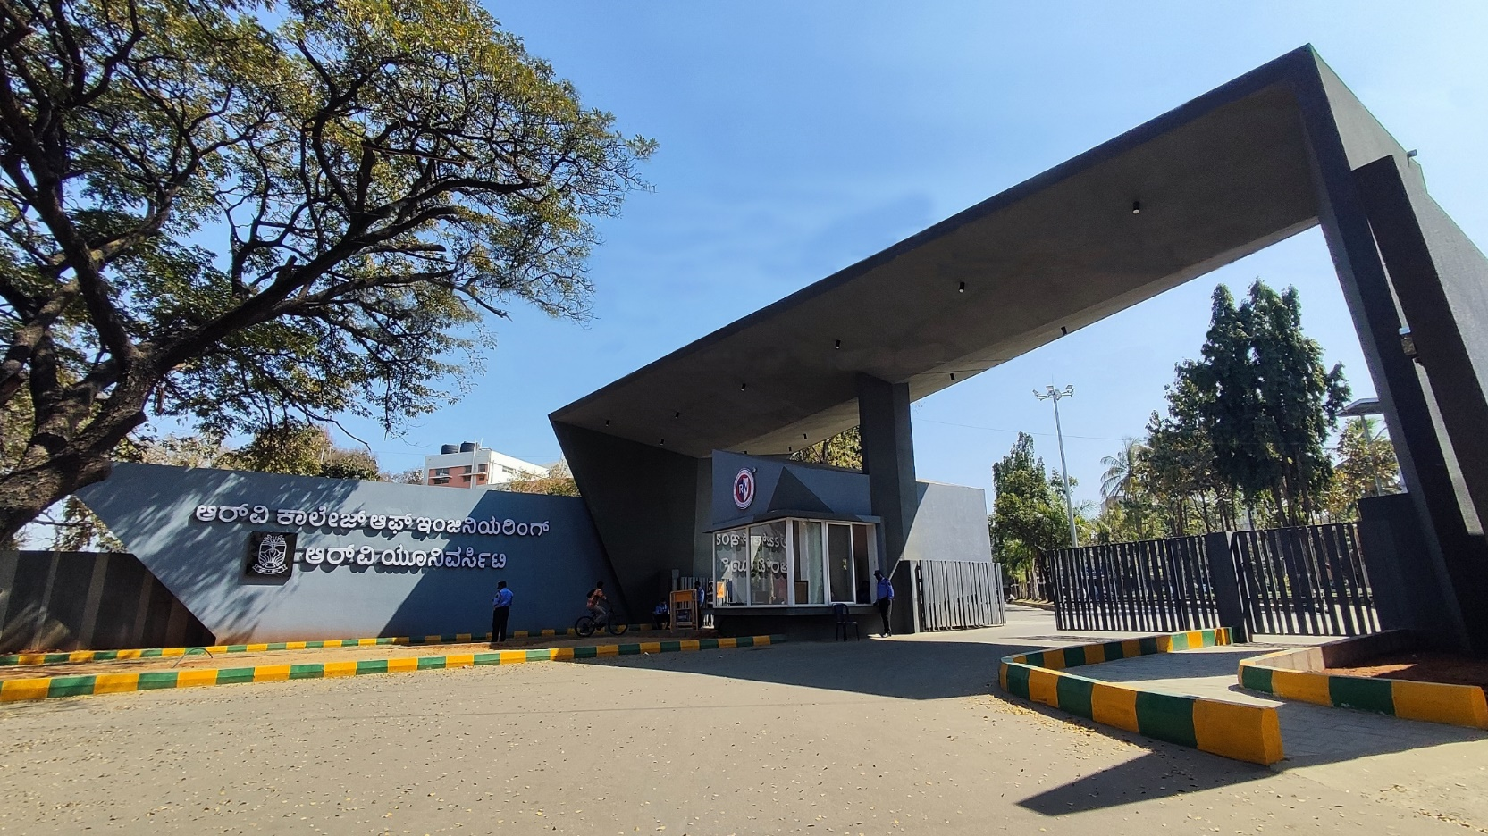
Library Management System implemented using emu8086

Slide 2
Presentation Outline
Introduction
Problem Statement
Objectives
Literature Review
Methodology
Design and Implementation
Results/Simulation
Future Scope
Conclusion
References

Slide 3
Introduction
Library management is a fundamental requirement in education institutions and data driven environments
Traditional manual systems are inefficient, difficult to scale and prone to record inconsistencies
Most existing implementations rely on high-level languages, offering limited visibility into processor-level memory operations
This project implements a menu-driven Library Management System using 8086 Assembly Language
Parallel in-memory array structures are used to manage student records, book inventories and issue logs efficiently
Base-indexed addressing and pointer arithmetic ensure safe memory handling in a 16-bit real-mode environment
The system supports authentication, signup approval, book issuing/return, inventory tracking and deadline simulation

Slide 4
Problem Statement
Library management is an essential institutional process, yet manual systems and basic digital solutions often lead to inefficient record handling, weak access control, and data inconsistencies. High-level implementations abstract internal memory operations, limiting understanding of low-level system behavior. Designing a secure and efficient library management system on the 8086 architecture is challenging due to fixed memory constraints, segmented addressing, and dynamic record manipulation requirements. Therefore, a structured assembly-level solution is needed to ensure secure authentication, efficient in-memory data handling, and reliable operation within real-mode architectural limitations.

Slide 5
Objectives
To design a menu-driven Library Management System using 8086 Assembly Language
To manage student records, book inventories and issuance logs efficiently
To implement secure authentication with role-based access control (Admin and Student)
To ensure safe memory handling using base-indexed addressing and pointer arithmetic
To implement dynamic record manipulation through structured memory shifting techniques
To apply modular and structured assembly programming principles
To ensure accuracy, reliability and efficient data handling within fixed 16-bit real-mode memory limits

Slide 6
Methodology
Development Environment
Language/Assembler: 8086 Assembly Language (ALP)
Assembler/Simulator: emu8086
Target Architecture: Intel 8086 Microprocessor.
Memory Model: Small (64KB Code + 64KB Data Segments).
I/O: DOS interrupts (INT 21h)
Execution Mode: 16-bit Real Mode
Data Structure Architecture: Overview
Challenge: Managing multiple users (Admin & Student), book records, and issuance logs within fixed 16-bit segmented memory while maintaining secure state transitions
Solution: Parallel in-memory arrays with indexed addressing
Efficient contiguous storage
Pointer-based record mapping
Memory shifting to avoid fragmentation
Role-based access control via state logic

Slide 7
Methodology
Memory Layout Design
1. Student Records (Array)
Size: 64 Bytes per record.
Layout:
  Bytes 0-15: Student ID (16-byte ASCII)
  Bytes 16-31: Encrypted Password (16 bytes)
  Bytes 32-55: Name (24-byte ASCII string)
  Bytes 56: Role/Status Flage (Admi/Student/Pending/Locked)
  Bytes 57-63: Reserved/Future Expansion
2. Book Records (Array)
Size: 48 Bytes per record.
Layout:
  Bytes 0-15: Book ID (16 bytes ASCII).
  Bytes 16-39: Book Title (24-byte ASCII string)
  Bytes 40: Availability Flag (Issued/Available)
  Bytes 41-47: Issued to index/padding

Slide 8
Methodology
3. Issue Records (Parallel Arrays)
Logical Record Size: 7 Bytes per Issue
Layout:
  issue_bookno[k]: 1 Byte (Book Number)
  issue_userid[k x 5] to issue_userid[k x 5 + 4]: 5 Bytes (Student/User ID)
  issue_days[k]: 1 Byte (Issue Days Counter)
4. Indexed Relational Mapping Approach
Array-Based Structure
Every issue record stored relational indices:
Student Reference: Stores the User ID associated with the issue
Book Reference: Stores the Book Number associated with the issue

Slide 9
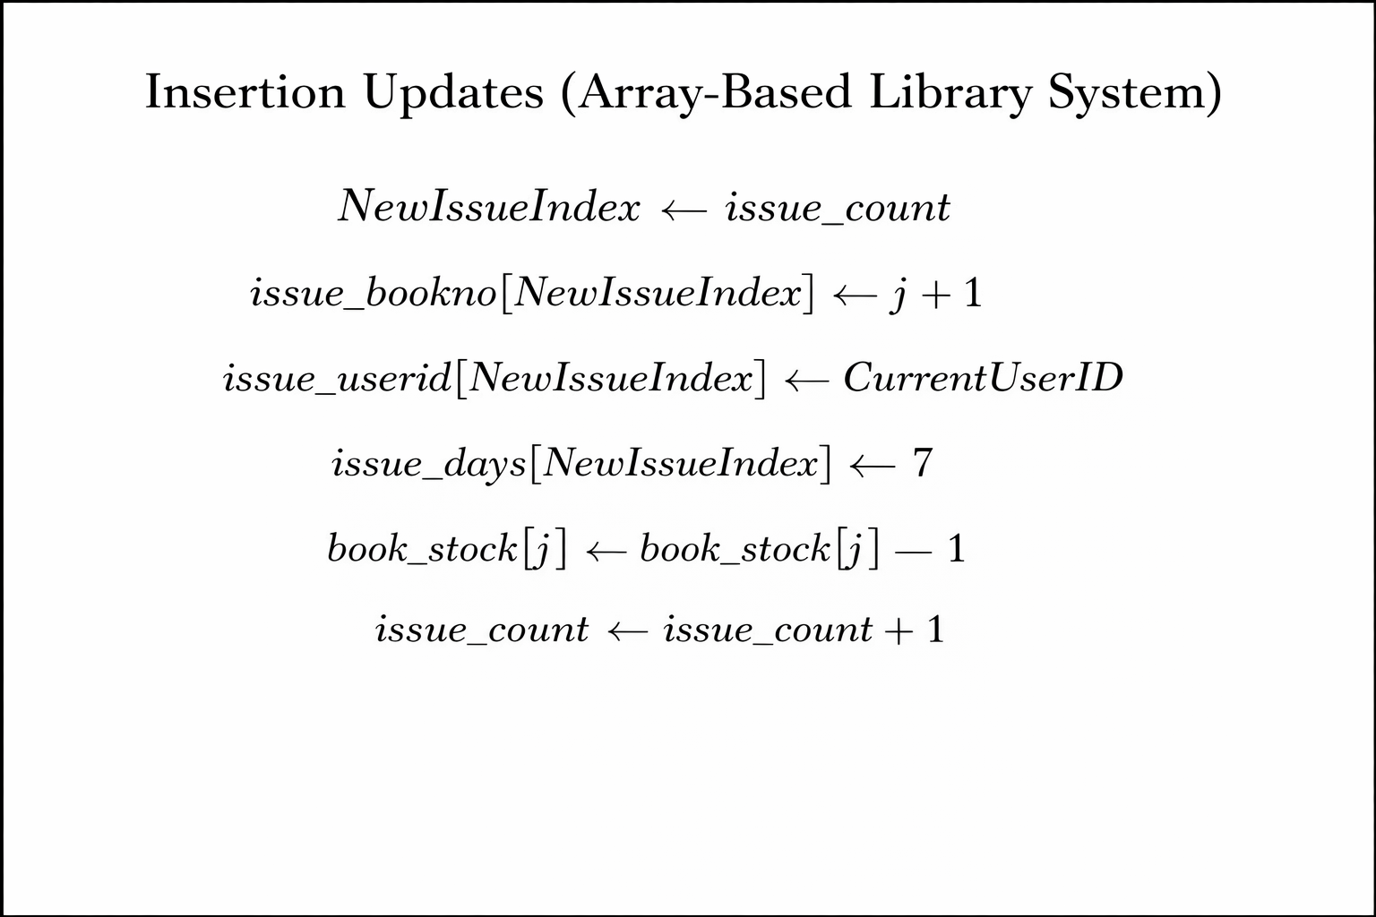
Methodology
Insertion Logic (Constant Time O(1))
New issue Records are inserted sequentially using indexed arrays:
IssueIndex <- issue_count
Store Book Number
Store StudentID
Set Deadline
Increment Total Issue Count
Decrease Book stock
Algorithm:

Slide 10
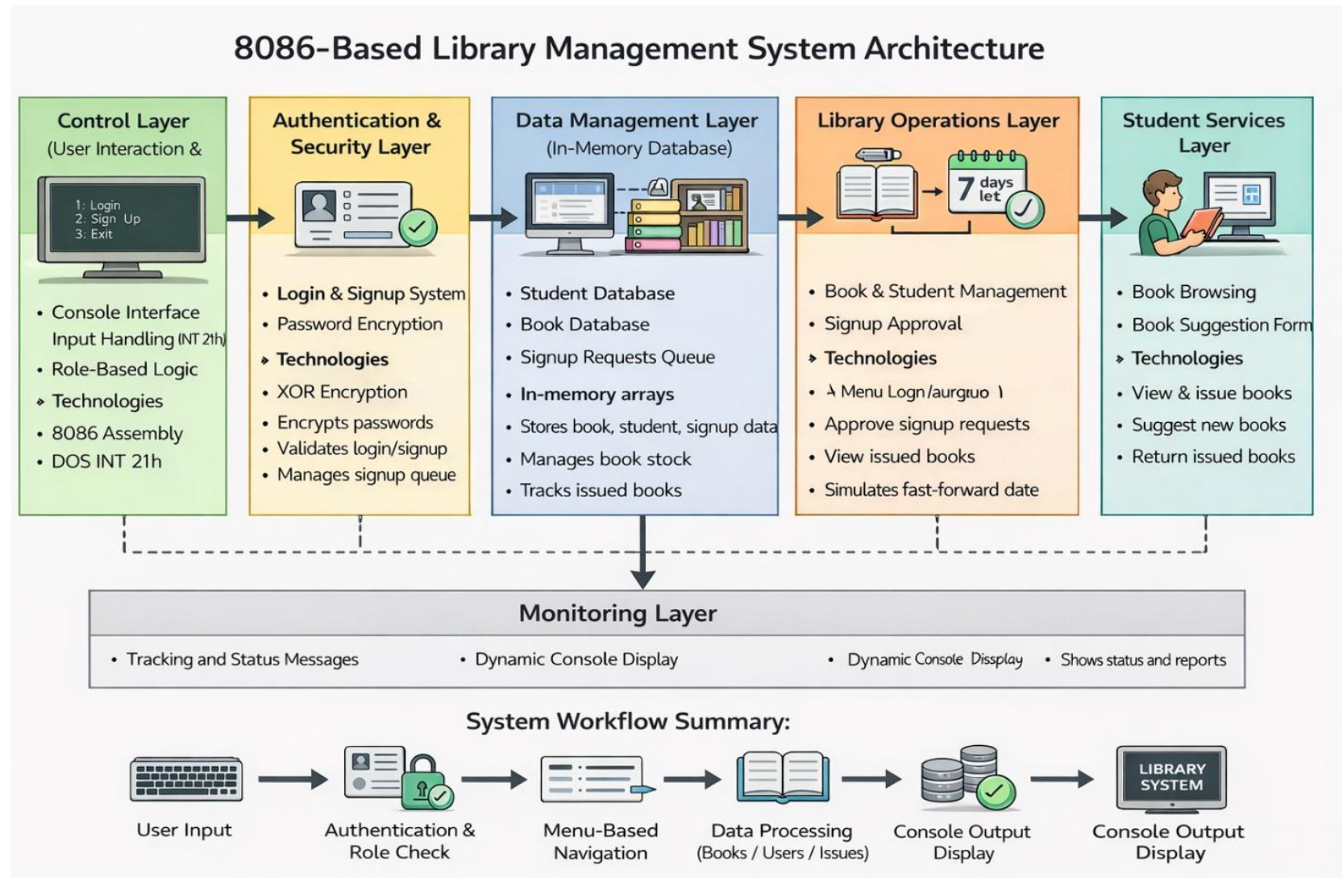
Design and implementation
A high-level architectural overview of the 8086 Assembly–based Library Management System, illustrating the structured flow from User Input and Authentication through layered processing, in-memory array-based data management, and console output handling within real-mode system constraints.

Slide 11
Design and Implementation
Pointer Arithmetic & Addressing
Mechanism: Uses 16 bit indexed addressing to calculate record locations inside fixed-size-in memory array.
Formula: Address = Base + (Index x RecordSize)
Assembly Logic:
  MUL BX: Multiplies Index by record Size. Result stored in AX (offset)
  LEA DI/LEA SI: Loads base address of array (student_ids, book_names, issue_userid, etc.)
  ADD DI, AX: Adds computed offset to base address. Points to exact record in memory.
Duplicate Detection Logic (User ID)
Goal: Prevent duplicate user registration in the system
Process (Traversal-Based Search):
  Traverse: Compare entered User ID with existing student_ids.
  Traverse Signup Request Queue: compare entered User ID with pending request_ids.
  Decision Logic
    If Found: Display “User ID Already Exists"
    If Not Found: Allow signup request

Slide 12
Design and Implementation
Safety Mechanism: Controlled Loop Execution
Risk: Unbounded array traversal may cause memory corruption or unintended behavior
Solution:
  All loops bounded using:
    issue_count
    student_count
    request_count
  Uses LOOP instruction with fixed counters
  No dynamic memory allocation
  No pointer-based traversal
Solution:
  Prevents infinite loops
  Prevents out-of-bounds access
  Ensures stable execution within 64KB memory model

Slide 13
Design and Implementation
Data Storage & Output Strategy
Data Representation:
Student Records: Fixed-size ID, password (XOR, encrypted), name, status
Book Records: Title, stock count, maximum limit
Issue Records: Book index, User ID (5bytes), Days remaining.
Key Conversion Algorithms:
Numeric to ASCII:
  ADD AL, ‘0’ for digit conversion
  DIV 10 for two digit display
Output Handling:
  DOS INT 21H services
  Tabular console formatting with space padding

Slide 14
Design and Implementation
Helper Procedures
encrypt_password: Applies XOR-based encryption to user passwords
check_uid_exists: Traverses student database to detect duplicate User IDs
show_digit: Convers numeric value to ASCII using DIV 10 and prints via DOS
System Output Handling
Uses DOS INT 21H for console display
Prints formatted tabular data for:
  Books
  Students
  Issued records
    Handles fixed-length string printing with manual spacing
    Displays numeric values using ASCII conversion

Slide 15
Results/Simulation
System Performance Metrics
Computational Complexity
Insertion: O(1) (Direct index-based array insertion using issue_count)
Search/Duplicate Check (User ID): O(N) (Linear traversal of student array)
Return/Record Deletion: O(N) (Linear Search + element shifting in issue array)
Book Display/Reports: O(N) (Sequential array traversal)
Memory Efficiency
Storage Model: Fixed-size in memory arrays (No dynamic allocation)
Data Segment Limit: Fully operates within 64KB real-mode segment
Compact Issue Records: 7 bytes per logical issue entry (parallel array model).

Slide 16
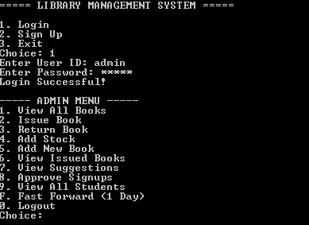
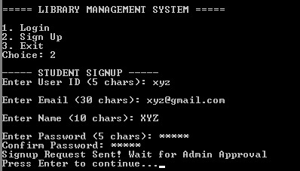
Results/Simulation
emu8086 Environment
Starting & Signup for student user
Admin login menu

Slide 17
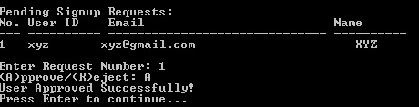
Results/Simulation
Approval of Request for signup of students

Slide 18
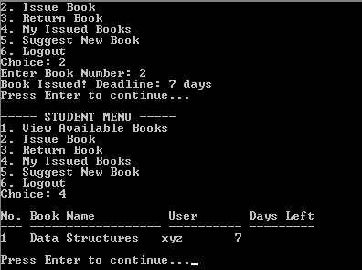
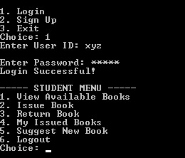
Results/Simulation
Login for Student user and menu
Issuing of a book for student

Slide 19
Results/Simulation
Critical Technical Resolutions
1. Index Offset Miscalculation
Issue: Incorrect record addressing when calculation (Index x RecordSize) could access wrong memory locations
Fix: Standardized 16-bit multiplication using MUL BX and controlled offset addition before record access
2. Array Boundary & Loop Control Errors
Issue: Potential out-of-bounds traversal during search, issue, or return operation
Fix: Bounded all loops using record counters (issue_count, student_count) and controlled iteration via LOOP instruction
3. Record Deletion Shifting Logic
Issue: Returning a book required shifting array elements which could cause data misalignment
Fix: Implemented controlled index-based shifting across all related arrays before safely decrementing issue_count

Slide 20
Future Scope
Binary State Persistence:
Implement a binary save/load system (e.g., LIBDATA.DAT) to store complete student, book, and issue arrays for faster system restoration compared to manual reinitialization.
Algorithmic Scalability:
Introduce Binary Search (O(log N)) for sorted student/book IDs and optional Hash-Based Indexing to reduce reliance on current linear searches.
Optimized Record Reuse:
Replace array shifting during deletion with a Free-Slot Tracking Mechanism to reuse deleted issue entries and improve performance.
Enhanced Security Model:
Upgrade from basic XOR-based password encryption to stronger hashing techniques while maintaining compatibility with 8086 real-mode constraints.

Slide 21
Conclusion
Structured Library System in 8086 Assembly:
Successfully implemented a complete role-based Library Management System using pure 8086 Assembly with fixed-size in-memory arrays and DOS interrupt services.
Efficient Index-Based Architecture:
Achieved predictable performance through direct index computation, constant-time issue insertion (O(1)) and controlled linear traversal for search and updates.
Robust Memory Control:
Ensured stable operation within the 64KB real-mode constraint using bounded loops, manual record shifting, and disciplined register management.
Practical Low-Level Learning:
Applied core system concepts—pointer arithmetic, segmented memory addressing, register-level optimization, and interrupt-driven I/O—demonstrating their relevance to embedded and low-level system design.

Slide 22


