Slide 1

TITLE: Minimizing Energy Consumption and Delivery Time while Ensuring High Reliability in UAVs
TEAM No: [Team No.] TEAM NAME: [Team name]
[USN 1] [Name 1]
[USN 2] [Name 2]
[USN 3] [Name 3]
[USN 4] [Name 4]

Slide 2
EL Phase-II
Presentation Outline
Project Execution: plan vs progress, methodology adherence, benchmark, verification
Tools and Techniques: tool selection, models, optimisers, integration
Partial Results: optimal speeds, Pareto fronts, sensitivity analysis
Next Steps & References

Slide 3
Execution Status: Plan vs Progress
Project Execution
Phase-1 plan | Weeks | Planned deliverable | Status | Evidence
Literature survey | 1–2 | Select power & reliability models | Done | Zeng et al. (2019) power model; Petritoli et al. (2018) reliability
Simulation model | 3–5 | Energy, time, reliability in Python | Done | uav_opt/model.py; 19 automated tests pass
Optimization | 6–8 | Constraints, weighted sum, NSGA-II | Done | uav_opt/optimize.py; 3 optimisers agree
Dashboard & testing | 9–11 | Sensitivity runs; optional ML | In progress | Web app + sensitivity study done; ML pending
Closure | 12–13 | Report, paper draft, review | Planned | —
Beyond the plan: we also built a UAV Industry Benchmark (50 companies, 6 categories), so our model inputs come from real published specifications instead of one assumed drone.
Scope: all our Phase-1 objectives are on track; the only open item is the optional ML layer, which we will take up along with testing.
Timeliness: we finished and verified everything planned up to week 8, and started the week 9–11 work early (the web app is already running).
3
Notes:
Walk through the Phase-1 timeline row by row. Emphasise that everything planned up to optimisation is finished and tested.

Slide 4
Adherence to the Phase-1 Methodology
Project Execution
Mission inputs
distance, payload, wind
Simulation model
P(V), E, T, R(V)
Constraint filter
R ≥ Rmin, E ≤ budget, V ≤ Vmax
Optimisers
grid · weighted sum · NSGA-II
Optimal speed V*
+ Pareto front
Web app
what-if analysis
Implemented
Implemented
Implemented
Implemented
Implemented
Prototype
inputs
model.py
model.py
optimize.py
run_phase2.py
web/server.py
UAV Industry Benchmark (new)
category medians: mass, Vmax, flight time, robustness
Same pipeline as Phase-1: we implemented every block of our proposed flowchart as tested code.
Same formulation: min {E, T} s.t. R ≥ Rmin, E ≤ η·E_batt, Vmin ≤ V ≤ Vmax.
Deviation (minor): we added headwind to the time model and a benchmark data layer; the optional ML layer stays in weeks 9–11 as planned.
4

Slide 5
New Data Layer: UAV Industry Benchmark
Project Execution
50
6
11
100%
companies benchmarked
drone categories
spec fields per drone
rows with a source link
Category | Companies | Median mass (kg) | Median flight time (min) | Median max speed (m/s) | Median wind (m/s)
Delivery / Logistics | 10 | 28.6 | 54 | 22.4 | 15.0
Disaster Relief & SAR | 9 | 4.6 | 42 | 19.1 | 9.7
Agricultural | 9 | 67.0 | 17.5 | 13.8 | 8.0
Surveillance & Security | 8 | 1.9 | 52 | 19.0 | 12.1
Mapping & Surveying | 7 | 1.6 | 54 | 21.3 | 12.4
Industrial Inspection | 7 | 3.2 | 43 | 16.0 | 12.0
Quality rules
Official spec sheets / reputable sources only
Blank = not disclosed, never guessed
Conflicting figures logged in notes
Defunct firms excluded (e.g. Swoop Aero, Guardian Agriculture)
Key finding: none of the 50 companies publishes MTBF or failure-rate data, so the reliability model stays an explicit assumption, now scaled by each category's disclosed robustness score.
5

Slide 6
Quality: Model Verification & Testing
Project Execution
Reproduces the Phase-1 reference curve (5 km, 2 kg drone)
What we test
Speed V (m/s) | Phase-1 value (kJ) | Phase-2 code (kJ) | Error (kJ)
4 | 188.3 | 188.28 | 0.02
8 | 80.6 | 80.63 | 0.03
12 | 53.3 | 53.25 | 0.05
18 | 44.2 | 44.16 | 0.04
24 | 48.4 | 48.35 | 0.05
30 | 59.4 | 59.38 | 0.02
Energy curve matches the Phase-1 chart at all 14 speeds
Hover power equals P0 + Pi (Zeng et al., 2019)
Time model: 5 km at 10 m/s = 500 s; headwind halves ground speed correctly; infeasible when wind ≥ airspeed
Reliability decreases with distance and stays in (0, 1)
Grid search, SciPy and NSGA-II agree on V* within 0.15–0.5 m/s
Optimiser reports 'no feasible speed' when the battery is too small
0.05 kJ
19 / 19
max error over 14 speeds
automated tests pass (pytest)
6

Slide 7
Tool Selection and Justification
Tools and Techniques
Tool | Used for | Why this tool
Python 3.13 + NumPy | Vectorised physics model (E, T, R over speed grids) | Fast array maths; standard in scientific computing
SciPy (optimize) | Weighted-sum optimiser (bounded Brent search) | Robust, well-tested 1-D optimisation
pymoo | NSGA-II multi-objective optimiser with constraints | Reference implementation of Deb et al. (2002)
Matplotlib | Publication-quality result figures | Reproducible plots straight from the scripts
Flask + HTML/CSS/JS + Plotly.js | Web app: REST API over the optimisers + custom UI | Full control of the interface; runs offline in any browser
Excel + openpyxl | Industry benchmark with live formulas; loaded into Python | Auditable data source that non-programmers can read
pytest | Automated verification against Phase-1 values | Catches regressions as the model grows
7

Slide 8
Techniques I: Mathematical Models Applied
Tools and Techniques
Power (Zeng et al., 2019)
Energy and time
P(V) = P0(1 + 3V²/U²tip) + Pi·√(√(1 + V⁴/4v0⁴) − V²/2v0²) + ½·d0·ρ·s·A·V³
Scaled to each category's median mass (constant disc loading; drag ∝ m^2/3)
T(V) = D / (V − w) (w = headwind)
E(V) = P(V) · T(V)
Battery budget = η · P_hover · published flight time (η = 0.8)
Reliability (assumption)
Optimisation problem
R(V) = exp(−λ(V) · T(V))
λ(V) = λ0 (1 + k (V/Vmax)²), λ0 = 0.01 /h, k = 2
λ0 scaled by category robustness score: λ0·(1.5 − score/100)
min {E(V), T(V)}
s.t. R(V) ≥ 0.995, E(V) ≤ budget, 1 ≤ V ≤ Vmax
Weighted sum: J = w·E/E_min + (1 − w)·T/T_min
8

Slide 9
Techniques II: Optimisation Algorithms
Tools and Techniques
Grid search
Weighted sum (SciPy)
NSGA-II (pymoo)
Evaluates every speed on a 0.05 m/s grid, filters infeasible points, reads off V_E*, V_T* and V*.
Bounded Brent search on a penalised objective; bisection finds the fastest feasible speed.
Population 40, 60 generations, constraint-dominance; returns the whole Pareto set.
Baseline / ground truth
Fastest per evaluation
Scales to multi-variable problems
Method | Avg evaluations | Avg runtime (ms) | V* agrees with grid (6/6 categories)
Grid search | 368 | 0.06 | 6/6
Weighted sum (SciPy) | 42 | 0.83 | 6/6
NSGA-II (pymoo) | 2,400 | 185.81 | 6/6
What we learned: with only one decision variable, grid search is the cheapest and is exact. NSGA-II needs about 2,400 evaluations but gives the whole trade-off curve, and it is the method we will need for route-level (multi-variable) optimisation in Phase-3.
9

Slide 10
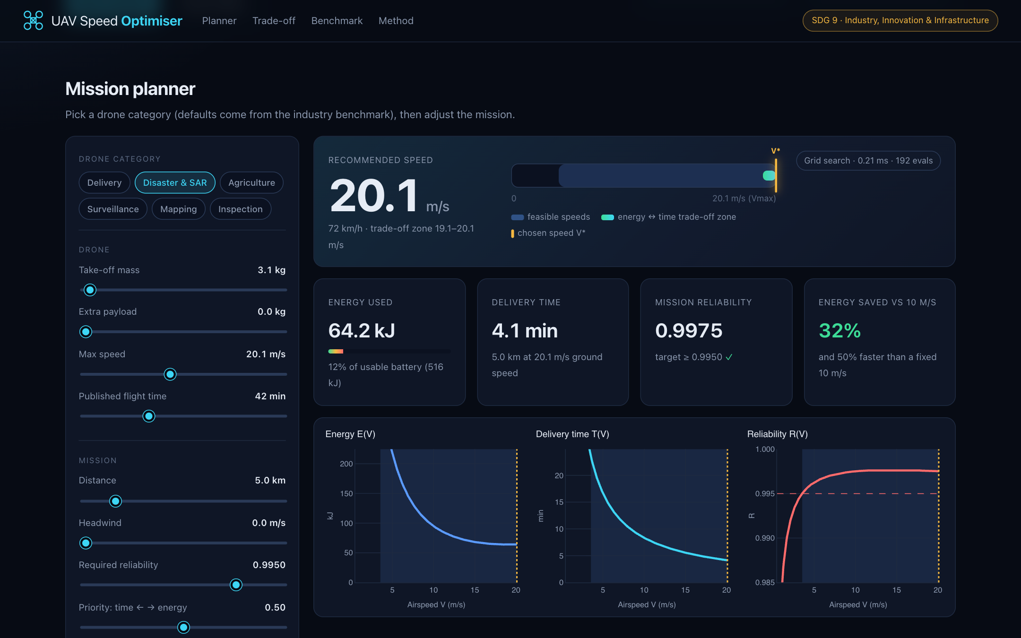
Integration: Pipeline and Web App
Tools and Techniques
Benchmark (Excel)
50 companies → category medians
benchmark.py
loads specs, builds UAV objects
model.py
P, E, T, R for any speed
optimize.py
grid · SciPy · NSGA-II
web/server.py (Flask API)
/api/optimize · /api/compare → web UI
Web app (prototype): pick a drone category, move the mission sliders, and the optimal speed V* updates live.
10

Slide 11
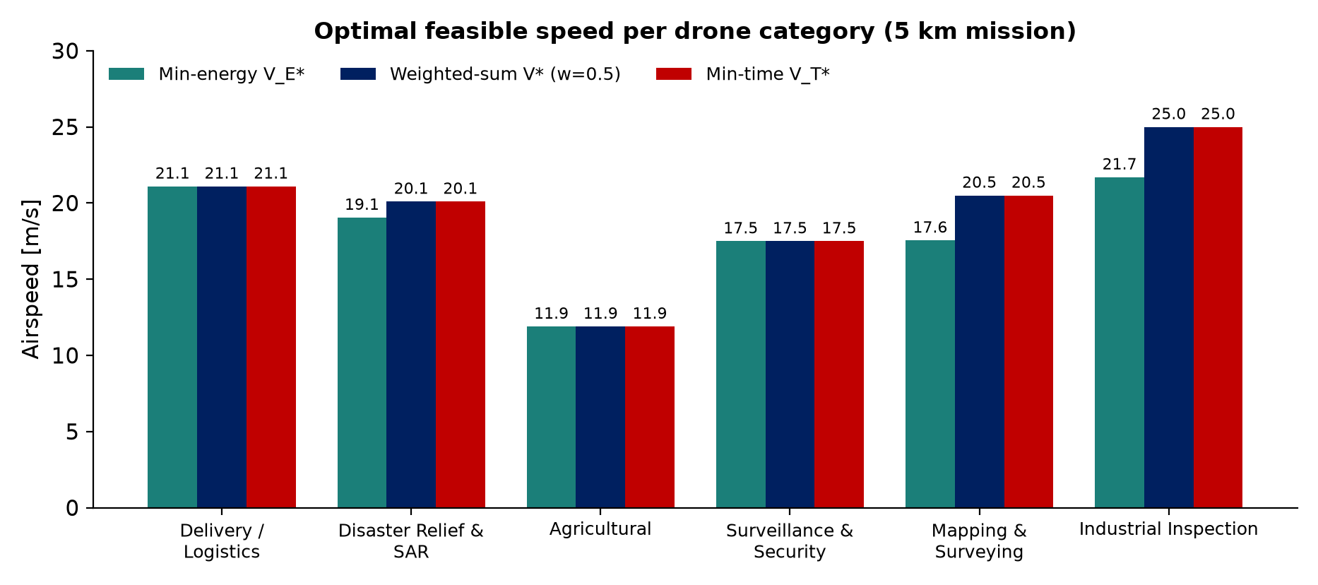
Result 1: Optimal Speed per Drone Category
Partial Results
Category | V* (m/s) | Energy saved vs 10 m/s | Time saved
Delivery | 21.1 | 47% | 53%
SAR | 20.1 | 32% | 50%
Agricultural | 11.9 | 18% | 16%
Surveillance | 17.5 | 28% | 43%
Mapping | 20.5 | 25% | 51%
Industrial Inspection | 25.0 | 39% | 60%
Clear: for a 5 km mission every category's optimum is well above a rule-of-thumb 10 m/s.
Benefit: flying at V* saves 18–47% energy and 16–60% time versus 10 m/s, because hover-like flight at low speed burns induced power.
Constraint that binds: in Delivery, Agricultural and Surveillance the energy-optimal speed sits at or beyond the published Vmax, so V_E* = V* = V_T* = Vmax.
11

Slide 12
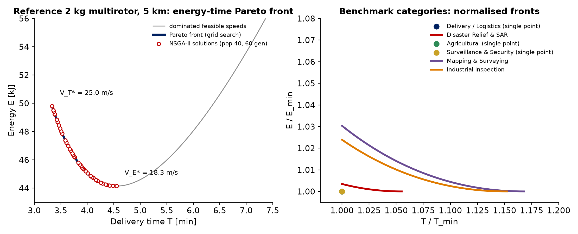
Result 2: Energy–Time Pareto Front
Partial Results
Trade-off quantified: for the reference 2 kg drone, going from V_E* = 18.3 m/s to 25 m/s costs +12% energy but cuts delivery time by 27%.
Algorithms agree: NSGA-II's 40 solutions lie exactly on the grid-search front.
Category view: SAR, Mapping and Inspection drones have a real trade-off; the other three collapse to a single point at Vmax.
12

Slide 13
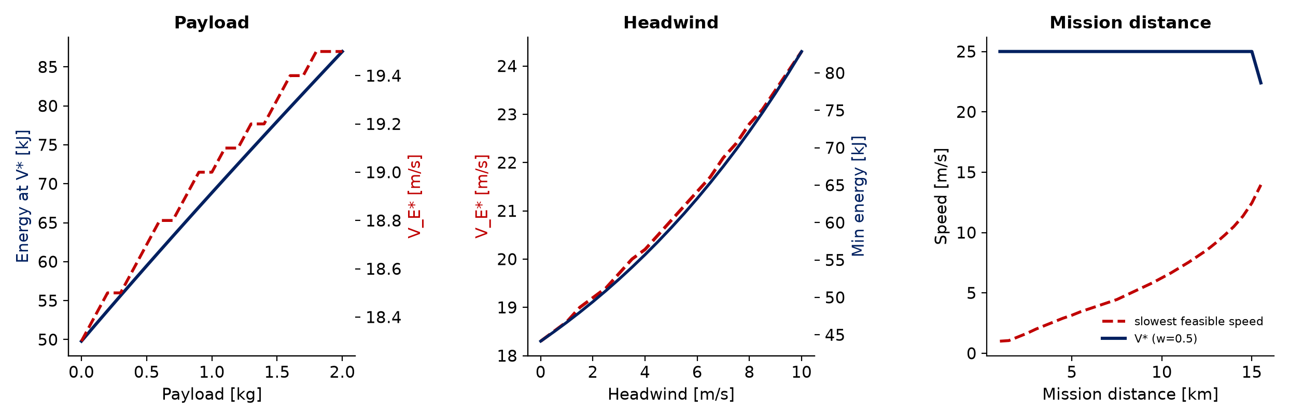
Result 3: Sensitivity Analysis
Partial Results
Payload
Headwind
Distance
+2 kg payload → +75% energy at V* (49.8 → 87.0 kJ)
V_E* rises only 18.3 → 19.5 m/s
10 m/s headwind → V_E* 18.3 → 24.3 m/s
Fly faster into wind; min energy ×1.9
Slowest feasible speed rises with distance (reliability + battery)
Reference drone infeasible beyond ≈15.5 km
13

Slide 14
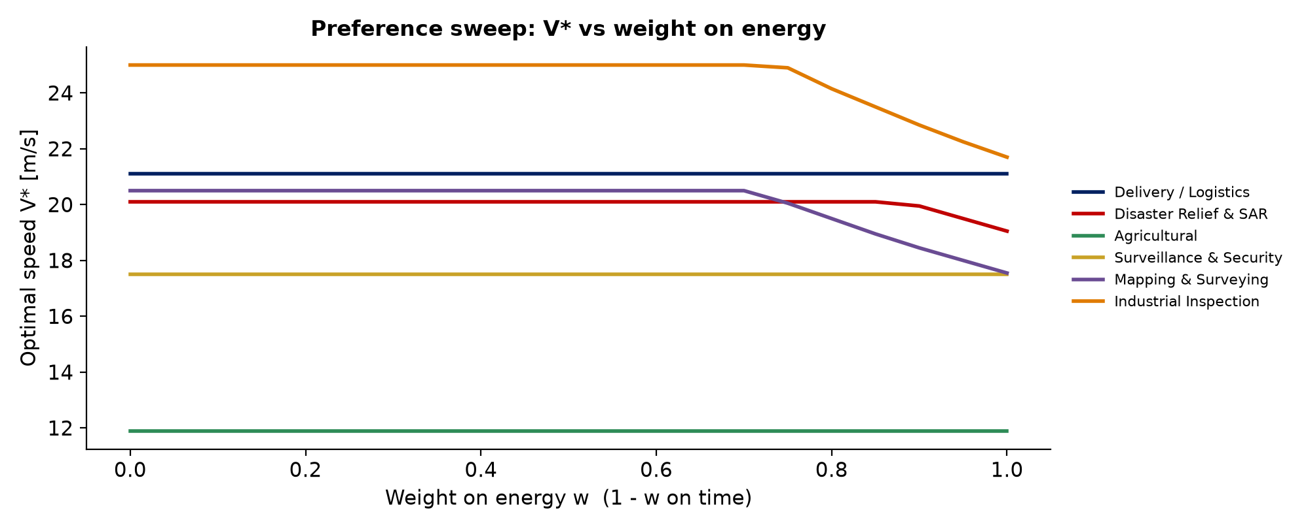
Analysis and Interpretation
Partial Results
Preference matters only near Vmax: V* moves below Vmax only when w > 0.7 (energy-focused planner).
Reliability binds at low speed: long, slow flights accumulate failure exposure; the speed-stress term is weaker than the exposure-time effect.
Wind is the biggest lever: a 10 m/s headwind shifts the energy optimum by 6 m/s, so a wind-aware speed schedule is worth more than tuning w.
Limitations: reliability parameters are assumed (no public failure data); power model is rotary-wing only; not yet validated on real flight logs.
14

Slide 15
Next Steps (Phase-3)
Partial Results
1. Validate
2. Wind-aware schedule
3. ML surrogate (optional)
4. Web app & report
Compare E(V) with a public multirotor flight-energy dataset; calibrate model coefficients.
Optimise speed per route segment using forecast wind.
Learn energy / reliability from flight data and compare with the physics model.
Usability polish, export of recommendations, paper draft and final review.
SDG 9 link: energy-aware, reliable UAV operations support resilient logistics and disaster-response infrastructure (target 9.1) and industrial innovation (target 9.5).
Reproducible: all results regenerate with one command (python run_phase2.py); the web app runs with python -m web.server.
15

Slide 16
References
Zeng, Y., Xu, J., & Zhang, R. (2019). Energy minimization for wireless communication with rotary-wing UAV. IEEE Trans. Wireless Communications, 18(4), 2329–2345.
Petritoli, E., Leccese, F., & Ciani, L. (2018). Reliability and maintenance analysis of unmanned aerial vehicles. Sensors, 18(9), 3171. https://doi.org/10.3390/s18093171
Deb, K., Pratap, A., Agarwal, S., & Meyarivan, T. (2002). A fast and elitist multiobjective genetic algorithm: NSGA-II. IEEE Trans. Evolutionary Computation, 6(2), 182–197.
Blank, J., & Deb, K. (2020). pymoo: Multi-objective optimization in Python. IEEE Access, 8, 89497–89509.
Virtanen, P., et al. (2020). SciPy 1.0: Fundamental algorithms for scientific computing in Python. Nature Methods, 17, 261–272.
Wu, K., Lu, S., Chen, H., Feng, M., & Lu, Z. (2024). An energy-efficient logistic drone routing method considering dynamic drone speed and payload. Sustainability, 16(12), 4995.
Ji, Y., Liu, L., Wang, Y., Wang, X. V., & Wang, L. (2026). Time-efficient routing and speed control for truck drone delivery under non-linear energy constraints. Drones, 10(6), 466.
UAV Industry Benchmark (2026). Team-compiled dataset of 50 UAV products from official specification sheets (UAV_Industry_Benchmark_v2.xlsx).
16

Slide 17
Thank you

