Slide 1



EngagePredict: Social Media Post Engagement Prediction Using Supervised Machine Learning Techniques
DEPARTMENT OF COMPUTER SCIENCE AND ENGINEERING MACHINE LEARNING PROJECT ASSESSMENT
By
DIVITH K RATHOD GAGAN GOWDA S
: 1BH23CS017
: 1BH23CS020
Under the Guidance of Mrs. Shylaja D N Assistant Professor
Dept. of Computer Science and Engineering

Slide 2


DEPARTMENT OF COMPUTER SCIENCE AND ENGINEERING
INTRODUCTION
Social media and online platforms have changed how information is shared and consumed.
User engagement (likes, shares, comments, reach) is a key way to measure how audiences interact with content.
Predicting this engagement is important for improving platforms and communication strategies.
Traditional methods fail because user behavior is complex and non-linear.
Data-driven approaches help predict engagement better, enabling personalization and efficient resource use.
02

Slide 3
PROBLEM STATEMENT
DEPARTMENT OF COMPUTER SCIENCE AND ENGINEERING
The problem objective is to predict social media post engagement levels by analyzing content features and platform characteristics in order to provide actionable recommendations for optimizing posting strategies and improving content reach.
03

Slide 4
SDG 9 RELEVANCE – INDUSTRY, INNOVATION AND INFRASTRUCTURE
DEPARTMENT OF COMPUTER SCIENCE AND ENGINEERING
This project aligns with Sustainable Development Goal 9 (SDG 9): Industry, Innovation and Infrastructure, specifically:
Target 9.5: Enhance scientific research, upgrade the technological capabilities of industrial sectors in all countries, in particular developing countries, including, by 2030, encouraging innovation and substantially increasing the number of research and development workers per 1 million people and public and private research and development spending
Target 9.B: Support domestic technology development, research and innovation in developing countries, including by ensuring a conducive policy environment for, inter alia, industrial diversification and value addition to commodities
The project demonstrates technological innovation in social media analytics and provides tools
that can enhance digital communication strategies for businesses and individuals.
04

Slide 5
OBJECTIVES
DEPARTMENT OF COMPUTER SCIENCE AND ENGINEERING
Predict engagement potential of social media content using
machine learning models
Analyze media files for quality and optimization recommendations
Provide personalized, platform-specific suggestions to improve content performance
05

Slide 6
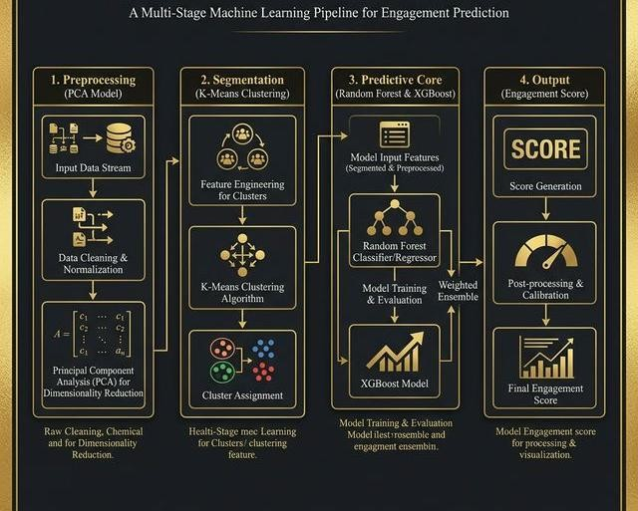
DEPARTMENT OF COMPUTER SCIENCE AND ENGINEERING
SYSTEM ARCHITECTURE
06

Slide 7
DEPARTMENT OF COMPUTER SCIENCE AND ENGINEERING
TECHNIQUES AND DATASET USED
ML Supervised Learning Techniques Used
This project heavily utilizes two primary Supervised Learning techniques for its core predictive engine:
Classification (Random Forest Classifier): A technique used to categorize data into discrete buckets. Here, Random Forest uses an ensemble of dozens of decision trees to classify users into distinct tiers: *Low, Medium, or High* engagement.
Regression (XGBoost Regressor): A technique used to forecast exact numerical values. Here, Extreme Gradient Boosting (XGBoost) evaluates behavior to predict continuous variables, specifically the numerical *Churn Probability* percentage (e.g., 75% likely to churn).
Dataset Used
The project utilizes a custom synthesized dataset named `engage_predict_dataset.csv`, consisting of 1,000 unique user interaction records. It maps directly into a Pandas DataFrame for Machine Learning, capturing the following vital features:
Demographics/Technical: `user_id`, `device_type`
Activity Metrics: `session_duration_minutes`, `pages_visited`, `click_through_rate`
Historical Data: `historical_likes`, `historical_comments`, `days_since_last_login`
Target Variables for ML: `engagement_tier` (Low/Medium/High) and `churn_probability` (0.01 to 0.95).
07

Slide 8
METHODOLOGY
DEPARTMENT OF COMPUTER SCIENCE AND ENGINEERING
Data Collection: Gathering behavioral data from user sessions.
Data Preprocessing & PCA: Cleaning the data, handling missing information, and reducing dimensionality.
User Segmentation: Using K-Means to find natural behavioral groupings.
Model Training: Training Random Forest and XGBoost models on the segmented data.
Evaluation: Testing the models to ensure their predictions are accurate.
Output Prediction: Generating the final engagement score.
08

Slide 9
DEPARTMENT OF COMPUTER SCIENCE AND ENGINEERING
THANK YOU

