Slide 1
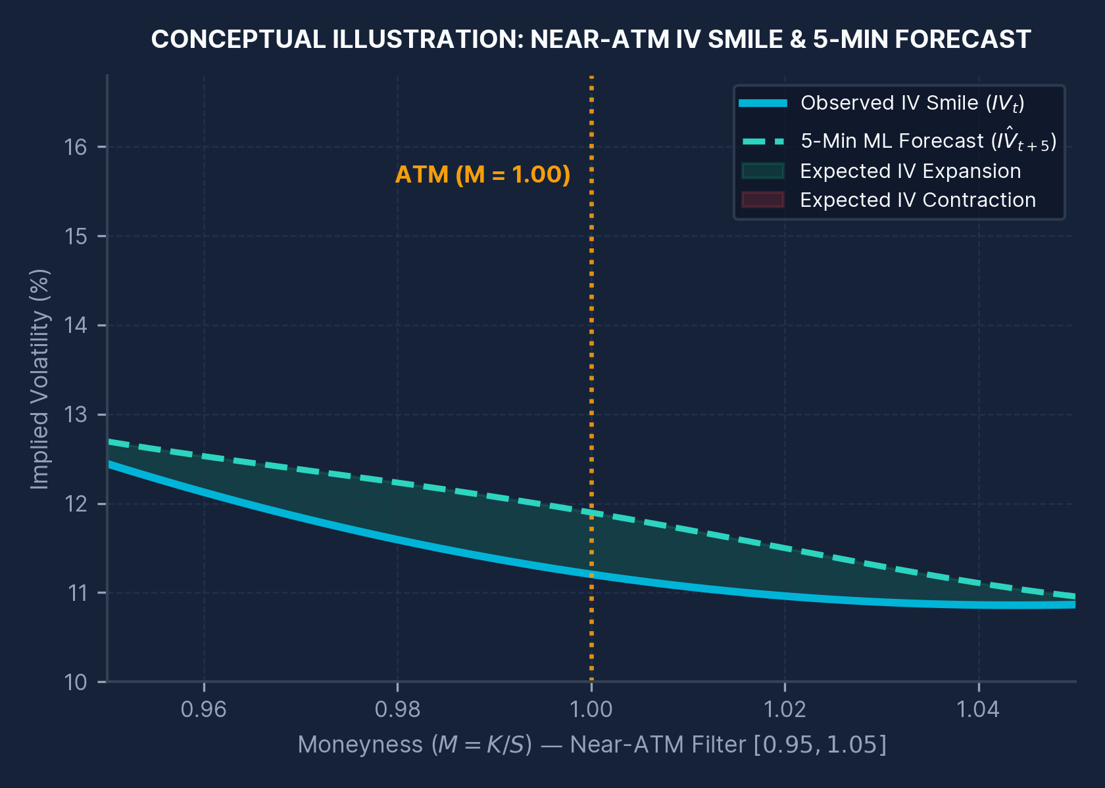
ACADEMIC INTERNSHIP PROJECT • M.Sc. QUANTITATIVE FINANCE
Real-Time Implied Volatility Forecasting and Relative Valuation of NIFTY 50 Options Using Machine Learning
A 5-minute forecasting prototype integrating option-chain analytics, machine learning, relative-IV interpretation, stress testing and a live dashboard.
NIFTY 50 Options
5-Minute Horizon
Random Forest ML
END-TO-END QUANTITATIVE RESEARCH PIPELINE
Data Pipeline: 81 NSE option-chain snapshots & live Upstox API integration.
ML Forecasting: 39-feature Random Forest vs Persistence & XGBoost (+5m ΔIV).
Risk & Valuation: Relative-IV classification, Black–Scholes stress tests & Streamlit app.
PRESENTED BY
Diviya C.
Second Year M.Sc. Quantitative Finance
Registration No. 25MSQUFPY0018
Pondicherry University
Academic Year 2026–27
INTERNSHIP ORGANISATION
Surabhi Investment Services Pvt. Ltd.
Location: Tiruchirappalli, Tamil Nadu
Internship Period:
18 June 2026 – 15 August 2026
(59 Calendar Days)
Quantitative Options Analytics | Implied Volatility Intelligence | Machine Learning | Risk-Aware Decision Support • Slide 1 / 15
Notes:
1. What to explain: Introduce yourself (Diviya C., Reg. No. 25MSQUFPY0018, Second Year M.Sc. Quantitative Finance, Pondicherry University, Academic Year 2026-27) and state the full project title completed during your internship at Surabhi Investment Services Pvt. Ltd., Tiruchirappalli (18 June 2026 – 15 August 2026).
2. Why the method/concept was used: Explain that this project builds an end-to-end 5-minute implied volatility forecasting and risk-aware decision-support prototype for NIFTY 50 index options.
3. What the result means: Rather than treating ML predictions as standalone trading signals, the prototype integrates option-chain feature engineering, chronological holdout evaluation, relative-IV classification, and Black-Scholes stress testing.
4. Likely Viva Question & Answer:
Q: In one sentence, what is the core contribution of your internship project?
A: It develops and chronologically validates a 39-feature Random Forest model that predicts 5-minute changes in near-ATM NIFTY 50 implied volatility—outperforming the persistence baseline by 5.28% in MAE and 7.72% in RMSE in the development regime—and embeds the forecast into a relative-IV and Black-Scholes stress-testing dashboard.

Slide 2
01 • INTERNSHIP OVERVIEW & INSTITUTIONAL CONTEXT
Internship Context: Options-Trading Focus & Quantitative Finance Relevance
Translating derivatives pricing, implied volatility dynamics, and risk management into an empirical research prototype
HOST ORGANISATION
Surabhi Investment Services Pvt. Ltd.
Tiruchirappalli (Trichy), Tamil Nadu
NATURE OF FIRM
Investment Company
Financial & derivatives market focus
INTERNSHIP AREA
Options Trading
Index derivatives & volatility analysis
INTERNSHIP DURATION
59 Calendar Days
18 June 2026 – 15 August 2026
WHY IMPLIED VOLATILITY MATTERS IN OPTIONS TRADING
Directly Observable Market Expectation: Options trading makes implied volatility (IV) an economically vital variable reflecting forward-looking uncertainty embedded in option prices.
Short-Horizon Price & Risk Impact: Intraday 5-minute shifts in IV directly impact option premiums, relative strike valuation, and short-term risk exposure.
Quantitative Finance Translation: The internship provided a practical derivatives setting to translate option-pricing theory, time-series engineering, and ML validation into a working tool.
Core Practical Research Question: Can near-term (5-minute) IV movements be forecast accurately and interpreted alongside spot and volatility risk?
BRIDGING OPTIONS PRACTICE & QUANTITATIVE RESEARCH
1. Market Domain (Options Trading)
Observe live NIFTY 50 Call (CE) & Put (PE) option chains, strike prices, LTP, liquidity (OI, volume, bid-ask), and implied volatility.
2. Quantitative Research Formulation
Formulate exact 5-minute IV change forecasting (ΔIV at t+5) within the liquid near-ATM moneyness band (0.95 ≤ M ≤ 1.05).
3. Risk-Aware Decision Support
Combine ML forecast with Relative-IV classification and Black–Scholes stress testing so volatility views are weighed against spot risk.
Scope Note: No additional company responsibilities are claimed beyond the project and internship details documented in this work.
Quantitative Options Analytics | Implied Volatility Intelligence | Machine Learning | Risk-Aware Decision Support
Slide 2 / 15
Notes:
1. What to explain: State the internship organisation (Surabhi Investment Services Pvt. Ltd., Tiruchirappalli, Tamil Nadu), nature (Investment company), domain (Options Trading), and exact duration (18 June 2026 to 15 August 2026, 59 calendar days inclusive).
2. Why the method/concept was used: Explain why implied volatility is central to options trading—unlike historical volatility, IV is forward-looking and embedded directly in option premiums.
3. What the result means: Emphasise how the internship bridged academic quantitative finance theory and practical index-options analytics without claiming undocumented corporate duties.
4. Likely Viva Question & Answer:
Q: Why did you choose implied volatility forecasting as your internship topic at an investment firm?
A: Because in options trading, every quote is effectively a quote on implied volatility. Short-horizon changes in IV directly affect option premiums and hedging costs, making short-term IV dynamics and risk-scenario analysis highly relevant to quantitative derivatives research.

Slide 3
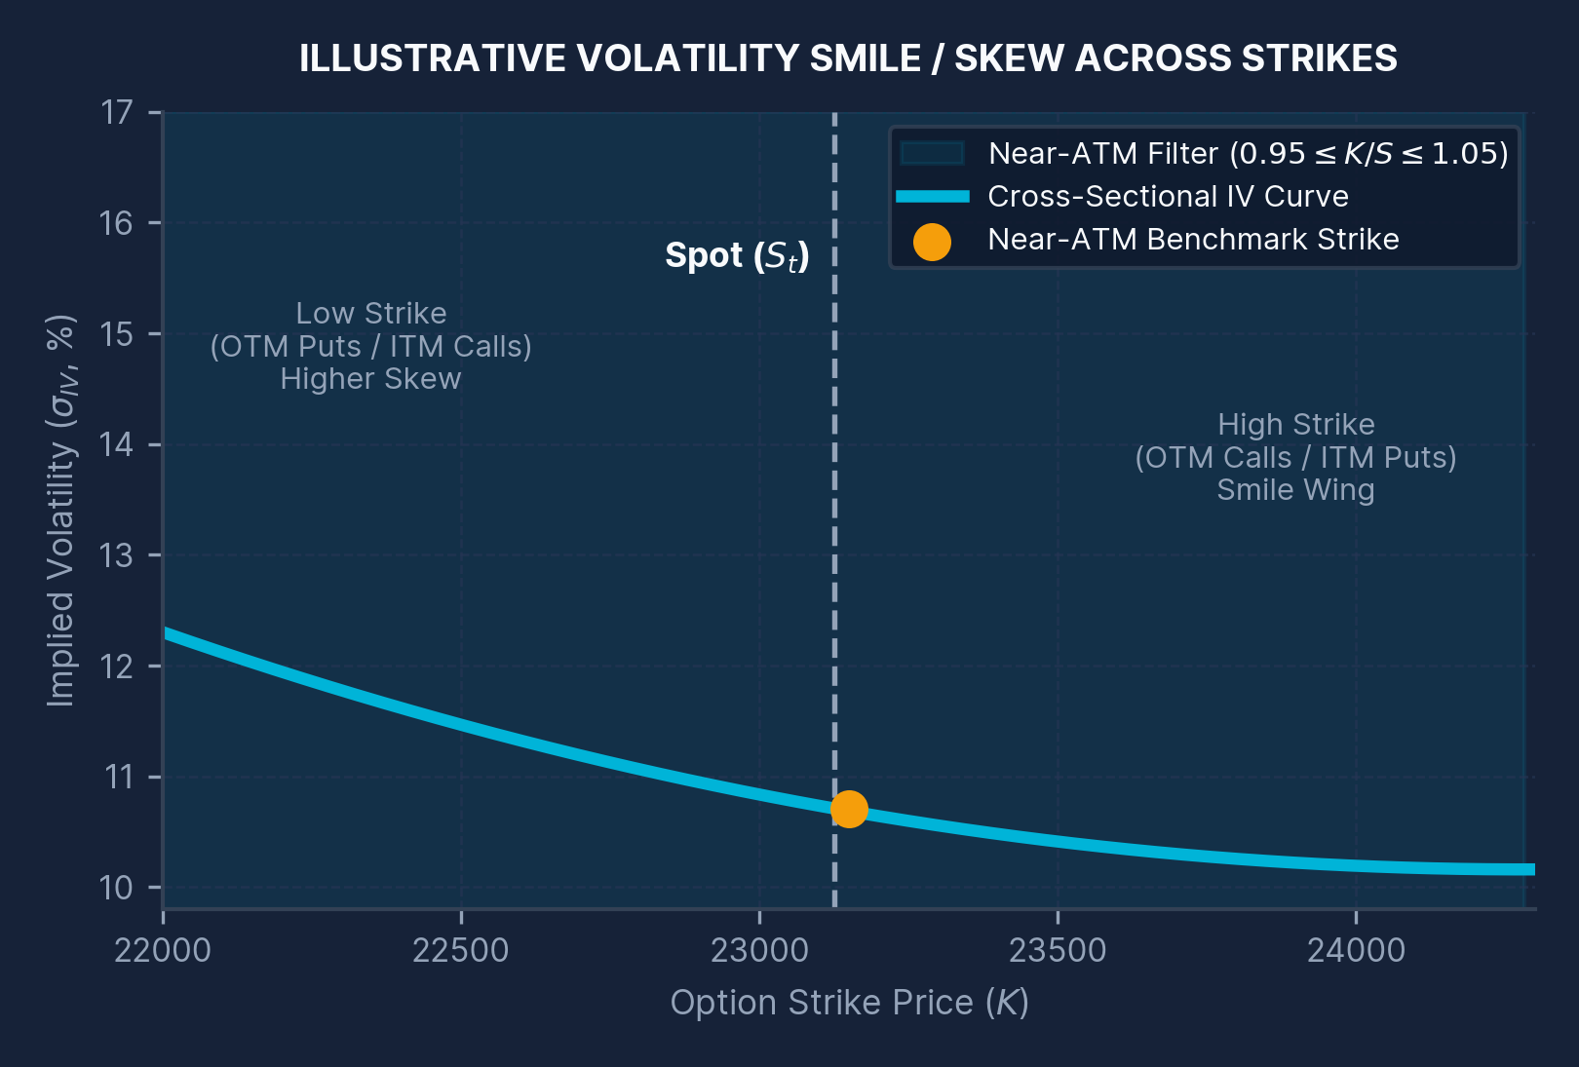
02 • INTRODUCTION & PROJECT BACKGROUND
Implied Volatility as a Forward-Looking Market Signal Across Strikes
Understanding the volatility smile/skew, cross-sectional strike dynamics, and 5-minute forecasting scope
1 | IMPLIED VOLATILITY (IV) AS MARKET EXPECTATION
The volatility level (σ) embedded in an option's observed market price. It reflects forward-looking market expectations of underlying price variability and varies continuously with strike price, moneyness, and time to expiry.
Why It Matters: IV is central to option pricing, relative valuation across strikes, vega risk management, and trading decisions.
2 | THE VOLATILITY SMILE & SKEW STRUCTURE
Contrary to constant-volatility textbook assumptions, IV is not flat across strikes. The cross-section forms a volatility smile or skew, making strike position and moneyness essential dimensions in option-chain analysis.
Project Focus: Map current near-ATM IV structure and forecast how each contract's IV will change over the next 5 minutes.
3 | QUANTITATIVE-FINANCE & DECISION-SUPPORT LINK
This study integrates derivatives pricing theory, exact time-series lag engineering, nonlinear tree ensembles, strict chronological out-of-sample validation, and scenario-based risk stress testing.
Decision Support Philosophy: Forecasts are treated strictly as analytical research signals—not guaranteed buy or sell recommendations.
KEY ANALYTICAL TAKEAWAYS FROM THE IV SURFACE
Cross-Sectional Heterogeneity: Deep OTM/ITM wings often exhibit higher IV sensitivity and wider bid-ask spreads than near-ATM strikes.
Dynamic Surface Shift: Over a 5-minute interval, both spot movement and order-flow pressure shift individual strike IVs.
Quantitative Options Analytics | Implied Volatility Intelligence | Machine Learning | Risk-Aware Decision Support
Slide 3 / 15
Notes:
1. What to explain: Define implied volatility simply as the volatility level implied by an option's market price when inverted through an option pricing model. Explain the volatility smile/skew diagram on the right.
2. Why the method/concept was used: Because IV varies across strikes (forming a smile or skew), a forecasting model cannot treat all strikes identically—it must incorporate moneyness, strike distance, and contract liquidity.
3. What the result means: Positioning the model as a research signal rather than an automated trading bot ensures sound quantitative risk governance.
4. Likely Viva Question & Answer:
Q: Why does a volatility smile or skew exist in index options like NIFTY 50 if Black-Scholes assumes constant volatility?
A: In real markets, return distributions exhibit fat tails and negative skewness (crash risk), and hedging demand for OTM puts/calls creates strike-dependent supply-demand imbalances. Market participants therefore price different implied volatilities across strikes.

Slide 4
03 • PROBLEM STATEMENT & MOTIVATION
Can 5-Minute NIFTY 50 IV Changes Beat the Persistence Benchmark?
Distinguishing the short-horizon forecasting challenge, baseline rigor, and risk-aware decision support
CENTRAL RESEARCH QUESTION
“Can short-horizon (5-minute) changes in NIFTY 50 option implied volatility be forecast more effectively than a simple ‘IV stays unchanged’ persistence benchmark?”
THE FORECASTING PROBLEM
Static IV Is Incomplete
Unobserved Direction: Current IV alone does not indicate whether volatility is likely to expand or contract over the next 5 minutes.
Microstructure Noise: Short-horizon option snapshots contain bid-ask bounce and cross-sectional strike variation.
THE PERSISTENCE BENCHMARK
Why IV(t+5) = IV(t) Is Tough
High Autocorrelation: Over a 5-minute window, implied volatility levels are highly persistent (R² > 0.98 even for naive no-change).
Strict Value-Add Test: An ML model adds real value only if its chronological out-of-sample error beats ΔIV = 0.
WHY RISK PAIRING IS ESSENTIAL
Multi-Factor Option Sensitivity
Joint Greek Exposure: Option premiums react simultaneously to IV (Vega), spot price movement (Delta/Gamma), and time decay (Theta).
Holistic Evaluation: Forecast interpretation must be paired with Black–Scholes scenario stress testing.
PROJECT MOTIVATION: FROM RAW OPTION-CHAIN SNAPSHOTS TO A USABLE DECISION-SUPPORT PROTOTYPE
1. 5-Minute IV Forecast
Predict exact ΔIV(t+5) using 39 current & lagged option-chain features
2. Relative-IV Layer
Classify current IV as Low, Fair/Neutral, or High vs ML forecast
3. Option Stress Testing
Evaluate Black–Scholes option value under Spot & IV shock scenarios
4. Interactive Dashboard
Deploy live Upstox feed + model analytics in a Streamlit interface
Quantitative Options Analytics | Implied Volatility Intelligence | Machine Learning | Risk-Aware Decision Support
Slide 4 / 15
Notes:
1. What to explain: Frame the central research question: whether short-horizon (5-minute) changes in NIFTY 50 implied volatility can be predicted more accurately than the naive persistence benchmark (which assumes IV stays unchanged over the next 5 minutes).
2. Why the method/concept was used: Over a 5-minute horizon, financial time series exhibit strong autocorrelation, making the persistence baseline (Predicted IV_{t+5} = IV_t) a tough benchmark to beat.
3. What the result means: Furthermore, predicting IV alone is not enough for decision support because option prices also depend heavily on spot price movement (Delta/Gamma) and time decay (Theta). Hence, the motivation is a 4-part system: Forecast -> Relative-IV -> Stress Test -> Dashboard.
4. Likely Viva Question & Answer:
Q: Why is the persistence model (no-change forecast) considered such an important benchmark in short-horizon volatility forecasting?
A: Because implied volatility is highly autocorrelated at 5-minute intervals. A complex machine-learning model can show a high R² simply by mimicking the current IV level; proving genuine predictive skill requires achieving lower out-of-sample MAE and RMSE than the persistence forecast.

Slide 5
04 • PROJECT OBJECTIVES & END-TO-END WORKFLOW
Five Core Objectives: From Option-Chain Acquisition to Live Deployment
Structured research architecture spanning data engineering, ML forecasting, valuation, and stress testing
01
COLLECT
Option-Chain Pipeline
02
ENGINEER
Leakage-Free Features
03
FORECAST
Short-Horizon ML Model
04
INTERPRET
Relative-IV Valuation
05
DEPLOY
Stress Test & App
Build a repeatable NIFTY 50 option-chain data pipeline using historical NSE CSV snapshots for model development and Upstox Developer API connectivity for live market ingestion.
Construct moneyness (M = K/S), near-ATM filtering (0.95–1.05), liquidity metrics, exact 5m/10m lags, momentum indicators, and exact +5m target alignment without look-ahead leakage.
Predict 5-minute-ahead implied volatility change (ΔIV at t+5) using nonlinear tree ensembles (Random Forest & XGBoost) and evaluate chronologically against persistence.
Translate the model's 5-minute IV forecast into an intuitive relative valuation signal classifying current strike IV as Low, Fair/Neutral, or High relative to expected IV.
Stress-test theoretical option values under adverse spot, IV, and time shocks via the Black–Scholes model and present integrated analytics in an interactive Streamlit dashboard.
Output: 81 development snapshots & 5-minute automated API polling loop.
Output: 39 features (15 current + 24 lag/momentum) across 4,853 lag-ready rows.
Output: Selected 300-tree Random Forest achieving 5.28% MAE & 7.72% RMSE gain.
Output: Holdout classification across 983 observations + directional threshold analysis.
Output: Near-ATM 23,150 CE stress matrix & live Streamlit monitoring interface.
ARCHITECTURAL DESIGN PRINCIPLE: END-TO-END RESEARCH INTEGRITY
Strict Separation of Training & Evaluation: Data collection (Obj. 01) and feature engineering (Obj. 02) enforce exact timestamp alignment so forecasting (Obj. 03) suffers zero future leakage.
From Point Prediction to Risk Context: Relative-IV interpretation (Obj. 04) and Black–Scholes stress testing (Obj. 05) ensure forecasts are never used in isolation from spot risk.
Quantitative Options Analytics | Implied Volatility Intelligence | Machine Learning | Risk-Aware Decision Support
Slide 5 / 15
Notes:
1. What to explain: Walk through the five sequential project objectives: (01) Collect option-chain snapshots via NSE CSVs and Upstox API, (02) Engineer 39 leakage-free features, (03) Forecast 5-minute IV change and benchmark against persistence, (04) Interpret predictions via a relative-IV layer, and (05) Stress-test option values via Black-Scholes and deploy in Streamlit.
2. Why the method/concept was used: Structuring the objectives as a 5-stage pipeline shows the examiner that this was a complete quantitative systems engineering and empirical research project, not merely an isolated curve-fitting exercise.
3. What the result means: Each objective feeds directly into the next, ensuring that data hygiene supports model validity, and model outputs support risk-aware option valuation.
4. Likely Viva Question & Answer:
Q: Why did you include Objective 05 (Black-Scholes stress testing) when your primary ML model forecasts implied volatility?
A: Because an option trader or risk analyst cares about option rupee value, not just volatility points. Even if IV rises as predicted, an adverse spot price move can wipe out a Call option's value. Stress testing quantifies that joint spot-and-IV exposure.

Slide 6
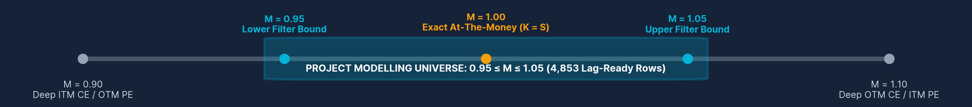
05 • THEORETICAL BACKGROUND & MATHEMATICAL FORMULATION
Black–Scholes Valuation, Moneyness Filtering & Forecast Target Equations
Mathematical foundations governing option pricing, implied volatility inversion, and 5-minute benchmark evaluation
1. BLACK–SCHOLES & IMPLIED VOLATILITY
2. MONEYNESS & NEAR-ATM FILTER
3. FORECAST TARGET & BENCHMARK
C = S N(d₁) − K e⁻ʳᵀ N(d₂)
σ ↑ ⇒ Option Value ↑ (All Else Equal)
M = K / S
Near-ATM Filter: 0.95 ≤ M ≤ 1.05
ΔIV(t+5) = IV(t+5) − IV(t)
Persistence Forecast: IV_pred(t+5) = IV(t)
Implied Volatility Definition: IV is the value of σ that equates the theoretical Black–Scholes price to the observed market price.
Numerical Inversion: Because no closed-form algebraic inverse exists for σ, numerical root-finding is required.
Stress-Test Rate: Annual risk-free rate assumption r = 6% used in Black–Scholes valuation scenarios.
Standardised Strike Ratio: Moneyness standardises strike price (K) relative to underlying NIFTY 50 spot price (S).
Strike Interpretation: M ≈ 1 is near ATM; M < 1 or M > 1 represent ITM or OTM positions depending on option type (CE vs PE).
Economic Rationale: Restricting to 0.95 ≤ M ≤ 1.05 focuses on liquid strikes and removes noisy deep-wing quotes.
First-Difference Target: Predicting 5-minute change ΔIV(t+5) rather than raw level avoids non-stationary level drift.
Implied Level Reconstruction: Predicted future IV is recovered directly via IV_pred(t+5) = IV(t) + ΔIV_pred(t+5).
Benchmark Criterion: The ML model adds value only if its out-of-sample error is strictly lower than persistence.
Quantitative Options Analytics | Implied Volatility Intelligence | Machine Learning | Risk-Aware Decision Support
Slide 6 / 15
Notes:
1. What to explain: Explain the three mathematical pillars on this slide: (1) The Black-Scholes Call pricing equation and why IV requires numerical inversion, (2) Moneyness M = K/S and the exact near-ATM filter 0.95 <= M <= 1.05, and (3) The 5-minute IV change target Delta_IV(t+5) = IV(t+5) - IV(t) alongside the persistence benchmark IV_pred(t+5) = IV(t).
2. Why the method/concept was used: Predicting the 5-minute change (Delta_IV) instead of raw IV levels focuses the tree ensemble on short-term dynamics, after initial direct-level Linear Regression proved much weaker (MAE approx. 6.17).
3. What the result means: Restricting the universe to 0.95 <= M <= 1.05 ensures that model training and evaluation occur on actively traded near-ATM strikes where implied volatility signals are economically meaningful.
4. Likely Viva Question & Answer:
Q: Why did you define your machine-learning target as the 5-minute change (Delta_IV_{t+5} = IV_{t+5} - IV_t) rather than predicting IV_{t+5} directly?
A: Implied volatility levels are strongly autocorrelated over 5-minute intervals. Predicting Delta_IV centers the learning task on the increment over the current level, whereas direct-level regression (such as our initial Linear Regression baseline with MAE approx. 6.17) struggles with level shifts and cross-strike scale differences.

Slide 7
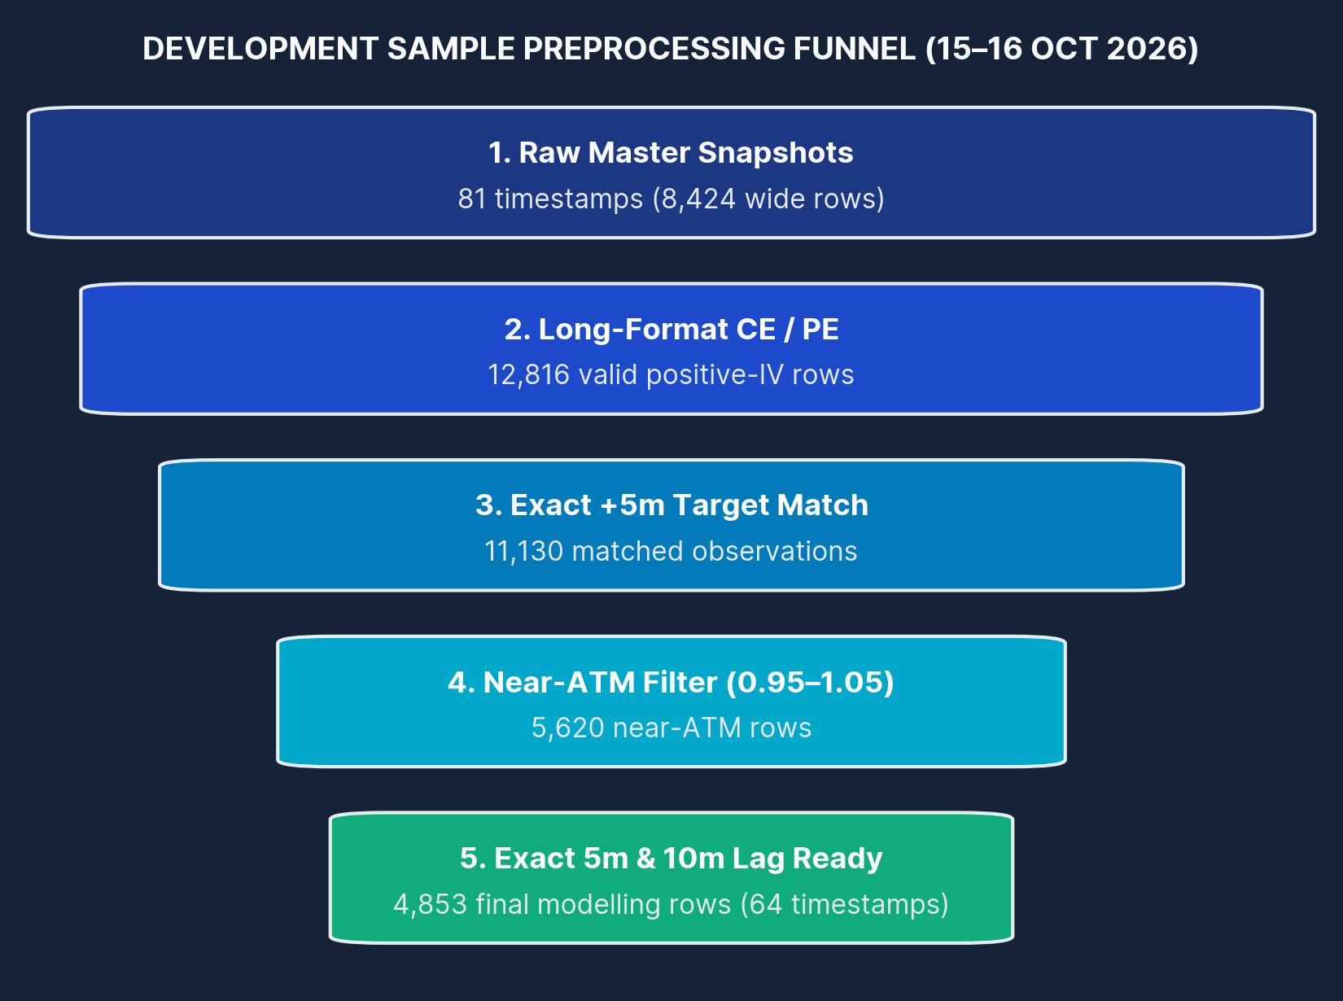
06 • DATA DESCRIPTION, SOURCES & PREPROCESSING FUNNEL
NIFTY 50 Option-Chain Dataset & Exact 5-Stage Preprocessing Funnel
Preserving exact timestamp alignment and separating the 15–16 Oct development set from the 19 Oct expiry-day test
Dataset Dimension | Exact Project Specification
Data Source | NSE option-chain CSV snapshots; Upstox option-chain API for live prototype
Instrument | NIFTY 50 weekly index options — Call (CE) and Put (PE) contracts
Development Period | 15–16 October 2026 (Contract Expiry: 19 October 2026)
Development Raw Master | 8,424 wide option-chain rows across 81 successful 5-minute snapshots
Final Lag-Ready Sample | 4,853 near-ATM rows across 64 unique lag-ready timestamps
Expiry-Day Robustness Set | 1,137 near-ATM rows across 18 lag-ready timestamps on 19 October 2026
Core & Engineered Variables | IV, LTP, volume, OI, bid, ask, strike, spot; plus 39 engineered current & lag features
RIGOROUS DATA HYGIENE & CLEANING PRINCIPLES
• Positive IV only (IV > 0) • Near-ATM economic filter (0.95 ≤ M ≤ 1.05)
• Exact 5m/10m timestamp matching • Zero target-based outlier deletion (preserves real spikes)
SEPARATE EXPIRY-DAY ROBUSTNESS SAMPLE (19 OCT 2026)
Kept strictly separate from development data: 1,137 near-ATM rows across 18 lag-ready timestamps (TTE: 0.17–1.58 hrs) to test out-of-regime behaviour.
Quantitative Options Analytics | Implied Volatility Intelligence | Machine Learning | Risk-Aware Decision Support
Slide 7 / 15
Notes:
1. What to explain: Walk through the exact data sources and the 5-stage preprocessing funnel on the right: starting from 81 raw snapshots (8,424 wide rows where CE and PE sit side-by-side per strike), reshaping into long format (16,848 contract rows, of which 12,816 have valid positive IV), matching exact +5-minute targets (11,130 rows), applying the near-ATM filter 0.95 <= M <= 1.05 (5,620 rows), and requiring exact 5m and 10m lags to reach the final development sample of 4,853 rows across 64 timestamps.
2. Why the method/concept was used: Highlight two critical methodological choices: (a) we never interpolate across missing timestamps—every 5m and 10m lag is an exact timestamp match, and (b) we did not delete large target movements as 'outliers', because volatility spikes are real market events.
3. What the result means: Also note that the 19 October 2026 expiry-day sample (1,137 rows across 18 timestamps) is kept completely separate as an out-of-regime stress test.
4. Likely Viva Question & Answer:
Q: How can 8,424 raw master rows become 12,816 valid IV rows in Step 2 of your funnel?
A: Each row in the raw NSE master table is a wide strike snapshot containing both Call (CE) and Put (PE) columns side by side. Reshaping the 8,424 wide rows into long contract format (stacking CE and PE separately) produces 16,848 contract-level rows; removing zero or missing IV quotes leaves 12,816 valid positive-IV rows.

Slide 8
07 • METHODOLOGY & ANALYTICAL FRAMEWORK
Eight-Stage Analytical Pipeline & Chronological Validation Safeguards
Preventing cross-sectional look-ahead leakage through strict timestamp-based splitting and exact horizon matching
STAGE 01 • ACQUIRE
Option-chain snapshots
Ingest 5-minute NIFTY 50 NSE CSV snapshots & Upstox API feeds.
STAGE 02 • CLEAN
CE/PE long format
Stack Calls & Puts into long format; retain valid positive IV (12,816 rows).
STAGE 03 • ENGINEER
39 current + lag features
Compute moneyness, liquidity, bid-ask spread, and exact 5m & 10m lags.
STAGE 04 • TARGET
Exact ΔIV at t+5
Match each strike & option type to its exact t+5m snapshot (4,853 rows).
STAGE 05 • VALIDATE
Chronological split
Split strictly by unique ordered timestamps (51 train / 13 holdout).
STAGE 06 • COMPARE
Persistence / RF / XGB
Evaluate MAE, RMSE, R² & directional accuracy against ΔIV = 0 baseline.
STAGE 07 • INTERPRET
Relative-IV signals
Classify current strike IV into Low, Fair/Neutral, or High vs forecast.
STAGE 08 • RISK TEST
Black–Scholes scenarios
Quantify option rupee valuation under Spot, IV & combined shocks.
CRITICAL VALIDATION PRINCIPLE: WHY CHRONOLOGICAL TIMESTAMP SPLITTING IS MANDATORY
Cross-sectional strikes observed at the same timestamp share the exact same underlying NIFTY 50 spot shock and market regime—they are NOT independent time periods.
✗ INVALID: RANDOM ROW-LEVEL SPLIT (DATA LEAKAGE)
Same-Timestamp Leakage: If Strike 23,100 CE at 10:15 is in Train and Strike 23,150 CE at 10:15 is in Test, the model already knows the 10:15→10:20 market shock.
Artificially Inflated Metrics: Random splitting mixes future timestamps into training and memorises cross-sectional shocks.
✓ PROJECT PROTOCOL: CHRONOLOGICAL TIMESTAMP SPLIT
Strict Temporal Boundary: Split by unique ordered timestamps: first ~80% of timestamps for training (3,870 rows), final ~20% for holdout testing (983 rows).
True Out-of-Sample Evaluation: Every holdout timestamp occurs strictly after all training timestamps, mimicking real-time deployment.
Quantitative Options Analytics | Implied Volatility Intelligence | Machine Learning | Risk-Aware Decision Support
Slide 8 / 15
Notes:
1. What to explain: Walk through the 8-stage pipeline from option-chain snapshot acquisition to Black-Scholes risk testing, and focus heavily on the bottom validation diagram.
2. Why the method/concept was used: Explain why standard random train/test splitting (like scikit-learn's default train_test_split on rows) is methodologically invalid for option-chain panel data: at any single timestamp t, dozens of near-ATM strikes are observed simultaneously. If some strikes at timestamp t are placed in training and adjacent strikes at the same timestamp t are placed in testing, the tree model memorises the market-wide volatility shock between t and t+5.
3. What the result means: Splitting strictly by unique chronological timestamps guarantees zero look-ahead leakage and produces an honest out-of-sample holdout test (983 observations).
4. Likely Viva Question & Answer:
Q: Why couldn't you use a standard random 80/20 row split across the 4,853 observations?
A: Because the dataset is a panel of cross-sectional option strikes observed across 64 timestamps (~76 strikes per timestamp). Strikes at the same timestamp experience the same underlying NIFTY 50 spot and macro shock over the next 5 minutes. A random row split puts identical timestamps in both train and test sets, causing severe cross-sectional data leakage.

Slide 9
08 • IMPLEMENTATION, HYPERPARAMETERS & SYSTEM ARCHITECTURE
Random Forest Specifications, 39-Feature Design & Live Pipeline
Nonlinear tree ensemble configuration, current and lagged feature groups, and automated Upstox-to-Streamlit workflow
SELECTED MODEL: RANDOM FOREST
39-FEATURE ENGINEERING SET
ADDITIONAL IMPLEMENTATION
XGBoost Benchmark: Nonlinear gradient-boosted regression benchmark on identical features.
Direction Classifier: Experimental 3-class RF classifier tested for directional probabilities.
Stress-Test Rate: Black–Scholes stress testing used a 6% annual risk-free rate assumption.
Saved Joblib Artefacts: Trained RF model, 39-feature list, and training medians exported via joblib.
Live Upstox Loop: Upstox API connection and automated 5-minute collection loop implemented.
TREES
300
MAX DEPTH
12
CURRENT
15
IV, spot, strike...
LAG / MOM.
24
5m & 10m lags
MIN LEAF
3
MAX FEATURES
sqrt
15 Current Features: Current IV, spot, strike, CE/PE flag, moneyness (K/S), LTP, bid, ask, spread, volume, and OI.
24 Lagged Variables: Exact 5m & 10m lags and changes for IV, spot, LTP, volume, OI, and bid-ask spread.
Exact Time-to-Expiry: Engineered later for expiry-day analysis and option-pricing stress tests.
Target: ΔIV(t+5) = IV(t+5) − IV(t)
Why Random Forest?
Nonlinear tree ensemble suitable for complex interactions among IV, moneyness, liquidity, and recent market movement.
LIVE DATA-TO-MODEL-TO-DASHBOARD SYSTEM ARCHITECTURE
1. Upstox API / CSV
5-Min Option Snapshots
2. Feature Engine
Near-ATM + 39 Features
3. Joblib RF Model
300-Tree RF + Medians
4. Valuation & Risk
Rel-IV + BS Stress (6%)
5. Streamlit App
Live Analytics Dashboard
Quantitative Options Analytics | Implied Volatility Intelligence | Machine Learning | Risk-Aware Decision Support
Slide 9 / 15
Notes:
1. What to explain: Detail the selected Random Forest Regressor specifications (300 trees, max_depth=12, min_samples_leaf=3, max_features='sqrt', target = Delta_IV_{t+5}), the 39-feature design (15 current snapshot features + 24 exact 5m and 10m lag/momentum features across IV, spot, LTP, volume, OI, and bid-ask spread), and the live Upstox-to-Streamlit deployment pipeline.
2. Why the method/concept was used: Constraining tree depth to 12 and requiring at least 3 samples per leaf prevents the 300-tree ensemble from memorising noisy single-strike ticks, while 'sqrt' feature subsampling decorrelates trees across the 39 collinear market features.
3. What the result means: Exporting the trained model, exact 39-feature schema, and training medians via joblib ensures that the Streamlit dashboard applies identical preprocessing during live Upstox API polling.
4. Likely Viva Question & Answer:
Q: Why did you set max_depth=12 and min_samples_leaf=3 in your Random Forest instead of letting trees grow unpruned?
A: High-frequency 5-minute option-chain data contains microstructure noise and bid-ask bounce. Unpruned trees overfit to isolated noise observations; capping depth at 12 and requiring at least 3 observations per leaf acts as regularisation, improving out-of-sample generalisation.

Slide 10
09 • EMPIRICAL RESULTS & OUT-OF-SAMPLE MODEL COMPARISON
Random Forest Outperforms Persistence & XGBoost on Chronological Holdout
Comparable out-of-sample evaluation on the final chronological development holdout (983 near-ATM observations)
OUT-OF-SAMPLE ERROR COMPARISON (IV PERCENTAGE POINTS — LOWER IS BETTER)
Model Specification | MAE | RMSE | Implied R²
Persistence Baseline | 0.5505 | 1.3207 | 0.9843
Random Forest + Lag (Selected) | 0.5214 | 1.2188 | 0.9866
XGBoost + Lag | 0.5530 | 1.2964 | 0.9849
MAE IMPROVEMENT
5.28%
Random Forest vs Persistence
(0.5214 vs 0.5505 IV pts)
RMSE IMPROVEMENT
7.72%
Random Forest vs Persistence
(1.2188 vs 1.3207 IV pts)
CRITICAL QUANTITATIVE INTERPRETATION OF MODEL PERFORMANCE
Why Nonlinear Tree Models Were Required: Initial direct-level Linear Regression was much weaker (MAE ≈ 6.17), motivating target differencing (ΔIV) and nonlinear tree ensembles.
Why High R² (0.9866) Must Not Be Overstated: Persistence alone achieves R² = 0.9843 because 5-minute IV levels are highly autocorrelated. The true proof of skill is the 5.28% MAE and 7.72% RMSE reduction.
Quantitative Options Analytics | Implied Volatility Intelligence | Machine Learning | Risk-Aware Decision Support
Slide 10 / 15
Notes:
1. What to explain: Present the core out-of-sample comparison on the chronological development holdout. Random Forest + Lag achieved the lowest MAE (0.5214) and lowest RMSE (1.2188), beating the persistence baseline (MAE 0.5505, RMSE 1.3207) by 5.28% in MAE and 7.72% in RMSE. XGBoost + Lag reduced RMSE (1.2964) relative to persistence but had a slightly higher MAE (0.5530).
2. Why the method/concept was used: Also note that an initial direct-level Linear Regression baseline yielded MAE approx. 6.17, proving why predicting Delta_IV with nonlinear tree ensembles was necessary.
3. What the result means: Emphasise academic honesty regarding R²: although Random Forest achieves R² = 0.9866 on implied future IV levels, persistence already achieves R² = 0.9843 because IV moves slowly over 5 minutes. Therefore, MAE and RMSE reductions are the proper evaluation metrics.
4. Likely Viva Question & Answer:
Q: Your R² is 0.9866—does that mean your model explains 98.66% of future volatility changes?
A: No, and it is crucial not to overstate that figure. The R² of 0.9866 is measured on the reconstructed future IV level (IV_hat_{t+5}), where the naive persistence forecast already gets R² = 0.9843 due to strong autocorrelation. The genuine predictive gain of Random Forest is the 5.28% reduction in MAE and 7.72% reduction in RMSE over persistence.

Slide 11
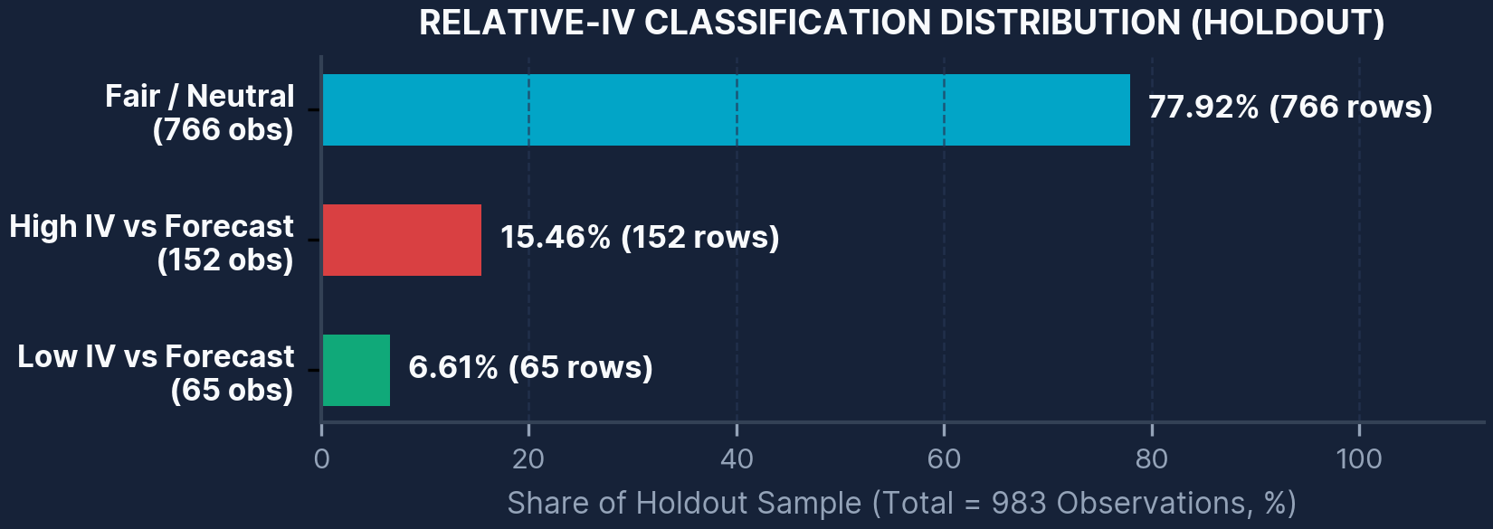
10 • FEATURE IMPORTANCE, RELATIVE-IV & DIRECTIONAL ANALYSIS
Feature Drivers, Relative-IV Signals & Directional Thresholding
Decomposing Random Forest feature importance and translating 5-minute forecasts into relative-IV regimes
TOP 6 RANDOM FOREST FEATURE IMPORTANCES (ORIGINAL VALUES)
CRITICAL VIVA DISTINCTION: WHAT 'LOW IV VS FORECAST' MEANS
“Low IV vs forecast” (65 obs, 6.61%) means current IV is below the model's 5-minute forecast (IV is expected to rise)—it does NOT automatically mean the option is cheap or should be bought.
DIRECTIONAL FILTERING
53.20% → 63–64%
All Holdout Rows: 53.20% directional accuracy across all 983 rows.
Thresholds (0.05–0.25): Accuracy rose to ~63–64% while coverage fell to ~16–28%.
PROBABILITY EXPERIMENT
50.36% | 51.44%
3-Class RF Classifier: 50.36% overall accuracy; 51.44% balanced accuracy.
Rigorous Conclusion: Probability scores were NOT treated as reliable trading confidence.
ECONOMIC INTERPRETATION OF TOP PREDICTORS
Short-Horizon IV Momentum Dominates: 5m IV change (0.0721), 10m IV change (0.0674), Current IV (0.0653), and 5m lagged IV (0.0427) are the strongest signals.
Liquidity & Underlying Context: Bid-ask spread (0.0352) and 5m lagged spot (0.0340) capture microstructure friction and index pressure.
Quantitative Options Analytics | Implied Volatility Intelligence | Machine Learning | Risk-Aware Decision Support
Slide 11 / 15
Notes:
1. What to explain: Explain the three analytical layers on this slide: (1) Feature importance led by 5m IV change (0.0721), 10m IV change (0.0674), Current IV (0.0653), 5m IV lag (0.0427), bid-ask spread (0.0352), and 5m spot lag (0.0340); (2) Relative-IV holdout distribution (766 Fair/Neutral = 77.92%, 152 High IV vs forecast = 15.46%, 65 Low IV vs forecast = 6.61%); and (3) Directional accuracy and probability classification results.
2. Why the method/concept was used: Most observations (77.92%) were classified as Fair/Neutral because over a 5-minute interval, expected IV changes are typically small unless a stronger move is predicted. When filtering for larger predicted movements (|Delta_IV_hat| between 0.05 and 0.25), directional accuracy improves from 53.20% overall to roughly 63–64%, though coverage drops to 16–28% of observations.
3. What the result means: Emphasise two critical viva points: first, 'Low IV vs forecast' means current IV is below the model's 5-minute forecast, NOT that the option is guaranteed to be cheap or profitable to buy. Second, the experimental 3-class direction classifier achieved only 50.36% accuracy (51.44% balanced accuracy), so its uncalibrated probabilities were rightly rejected as trading confidence scores.
4. Likely Viva Question & Answer:
Q: If an option is flagged as 'Low IV vs forecast' (6.61% of cases), should a trader immediately buy it?
A: No. 'Low IV vs forecast' only means current IV is lower than the model's 5-minute forecast (i.e., IV is predicted to rise). Whether the option's rupee price actually rises depends heavily on underlying spot movement (Delta/Gamma) and bid-ask transaction costs, which is why we pair the signal with Black-Scholes stress testing.

Slide 12
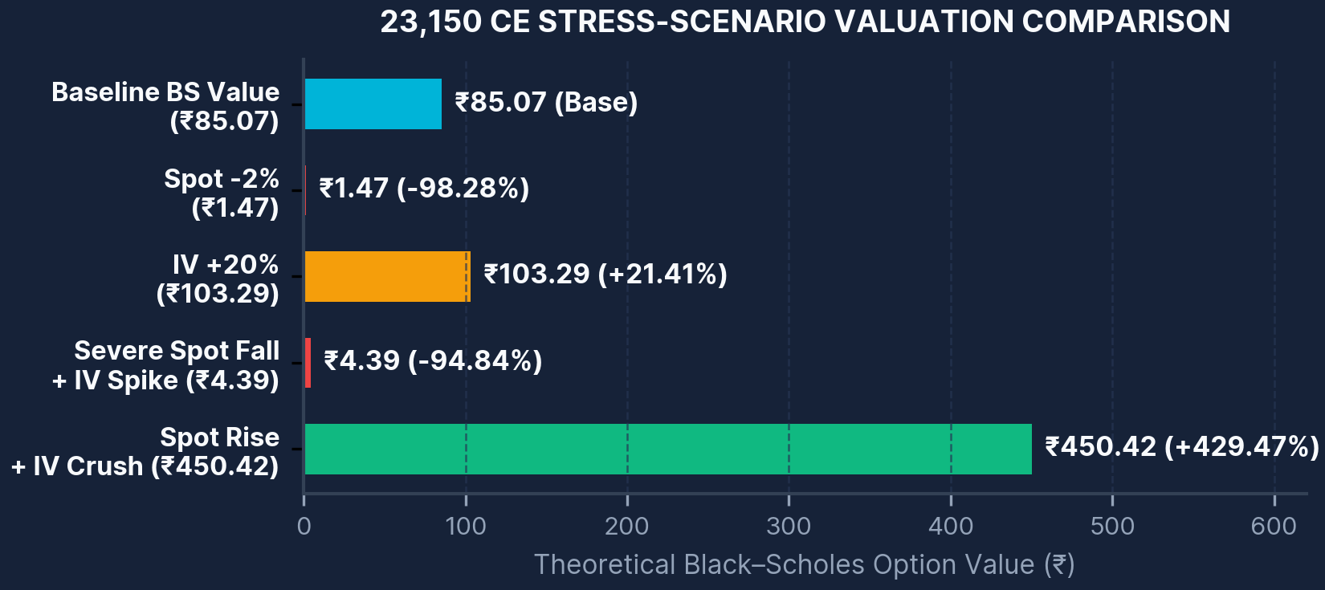
11 • PRACTICAL APPLICATIONS & BLACK–SCHOLES RISK STRESS TESTING
Linking IV Forecasts to Option Valuation, Stress Scenarios & Live Workflow
Evaluating how underlying spot shocks and implied volatility shifts jointly impact near-ATM option premiums
STRESS-TEST CASE: NEAR-ATM 23,150 CALL OPTION (23,150 CE)
Spot
23,125.65
Market LTP
₹81.70
Current IV
10.71%
TTE (Hours)
74.58 hrs
BS Value
₹85.07
Stress Scenario (vs BS Base ₹85.07) | Option Value | % Change
Spot −2% | ₹1.47 | −98.28%
IV +20% | ₹103.29 | +21.41%
Severe spot fall + IV spike | ₹4.39 | −94.84%
Spot rise + IV crush | ₹450.42 | +429.47%
PRACTICAL WORKFLOW & SKILLS DEVELOPED
Relative Screening: Screen current strike IV against the model's expected 5-minute IV forecast.
Integrated Monitoring: Monitor volatility smile, moneyness, liquidity, and ML output together.
Automated Live Loop: Run an automated Upstox API → 39 features → saved RF → Streamlit workflow.
Skills Developed: Options analytics • Python/pandas • API integration • ML validation • Risk modelling • Streamlit dashboarding
KEY RISK INTERPRETATION: DELTA DOMINATES VEGA FOR NEAR-ATM CALLS
For the selected 23,150 CE, spot-price exposure dominated moderate IV and short-horizon time-decay effects: even with an IV spike, a severe spot fall wiped out 94.84% of option value (₹85.07 → ₹4.39).
Quantitative Options Analytics | Implied Volatility Intelligence | Machine Learning | Risk-Aware Decision Support
Slide 12 / 15
Notes:
1. What to explain: Walk through the near-ATM 23,150 CE stress-test case (Spot = 23,125.65, Market LTP = Rs 81.70, Current IV = 10.71%, Time to expiry = 74.58 hours, Baseline Black-Scholes value = Rs 85.07 at r = 6%). Then compare the four stress scenarios: Spot -2% drops value to Rs 1.47 (-98.28%), IV +20% lifts value to Rs 103.29 (+21.41%), Severe spot fall + IV spike collapses value to Rs 4.39 (-94.84%), and Spot rise + IV crush surges value to Rs 450.42 (+429.47%).
2. Why the method/concept was used: This concrete numerical test proves why an 'IV expected to rise' forecast is NEVER a standalone signal to buy a Call option.
3. What the result means: If a trader buys the 23,150 CE expecting higher IV, and IV indeed spikes during a sharp market sell-off ('Severe spot fall + IV spike'), the negative Delta effect crushes the Call option from Rs 85.07 to Rs 4.39 (-94.84%), completely overwhelming the positive Vega effect.
4. Likely Viva Question & Answer:
Q: Why is the theoretical Black-Scholes baseline price (Rs 85.07) slightly different from the observed market LTP (Rs 81.70)?
A: The Black-Scholes calculation uses the continuous 6% annual risk-free rate assumption, spot price (23,125.65), reported IV (10.71%), and time to expiry (74.58 hours), whereas market LTP reflects discrete bid-ask quotes, implied dividend/futures basis, and microstructure timing. All stress percentage changes (-98.28%, +21.41%, -94.84%, +429.47%) are measured consistently against the Rs 85.07 Black-Scholes baseline.

Slide 13
12 • EXPIRY-DAY ROBUSTNESS TEST, LIMITATIONS & FUTURE RESEARCH
Expiry-Day Regime Shift (19 Oct) & Scope for Future Research
Transparently evaluating out-of-regime model breakdown on expiry day and defining research extensions
19 OCT 2026 EXPIRY-DAY DETERIORATION AS CLOSE APPROACHED
RF MAE (19 OCT)
17.42
Expiry-day error
PERSISTENCE MAE
14.47
Better baseline
DIRECTION ACC.
19.09%
Collapsed
CURRENT PROJECT LIMITATIONS
Short Development Window: Only 64 lag-ready development timestamps across two trading days (15–16 Oct 2026).
Cross-Sectional Dependence: Cross-sectional option rows at the same timestamp are not independent time periods.
Unmodelled Market Frictions: Transaction costs, bid-ask slippage, and live order execution latency are not modelled.
WHY THE MODEL BROKE DOWN ON EXPIRY DAY: UNSEEN REGIME SHIFT
• Development TTE: 74.6 – 100.6 hours remaining (Normal multi-day regime)
• 19 Oct Expiry TTE: 0.17 – 1.58 hours remaining (Final minutes to settlement)
As T → 0 on expiry afternoon, tiny price ticks cause extreme swings in inverted IV. The model had never seen true expiry-day conditions during training.
FUTURE RESEARCH PRIORITIES
Multi-Month & Expiry Dataset: Collect months of 5-minute data spanning multiple weekly expiry cycles.
Explicit TTE & Option Greeks: Include exact time-to-expiry and analytical Greeks (Delta, Gamma, Vega, Theta) directly in training features.
Regime-Aware & Cost-Aware Models: Implement calibrated directional probabilities, rolling time-series CV, regime-switching models, and cost-aware backtesting.
Quantitative Options Analytics | Implied Volatility Intelligence | Machine Learning | Risk-Aware Decision Support
Slide 13 / 15
Notes:
1. What to explain: Present the 19 October 2026 expiry-day robustness test transparently. Across 1,137 rows (18 timestamps with only 0.17 to 1.58 hours to expiry), Random Forest MAE jumped to 17.42 vs Persistence MAE of 14.47, and directional accuracy collapsed to 19.09%. Show on the line chart how both actual |Delta_IV| and RF error exploded between 13:55 and 15:20 as settlement approached.
2. Why the method/concept was used: Rather than hiding or deleting the expiry-day sample, evaluating the model on 19 October provided crucial scientific evidence of regime shift: a model trained when 74.6 to 100.6 hours remained to expiry cannot extrapolate to the final 10–95 minutes before expiry when Vega approaches zero and Gamma/Theta explode.
3. What the result means: Highlight the limitations (64 timestamps over 2 days, cross-sectional correlation, unmodelled transaction costs/slippage/latency) and the concrete roadmap for future research.
4. Likely Viva Question & Answer:
Q: Why did your Random Forest model perform worse than persistence on 19 October (MAE 17.42 vs 14.47, direction accuracy 19.09%)?
A: Because of a severe regime shift in time-to-expiry. During training (15–16 Oct), options had 74.6 to 100.6 hours left to expiry, where 5-minute IV changes averaged ~0.55 points. In the 19 Oct test window (13:55–15:20), only 0.17 to 1.58 hours remained. Near expiry, option Vega collapses toward zero, so tiny ₹0.05–₹0.50 price ticks cause massive inverted IV jumps (mean |Delta_IV| reached 53.23 points by 15:20). Because the tree ensemble never saw expiry-day observations in training, its mean-reversion splits misfired.

Slide 14
13 • EXECUTIVE SUMMARY & PROJECT CONCLUSIONS
Conclusions: Modest Out-of-Sample Forecast Gain & Regime-Aware Risk Support
Synthesising empirical findings across forecasting, relative-IV valuation, stress testing, and live deployment
MAIN EMPIRICAL CONCLUSION
A nonlinear Random Forest regressor engineered with exact 5-minute and 10-minute lag features produced a modest but measurable out-of-sample improvement over the persistence benchmark in the normal development regime.
1. FORECASTING OBJECTIVE
ACHIEVED (PROTOTYPE)
2. INTERPRETATION OBJECTIVE
ACHIEVED
Random Forest + Lag achieved MAE = 0.5214 and RMSE = 1.2188 on the chronological holdout, improving on Persistence (MAE = 0.5505, RMSE = 1.3207) by 5.28% in MAE and 7.72% in RMSE.
Implemented a Relative-IV interpretation layer classifying strike IV into Fair/Neutral (77.92%), High IV vs forecast (15.46%), and Low IV vs forecast (6.61%), plus directional threshold analysis.
3. RISK STRESS-TESTING OBJECTIVE
ACHIEVED
4. LIVE DEPLOYMENT OBJECTIVE
PARTIALLY VALIDATED
Implemented Black–Scholes scenario analysis (23,150 CE case), demonstrating quantitatively that underlying spot price exposure (Delta/Gamma) can dominate moderate IV changes.
Upstox API connectivity, automated 5-minute snapshot collection loop, joblib model pipeline, and Streamlit dashboard are operational; full market-hours live validation remains future work.
OVERALL QUANTITATIVE SYNTHESIS
Overall, the project demonstrates both the practical usefulness and the real-world boundaries of short-horizon implied volatility forecasting: measurable predictive value exists in normal multi-day regimes, but performance is strongly regime-dependent (especially near expiry) and must be combined with option risk stress testing rather than treated as a stand-alone trading rule.
Quantitative Options Analytics | Implied Volatility Intelligence | Machine Learning | Risk-Aware Decision Support
Slide 14 / 15
Notes:
1. What to explain: Summarise the four project objectives and their exact validation status: Forecasting (Achieved as a prototype: RF MAE 0.5214 vs Persistence 0.5505), Relative-IV Interpretation (Achieved), Black-Scholes Risk Stress Testing (Achieved), and Live Dashboard Deployment (Partially validated—API connection and 5-minute collection loop work, while full market-hours live validation remains to be completed).
2. Why the method/concept was used: Presenting an honest scorecard that distinguishes completed offline validation from partial live validation demonstrates research maturity.
3. What the result means: Close the technical narrative by reiterating that short-horizon IV forecasts provide useful context in normal regimes but are regime-dependent near expiry and must always be paired with spot/volatility risk analysis.
4. Likely Viva Question & Answer:
Q: Why do you classify the Deployment Objective as 'Partially validated' rather than fully completed?
A: While the Upstox API integration, automated 5-minute data collection loop, joblib model inference pipeline, and Streamlit dashboard interface were fully coded and verified functionally, continuous multi-week live market-hours validation was not completed within the internship window.

Slide 15
14 • REFERENCES, ACKNOWLEDGEMENT & VIVA SIGN-OFF
Selected References, Institutional Acknowledgement & Software Stack
Traceable academic literature, market data authorities, API documentation, and open-source quantitative libraries
SELECTED REFERENCES
Black, F., & Scholes, M. (1973). The Pricing of Options and Corporate Liabilities. Journal of Political Economy, 81(3), 637–654. DOI: 10.1086/260062.
National Stock Exchange of India (NSE). NIFTY Option Chain (Equity Derivatives): https://www.nseindia.com/option-chain
Upstox Developer API. Put/Call Option Chain Documentation: https://upstox.com/developer/api-documentation/get-pc-option-chain/
Upstox Developer API. Option Contracts Documentation: https://upstox.com/developer/api-documentation/get-option-contracts/
scikit-learn Documentation. RandomForestRegressor API: https://scikit-learn.org/stable/modules/generated/sklearn.ensemble.RandomForestRegressor.html
XGBoost Documentation. Python / XGBRegressor API: https://xgboost.readthedocs.io/en/latest/python/python_api.html
Streamlit Documentation. Streamlit App Framework: https://docs.streamlit.io/
INSTITUTIONAL ACKNOWLEDGEMENT
I sincerely acknowledge Surabhi Investment Services Pvt. Ltd., Tiruchirappalli, for providing practical internship exposure in options trading, and the Department of Quantitative Finance, Pondicherry University, for academic guidance and research support.
SOFTWARE & QUANTITATIVE LIBRARIES USED
Python • pandas • NumPy • SciPy • scikit-learn • XGBoost • Matplotlib • Streamlit
Thank You
Open for Viva-Voce Questions & Discussion
Diviya C. • Reg. No. 25MSQUFPY0018
M.Sc. Quantitative Finance • Pondicherry University
Quantitative Options Analytics | Implied Volatility Intelligence | Machine Learning | Risk-Aware Decision Support
Slide 15 / 15
Notes:
1. What to explain: Conclude the presentation by acknowledging Surabhi Investment Services Pvt. Ltd. (Tiruchirappalli) and Pondicherry University, highlighting the open-source Python quantitative stack used, and inviting questions from the viva examination panel.
2. Why the method/concept was used: Every theoretical equation (Black & Scholes, 1973), market dataset (NSE Option Chain), live API endpoint (Upstox Developer API), and machine-learning implementation (scikit-learn, XGBoost, Streamlit) is formally cited and traceable.
3. What the result means: The presentation is complete, transparent, and grounded entirely in the empirical findings of the internship project.
4. Likely Viva Question & Answer:
Q: If you had to pick the single most important lesson from building this system end-to-end, what would it be?
A: That rigorous chronological validation and regime awareness matter even more than algorithm complexity: a well-regularised Random Forest with exact lag features can beat persistence in normal market regimes, but understanding where the model breaks down (such as expiry day) and pairing forecasts with Black-Scholes stress tests is what turns a statistical model into responsible quantitative finance research.

