Slide 1
Domain Model Generator
Iteration 2
Team6
Aravind Krishnakumar
Divya Maria Jose
Fuqiang Zhang
Jacob Danks
Negar Ziaee Nasrabadi

Slide 2
Requirements
R1. DMG shall identify the word’s part of speech automatically.
R2. DMG shall allow user to classify the phrases.
R3. DMG shall allow the user to choose multiple phrases in the text.
R4. DMG shall allow user to add one to many phrases to the model concept list.
R5. DMG shall allow user to assign one to many attributes to one of the classes in the model concept list.

Slide 3
Brainstorming
  The DMG has a text input area and a Model Concept List¹. The User¹ can open, write and save a text document.
  The user¹ can identify³ the Domain specific phrases¹. The user can select one or multiple Domain specific phrase(s) ¹, and drag and drop to the drop area. Noun / Noun phrase¹, X of Y expression¹, Transitive Verb¹ , Numeric ¹, Possession Expression¹, Adjective/Adverb/Enumeration¹, Part of expression¹, Containment expression¹, X is Y expression¹ are the Domain Specific Phrases¹. The Domain specific phrase(s)¹ are classified³ to Model Concepts¹.
  A Model Concept list¹ can have⁶ many⁵ Model Concepts¹. Model Concept¹ has⁶ name¹. Relationship¹ and Class¹ are Model Concepts.

Slide 4
Brainstorming(2)
  Association¹, Inheritance¹, Aggregation¹ and Association Class¹ are Relationship¹. Class¹ has⁶ Attribute¹. Relationship¹ has⁶ Class¹.
  Association¹ has⁶ Source Class Role¹, Source Class Multiplicity¹, Destination Class Role¹ and Destination Class multiplicity¹. Aggregation¹ has⁶ part class multiplicity¹. Attribute¹ has⁶ name¹.
  The user¹ can edit⁶ the Model Concept List¹ and the Model Concepts¹.

Slide 5
Classification
Brainstorming List | Classification Result | Rule
model Concept List¹ | (C) model concept list | 1A
relationship¹ | (C) relationship | 1D
class¹ | (C) class | 1D
attribute¹ | (C) attribute | 1A
aggregation¹ | (C) aggregation | 1D
association¹ | (C) association | 1D
association class¹ | (C) association class | 1D
inheritance¹ | (C) inheritance | 1D
domain specific phrase¹ | (C) domain specific phrase | 1D

Slide 6
Classification(2)
Noun/Noun phrase¹ | (C) Noun/Noun phrase | 1D
x of y expression¹ | (C) x of y expression | 1D
transitive verb¹ | (C) transitive verb | 1D
Adjective/Adverb/Enumeration¹ | (C) Adjective/Adverb/Enumeration | 1D
numeric¹ | (C) numeric | 1D
possession expression¹ | (C) posession expression | 1D
part of expression¹ | (C) part of expression | 1D
containment expression¹ | (C) containment expression | 1D
x is y expression¹ | (C) x is y expression | 1D
user¹ | (C) user | 1A
source class role¹ | (A) source class role | 1E

Slide 7
Classification(3)
destination class role¹ | (A) destination class role | 1E
source class multiplicity¹ | (A) source class multiplicity | 1E
destination class multiplicity¹ | (A) destination class multiplicity | 1E
part class multiplicity¹ | (A) part class multiplicity | 1E
model concept¹ | (C) model concept | 1A
diagram¹ | (C) diagram | 1A
Identify³ | (AS)Identify(User, Domain Specific Phrases) | 1A
Edit³ | (AS) Edit (User, Model concept list) | 3
Edit³ | (AS) Edit (User, Model Concept) | 3
Classify³ | (AS) Classify (Domain Specific Phrases, Model Concept) | 3

Slide 8
Classification(4)
Many⁵ | (0 ...*) | 5
Generate³ | (AS) Generate (User, Diagram) | 3
Has⁶ | (AG) Has (Class has Attribute) | 6(a)
Has⁶ | (AG) Has (Attribute has Name) | 6(a)
Has⁶ | (AG) Has (Relationship has Class) | 6(a)
Has⁶ | (AG) Has (Model concept list has model concepts) | 6(a)
Has⁶ | (AG) Has (Association class has Class) | 6(a)
Has⁶ |  | 6(b)
Has⁶ | (AG) Has (Diagram has Model Component) | 6(a)

Slide 9
Classification(5)
Noun/Noun phrase is Domain specific phrase¹ | (I) ISA(Noun/Noun phrase, Domain specific phrase) | 9
x of y expression is Domain specific phrase¹ | (I) ISA(x of y expression, Domain specific phrase) | 9
transitive verb is Domain specific phrase¹ | (I) ISA(transitive verb, Domain specific phrase) | 9
Adjective/Adverb/Enumeration is Domain specific phrase¹ | (I) ISA(Adjective/Adverb/Enumeration, Domain specific phrase) | 9
numeric is Domain specific phrase¹ | (I) ISA(numeric, Domain specific phrase) | 9
possession expression is Domain specific phrase¹ | (I) ISA(possession expression, Domain specific phrase) | 9
part of expression is Domain specific phrase¹ | (I) ISA(part of expression, Domain specific phrase) | 9

Slide 10
Classification(6)
containment expression is Domain specific phrase¹ | (I) ISA(conteinment expression, Domain specific phrase) | 9
x is y expression is Domain specific phrase¹ | (I) ISA(x is y expression, Domain specific phrase) | 9
inheritance is relationship¹ | (I) ISA(inheritance, relationship) | 9
aggregation is relationship¹ | (I) ISA(aggregation, relationship) | 9
association is relationship¹ | (I) ISA(association, relationship) | 9
association class is model concept¹ | (I) ISA(association class, model concept) | 9
class is model concept¹ | (I) ISA(class, model concept) | 9
relationship is model concept¹ | (I) ISA(relationship, model concept) | 9

Slide 11
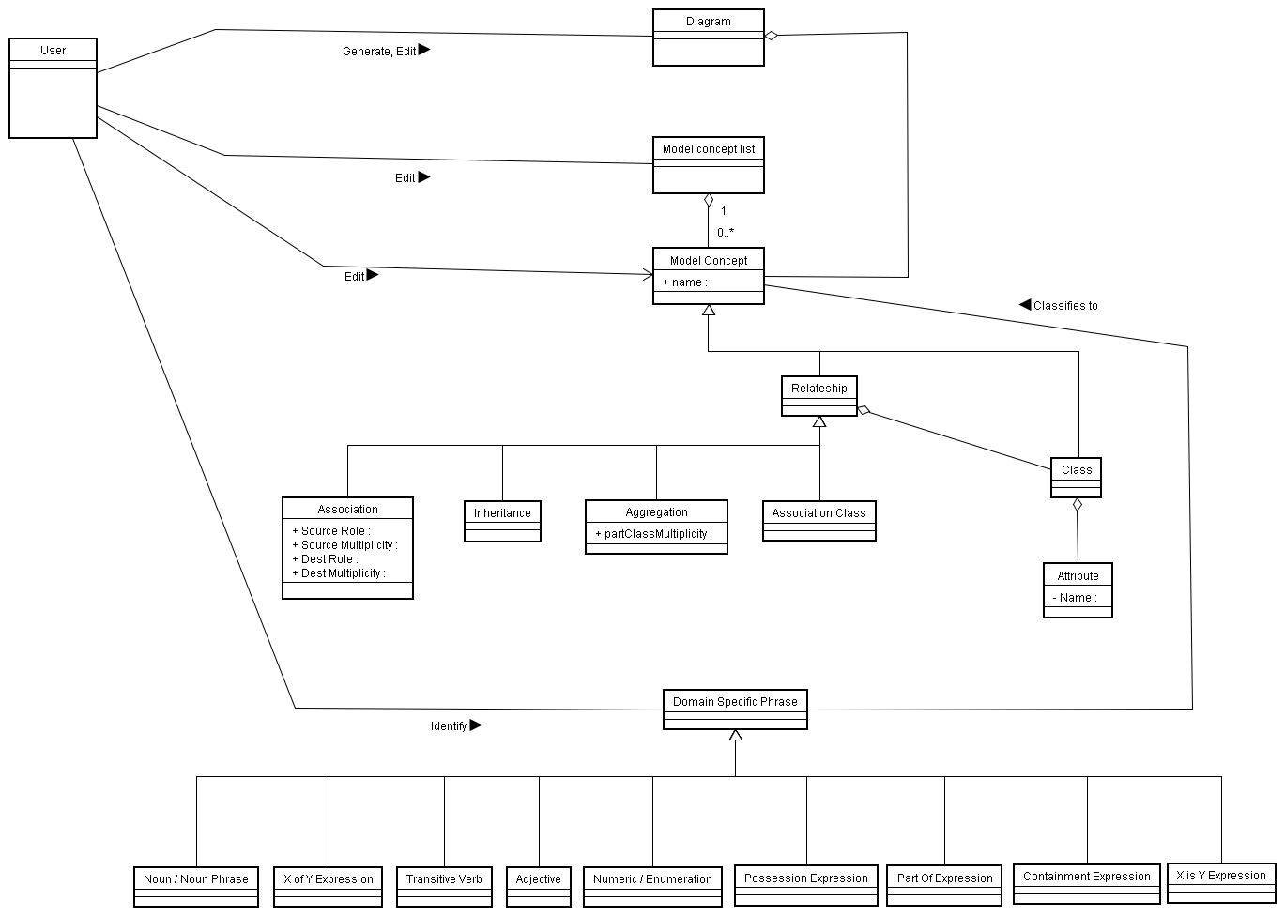
Domain Model Class Diagram

Slide 12
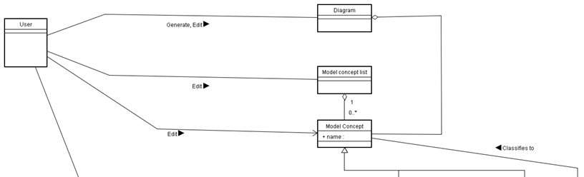
Domain class Diagram (1)

Slide 13
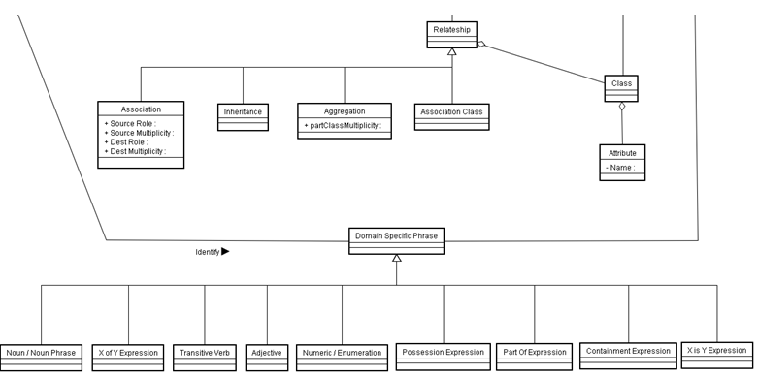
Domain Class Diagram (2)

Slide 14
Abstract and High level Use Cases
UC1. Auto Identify Phrases(Actor: User, System: DMG)
TUCBW a user clicks the “Identify Phrases” button.
  TUCEW The user sees the text, colored according to the Part of Speech of the phrases.
UC2. Classify Phrases (Actor: User, System: DMG )
  TUCBW a user selects one or multiple phrases.
  TUCEW the user is shown the added or modified Model Concepts in the Model Concept List.

Slide 15
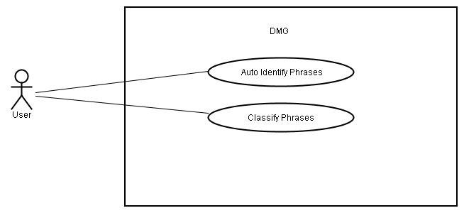
Use Case Diagram

Slide 16
Expanded Use Cases
UC1: Auto Identify Phrases
Actor : User | System : DMG
 | DMG Tool displays text in text area
TUCBW user clicks the Identify Phrases button. | *2. DMG tool identifies parts of speech and displays the color-coded phrases.
TUCEW the user is shown the phrases that are colored according to their parts of speech.

Slide 17
Expanded Use Cases (2)
UC2: Classify Phrases
Actor : User | System : DMG
 | 0. DMG tool displays the color-coded identified words
1. TUCBW a user selects one or more words | 2. DMG tool highlights the selected words
3. The user will drag the selected words into the drop area | *4. If the dropped Model Concept is class , TUCCW the concept is added to the Model Concept List Else if the Model Concept is a attribute TUCCW DMG add the attribute to the class Else DMG displays a dialog which asks for the Model Concept properties.
5. User will input the appropriate values for the selected Model Concept and clicks OK button | 6. DMG updates the Model Concept and refreshes the Model Concept List
7. TUCEW the user is shown the added or modified Model Concepts in the Model Concept List

Slide 18
Scenarios
Scenario for nontrivial step 2 of UC1, Auto Identify Phrases:
1. A user clicks the “Identify Phrases” button.
2.1 The DomainModelGUI identifies the phrases with TaggerController using the requirments text (reqs).
2.2. The TaggerController gets the tokenized text from the Stanford NLP Tagger API.
2.3. For each text sentences,
2.3.1. The TaggerController gets the tagged sentences (Tagged) form the Standford NLP API.
2.3.2. For each tagged word,
2.3.2.1. The TaggerController creates a domain specific phrase with DSPFactory using TaggedWord.
2.3.2.2. The TaggerController uses the style attribute in the Phrase object to set the color on the words
2.4. The TaggerController returns the styled document to the DomainModelGUI.
2.4. The DomainModelGUI displays the text, colored according to the Part of Speech of the phrases.

Slide 19
Scenario table
Scenario table for step2 UC1, Auto identify phrases use case (1):
# | Subject | Subject Action | Other Data/Objects | Object Acted On
1 | User | Clicks |  | Identify Phrases Button
2.1 | DomainModelGUI | Sends | IdenfiyCmd | RequirementsText
2.1.1 | IdenfiyCmd | Sends | TaggerController | RequirementsText
2.2 | TaggerController | Gets | Stanford NLP Tagger API | tokenized text
2.3. | Foreach textsentences
2.3.1 | TaggerController | Gets | Stanford NLP Tagger API | tagged sentences
2.3.2 | Foreach tagged word

Slide 20
Scenario table
Scenario table for step2 UC1, Auto identify phrases use case (2):
# | Subject | Subject Action | Other Data/Objects | Object Acted On
2.3.2.1 | DSPFactory | Creates | TaggedWord | Domain specific phrase
2.3.2.2 | TaggerController | Sets | Phrase object’s style | Word’s color
2.4 | TaggerController | returns | DomainModelGUI | styled text
2.5 | DomainModelGUI | Displays | Phrases | Color

Slide 21
Scenarios
Scenario for nontrivial step 4 of UC2, Classify Phrases(1):
3. The user drags and drops the words into the drop area.
4.1. GUI sends the words to the TableHandeler using the component and list of words.
4.2. TableHandeler sends the list of words to the ClassifyPhraseController.
4.3. ClassifyPhraseController gets drop locations from table.
4.4. ClassifyPhraseController gets the DomainModel instance.
4.5. For each dropped words,
4.5.1.If the dropLocation is not class
4.5.1.1. the ClassifyPhraseController shows a dialog with DialogManager using dropLocation and word.
4.5.1.2. DialogManager creates a dialog object.
4.5.1.3. DialogManager invokes dialog object to display a dialog.

Slide 22
Scenarios(2)
Scenario for nontrivial step 4 of UC2, Classify Phrases(2):
4.5.1.4. dialog object display the dialog.
4.5.1.6. classifyPhraseController adds the model concept to the DomainModel object.
4.5.2. else if, dropLocation cell is not empty
4.5.2.1. ClassifyPhraseController adds attributes to the class
4.5.3. else
4.4.3.1. ClassifyPhraseController adds a class to the DomainModel object.
4.6 ClassifyPhraseController refreshes the table with the GUI
4.7 GUI displays the modified table to the user.

Slide 23
Scenario table
Scenario table for step 4 UC2, Classify phrases use case (2):
# | Subject | Subject Action | Other Data/Objects | Object Acted On
3. | user | drags and drops | words | table
4.1 | GUI | Sends | component name and list of words. | TableHandeler
4.2 | TableHandeler | sends | List of words | ClassifyPhraseController
4.3 | ClassifyPhraseController | Gets | Drop location and list of words. | table
4.4 | ClassifyPhraseController | Gets |  | DomainModel instance
4.5 | For each phrase dropped
4.5.1 | If the dropLocation is not class

Slide 24
Scenario table
Scenario table for step 4 UC2, Classify phrases use case (2):
# | Subject | Subject Action | Other Data/Objects | Object Acted On
4.5.1.1 | ClassifyPhraseController | shows | DialogManger, dropLocation and word | Dialog
4.5.1.2 | DialogManager | creates |  | dialog
4.5.1.3 | DialogManager | invokes | dialog | Dialog object
4.5.1.4 | Dialog object | displays |  | dialog
4.5.1.5 | classifyPhraseController | adds | domainModel object | Model concept
4.5.2. | else if, dropLocation cell is not empty

Slide 25
Scenario table
Scenario table for step 4 UC2, Classify phrases use case (2):
# | Subject | Subject Action | Other Data/Objects | Object Acted On
4.5.2.1 | ClassifyPhraseController | adds | attribute | DomainModel object
4.5.3 | Else
4.5.3.1 | ClassifyPhraseController | Adds | class | DomianModel object
4.6. | ClassifyPhraseController | refreshes | table | GUI
4.7. | GUI | displays | table | user

Slide 26
Controller Pattern
Name | Controller
Type | GRASP
Specification
Problem | 1- Who should be responsible for getting the tagged text from NLPStandfordAPI, going through all the tagged words and getting the domain specific phrases’ color codes. 2- Who should be responsible for going through all the words, classifying the words, and adding model concepts.

Slide 27
Controller Pattern(2)
Solution | 1- Assign the responsibility to TaggerController to get the Tagged text from NLPStanford API, go through all the tagged word and get the domain specific phrases’ color codes. 2- Assign the responsibility to ClassifyPhraseController to go through the words list in a loop, and check the drop location. If the model concept is not class, it asks DialogManager to show a dialog. If model concept is class it asks DomainModel to create a class. Otherwise model concept is attribute and ask DomainModel to add attribute to the class.

Slide 28
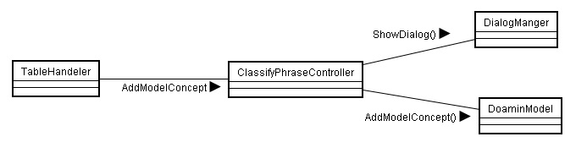
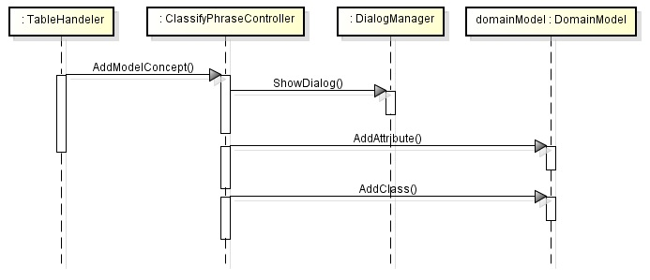
Controller Pattern(3)
Design
Structural
Behavioral

Slide 29
Controller (4)
Roles and Responsibilities | DomainModel: A class responsible for adding model concepts. ClassifyPhraseController: A class dedicated to take drop location and list of words from the TableHandler and works with the DialogManager and DomainModel to create model concepts. TableHandler: A class responsible for getting the drop and give list of words to controller.

Slide 30
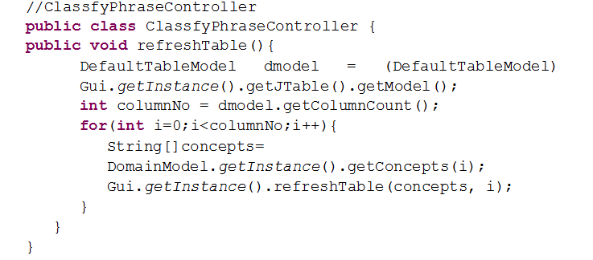
Sample Code

Slide 31
Expert Pattern
Name | Expert Pattern
Type | GRASP
Specification
Problem | Which object should be assigned the responsibility to give the domain specific phrase color code? 2) Which object should be assigned the responsibility to give the drop location?
Solution | Assigning the responsibility to DomainSpecificphrase object, dsp, to give the phrase color because dsp has the information to fulfill the request. 2) Assigning the responsibility to Table object, table, to give the drop location because table has the information to fulfill the request.

Slide 32
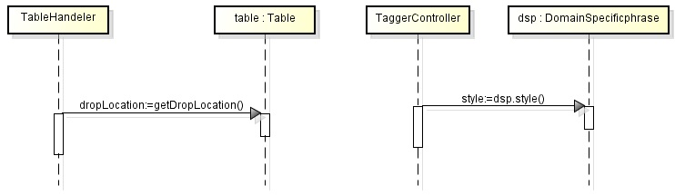
Expert Pattern (2)
Design
Behavioral

Slide 33
Expert Pattern (3)
Roles and Responsibilities | dsp: Object responsible for giving the phrase’s color code. table: Object responsible for giving the drop location.

Slide 34
Creator Pattern
Name | Creator Pattern
Type | GRASP
Specification
Problem | Who should be responsible for creating a DomainSpecificphrase object? 2) Who should be responsible for creating a Dialog object?
Solution | Assigning the responsibility to DSPFactory to create DomainSpecificphrase, dsp. 2) Assigning the responsibility to DialogManager to create Dialog object, dialog.

Slide 35
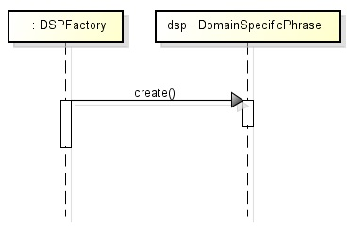
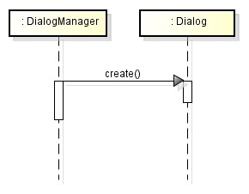
Creator Pattern (2)
Design
Specification

Slide 36
Creator Pattern (3)
Roles and Responsibilities | DomainSpecificphrase is responsible for creating the dsp. DialogManager is responsible for creating the dialog.

Slide 37
Template Pattern
Name | Template Method
Type | GOF/Behavioral
Specification
Problem | How do we vary displaying dialogs dynamically without using conditional statements?
Solution | Define an abstract class, Dialog, with a displayDialog() as a template method in which the steps to vary are treated as calls to abstract methods, display(). The AssociationDialog, AgregationDialog, InheritanceDialog, and etc. implement the display() to provide varying behavior.

Slide 38
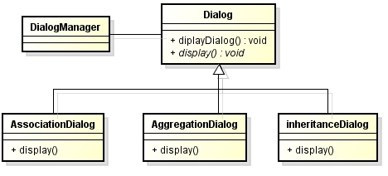
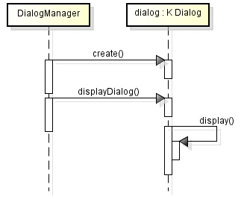
Template Pattern (2)
Design
Structural
Behavioral
…

Slide 39
Template Pattern (3)
Roles and Responsibilities | DialogManager: It creates the desired K Dialog object and invokes its displayDialog(). Dialog: It implements a template method, displayDialog, in which the steps to vary are calls to display() implemented by the AssociationDialog, AgregationDialog, InheritanceDialog, and etc. AssociationDialog, AgregationDialog, InheritanceDialog, and etc.: Each dialog class implements the display() according to its own behavior.

Slide 40
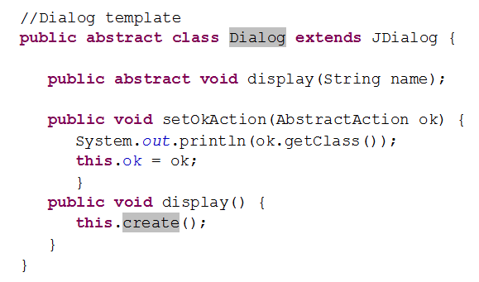
Sample Code(1)

Slide 41
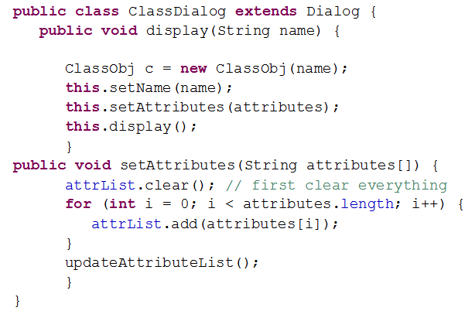
Sample Code(2)

Slide 42
Factory Pattern
Name | Factory Method
Type | GOF/Behavioral
Specification
Problem | How do we dynamically create the domain specific phrase object based on the word’s tag?
Solution | Define an abstract class, DSPFactory, with a displayDialog() as a template method in which the steps to vary are treated as calls to abstract methods, display(). The subclass implement the display() to provide varying behavior.

Slide 43
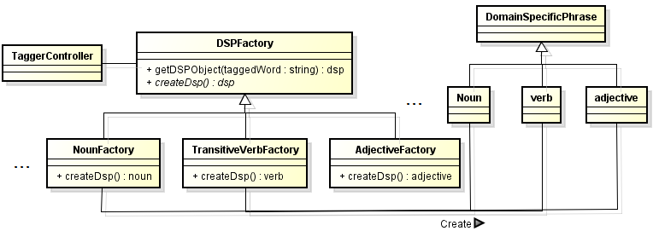
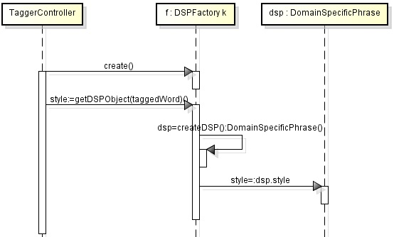
Factory Pattern (2)
Design
Structural
Behavioral

Slide 44
Factory Pattern (3)
Roles and Responsibilities | TaggerController: It creates the desired K factory object and invokes its getDSPObject(). DSPFactory: It implements a algorithm method, getDSPObject() that uses dsp object of varying classes returned by calls to createDSP(). It lets the Noun, Verb, Adjective, etc. classes implement the createDSP() to determine the type of product to create. NounFactory, AdjectiveFactory, etc.: Each class implements the createDSP method to return a dsp of certain type. DomainSpecificPhrase: They define the DomainSpecificPhrase interface for the the Noun, Verb, etc.classes. Noun, Verb, Adjective, etc.: These are concrete domain specific phrase classes.

Slide 45
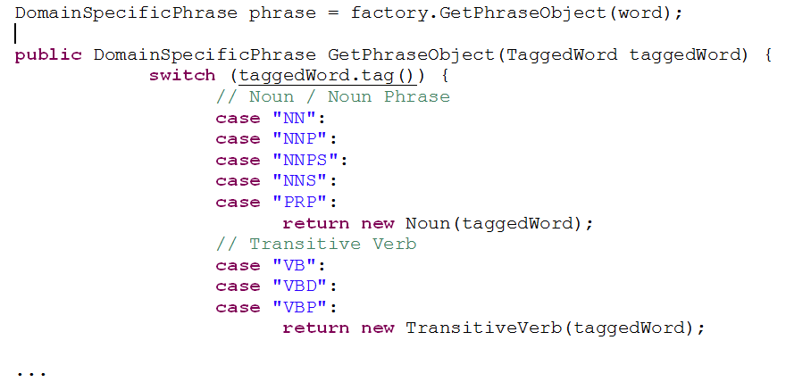
Sample Code

Slide 46
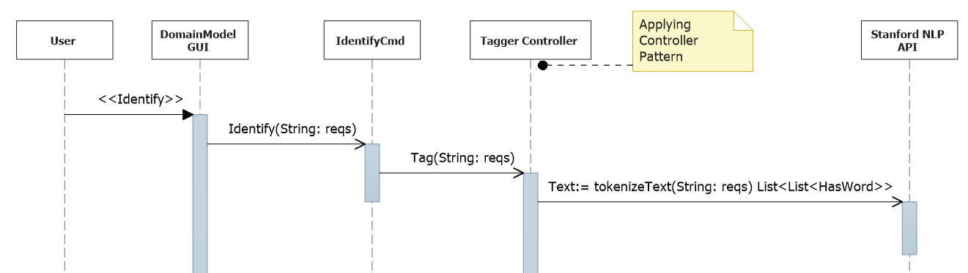
Sequence Diagram for step 2 of UC1, Auto Identify Phrases (1):
Sequence Diagram

Slide 47
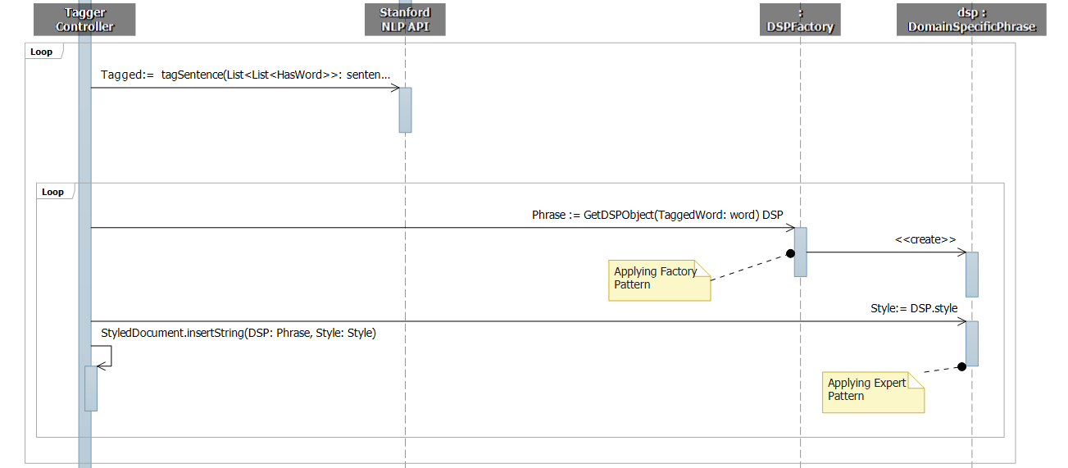
Sequence Diagram
Sequence Diagram for step 2 of UC1, Auto Identify Phrases: Part 2

Slide 48
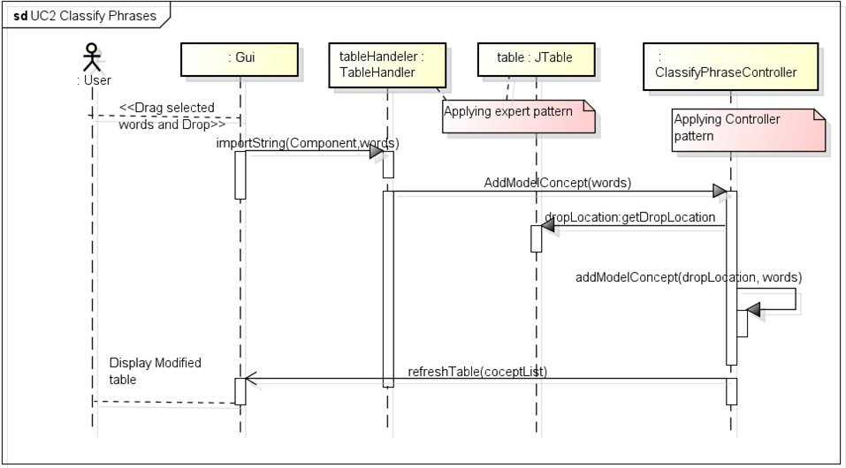
Sequence Diagram
Sequence Diagram for step 4 UC2, Classify Phrases (1):

Slide 49
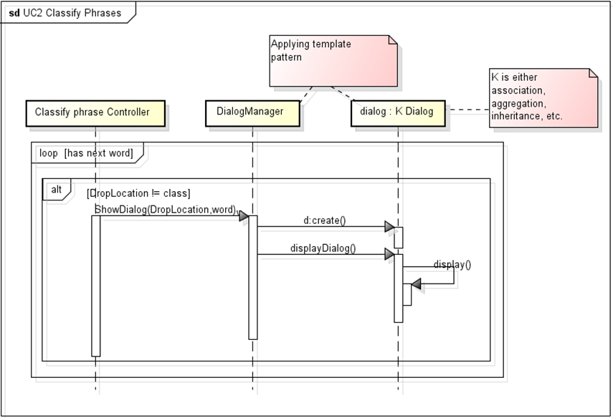
Sequence Diagram
Sequence Diagram for step 4 UC2, Classify Phrases (2):

Slide 50
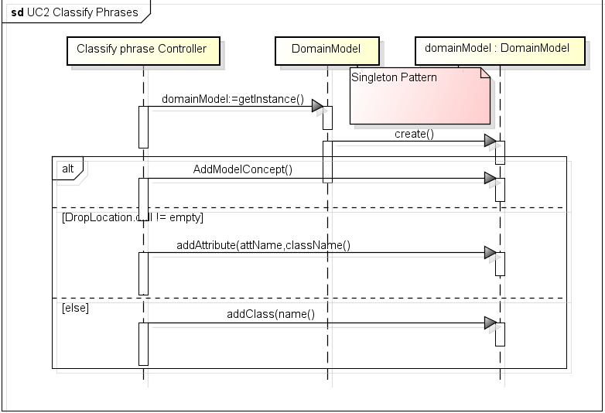
Sequence Diagram
Sequence Diagram for step 4 UC2, Classify Phrases (3):

Slide 51
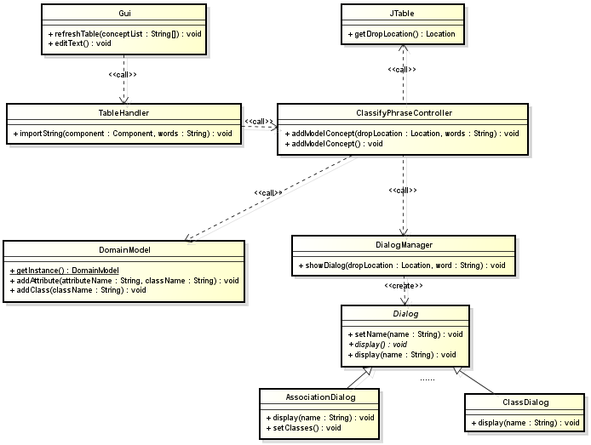
Design Class Diagram(1)

Slide 52
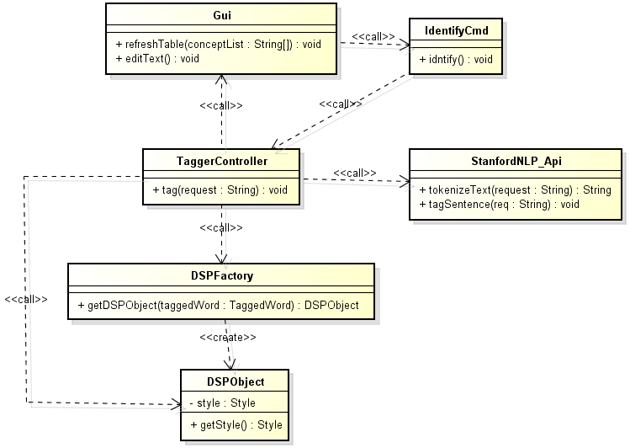
Design Class Diagram(2)

Slide 53
Auto Identify and Classify Phrases Test Case (1)
TEST CASE | Steps | Input Field | Type | Valid | Invalid | Expected Results | Status(Not Exec/Blocked/Fail/Pass)
TC_1 | When user clicks the Identify button ,we get the tagged list of words | JTextPane | String | All the words which are tagged | All the words/Some words are not tagged | All the words are tagged and colored | Pass
TC_2 | When the word is dragged and dropped into class column , it is added as Class | JTable | String | Added as Class | Not added as Class | Added as Class | Pass

Slide 54
Classify Phrase Test Case (2)
TEST CASE | Steps | Input Field | Type | Valid | Invalid | Expected Results | Status(Not Exec/Blocked/Fail/Pass)
TC_3 | When the word is dragged and dropped into class column , it returns the correct column integer value | JTable | String | It returns the correct column value | It doesn’t return the correct column value | It returns the correct column integer value | Pass
TC_4 | Selected words are dropped into class column it is added to list of classes | Jtable | String | Added to the List of Classes | Not added to the list of classes | Added to the List of Classes | Pass

Slide 55

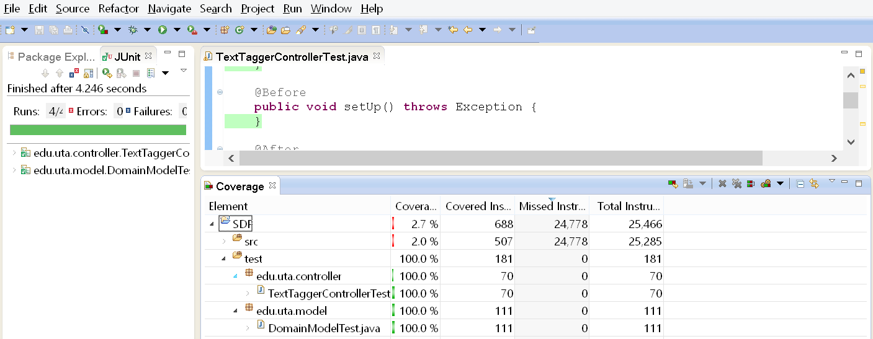
Test Coverage Report

Slide 56
Demo

