Slide 1
CMPE 255 Data Mining Project 1: AirBnb Analytics
Team Members
Neha Parakh Divjyot Khanuja
Yugeshwari Brahmankar Sunil Kumar Mummadi
Vinit Kumar Singh

Slide 2

Dataset
Listing Details (161)
Listing Summary (6.77 Mb)
Calendar Details(380 Mb)
Neighborhood (4Kb)
Problems Addressed
Where to invest in property to get more profit?
What price to have for new property listing?
When to plan a trip to get the deal in Price?

Slide 3
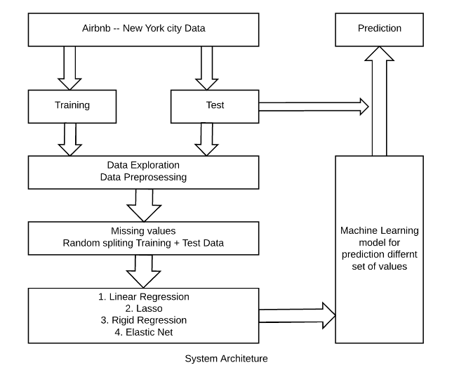
Solution

Slide 4
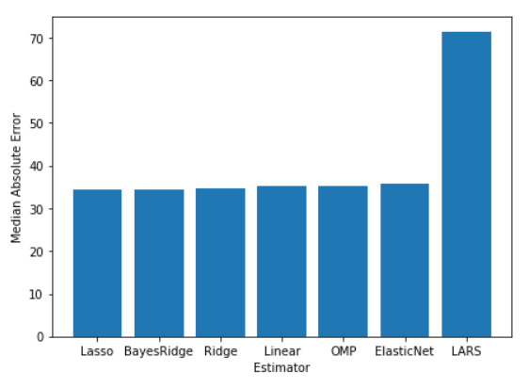
S
Where To Invest?
Data Cleaning
Encoding
Calculate Error values
Mean absolute error
Notes:
Data Cleaning-
1)Empty entries are replaced with 0
b)Few inputs like cleaning fee etc are converted into float
c)Excluding few listings with insufficient data
2)Feature Encoding- Text values such as room type, cancellation policy are converted into binary values
All of the above cleaning is done and converted into a single dataframe
3)Few algorithms like Lasso etc were run on the dataset where lasso performed the best
4)Mean absolute error was chosen as the metric as deals better with outliers
5)Tried to visualize the most important features which impacted the outcome and features like security deposit , location etc played a very crucial role
6)Lasso performed well as it has the property of built in feature selection,if there is group of highly correlated features-Lasso picks one of them and shrinks the others to 0, few insignificant coefficients become 0
7)LARS- Doesnt perform well as it is an iterative refitting algorithm which is extremely sensitive to noise

Slide 5
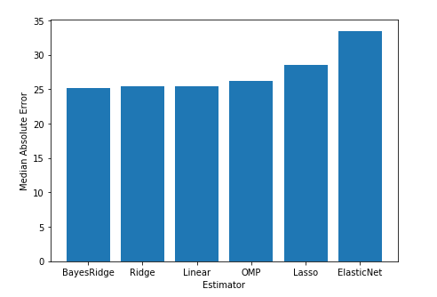
Average Price Predictor
Data Preprocessing
Encoding
Visualization
Feature Selection
Comparison of models
Linear vs Ensemble
Notes:
This analysis was done keeping the host’s perspective in mind and suggesting him what would be the appropriate price for a new listing.
On overlooking at the data for price prediction, one thing was clear that most of the features do not play a part in deciding the price for a listing.
So initially, we omitted various features like country, city, and some features related to reviews and details of host as they were not in any form going to affect the price.
Next, we preprocessed the data and encoded it, exactly as we did in Analysis 1.
Then we visualized it using box and scatter plots, where we found more features which did not affect the price.
Now coming onto the interesting part, we train and test the data.
We tested it for a number of linear models as you can see it on the screen and got the following MAEs (MAE because it is effective at a glance and it is less sensitive to outliers).
But the results were not very appealing.
On visualization we saw that there are a lot of features and there is no linear relationship for price variation.
So we trained the data using ensemble algorithms such as Gradient Boosting Regressor and voila, we had our much effective price predictor!

Slide 6
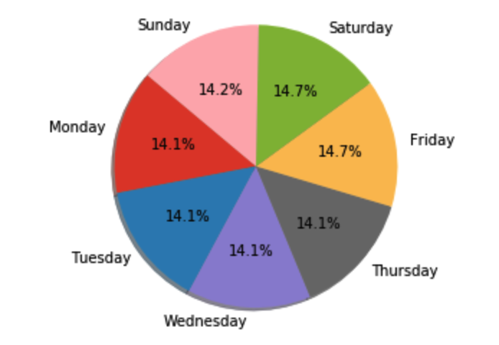
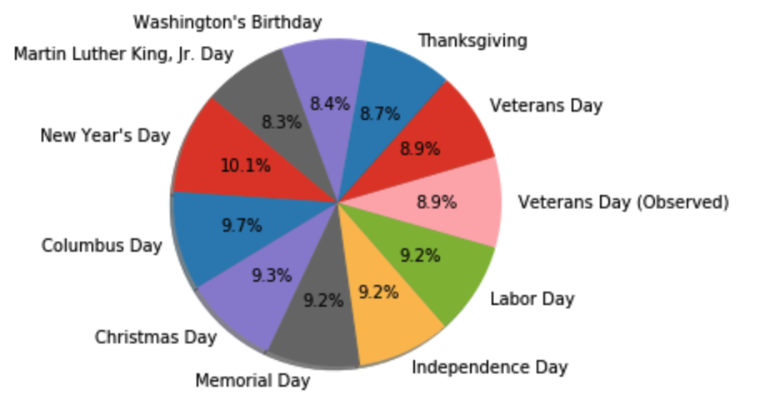
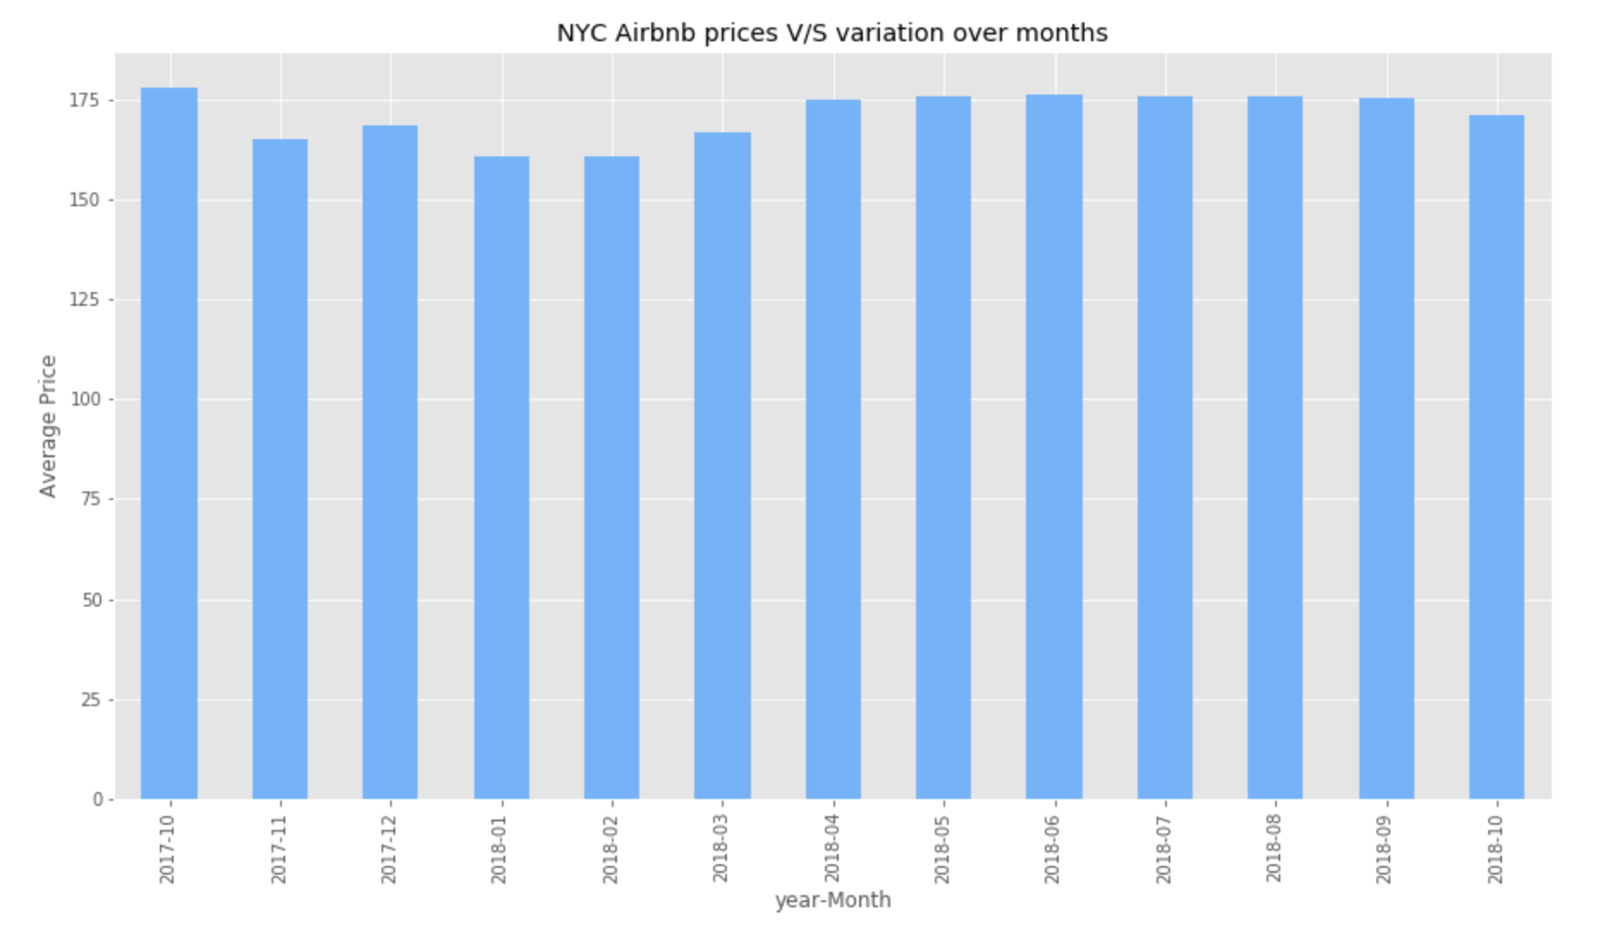
Analysis of Result

Slide 7
Conclusion

Slide 8
Difficulties
Very large dataset
Lot of effort in preprocessing the data
Selection of algorithm
Things that worked well
Effective use of data with various pre processing techniques
Performance of various linear models.
Things that did not work well
Sentimental analysis to predict the area to invest in property.
Notes:
To conclude
We were able to utilize pre processing effectively
We learnt how to use regression algorithms effectively to handle large datasets
Application of various algorithms on the same dataset to solve a different problem.

