Slide 1
🫁 Clinical Breath Analysis Results
Portable Respiratory Assessment System
Analysis Date: 2025-10-23 11:35:50

Slide 2
📊 Analysis Summary
Key Metrics:
• Total Samples: 59,993
• Test Duration: 60.0 seconds
• Breathing Rate: 55.0 breaths/min
Tidal Volume Analysis:
• Measured Average: 200.0 mL
• Expected for RR=55.0: 200.0 mL
• Accuracy: 1.00x expected (✅ Good)
Lung Function:
• FVC: 3.40 L
• FEV1: 2.55 L
• FEV1/FVC Ratio: 75.0%
• Average Exhalation Volume: 160.00 mL
• Shannon Entropy: 5.010
Clinical Assessment:
• Signal Quality: ⚠️ Low variation
• Respiratory Status: 🚨 Critical

Slide 3
⚕️ Respiratory Rate Assessment
Parameter | Value/Assessment
Current Respiratory Rate | 55.0 breaths/min
Clinical Status | 🚨 CRITICAL - Pneumonia Risk
Risk Level | Critical
Recommendation | Immediate clinical evaluation recommended
Normal Range | 12-20 breaths/min

Slide 4
🫁 Tidal Volume Analysis
Parameter | Value/Assessment
Measured Tidal Volume | 200.0 mL
Expected for RR | 200.0 mL (for 55.0 bpm)
Accuracy Ratio | 1.00x expected
Assessment | Matches Expected RR-TV Relationship
Clinical Concern | ✅ None

Slide 5
🔬 Lung Function Metrics
Parameter | Value/Assessment
FVC (Forced Vital Capacity) | 3.40 L
FEV1 (1-sec volume) | 2.55 L
FEV1/FVC Ratio | 75.0%
Average Exhalation Volume | 160.00 mL
Lung Function Status | ✅ Normal
Normal FEV1/FVC | ≥ 70%

Slide 6
📊 Signal Quality Assessment
Parameter | Value/Assessment
Power Variation (CV) | 0.6%
Shannon Entropy | 5.010
Signal Quality | ⚠️ Low signal variation

Slide 7
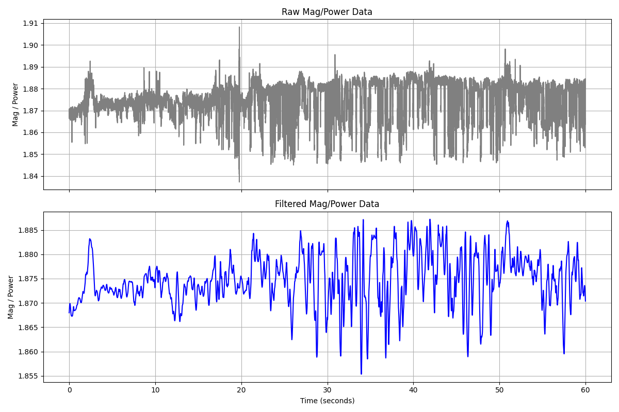
📊 Signal Processing: Raw vs Filtered Signal

Slide 8
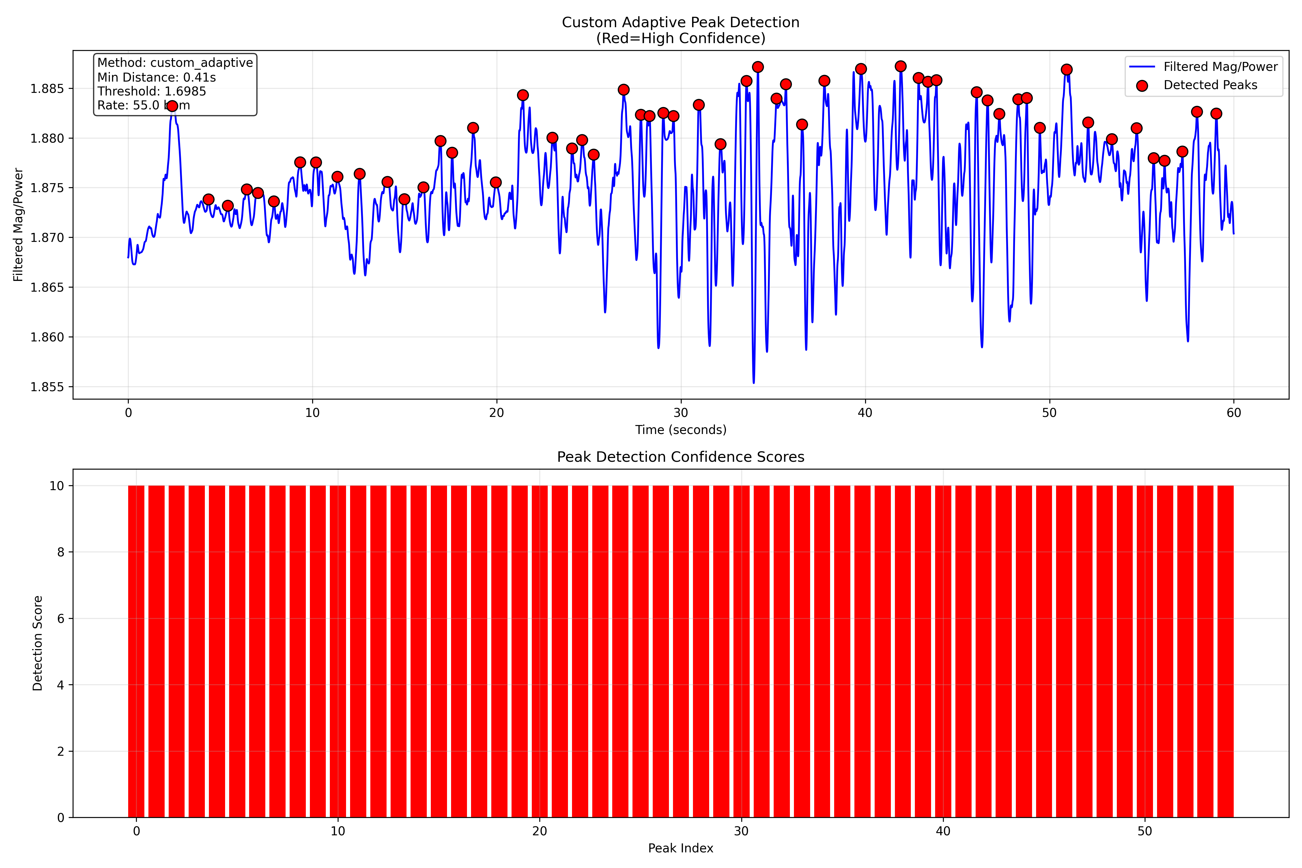
📊 Signal Processing: Custom Peak Detection

Slide 9
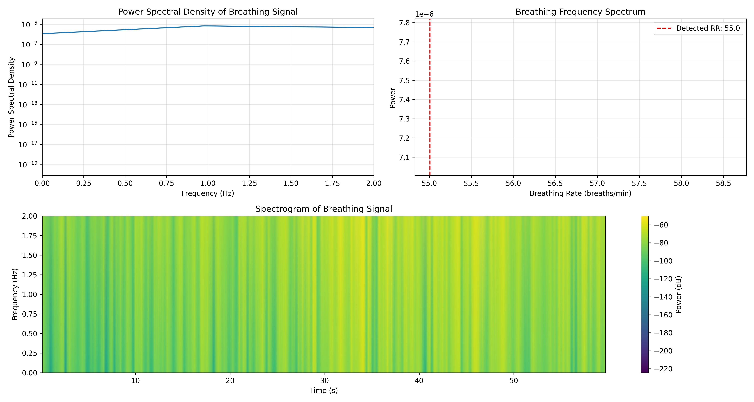
📊 Signal Processing: Frequency Domain Analysis

Slide 10
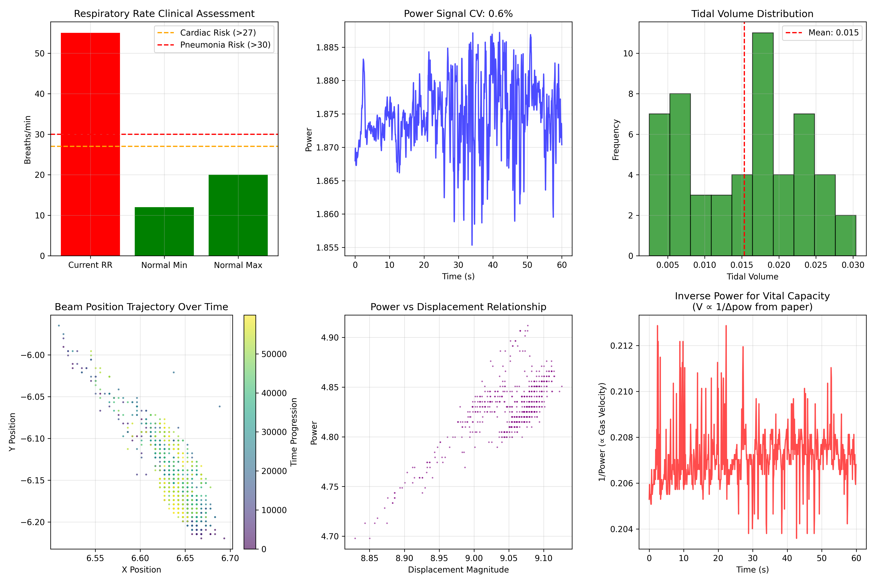
📊 Breath Analysis: Clinical Paper Analysis

Slide 11
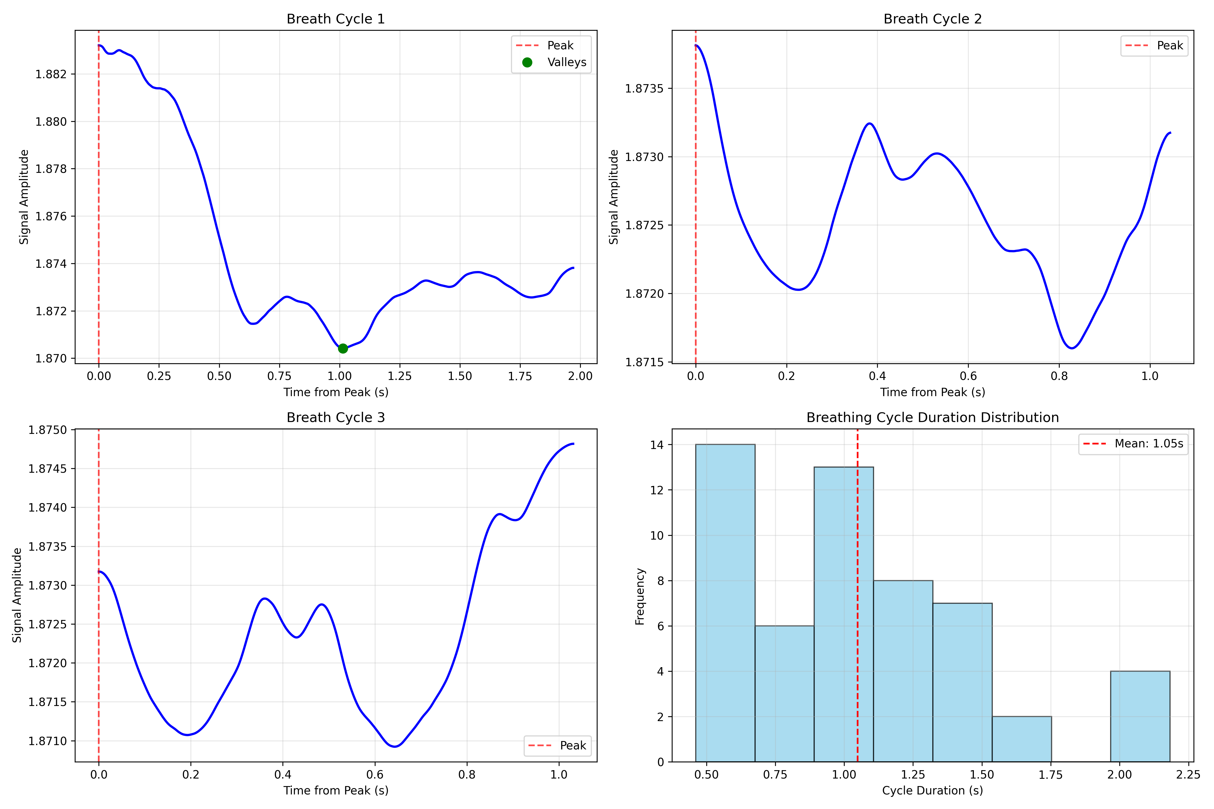
📊 Breath Analysis: Individual Breathing Cycles

Slide 12
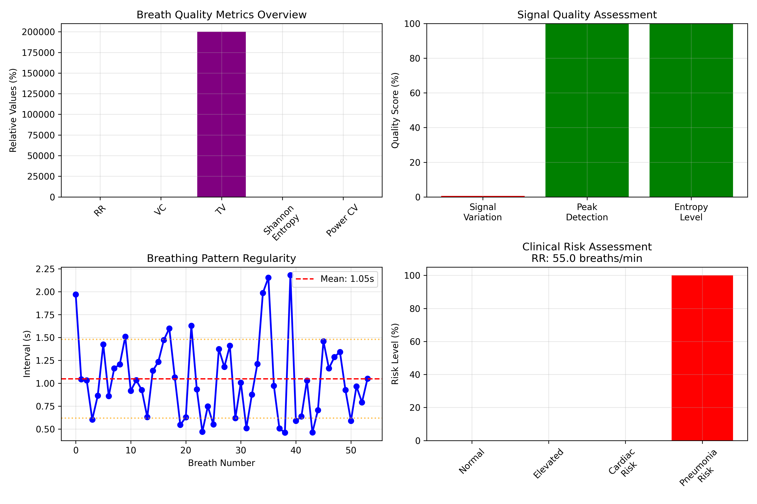
📊 Breath Analysis: Comprehensive Quality Metrics

Slide 13
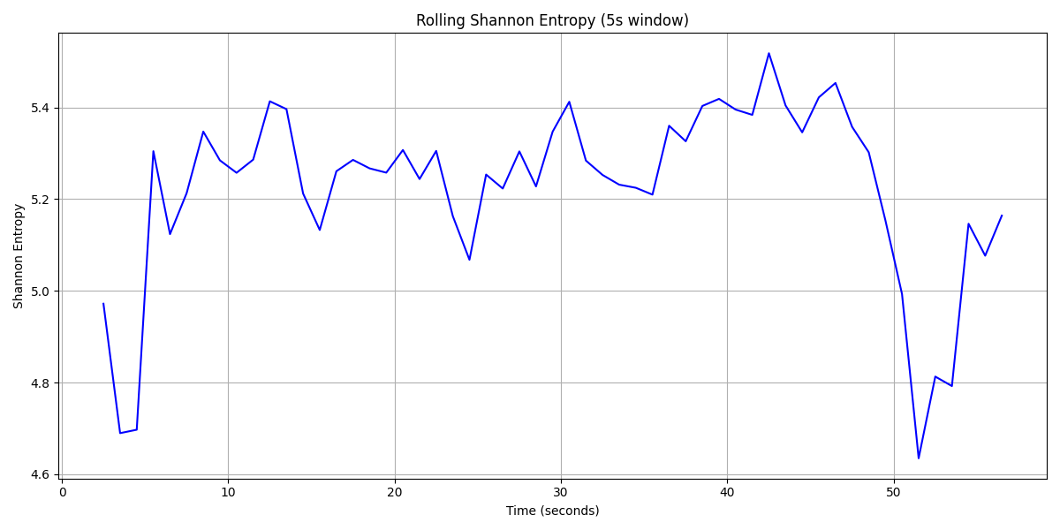
📊 Entropy Analysis: Rolling Shannon Entropy

Slide 14
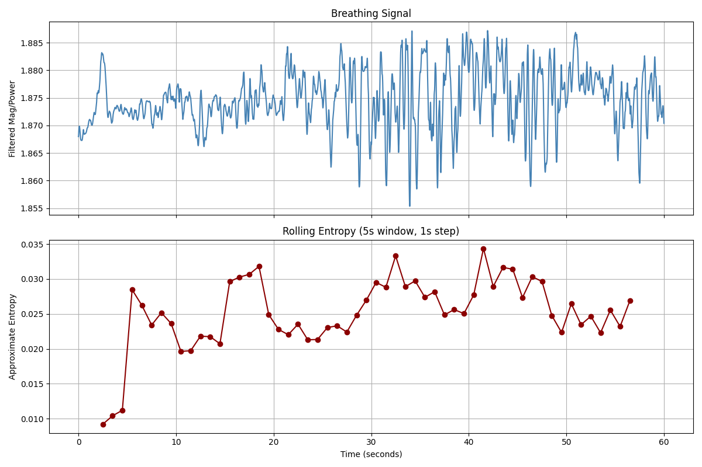
📊 Entropy Analysis: Rolling Entropy

Slide 15
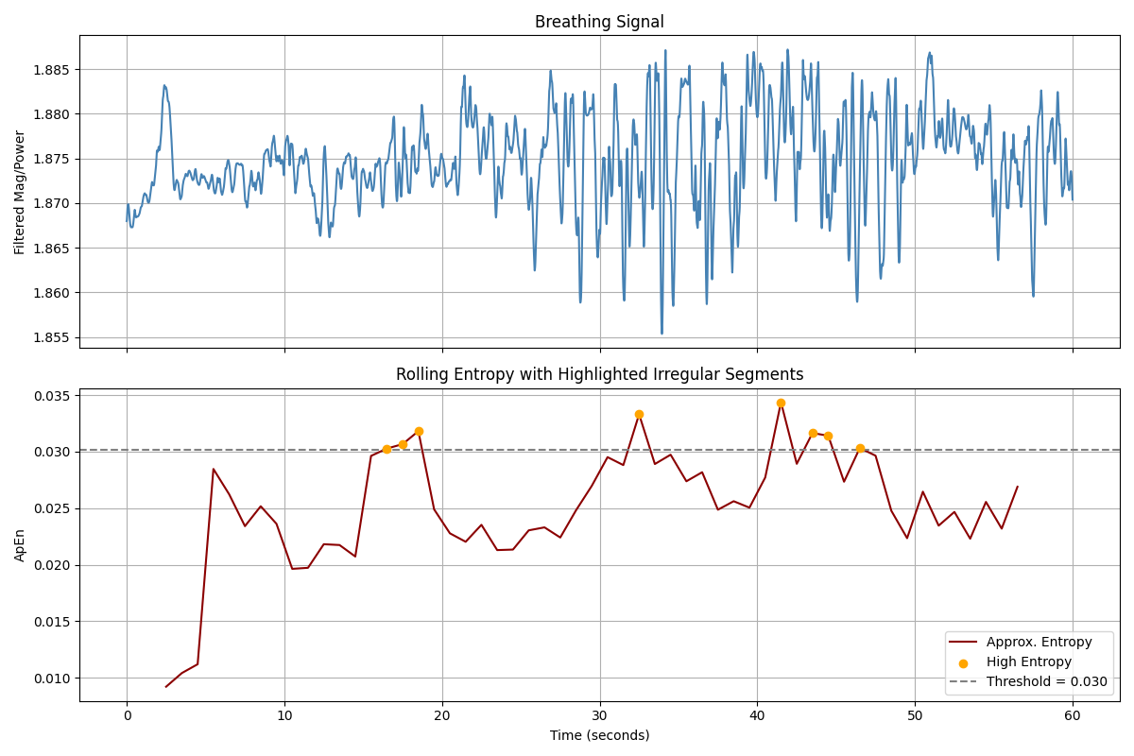
📊 Entropy Analysis: Highlighted High Entropy

Slide 16
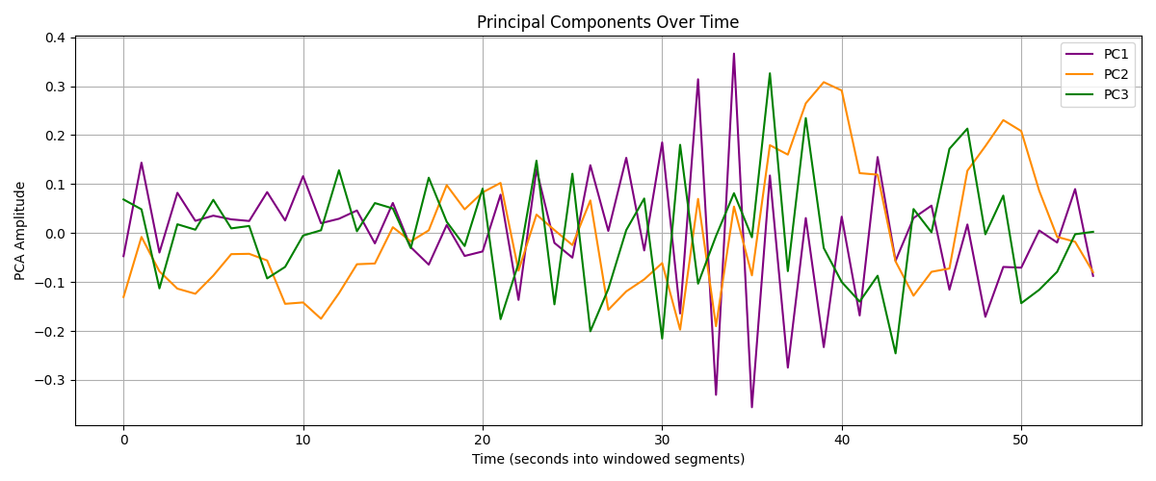
📊 PCA & Clustering: PCA Components Over Time

Slide 17
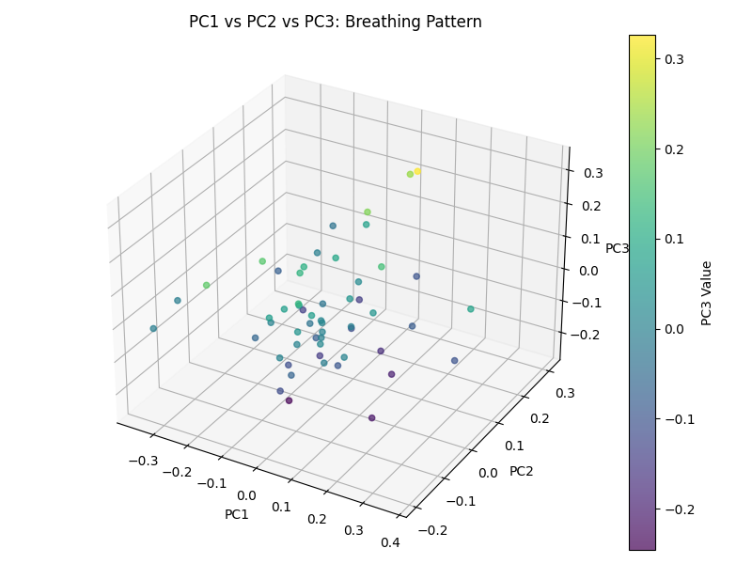
📊 PCA & Clustering: PC1 vs PC2 Scatter

Slide 18
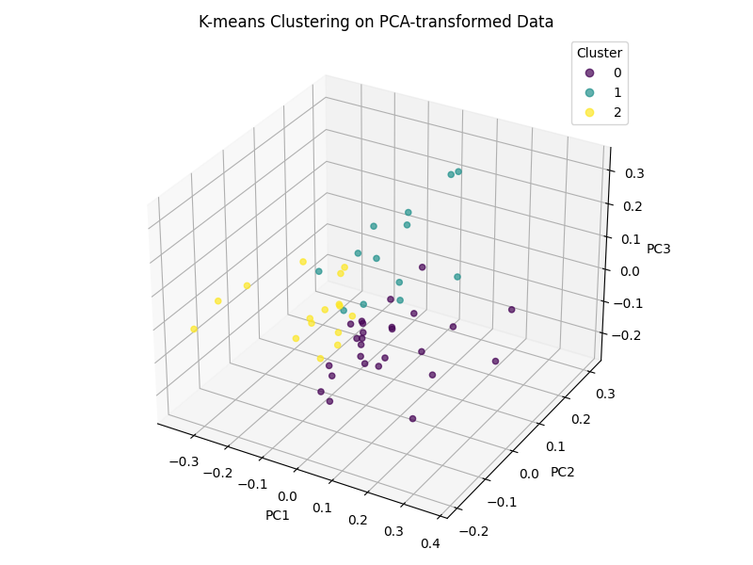
📊 PCA & Clustering: K-Means on PCA

Slide 19
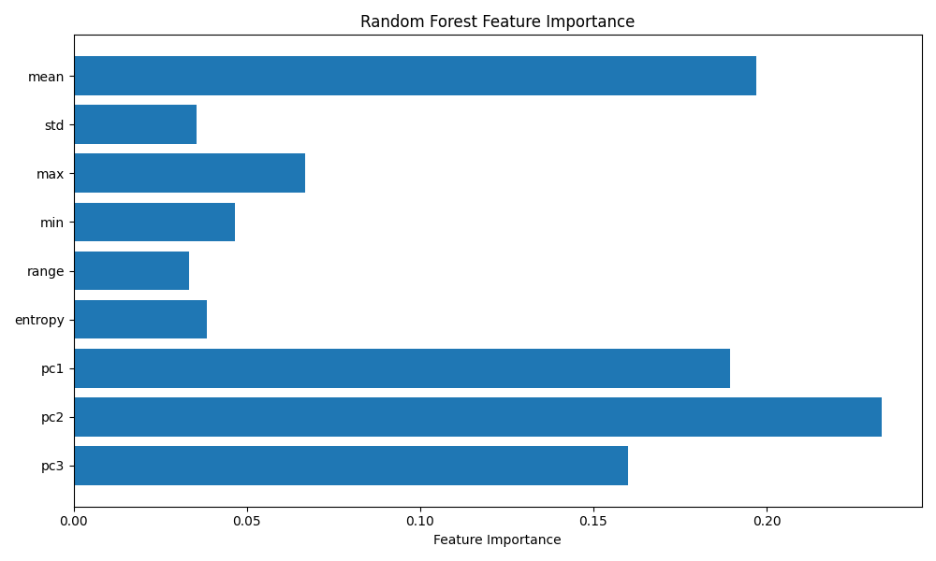
📊 PCA & Clustering: ML Feature Importance

Slide 20
📋 Clinical Recommendations
Based on Analysis Results:
Immediate Actions:
• Immediate clinical evaluation recommended
• Review spirometry results
• Monitor trend over time
Follow-up:
• Urgent medical attention needed
• Repeat assessment in 1-2 hours
Notes:
• This portable breath analyzer provides preliminary assessment
• Clinical correlation and standard spirometry recommended for diagnosis
• Results should be interpreted by qualified healthcare professional

