Slide 1

Queryfier
Code Analysis Report
Group 6: The Sixth Sense
Swen Grgičević, Doroteja Krtalić, Michel Brassard, Petra Cesar, Divna Mijić

Slide 2

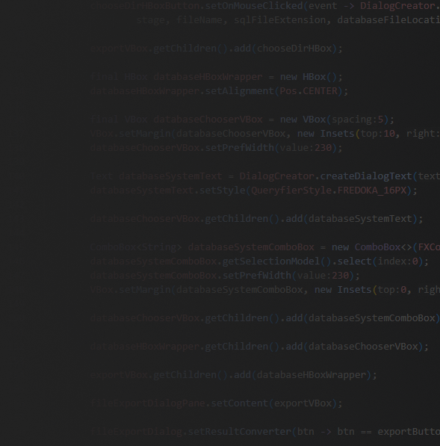




Outline
Tools & Technologies
Static Code Analysis
Overview
What issue we encountered
Dynamic Code Analysis
System Performance

Slide 3










Tools & Technologies
Technologies
Programming Language: Java
Framework: JavaFX Framework
FXML Builder: Scene Builder
Build Tool: Ant
Build Server: Gitlab CI/CD
Static Code Checker(s): SonarQube/SonarLint
Dynamic Code Checker: Intellij Profiler
Documentation & Design
Google Document, Spreadsheet
Figma

Slide 4
Static Code Analysis - Overview

Slide 5

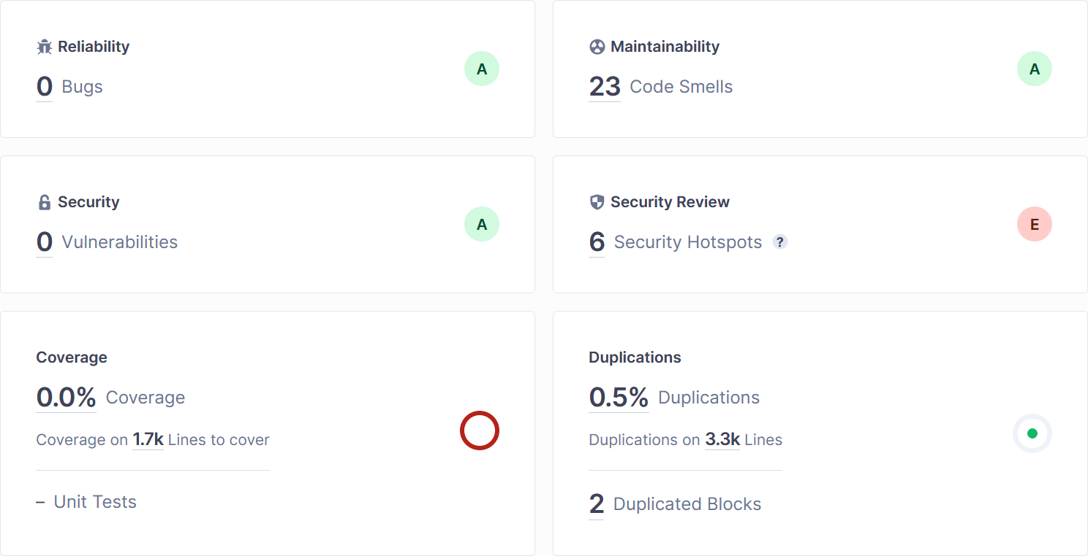
Starting Point

Slide 6
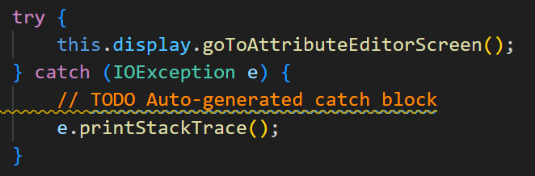
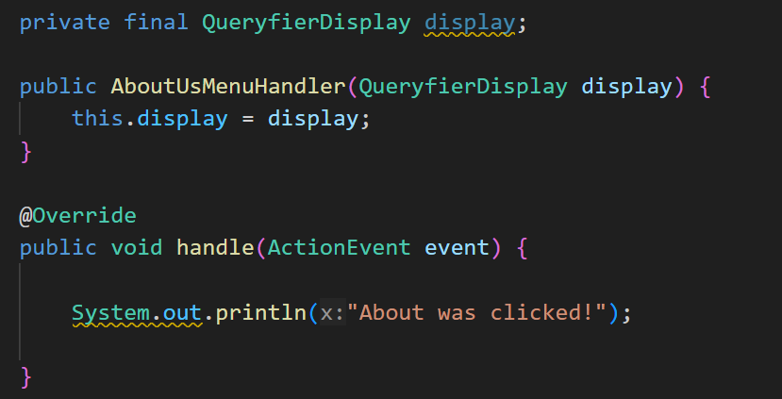
What did the analyzers find?
Mostly TODOs → Complete the task associated to this TODO comment x7
Provide the parameterized type for this generic x1
Remove this unused {name of field} private field x3
Remove this unused method parameter {name of parameter} x1
Replace this use of System.out by a logger x6
This block of commented-out lines of code should be removed x2
But there’s more…
Notes:
Now what issue we are going to cover is the one that we purposely left out from this slide, which is…

Slide 7

Cognitive Complexity

Slide 8
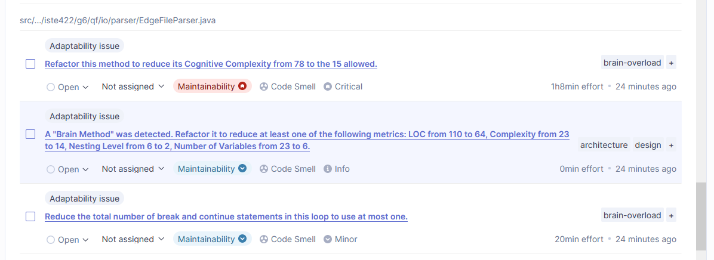
SonarQube Analysis
↪ Lines of Code
Notes:
Cognitive Complexity.
I want you remember this slide, remember any sort of information presented to you. For us, this appeared in the EdgeFileParser, which I am sure happened to you as well, where we also got “Brain Method” was detected - In short it is a method that performs too many operations making it difficult to understand, maintain, and reuse. It is characterized by high LOC number, high cyclomatic (more tests needed to test a single piece of code) and cognitive complexity, and a large number of variables being used.
Last but not least is the number of break and continue statements -> Because it was in a while loop, skipping a lot of lines that didn’t need to be read or further processed.

Slide 9
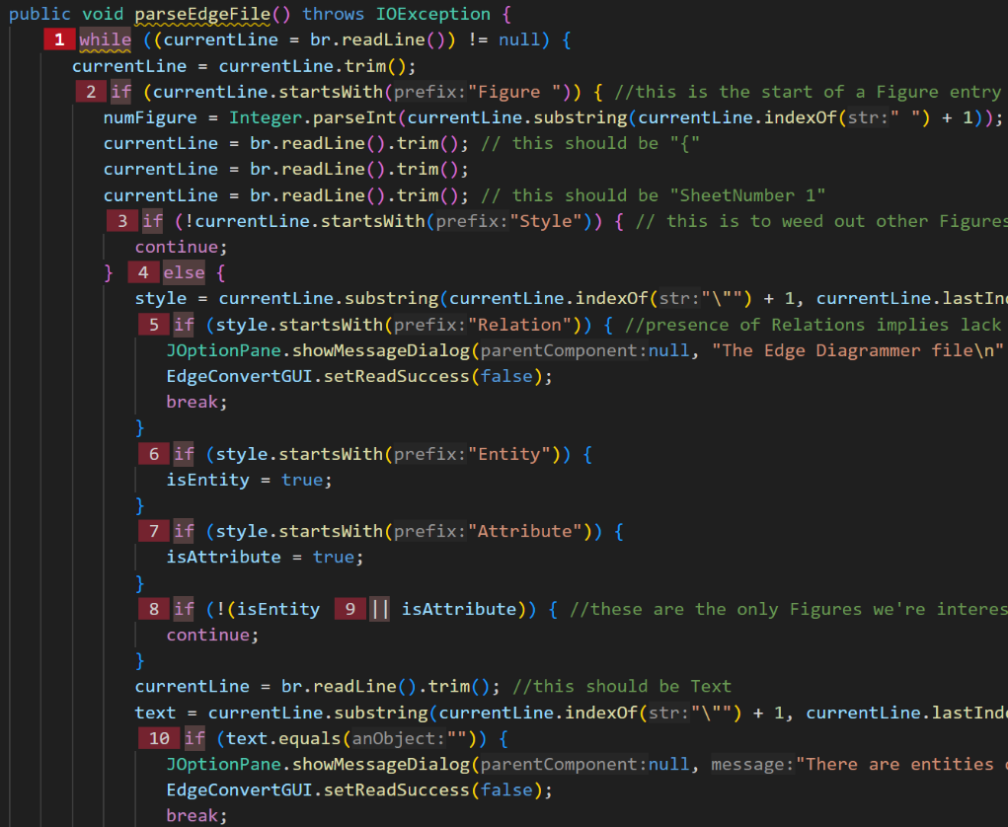
What is Cognitive Complexity?
Measure of how difficult it is to intuitively understand a unit of code
Calculated by the number control flow statements, and logical operators (“&&” and “||”)
Notes:
In other words, how hard much information you need to retain to understand a piece of code, which on our case was the parse function in the EdgeFileParser - rant a bit over here, what was the issue?
Control Flow Statements - “if” conditions, nested loops like “for”, “forEach”, “do-while”

Slide 10
Why is this an issue?
Methods with high Cognitive Complexity are difficult to maintain
Harder to understand, more bug-prone, adds more time to debug
Slower Application Development
Reduces Developer Collaboration
Resistance to Change
Notes:
Difficult to maintain - I am sure that at some point you went back to your own old code trying to understand what you did there and thought to yourself: Who wrote this? - We don’t want this.
Developers spending more time deciphering what the code does and have less time to write new features, resulting in not meeting deadlines
Harder to understand code -> Harder to explain the code -> Harder to maintain code (so when a developer leaves, what then?)
Quite obvious one, but do you really want to go through the process of “What did the author want to say?”, also quality and testing issues

Slide 11
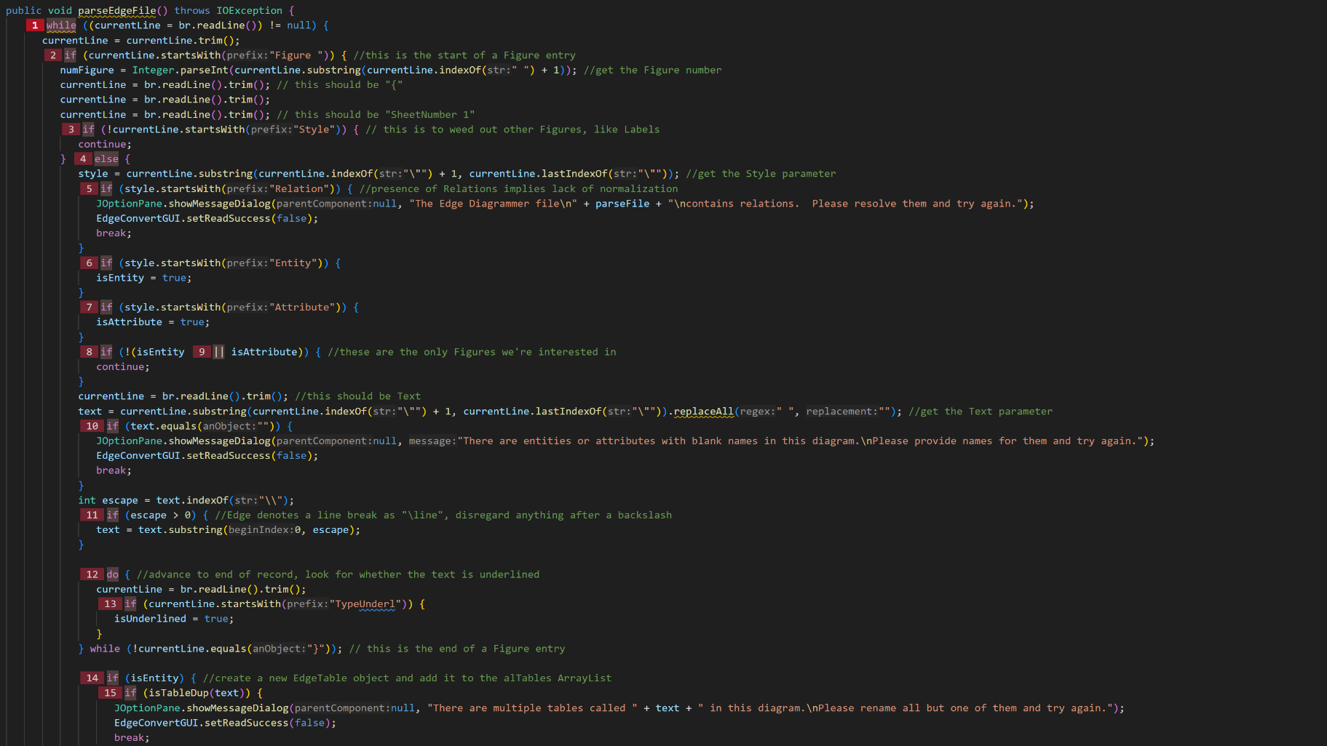

Slide 12
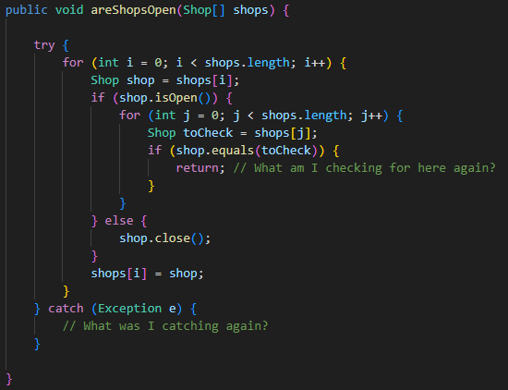



Static Code Analysis
Cognitive Complexity - How to remove it?
Why You Shouldn’t Nest Your Code - CodeAestetic
Extraction
move duplicate code, code checks <- SRP methods
Inversion
unnesting, making early returns, code checks
Notes:
In our case, what was our cognitive complexity? Does anybody remember? How do you get to that number? 78 (How much allowed? 15 allowed)
We can’t go really in depth why is it that number, but to resolve it, we applied the following

Slide 13
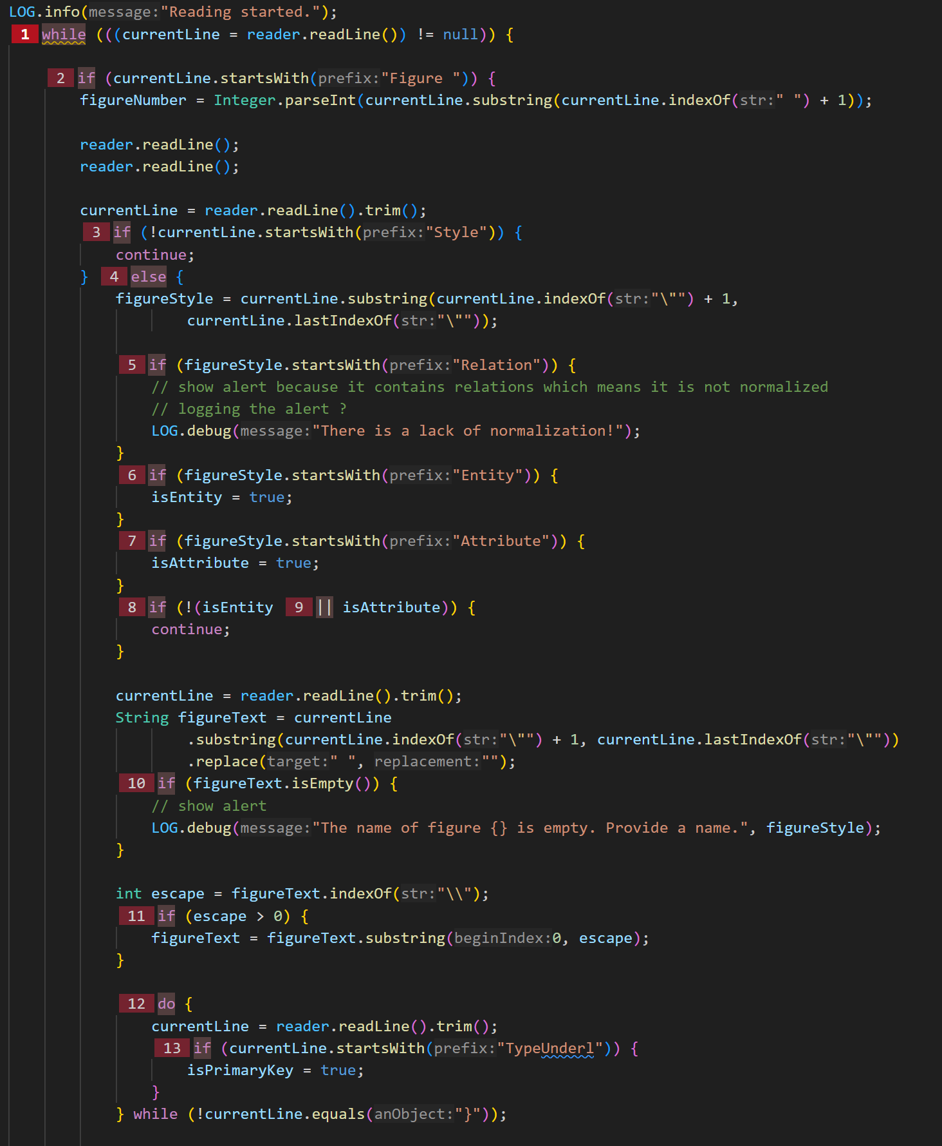
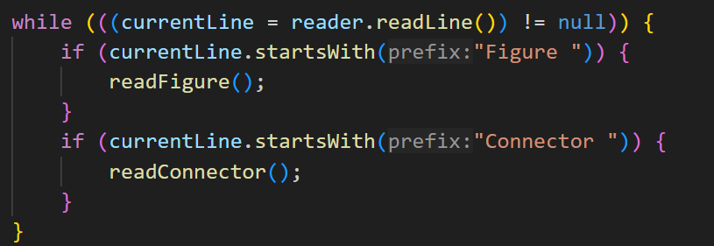
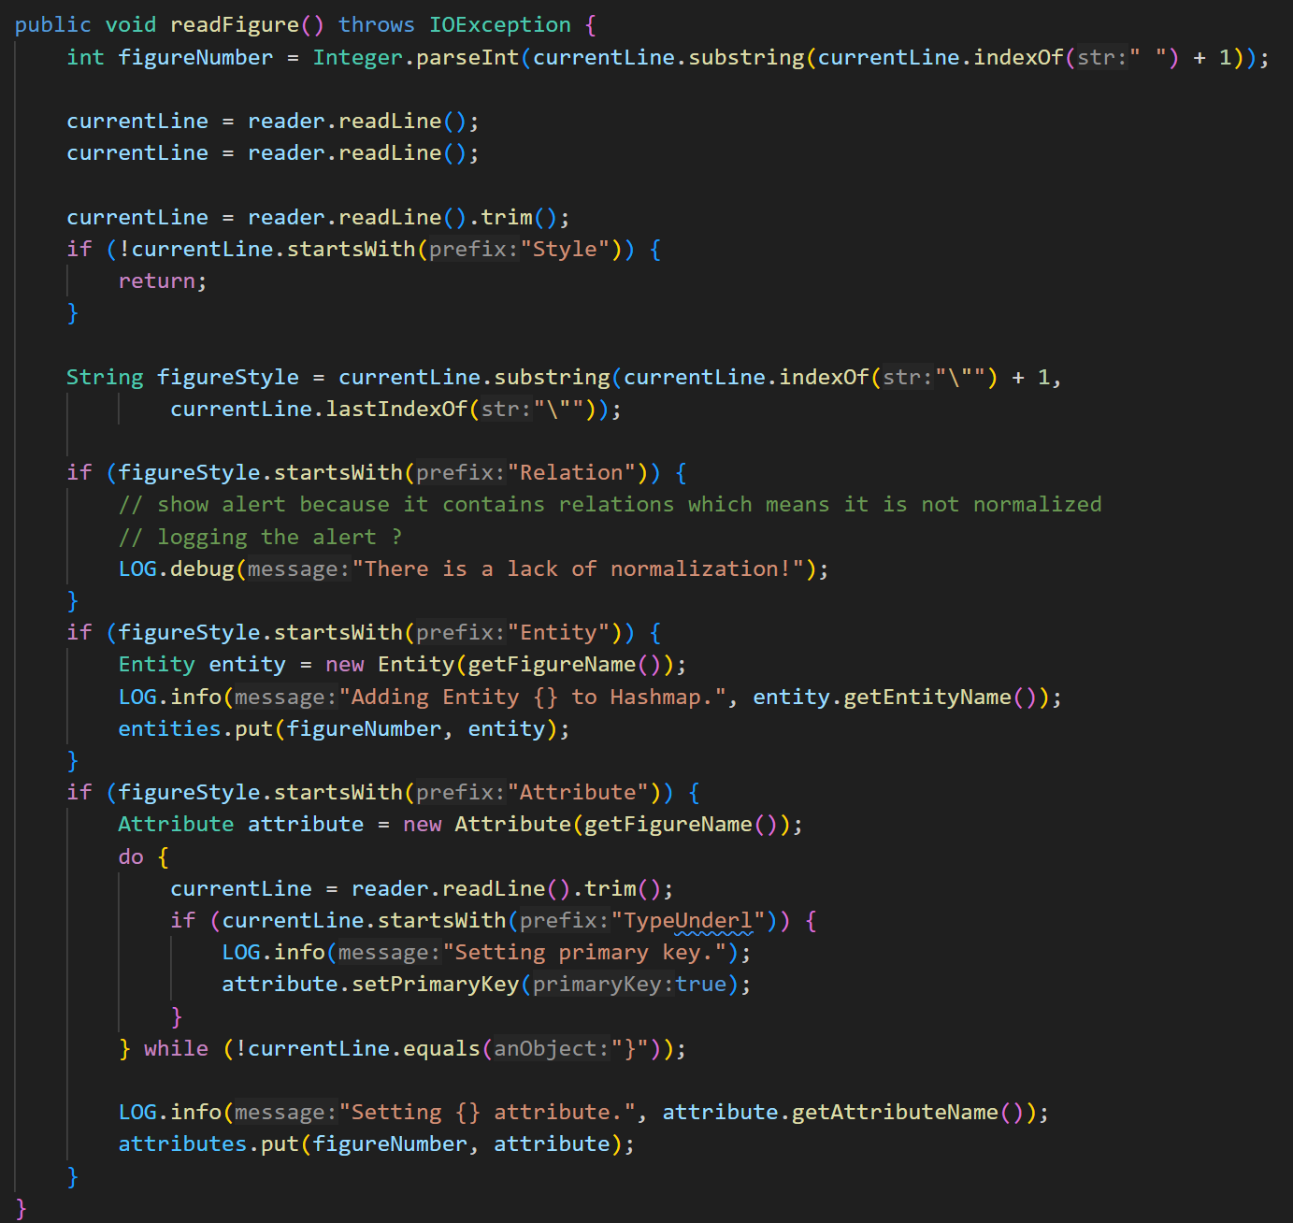
More lines below…

Slide 14
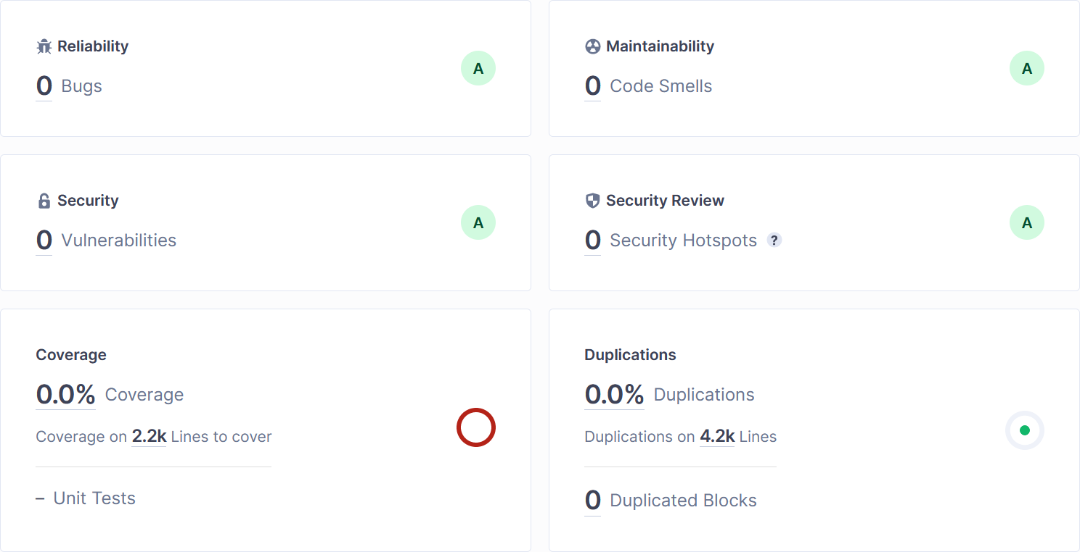
Achieved End Goal
+2.1K New Lines
+900 Total Lines

Slide 15
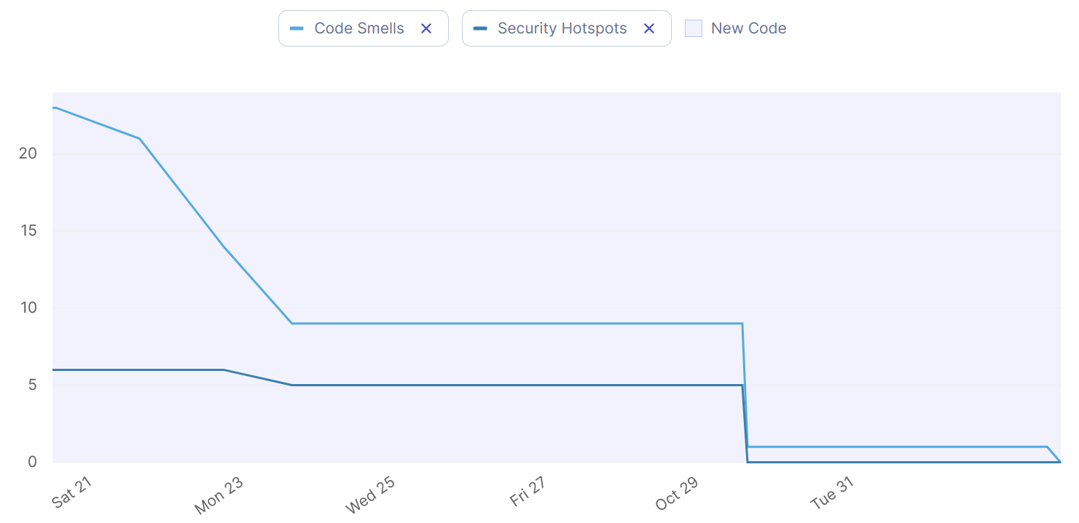
Static Code Analysis - Timeline

Slide 16

Dynamic Code Analysis - Overview

Slide 17
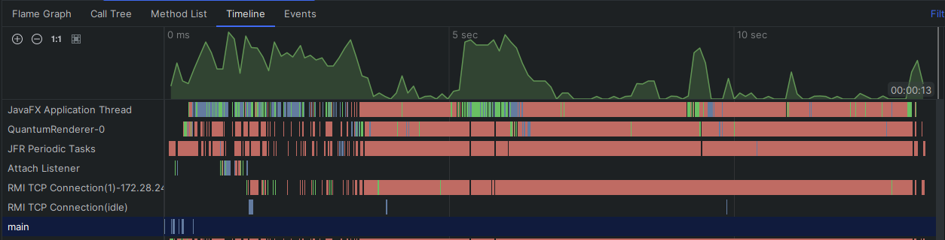

Dynamic Code Analysis
Edge File Parsing
Screen Setup
Screen Showing
Application Configuration Saving
Application Start
File Exporting
File Export Alert
Notes:
The application took the longest to run at the initialization stage. This is where the JavaFX Framework comes into play which we don’t have the control over, since this is where the file parsing of the screen happens, as well as our initialization of the application on top.
Other heatspots are the following… When choosing a file to import or open the project to, parsing the said file and the screen, setting up the screen and then finally show it.
Next hotspot is the file exporting, as it needs to be converted to DDL statements, which takes a while.
Last, but not least is the end of the application, where the application configuration is saved into a file.
Other smaller heatspots are these ones like the file export feedback alert, where it is shown to the user to show the export was successful.
To conclude, a lot of these processes also take a while when parsing, converting, and interpreting given styling to the application, which are a part of the JavaFX framework.
This can also be said in terms of memory, as the most memory was used by it as denoted by the memory usage of the stage.show() method. This shows 2 usage cases of when we showed two different screens, meaning that per screen loading, it uses at least 8MB to show it, without including in the FXML file parsing.

Slide 18
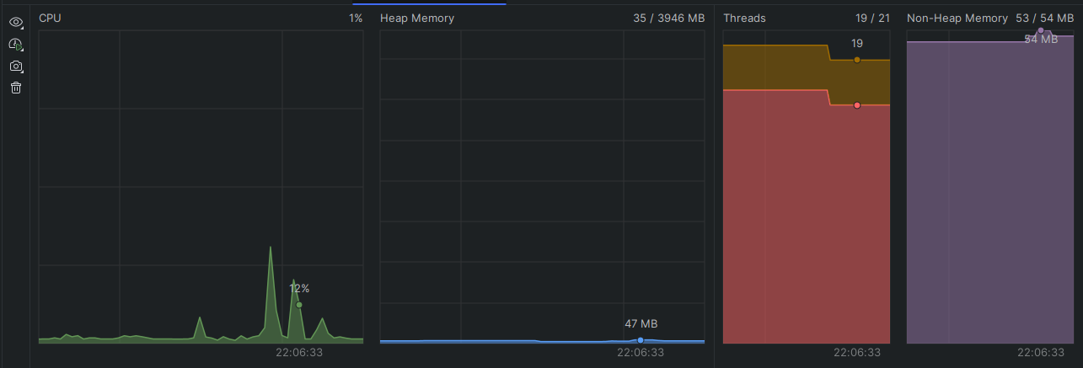
Dynamic Code Analysis
Maximum heap size: 50MB
Problem Solver’s cumulative size: 12MB
Threads: 19-20
Notes:
Non-heap memory -> It is created at the JVM startup and stores per-class structures such as runtime constant pool, field and method data, and the code for methods and constructors, as well as interned Strings

Slide 19



Dynamic Code Analysis
Some of the Methods with high CPU time usage
Notes:
Interesting thing to note is that the Logger interestingly enough took 300ms to initialize.
All of these methods are out of our control

Slide 20
Queryfier
Code Analysis Report
The End
Group 6: The Sixth Sense
Swen Grgičević, Doroteja Krtalić, Michel Brassard, Petra Cesar, Divna Mijić

