Slide 1
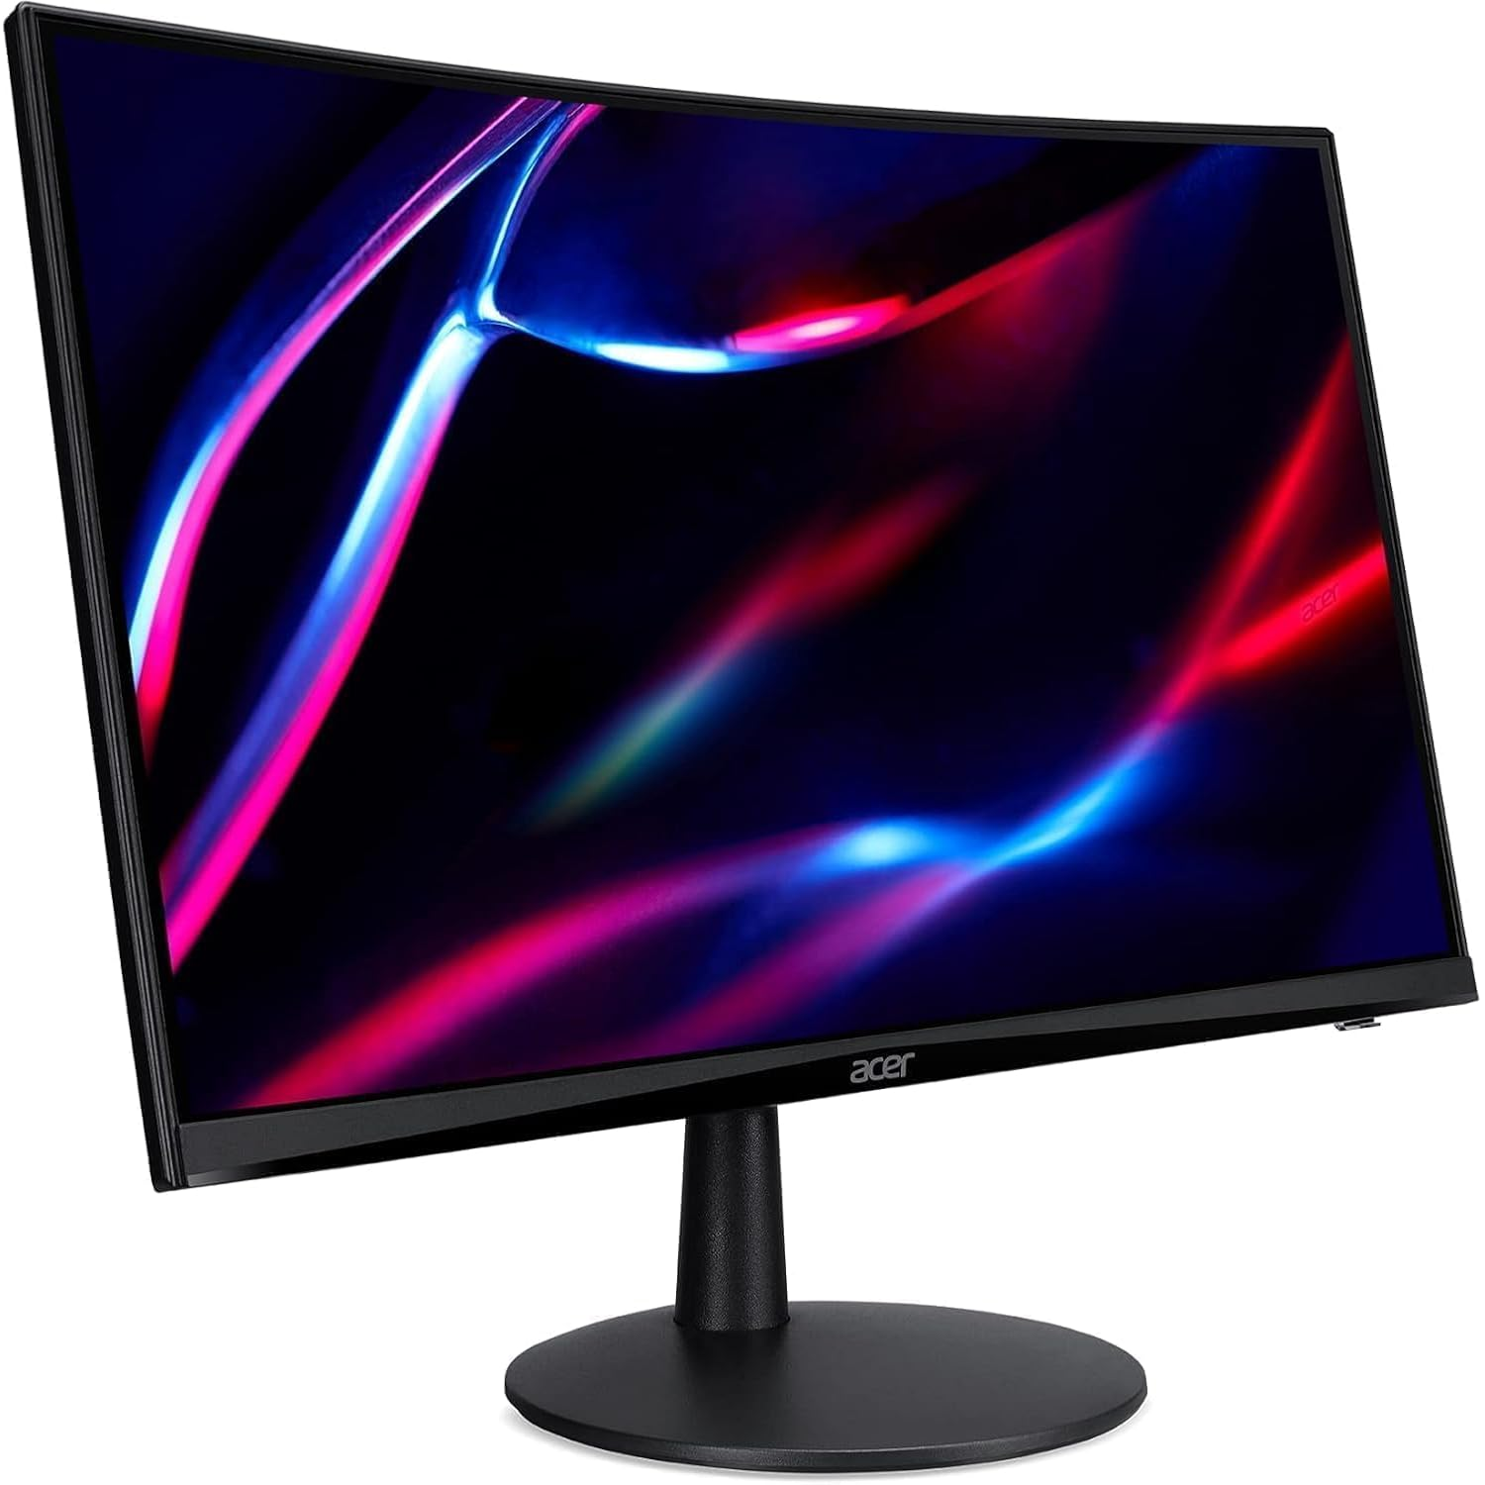
monitor
BY
DIVYA,SABINA,SHITAL&SAMJHANA

Slide 2
Introduction
Monitor :It is an output device that displays text, videos and images on a computer. So, it is also called a Visual Display Unit (VDU) .It allows users to see the processed information from the CPU. Video adapters are responsible for delivering images of monitor .
The global computer monitor market was valued at $39.3 billion in 2021 and is projected to reach $76 billion by 2031, growing at a CAGR of 6.9% (2022–2031).

Slide 3


Monitors are essential for work, gaming, entertainment and productivity.

Slide 4
Types of monitors.
Type | Description | Best for | Pros | Cons
CRT (Cathode Ray Tube) | Old-school, uses electron beams to light phosphors. | Retro setups or specific industrial uses. | High refresh rates, no input lag. | Bulky, heavy, power-hungry.
LCD (Liquid Crystal Display) | A flat-panel display that uses liquid crystal technology to produce images | General office work. | Affordable, energy-efficient. | Limited contrast, viewing angles.
LED (Light-Emitting Diode) | LCD with LED backlighting for brighter, thinner displays. | Everyday use, TVs. | Slim, vibrant colors, low power. | Can have backlight bleed.
OLED (Organic Light-Emitting Diode) | A display technology that uses organic light-emitting diodes to create images | Gaming, premium TVs. | Perfect blacks, infinite contrast, flexible. | Expensive, burn-in risk.
Curved Monitors | Bent screens for immersive viewing. | Gaming, video editing. | Wider field of view, reduced distortion. | Higher cost, not ideal for all tasks.
Touchscreen Monitors | Interactive displays with touch input. | Tablets, kiosks, creative work. | Intuitive interaction. | Higher price, potential,fingerprints.

Slide 5
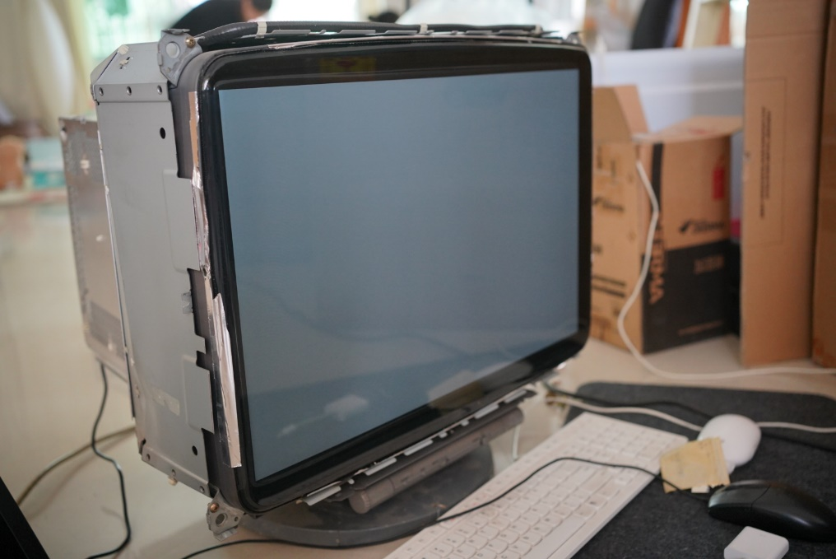
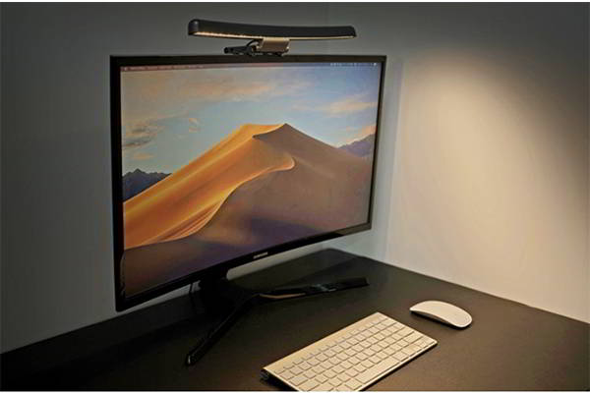
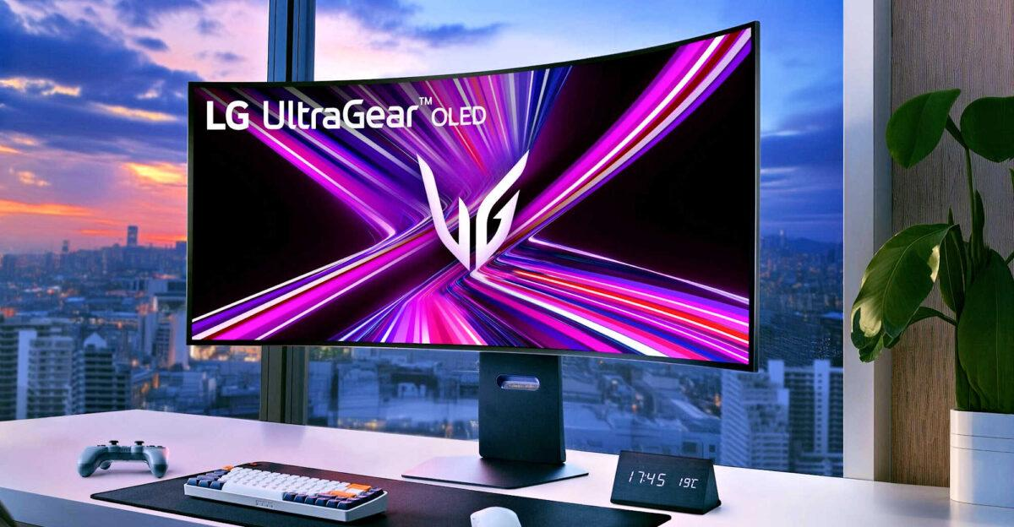
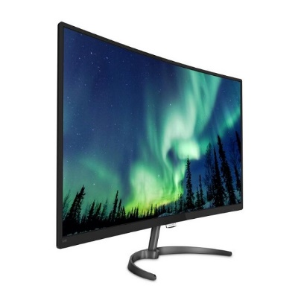
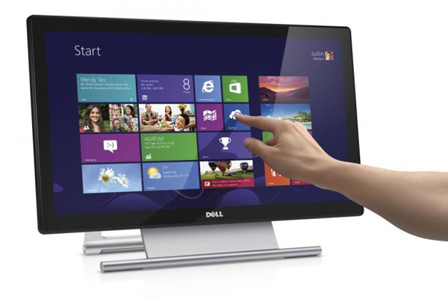
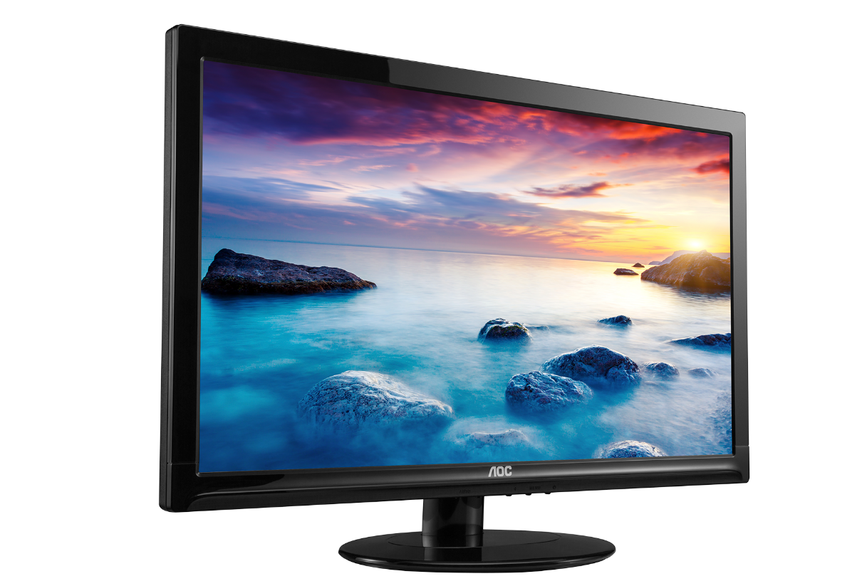

Slide 6
Components of a modern monitor
Power Supply: A unit that converts the AC power from the wall outlet into the DC power needed by the monitor's components.
Casing/Housing: The physical shell or housing that encloses all the internal components and provides a stand or mount.
User Controls: Buttons or a joystick on the monitor for adjusting settings like brightness, contrast, and input.
Connectors: Ports for the video signal (like HDMI, DisplayPort, or USB-C) and power. Some monitors also include ports for USB hubs or audio output for built-in speakers.

Slide 7
Importance in the field of IT.
Human-Computer Interaction.
Productivity and Multitasking.
Graphic Design/Video Editing.
Programming/System Administration.
Gaming/Simulation.
Ergonomics and Eye Health.

Slide 8
The Price of a Monitor
Entry-Level Monitors (Basic 1080p, 24-27 inch, for everyday use)
These are affordable options for office or casual viewing. Prices in Nepal typically range from NPR 8,000 to 20,000 (about $60-150 USD). Examples:
• Dell S2421H (24-inch, 1080p): ~NPR 12,000-15,000.
• Samsung S24R650 (24-inch, 1080p): ~NPR 10,000-13,000.
Middle-Level Monitors (1440p or 144Hz, 27-32 inch, for gaming/productivity)
Better for multitasking or light gaming, with prices from NPR 20,000 to 50,000 (about $150-380 USD). Examples:
• AOC CU32V2 (32-inch, 1440p, 75Hz): ~NPR 25,000-30,000.
• MSI Optix G241 (24-inch, 1080p, 144Hz): ~NPR 18,000-22,000.
High-Level Monitors (4K or 144Hz+, 32+ inch, for professionals/gamers)
Premium features like high refresh rates and resolutions, costing NPR 50,000+ (about $380+ USD). Examples:
• Samsung UR59C (32-inch, 4K, 60Hz): ~NPR 50,000-60,000.
• LG 32UN880-B (32-inch, 4K, 60Hz): ~NPR 55,000-70,000.

Slide 9
Conclusion:
In conclusion, the monitor plays a crucial role as the primary visual interface between the user and the computer. Its evolution from CRT to advanced LED and LCD displays reflects major technological progress. Modern monitors offer high resolution, better color accuracy & energy efficiency making them indispensable in today's digital world.

