Slide 1

Simplify banking via voice
Divya Singhal
Ben Clayton
Lee Cox
Hoang
Hamza

Slide 2







Strategy
Alexa/ Google home/ Raspberry Pi) + Microsoft Platform
Integrate Alexa + Microsoft platform
Get balance
Payment
Money In & out
Last Transactions
Raspberry pi
Backup plan → chat bot

Slide 3





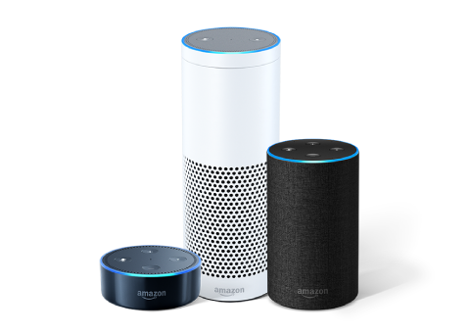


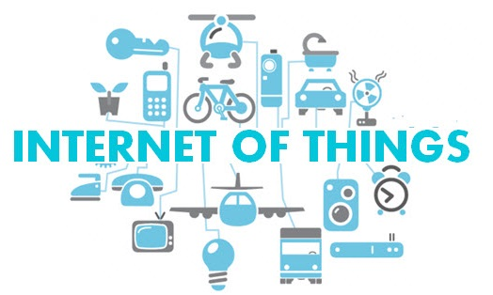

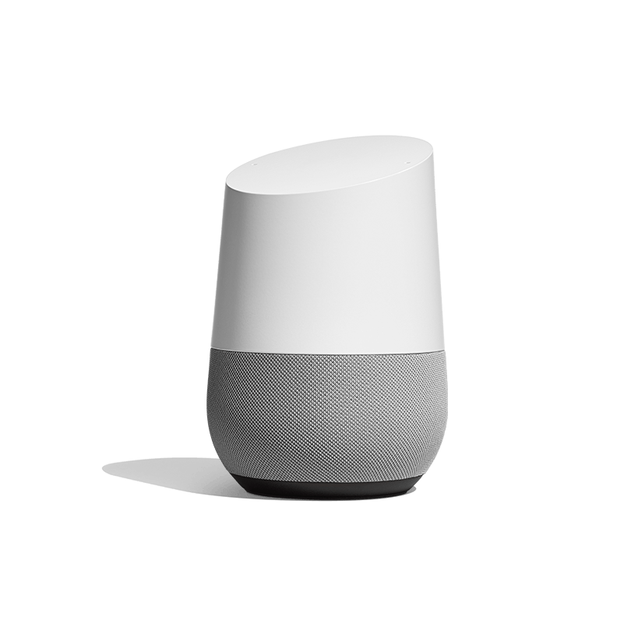
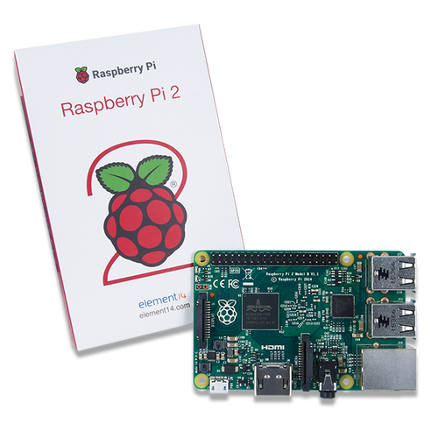
Scalability

Slide 4
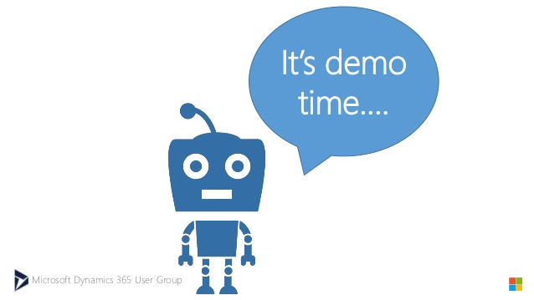

Slide 5
Future
- Voice authentication
- Aws Iot Button

Slide 6


Slide 7
Problem
Old age and disabled generation:
technology
Visit bank
Detect Fraud
No one

Slide 8
Solution
- voice based banking
You don’t need to be a financial expert or a mathematician
can be integrated to most of the available platform

Slide 9
- Can reduce visits to banks - Reduce telephone

