Slide 1

Simplify banking via voice
Divya Singhal
Ben Clayton
Lee Cox
Hoang
Hamza

Slide 2
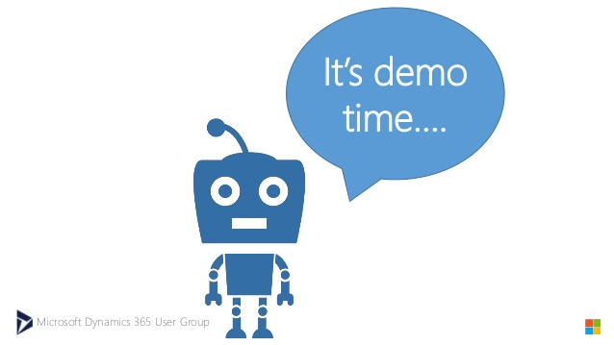

Slide 3





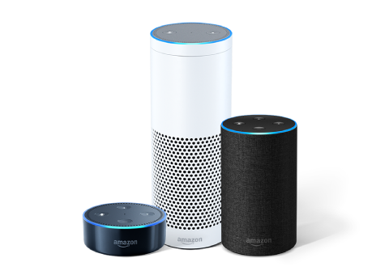




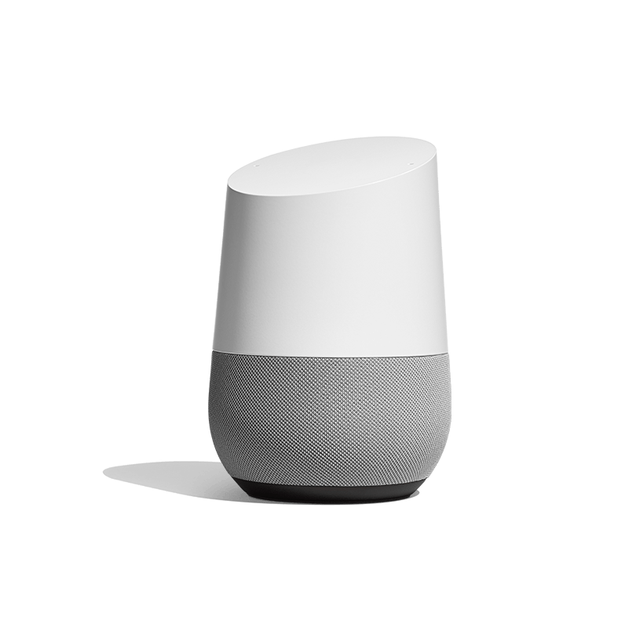
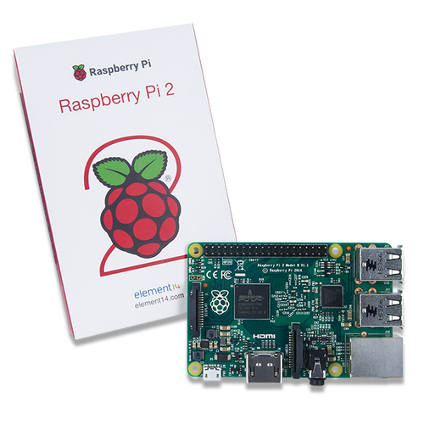
Scalability

Slide 4


