Slide 1


Slide 2


Problem
It is estimated that around £1.9bn of fraud goes undetected each year.
No policy or claim history sharing amongst Insurance providers.
Customers with low claim ratio seldom gets the benefit when buying any new insurance.

Slide 3

Scope
Platform to share policy and claim information
Reward like discount for low risk customers.

Slide 4

Out of Scope
Identity management for customer.

Slide 5


Slide 6

Use Case: Providers

Slide 7

Use Case: Customer

Slide 8
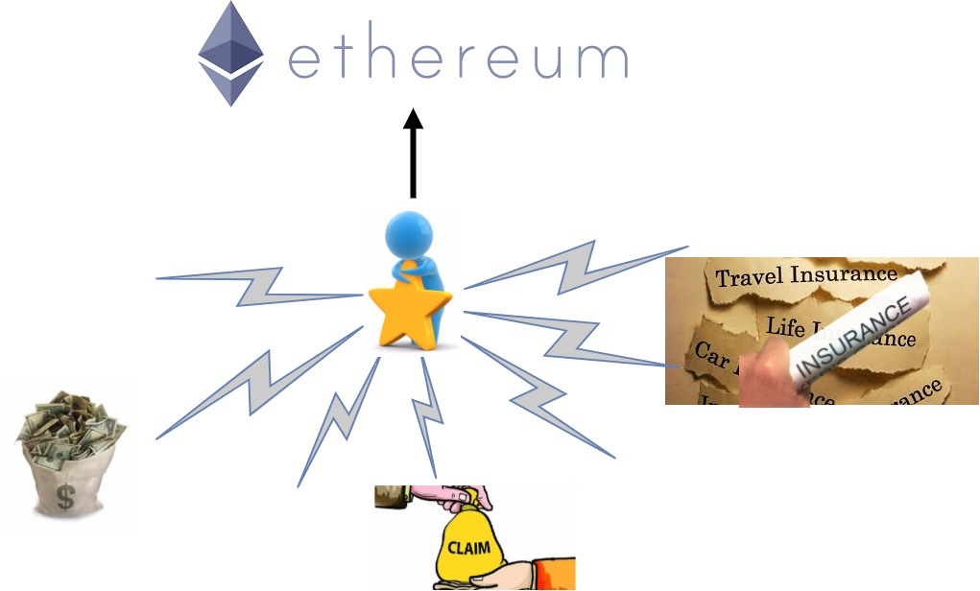
What does token represents ?

