Slide 1

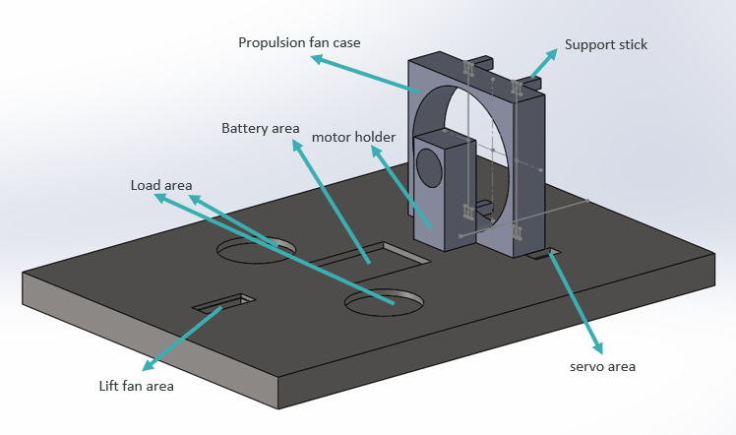
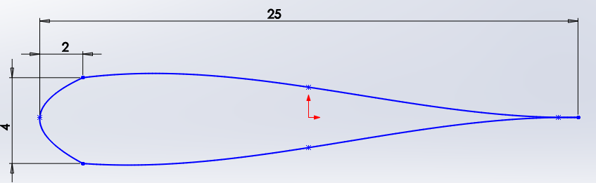
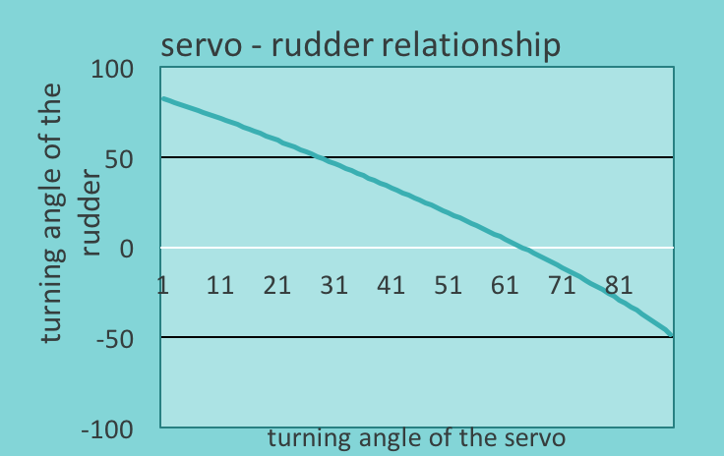
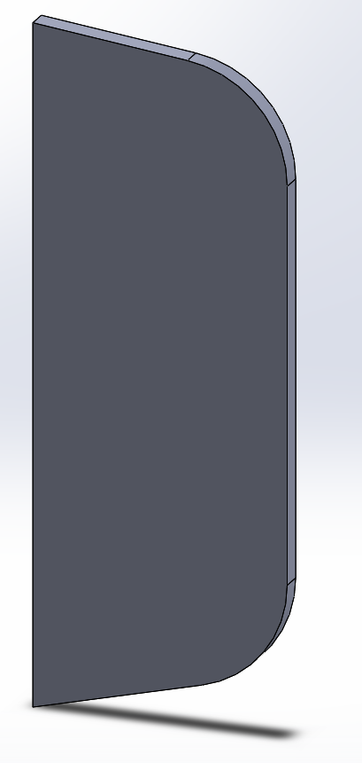
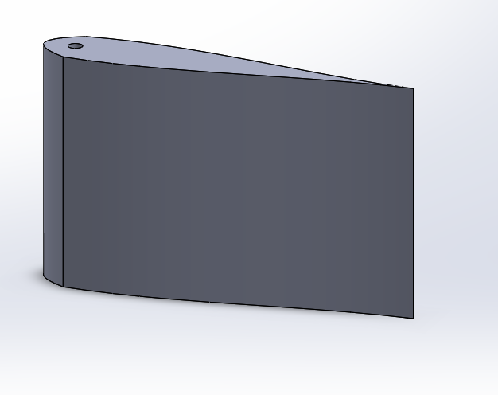
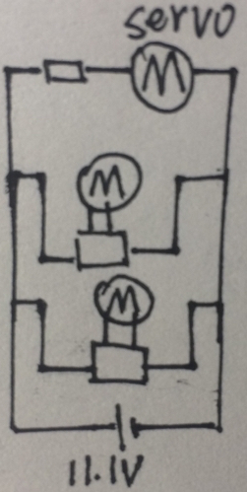
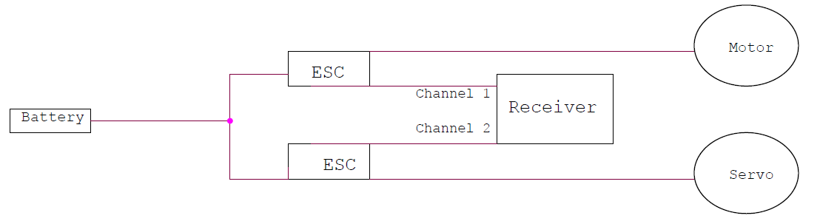

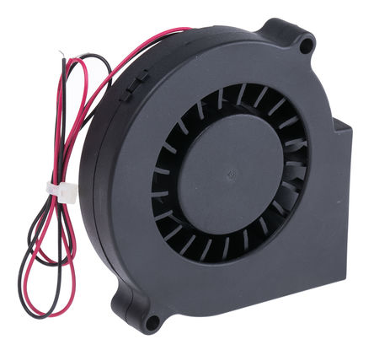
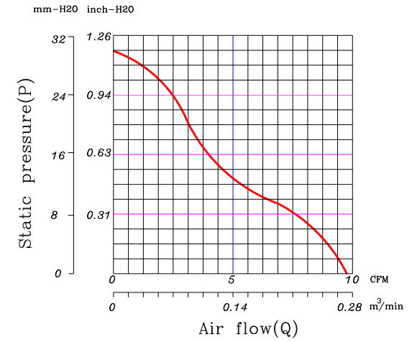
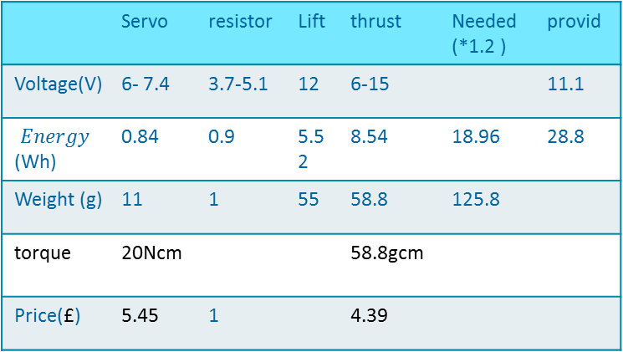
Group 13
Name | Length x width x thickness/mm | Weight/g
Payload area | 415 x 292 x 25 | 340(without load)
Battery | 74 x 55 x 20 | 145
Lift | 75 x 75 x 15.4 | 33
Propulsion | 100 x 100 x 25 | 150
servo | 23 x 12 x 27 | 11
Load | 57 x 57 x 11.5 | 200
motor | 27.7 x 27.7 x 47 | 51
The shaped body will be roughly 418 x 295mm in size, allowing for the thickness of the skirt.
Motors selection
 | Servo | resistor | Lift | thrust | Needed (*1.2 ) | provid
Voltage(V) | 6- 7.4 | 3.7-5.1 | 12 | 6-15 |  | 11.1
$$Energy$$ (Wh) | 0.84 | 0.9 | 5.52 | 8.54 | 18.96 | 28.8
Weight (g) | 11 | 1 | 55 | 58.8 | 125.8
torque | 20Ncm |  |  | 58.8gcm
Price(£) | 5.45 | 1 |  | 4.39
Navigation
Exploded model
Rudder angle 60°
Time (s) | Angle turned(°)
0.1 | 11.58
0.2 | 46.31
0.3 | 104.20
0.4 | 185.25
Rudder angle 70°
Time (s) | Angle turned(°)
0.1 | 12.56
0.2 | 50.25
0.3 | 113.06
0.4 | 201.00
Circuit diagram
Complete Circuit Diagram
It shows a 10° increase in rudder angle results in a 8.5% increase in turn for all times
Lift fan Calculations
Weight Force in Newtons: F=m x g = 2kg x 9.81 m/s²
F≈ 19,62 N
Force acting under the surface: Hole: 45mm x 15mm, Surface: 292mm x 415mm So, A≈ (0.292 x 0.415) – (0.045 x 0.015)
A≈ 0.120505m²
Pressure needed in order to lift the hovercraft is: P≈FA ≈ 19.62 0.120505 ≈ 162.81 Pa or (N/m²) A centrifugal fan will be used for the lift.
Budget
Product | Number of Products | Price (£)
Centrifugal Fan | 1 | 10.60
Blades | 2 | 6.80
Craft Foam Blue | 1 | 12
Motor | 2 | 8
6 Channel Radio | 1 | 30
Battery-Charger | 1 | 60
Electronic Speed Controller (ESC) | 4 | 16
Other Material | _ | 30
Servo | 1 | 6.67
Total | 13 | 180.07
Dynamic Pressure: Q= ½ x ρ x v² where: ρ= Air density (Kg/m³) v=Fluid velocity (m/s)
We know: ρ= 1.225 kg/m³ & v≈2.29 m/s. We know the velocity from the graph provided from the company’s data sheet. In order to produce high pressure, the velocity has to be under 2.3 m/s. Therefore, Q= ½ x 1.225 x (2.29)²
Q= 3.21 Pa
Total Pressure produced from the centrifugal fan: P_{t}= P_{D} + P_{S} P_{t}= 176.94 Pa at 2.29 m/s air flow. P_{S}= Static Pressure (at 2.29m/s) = 173.73 Pa

