Slide 1
Chapter 4 – Requirements Engineering
Lecture 1

Slide 2
Topics covered
Functional and non-functional requirements
The software requirements document
Requirements specification
Requirements engineering processes
Requirements elicitation and analysis
Requirements validation
Requirements management

Slide 3
Requirements engineering
The process of establishing the services that the customer requires from a system and the constraints under which it operates and is developed.
The requirements themselves are the descriptions of the system services and constraints that are generated during the requirements engineering process.

Slide 4
What is a requirement?
It may range from a high-level abstract statement of a service or of a system constraint to a detailed mathematical functional specification.
This is inevitable as requirements may serve a dual function
  May be the basis for a bid for a contract - therefore must be open to interpretation;
  May be the basis for the contract itself - therefore must be defined in detail;
  Both these statements may be called requirements.

Slide 5
Requirements abstraction (Davis)
“If a company wishes to let a contract for a large software development project, it must define its needs in a sufficiently abstract way that a solution is not pre-defined. The requirements must be written so that several contractors can bid for the contract, offering, perhaps, different ways of meeting the client organization’s needs. Once a contract has been awarded, the contractor must write a system definition for the client in more detail so that the client understands and can validate what the software will do. Both of these documents may be called the requirements document for the system.”

Slide 6
Types of requirement
User requirements
  Statements in natural language plus diagrams of the services the system provides and its operational constraints. Written for customers.
System requirements
  A structured document setting out detailed descriptions of the system’s functions, services and operational constraints. Defines what should be implemented so may be part of a contract between client and contractor.

Slide 7
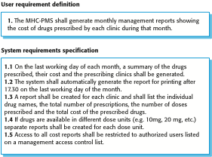
User and system requirements

Slide 8
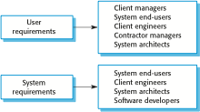
Readers of different types of requirements specification

Slide 9
Functional and non-functional requirements
Functional requirements
  Statements of services the system should provide, how the system should react to particular inputs and how the system should behave in particular situations.
  May state what the system should not do.
Non-functional requirements
  Constraints on the services or functions offered by the system such as timing constraints, constraints on the development process, standards, etc.
  Often apply to the system as a whole rather than individual features or services.
Domain requirements
  Constraints on the system from the domain of operation

Slide 10
Functional requirements
Describe functionality or system services.
Depend on the type of software, expected users and the type of system where the software is used.
Functional user requirements may be high-level statements of what the system should do.
Functional system requirements should describe the system services in detail.

Slide 11
Functional requirements for the MHC-PMS
A user shall be able to search the appointments lists for all clinics.
The system shall generate each day, for each clinic, a list of patients who are expected to attend appointments that day.
Each staff member using the system shall be uniquely identified by his or her 8-digit employee number.

Slide 12
Requirements imprecision
Problems arise when requirements are not precisely stated.
Ambiguous requirements may be interpreted in different ways by developers and users.
Consider the term ‘search’ in requirement 1
  User intention – search for a patient name across all appointments in all clinics;
  Developer interpretation – search for a patient name in an individual clinic. User chooses clinic then search.

Slide 13
Requirements completeness and consistency
In principle, requirements should be both complete and consistent.
Complete
  They should include descriptions of all facilities required.
Consistent
  There should be no conflicts or contradictions in the descriptions of the system facilities.
In practice, it is impossible to produce a complete and consistent requirements document.

Slide 14
Non-functional requirements
These define system properties and constraints e.g. reliability, response time and storage requirements. Constraints are I/O device capability, system representations, etc.
Process requirements may also be specified mandating a particular IDE, programming language or development method.
Non-functional requirements may be more critical than functional requirements. If these are not met, the system may be useless.

Slide 15
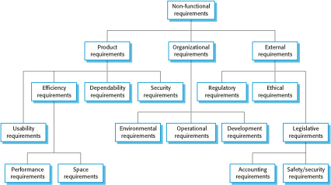
Types of nonfunctional requirement

Slide 16
Non-functional requirements implementation
Non-functional requirements may affect the overall architecture of a system rather than the individual components.
  For example, to ensure that performance requirements are met, you may have to organize the system to minimize communications between components.
A single non-functional requirement, such as a security requirement, may generate a number of related functional requirements that define system services that are required.
  It may also generate requirements that restrict existing requirements.

Slide 17
Non-functional classifications
Product requirements
  Requirements which specify that the delivered product must behave in a particular way e.g. execution speed, reliability, etc.
Organisational requirements
  Requirements which are a consequence of organisational policies and procedures e.g. process standards used, implementation requirements, etc.
External requirements
  Requirements which arise from factors which are external to the system and its development process e.g. interoperability requirements, legislative requirements, etc.

Slide 18
Examples of nonfunctional requirements in the MHC-PMS
Product requirement The MHC-PMS shall be available to all clinics during normal working hours (Mon–Fri, 0830–17.30). Downtime within normal working hours shall not exceed five seconds in any one day. Organizational requirement Users of the MHC-PMS system shall authenticate themselves using their health authority identity card. External requirement The system shall implement patient privacy provisions as set out in HStan-03-2006-priv.

Slide 19
Goals and requirements
Non-functional requirements may be very difficult to state precisely and imprecise requirements may be difficult to verify.
Goal
  A general intention of the user such as ease of use.
Verifiable non-functional requirement
  A statement using some measure that can be objectively tested.
Goals are helpful to developers as they convey the intentions of the system users.

Slide 20
Usability requirements
The system should be easy to use by medical staff and should be organized in such a way that user errors are minimized. (Goal)
Medical staff shall be able to use all the system functions after four hours of training. After this training, the average number of errors made by experienced users shall not exceed two per hour of system use. (Testable non-functional requirement)

Slide 21
Metrics for specifying nonfunctional requirements
Property | Measure
Speed | Processed transactions/second User/event response time Screen refresh time
Size | Mbytes Number of ROM chips
Ease of use | Training time Number of help frames
Reliability | Mean time to failure Probability of unavailability Rate of failure occurrence Availability
Robustness | Time to restart after failure Percentage of events causing failure Probability of data corruption on failure
Portability | Percentage of target dependent statements Number of target systems

Slide 22
Domain requirements
The system’s operational domain imposes requirements on the system.
  For example, a train control system has to take into account the braking characteristics in different weather conditions.
Domain requirements be new functional requirements, constraints on existing requirements or define specific computations.
If domain requirements are not satisfied, the system may be unworkable.

Slide 23
Train protection system
This is a domain requirement for a train protection system:
The deceleration of the train shall be computed as:
  Dtrain = Dcontrol + Dgradient
  where Dgradient is 9.81ms2 * compensated gradient/alpha and where the values of 9.81ms2 /alpha are known for different types of train.
It is difficult for a non-specialist to understand the implications of this and how it interacts with other requirements.

Slide 24
Domain requirements problems
Understandability
  Requirements are expressed in the language of the application domain;
  This is often not understood by software engineers developing the system.
Implicitness
  Domain specialists understand the area so well that they do not think of making the domain requirements explicit.

Slide 25
Key points
Requirements for a software system set out what the system should do and define constraints on its operation and implementation.
Functional requirements are statements of the services that the system must provide or are descriptions of how some computations must be carried out.
Non-functional requirements often constrain the system being developed and the development process being used.
They often relate to the emergent properties of the system and therefore apply to the system as a whole.

Slide 26
Chapter 4 – Requirements Engineering
Lecture 2

Slide 27
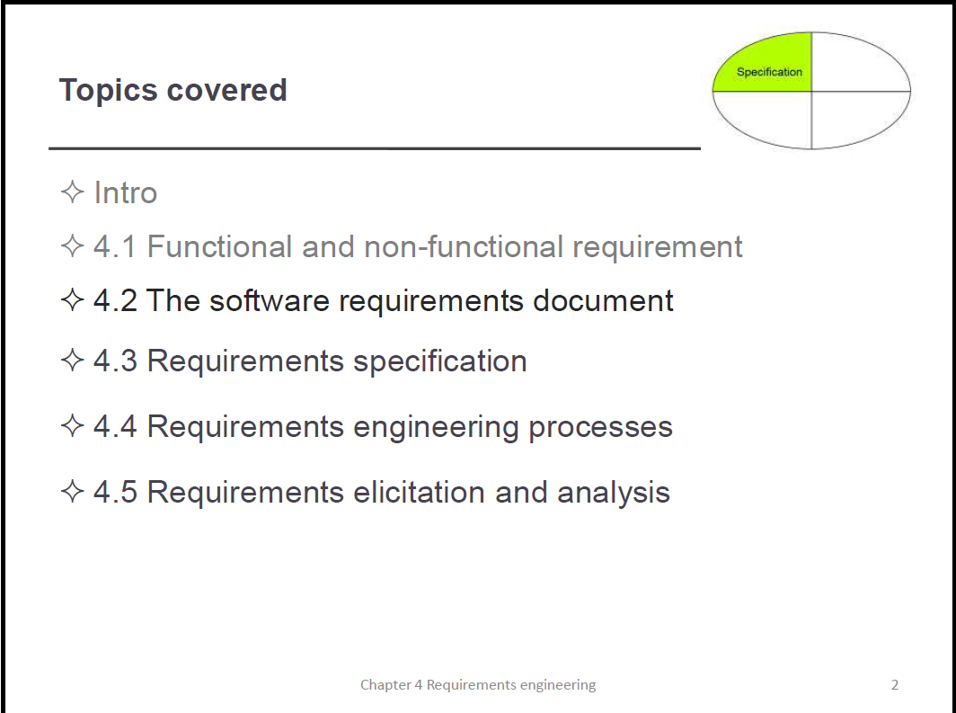

Slide 28
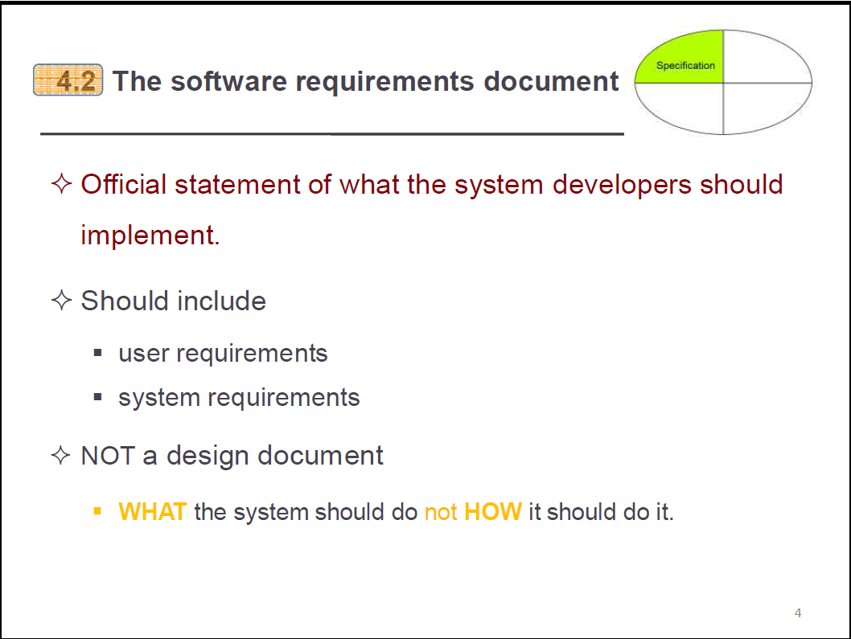
The software requirements document
The software requirements document is the official statement of what is required of the system developers.
Should include both a definition of user requirements and a specification of the system requirements.
It is NOT a design document. As far as possible, it should set of WHAT the system should do rather than HOW it should do it.

Slide 29
Agile methods and requirements
Many agile methods argue that producing a requirements document is a waste of time as requirements change so quickly.
The document is therefore always out of date.
Methods such as XP use incremental requirements engineering and express requirements as ‘user stories’ (discussed in Chapter 3).
This is practical for business systems but problematic for systems that require a lot of pre-delivery analysis (e.g. critical systems) or systems developed by several teams.

Slide 30
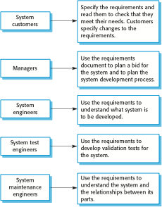
Users of a requirements document

Slide 31
Requirements document variability
Information in requirements document depends on type of system and the approach to development used.
Systems developed incrementally will, typically, have less detail in the requirements document.
Requirements documents standards have been designed e.g. IEEE standard. These are mostly applicable to the requirements for large systems engineering projects.

Slide 32
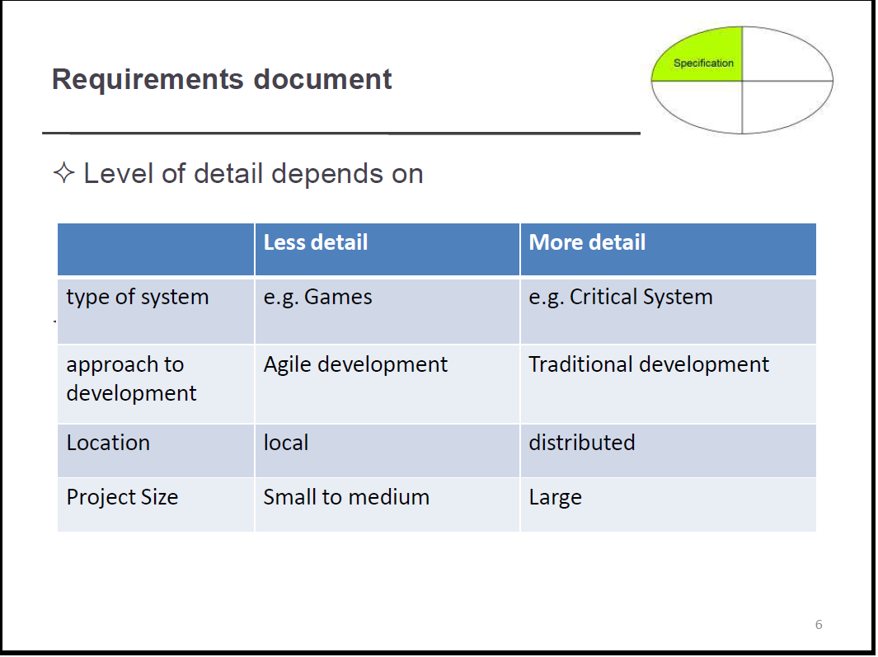

Slide 33
The structure of a requirements document
Chapter | Description
Preface | This should define the expected readership of the document and describe its version history, including a rationale for the creation of a new version and a summary of the changes made in each version.
Introduction | This should describe the need for the system. It should briefly describe the system’s functions and explain how it will work with other systems. It should also describe how the system fits into the overall business or strategic objectives of the organization commissioning the software.
Glossary | This should define the technical terms used in the document. You should not make assumptions about the experience or expertise of the reader.
User requirements definition | Here, you describe the services provided for the user. The nonfunctional system requirements should also be described in this section. This description may use natural language, diagrams, or other notations that are understandable to customers. Product and process standards that must be followed should be specified.
System architecture | This chapter should present a high-level overview of the anticipated system architecture, showing the distribution of functions across system modules. Architectural components that are reused should be highlighted.

Slide 34
The structure of a requirements document
Chapter | Description
System requirements specification | This should describe the functional and nonfunctional requirements in more detail. If necessary, further detail may also be added to the nonfunctional requirements. Interfaces to other systems may be defined.
System models | This might include graphical system models showing the relationships between the system components and the system and its environment. Examples of possible models are object models, data-flow models, or semantic data models.
System evolution | This should describe the fundamental assumptions on which the system is based, and any anticipated changes due to hardware evolution, changing user needs, and so on. This section is useful for system designers as it may help them avoid design decisions that would constrain likely future changes to the system.
Appendices | These should provide detailed, specific information that is related to the application being developed; for example, hardware and database descriptions. Hardware requirements define the minimal and optimal configurations for the system. Database requirements define the logical organization of the data used by the system and the relationships between data.
Index | Several indexes to the document may be included. As well as a normal alphabetic index, there may be an index of diagrams, an index of functions, and so on.

Slide 35
Requirements specification
The process of writing down the user and system requirements in a requirements document.
User requirements have to be understandable by end-users and customers who do not have a technical background.
System requirements are more detailed requirements and may include more technical information.
The requirements may be part of a contract for the system development
  It is therefore important that these are as complete as possible.

Slide 36
Ways of writing a system requirements specification
Notation | Description
Natural language | The requirements are written using numbered sentences in natural language. Each sentence should express one requirement.
Structured natural language | The requirements are written in natural language on a standard form or template. Each field provides information about an aspect of the requirement.
Design description languages | This approach uses a language like a programming language, but with more abstract features to specify the requirements by defining an operational model of the system. This approach is now rarely used although it can be useful for interface specifications.
Graphical notations | Graphical models, supplemented by text annotations, are used to define the functional requirements for the system; UML use case and sequence diagrams are commonly used.
Mathematical specifications | These notations are based on mathematical concepts such as finite-state machines or sets. Although these unambiguous specifications can reduce the ambiguity in a requirements document, most customers don’t understand a formal specification. They cannot check that it represents what they want and are reluctant to accept it as a system contract

Slide 37
Requirements and design
In principle, requirements should state what the system should do and the design should describe how it does this.
In practice, requirements and design are inseparable
  A system architecture may be designed to structure the requirements;
  The system may inter-operate with other systems that generate design requirements;
  The use of a specific architecture to satisfy non-functional requirements may be a domain requirement.
  This may be the consequence of a regulatory requirement.

Slide 38
Natural language specification
Requirements are written as natural language sentences supplemented by diagrams and tables.
Used for writing requirements because it is expressive, intuitive and universal. This means that the requirements can be understood by users and customers.

Slide 39
Guidelines for writing requirements
Invent a standard format and use it for all requirements.
Use language in a consistent way. Use shall for mandatory requirements, should for desirable requirements.
Use text highlighting to identify key parts of the requirement.
Avoid the use of computer jargon.
Include an explanation (rationale) of why a requirement is necessary.

Slide 40
Problems with natural language
Lack of clarity
  Precision is difficult without making the document difficult to read.
Requirements confusion
  Functional and non-functional requirements tend to be mixed-up.
Requirements amalgamation
  Several different requirements may be expressed together.

Slide 41
Example requirements for the insulin pump software system
3.2 The system shall measure the blood sugar and deliver insulin, if required, every 10 minutes. (Changes in blood sugar are relatively slow so more frequent measurement is unnecessary; less frequent measurement could lead to unnecessarily high sugar levels.) 3.6 The system shall run a self-test routine every minute with the conditions to be tested and the associated actions defined in Table 1. (A self-test routine can discover hardware and software problems and alert the user to the fact the normal operation may be impossible.)

Slide 42
Structured specifications
An approach to writing requirements where the freedom of the requirements writer is limited and requirements are written in a standard way.
This works well for some types of requirements e.g. requirements for embedded control system but is sometimes too rigid for writing business system requirements.

Slide 43
Form-based specifications
Definition of the function or entity.
Description of inputs and where they come from.
Description of outputs and where they go to.
Information about the information needed for the computation and other entities used.
Description of the action to be taken.
Pre and post conditions (if appropriate).
The side effects (if any) of the function.

Slide 44
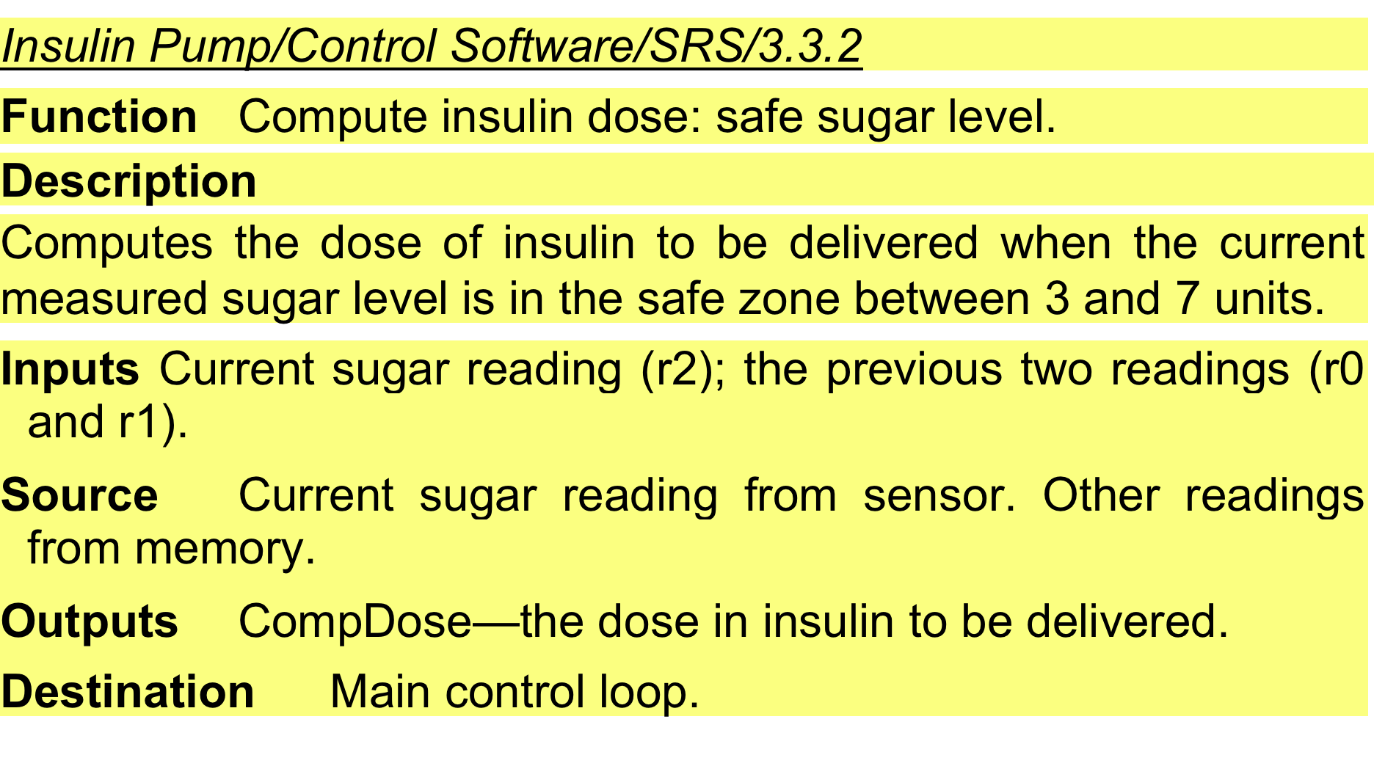
A structured specification of a requirement for an insulin pump

Slide 45
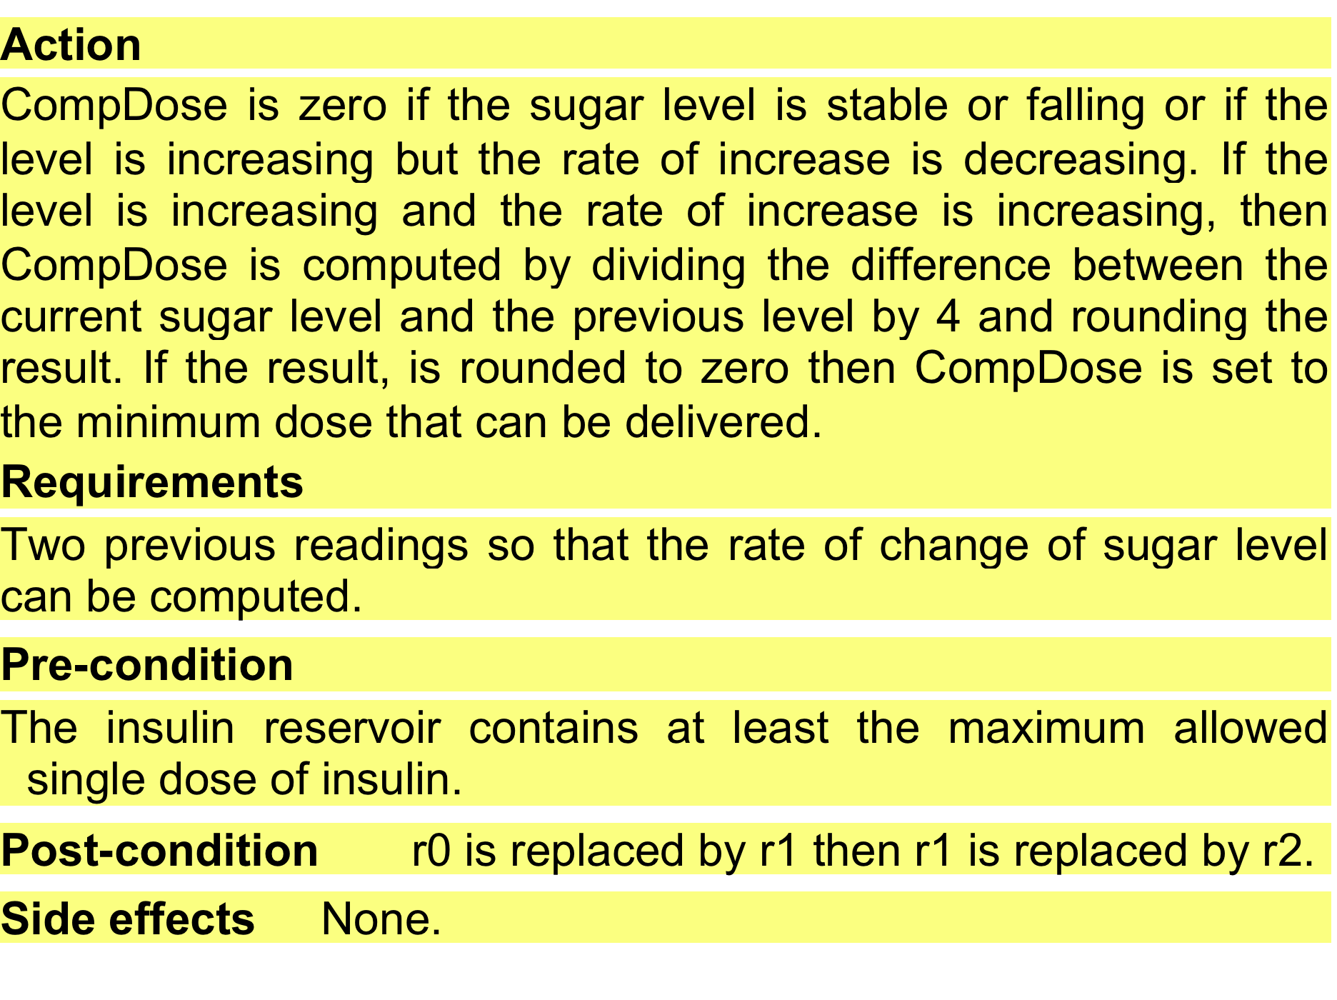
A structured specification of a requirement for an insulin pump

Slide 46
Tabular specification
Used to supplement natural language.
Particularly useful when you have to define a number of possible alternative courses of action.
For example, the insulin pump systems bases its computations on the rate of change of blood sugar level and the tabular specification explains how to calculate the insulin requirement for different scenarios.

Slide 47
Tabular specification of computation for an insulin pump
Condition | Action
Sugar level falling (r2 < r1) | CompDose = 0
Sugar level stable (r2 = r1) | CompDose = 0
Sugar level increasing and rate of increase decreasing ((r2 – r1) < (r1 – r0)) | CompDose = 0
Sugar level increasing and rate of increase stable or increasing ((r2 – r1) ≥ (r1 – r0)) | CompDose = round ((r2 – r1)/4) If rounded result = 0 then CompDose = MinimumDose

Slide 48
Requirements engineering processes
The processes used for RE vary widely depending on the application domain, the people involved and the organisation developing the requirements.
However, there are a number of generic activities common to all processes
  Requirements elicitation;
  Requirements analysis;
  Requirements validation;
  Requirements management.
In practice, RE is an iterative activity in which these processes are interleaved.

Slide 49
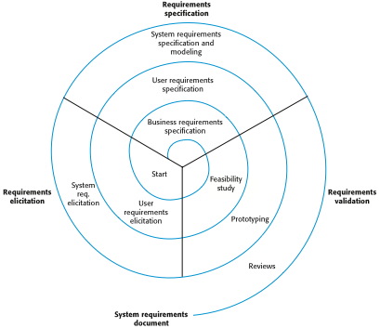
A spiral view of the requirements engineering process

Slide 50
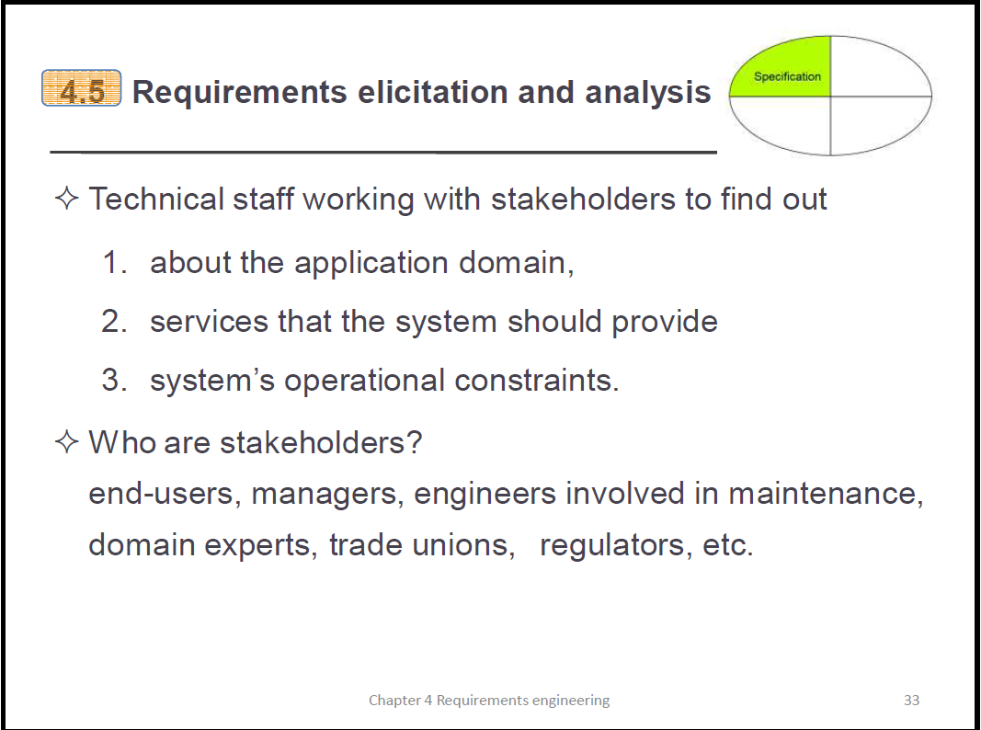
Requirements elicitation and analysis
Sometimes called requirements elicitation or requirements discovery.
Involves technical staff working with customers to find out about the application domain, the services that the system should provide and the system’s operational constraints.
May involve end-users, managers, engineers involved in maintenance, domain experts, trade unions, etc. These are called stakeholders.

Slide 51
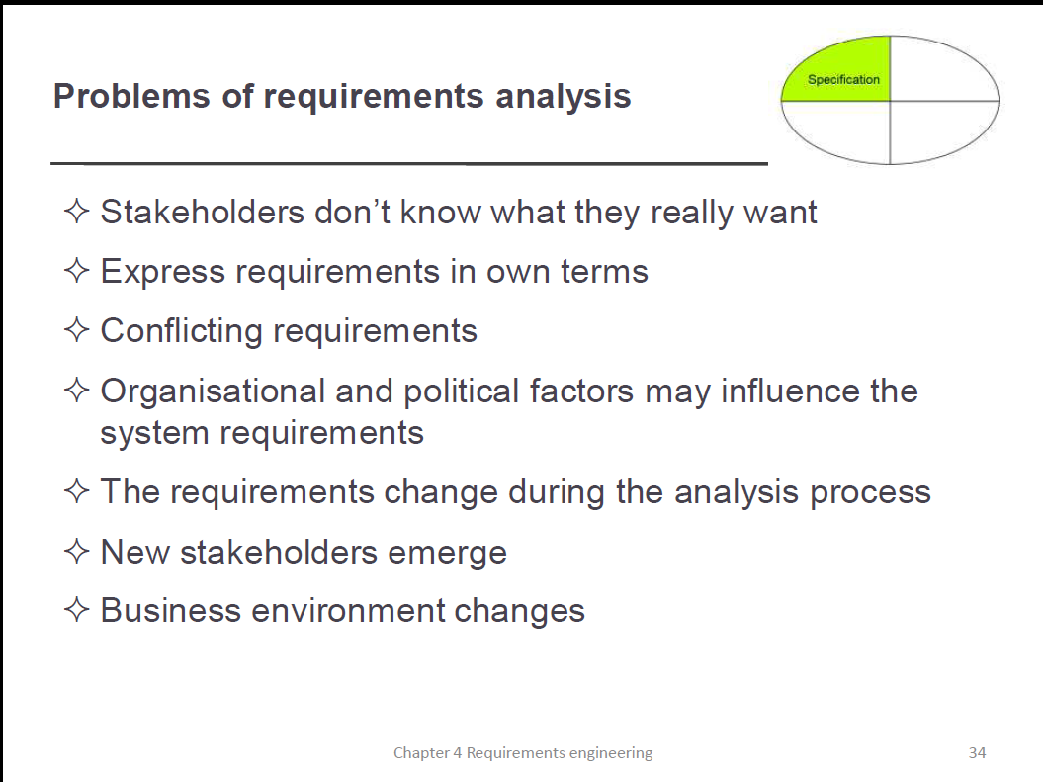
Problems of requirements analysis
Stakeholders don’t know what they really want.
Stakeholders express requirements in their own terms.
Different stakeholders may have conflicting requirements.
Organisational and political factors may influence the system requirements.
The requirements change during the analysis process. New stakeholders may emerge and the business environment may change.

Slide 52
Requirements elicitation and analysis
Software engineers work with a range of system stakeholders to find out about the application domain, the services that the system should provide, the required system performance, hardware constraints, other systems, etc.
Stages include:
  Requirements discovery,
  Requirements classification and organization,
  Requirements prioritization and negotiation,
  Requirements specification.

Slide 53
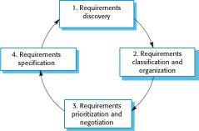
The requirements elicitation and analysis process

Slide 54
Process activities
Requirements discovery
  Interacting with stakeholders to discover their requirements. Domain requirements are also discovered at this stage.
Requirements classification and organisation
  Groups related requirements and organises them into coherent clusters.
Prioritisation and negotiation
  Prioritising requirements and resolving requirements conflicts.
Requirements specification
  Requirements are documented and input into the next round of the spiral.

Slide 55
Requirements discovery
The process of gathering information about the required and existing systems and distilling the user and system requirements from this information.
Interaction is with system stakeholders from managers to external regulators.
Systems normally have a range of stakeholders.

Slide 56
Stakeholders in the MHC-PMS
Patients whose information is recorded in the system.
Doctors who are responsible for assessing and treating patients.
Nurses who coordinate the consultations with doctors and administer some treatments.
Medical receptionists who manage patients’ appointments.
IT staff who are responsible for installing and maintaining the system.

Slide 57
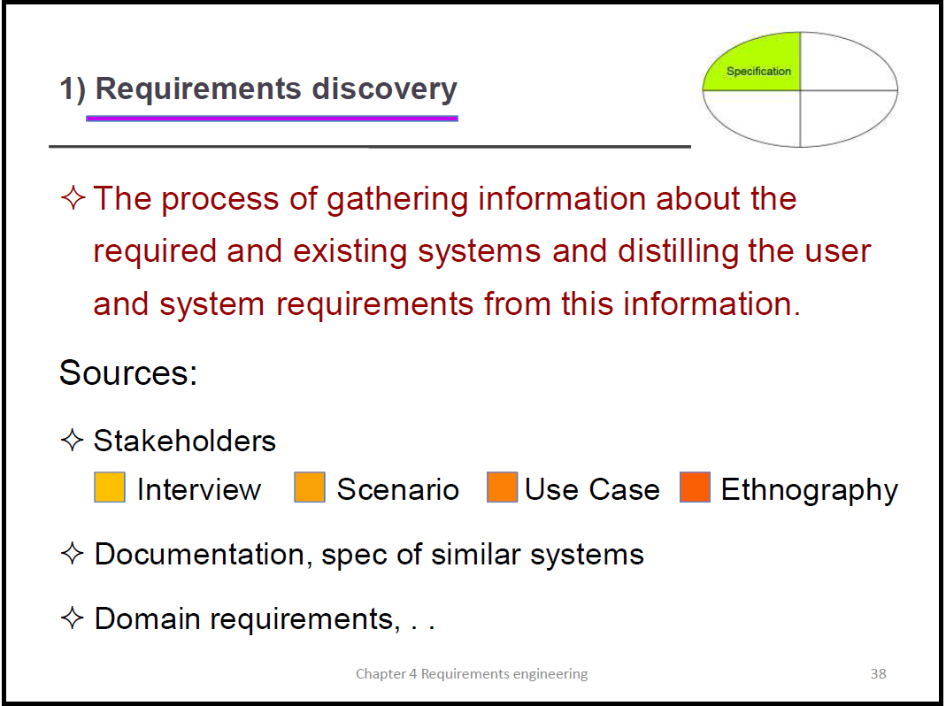

Slide 58
Interviewing
Formal or informal interviews with stakeholders are part of most RE processes.
Types of interview
  Closed interviews based on pre-determined list of questions
  Open interviews where various issues are explored with stakeholders.
Effective interviewing
  Be open-minded, avoid pre-conceived ideas about the requirements and are willing to listen to stakeholders.
  Prompt the interviewee to get discussions going using a springboard question, a requirements proposal, or by working together on a prototype system.

Slide 59
Interviews in practice
Normally a mix of closed and open-ended interviewing.
Interviews are good for getting an overall understanding of what stakeholders do and how they might interact with the system.
Interviews are not good for understanding domain requirements
  Requirements engineers cannot understand specific domain terminology;
  Some domain knowledge is so familiar that people find it hard to articulate or think that it isn’t worth articulating.

Slide 60
Scenarios
Scenarios are real-life examples of how a system can be used.
They should include
  A description of the starting situation;
  A description of the normal flow of events;
  A description of what can go wrong;
  Information about other concurrent activities;
  A description of the state when the scenario finishes.

Slide 61
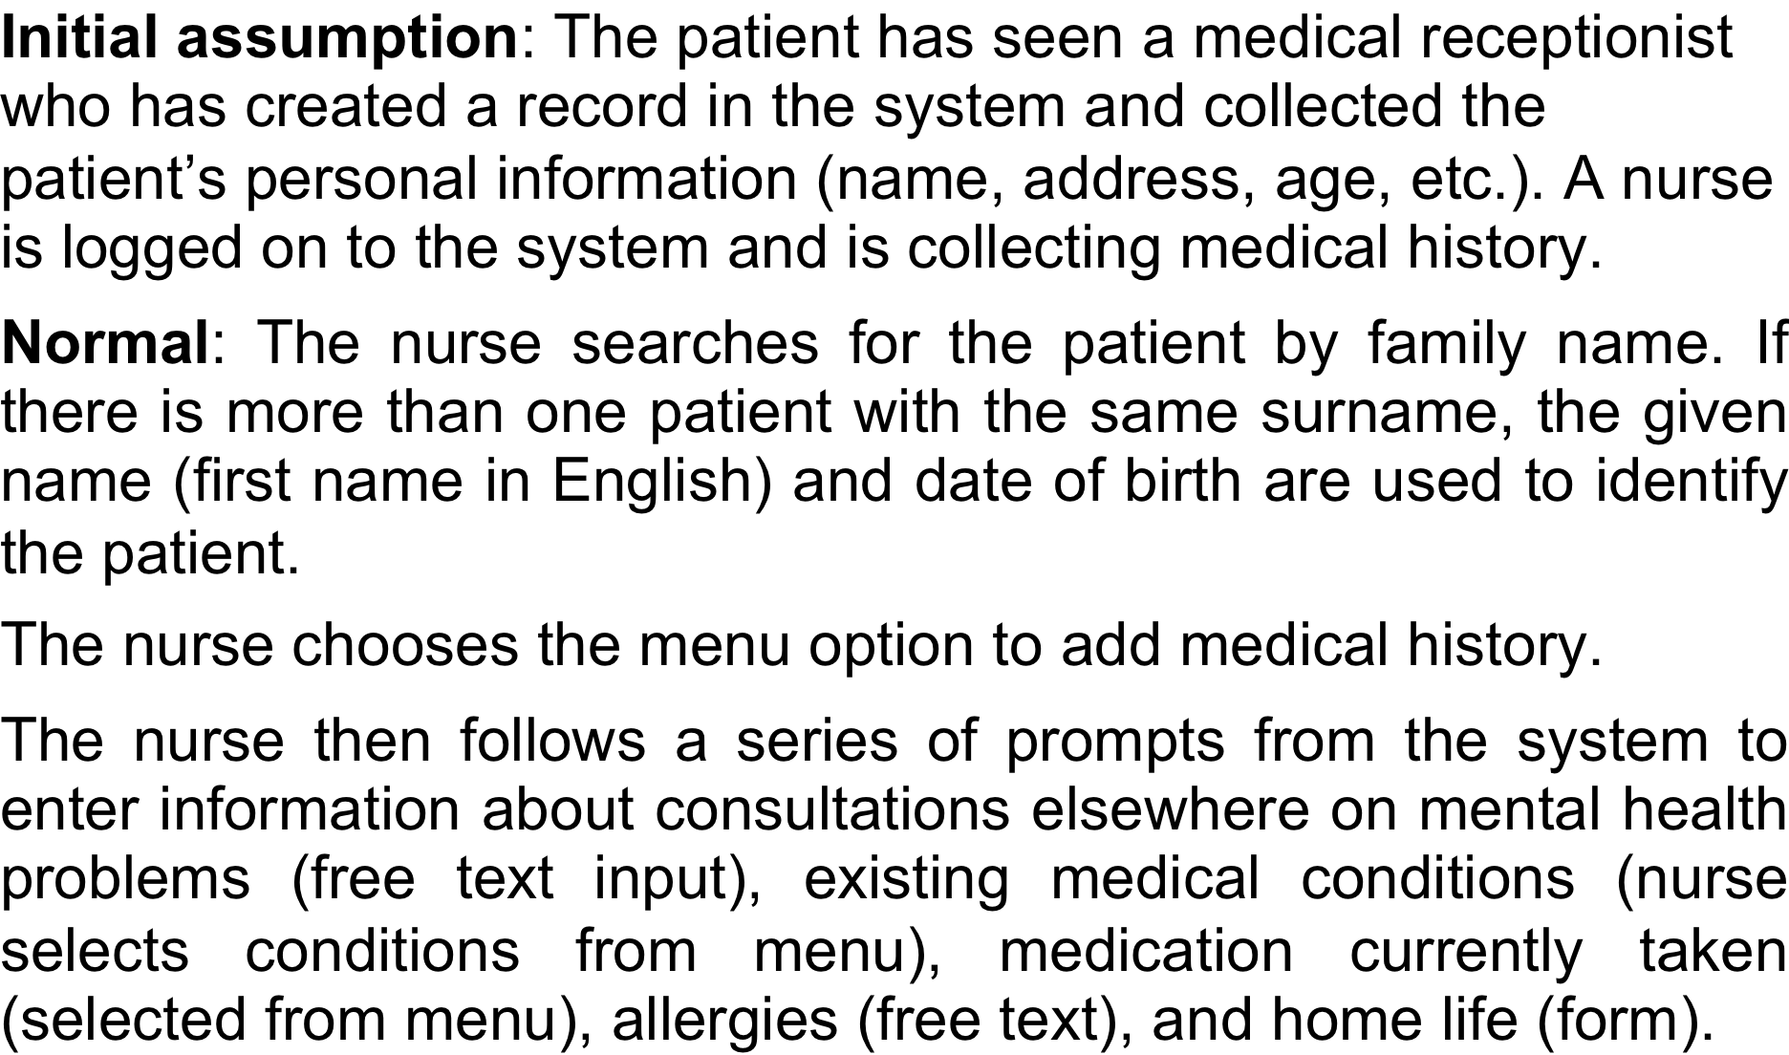
Scenario for collecting medical history in MHC-PMS

Slide 62
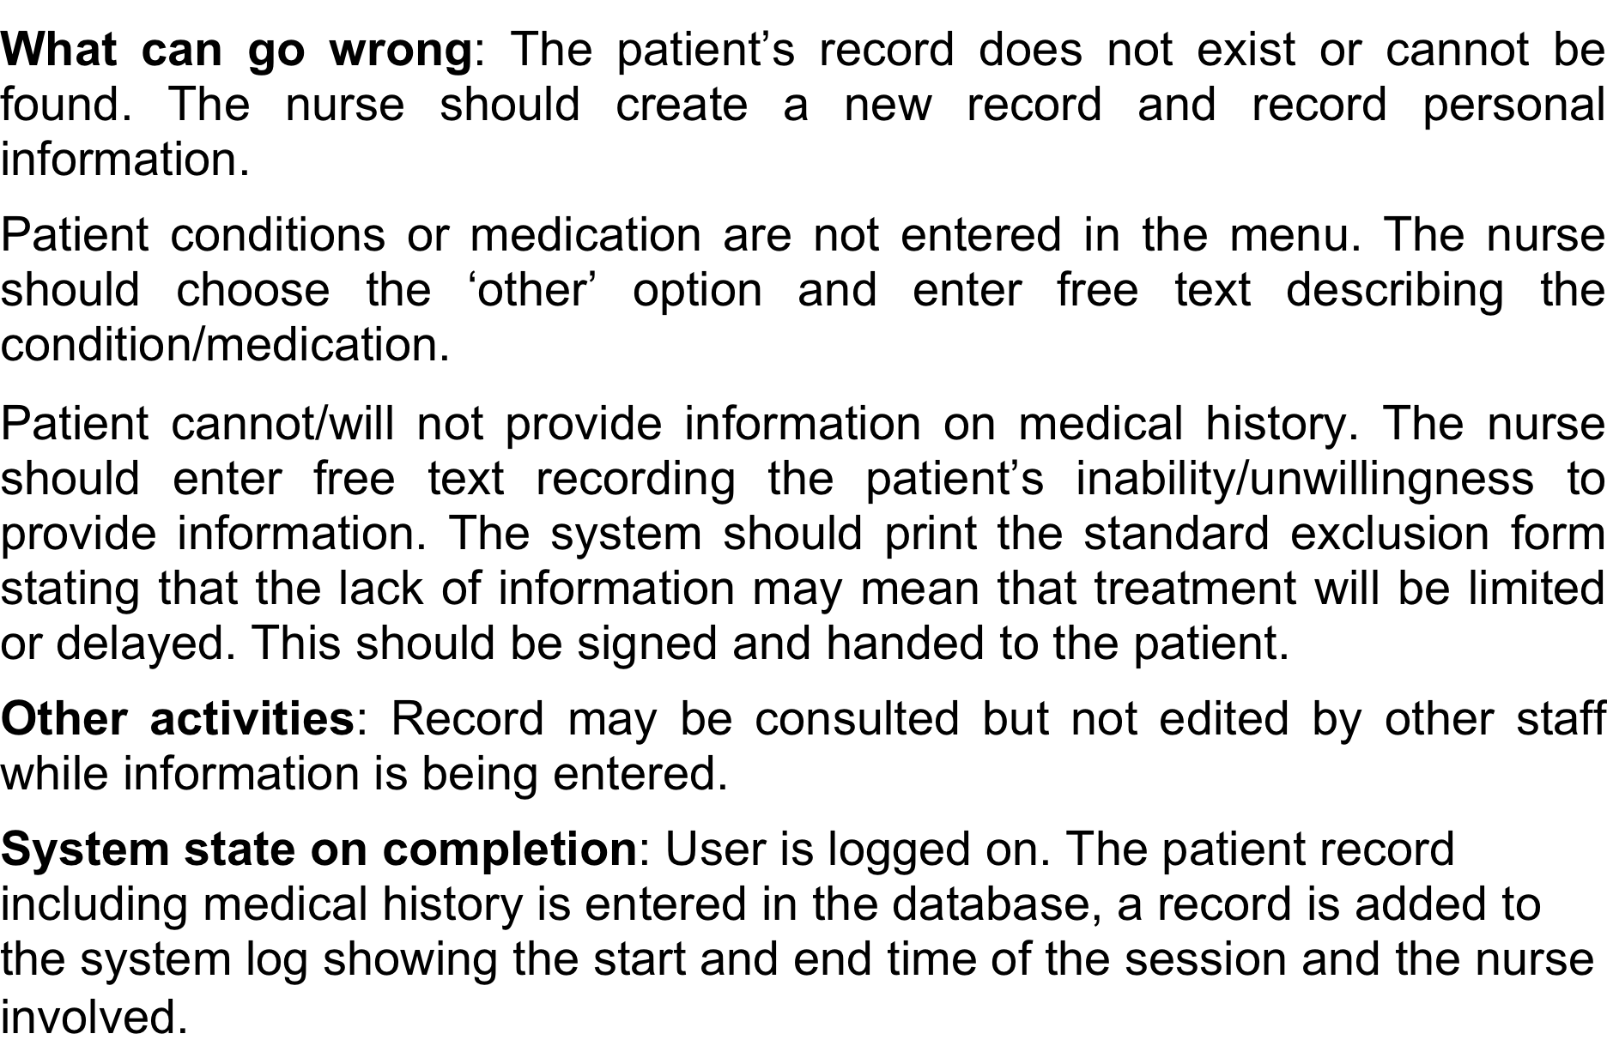
Scenario for collecting medical history in MHC-PMS

Slide 63
Use cases
Use-cases are a scenario based technique in the UML which identify the actors in an interaction and which describe the interaction itself.
A set of use cases should describe all possible interactions with the system.
High-level graphical model supplemented by more detailed tabular description (see Chapter 5).
Sequence diagrams may be used to add detail to use-cases by showing the sequence of event processing in the system.

Slide 64
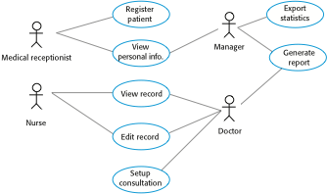
Use cases for the MHC-PMS

Slide 65
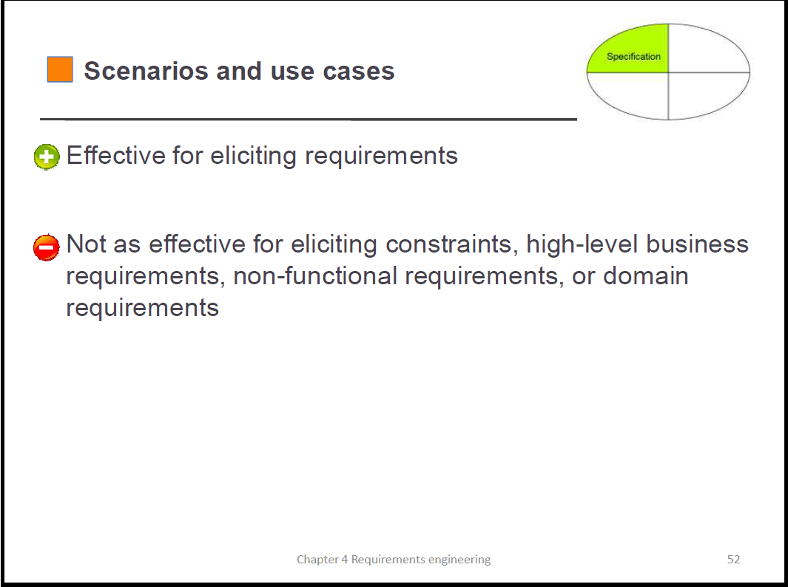

Slide 66
Ethnography
A social scientist spends a considerable time observing and analysing how people actually work.
People do not have to explain or articulate their work.
Social and organisational factors of importance may be observed.
Ethnographic studies have shown that work is usually richer and more complex than suggested by simple system models.

Slide 67
Scope of ethnography
Requirements that are derived from the way that people actually work rather than the way I which process definitions suggest that they ought to work.
Requirements that are derived from cooperation and awareness of other people’s activities.
  Awareness of what other people are doing leads to changes in the ways in which we do things.
Ethnography is effective for understanding existing processes but cannot identify new features that should be added to a system.

Slide 68
Focused ethnography
Developed in a project studying the air traffic control process
Combines ethnography with prototyping
Prototype development results in unanswered questions which focus the ethnographic analysis.
The problem with ethnography is that it studies existing practices which may have some historical basis which is no longer relevant.

Slide 69

Ethnography and prototyping for requirements analysis

Slide 70
Requirements validation
Concerned with demonstrating that the requirements define the system that the customer really wants.
Requirements error costs are high so validation is very important
  Fixing a requirements error after delivery may cost up to 100 times the cost of fixing an implementation error.

Slide 71
Requirements checking
Validity. Does the system provide the functions which best support the customer’s needs?
Consistency. Are there any requirements conflicts?
Completeness. Are all functions required by the customer included?
Realism. Can the requirements be implemented given available budget and technology
Verifiability. Can the requirements be checked?

Slide 72
Requirements validation techniques
Requirements reviews
  Systematic manual analysis of the requirements.
Prototyping
  Using an executable model of the system to check requirements. Covered in Chapter 2.
Test-case generation
  Developing tests for requirements to check testability.

Slide 73
Requirements reviews
Regular reviews should be held while the requirements definition is being formulated.
Both client and contractor staff should be involved in reviews.
Reviews may be formal (with completed documents) or informal. Good communications between developers, customers and users can resolve problems at an early stage.

Slide 74
Review checks
Verifiability
  Is the requirement realistically testable?
Comprehensibility
  Is the requirement properly understood?
Traceability
  Is the origin of the requirement clearly stated?
Adaptability
  Can the requirement be changed without a large impact on other requirements?

Slide 75
Requirements management
Requirements management is the process of managing changing requirements during the requirements engineering process and system development.
New requirements emerge as a system is being developed and after it has gone into use.
You need to keep track of individual requirements and maintain links between dependent requirements so that you can assess the impact of requirements changes. You need to establish a formal process for making change proposals and linking these to system requirements.

Slide 76
Changing requirements
The business and technical environment of the system always changes after installation.
  New hardware may be introduced, it may be necessary to interface the system with other systems, business priorities may change (with consequent changes in the system support required), and new legislation and regulations may be introduced that the system must necessarily abide by.
The people who pay for a system and the users of that system are rarely the same people.
  System customers impose requirements because of organizational and budgetary constraints. These may conflict with end-user requirements and, after delivery, new features may have to be added for user support if the system is to meet its goals.

Slide 77
Changing requirements
Large systems usually have a diverse user community, with many users having different requirements and priorities that may be conflicting or contradictory.
  The final system requirements are inevitably a compromise between them and, with experience, it is often discovered that the balance of support given to different users has to be changed.

Slide 78
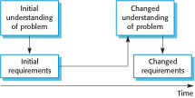
Requirements evolution

Slide 79
Requirements management planning
Establishes the level of requirements management detail that is required.
Requirements management decisions:
  Requirements identification Each requirement must be uniquely identified so that it can be cross-referenced with other requirements.
  A change management process This is the set of activities that assess the impact and cost of changes. I discuss this process in more detail in the following section.
  Traceability policies These policies define the relationships between each requirement and between the requirements and the system design that should be recorded.
  Tool support Tools that may be used range from specialist requirements management systems to spreadsheets and simple database systems.

Slide 80
Requirements change management
Deciding if a requirements change should be accepted
  Problem analysis and change specification
    During this stage, the problem or the change proposal is analyzed to check that it is valid. This analysis is fed back to the change requestor who may respond with a more specific requirements change proposal, or decide to withdraw the request.
  Change analysis and costing
    The effect of the proposed change is assessed using traceability information and general knowledge of the system requirements. Once this analysis is completed, a decision is made whether or not to proceed with the requirements change.
  Change implementation
    The requirements document and, where necessary, the system design and implementation, are modified. Ideally, the document should be organized so that changes can be easily implemented.

Slide 81

Requirements change management

Slide 82
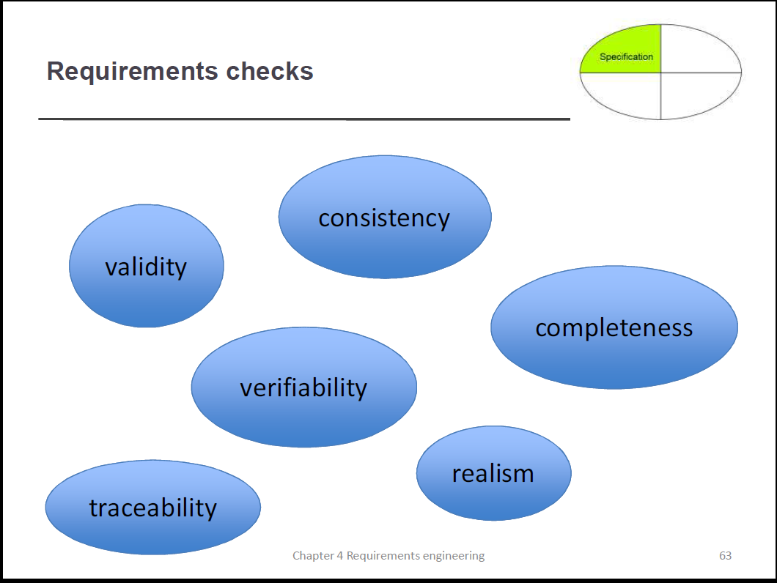
Key points
You can use a range of techniques for requirements elicitation including interviews, scenarios, use-cases and ethnography.
Requirements validation is the process of checking the requirements for validity, consistency, completeness, realism and verifiability.
Business, organizational and technical changes inevitably lead to changes to the requirements for a software system. Requirements management is the process of managing and controlling these changes.

