Slide 1
ESD G7T1 Proposal
Tuition

Slide 2
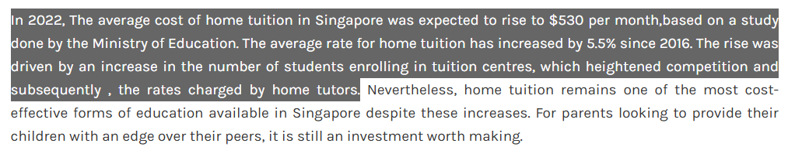
Business Problem
Due to high demand of tutors, tuition centers are becoming more expensive.
https://www.tutornow.sg/blog/home-tuition-rates-2024-the-average-cost-of-home-tuition-in-singapore
This creates an inequality gap in the education system, where students are unable to access further enrichment without paying large amounts well beyond their budget. Furthermore, the ratio of students to teacher at these tuition centers is too large for focused, quality education.

Slide 3
Business Problem
Telegram channels that connect tutors to students are too fragmented, and many students get ghosted or do not hear back from administrators of these channels. This result in the stagnant high demand for tutors, eventually leading to stagnant high tuition costs
This is where Tutor comes in to properly connect students to the right tutor of their choosing, hopefully decreasing the demand for tutors, decreasing tuition costs.

Slide 4
Tutor to students
Scenario 1: Student Indicates Interest (Composite & Asynchronous Notification)
Browse: The Student UI sends a synchronous HTTP GET to the Tutors atomic microservice to display the list of tutors.
Select: The student selects a tutor. The UI sends an HTTP POST with student_id and tutor_id to an Indicate Interest composite microservice.
Data Fetch: The composite service sends an HTTP GET to the Tutors service to retrieve the tutor's contact information.
Save State: The composite service sends an HTTP POST to the Interest atomic microservice to create a PENDING request in its exclusive database.
Async Event: The composite service drops an InterestCreated message (containing the contact info) into RabbitMQ.
Notify: The Notification microservice consumes the message and triggers an external email/SMS API to alert the tutor.
Business Exception: If the tutor does not reply within 48 hours, a scheduled job updates the Interest database to EXPIRED and notifies the student to try again.

Slide 5
Tutor to students
Scenario 2: Tutor Reviews Interested Students (Choreography)
Review: The Tutor UI sends an HTTP GET to the Interest microservice to fetch pending requests.
Decision Input: The tutor accepts a student and selects available dates. The UI sends an HTTP PUT to the Interest microservice with {"status": "ACCEPTED", "proposed_dates": [...]}.
Update State: The Interest microservice updates the record in its database.
Choreography Trigger: The Interest microservice publishes an InterestAccepted message (containing the dates) to RabbitMQ.
Independent Reactions:
The Booking microservice consumes the message and creates a PENDING_STUDENT_CONFIRMATION record with the proposed dates.
The Notification microservice consumes the same message and emails the student to prompt their selection.

Slide 6
Tutor to students
Scenario 3: Booking Coordination & Confirmation (Orchestration & Rollback)
View Dates: The Student UI sends an HTTP GET to the Booking microservice to view the tutor's proposed dates.
Path A (Rollback): * The student cancels. The UI sends an HTTP PUT to the Booking microservice ({"status": "CANCELLED"}).
The Booking service frees the schedule in its DB and publishes a TrialCancelled message to RabbitMQ to notify the tutor.
Path B (Proceed to Pay): * The student selects a date. The UI sends an HTTP POST to the Booking microservice.
The Booking service temporarily locks the slot as PENDING_PAYMENT.
Payment Orchestration: The Booking service acts as an orchestrator and sends a synchronous HTTP POST to the Payment microservice.
External API: The Payment service invokes an external mock payment gateway (sandbox version) to process the transaction.
Confirmation: Upon success, the Payment service returns an HTTP 200 OK to the Booking service. The Booking service updates the status to CONFIRMED and drops a LessonConfirmed message into RabbitMQ. The Notification service emails the final calendar invite to both parties.

Slide 7
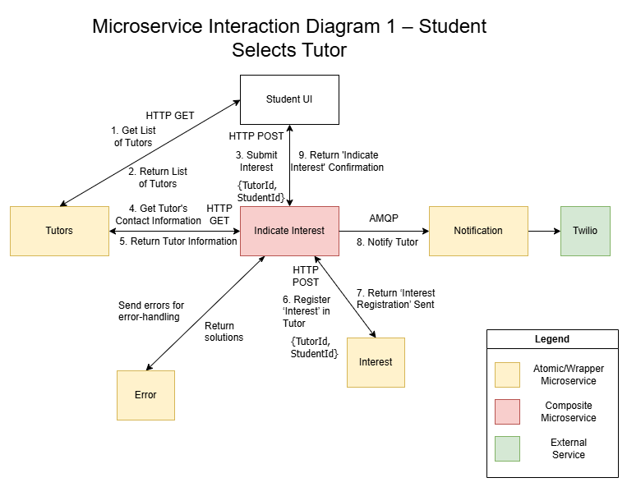
Microservice Interaction Diagram 1
– Student Selects Tutor
Notes:
Scenario 1: Student Indicates Interest (Composite & Asynchronous Notification)
Browse: The Student UI sends a synchronous HTTP GET to the Tutors atomic microservice to display the list of tutors.
Select: The student selects a tutor. The UI sends an HTTP POST with student_id and tutor_id to an Indicate Interest composite microservice.
Data Fetch: The composite service sends an HTTP GET to the Tutors service to retrieve the tutor's contact information.
Save State: The composite service sends an HTTP POST to the Interest atomic microservice to create a PENDING request in its exclusive database.
Async Event: The composite service drops an InterestCreated message (containing the contact info) into RabbitMQ.
Notify: The Notification microservice consumes the message and triggers an external email/SMS API to alert the tutor.
Business Exception: If the tutor does not reply within 48 hours, a scheduled job updates the Interest database to EXPIRED and notifies the student to try again.

Slide 8
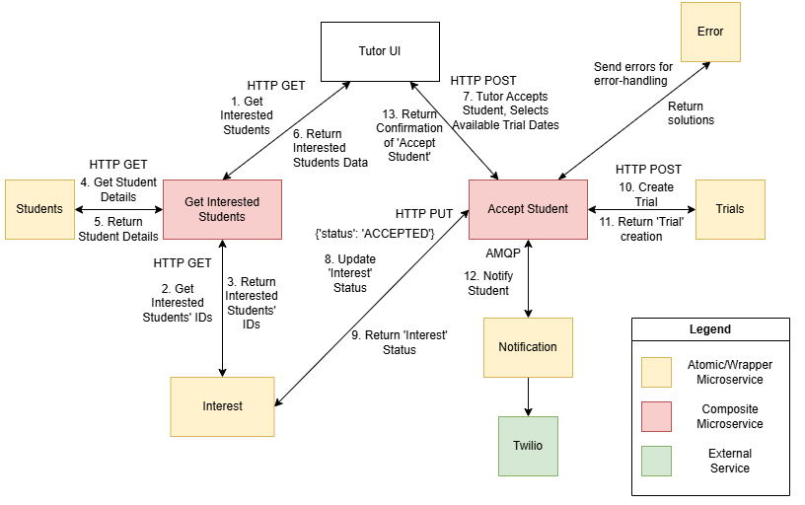
Microservice Interaction Diagram 2a
– Tutor Accepts Student, Arranges Trial Lesson
KONG API to replace ‘Get Interested Students’
BTL (?)
Notes:
Scenario 2: Tutor Reviews Interested Students (Choreography)
Review: The Tutor UI sends an HTTP GET to the Interest microservice to fetch pending requests.
Decision Input: The tutor accepts a student and selects available dates. The UI sends an HTTP PUT to the Interest microservice with {"status": "ACCEPTED", "proposed_dates": [...]}.
Update State: The Interest microservice updates the record in its database.
Choreography Trigger: The Interest microservice publishes an InterestAccepted message (containing the dates) to RabbitMQ.
Independent Reactions:
The Booking microservice consumes the message and creates a PENDING_STUDENT_CONFIRMATION record with the proposed dates.
The Notification microservice consumes the same message and emails the student to prompt their selection.

Slide 9
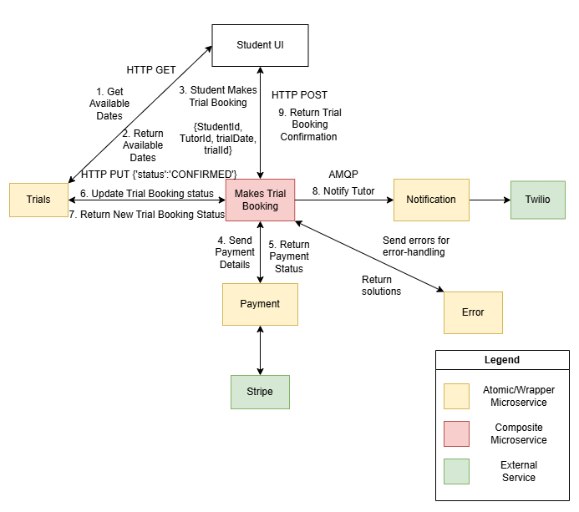
Microservice Interaction Diagram 2b
– Student Confirms Trial Lesson Booking
Notes:
Scenario 3: Booking Coordination & Confirmation (Orchestration & Rollback)
View Dates: The Student UI sends an HTTP GET to the Booking microservice to view the tutor's proposed dates.
Path A (Rollback): * The student cancels. The UI sends an HTTP PUT to the Booking microservice ({"status": "CANCELLED"}).
The Booking service frees the schedule in its DB and publishes a TrialCancelled message to RabbitMQ to notify the tutor.
Path B (Proceed to Pay): * The student selects a date. The UI sends an HTTP POST to the Booking microservice.
The Booking service temporarily locks the slot as PENDING_PAYMENT.
Payment Orchestration: The Booking service acts as an orchestrator and sends a synchronous HTTP POST to the Payment microservice.
External API: The Payment service invokes an external mock payment gateway (sandbox version) to process the transaction.
Confirmation: Upon success, the Payment service returns an HTTP 200 OK to the Booking service. The Booking service updates the status to CONFIRMED and drops a LessonConfirmed message into RabbitMQ. The Notification service emails the final calendar invite to both parties.

Slide 10
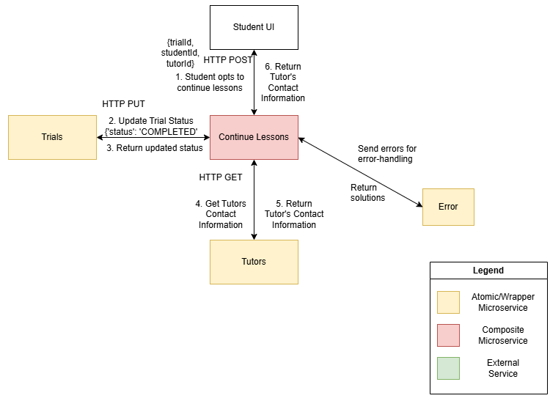
Microservice Interaction Diagram 2c
– Student continues lesson with tutor after trial lesson
Notes:
Scenario 3: Booking Coordination & Confirmation (Orchestration & Rollback)
View Dates: The Student UI sends an HTTP GET to the Booking microservice to view the tutor's proposed dates.
Path A (Rollback): * The student cancels. The UI sends an HTTP PUT to the Booking microservice ({"status": "CANCELLED"}).
The Booking service frees the schedule in its DB and publishes a TrialCancelled message to RabbitMQ to notify the tutor.
Path B (Proceed to Pay): * The student selects a date. The UI sends an HTTP POST to the Booking microservice.
The Booking service temporarily locks the slot as PENDING_PAYMENT.
Payment Orchestration: The Booking service acts as an orchestrator and sends a synchronous HTTP POST to the Payment microservice.
External API: The Payment service invokes an external mock payment gateway (sandbox version) to process the transaction.
Confirmation: Upon success, the Payment service returns an HTTP 200 OK to the Booking service. The Booking service updates the status to CONFIRMED and drops a LessonConfirmed message into RabbitMQ. The Notification service emails the final calendar invite to both parties.

Slide 11
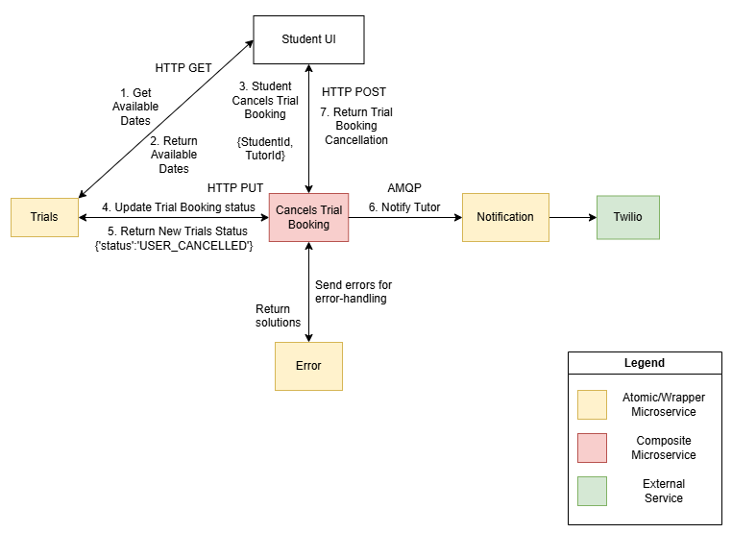
Microservice Interaction Diagram 3a
– Student Cancels after tutor proposes trial booking
Notes:
Scenario 3: Booking Coordination & Confirmation (Orchestration & Rollback)
View Dates: The Student UI sends an HTTP GET to the Booking microservice to view the tutor's proposed dates.
Path A (Rollback): * The student cancels. The UI sends an HTTP PUT to the Booking microservice ({"status": "CANCELLED"}).
The Booking service frees the schedule in its DB and publishes a TrialCancelled message to RabbitMQ to notify the tutor.
Path B (Proceed to Pay): * The student selects a date. The UI sends an HTTP POST to the Booking microservice.
The Booking service temporarily locks the slot as PENDING_PAYMENT.
Payment Orchestration: The Booking service acts as an orchestrator and sends a synchronous HTTP POST to the Payment microservice.
External API: The Payment service invokes an external mock payment gateway (sandbox version) to process the transaction.
Confirmation: Upon success, the Payment service returns an HTTP 200 OK to the Booking service. The Booking service updates the status to CONFIRMED and drops a LessonConfirmed message into RabbitMQ. The Notification service emails the final calendar invite to both parties.

Slide 12
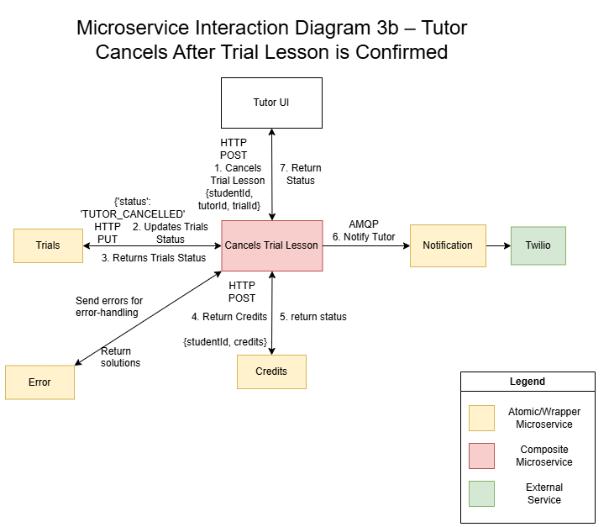
Microservice Interaction Diagram 3b
– Tutor Cancels after Trial Lesson is confirmed
6.

Slide 13
Microservice Interaction Diagram – Other Possible Scenarios
Student Cancels after tutor accepts them and proposes available dates (student may not be able to make any of the available dates)
Tutor Cancels after trial lesson booking confirmation
Student’s payment becomes credit for next booking
Tutor takes too long (>48 Hours) to respond to student’s interest request
Double Booking of tutor’s timeslot (with another tutoring platform)
Issue immediate refund to student

Slide 14
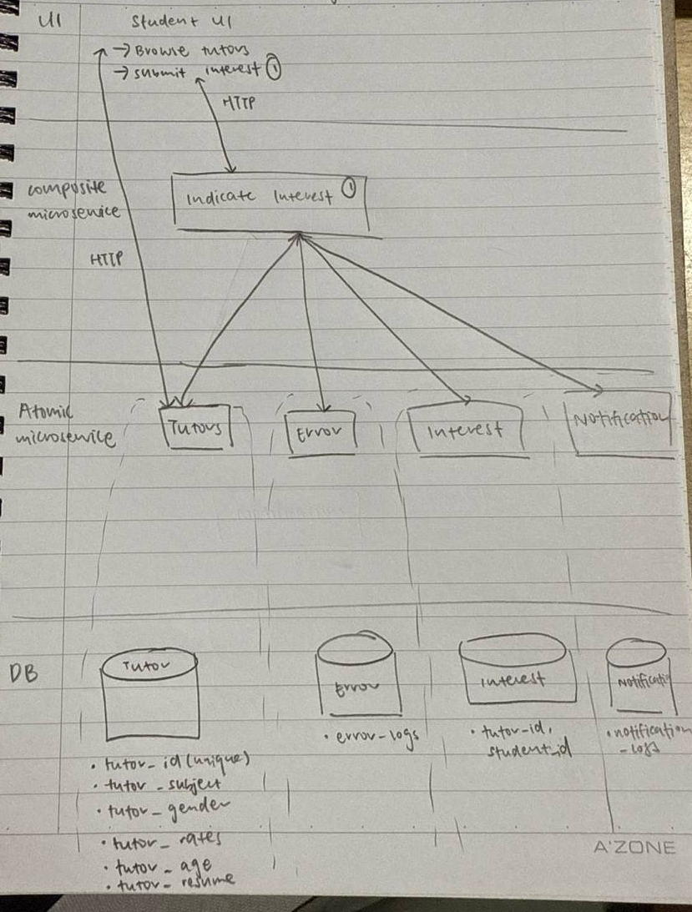
Scenario 1 Technical Overview Diagram

Slide 15
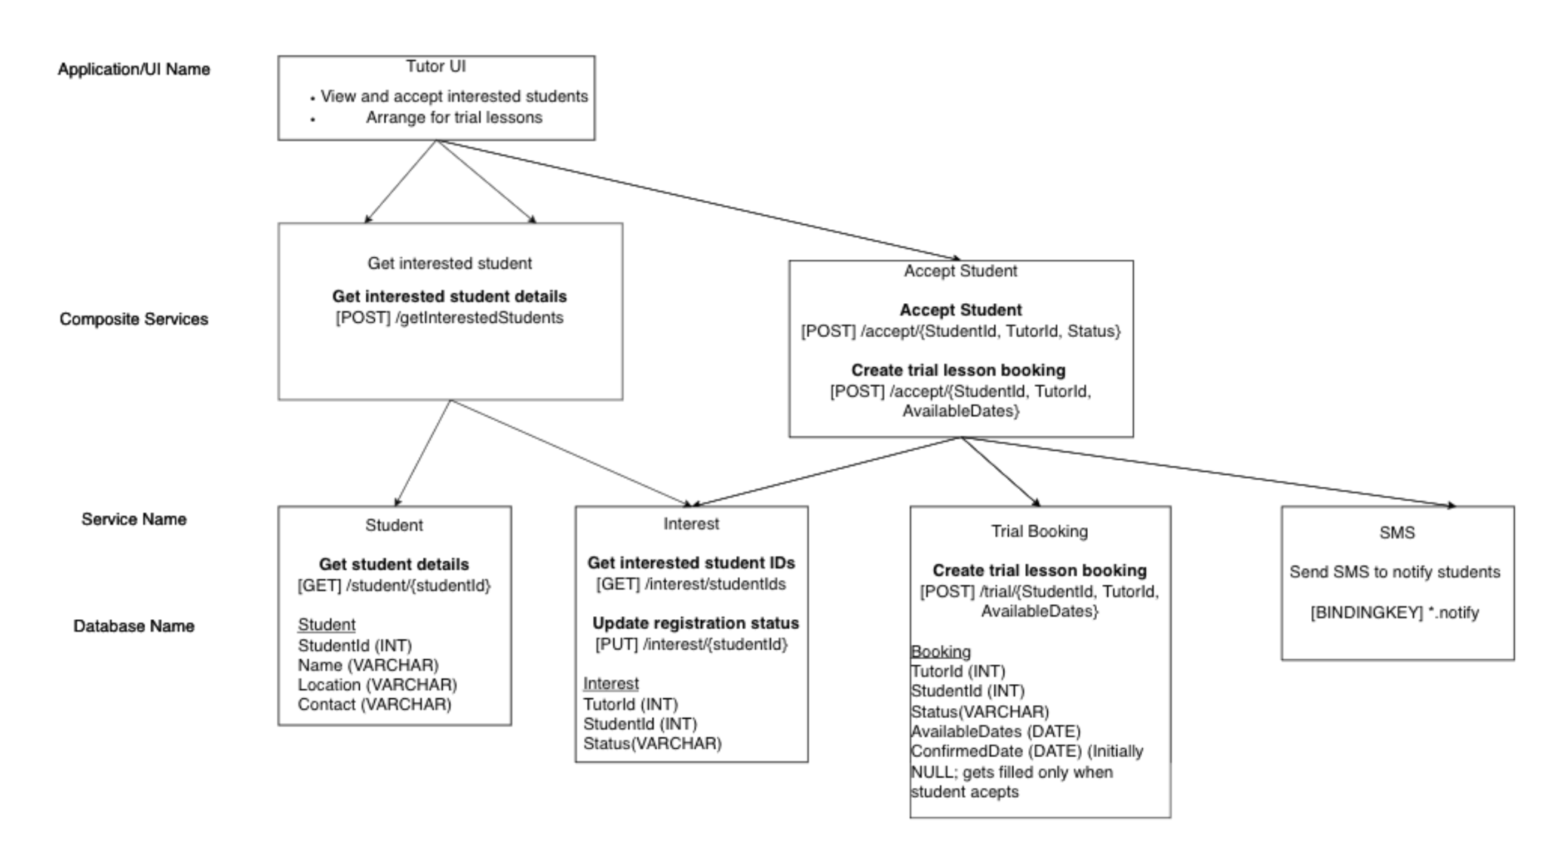
Scenario 2a Technical Overview Diagram

Slide 16
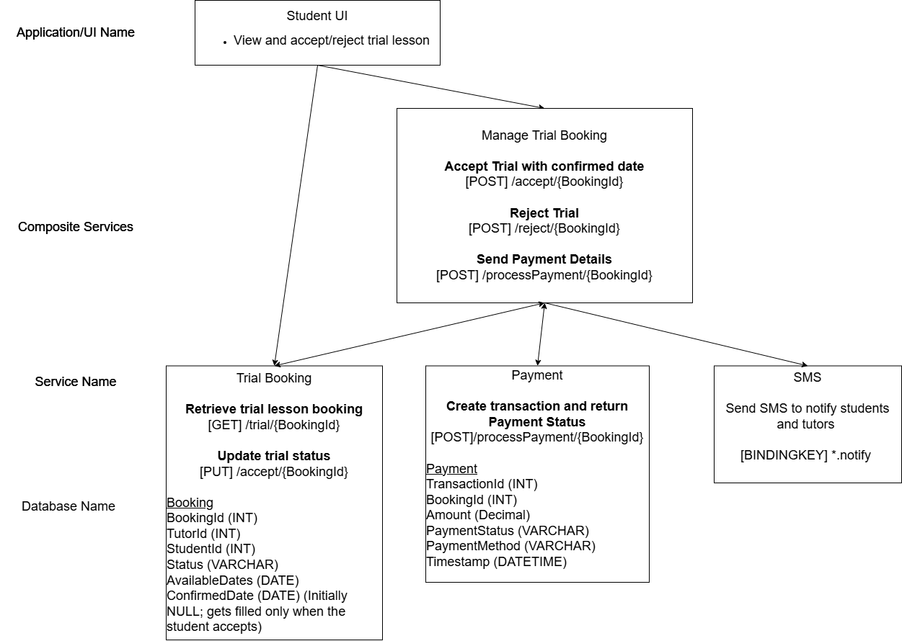
Technical Overview Diagram 2b
Notes:
This is an overall showing the needed (micro)services in the scenario and possible implementation details.
It is good to fill this in with as many details as possible to plan your implementation, and observe the dependency between the UI to the (micro)services.
[BKEY] → Binding Key

