Slide 1
Store Sales Prediction (Regression)
By : Divya Ramani

Slide 2

Business Objective
Build a best model that predicts Sales of a store

Slide 3
Why Store Sales Prediction?
Any successful retail store depends upon its sales
Sales and revenue are directly proportional to each other
A good shopping experience indirectly results in increase in sales
Analysis of product related features

Slide 4
Benefits of Store Sales Prediction
Understand trend
Which product is comparatively sold faster
Set realistic goals
Strategizing business models
Best location to open branch
Innovative ideas to attract customers

Slide 5
Methodology
Break problem into parts
Try different solutions to each problem
Face the challenges
Select the best solution

Slide 6
Steps of Mentioned Methodology
Read data
Describe data
Pre-Process the data
Perform Exploratory Data Analysis (EDA)
Feature Engineering
Split data
Build model
Evaluate model
Rebuild model with hyperparameter tuning if required
Compare models (if more than one)
Select best model
Predict data
Visualize data

Slide 7
Data Dictionary
S.No | Feature | Data Type | Description
1 | Item_identifier | Character | Unique Product ID
2 | Item_weight | Numeric | Weight of the product
3 | Item_Fat_Content | Numeric | Total fat content in the product
4 | Item_Visibility | Numeric | How visible is the product in the store
5 | Item_Type | Categorical | Product category of the selected product
6 | Item_MRP | Numeric | Product cost
7 | Outlet_Identifier | Categorical | The store ID
8 | Outlet_Establishment_Year | Numeric | The year when the store was opened
9 | Outlet_Size | Categorical | Size of the store
10 | Outlet_Size | Categorical | Store size type
11 | Outlet_Location_ Type | Categorical | Location type where the store is located
12 | Outlet_Type | Categorical | The type of store
13 | Item_Outlet_Sales | Numeric | Sales made by the store outlet

Slide 8
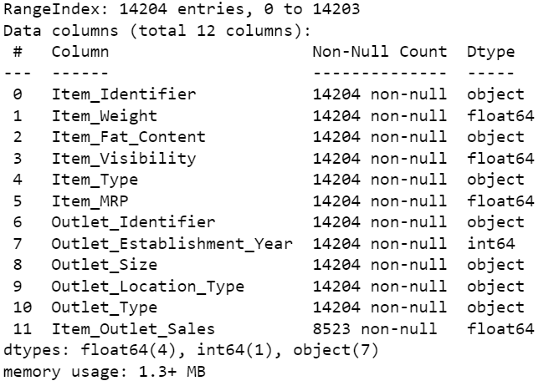
Data Information

Slide 9
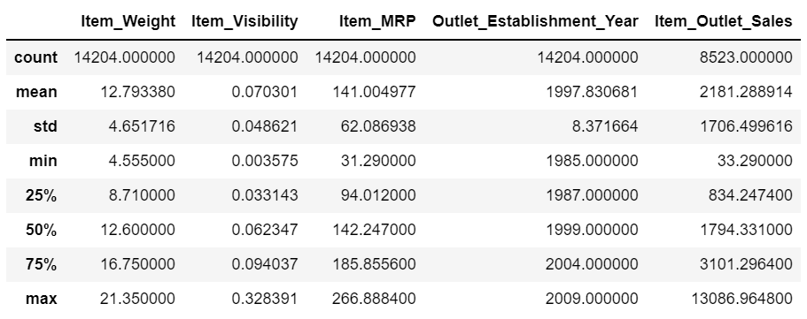
Data Description

Slide 10
Pre-Process data + EDA

Slide 11
EDA before pre-processing data

Slide 12
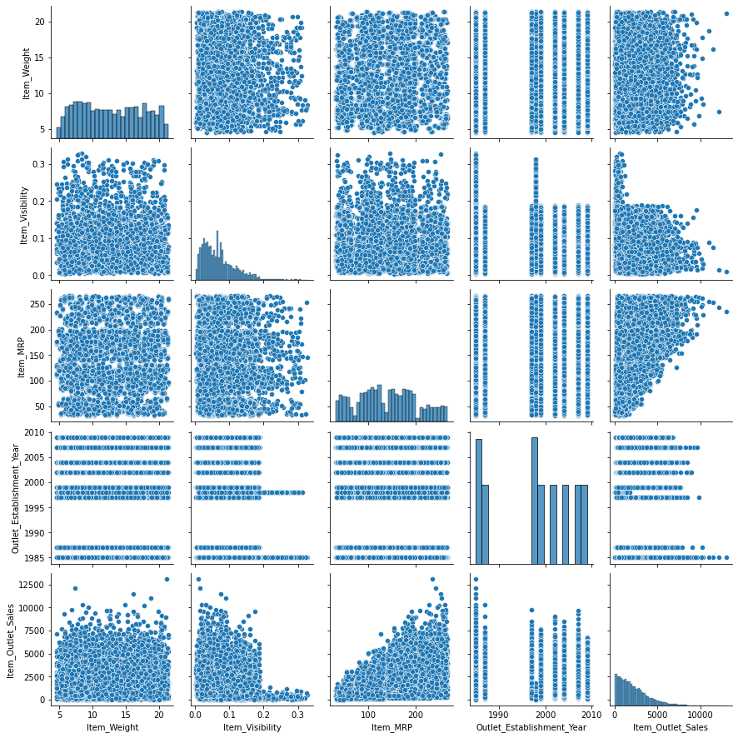

Slide 13
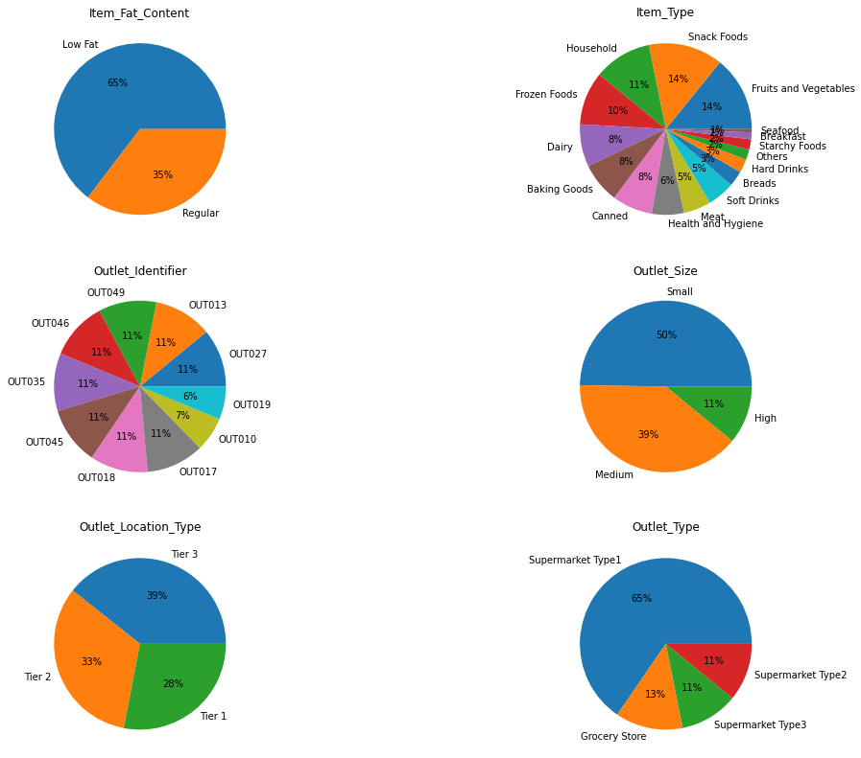

Slide 14
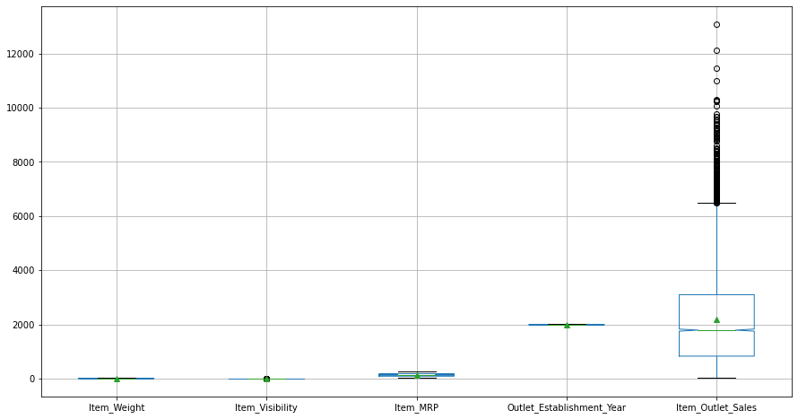

Slide 15
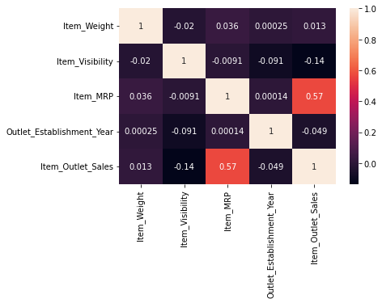

Slide 16
Challenge 1 : Treating Null Values
Imputing null values:
Central Tendency
Dropping
Carry forward/backward
Randomly imputing between minimum and maximum

Slide 17
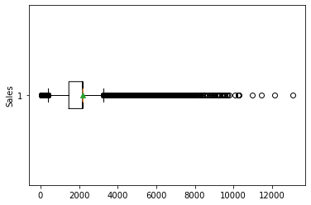
Imputing using Central Tendency

Slide 18
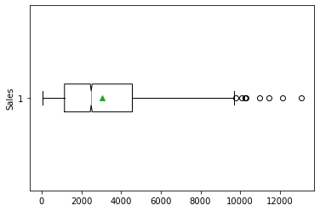
Randomly imputing values

Slide 19
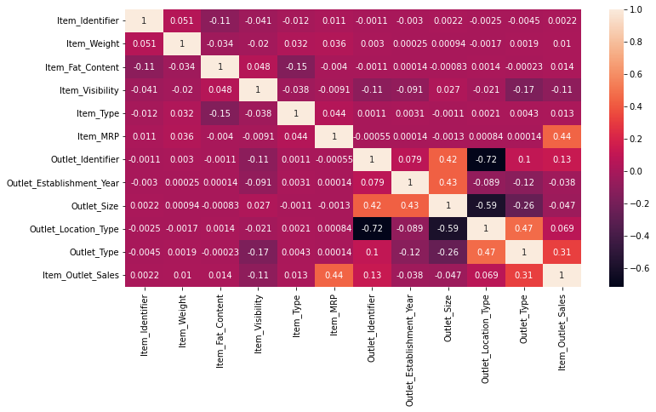

Slide 20
Feature Engineering
Feature transformation: Convert categorical features to numerical
Data Scaling: Scale the data using MinMaxScalar
Feature Selection: Remove unwanted features/Select wanted features
Reduce multicollinearity using PolynomialFeatures

Slide 21
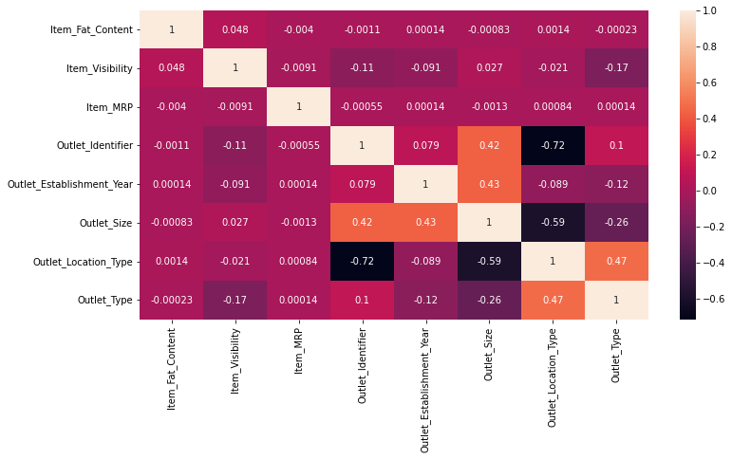

Slide 22
Split data
Training data : 70%
Test data : 30%

Slide 23
Challenge 2 : Model comparison
Compare regression type
Build models
Fit data
Evaluate models’ performance
Compare performance
Abbreviations:
lr : Linear Regression
dtr : Decision Tree Regression
rfr : Random Forest Regression
bag : bagging regression

Slide 24
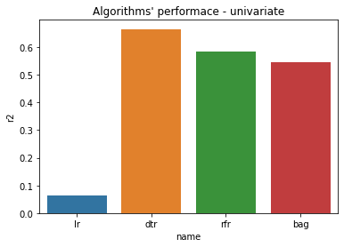
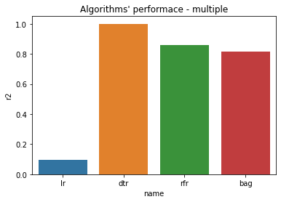
Comparison (r2): Univariate vs Multiple

Slide 25
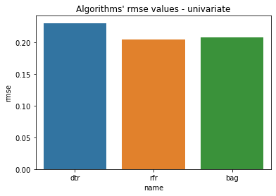
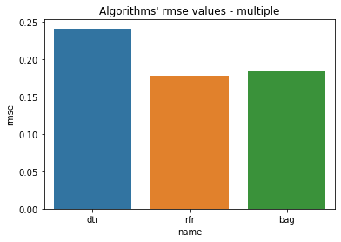
Comparison (rmse): Univariate vs Multiple

Slide 26
Multiple Linear Regression
Comparison (best among all):
r2
rmse
Bias
Variance
Predict error rate

Slide 27
R2 comparison

Slide 28
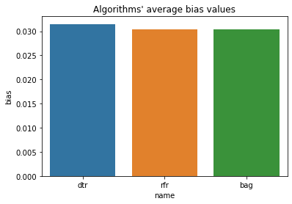
Bias comparison

Slide 29
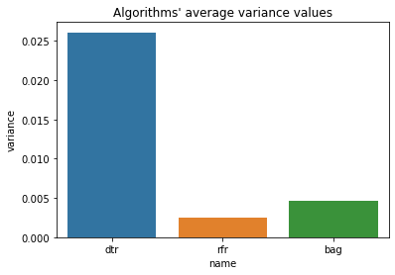
Variance comparison

Slide 30
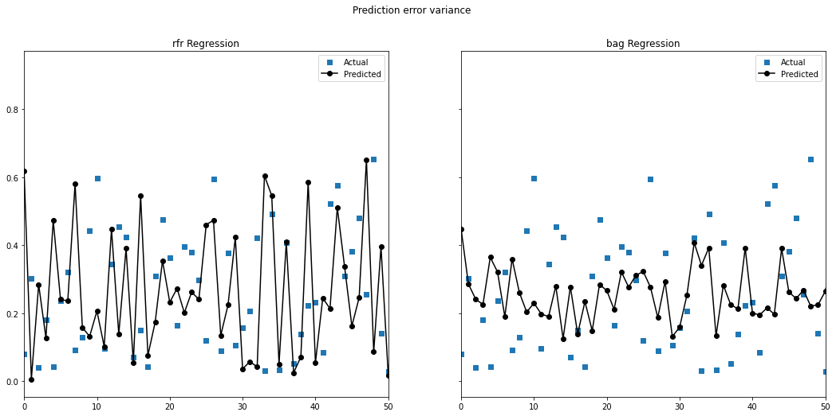
Prediction error variance comparison

Slide 31
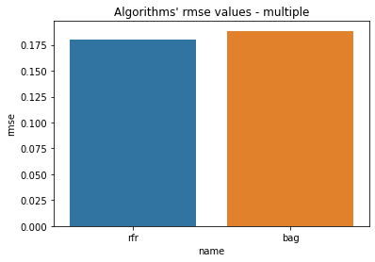
Rmse comparison

Slide 32
Conclusion + Business Insights
RandomForestRegressor is the best model for predicting sales values for the given dataset
Items can be placed at such locations that can be in more visibility
Item MRP price can be taken into consideration according to the location type
Healthy Items can be stored more if health issues are higher (can be based on year too)
Sales can be increased on the basis of outlet type, depending on locality

Slide 33
Thank you

