Slide 1
Bank Churn prediction (Classification)
By : Divya Ramani

Slide 2

Business Objective
Build a best model that predicts which customers are likely to churn

Slide 3
Why Bank churn Prediction?
It is a challenge to retain customers
Retaining customers takes less efforts than targeting new customers

Slide 4
Benefits of Bank churn Prediction
Understand situations
Set realistic goals
Strategizing business models
Best location to open branch
Innovative ideas to retain customers & target customers

Slide 5
Methodology
Break problem into parts
Try different solutions to each problem
Face the challenges
Select the best solution

Slide 6
Steps of Mentioned Methodology
Read data
Describe data
Pre-Process the data
Perform Exploratory Data Analysis (EDA)
Feature Engineering
Split data
Build model
Evaluate model
Compare models (if more than one)
Select best model
Tune model with hyperparameter tuning if required
Predict data
Visualize data

Slide 7
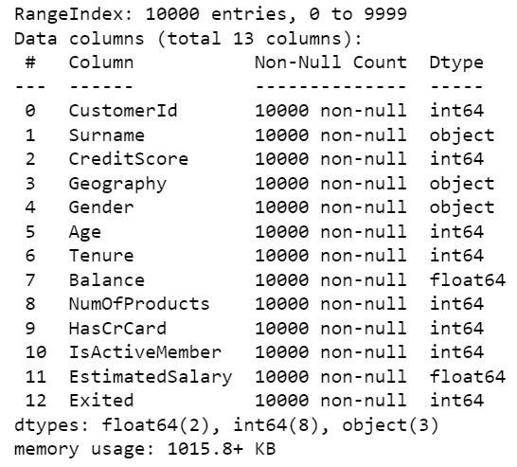
Data Information

Slide 8
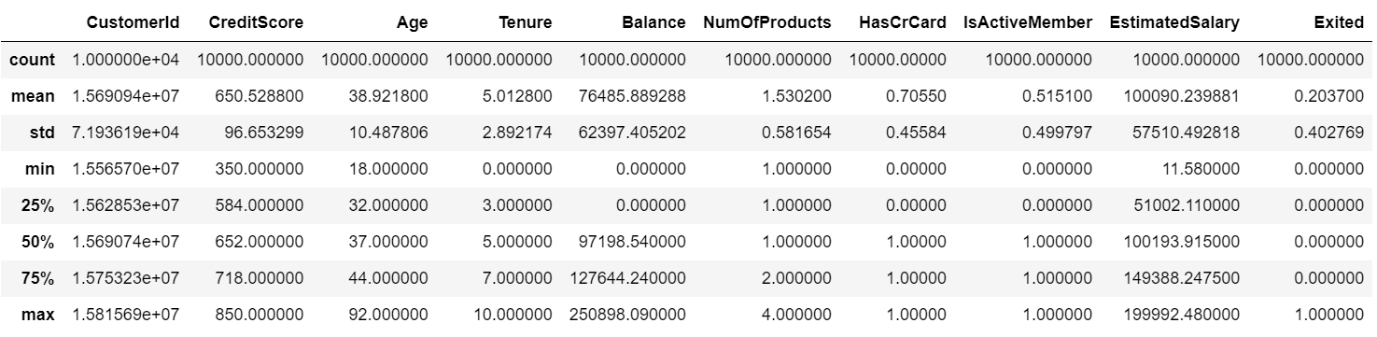
Data Description

Slide 9
EDA

Slide 10
1) Check skewness

Slide 11
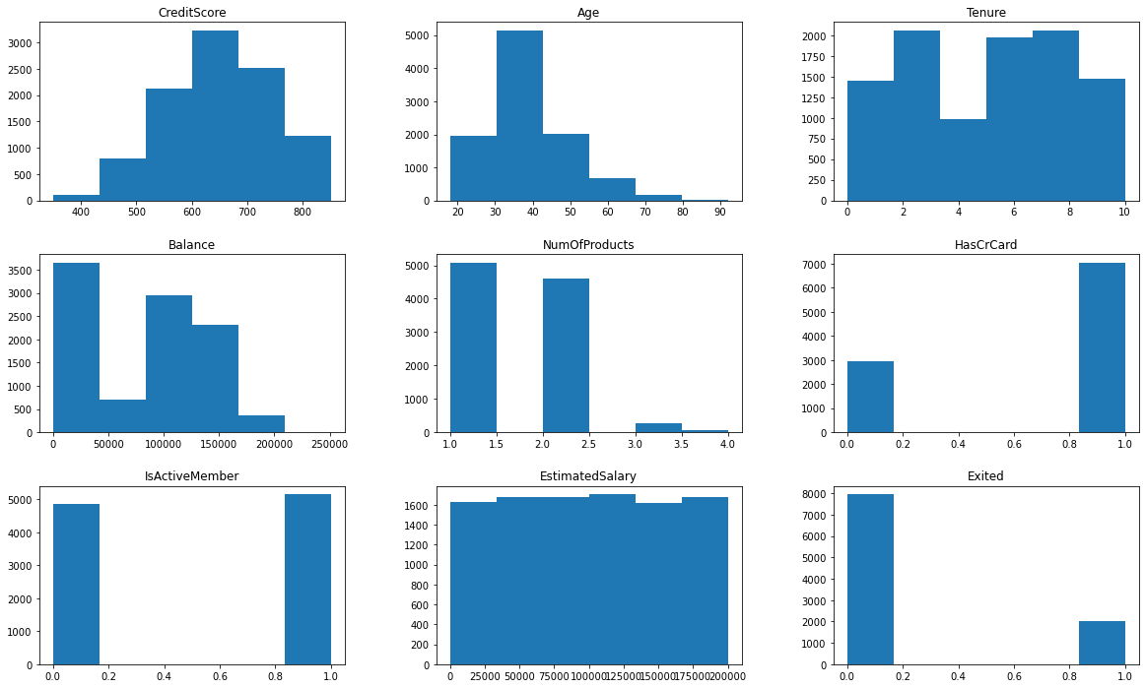

Slide 12
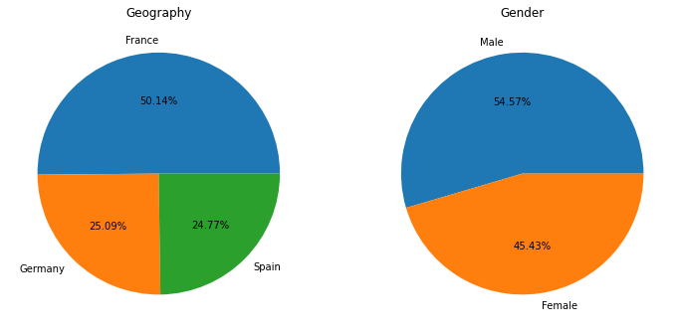
Textual data

Slide 13
2) Check correlations and multicollinearity

Slide 14
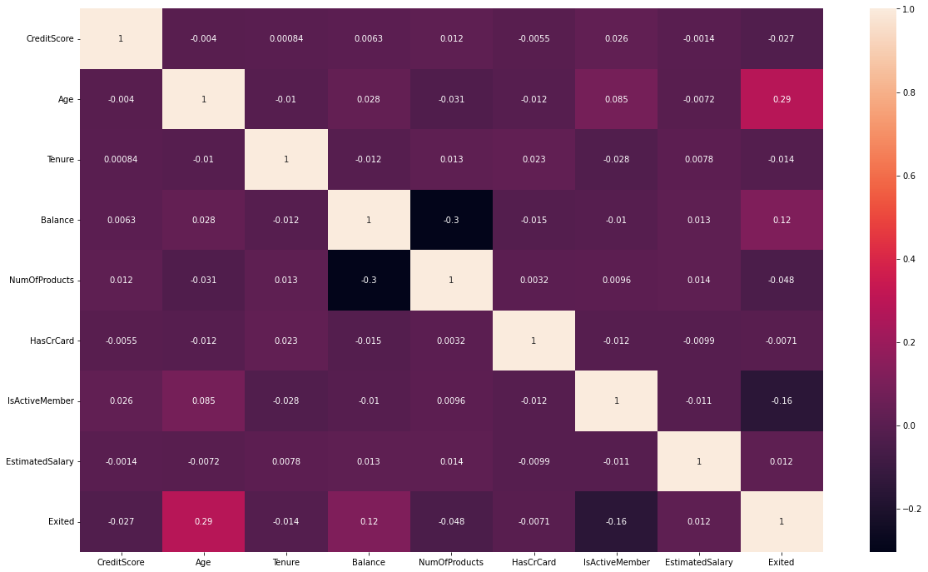

Slide 15
Data pre-processing + Feature Engineering
Check values of categorical features
Feature transformation: Convert categorical features to numerical using label encoder
Feature Selection: Remove unwanted features/Select wanted features using significance(Anova test – Numerical features, chi-square test – categorical features)

Slide 16
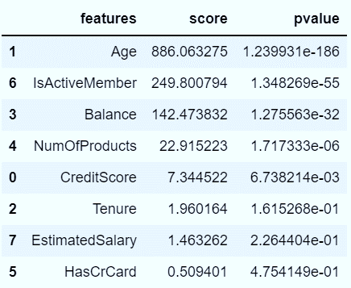
Anova test for numerical features

Slide 17
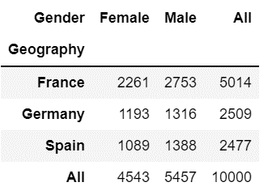
Chi-square test for categorical features
p_value | Degree of freedom
0.1314 | 2

Slide 18
Split data
Divide dataset into:
Independent
Dependent
Training data : 70%
Test data : 30%

Slide 19
Challenge 1 : Model comparison
Build models
Fit data
Evaluate models’ performance
Compare various performance parameters

Slide 20
Abbreviations
lr : Logistic Regression
gnb : Gaussian naïve bayes
knn : k-nearest neighbors
svc : Support Vector Classification
dtc : Decision Tree Classification
rfc : Random Forest Classification
bag : Bagging Classification
abc : Adaptive Boosting Classification
xgb : Extreme Gradient Boosting Classification
stc : Stacking Classification
CV : Cross Validation

Slide 21
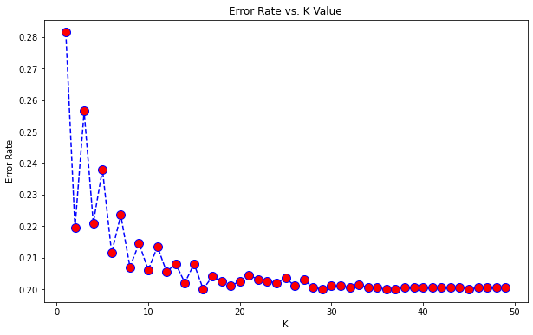

Finding optimum k in inn

Slide 22
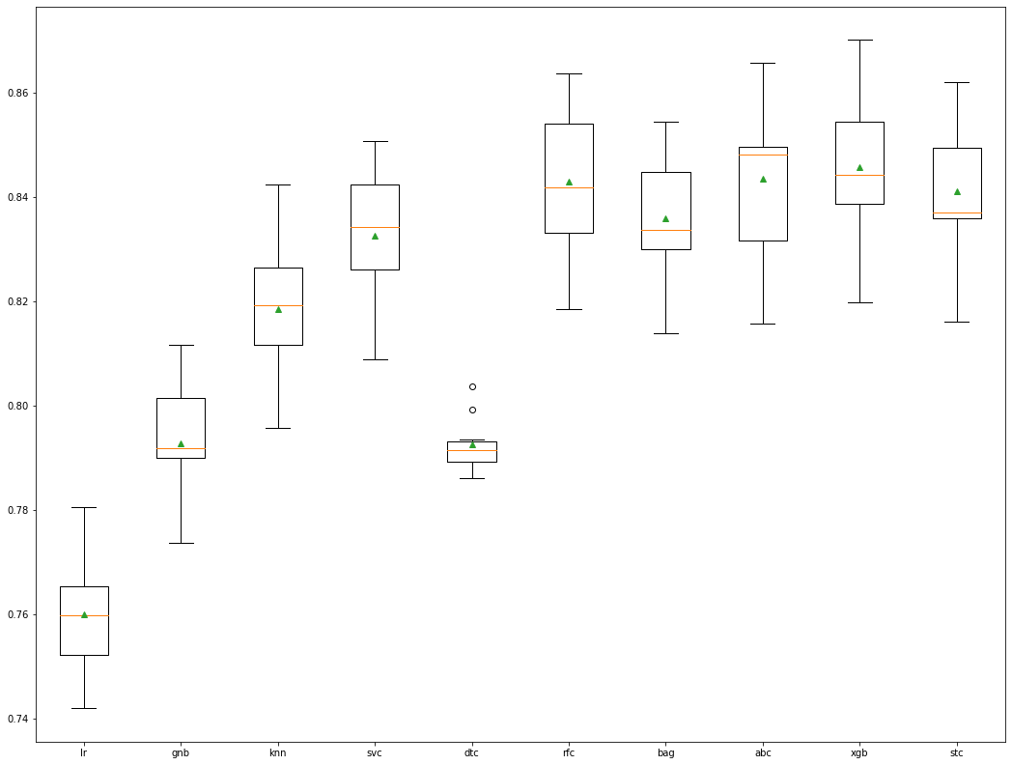
Comparison (f1_train - CV)

Slide 23
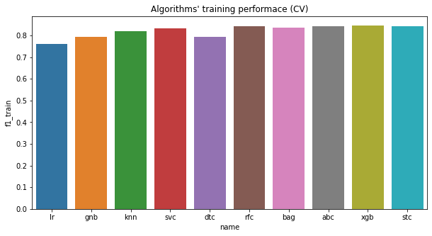
Comparison (f1-train)

Slide 24
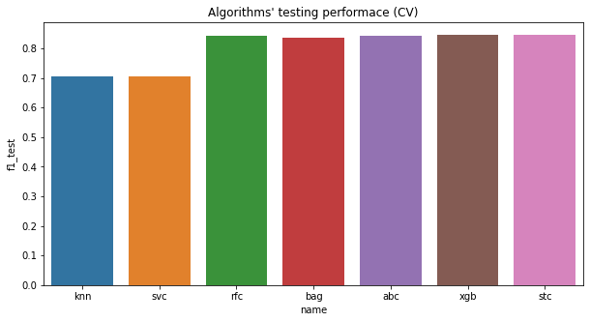
Comparison (f1-test)

Slide 25
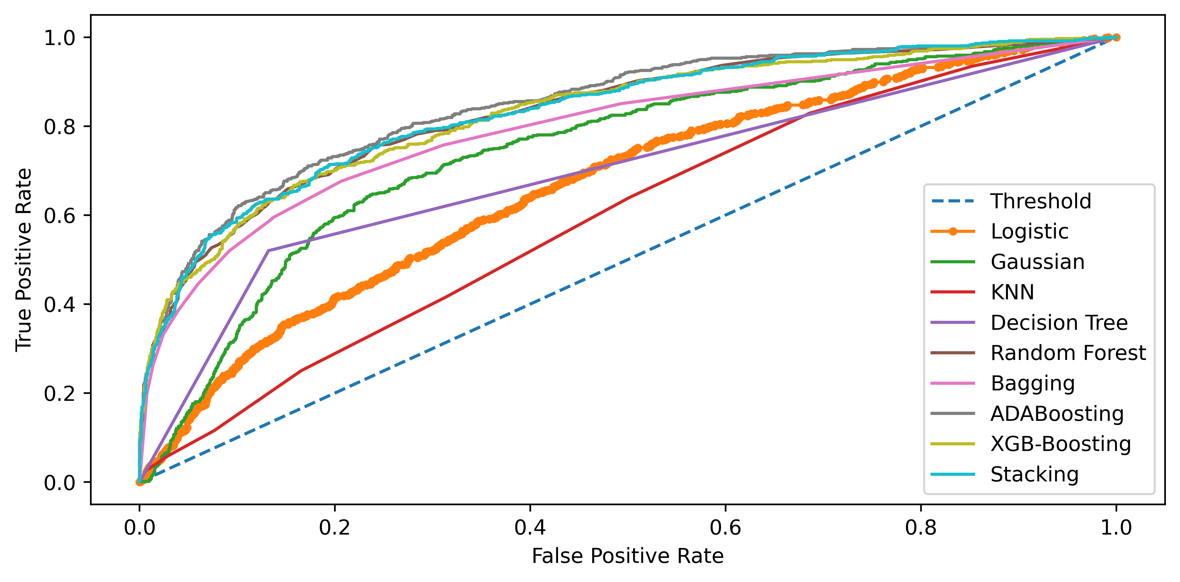
Comparison (ROC_AUC curve)

Slide 26
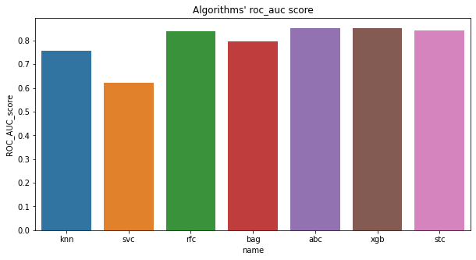
Comparison (ROC_AUC score)

Slide 27
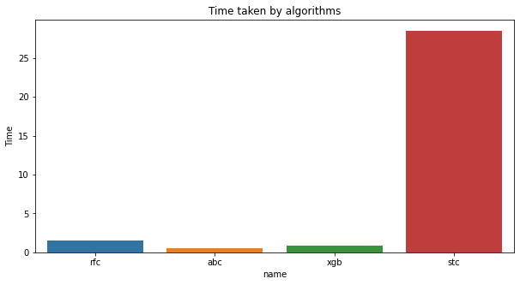
Comparison : Time taken

Slide 28
Comparison : Confusion matrix

Slide 29
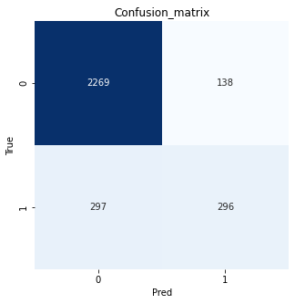

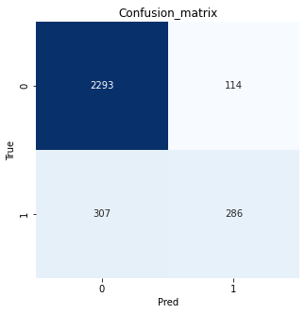
rfr
abc
xgb

Slide 30
Comparison : Classification_report
Algorithm name | Prediction Classes | Accuracy | Precision | Recall | F1 score
rfc | 0 | 0.85 | 0.88 | 0.94 | 0.91
 | 1 |  | 0.69 | 0.48 | 0.56
abc | 0 | 0.86 | 0.87 | 0.96 | 0.91
 | 1 |  | 0.74 | 0.46 | 0.57
xgb | 0 | 0.84 | 0.87 | 0.94 | 0.91
 | 1 |  | 0.67 | 0.48 | 0.56

Slide 31
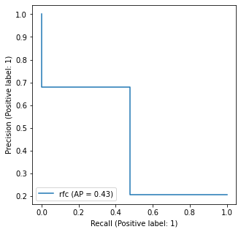
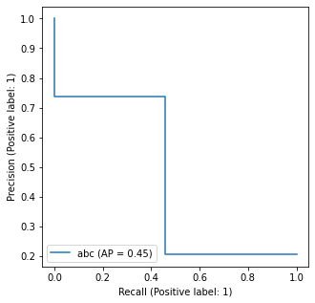
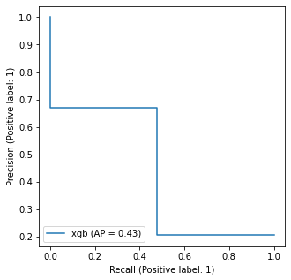
Comparison : Precision-Recall curve
rfc
abc
xgb

Slide 32
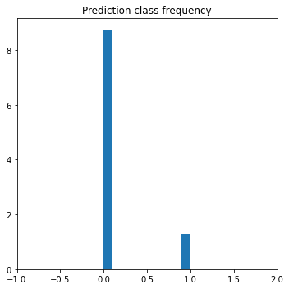
Prediction Class Frequency

Slide 33
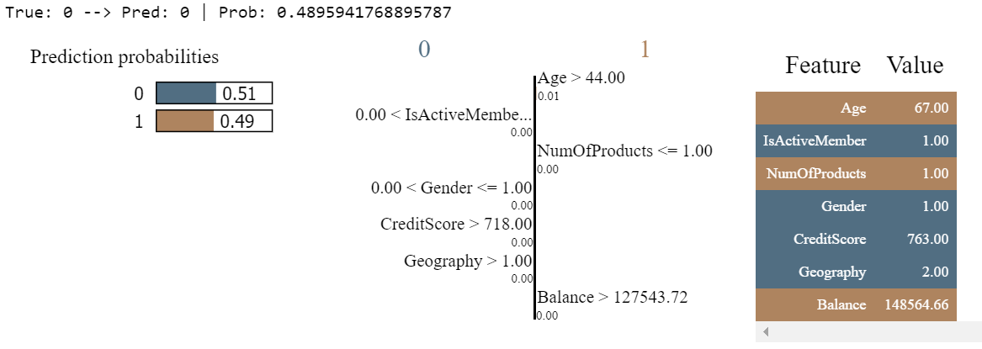
Lime tabular explainer at instance x_test - 7

Slide 34
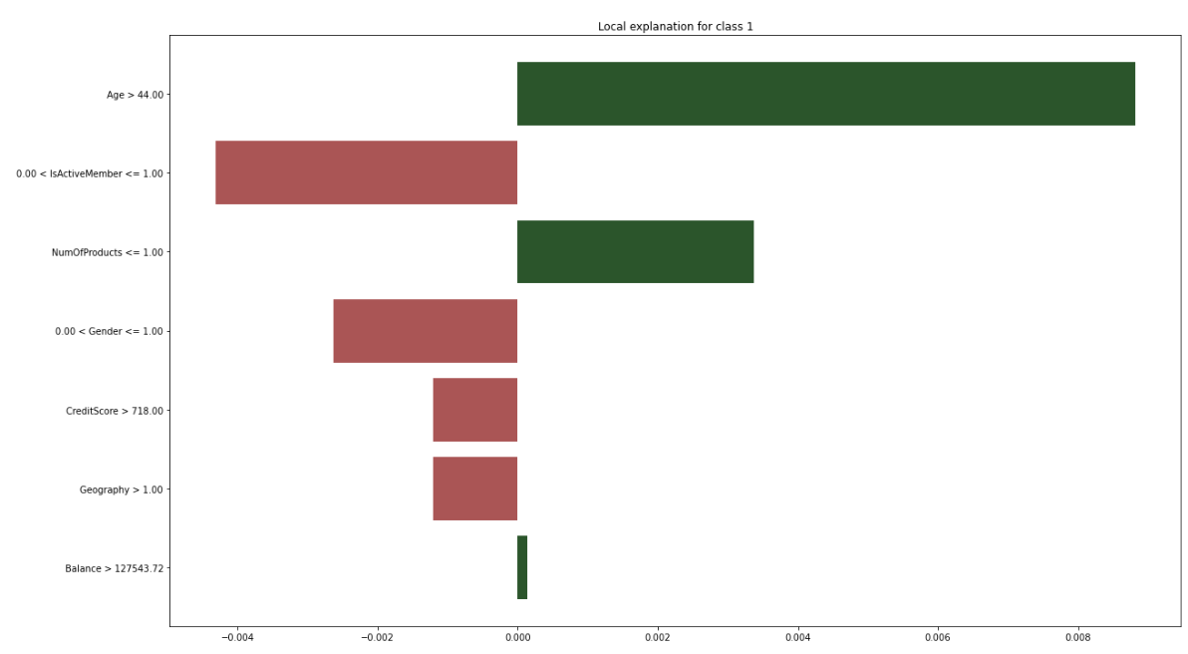

Slide 35
Conclusion – Best model
AdaBoostClassifier is the best model for predicting customer attrition for the given dataset

Slide 36
Business Insights (customer attrition = yes)

Slide 37
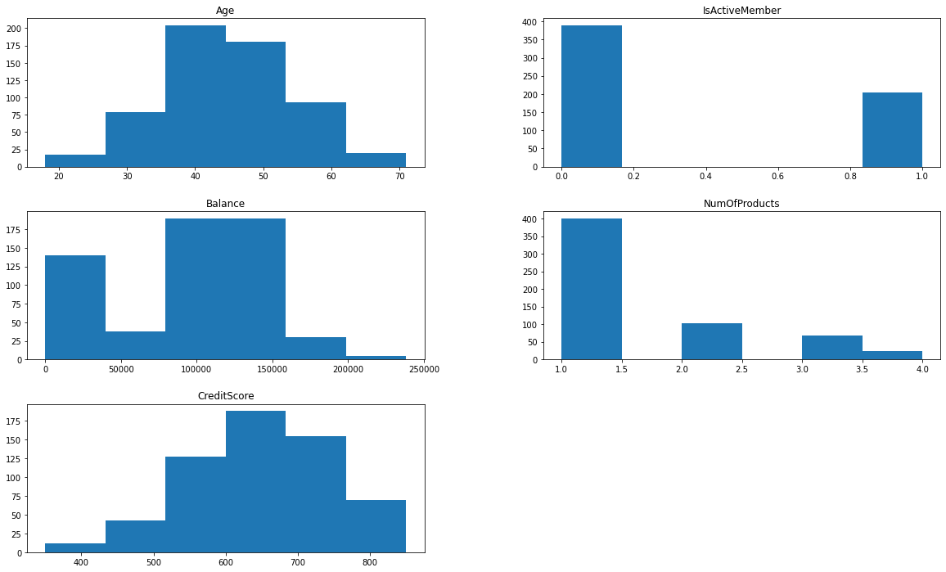

Slide 38
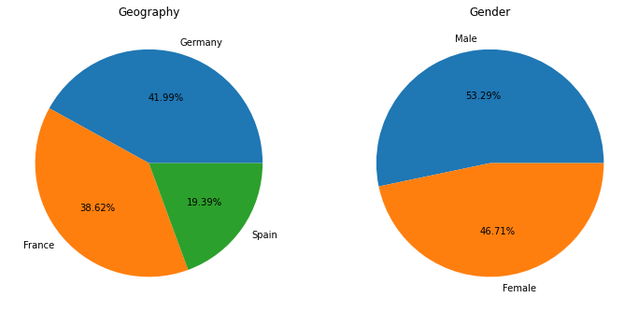

Slide 39
Business Insights
Special attention should be paid to attrition of customers of both genders having :
Geography : Germany, France
Age group : [35-55]
Inactive members
Balance : [90,000 – 1,60,000]
Credit score : [550 – 750]
No. of products = 1

Slide 40
Thank you
Questions please….

