Slide 1
Mall Customers Segmentation (Clustering)
By : Divya Ramani

Slide 2

Business Objective
Build a best model that clusters similar customers

Slide 3
Why Customer Segmentation?
Customers can be grouped in various ways
Meet needs of each segmented base groups
Boosts sales and revenue
Customer satisfaction helps to retain existing customers and bring in more new customers

Slide 4
Benefits of Customer Segmentation
Understand target audience
Improved Customer services and offerings
Set realistic goals
Re-Strategizing business models
Best location to open branch
Innovative ideas to retain customers & target customers

Slide 5
Methodology
Break problem into parts
Try different solutions to each problem
Face the challenges
Select the best solution

Slide 6
Steps of Mentioned Methodology
Read data
Describe data
Pre-Process the data
Perform Exploratory Data Analysis (EDA)
Feature Engineering
Build model
Evaluate model
Compare models (if more than one)
Select best model
Tune model with hyperparameter tuning if required
Cluster data
Visualize data

Slide 7
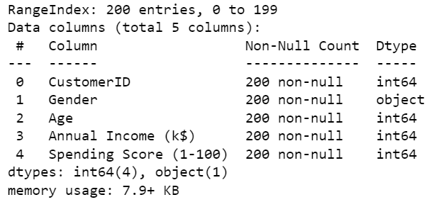
Data Information

Slide 8
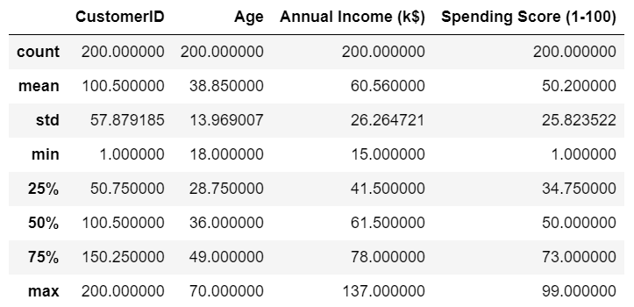
Data Description

Slide 9
EDA

Slide 10
1) Check skewness and density

Slide 11
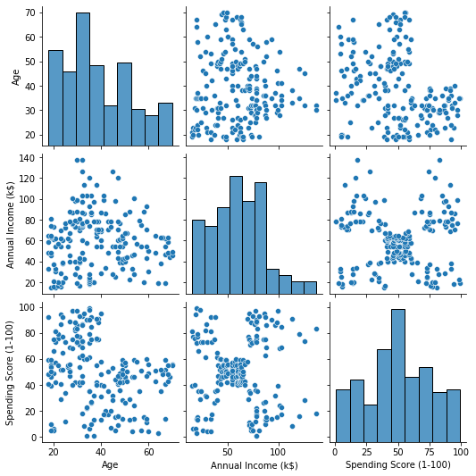

Slide 12
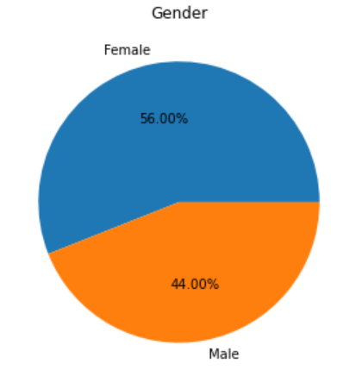

Slide 13
2) Check correlations and multicollinearity

Slide 14
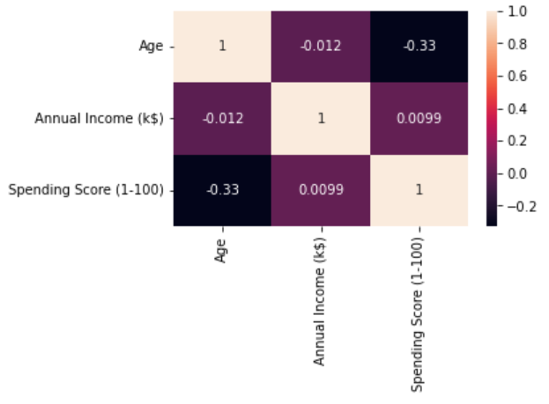

Slide 15
3) Check outliers

Slide 16
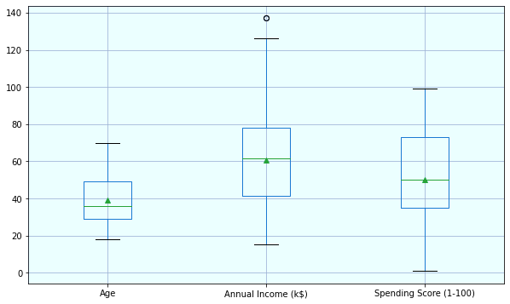

Slide 17
Challenge 1 : Model comparison
Build models
Fit data
Evaluate models’ performance
Compare various performance parameters

Slide 18
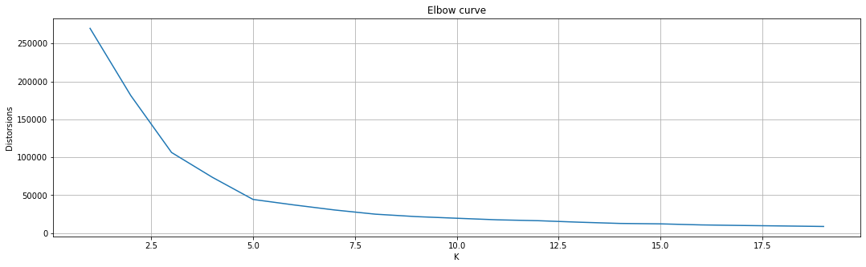
Finding optimum k in k-means
K = 5

Slide 19
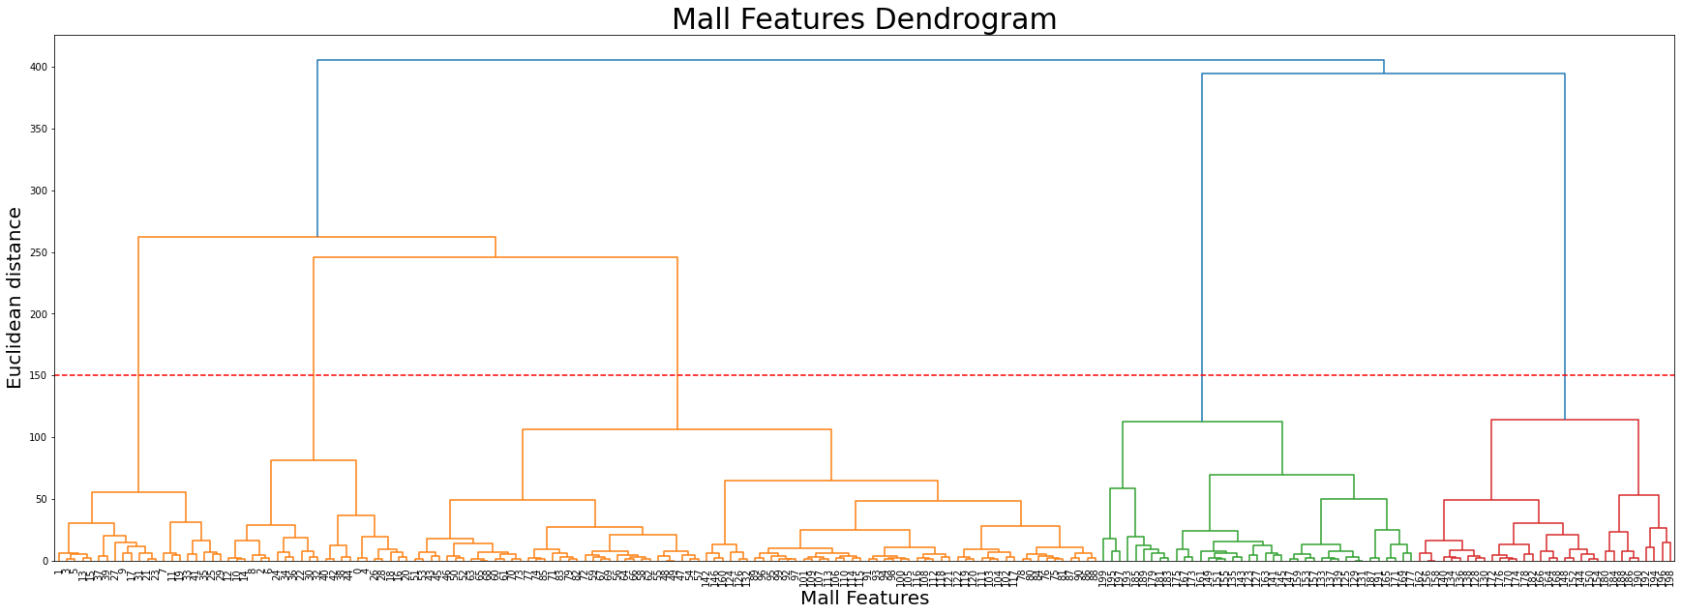
Finding optimum k in agglomerative
K = 5

Slide 20
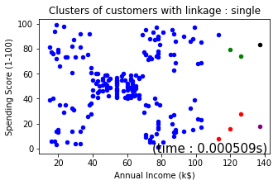
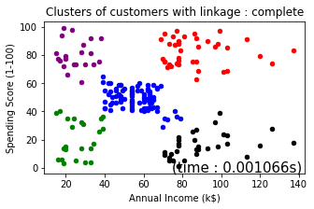
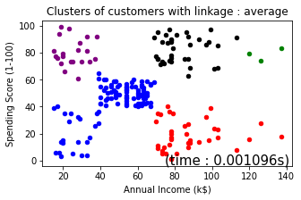
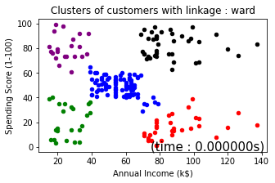
Comparison (linkage in agglomerative)

Slide 21
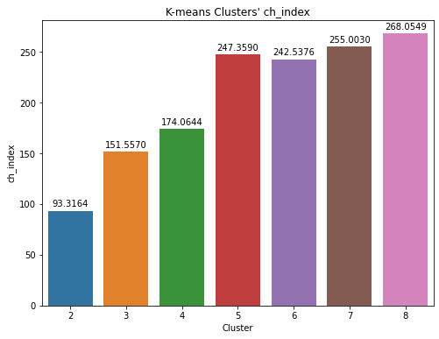
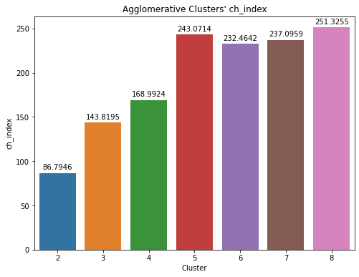
Comparison (ch_index/VRC)

Slide 22
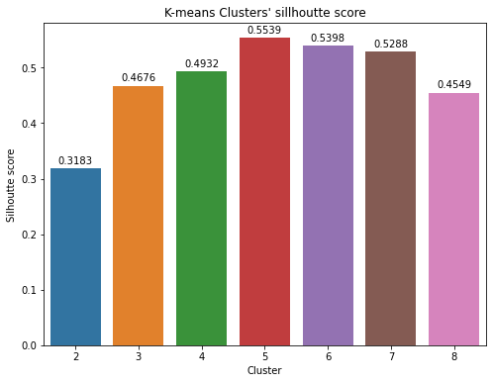
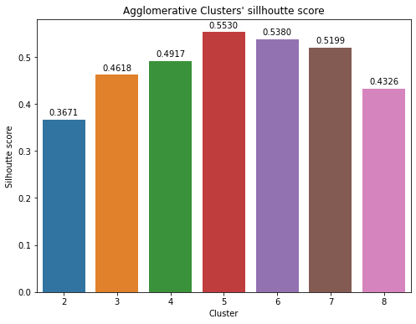
Comparison (silhouette score)

Slide 23
Comparison : k-means vs agglomerative plots
k = k-means
a = agglomerative

Slide 24
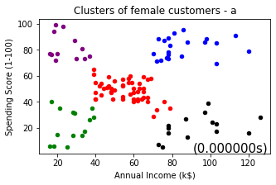
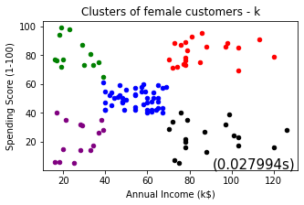
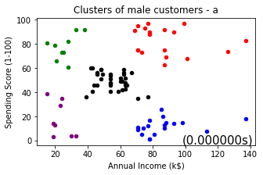
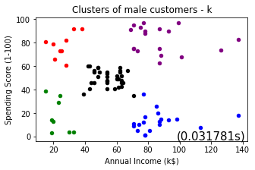
Annual income vs spending score

Slide 25
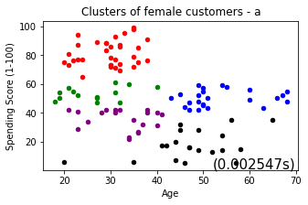
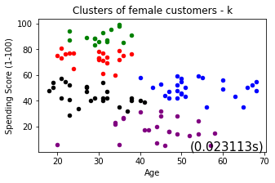
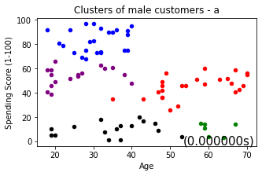
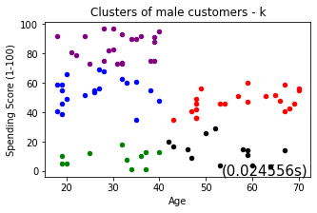
Age vs spending score

Slide 26
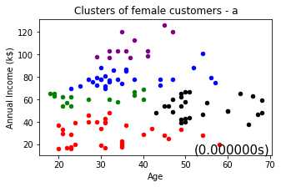
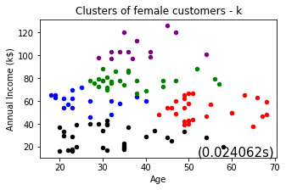
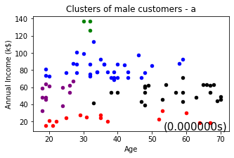
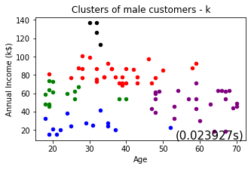
Age vs Annual income

Slide 27
Conclusion – Best model
Both models provide good clusters
Agglomerative is the best model (time taken - wise) for segmenting mall customers for the given dataset

Slide 28
Business Insights
Male spend less than females
(In terms of sales) Special attention should be paid to customers of both genders having:
High income and high spending score – Target audience(1)
30 - 50 age and high annual income – Target audience(2)
< 40 age and low spending score – Target audience(3)

Slide 29
Thank you
Questions please….

