Slide 1
PPI Forecasting (Time series analysis)
By : Divya Ramani

Slide 2

Business Objective
Build a best model that forecasts future producer per index

Slide 3
Why PPI forecasting?
Average change over time in the selling prices received by domestic producers of goods and services
Deflate revenue streams in order to measure real growth in output
PPI of an economy is rising strongly, it tends to result in future inflation in the prices of consumer goods that discourage consumers from
saving
reduces their purchasing power.

Slide 4
Benefits of PPI forecasting
Understand future inflation situations
Indicator of overall price movement at the producer level
Deflator of other economic series
Comparison of input and output costs
Find appropriate and best solution to reduce upcoming inflation

Slide 5
Methodology
Break problem into parts
Try different solutions to each problem
Face the challenges
Select the best solution

Slide 6
Steps of Mentioned Methodology
Read data
Describe data
Pre-Process the data
Perform Exploratory Data Analysis (EDA)
Feature Engineering (if required)
Split data
Build model
Evaluate model
Compare models (if more than one)
Select best model
Tune model with hyperparameter tuning if required
Predict data
Visualize data

Slide 7
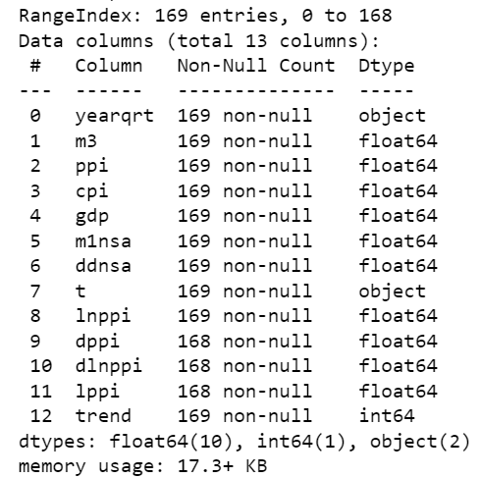
(raw) Data Information

Slide 8
Pre-process data
Drop unnecessary columns
Check for duplicates
Create dates according to year quarters
Arrange data sequentially, if not
Set date column as index

Slide 9
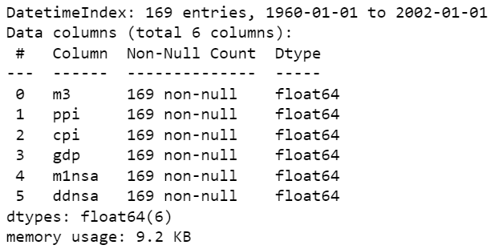
(final) Data Information

Slide 10
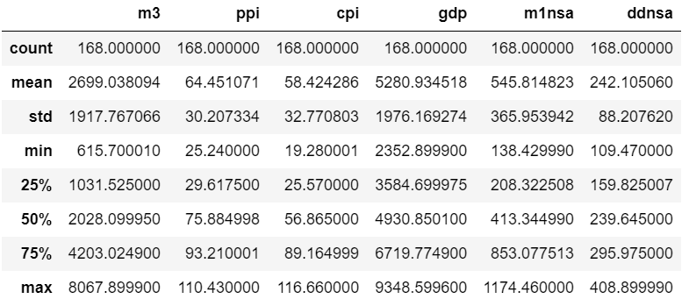
Data Description

Slide 11
EDA

Slide 12
1) Check skewness

Slide 13
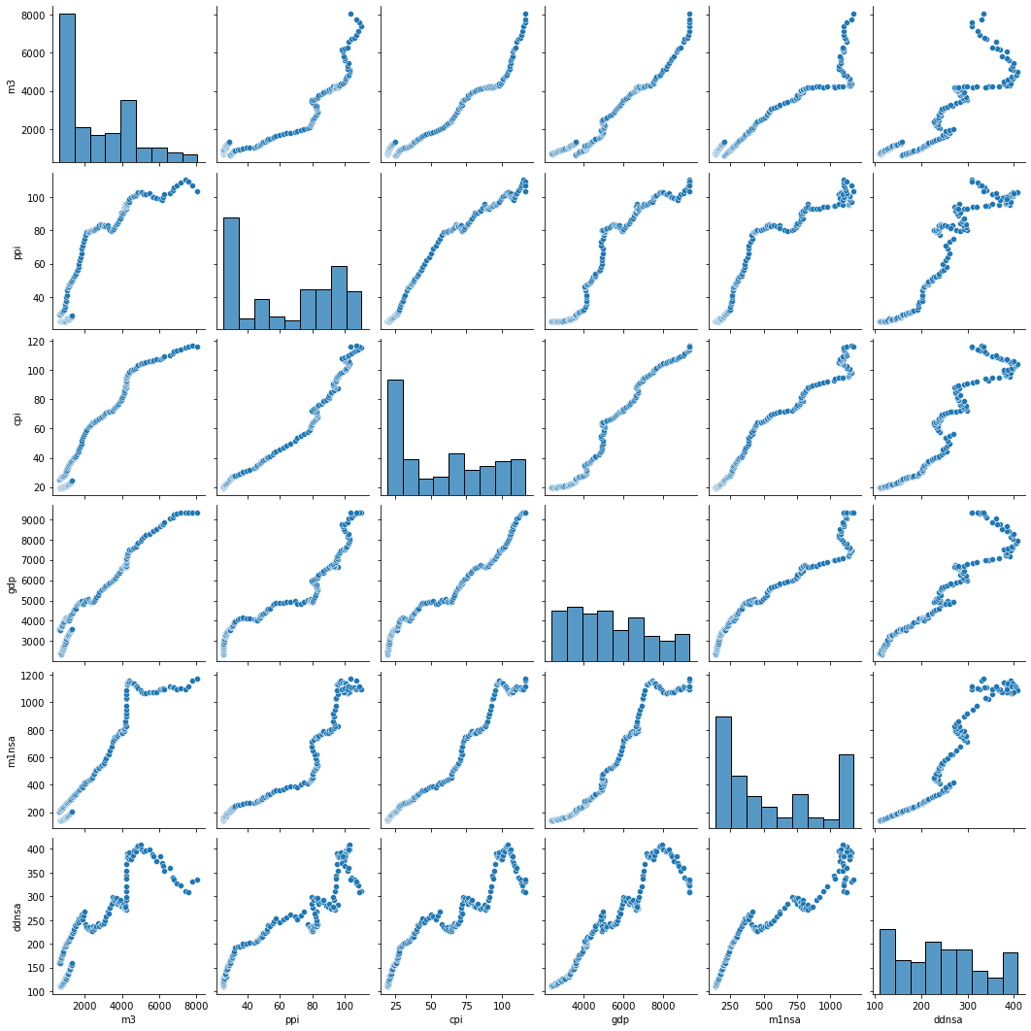

Slide 14
2) Check outliers

Slide 15
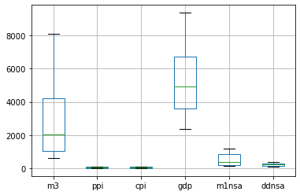

Slide 16
3) Check correlations and multicollinearity

Slide 17
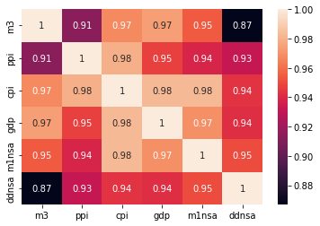

Slide 18
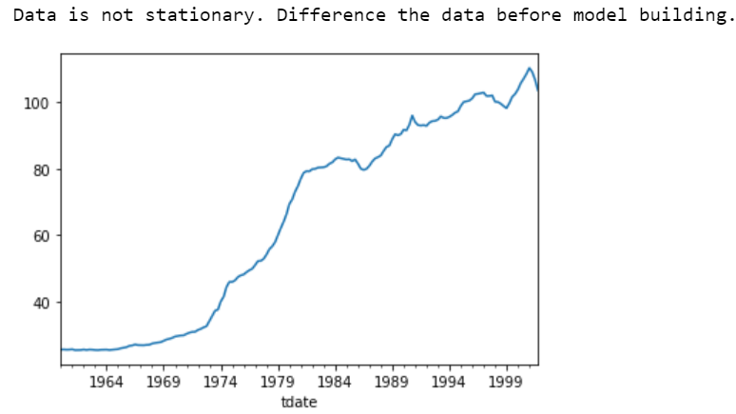
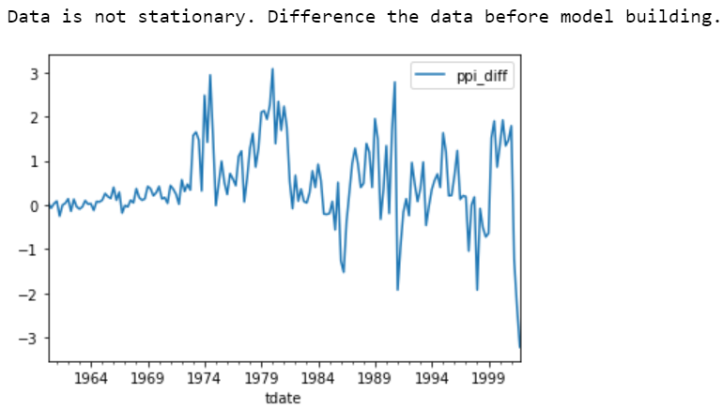
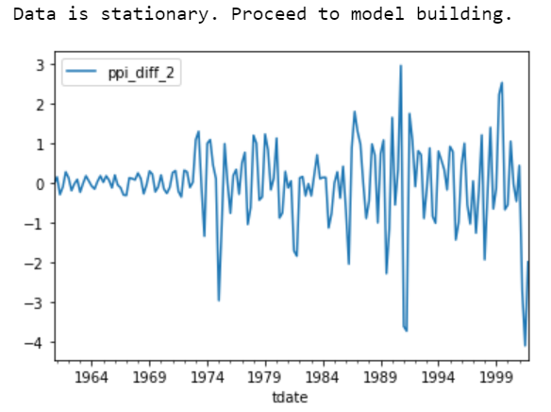
Check Data Stationarity
Actual data

Slide 19
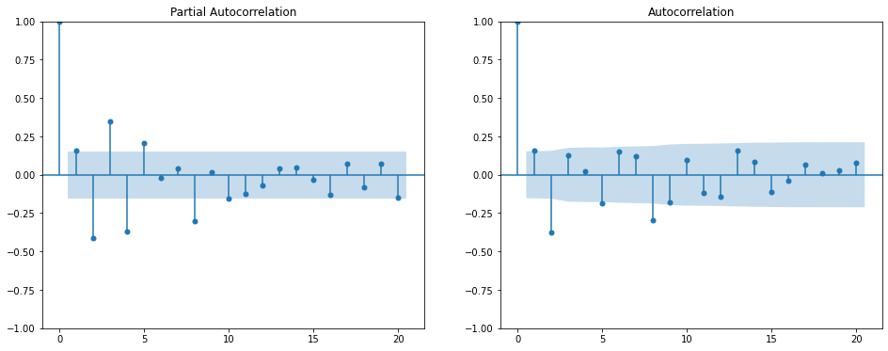
PACF/ACF plots (all data)

Slide 20
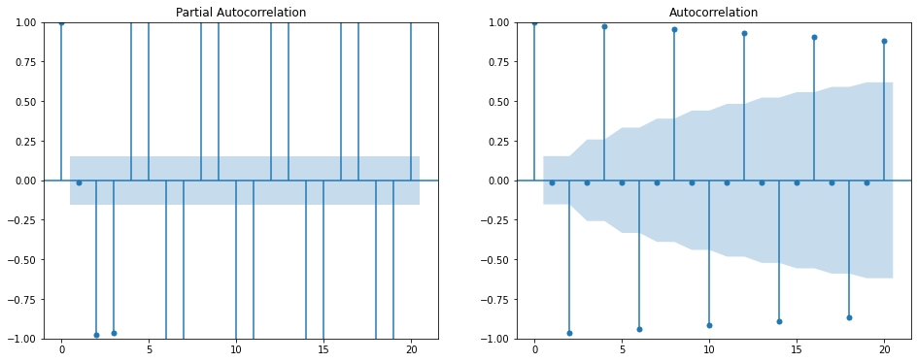
PACF/ACF plots (seasonal data)

Slide 21
Split data
Define target variable
Training data : 80%
Test data : 20%

Slide 22
Challenge 1 : Model comparison
NOTE : Due to very long execution time on my local machine, p and q of seasonal data is limited to 3.
Build models
Fit data
Evaluate models’ performance
Compare various performance parameters
Abbreviations
a : arima
ax : arimax
s : sarima
sx : sarimax

Slide 23
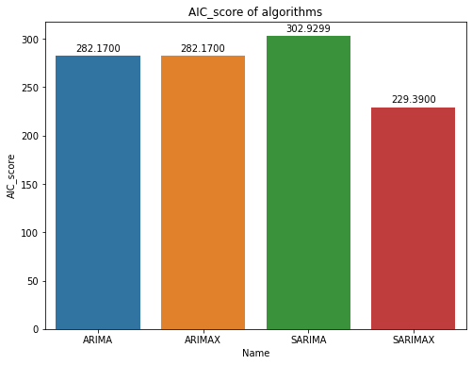
Comparison (AIC score)

Slide 24
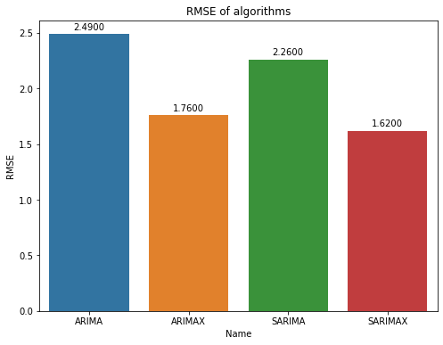
Comparison (rmse)

Slide 25
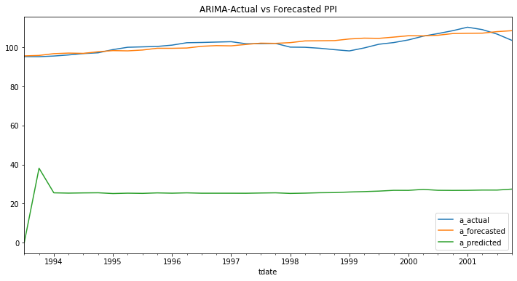
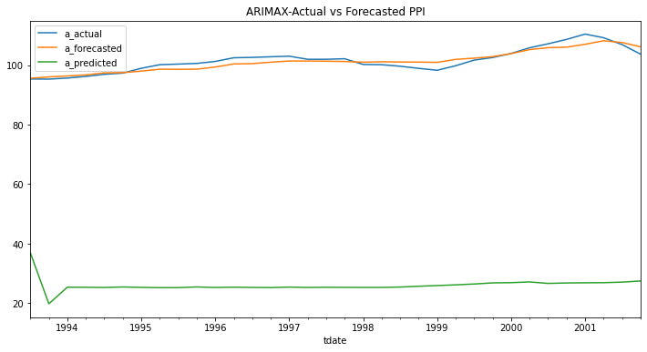
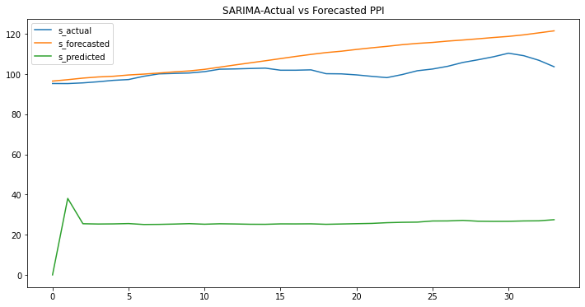
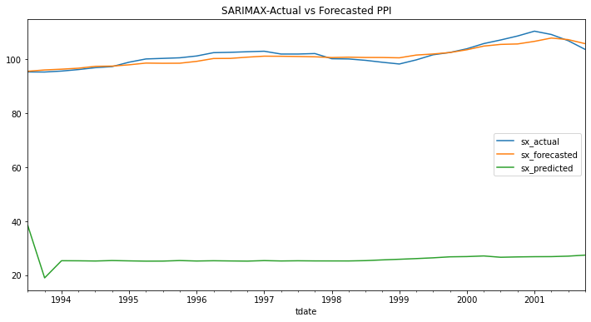
Comparison (Forecasting)

Slide 26
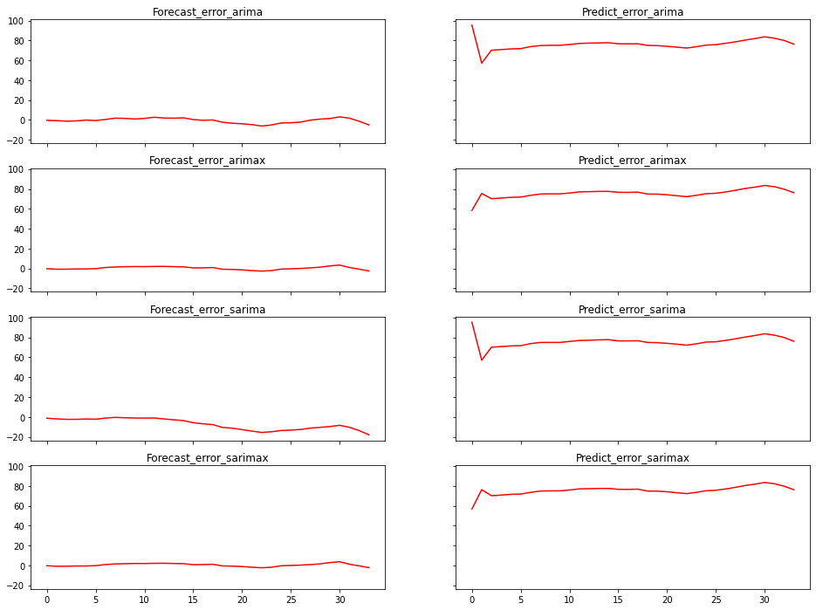
Comparison (Forecasting error rate)

Slide 27
Conclusion – Best model
SARIMAX is the best model for forecasting ppi for the given dataset

Slide 28
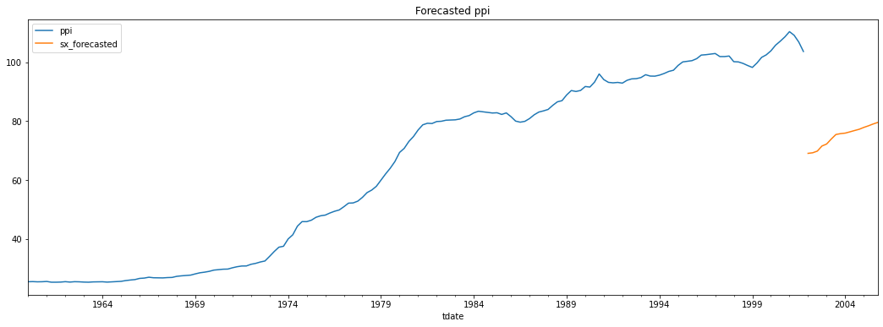
Final Forecast

Slide 29
Insight
PPI is
decreasing in 2002(economic slowdown)
increasing after 2002(high rise leads to inflation)

Slide 30
Thank you
Questions please….

