Slide 1
SLA Doc Insight Platform
Team Name : Merge Conflicts
Divyanshu Srivastava
Hardik Panchal
Naga Sandeep Purushothama
Saran Babu
Sourabh Zalke

Slide 2
Technology Stack
Technology | Use
Python | To create backend Apis using flask | Free
LangChain | Framework used to Parse PDF and interact with LLM using custom created pipelines. | Free
OpenAI Api | Using GPT-4o model for all answer generations. | Paid
PineCone | After processing the PDF, data being embedded into chunks. This chunks being stored in vector database (pinecone in our case) | Free Tier
Angular | User Interface | Free
Redis | Redis is used for background service’s queue. | Free
SQLite | SQL is being used as primary data source. | Free

Slide 3
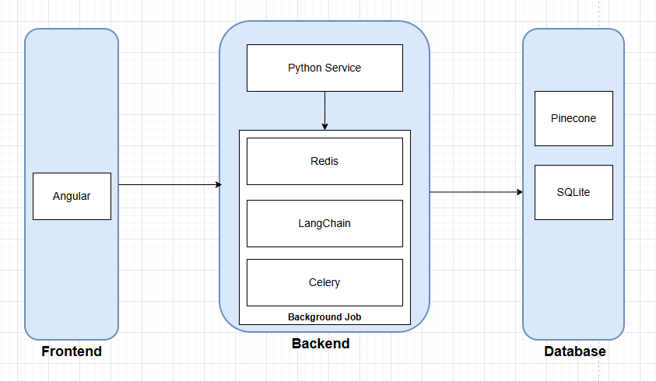
High Level Architecture

Slide 4
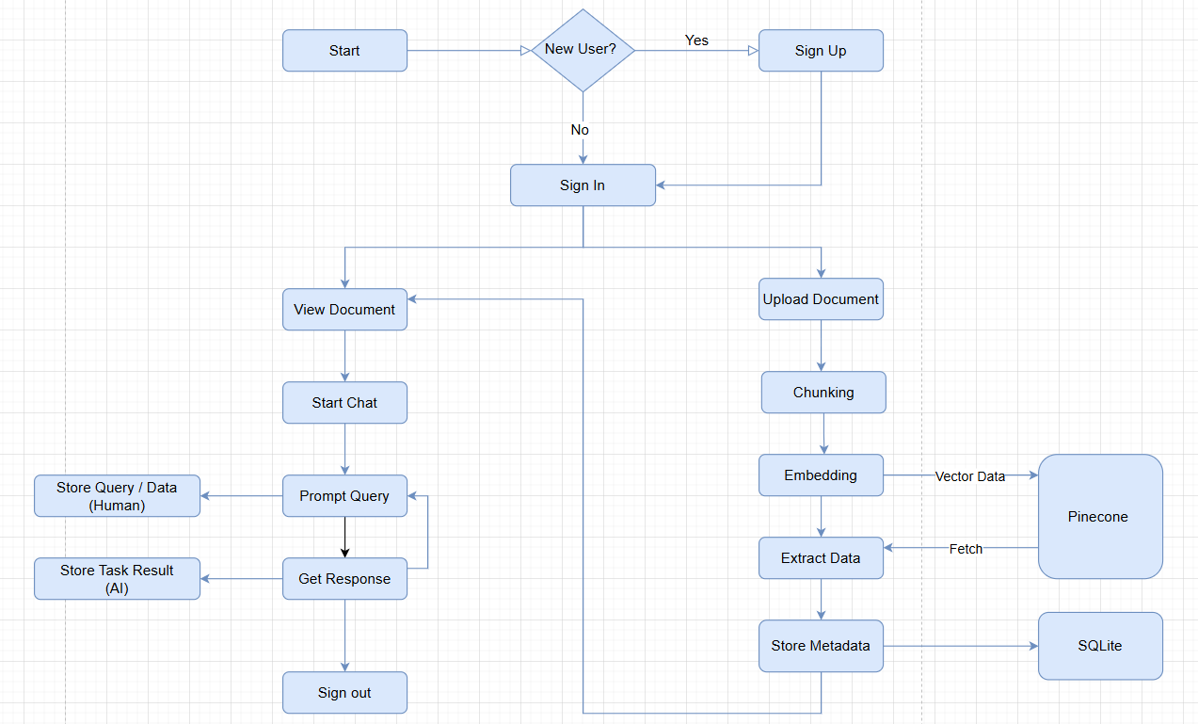
Flow Diagram

Slide 5
Application Demo

Slide 6
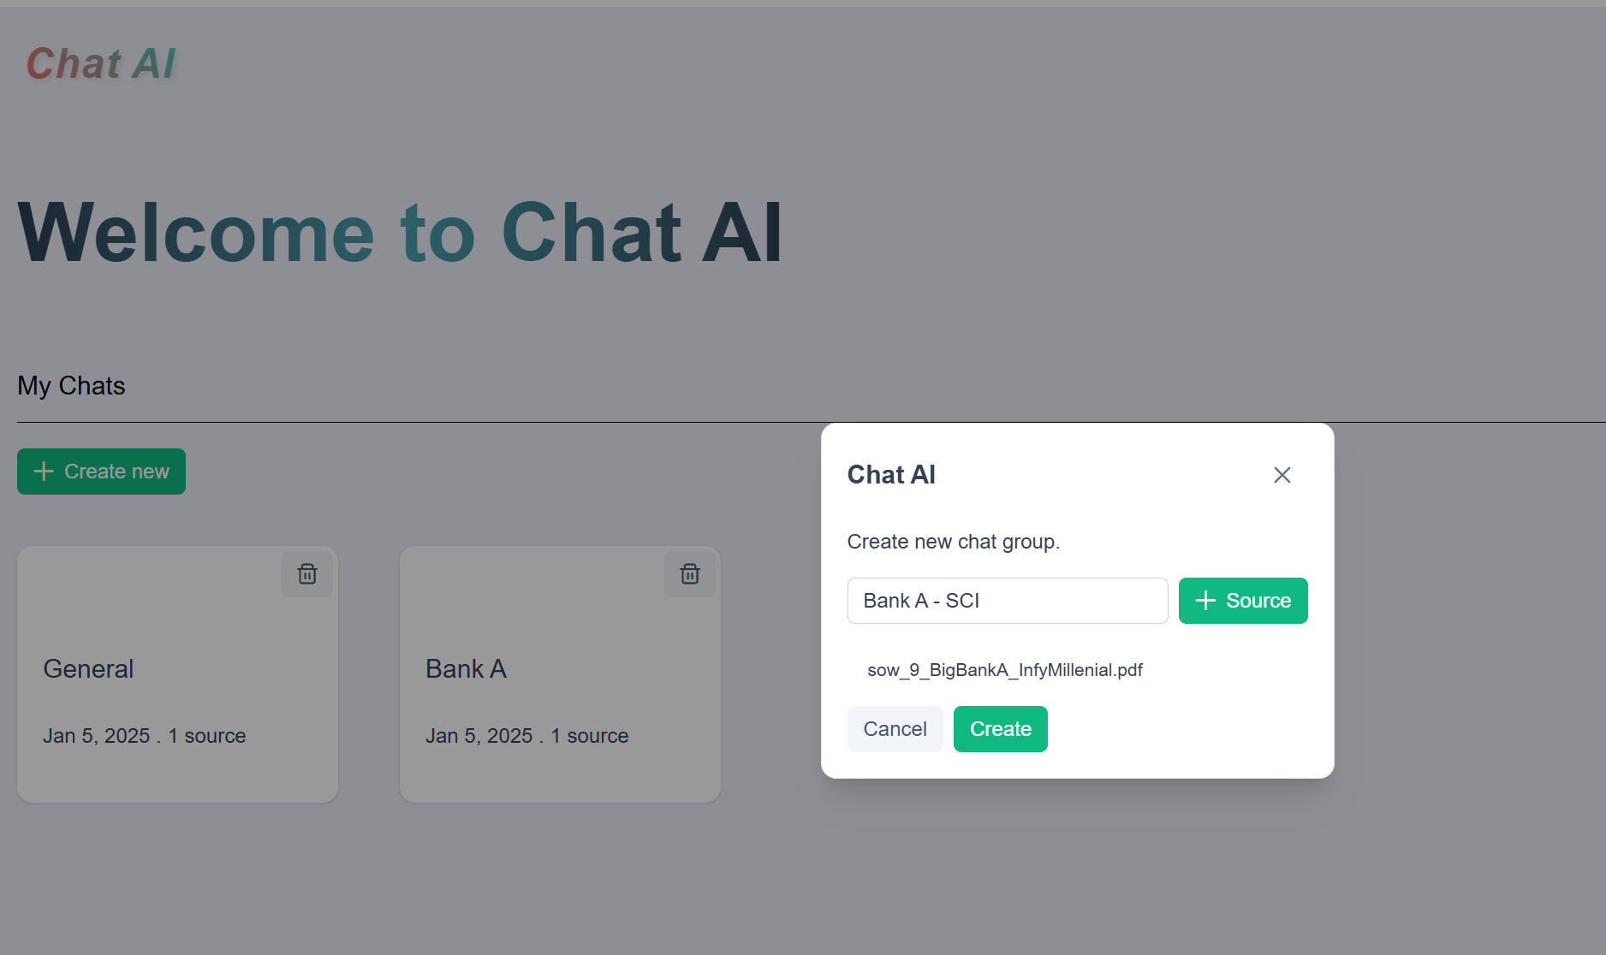
Application Demo
Create Chat Group

Slide 7
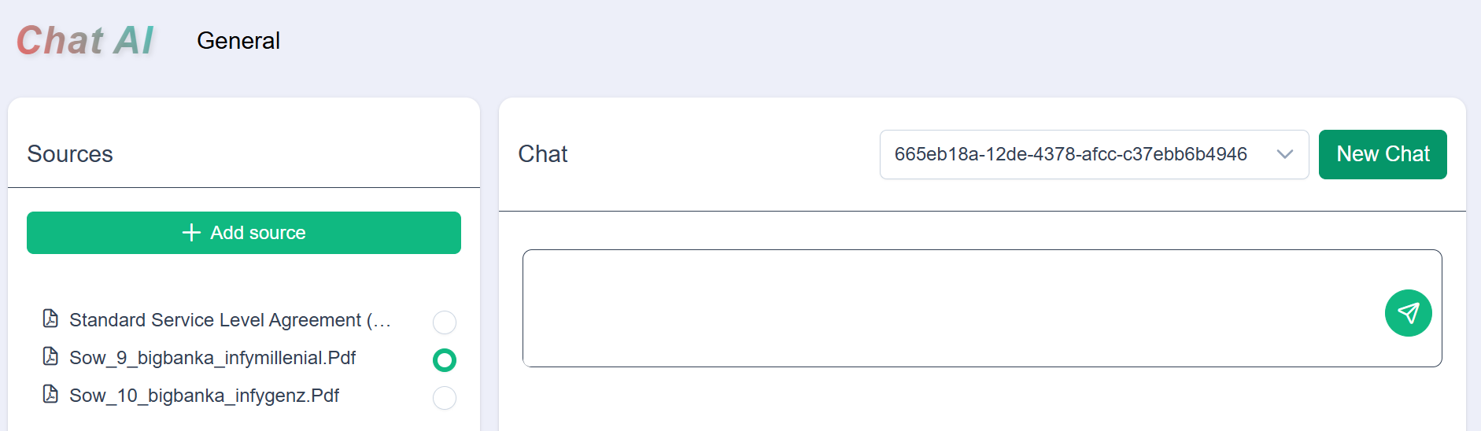
Application Demo
Start new chat

Slide 8
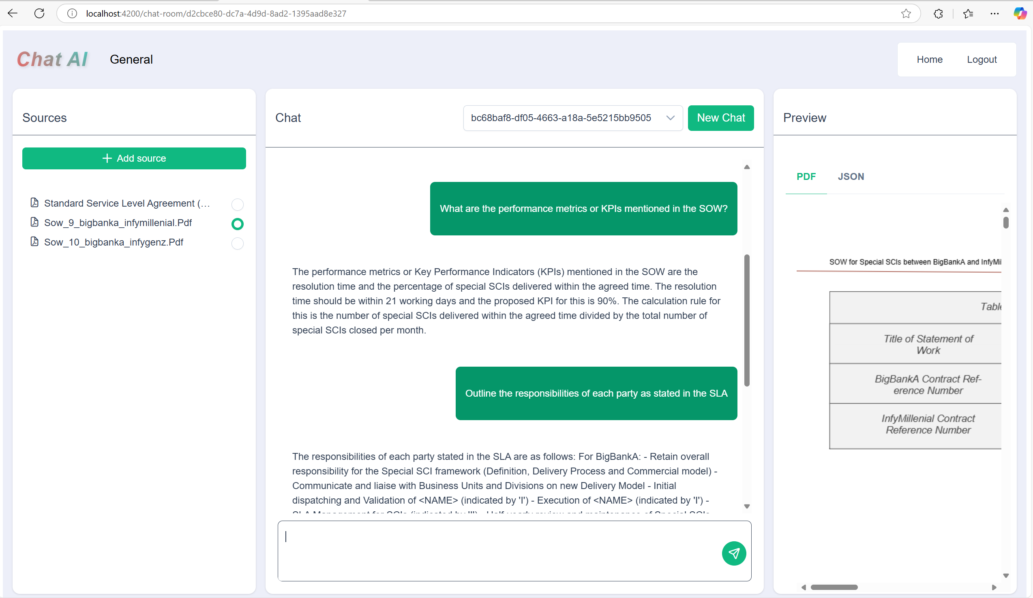
Application Demo
Human Query – 1

Slide 9
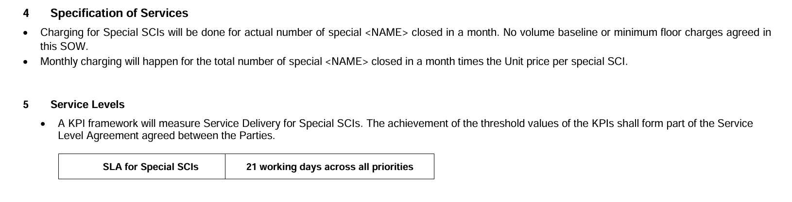
Application Demo
Source – prompt 1

Slide 10
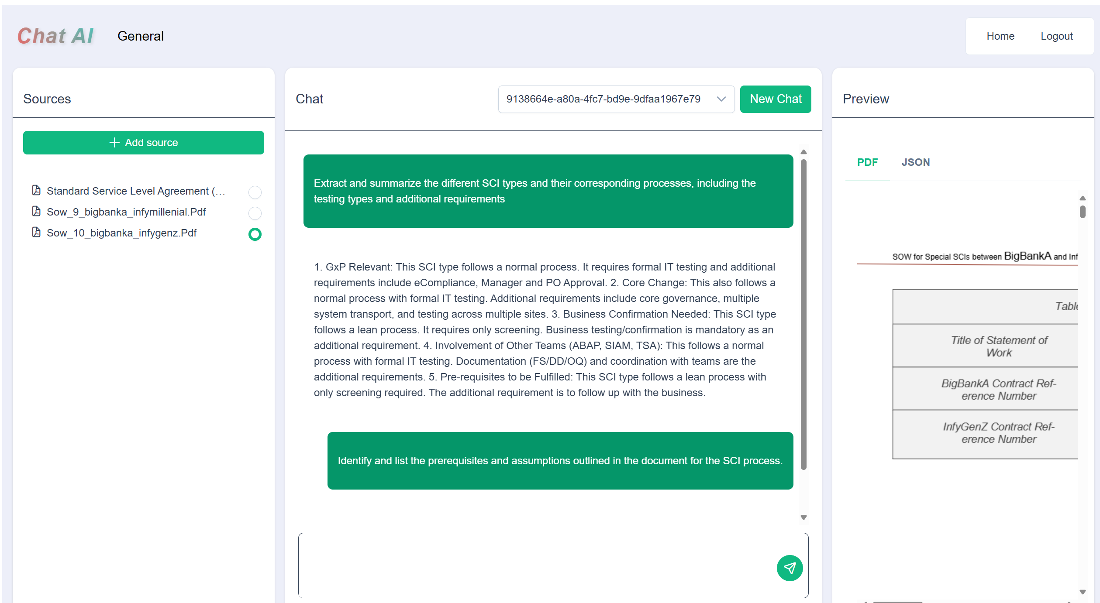
Application Demo
Human Query – 2

Slide 11
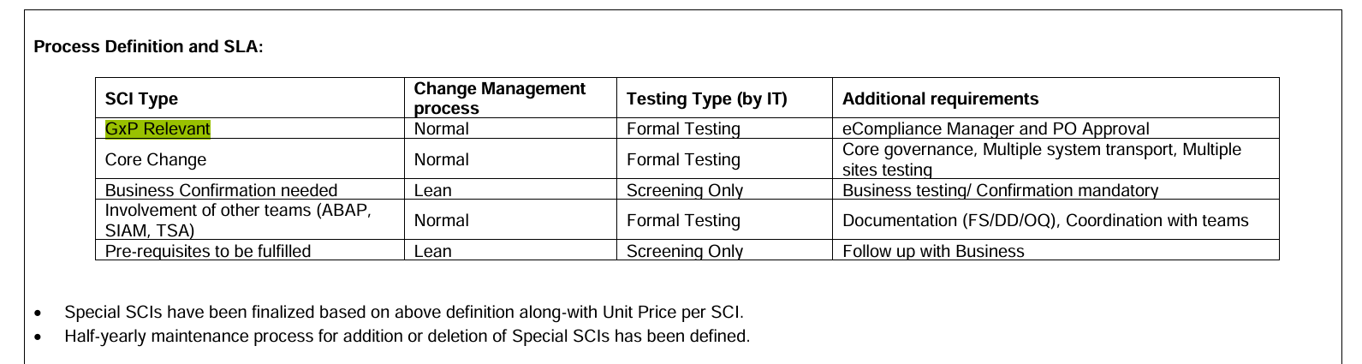
Application Demo
Source – prompt 2

Slide 12
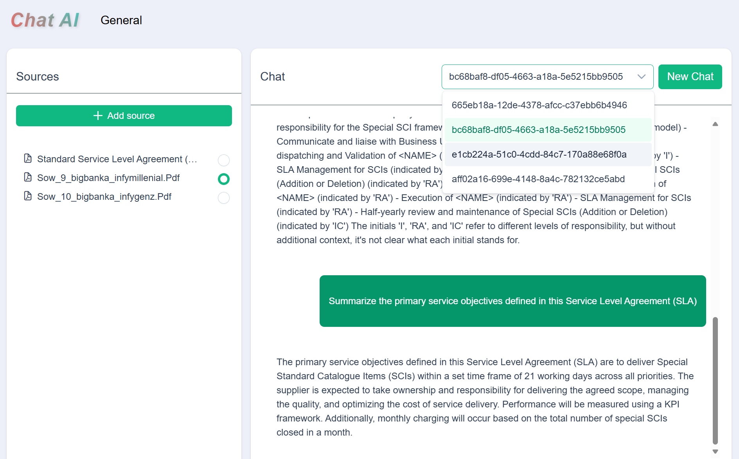
Application Demo
See History

Slide 13
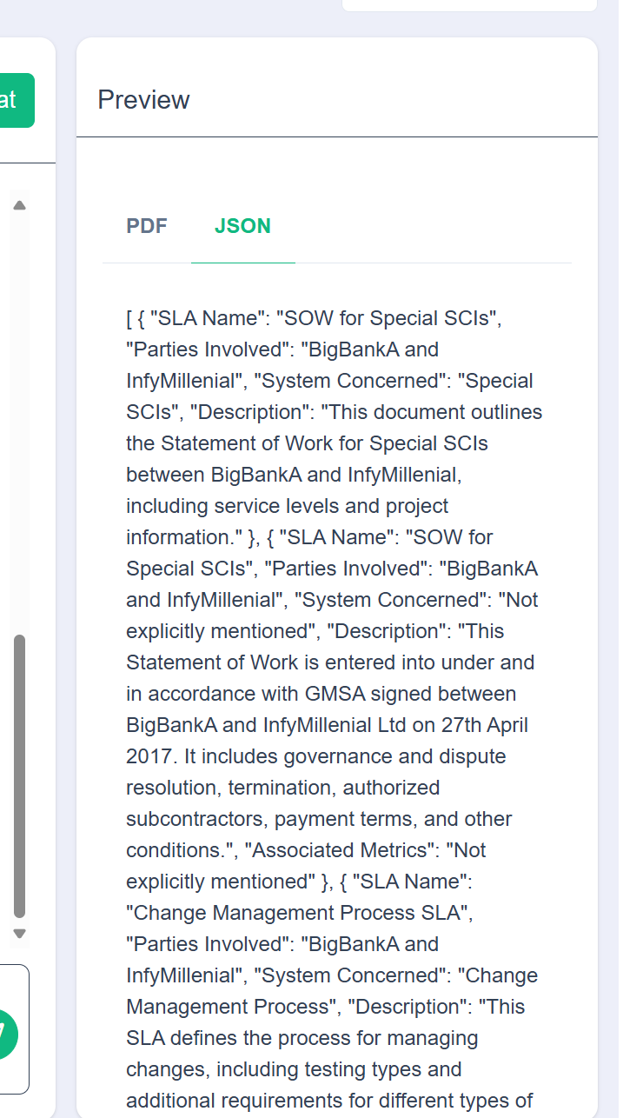
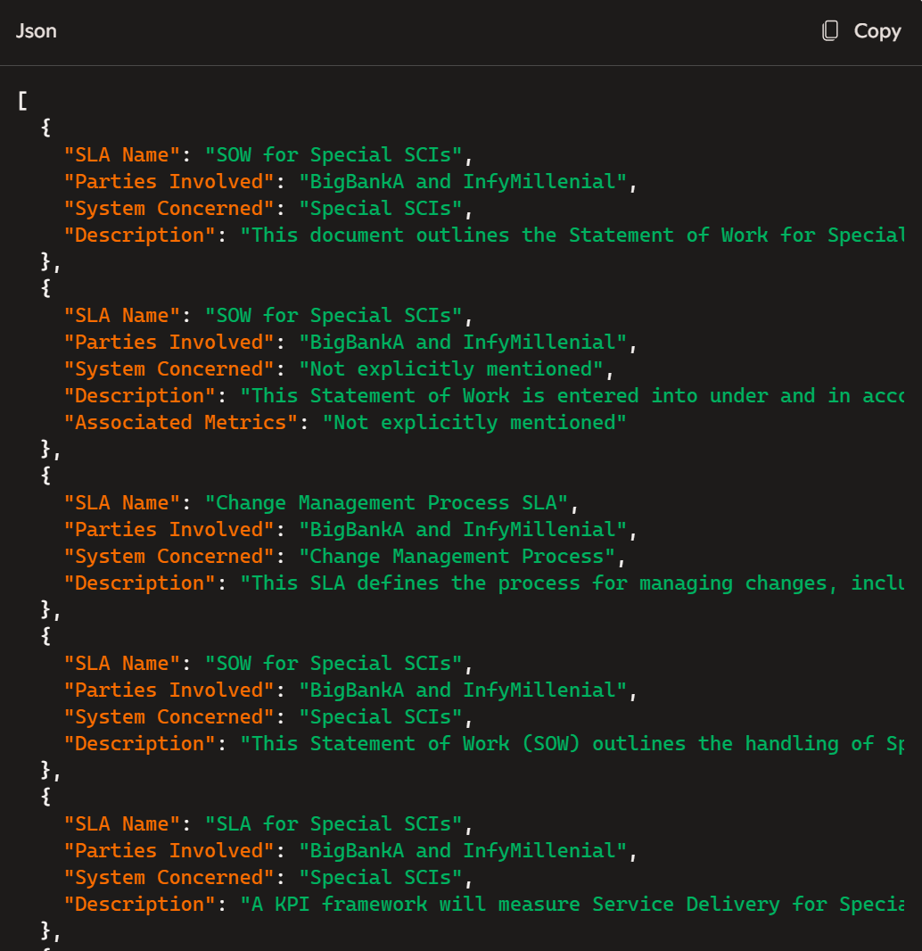
Application Demo
Json Format

Slide 14
Questions

Slide 15
THANK YOU

