Slide 1
SLA Doc Insight Platform
Team Name : Merge Conflicts
Divyanshu Srivastava
Hardik Panchal
Naga Sandeep Purushothama
Saran Babu
Sourabh Zalke

Slide 2
Technology Stack
Technology | Use
Python | To create backend Apis
LangChain | To parse the text from document and break up in to chunks.
GPT – 4 | Format question into prompt and send response.
PineCone | To store result into database.
Angular | To create a UI
Redis

Slide 3
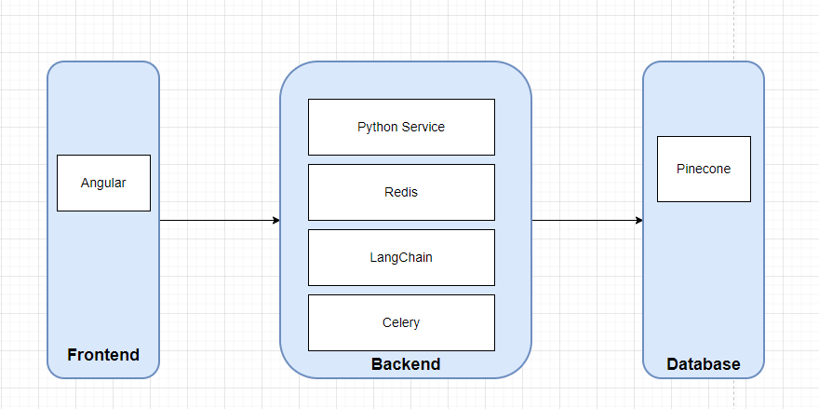
High Level Architecture

Slide 4
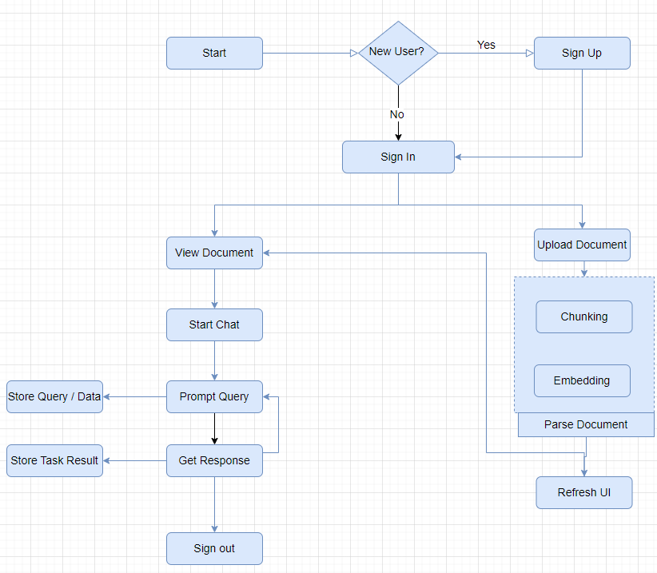
Flow Diagram

Slide 5
Application Demo

Slide 6
THANK YOU

