Slide 1
Ski Season Additional Cost Solutions
Div (Springboard)

Slide 2
Background
Problem Statement: How to absorb $1540000 of additional operating costs this Ski season?
Background: Recent install of an additional ski lift increased the operating cost for the season by $1540000. This install was done to increase the distribution of visitors across the mountain.
Our goal is to evaluate:
cutting operating costs by $1540000 without change in ticket price and revenue
Or, justify an increase in ticket prices to offset the increase in operating costs.

Slide 3
Modeling Results and Analysis
Big Mountain resort charges $81 for both weekend and weekday tickets.
Baseline average ticket price in the market is $63.81
Weekend prices were higher than weekday prices for resorts with sub $100 pricing. For this analysis only AdultWeekend ticket prices were used.
Fast Eigths were not evaluated due to more than 50% of missing market data.

Slide 4
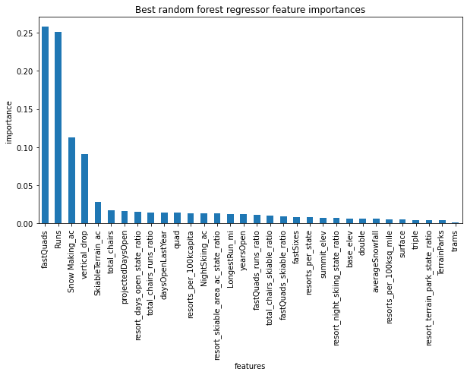
Modeling Results and Analysis
Random Forest Model:
4 dominant features:
fastQuads
Number of Runs
SnowMaking AC
Vertical drop
9.53 Mean Absolute Error
(vs. 11.79 MAE for Linear Regression)

Slide 5
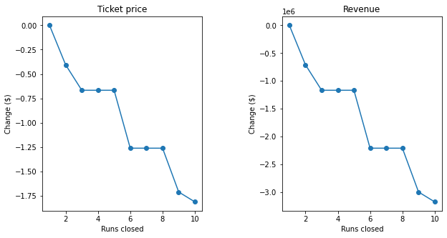
Negative impact of closing runs

Slide 6
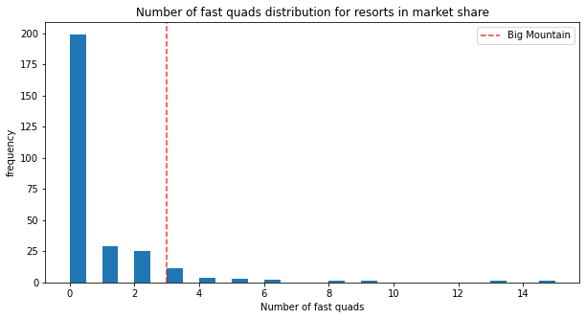
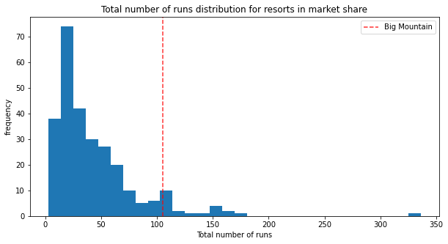
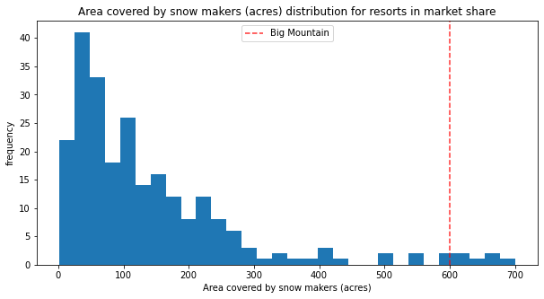
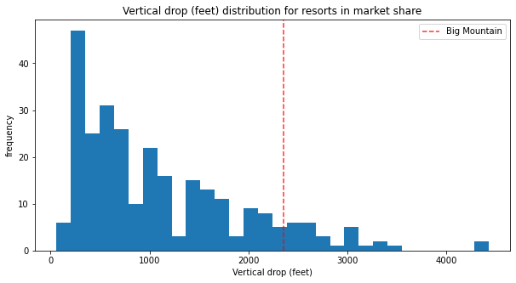
Select Features Market Share

Slide 7
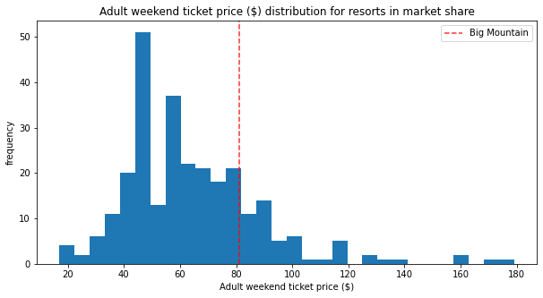
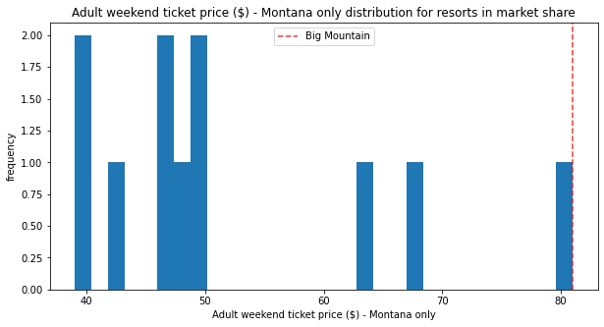
Adult Weekend Ticket Price

Slide 8
Proposals based on Random Forest Model
☒ Scenario#1: Permanently closing down up to 10 of the least used runs. This doesn't impact any other resort statistics.
Impact: Permanently closure of least runs make no difference to negatively impacting revenue.
☑ Scenario#2: Increase the vertical drop by adding a run to a point 150 feet lower down but requiring the installation of an additional chair lift to bring skiers back up, without additional snow making coverage
Impact: This scenario increases support for ticket price by $1.99. Over the season, this could be expected to amount to $3474638
☑ Scenario#3: Same as number 2, but adding 2 acres of snow making cover
Impact: This scenario increases support for ticket price by $1.99. Over the season, this could be expected to amount to $3474638
☒ Scenario#4: Increase the longest run by 0.2 mile to boast 3.5 miles length, requiring an additional snow making coverage of 4 acres
Impact: Made no difference to revenue.

Slide 9
Conclusion
Further analysis needed:
1.) ↗ ticket price up by $1.99: If we move forward with a ticket price increase, we need to evaluate if this needs to be done for weekday ticket, weekend ticket or both.
2.) ↗ 2 acres Snowmaking vs. ↗ vertical drop 150ft: Data on operating costs of snow making and installation costs of an additional chair lift will allow for ROI evaluation.
3.) Build a front end for business analysts to explore different scenarios.

