Slide 1
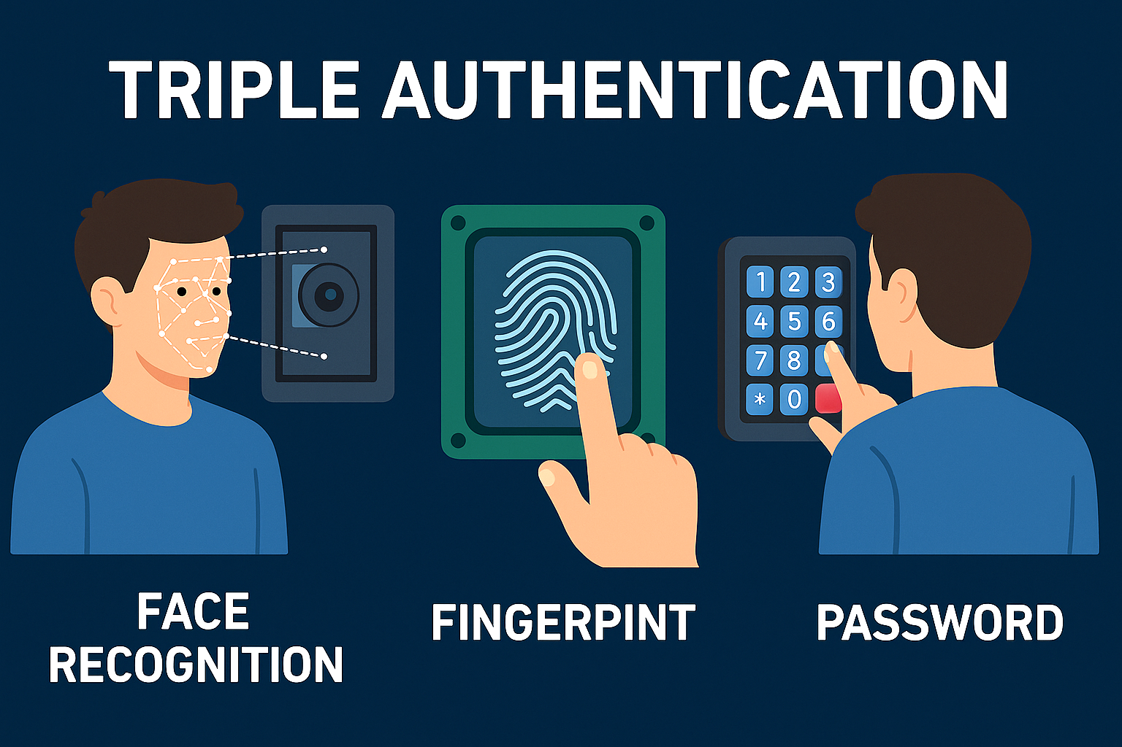
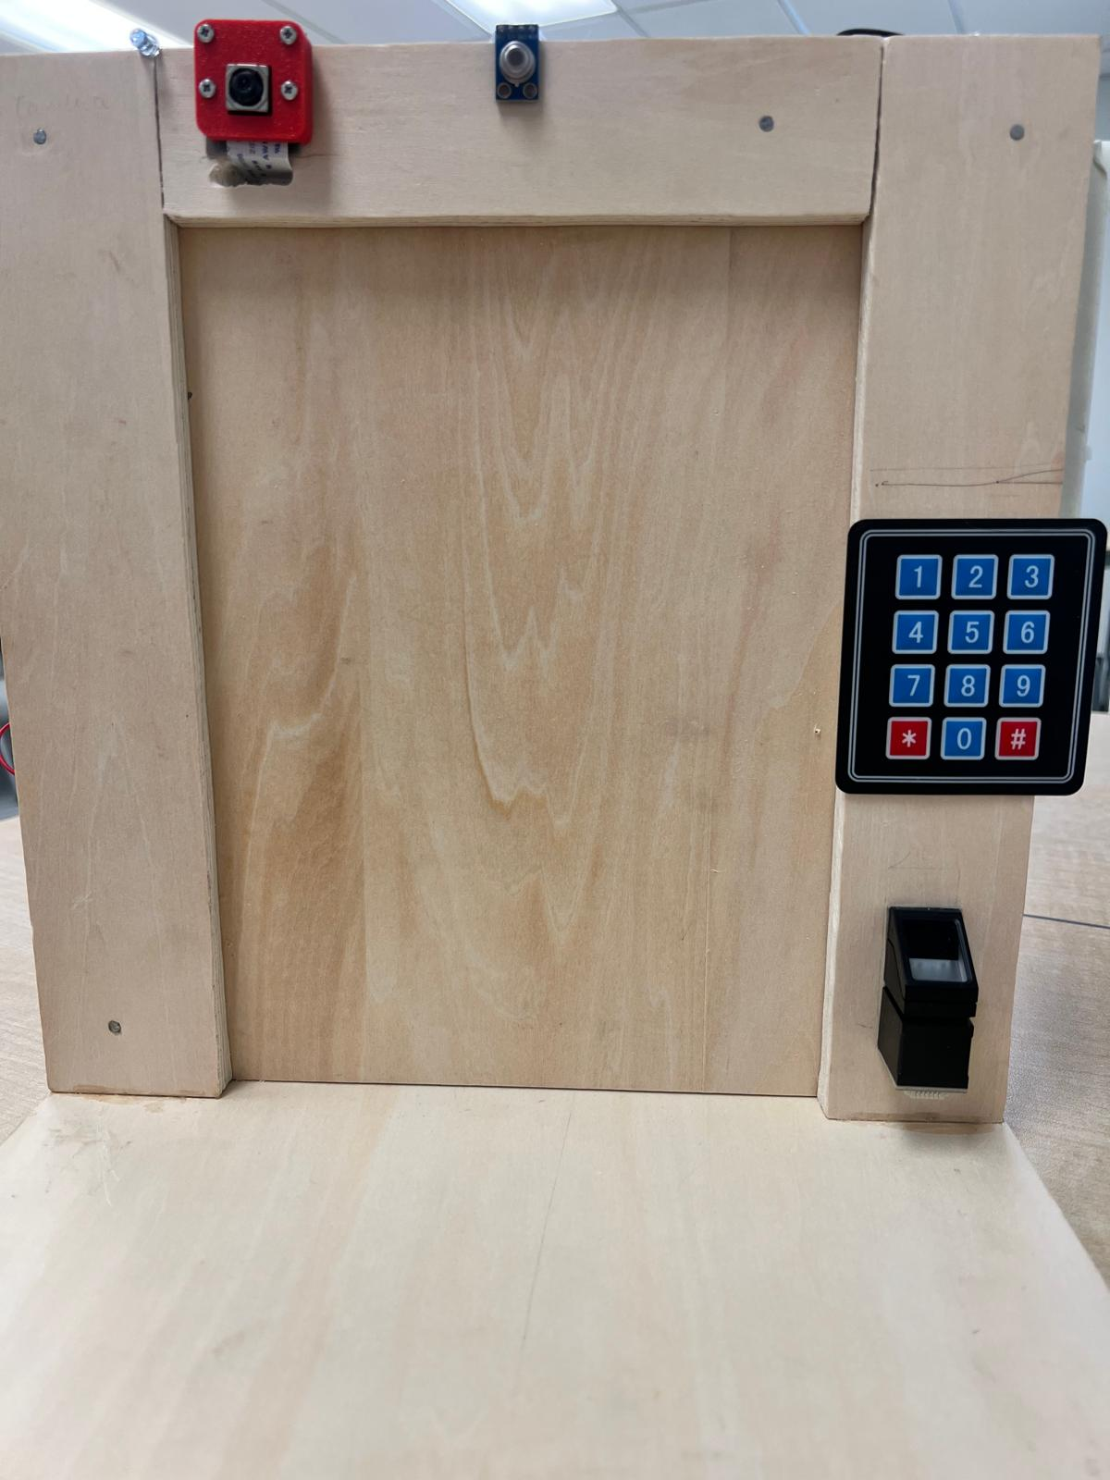
 |  | 📌 Project Description This system is a Raspberry Pi–based smart door security solution integrating 👁️ face recognition with IR LED blink detection and 🌡️ temperature spoof check, 🔑 fingerprint verification, and ⌨️ keypad password entry. The triple authentication ensures high-level security, while ☁️ cloud logging provides real-time monitoring and alerts for unauthorized access.
System Overview
Smart Triple Authentication Door System
MLX90614 Temperature Sensor
Face Detection+ Blink Detection
By: Divyanshi Daroch
Relay and Solenoid Lock
Keypad
Fingerprint Sensor
Abstract
Smart triple authentication door- security system combining face recognition with IR LED blink detection and temperature spoof check.
Fingerprint authentication via an R307 sensor, and Keypad password entry.
Authorized users must pass all three layers of authentication.
Cloud logging- implemented, a confirmation of a secure and additional layer of security during an unauthorized access.
Results
System offers a high level of security combining with these methods for securing access.
Conclusions
Project successfully implemented a robust method for securing the door.
The system’s effectiveness in three combined methods.
Future Work
Explore integrated section of the systems using a dedicated mobile app, using AWS database, using weight sensor etc.
Acknowledgement: I would like to thank my professors, peers, and family for their valuable guidance and support throughout this project.
Contact Info.: divudaroch67@gmail.com

