Slide 1
HI

Slide 2
Here’s something we have been doing all the semester

Slide 3
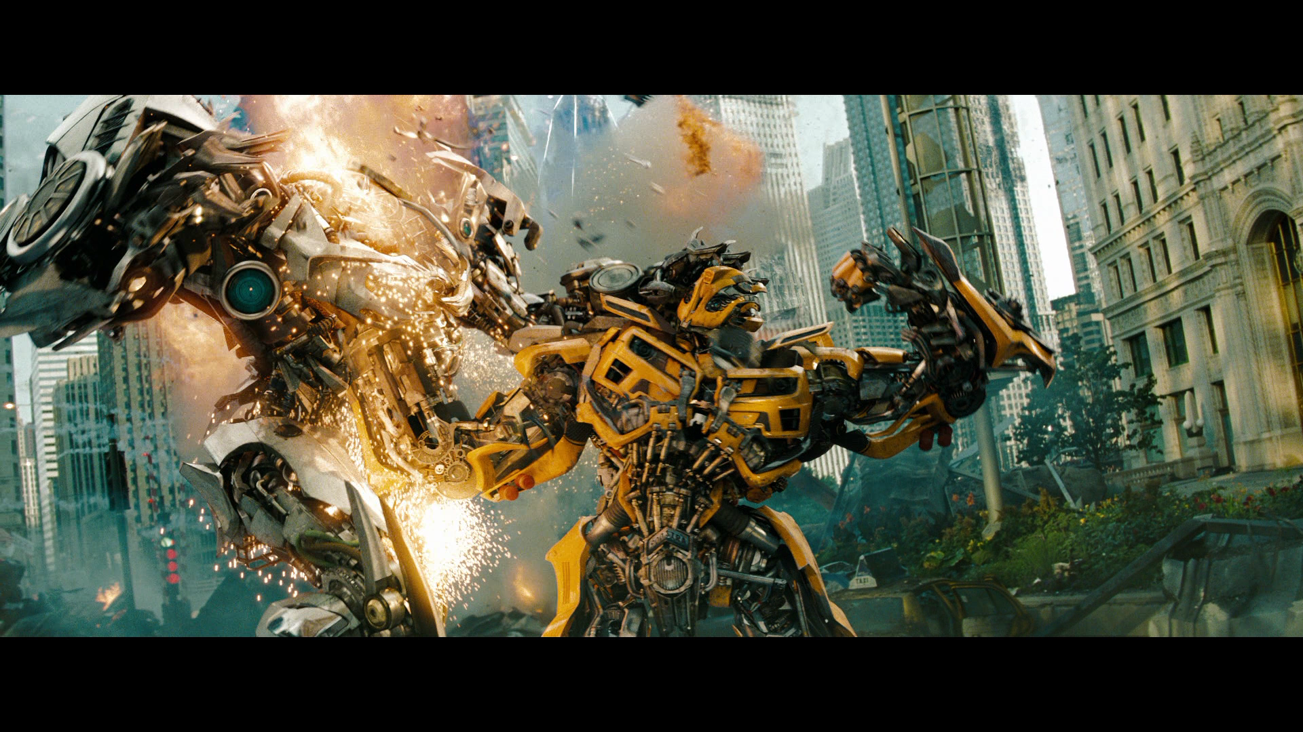

Slide 4
Wait, we weren’t not watching transformers

Slide 5
We’ve been making bots to fight
Well not that awesome as in the picture

Slide 6
But Something like these

Slide 7
And also we have made a new programming language, To code those Bots

Slide 8
Not anywhere near these

Slide 9
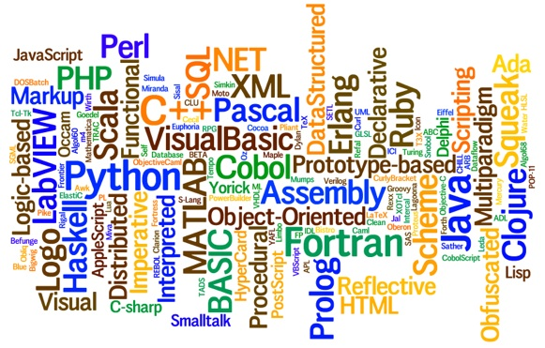

Slide 10
But we tried…..

Slide 11
We used python3.3+ to make our ‘game’
It worked well

Slide 12
What we had to do?

Slide 13
The Code
First, we had to decide what our new language would do.
I should say that was tough Deciding what variables we had to put so someone could use it
But we sorted it out

Slide 14
The Interpreter
Then we had to make an ‘interpreter’ that could understand our new language and convert it into its own understandable form.
This was a little tricky part
Each of us had different ways to make interpreters but finally our opinions concurred
We did a bit of googling, bugged the mentor
And finally had a working Interpreter

Slide 15
The Arena
This was a part where we had our Brains scratching
The machine understood what we said, but it didn’t know what it had to do next.
We had to build algorithms for the motion and defense capabilities of the bot and fix Values for parameters
In the end…. The Bots fought We Knew Who was dead
But there was nothing to be ‘seen’

Slide 16
The GUI
Now we actually had to put the bots on screen and make them do things they are supposed to do.
This is a time, when the Internet can do miracles at the same time eat your brains…
Lots of things crossed our path
But only one was Lucky The good old ‘Turtle’

Slide 17
We used the Turtle module to pull up our robots onto the screen for their real time battle
Robots were fine
But we had problems with bullets, shields,bombs….
We have to mention BOMBS were hilarious and we had a really good time to fix them
Not to forget the shields that were shedded behind like snake skins

Slide 18
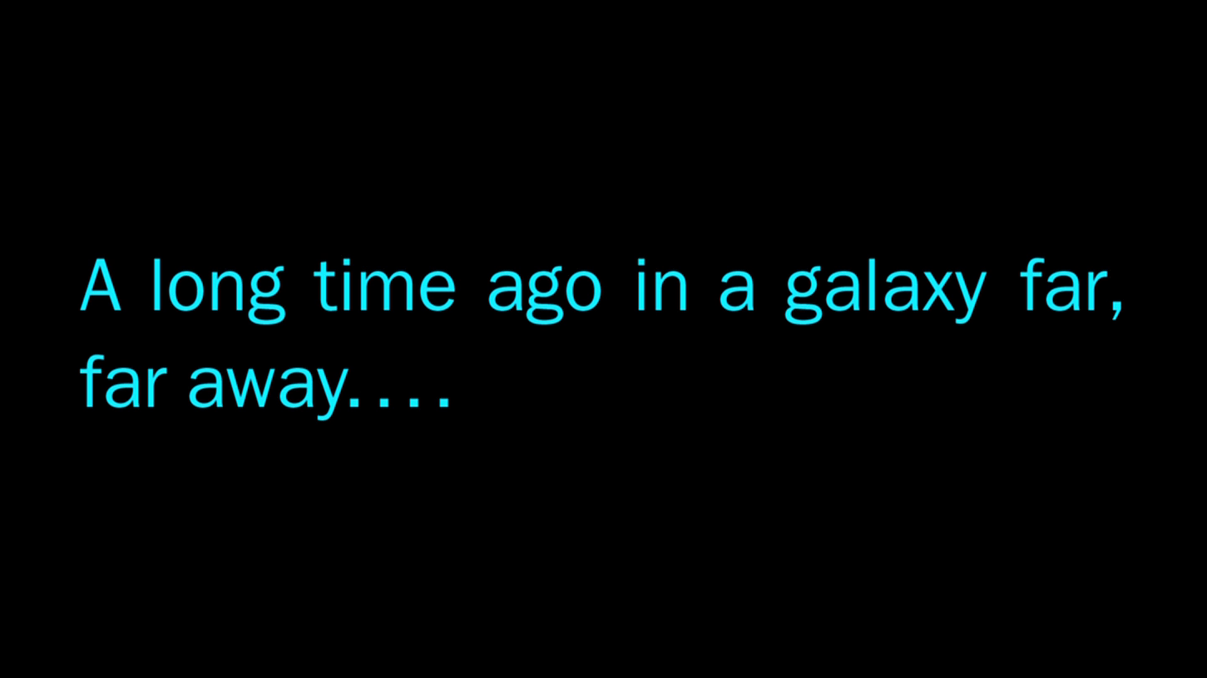

Slide 19
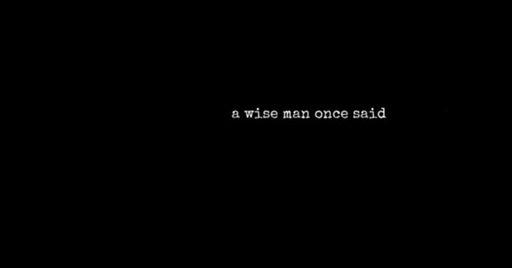

Slide 20
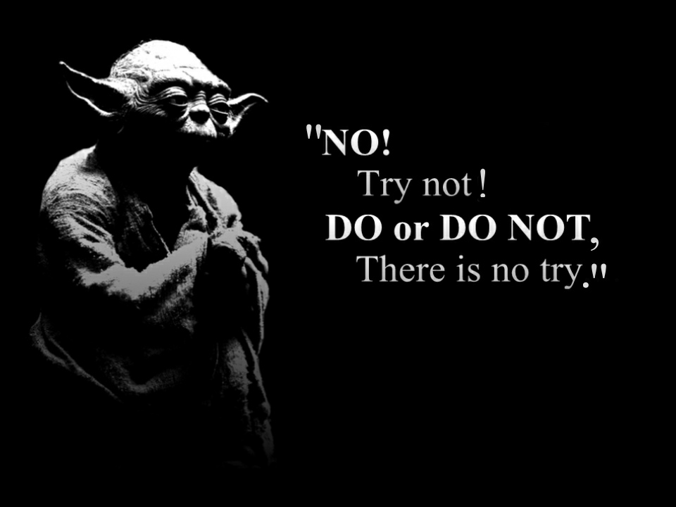

Slide 21
And We Did It

Slide 22
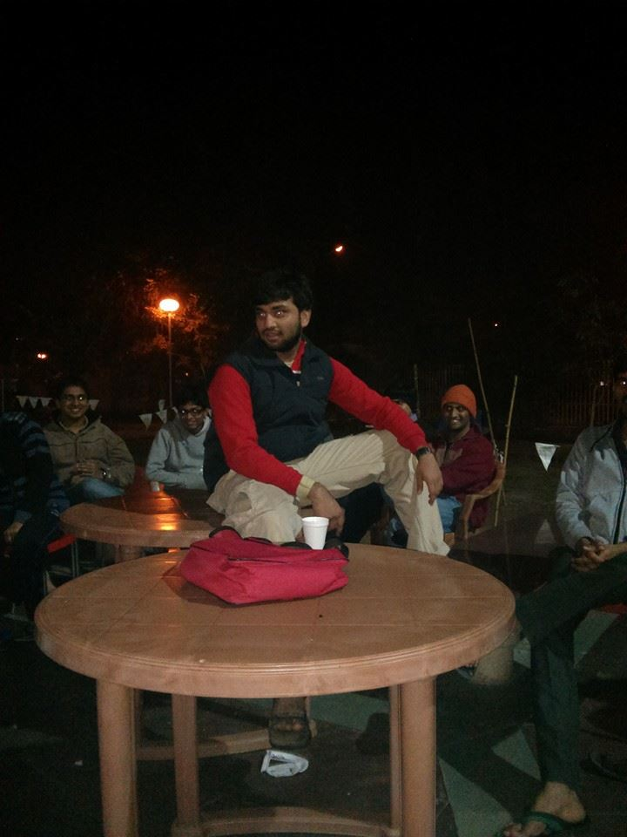
A Special Thanks to this person

Slide 23
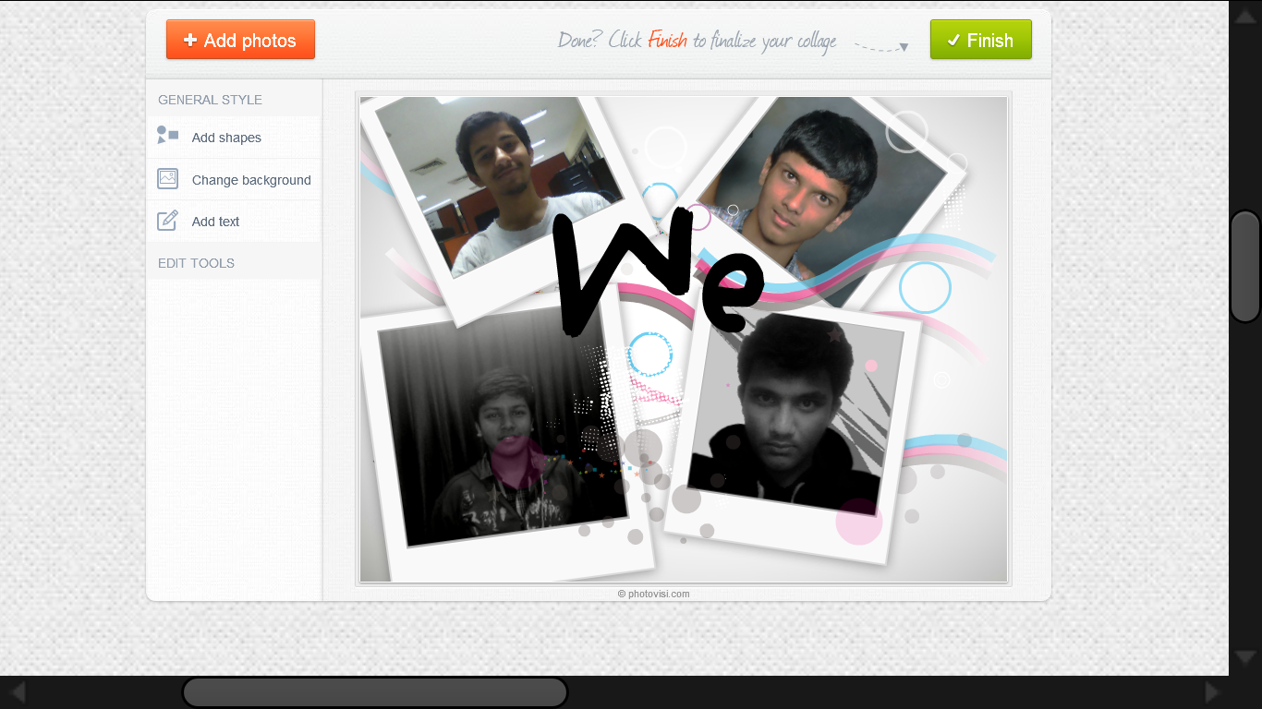
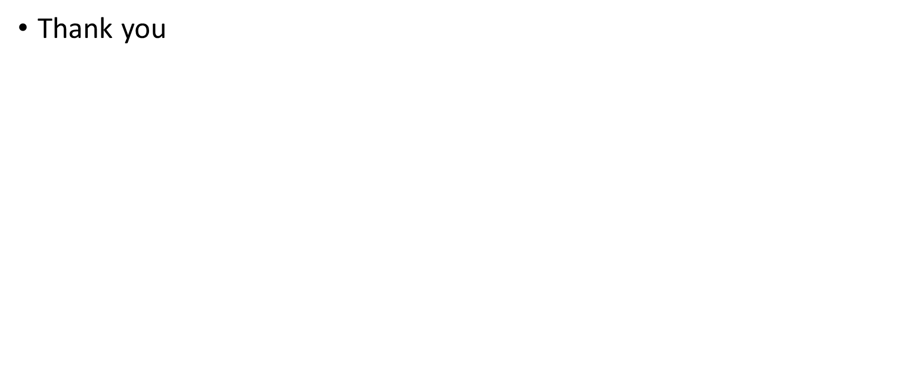
Thank you

