Slide 1
Detection of Spelling Errors in Swedish Clinical Text
Nizamuddin Uddin and Hercules Dalianis
Department of Computer and Systems Sciences, (DSV)

Slide 2
Introduction
Hospitals produce text based records at different stages of patient health care process.
  Stored in Electronic Patient Record System (EPRS)
  Contain valueable information such as patient symptoms, diagnoses, treatment and future plans etc.
Uddin & Dalianis

Slide 3
To improve patient health care process.
Important resource for research in the clinical domain.
Automatic text processing methods to use
  information retrieval
  text summarization
  decision support and statistical analysis etc.
Uddin & Dalianis

Slide 4
Problem
The text is in non-standardized form
May contain:
  Spelling errors.
  Medical jargons and domain specific abbreviations.
  Telegraphic style, not complete style sentences
The reason for that is:
  It may entered in time presure.
  It is mostly used for internal communication.
Uddin & Dalianis

Slide 5
Related Research
The spelling problem was addressed previously by many researchers.
  In 1994 Domeij et al, developed an algorithm for detection spelling errors in Swedish ordinary text.
  Patrick and Nguyen in 2006 developed a rule based system for detection and correction of spelling errors of clinical text.
  Recently Isenius et al (2012) developed an algorithm which detects abbreviations.
  Ruch et al (2003) detects 10 percent spelling errors in clinical text written in French.
Uddin & Dalianis

Slide 6
Methods
Techniques
  N-gram analysis.
    Uses predefined word list table called N-gram table.
  Lexical Lookup.
    Uses dictionaries or word lists and simply search input text in the available dictionaries.
Uddin & Dalianis

Slide 7
Data
Stockholm EPR Corpus
  Karolinska University Hospital patient records
  2006-2010
  Over one million patients
Subset
  Stockholm EPR PHI Corpus
  100 patient records 151,924 words
Uddin & Dalianis

Slide 8
Preprocessing
Preprocessing
  Tokenization.
    Split the stream of word into token.
    Remove PHI (Named entities) instances.
    Remove digits etc.
  Compound splitting.
    Swedish language is compound rich language.
    Used compound splitter.
  Lemmatization.
    To convert each input string into its base form.
    Used CST lemmatizer.
Uddin & Dalianis

Slide 9
Algorithm
Developed an algorithm
  Use Stockholm EPR PHI Corpus
  Uses seven different dictionaries (Medical + Swedish).
Algorithm detects spelling errors in two stages.
  Perform preprocessing (Tokenization + Compound splitting).
  Compare or search each input string in available dictionaries.
Uddin & Dalianis

Slide 10
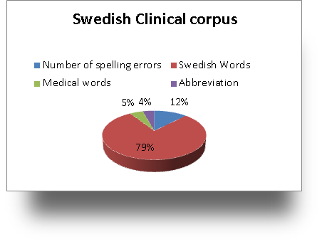
Results
Uddin & Dalianis

Slide 11
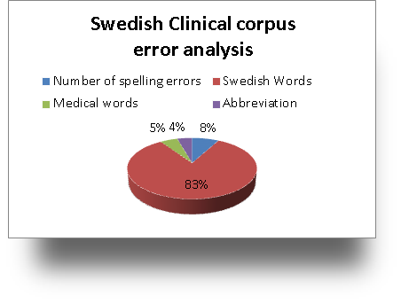
Continue...
Uddin & Dalianis

Slide 12
Continue…
36.8 percent were correctly spelled words that was detected as misspelled words (false positives).
7.6 percent spelling errors after correcting false positive.
4.2 percent were compound words.
2.9 percent were abbreviations.
Uddin & Dalianis

Slide 13
Discussion
Error rate in patient record is much higher (8%) than other type of text (1-2%)
Reasons are
  Other type of text are read by a large number of people
  While patient records are mostly used for internal communication
  No spelling correction in EPRS
Result supports the previous research
  10 percent spelling errors in clinical text written in French by Ruch et al., (2003).
Uddin & Dalianis

Slide 14
Discussion
Performance of the algorithm.
  Exclusively depends on dictionaries
  Improved word lists or dictionaries may improve the result.
  Improved preprocess may also improve the result for example better compound splitter.
Uddin & Dalianis

Slide 15
Future Work
Use Web instead of dictionaries for of detection spelling errors.
The existing algorithm can be improved with correction feature by using edit distance algorithm.
Uddin & Dalianis

Slide 16
Thank you!
Questions?

