Slide 1
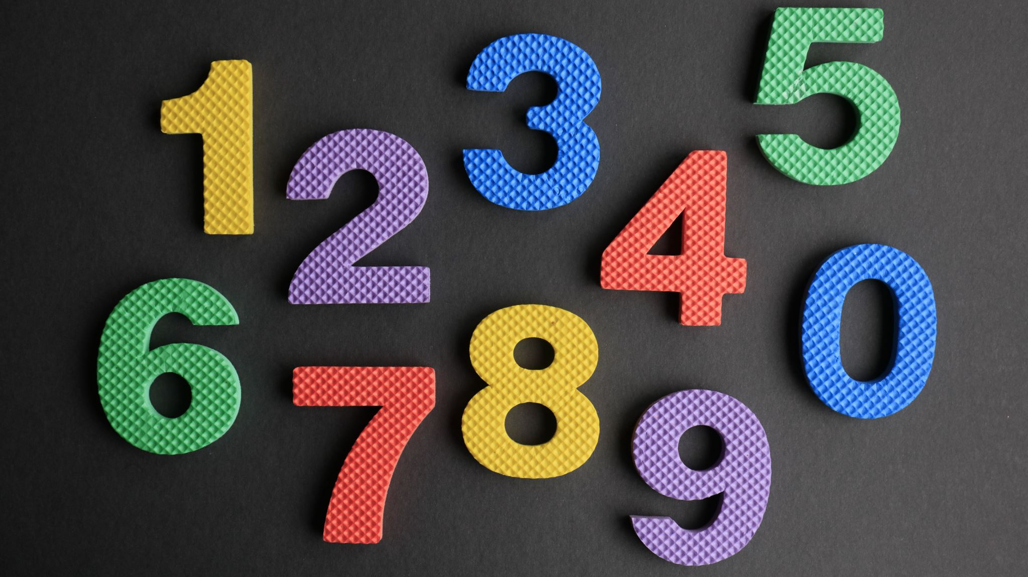
Guess the number
Divya Rajeswari Pamula
220318055

Slide 2
Introduction:
Guess the number
The objective of this game is let the player guess the program generated random number within number of chances chosen by the player
OOPS concepts and Robust Boundary Value Analysis (RBVA) are used to build and test this game

Slide 3
Need
NO
Let’s start the
NO
Closed
introduction
game
YES
YES
Select which digit
Computer
YES
Introduction to
number (3,4 or 5)
Generates a
the game
to be guessed
random number in
backend
Input in how many
Wrong
Enter number again
Chances got
Chances are
chances you will
Enter the
Guess
until you guess
completed
completed,
guess the number
number
correctly or chances
Do you want play
get completed
again
Correct
Correct Guess
Guess
NO
YES
Congratulations,
NO
Do you wan to
Closed
play again

Slide 4
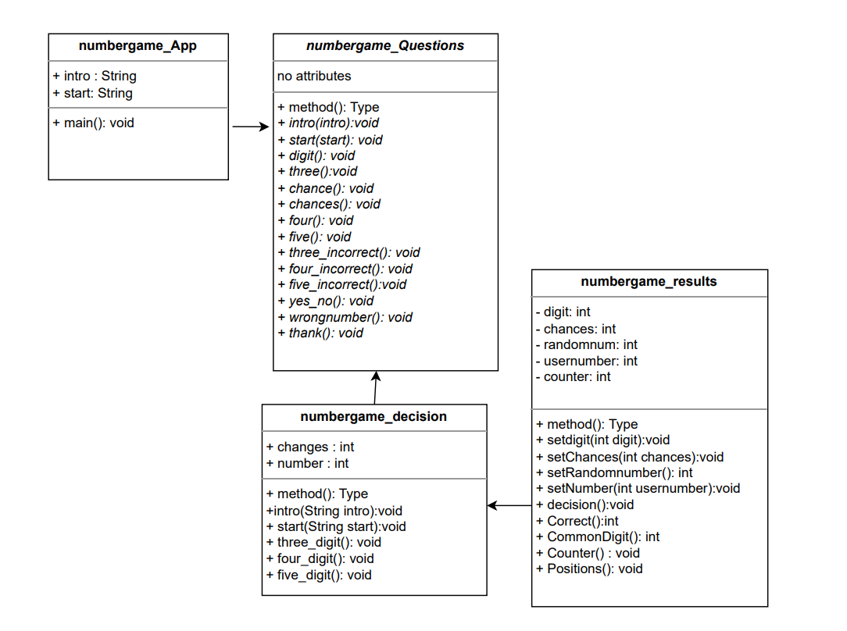
UML diagram:

Slide 5
Objects
Questions
Gamestart
random

Slide 6
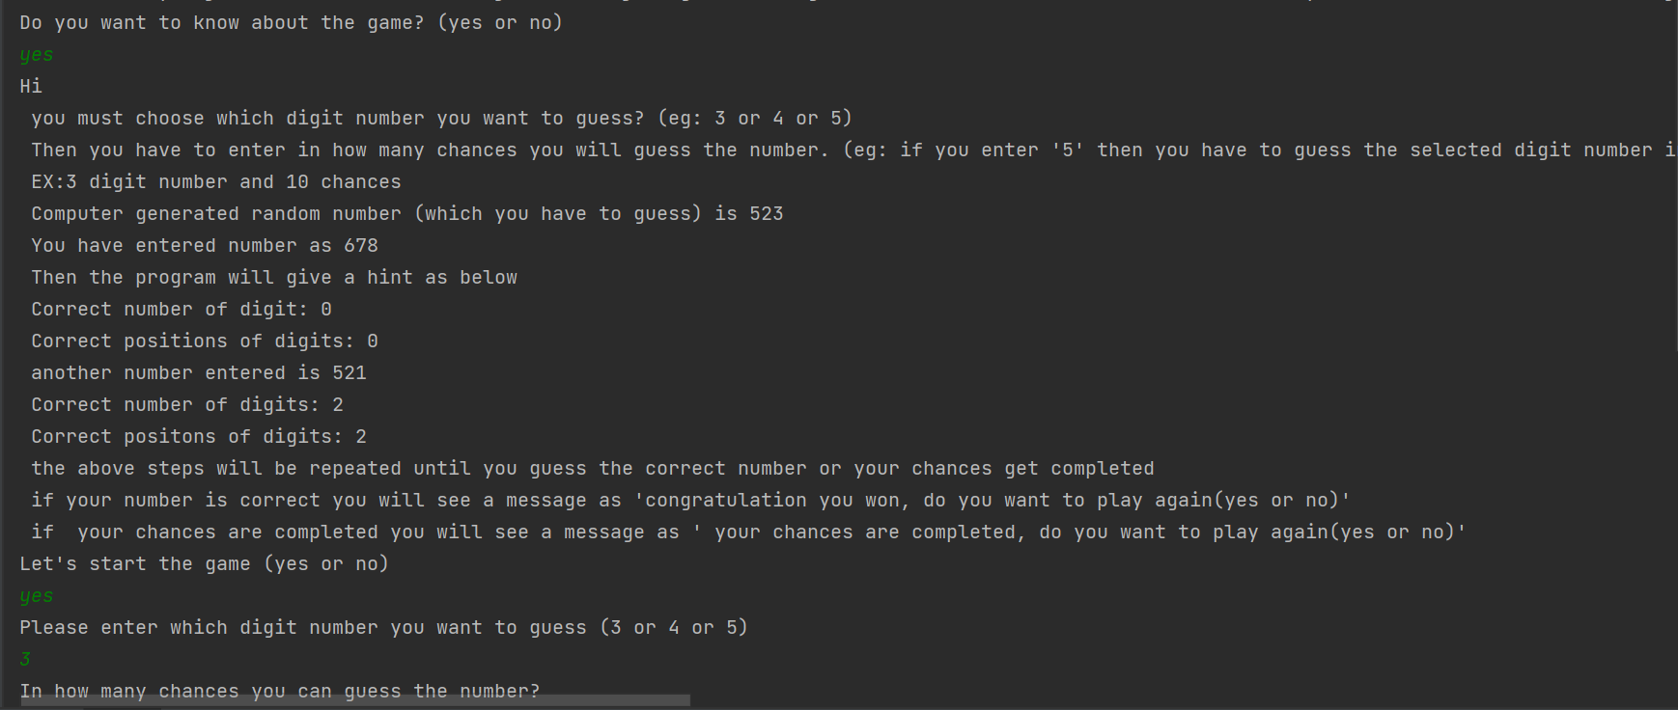
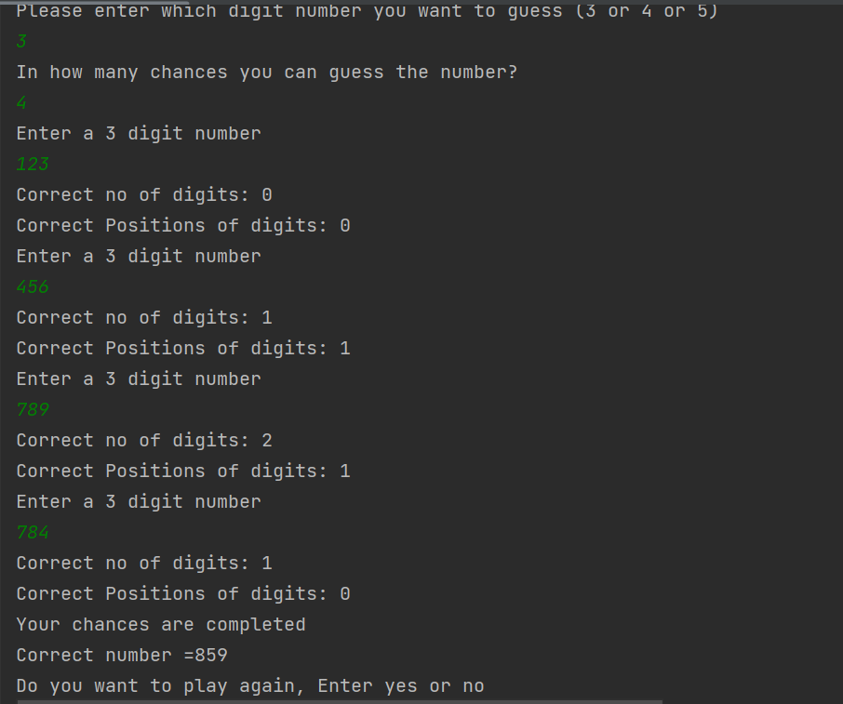
Output: (Example 1)

Slide 7
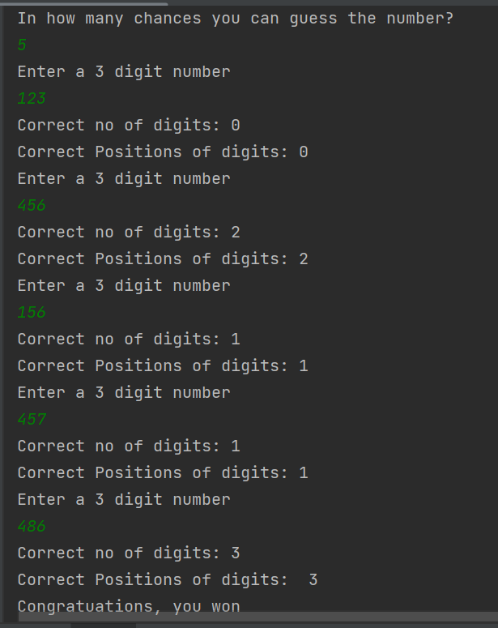
Output: (Example 2)

Slide 8

Thank You

