Slide 1
APS Research Project
Single Image Haze Removal Using Dark Channel Prior
Submitted by:
Divy Kala
Divyansh Shrivastava
Ankit Gupta

Slide 2
Overview
The dark channel prior is based on a key observation.
Most local patches in haze-free outdoor images contain some pixels which have very low intensities in at least one color channel.
If an image is hazy the above does not hold true for the hazy parts (and the parts with sky in it).
Using this prior with the haze imaging model, we can directly estimate the thickness of the haze and recover a high quality haze-free image.

Slide 3

Dark Channel
Where for an image J is the scene radiance,
J^{c} is a colour channel of J.
Ω(x) is a local patch centered at x.
J^{dark} is the dark channel, which is dark in all the regions except the sky (and the haze, and other very bright parts).
The dark channel has a special property for hazy images without sky in it.

Slide 4
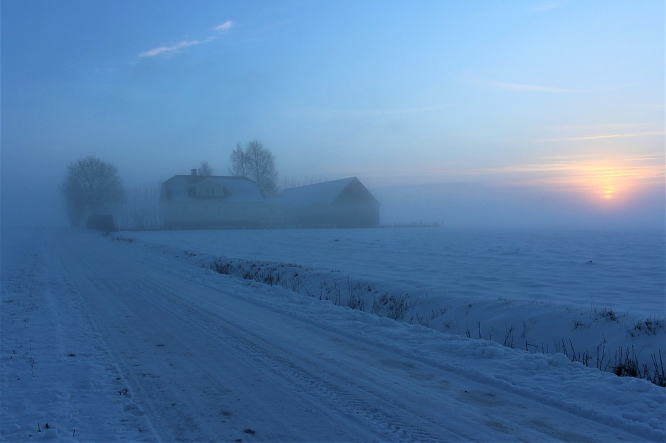
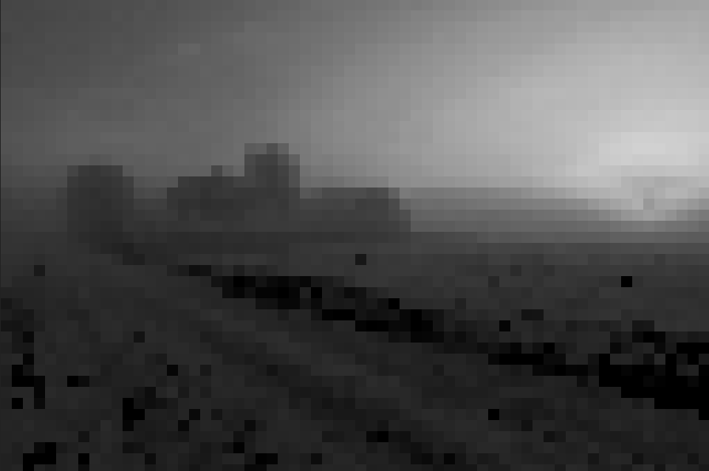
Demonstration

Slide 5
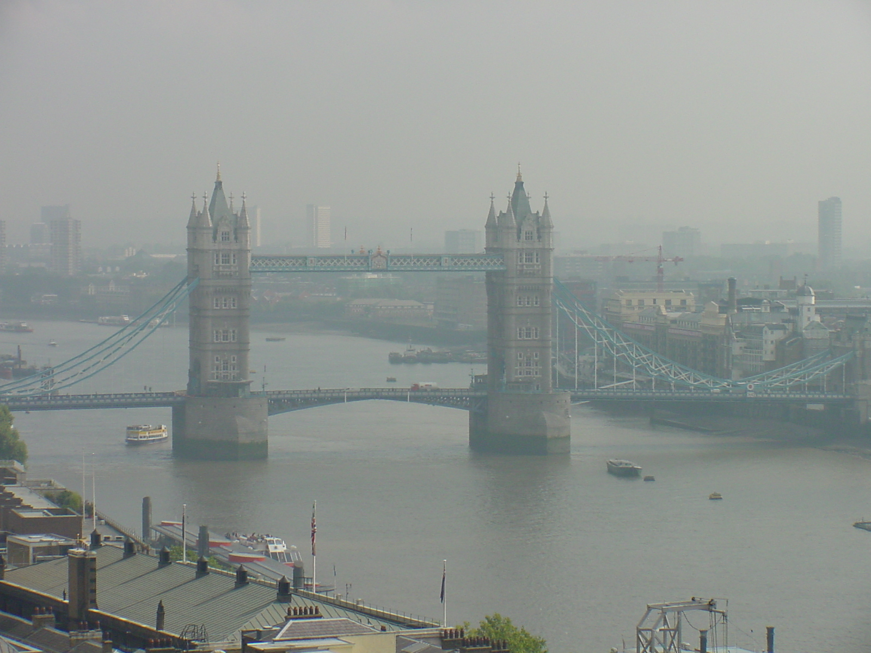
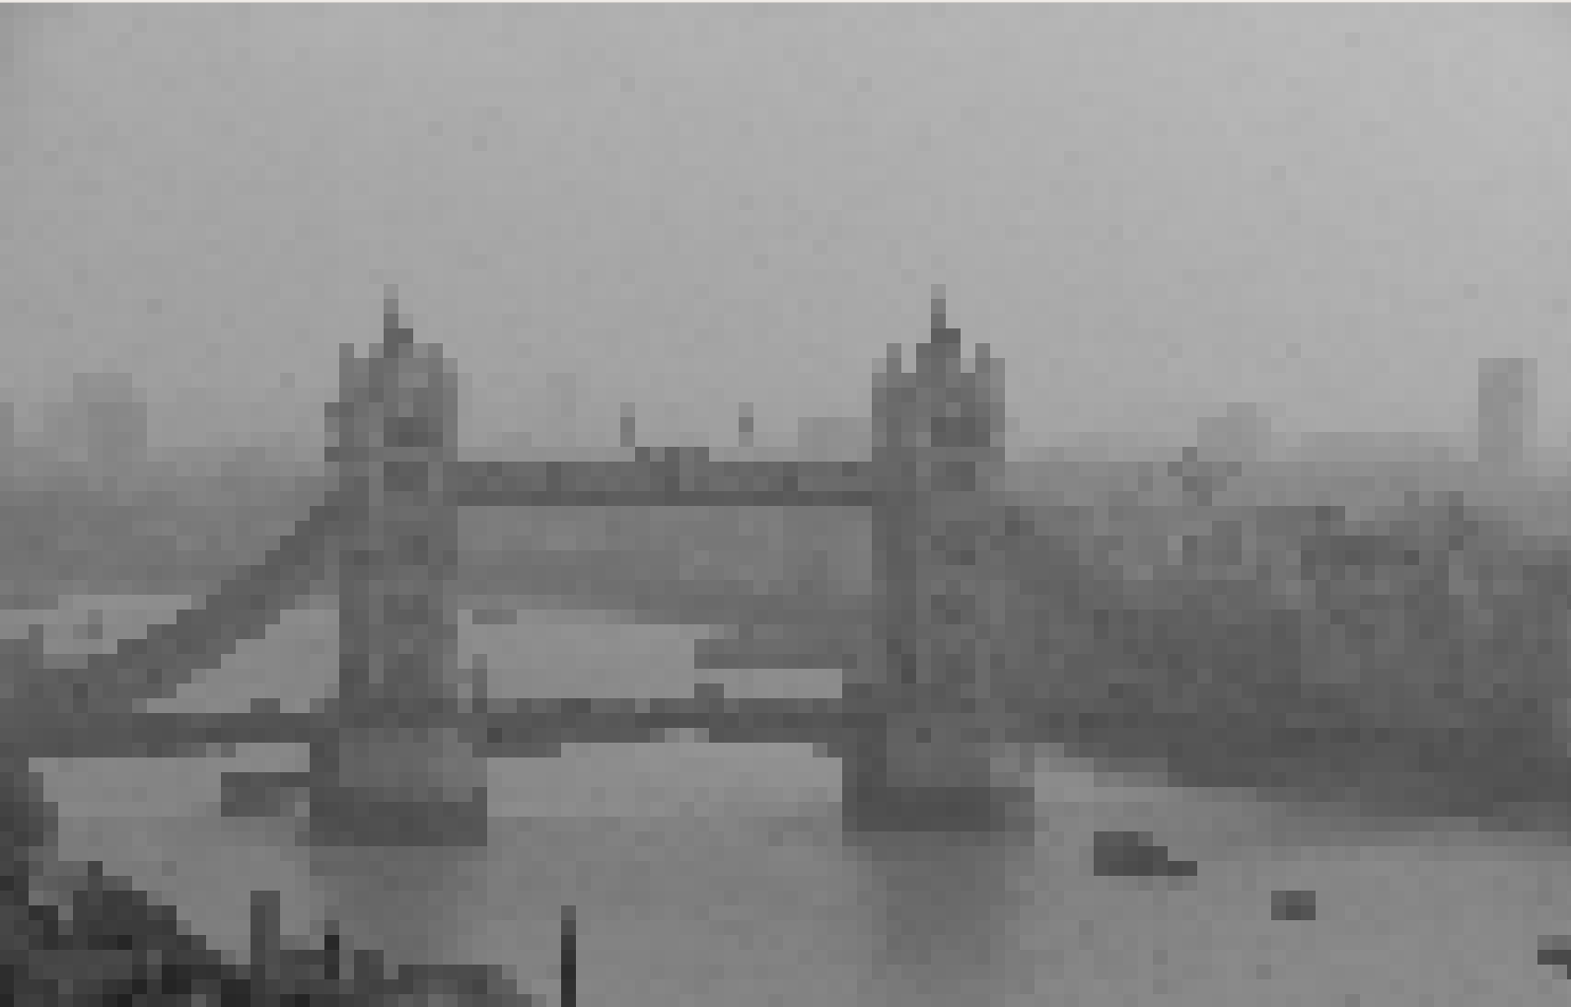
Demonstration

Slide 6
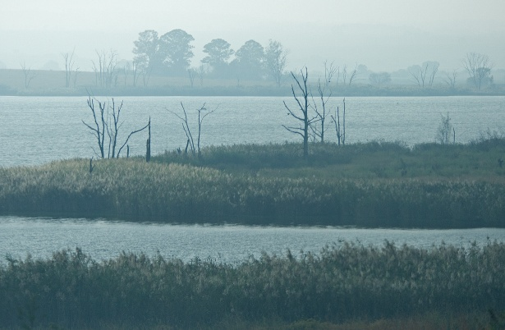
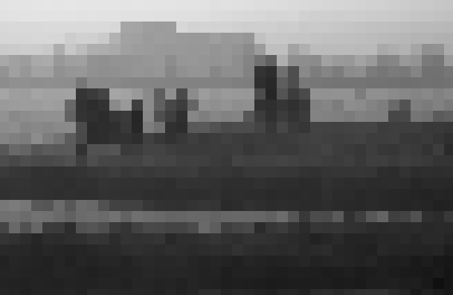
Demonstration

Slide 7
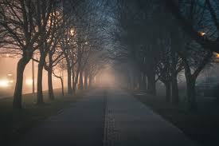
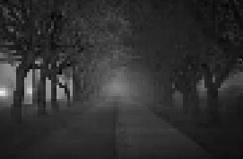
Demonstration

Slide 8
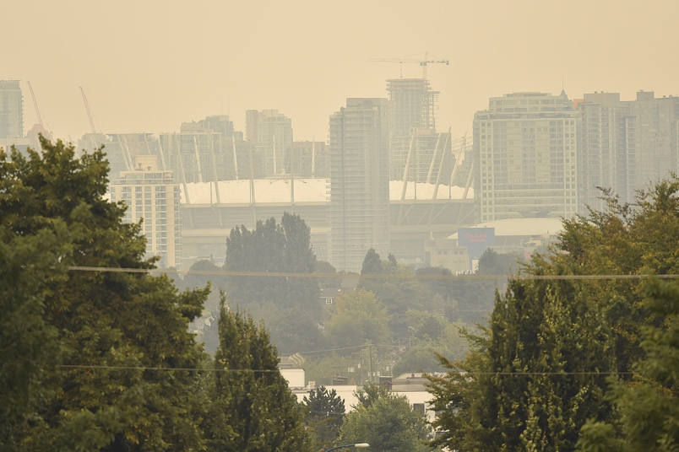
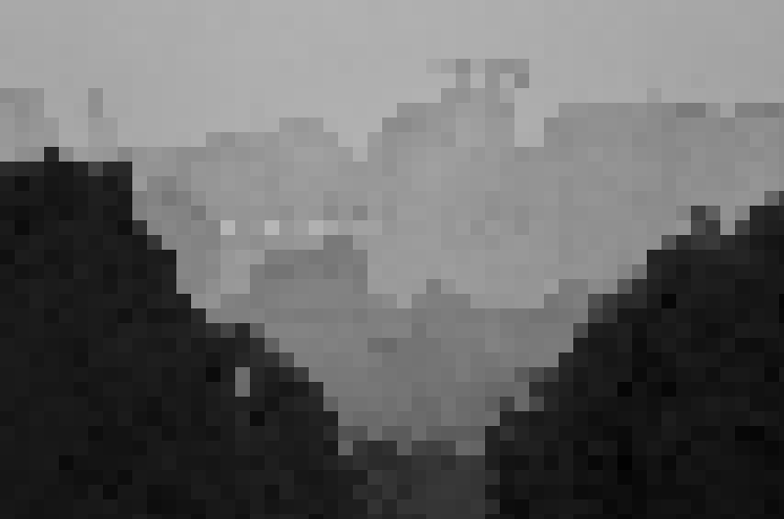
Demonstration

Slide 9
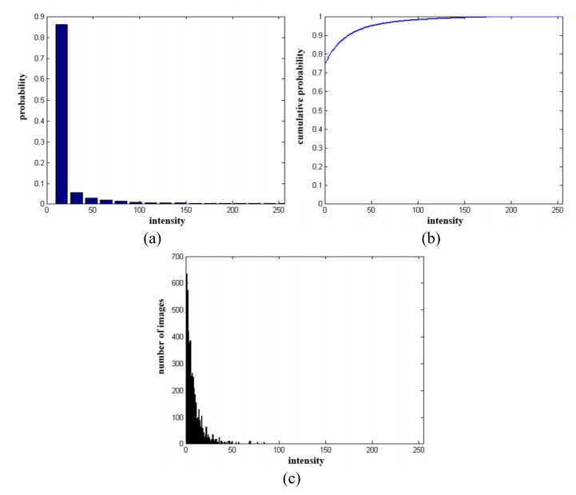
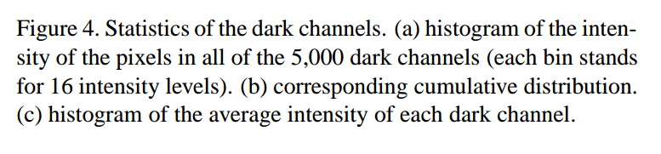

Slide 10

Dark Channel Prior
According to the dark channel prior, the dark channel
J^{dark} of the haze-free radiance J tend to be zero:

Slide 11

Haze image formation model
I is observed intensity
J is scene radiance
A is the global atmospheric light
t is the medium transmission describing the portion of light not scattered and reaches the camera

Slide 12

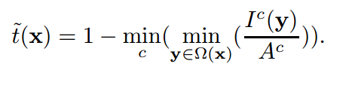
Estimating the transmission
Assume that the transmission in a local patch Ω(x) is constant
We denote the patch’s transmission as t˜(x).
Taking the min operation in the local patch on the haze imaging equation
Using the Dark Channel Prior, we take the min operation among three color channels on the above equation and obtain:
Where (I^{c} / A^{c}) is the normalized haze image. I^{c} is a known quantity, but A^{c} needs to be estimated.

Slide 13
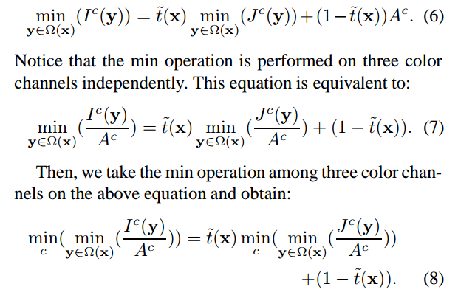
Details:

Slide 14
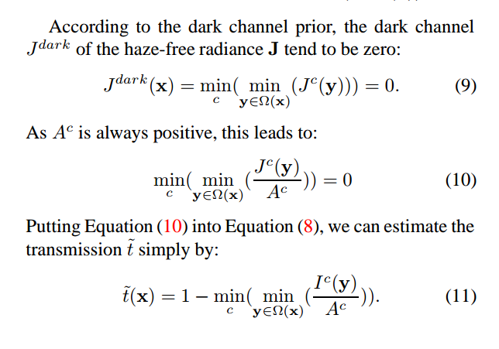
Details:

Slide 15
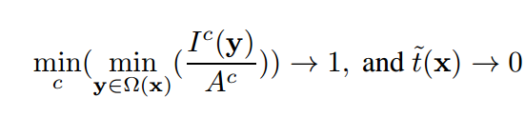
What about the sky region?
Dark channel prior does not hold good in sky regions.
Fortunately, the color of the sky is similar to Atmospheric light A in a hazy image. i.e I^{c} ~ A^{c}, therefore,
Sky regions tend to have 0 transmission, this is handled gracefully by our method of estimating transmission t~.
Hence, sky and non-sky regions are both handled gracefully by the same method of estimating transmission.

Slide 16
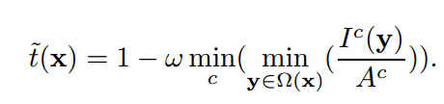
Aerial Perspective
Completely haze free images look fake.
Some haze must be left in the processed image
We use a parameter ω to permit some haze for distant objects. 0< ω <= 1
Good values of ω are 0.9 to 0.95

Slide 17
Atmospheric Light – The next piece in the puzzle
The most haze-opaque pixel will give a good idea of the atmospheric light A.
Because t(x) for this pixel tends to 0.
Therefore we get I(x) = A

Slide 18
Approaches for picking haze-opaque pixels
The max intensity pixel.
  The brightest pixel could be a lamp, mirror, etc.
Using Dark channel
  Dark channel represents haze-denseness well
  We first pick the top 0.1% brightest pixels in the dark channel.
  These pixels are most haze-opaque
  Among these pixels, the pixels with highest intensity in the input image I is selected as the atmospheric light.
  This gives us the truly brightest pixels, that are also haze-opaque

Slide 19
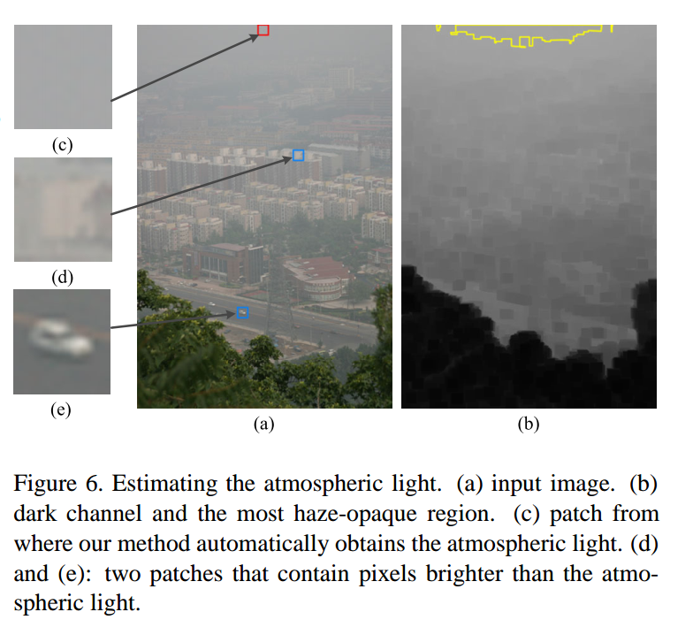
Atmospheric Light – The next piece in the puzzle

Slide 20
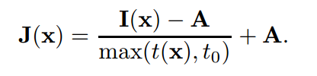
Recovering the scene radiance
With all the pieces in hand, we use Haze Imaging Model to recover scene radiance J:
t₀ is used because J(x)t(x) can become very small for small values of t, making J prone to noise. We use t₀ = 0.1.
Since t(x) has a lower bound, some haze is preserved in very dense haze regions (where transmission is very low).
Finally, exposure of J may be increased as after haze removal the image looks dim.

Slide 21
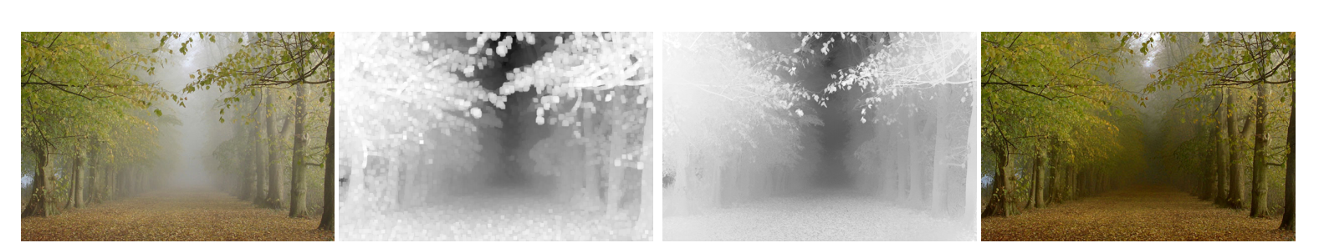
A high quality depth map can also be obtained as a by-product of haze removal.

Slide 22
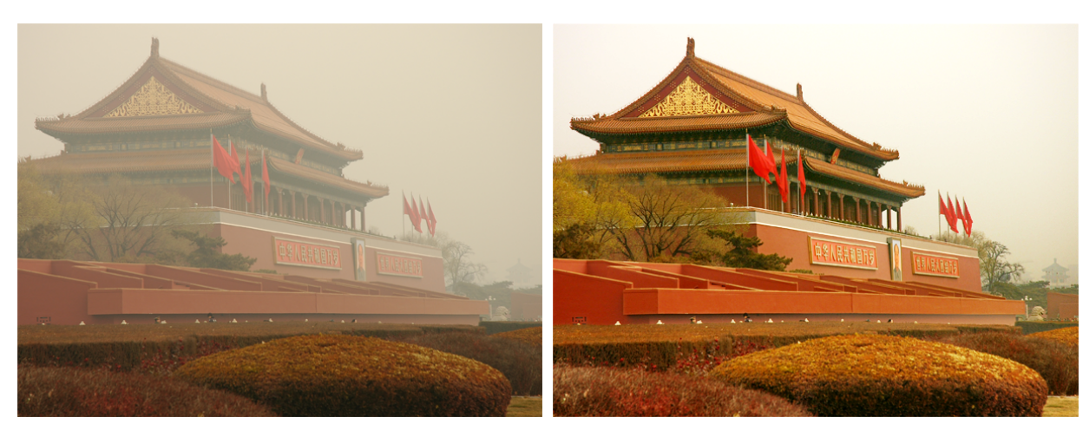
Results

