Slide 1


ESG Resolve: AI-Powered ESG Analytics for SMEs
More than a Chatbot. More than a Dashboard. An Autonomous ESG Action Engine for SMEs.
Team Velocity | Autonomous Hacks’26
SMEs need AI-powered ESG analytics with roadmap, opportunities, and recommendations.
Small and Medium-sized Enterprises (SMEs) face increasing pressure to adopt robust Environmental, Social, and Governance (ESG) practices. However, existing ESG tools are often:
  Complex and expensive, designed for large enterprises.
  Lacking in actionable guidance and clear expertise for SMEs.
The result is widespread ESG confusion, inaction, and missed business opportunities for a vital segment of the global economy.
Team Velocity

Slide 2
What This Problem Solves
ESG Resolve transforms ESG from a daunting reporting burden into a practical path for improvement by:
  Making ESG accessible and actionable for SMEs.
  Enabling SMEs to understand their ESG readiness without costly consultants.
  Bridging the critical gap between raw ESG data and tangible execution.
Our Solution: ESG Resolve
ESG Resolve is an AI-powered ESG analytics and readiness platform that acts as a virtual Chief Sustainability Officer for SMEs.
  Provides comprehensive ESG scoring and carbon footprint analysis.
  Delivers insightful analytics and practical improvement guidance.
  Focuses intensely on actionable steps, not just compliance or certification.
Team Velocity

Slide 3

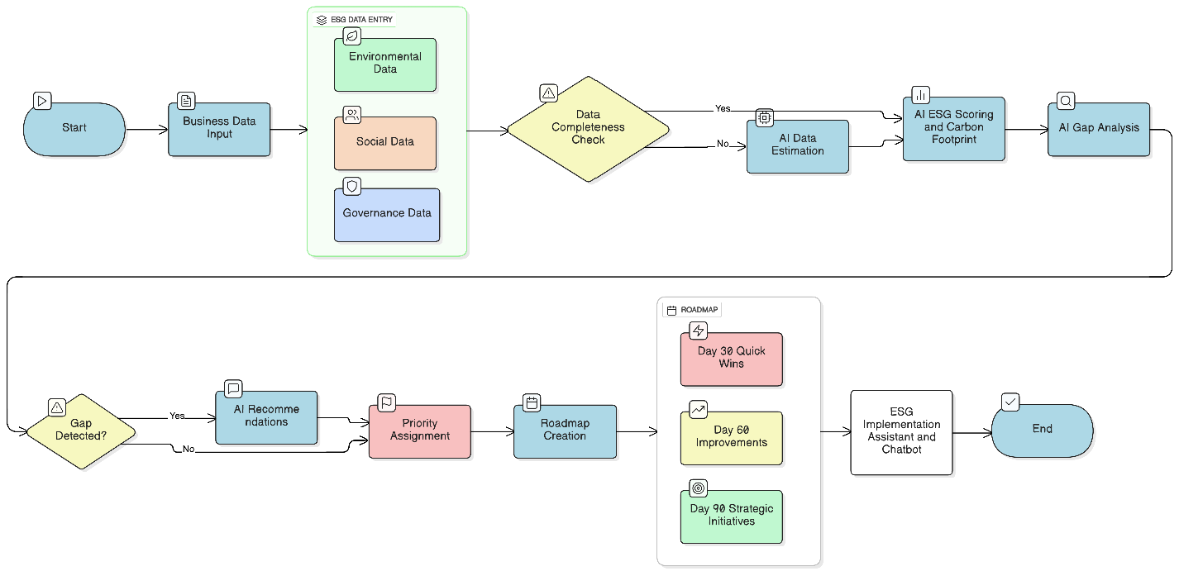
Flowchart
Team Velocity

Slide 4


How ESG Resolve Works: From Data to Action
Business Data Input
AI-Driven Analysis
Users provide essential environmental, social, and governance data points.
Our AI conducts ESG and carbon analysis, generating explainable scores with confidence indicators.
Action Roadmap
Implementation Assistant
AI-generated recommendations are converted into a 30-60-90 day ESG action roadmap.
A state-aware AI assistant guides users through continuous ESG implementation.
ESG Resolve provides a clear path from data ingestion to actionable ESG strategy.
Automated Scoring
Prioritized Recommendations
ESG and carbon footprint scoring with advanced analytics.
AI-generated, color-coded (Red/Yellow/Green) recommendations for urgency.
Autonomous Roadmaps
State-Aware AI Insights
30-60-90 day ESG action roadmaps tailored to your progress.
An AI assistant that understands your ESG state and guides your next steps.
Team Velocity

Slide 5
Behind the Scenes: Tech and Intelligence
Tech Stack
Autonomous Agentic Intelligence
Frontend
  Our system leverages autonomous intelligence to:
  Independently analyze ESG data and detect gaps.
  Generate recommendations and roadmaps automatically.
  Guide users continuously from assessment to execution.
The AI assistant understands the current ESG state, progress, and crucial next actions.
React, Tailwind CSS, Recharts for dynamic and intuitive user interfaces.
Backend
Python, Django, Django REST Framework ensuring scalable and secure operations.
Database & AI
PostgreSQL for data management and Groq Llama for powerful AI processing.
Reports
Integrated PDF/HTML generation for comprehensive reporting.
Team Velocity

Slide 6
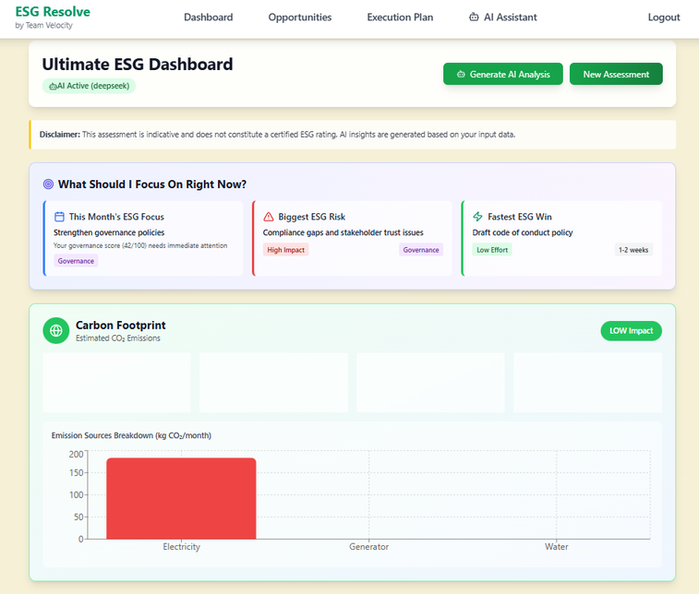
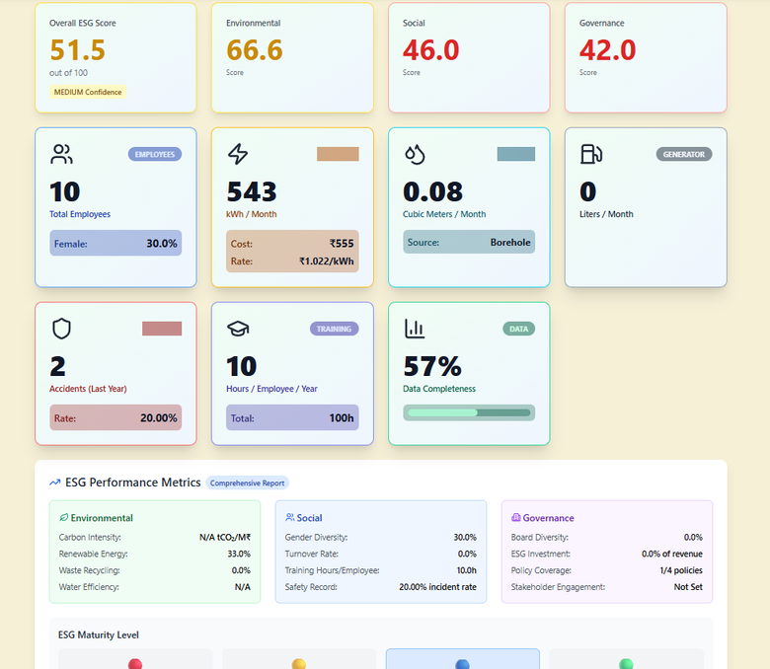
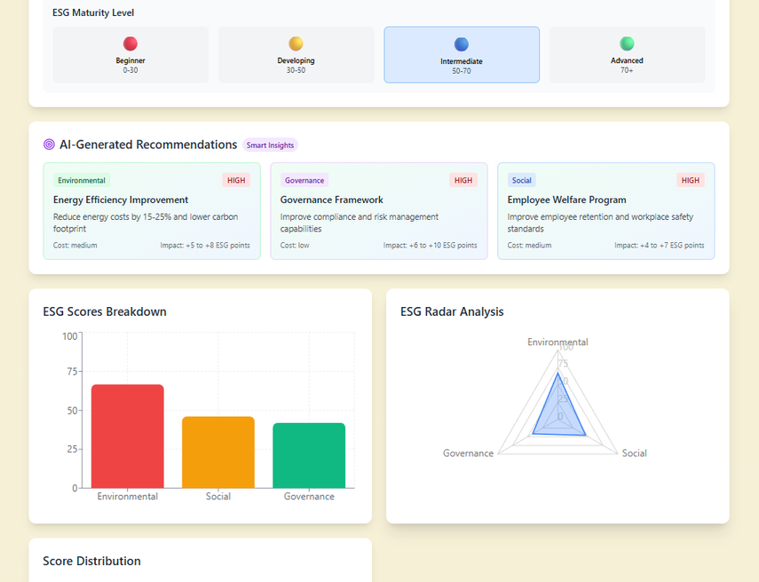
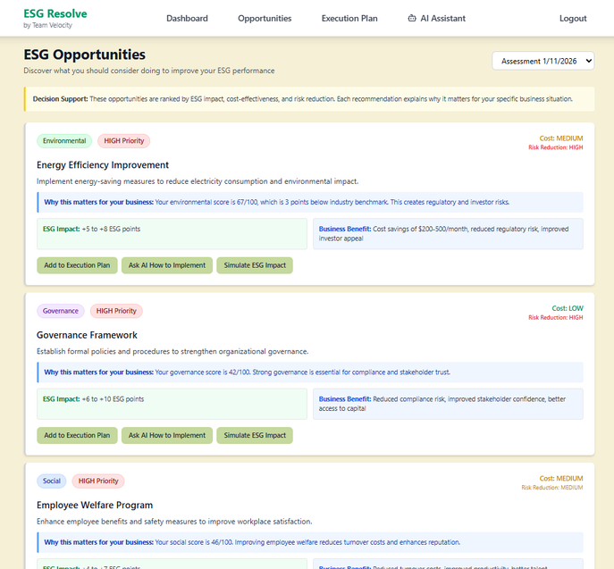
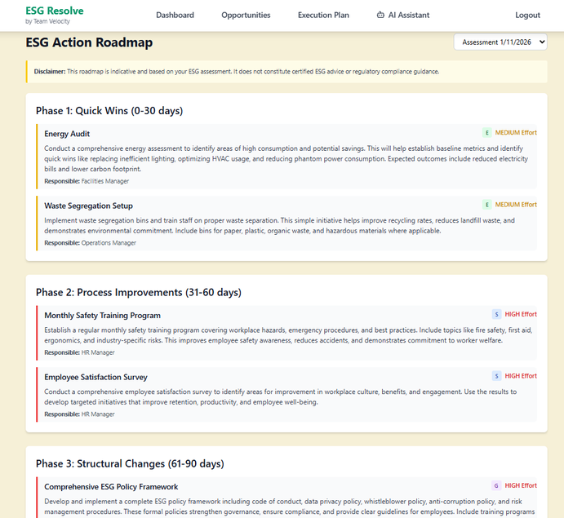
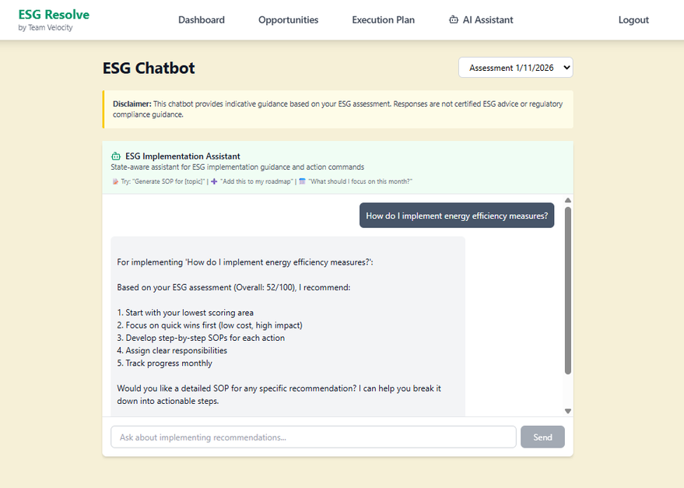

Slide 7






Innovation & Uniqueness: Differentiated for SMEs
SME-Centric Design
Explainable Scoring
Built specifically for the unique needs of small and medium-sized enterprises, not large corporations.
ESG scoring is transparent and confidence-weighted, providing clarity and trust.
Integrated Carbon Analytics
Action-First Approach
Seamlessly incorporates carbon footprint analysis for holistic environmental impact.
Focuses on tangible actions and improvements, moving beyond mere compliance.
State-Aware AI
Lightweight & Scalable
An intelligent assistant that understands context, offering more than basic chatbot functionality.
A demo-ready system designed for ease of use and future growth.
Team Velocity

Slide 8
Business Model & Long-Term Impact
Sustainable Business Model
Transformative Long-Term Impact
ESG Resolve is designed for lasting positive change:
  Reduces SME emissions and operational waste.
  Encourages responsible business practices across sectors.
  Scales across diverse industries and geographical regions.
  Reduces reliance on expensive ESG consultants, democratizing sustainability.
  Supports long-term ESG maturity and business resilience.
Freemium Model
Offers free ESG assessment and a basic dashboard to onboard users.
Paid Subscriptions
Advanced analytics, carbon tracking, AI assistant, and custom reports are available through B2B SaaS plans.
Strategic Partnerships
Potential collaborations with banks, lenders, and ESG programs to expand reach.
Team Velocity

Slide 9
Challenges Faced: Navigating the Path to Innovation
01
02
03
Incomplete ESG Data Handling
Carbon Footprint Accuracy
AI Response Stability
Developing robust mechanisms to manage and derive insights from partial or ambiguous SME data.
Ensuring precise and reliable carbon emission estimations for varied SME operations.
Optimizing AI models for consistent, relevant, and actionable recommendations in diverse scenarios.
04
05
Backend-Frontend Integration
Deployment and Hosting
Seamlessly connecting the powerful analytics engine with an intuitive user interface.
Establishing a stable, secure, and scalable infrastructure for continuous service delivery.
Team Velocity

Slide 10
Future Enhancements: Evolving for Greater Impact
1
2
3
Refined Models
Advanced Benchmarking
Enhanced UX & Onboarding
Developing even more accurate ESG and carbon models for granular insights.
Introducing sophisticated analytics and benchmarking capabilities against industry peers.
Improving user experience and providing guided onboarding for seamless adoption.
4
5
Real-Time Integrations
Predictive ESG Insights
Integrating with various data sources for live ESG data updates and monitoring.
Offering forward-looking analysis to anticipate and mitigate potential ESG risks.
Team Velocity

Slide 11

Turning ESG Readiness into Real Business Advantage
ESG Resolve transforms ESG from confusion to action, making sustainability practical, affordable, and scalable for Small and Medium-sized Enterprises.
Empowering SMEs for a Sustainable Future.

