Slide 1
Design and Analysis of Algorithm
Assignment 6
Group 9 :
Aditya Aggarwal - IIT2019210
Divy Agrawal - IIT2019211
Aman Rubey - IIT2019212

Slide 2
Problem Statement
To Find the Minimum spanning tree by Prim’s Algorithm

Slide 3
Minimum Spanning tree
Spanning tree is sub-graph of a graph. It has one less edge than the original graph and same number of vertices as that of original graph.
There are ^{|E|} C _{|V|-1} - number of cycles, spanning trees (where |E| is number of edges and |V| is number of vertices) if there is no cycle in the graph. When there are multiple cycles in the graph and number of edges are greater than 4 then number of spanning trees decreases.
Minimum cost spanning tree is a spanning tree (of a weighted graph) whose cost is minimum where cost(Edge1 , Edge2) is the weight if the edge between Edge1 and Edge2.

Slide 4
Prim’s Algorithm
Create a flag array which has size as number of vertices which will be used to track that which vertex is taken for MST and which not.
Create another vector namely, ‘min_weight’ of same size where we will store the weight of the minimum weighted edge its connected to, such that the other endpoint of the edge is already taken in flag array.
Start from the first vertex so include it in flag and also min_weight for it will 0.
Now, iterate for (vertices-1) times and in every iteration follow next steps:
Get the the minimum weighted index or (u).
A minimum weighted index is that index for which the corresponding vertex is not taken and also it has minimum key in the min_weight vector.
Include u to flag array.
For every v in V update the min_weight , where V is set of all vertices for which graph(u, v)>0.
To update min_weight for ‘v’: if graph(u,v)<min_weight[v] then min_weight[v]=graph(u,v)
Note: graph is a vector which is used to store the original graph in the form of adjacency matrix.

Slide 5
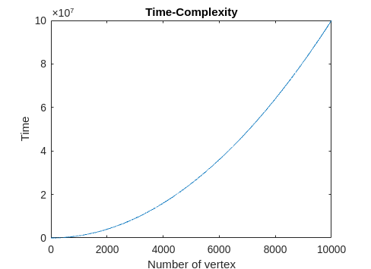
Time Complexity
The time complexity of this problem is O(V^2) where V is number of vertex in the graph.
The outer for loop of the Prim_Min_spanning_Tree function is running V times and the getMinWeight function is also running V times. Similarly the Inner for loop in Prim_Min_spanning_Tree function is also running V times. Therefore,
T(V) = O(V²)

Slide 6
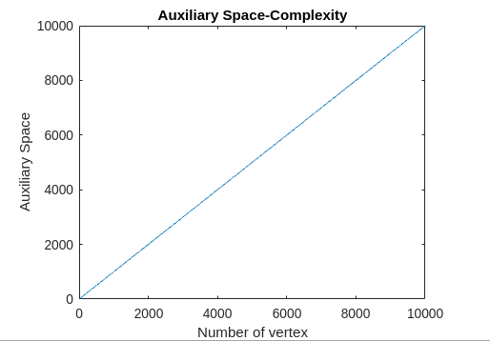
Auxiliary Space Complexity
The Auxiliary space complexity is O(V).
In the code we have created only three vectors of size V(number of Vertices) mainly flag, min_weight and min_spanning_tree. Therefore, Auxiliary Space complexity will be,
S(V) = O(V)

Slide 7
TEST CASE
Enter Vertex: 6
Enter edges count: 10
1 2 11
1 6 20
1 3 3
1 4 22
2 6 12
3 6 1
3 4 13
3 5 4
4 5 10
5 6 6
INPUT
OUTPUT
MST:
1 2 11
1 3 3
5 4 10
3 5 4
3 6 1

Slide 8
Example

Slide 9
Consider a Graph shown below, now we have to find the MST using Prim Algorithm
1
22
4
3
3
13
11
10
20
1
4
2
6
5
12
6

Slide 10
Initially there will be no edge in the MST
Flag Table
min_weight Table
1 | 2 | 3 | 4 | 5 | 6
F | F | F | F | F | F
1 | 2 | 3 | 4 | 5 | 6
0 | ∞ | ∞ | ∞ | ∞ | ∞

Slide 11
1
Flag Table
min_weight Table
1 | 2 | 3 | 4 | 5 | 6
T | F | F | F | F | F
1 | 2 | 3 | 4 | 5 | 6
0 | 11 | 3 | 22 | ∞ | 20

Slide 12
1
3
3
Flag Table
min_weight Table
1 | 2 | 3 | 4 | 5 | 6
T | F | T | F | F | F
1 | 2 | 3 | 4 | 5 | 6
0 | 11 | 3 | 13 | 4 | 1

Slide 13
1
3
3
1
6
Flag Table
min_weight Table
1 | 2 | 3 | 4 | 5 | 6
T | F | T | F | F | T
1 | 2 | 3 | 4 | 5 | 6
0 | 11 | 3 | 13 | 4 | 1

Slide 14
1
3
3
1
4
6
5
Flag Table
min_weight Table
1 | 2 | 3 | 4 | 5 | 6
T | F | T | F | T | T
1 | 2 | 3 | 4 | 5 | 6
0 | 11 | 3 | 10 | 4 | 1

Slide 15
1
4
3
3
10
1
4
6
5
Flag Table
min_weight Table
1 | 2 | 3 | 4 | 5 | 6
T | F | T | T | T | T
1 | 2 | 3 | 4 | 5 | 6
0 | 11 | 3 | 10 | 4 | 1

Slide 16
1
4
3
3
11
10
1
4
2
6
5
Flag Table
min_weight Table
1 | 2 | 3 | 4 | 5 | 6
T | T | T | T | T | T
1 | 2 | 3 | 4 | 5 | 6
0 | 11 | 3 | 10 | 4 | 1

Slide 17
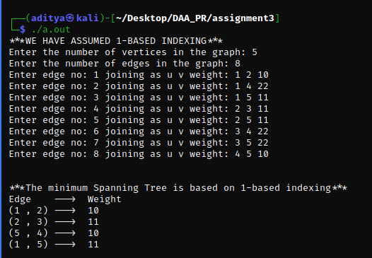
SCREENSHOT

Slide 18
THANKS

