Slide 1
GLOBAL FASHION RETAIL ANALYTICS
Global Store Location
Performance Map
An Interactive Tableau Dashboard for Global Fashion Retail Store Performance Analysis
Domain: Retail Analytics
Tools: MS Excel (Power Query, Power Pivot) + Tableau
Dataset: Kaggle – Global Fashion Retail Sales
Prepared by Divyaa Shri B | Project Presentation | September 2026

Slide 2
≡
Agenda
Project documentation walkthrough
1
Problem Statement
8
Data Modeling
2
Objective
9
Feature Engineering
3
Proposed Solution
10
Dashboard Development
4
Methodology
11
Key Business Insights
5
Data Collection
12
Tools Used
6
Data Understanding
13
Conclusion
7
Data Cleaning & Transformation
14
Future Scope
Global Store Location Performance Map
2

Slide 3
01
Problem Statement
Store performance is reviewed through flat tables with no geographic view
CORE PROBLEM SUMMARY
No spatial view exists to connect store location with performance outcomes.
Regional and country-level performance patterns are difficult to identify from flat, unordered tables.
Converging or diverging of Revenue & Profit are difficult to investigate using existing reports.
GEOGRAPHIC BLIND SPOT
Monthly and yearly performance patterns are not connected to store geography in existing reporting.
Location and performance data are viewed separately — with no map to connect them.
Product-category performance cannot currently be analysed geographically through interactive filtering.
Global Store Location Performance Map
3

Slide 4
02
Objective
Design an interactive dashboard connecting store location with performance
Primary objective: visualise store performance geographically so management can identify high- and low-performing locations and compare markets.
SPECIFIC OBJECTIVES
✓
Plot all 30 store locations on an interactive world map using latitude & longitude.
✓
Rank countries and individual stores by Net Revenue.
✓
Represent Net Revenue and Profit using marker size and colour.
✓
Enable filtering by Year, Month, Country and Category.
✓
Classify stores into High/Low Net Revenue – Profit quadrants.
✓
Present KPIs in a consolidated scorecard view.
Global Store Location Performance Map
4

Slide 5
03
Proposed Solution
A single-page interactive Tableau dashboard
Geographic, comparative, trend and ranking visualisations combined into one consolidated view of store performance.
1
2
3
4
Geographic Store Map
Performance Quadrant
Monthly Revenue & Profit Trend
Country Performance Chart
Marker size = Revenue, colour = Profit
High/Low Revenue vs Profit segments
2023–2025 monthly pattern
Net Revenue across 6 countries
5
6
7
Store Performance Ranking
KPI Scorecards
Interactive Filter Panel
Stores ranked by Net Revenue
Revenue, Profit, Margin, Store Count
By Year, Month, Country, Category
Global Store Location Performance Map
5

Slide 6
04
Methodology & Data Pipeline
A structured six-stage workflow from raw data to interactive dashboard
1
2
3
Data Collection
Data Understanding
Data Cleaning &
Transformation
→
→
Kaggle
MS Excel
Power Query
Source CSV files and identify relevant source tables.
Review 6 tables and determine relevant attributes.
Clean, merge and prepare data for analysis.
↓
4
5
6
Data Modeling
Feature Engineering
Dashboard Development
→
→
Power Pivot
Power Query
Tableau Desktop
Establish Store & Product ↔ Transaction relationships.
Create Revenue, Cost, Profit & Margin fields.
Build the interactive Tableau dashboard.
Global Store Location Performance Map
6

Slide 7
05–06
Data Collection & Understanding
Six Kaggle source files reviewed — three tables selected for the analysis
DATA COLLECTION
DATA UNDERSTANDING
Sourced from Kaggle — “Global Fashion Retail Sales Data”, provided as 6 CSV files: Customers, Employees, Discounts, Stores, Products & Transactions.
1
Stores
30 records
Store ID, Country, City, Latitude, Longitude → powers the geographic map.
Reviewed to determine relevance to the store-location & performance objective.
SELECTED FOR THIS PROJECT
2
Products
~17,940 records · 3 categories · 21 sub-categories
Stores
Products
Transactions
Category, Sub Category, Production Cost → filtering & profitability.
NOT REQUIRED FOR THIS PROJECT
3
Transactions
Customers — customer-level analysis is outside current scope.
Employees — employee-level performance not required.
Discounts — discount-period analysis not required.
2023–2025 transaction history
Invoice ID, Store ID, Product ID, Line Total, Transaction Type → core fact table.
Global Store Location Performance Map
7

Slide 8
07
Data Cleaning & Transformation
Nine structured steps performed in Microsoft Excel Power Query
1
2
3
Import Source Data
Exclude Irrelevant Tables
Remove Unneeded Transaction Fields
All 6 CSV files loaded into Power Query as separate queries.
Customers, Employees & Discounts removed; Stores, Products & Transactions retained.
9 fields dropped, incl. Customer ID, Size, Color, Employee ID, Currency, SKU.
4
5
6
Remove Unneeded Product Fields
Reorder Columns
Merge Products & Transactions
Description, Color & Size dropped from the Products table.
Retained columns reordered for readability and logical structure.
Queries merged using Product ID as the matching key.
7
8
9
Expand Production Cost
Rename Production Cost
Create Calculated Fields
Production Cost brought from Products into the Transactions query.
Kept a consistent field name for downstream calculations.
5 custom columns added: Product Cost, Net Revenue, Adjusted Product Cost, Profit, Profit Margin %.
Global Store Location Performance Map
8

Slide 9
08
Data Modeling
Relationships established in Power Pivot, then recreated in Tableau
Stores
Products
Store ID
Product ID
Transactions
Fact table — Net Revenue, Profit, Profit Margin
POWER PIVOT MODEL (EXCEL)
TABLEAU DATA MODEL
• 3 tables: Stores, Products, Transactions
• 2 relationships built on Store ID & Product ID
• Same 2 relationships recreated after connecting the cleaned workbook
• Combines geographic, product & transaction data without duplication
Global Store Location Performance Map
9

Slide 10
09
Feature Engineering
Five calculated fields built in Power Query on the Transactions table
1
2
3
Product Cost
Net Revenue
Adjusted Product Cost
Production Cost × Quantity
Return: −Line Total · Sale: Line Total
Return: −Product Cost · Sale: Product Cost
Converts unit production cost into total transaction cost.
Reverses revenue for returned transactions.
Reverses cost for returned transactions.
4
5
Profit
Profit Margin %
Net Revenue − Adjusted Product Cost
Profit ÷ Net Revenue
Core profitability metric used throughout the dashboard.
Overall profitability indicator, shown as a percentage.
Global Store Location Performance Map
10

Slide 11
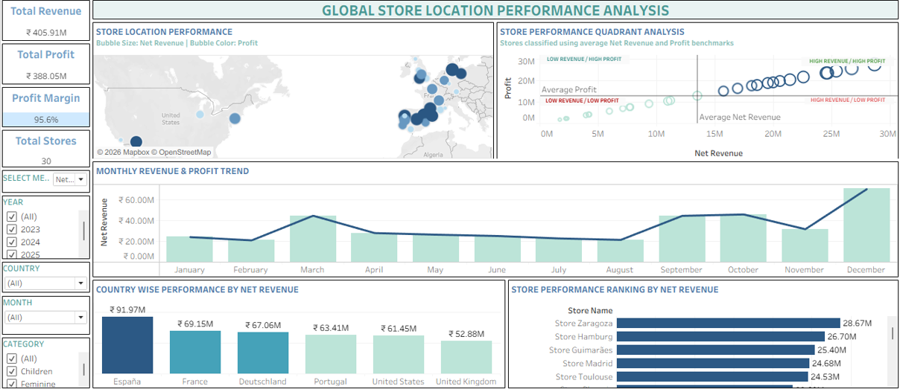
10
Dashboard Development
Built in Tableau Desktop — a single-page interactive analytical view
₹405.91M
₹388.05M
95.6%
30
Total Net Revenue
Total Profit
Profit Margin
Total Stores
Figure: Global Store Location Performance Analysis — Tableau dashboard (local workbook)
Global Store Location Performance Map
11

Slide 12
11
Key Business Insights
What the dashboard reveals about store and country performance
1
2
3
Overall Performance
Country Leaders
Top Stores
₹405.91M revenue and ₹388.05M profit across 30 stores — a 95.6% profit margin.
España leads at ₹91.97M; the United Kingdom is lowest at ₹52.88M.
Store Zaragoza ranks first at ₹28.67M, followed by Hamburg and Guimarães.
4
5
6
Geographic Spread
Performance Segments
Seasonal Trend
Stores are concentrated across Spain, France, Germany & Portugal vs. the US.
Most stores fall in the High Revenue – High Profit quadrant.
Revenue and profit dip mid-year, then rise from September through December.
Global Store Location Performance Map
12

Slide 13
12
Tools Used
The technology stack behind data preparation and dashboard delivery
KG
Kaggle
Source of the Global Fashion Retail Sales Data CSV files.
XL
Microsoft Excel
Storing, organising and managing source and cleaned datasets.
PQ
Excel Power Query
Importing, cleaning, merging and creating calculated columns.
PP
Excel Power Pivot
Establishing and validating relationships between tables.
TB
Tableau Desktop
Connecting data, recreating relationships and building the dashboard.
Global Store Location Performance Map
13

Slide 14
PROJECT WRAP-UP
Conclusion & Future Scope
CONCLUSION
FUTURE SCOPE
This project turned raw Kaggle retail data into a single interactive Tableau dashboard connecting store location with performance. Data was cleaned in Power Query, modelled in Power Pivot, and visualised in Tableau Desktop.
The result gives management a geographic, filterable view of revenue, profit and store rankings — one the original tabular reports could not provide — supporting more informed decisions on expansion, consolidation and regional strategy.
1
Footfall & Conversion Analysis
Link footfall data to gauge traffic vs. conversion at low-performing stores.
2
Cannibalisation Analysis
Flag stores within a set radius to spot overlap and inform expansion decisions.
3
Revenue & Profit Forecasting
Project future country- and store-level performance for planning.
Global Store Location Performance Map — Divyaa Shri B
14

