Slide 1
Retail Transaction Case study Objective : Predict Probability of Customer purchasing next month
1
2
3
Data: Transactions Data
Date Range :
12/1/2009 to 11/9/2011
Unique Customers : 5780
Invoices : 41699
Cancelled Invoices : 7364
Data Processing
Express the data like a sequence[1] , and use LSTM to perform a sequence classification task.
Removed transactions without any Customer ID
Total 25 Features Created
Used RFM* Framework
Additional layer added by looking at Cancelled invoices, and Invoices with Postage charges separately. **
Aggregated data at customer and month level
Followed by feature standardization
4
Feature category | Exact Features [2] | Missing Value Treatment
Recency | Months since last Purchase | 999
Frequency | Count of invoices, Daily avg count of invoices - Purchase and Cancel Invoices | 0
Monetary Value | Total spend, Avg spend, Cancel to Purchase spend Ratio Postage to Item Price ratio – on Purchase and Cancel Invoices | Divide by 0 error in Ratio variables was replaced by 0
*Using RFM for feature creation
** Found only 5 invoices with Discount , therefore did not look at discount separately

Slide 2
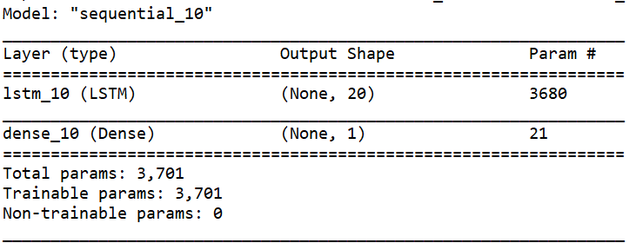
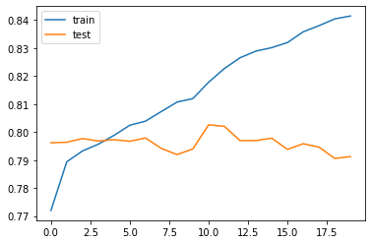
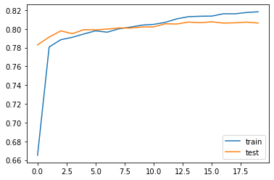
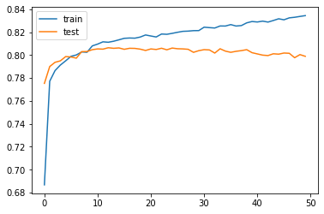
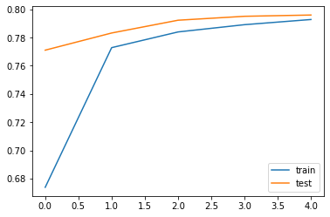
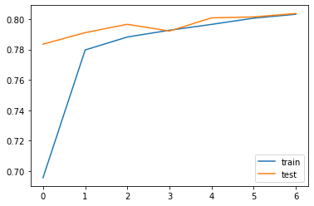
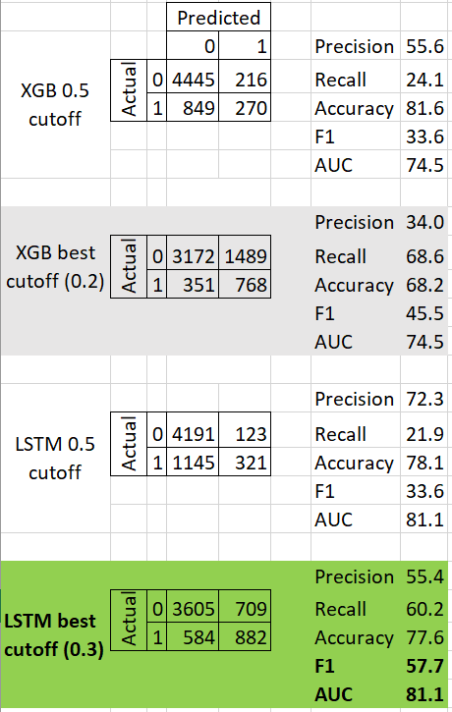
Model Details
5
6
7
Label creation
For the month of interest,
If customer has a purchase invoice , they belong to class 1,
remaining customers belong to class 0
Test Harness
train_X = Features from month1 to month22
train_Y = Binary classes from month23 (22% class 1)
val_x = Features from month2 to month23
val_y = Binary classes from month24 (25% class 1)
test_X = Features from month3 to month24
Model Details
LSTM with Dense layer
LSTM input shape = samples, timesteps, features (5780, 21, 25)
Dense layer activation = Sigmoid (for binary predictions)
8
9
Experiments with LSTM Parameters
Batch size = 2
Batch size = 72
Learning curves
X axis = Epoch
Y axis = AUC
10
Results: Predicted Probability and calculated the best cutoff based on maximizing F1
50 Epochs (Overfit)
5 Epochs (Underfit)
7 Epochs (Balanced)

Slide 3
Alternates Explored
12
11
Comparison with Baseline XGBoost
Created multiple aggregate level features at different time slices over the entire transaction history.
For every time slice being aggregated, the customer’s purchase invoice in next month is considered for Label Creation
Final shape of data = (34680, 170)
LSTM outperforms XGBoost on AUC
13
To explore in the future:
Perform operations on Time series analysis data – Removing stationarity, accounting for seasonality
Looking at different granularities – weekly data, daily data, Quarterly data
Looking at different slices of the data – like 1, 2, 3, 6, 9, 12, 18 months of data
Creating an ensemble of XGBoost and LSTM model
Experiment with more parameters in both LSTM and XGB
Try different Architectures of LSTM, like training different LSTMs on data of different Granularity and merging their predictions.
Experiment with a rolling setup for LSTM
14
References :
[1] Generating Realistic Sequences of Customer data
[2] Deep Temporal Features to Predict Repeat Buyers

