Slide 1
Intel Cloud Security Practicum
Sponsor - Intel Point of contact - Jonathan Buhacoff, Eric Gee Faculty Advisor - Patrick Tague Team BlueChip- Deepti, Divya, Marcelo, Rashmi
INI Project Practicum, Fall 2014

Slide 2
Agenda
Challenges in Cloud Infrastructure Security
Solutions
Remote Attestation & Trusted Compute Pools
Trusted Compute Pool for OpenStack
Barbican
Project Timeline
Geolocation
Challenges in Project
References

Slide 3
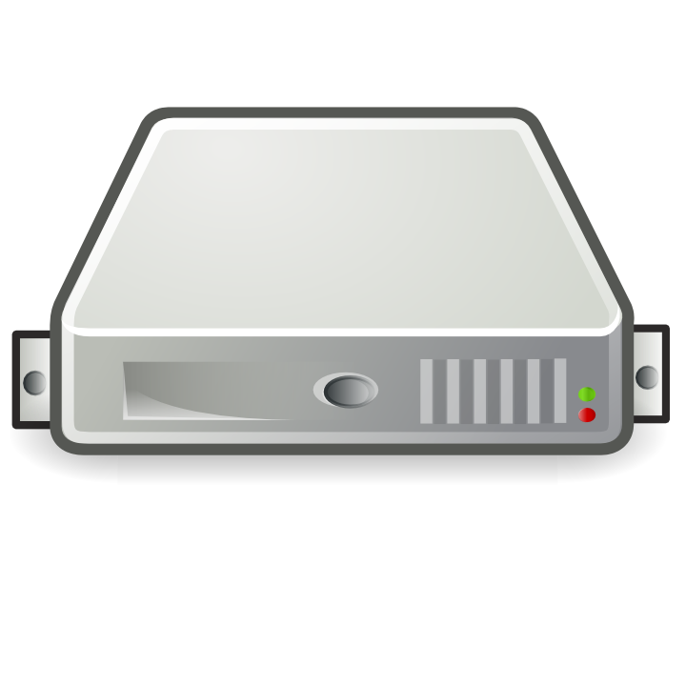



Challenges with Cloud (IaaS)
Boot code, BIOS, OS loader, Hypervisor

Slide 4



Challenges with Cloud (IaaS)

Slide 5
Challenges with Cloud (IaaS)
How to ensure
Compromised system doesn’t infect others in environment?
Sensitive workloads run in protected, trusted, compliant environments?
Moving workloads doesn’t expose image or infrastructure to risks?

Slide 6
Solutions
Ineffective:
Anti-malware software.
Software based blacklisting.
Heuristic based anti-malware.
Intel’s solution:
Remote Attestation & Trusted Computing Pools.
Trusted Geolocation in Cloud.
Notes:
Anti-malware - might not catch threats before they spread to multiple systems across the cloud environment.
Software based blacklisting - Susceptible to more sophisticated stealth attacks such as privilege escalation attacks, & blacklisting is always one step behind the current threats as they are reactively identifying and disseminating current threat information to users.
Heuristic based - better protection but can’t fully secure hypervisor and BIOS on which your software and virtual machine images reside. This solution is not designed to verify the integrity of the underlying platform so it doesn’t assist with compliance needs in highly regulated industries.

Slide 7
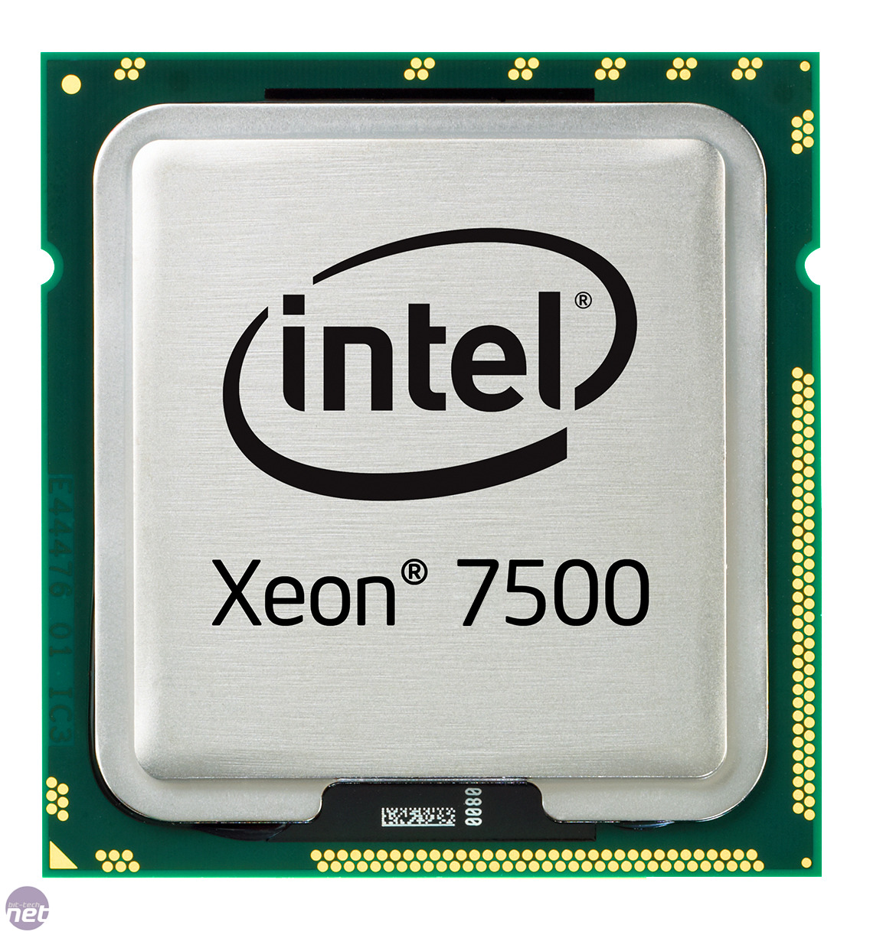

Remote Attestation & Trusted Computing Pools
High Level:
Combination of hardware and software mechanism.
Leverages Intel’s TPM and TXT to establish trust.
Leverages OpenStack’s OAT (OpenAttestation) to verify trust.
Can I be launched?
Notes:
OpenAttestation(OAT) project is a Intel initiated open source project providing a SDK for managing host integrity verification using TCG-defined remote attestation protocol, targeting to be integrated into cloud and enterprise management tools

Slide 8
Remote Attestation & Trusted Computing Pools
Establish trust with Trusted boot.
Launch MLE (Measured Launch Environment).
Intel VT-d (Virtualization Technology for Directed I/O) for MLE to protect itself.
Verify trust with Open Attestation.
Build Trusted Computing pool.
Prepare for Trust
Enable TXT & TPM
Populate whitelist
Establish Trust
TXT measures launch stack
Compare with states in TPM
Verify
Verify trust status (OpenStack scheduler -> OAT)

Slide 9
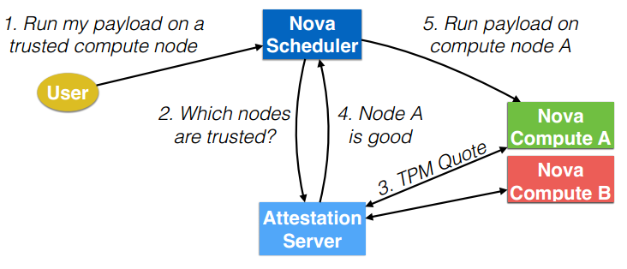
Trusted Computing Pool for OpenStack
Image from http://saweis.net/pdfs/weis-trusted-computing-openstack.pdf

Slide 10
Trusted Virtual Machines
IaaS providers store tenant VMs:
in the clear (no encryption -> no thanks!)
encrypted (but keys with provider)
But what about tenants who store sensitive information in their VMs and want to control its lifecycle?
Integrity & Confidentiality
The solution is to provide a means for the tenant to control the keys encrypting its VMs, and release them only to trusted servers.
Notes:
decommissioning

Slide 11
OpenStack Barbican
Barbican is a REST API which provides secure storage, provisioning and management of secrets. It can handle many types of secrets, including:
Symmetric Keys
Asymmetric Keys
Raw secrets
Barbican fits into Intel’s Trusted VM solution model as a key management server, which stores keys and provisions requesting cloud servers with keys based on their trust and policy compliance as attested by trust authority OAT/MtW.

Slide 12
Project Timeline
Research on OpenStack Barbican for support of - plugin support - KMIP support | Milestone 1 | Started
Creation of plugin for - interception of key request - call attestation service - key retrieval - key wrapping | Milestone 2 | Not Started
Plugin Support for Barbican to use backend KMIP server for key generation, storage and retrieval. | Milestone 3 | Not Started

Slide 13
Geolocation
With remote attestation, we guarantee platform and/or VM
Data stored in different volumes/location is not guaranteed
Organizations have concerns over location of their cloud servers
Thus it is necessary to prove server’s location and integrity of such measurements
Requirement: Trusted geolocation
Notes:
Concerns over data security policies, privacy etc
There could be conflict in different organization’s policies
Trusted geolocation allows organizations to determine and control the location of hardware that processes and stores sensitive information and applications in cloud

Slide 14
Trusted Compute Pool with Trusted Geolocation
Platform Attestation and Safe Hypervisor Launch
Trust-based Secure Migration
Trust and Geolocation based secure migration
Notes:
Stage 1: 1.Configure the server 2. Verify the hypervisor 3. Continually monitor the hypervisor
Stage 2: 1. deploy to trusted platform 2. migrate to trusted platforms
Stage 3: 1. Verify the geolocation information 2. Enforce geolocation restrictions 3. Add geolocation to monitoring

Slide 15
Challenges in Project
Workaround to legal issues
Project under NDA
Presentation based on public and available information
Focused on open source software
Given time constraint focused on one project

Slide 16
References
https://github.com/cloudkeep/barbican
http://saweis.net/pdfs/weis-trusted-computing-openstack.pdf
“Building the Infrastructure for Cloud Security - A Solutions View”, by Raghuram Yeluri , Enrique Castro-Leon
http://fedscoop.com/wp-content/uploads/2013/03/intel-trusted-geolocation-in-the-cloud.pdf
Creating Trust in the Cloud: http://www.intel.com/content/dam/www/public/us/en/documents/white-papers/creating-trust-in-cloud-ubuntu-intel-white-paper.pdf
Notes:
Stage 1: 1.Configure the server 2. Verify the hypervisor 3. Continually monitor the hypervisor
Stage 2: 1. deploy to trusted platform 2. migrate to trusted platforms
Stage 3: 1. Verify the geolocation information 2. Enforce geolocation restrictions 3. Add geolocation to monitoring

Slide 17

Questions?

